Slide 1
April 2018
College and Career Ready IEPs (CCR-IEPs)
Improving Outcomes for Students Ages 3 through 21
The Five Step Process
Step 3: Develop IEP Goals
Notes:
This is the third of a series of webinars on the 5 Step Process for developing College and Career Ready IEPs or CCR IEPs. During Step three the IEP team develops ambitious and achievable IEP goals to address disability-related needs.
A version of this slide deck was presented as a webinar in April 2018 by Daniel Parker, Assistant Director of Special Education, WI DPI, Paula Volpiansky & Deb Heiss, Consultants on the Special Education Team, WI DPI and Cheri Sylla, WSPEI
The webinar was recorded and is accessible through the CCR IEP learning resources / CCR IEP Five Step Process / Step 3 web page. https://dpi.wi.gov/sped/college-and-career-ready-ieps/learning-resources

Slide 2
What is a CCR-IEP?
CCR-IEP = College and Career Ready IEP
An Individualized Education Program (IEP) developed to:
- meet the unique disability-related needs of the student and
- help ensure the student graduated ready for further education and the work place
Notes:
CCR IEP stands for College and Career Ready Individualized Education Program.
A CCR-IEP is an Individualized Education Program (IEP) developed to meet the unique disability-related needs of the student and help ensure the student graduates ready for further education and the workplace.
CCR IEPs are for all students in public school programs ages 3 through 21 who receive special education services. Thus, CCR IEPs are not just intended for high school students. Rather, CCR IEPs build knowledge, skills, and habits throughout a student’s public school experience, so when they graduate, they are college and career ready. This important foundation begins in early childhood.
Handout: https://dpi.wi.gov/sites/default/files/imce/sped/pdf/ccr-iep-overview-guide.pdf- link on slide

Slide 3
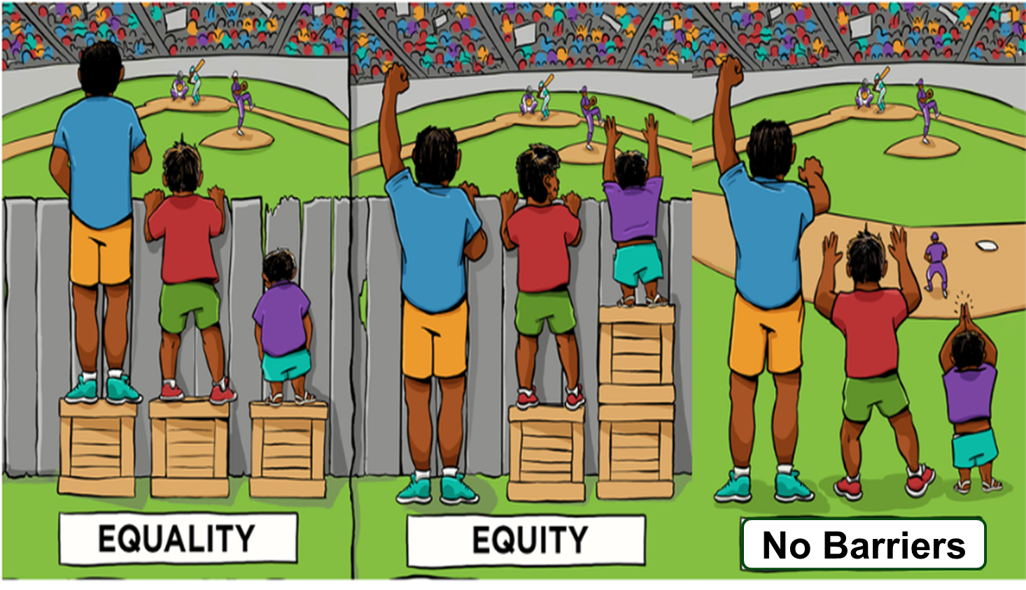
CCR-IEP 5 Beliefs
High Expectations
Culturally Responsive Practices
Student Relationships
Family and Community Engagement
Collective Responsibility
Notes:
Before we continue, I want to briefly mention the 5 Beliefs that are at the core of the CCR-IEP process.
The 5 core Beliefs are essential to developing IEPs that promote college and career readiness. The 5 Beliefs can have an important impact on the success of students with IEPs. Districts and IEP teams, including families, should consider and discuss these beliefs.
It is important to keep the 5 Beliefs in mind when completing each step of the IEP development process:
High Expectations/believing students with disabilities can meet early childhood/grade level academic standards and functional expectations or, for students with most significantly cognitive disabilities, alternate achievement standards aligned with grade level standards;
Culturally Responsive practices to honor and engage students;
Positive Student Relationships;
Family and Community Engagement; and,
Collective Responsibility for working together to support each student in addressing needs and achieving their IEP goals.
For more information on the 5 Beliefs, please visit our CCR IEP Resources webpage.
Handout- A handout of the 5 beliefs is available on the DPI website at - https://dpi.wi.gov/sites/default/files/imce/sped/pdf/rda-ccr-iep-five-beliefs.pdf (link on slide)

Slide 4
College and Career Ready IEP
5 Step Process
Step 1. Understand achievement of grade-level academic standards and functional expectations to identify the student’s strengths and needs.
Step 5. Analyze progress towards goals to evaluate what works and what is needed to close the student’s achievement gaps.
Step 2. Identify how the student’s disability affects academic achievement and functional performance.
Step 4. Align specially designed instruction, services, supports, and accommodations needed to support the goals and ensure access to the general curriculum.
Step 3. Develop ambitious and achievable goals that close achievement gaps and support the unique strengths and needs of the student.
Notes:
College and Career Ready IEPs are developed through a cyclical 5 Step Process in which each step informs the next. It is important to start at the beginning of the cycle with understanding the student’s present levels of performance.
As we go through the presentation today, keep in mind that the 5 Step Process is not about how to fill out an IEP form, but rather, provides a framework for having IEP team discussion about improving student outcomes while operationalizing special education legal (IDEA) requirements.
The outcome of the IEP team’s conversation and analysis using the 5 Step Process for developing CCR IEPs is documented on DPI’s sample IEP Linking Form (Form I-4). An online CCR IEP Discussion Tool has also been developed to help IEP team members prepare for these important conversations. More information about these and other resources is provided at the end of the presentation.
To learn more about all 5 steps, please refer to the resources on our CCR IEP Resources webpage. The link is on this slide and at the end of the presentation.
Handout- A handout on 5 Step Process is available on the DPI website at https://dpi.wi.gov/sites/default/files/imce/sped/pdf/rda-ccr-iep-five-step-process.pdf (link on slide)

Slide 5
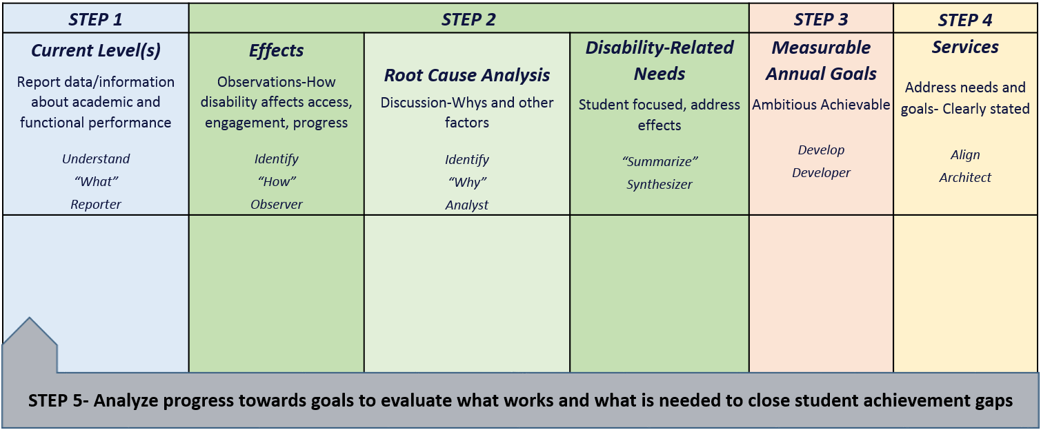
CCR-IEP Process Chart
Notes:
This chart was created to help clarify the main purposes and linkages between the steps in the 5 Step Process as well as to highlight the roles IEP team participants play during each step. In the webinar handouts, you have a copy of the full CCR IEP Process chart with descriptions of each step on one side and a blank copy on the other. The chart can be used both as a training tool when explaining the steps as well as a place to take notes when developing or reviewing IEPs.
The IEP team’s understanding of the student’s current levels of academic and functional performance reported during Step 1 provides IEP teams with quantitative information about the student’s skill and behavior at the time, or “the what” that is the basis for discussion in Step 2.
During Step 2, the IEP team reflects on the current level and special factor information (if any) and Identifies how the disability affects the student’s access, engagement, and progress based on observations, analyzes root causes of these affects (i.e., why the student has difficulty meeting standards and expectations), and finally synthesizes this information into summary statements clearly describing the student’s disability-related need(s).
The student’s disability-related needs represent the areas or skills to be addressed to improve the student’s access, engagement, and progress in general education curriculum, instruction, activities and environments (related to the effects of the student’s disability). These needs are the basis for developing IEP goals and services in Steps 3 and 4.
Today we will discuss Step 3. Our next webinar will focus on Step 4, Aligning Services to Goals and Needs.
Much of the information we will present today is summarized in the Step 3 - At a Glance Document

Slide 6
Step 3: Develop Ambitious and Achievable Goals
Develop ambitious and achievable goals that close achievement gaps and support the unique strengths and needs of the student.
Notes:
In Step 3, IEP teams develop ambitious and achievable annual IEP goals designed with the intent of closing individual achievement gaps. IEP goals also support the unique strengths and disability-related needs of the student.
Before getting into the details about goal development, we would like to highlight two CCR IEP Beliefs that are especially relevant to this step:
High Expectations - Goals are ambitious and achievable, aligned with grade-level content standards and expectations.
Collective Responsibility - Goals are written as a team to ensure the disability-related needs are being addressed in a collaborative manner across the curriculum and multiple school settings and contexts.

Slide 7
Step 3 Key Ideas
IEP goals are directed at “why” (i.e., root causes) the student is not meeting early childhood/grade-level standards or expectations
IEP goals address student-specific disability-related need(s) that will improve access, engagement and progress toward standards and expectations (i.e., address effects)
IEP goals are measurable, ambitious and achievable
One goal may address more than one disability-related need
Notes:
IEP goals address why the student is not achieving grade-level academic standards or functional expectations; including why the student is having difficulty accessing, engaging and making progress in the general education curriculum, instruction, or environment.
By connecting IEP goals to the disability-related need, the IEP team ensures the IEP goals address root causes of “why” the student is not meeting early learning/grade-level standards or expectations.
Focusing on Root Causes should also limit the number of IEP goals to those really needed to address a student’s individual DRNs
All goals should be student focused and strength-based. They should address what the student will accomplish…
Each goal must be linked to at least one disability-related need. A goal may address more than one disability-related need. Likewise, multiple disability-related needs can be addressed by one goal.

Slide 8
Step 3 Key Ideas
IEP goals specify what a student will learn (target skill(s)/behavior)
In rare circumstances a goal may not be required to address a disability related need
The need is still addressed with support(s) or accommodation(s) (supplementary aids/services, supports for staff)
How do we know when a goal is needed to address a disability related need?
Ask, “Does the student needs to develop a skill or just use a skill already mastered”?
Notes:
Goals address what student will learn specific to the student’s unique disability related needs (i.e. target skill/behavior related to root cause(s) rather than symptom/effect). Goals should reflect the students DRNs, not the entire educational program provided to all students.
Linking Step 2 with Step 3.
To make sure IEP goals address the student’s disability-related need(s):
The IEP team begins with the disability-related need(s) and then develops a goal specifically to address the need.
In rare instances, the IEP team may decide a goal is not necessary to address the need and the need may only be aligned with a supplementary aid or service or with a related service, such as transportation.
Before the IEP team decides a goal is not needed, it should consider whether the student really has needs that should be addressed by a goal (such those related to self-advocacy and independence).
How to decide if need a goal or just a support/accommodation service? Ask, Does student need to develop/improve or use/apply skill already mastered?)
Example: transportation: When a student has mobility needs that require transportation as a related service, the IEP team should ask whether the student has developed sufficient mobility skills or may need a self-advocacy goal related to the mobility needs.
Example: Anxiety control supports:
Does the student know how to identify triggers and use anxiety control strategies or does the student need to develop these skills?
Does the student self-advocate and request breaks or other anxiety supports when needed?
Example: Use of text reader:
Does the student know how to use a text reader to help them read grade level text and complete assignments or does the student still need help using this support?
Does the student self advocated and request access to or independently chooses to use a text reader when the student needs it?

Slide 9
Guidance from U.S. Department of Education
IEP goals must be . . .
Aligned with the academic content standards for the grade in which a student is enrolled
An IEP that focuses on ensuring a student is involved in general education curriculum will be aligned with the academic content standards
Ambitious and achievable
For students with the most significant cognitive disabilities, goals are aligned with alternate academic achievement standards aligned with grade-level content standards
Adapted from U.S. Department of Education Dear Colleague Letter, November 16, 2015: OSERS Policy Guidance on Free Appropriate Public Education (FAPE)
Notes:
The U.S. Department of Education issued a Dear Colleague Letter in November 2015 that has been giving additional emphasis to our CCR-IEP work.
In this letter, the U.S. DOE, clarified that ensuring that all children, including children with disabilities, are held to rigorous academic standards and high expectations is a shared responsibility for all of us.
To that end, IEP goals must be:
Aligned with the academic content standards for the grade in which the student is enrolled (early learning standards for preschool aged students).
An IEP that focuses on ensuring that the student is involved in the general education curriculum will necessarily be aligned with the academic content standards.
Ambitious but achievable.
The Department of Education recognizes that there is a very small number of students with the most significant cognitive disabilities whose performance must be measured against alternate academic achievement standards.
In Wisconsin, alternate academic achievement standards called the Essential Elements are aligned with grade-level content standards.
Reference: November Dear Colleague Letter: OSERS Policy Guidance on Free Appropriate Public Education (FAPE).
http://www2.ed.gov/policy/speced/guid/idea/memosdcltrs/guidance-on-fape-11-17-2015.pdf

Slide 10
Standards-Based IEPs
Completing Steps 1 and 2 of the 5 Step Process with fidelity will lead to the development of goals aligned with grade-level standards and expectations in Step 3
Identify student’s current performance related to early childhood/ grade-level standards.
Identify how the disability affects access, engagement and progress (effects)
Discuss why (root causes) the student is not meeting grade-level standards and summarize disability-related needs.
If goals address the whys and needs, the goal will be aligned with the standards
Notes:
Before we move lets address a question we often receive, “What are standards based goals and how do we develop them?
As mentioned in the Step 1 presentation, the discussion of the standards occurs primarily during step 1.
A few reminders:
The standards drive curriculum and instruction- We must use assessment tools to measure the skills associated with the standards; You can not directly measure the student “meeting grade level standards”. You can only measure the skills/behaviors that represent performance to the standards
A student may be “meeting” grade level standards in some areas and not in others. Students may be meeting some grade level standards across skills areas and not others (e.g., may be meeting grade level standard in some areas of reading comprehension, but not others--- comprehension vs. decoding fluency).
For these reasons, IEP goals are related to why the student is not meeting specific standards and are not a restatement of the standards that apply to all students
By focusing on the standards when discussing and reporting the student’s current levels of performance during Step 1 and THEN identifying how the student’s disability effects the student’s performance in related to the standards, before summarizing the student’s needs during Step 2, the IEP goals developed to address the student's needs will be aligned with the academic content or early learning standards for the grade in which the student is enrolled.
The relationship between a student’s current level of performance to early childhood/grade level standards is discussed in the Step 1 presentation.

Slide 11
Developing Measurable Annual Goals
The “measure” in measurable goals aligns all components
Baseline
Goal Statement
Procedures for Measuring Progress
Level of Attainment
Notes:
Now let’s move onto the meat of this webinar-
This graphic shows the components of an IEP Goal and how they are aligned.
As has always been the case when developing a measurable annual goal, you must include:
A goal statement: What the student will do (e.g., increase reading fluency, develop organizational skills). This relates to an area identified as a disability- related need.
Baseline: The student’s skill level at the time of the IEP meeting. This is related to information about the student’s current level of performance described in step 1.
Level of Attainment: The amount of growth anticipated within a year (or the specified duration) of special education services.
Procedures for Measuring Progress: The process or methods used to assess a student’s academic and functional performance during the school year for the purpose of analyzing the student’s response to special education services.
Also required: When progress will be reported to parents
The goal statement, baseline, level of attainment, and the procedures for measuring progress should all align to allow those implementing and periodically reviewing the IEP (including the IEP team, at least annually) to decide if the student is making progress towards the goal as well as the extent of progress being made.
As a quick reminder, progress on annual goals must be periodically reported to parents. Many IEP teams decide to report progress on the same schedule as general education progress reporting.
We will go over each of these components in the remainder of the presentation.

Slide 12
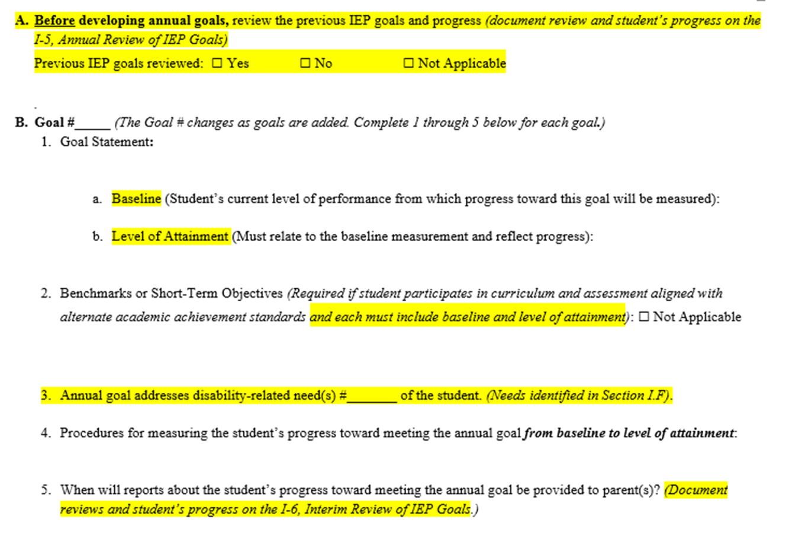
Individualized Education Program (I-4)
Measurable Annual Goals
Notes:
But before we do, I would like to show you where you will document the decisions the IEP team makes during Step 3.
This is a copy of the section of the IEP Linking Form where the goals are documented. You can see there is a place for all the components.
On the form, each goal is numbered so they can be linked directly to services in the Program Summary. In addition, the disability-related need that is the basis of the goal is noted by number. This helps ensure needs are addressed. These numbers are also referenced in the Program Summary when aligning services to the goals.
The IEP form prompts B 1-5 are completed for each goal in the student’s IEP. This section of the IEP is repeated (e.g., pages are added) for each goal.
Now let’s talk about each component:

Slide 13
Goal Statement
Reflects the disability-related need(s) and . . .
Must include a skill(s) that is measureable
Achieving the goal will improve the student’s access, engagement, and progress in general education curriculum and environment (ambitious/achievable)
May include condition statements
May include baseline and level of attainment in the goal statement OR under the goal statement
- Sample form I-4 has prompts for each under the goal statement
Notes:
As already mentioned, the goal statement reflects one or more disability-related needs.
Each goal statement names a target skill(s) or behavior(s) (i.e., root causes) related to why the student is not meeting grade-level standards and/or expectations and having difficulty accessing, engaging, and making progress in curriculum, instruction, activities and environments. Attaining the goal will address the related effect(s) of the disability and disability- related need(s).
A goal may include benchmarks or short-term objectives. We will say more about benchmarks and short-term objectives in a few minutes.
Each goal must be measurable
While conditions are not required, it is often helpful to include condition statements within the goal statement to provide context of when, how, or under what circumstances the goal is expected to be performed.
In order for a goal to be measurable, there must be a specific starting point (baseline) and target (level of attainment) . When developing a goal statement, you may include the baseline and the level of attainment right into the goal statement, or include them separately as on DPI form I-4.
Sometimes we are asked, when completing I-4 section 4 (Measurable Annual Goals), if the annual goal statement is written a way that includes a baseline and level of attainment (LOA), do you have to repeat the baseline and LOA in items 4a. and b.? i.e. Do you need to separate the baseline and LOA from the goal statement describing the target skill? The sample IEP forms provide a model for documenting IDEA requirements and encouraging discussions to address a student’s disability-related needs. We recommend IEP teams document the baseline and level of attainment separately from the goal statement for several reasons:
This helps ensure a discussion about the baseline and level of attainment occur during the IEP team meeting.
It makes it very clear to all IEP team members what is the current level (or starting point) of performance of the target skill(s) from which to measure progress, AND what will be the expected level of attainment at the end of the IEP period.
It makes it easier to align baseline and level of attainment with progress monitoring measures.

Slide 14
Condition Statements
(not required)
Condition statements describe the circumstances under which a goal, benchmark, or STO is expected (may address access, engagement, environment)
- Context (when, where, how)
During small group reading instruction . . .
When given access to a word processor . . .
- Define complexity of task
When reading a 4th grade text . . .
- Link accommodations to goals
Given a choice of self regulation techniques . . .
- Provide for student choice
When given a choice of text . . .
Notes:
Here are some examples of condition statements.
Read/Paraphrase Slide
Condition statements describe the circumstances under which a goal, benchmark or STO is expected. They may address the context for access, engagement, and/or environment
Here are some examples of condition statements:
Context (when, where, how)
During small group reading instruction . . .
When given access to a word processor . . .
Define complexity of task
When reading a 4th grade text . . .
Link accommodations to goals
Given a choice of self regulation techniques . . .
Provide for student choice
When given a choice of text . .

Slide 15
Practice Matching
Goals to Disability-Related Needs
Disability-related needs | Goals
Improve reading comprehension | A) Given 4th grade level text, student will read 100 words correctly per minute in 90% of trials
Improve phonology and decoding | B) Given passage at instructional level, student will answer inference questions and identify the main idea with 90% accuracy on five consecutive weekly quizzes
Develop and use strategies to reduce frustration so student can engage with peers during unstructured activities | C) After reviewing a social story and role playing, student will complete lunch at table with peers and play with at least one peer for at least 15 minutes, 3 out of 5 days per week without adult assistance
Notes:
Activity
Let’s stop and do a Quick Activity- before we move on:
B
A
C
Can Set up as Quiz
Here we want to reinforce the idea that the goal statement should address specific skills that relate back to the IEP team conversation about areas in which the student is and is not meeting standards as well as the root cause analysis that led to the summary of the student’s disability-related needs. For example, the goal related to the need to improve reading comprehension of grade level text, focuses on the specific skills of making inferences and identifying main idea.

Slide 16
Benchmarks or Short Term Objectives (STOs)
Required for students with the most significant cognitive disabilities who participate in alternate assessments aligned with alternate achievement standards
IEP teams may also determine benchmarks or STOs are appropriate for any other student with an IEP
Notes:
We have received a number of questions about the use of benchmarks and short term objectives.
As a reminder, benchmarks and STOs are:
Required for students with the most significant cognitive disabilities. The IEP team determines when a student meets the definition of “student with the most significant cognitive disability” who will participate in curriculum aligned with alternate academic achievement standards and who, therefore, will take alternate assessments aligned with such standards. Please remember, this is not the same as “intellectual disability”. Additional information about who are students with the most significant disabilities is available on the DPI website at https://dpi.wi.gov/sped/topics/essential-elements (Link on slide) .
IEP teams may also decide Benchmarks and STOs are appropriate for any other student with an IEP.
Generally, benchmarks refer to major milestones or time posts for progress toward the annual goal (e.g., X LOA performance by X date…. ).
Objectives generally refer to sub-components of the target skill/behavior in the goal statement.

Slide 17
Benchmarks or STOs
A separate baseline and level of attainment for the goal is not required if:
Related: Each benchmark or short-term objective is directly related to the goal;
Measurable: Each benchmark or short-term objective includes a measurable baseline and level of attainment; and
All Met: The goal is achieved when all STOs are met.
Notes:
You’ll recall we said earlier for an annual goal to be measurable, the goal must include a baseline measure to use as a starting point to measure progress and a level of attainment to identify the desired end point.
When they are included, benchmarks or short-term objectives are read as part of the annual goal statement and therefore, must also be measurable. This means, each benchmark and short-term objective must include baseline and level of attainment.
When a goal includes benchmarks or short-term objectives, if at all possible, the annual goal should include a baseline and level of attainment. In rare occasions when this is not reasonable, a separate baseline and level of attainment for the goal is not required if:
Each benchmark or short-term objective is directly related to the goal.
Each benchmark or short-term objective is measurable: i.e. it includes a baseline and level of attainment that can be observed and measured.
When benchmarks or short-term objectives are used to measure the annual goal, all benchmarks or short-term objectives must be met (each level of attainment attained) in order for the goal to be considered met. Progress monitoring measures must align with the baseline and level of attainment measures in order to determine progress.
(From FAQ)

Slide 18
Baseline
The Starting Point
A baseline should reflect multiple data points
By definition, a baseline reflects average or median performance during the baseline collection period before initiating a change in programming or, in this case, at the start of the annual goal period
Establish baseline for the target skill/behavior identified in the goal statement using the same measure that will be used to compare performance (i.e. monitor progress) to the level of attainment (LOA)
Notes:
As mentioned earlier, for a goal to be measurable, there must be a starting point as well as a goal point.
The baseline is the starting point for the target skill or behavior that you are addressing with the goal. It is where the student is at when you start working on this goal. It is also the point from which you start measuring progresses toward the LOA.
Reminders about establishing baselines:
Reliable baselines cannot be derived from a single data point
By definition, a baseline reflects average or median performance during the baseline collection period before initiating a change in programming or, in this case, at the start of the annual goal period.
The baseline should be established for the target skill identified in the using the same measure that will be used to compare performance to the level of attainment (LOA).
A well-developed baseline will include the number of trials as well as the type of measure used (note: refer back to this when get to slide XXX 2nd example).

Slide 19
Level of Attainment (LOA)
Student’s expected level of performance at the end of the IEP period (or other specified period of time, if different from duration of IEP)
Must be consistent with baseline measure
Must reflect progress from the baseline in target skill noted in goal statement
Should reflect ambitious and achievable progress
Will be linked to method of measuring progress
Notes:
The level of attainment (LOA) is like a goal post. It is where you expect the student to “get to” (or progress) by the end of the IEP term.
Similar to baselines, levels of attainment (LOAs) should be based on multiple data points. This slide includes guidelines for LOAs.
We have been getting some questions about how to set ambitious and achievable LOAs. Let’s stop for a moment to discuss this.
As mentioned earlier, when a student’s performance in a skill area is significantly below the expected level for students in the same grade, the annual goals need not necessarily result in the student’s reaching grade-level standards/expectations within the year covered by the IEP, but the goals should be sufficiently ambitious to help close the gap.
Ambitious and achievable means the goals are designed to accelerate growth rather than maintain slow growth or reflect limited expectations for the student.
Here are some guidelines that may be helpful when setting ambitious and achievable LOA:
The LOA should be student specific. What is ambitious and achievable will vary from student to student.
The LOA should be based on data about prior performance during evidence- based instruction and interventions closely matched to student need and implemented with fidelity.
These guidelines assume prior goals and instruction have been developed and provided with high expectations in mind.
i.e. Should not be based on progress made during prior instruction that was not specifically designed to address the target skill/behavior. So, the first time you set a LOA for a new goal, you may need to revise the goal after you start addressing it if you find the LOA is too ambitious or not ambitious enough.
NOTE: Acknowledge tension--- between ambitious and achievable- Want to find the “sweet spot” .
When an IEP is implemented as intended and appropriate instruction matched to the skill area and individualized student learning needs is provided, you should know from progress monitoring if the goal is too ambitious or not ambitious enough.

Slide 20
Examples:
Baseline to Level of Attainment
Baseline | Level of Attainment (within one year)
Reads 40 words correctly per minute in 3rd grade text | Read 100 words correctly per minute in 4th grade text
Sequences events from 5th grade narrative text with 40% accuracy across 10 probes | Sequence events from 6th grade narrative text with 80% accuracy across 10 probes
Needs average of 5 prompts per half hour period to use strategies to complete math assignments | Require an avg. of fewer than 2 prompts per half hour to use strategies needed to complete math assignments
Over 10 trials, correctly answers 50% of recall questions (“who”, “what’, “when”, “where”) after reading 3rd grade level text | Over 10 trials, correctly answers 90% of recall questions and explicitly refers back to text after reading 4th grade text
Notes:
Here are a few examples of baselines and LOAs.
Note consistency/linkage - same indicators are used for the same target skill.
Note 2nd example includes # of trials used to establish baseline. (Well developed based on guidance re: LOA from slide 21) Paula, I am not sure what this parenthetical information means . . . .

Slide 21
Procedures for Measuring Progress
Must be able to measure growth in the skill from baseline to level of attainment
Should include how often measure will be used
Notes:
Applying the procedures used to measure progress from baseline to LOA are often referred to a progress monitoring. “Progress monitoring” generally refers to an ongoing process and not a single event.
Progress toward the goal must be intermittently reported to parents on the schedule identified in the IEP.
§300.320 (a) (3)ii IEP must include… When periodic reports on the progress the child is making toward meeting the annual goals (such as through the use of quarterly or other periodic reports, concurrent with the issuance of report cards) will be provided to parents.
The decision about how progress from baseline toward LOA will be measured should allow for the collection of multiple data points during each monitoring period. There must be enough information each time to determine if progress is sufficient so this can be reported to the parent.
It would not be valid to base this decision on one observation, quiz, probe, or other single assessment.

Slide 22
Match Baseline/LOA to Progress Measures
Baseline/Level of Attainment | Measure
1. Correctly reads words from 40 to 100 words per minute (3nd to 4th gr text) | A) Daily frequency count
2. Sustains attention to stay on task from 50% to 80% of time during academic class periods | B) Monthly running records and weekly fluency probes
3. Requires average of 10 prompts to use strategies to complete math assignment to less than 2 prompts | C) Weekly comprehension quiz
4. Answers “who”, “what’, “when”, “where” questions from 50% accuracy to 90% accuracy(3rd to 4th gr) | D) Interval recording in two classes once every two weeks
Notes:
Joke--- does this remind you of your college days?
Answer key
1- B
2- D
3- A
4- C
IEP goal development can be complicated. This is one area that school staff and parents sometimes have difficulty discussing. Let's turn to the topic of how to engage families in Step 3.

Slide 23
Engaging Students in Step 3
Have a system for preparing the student to participate in the IEP team meeting
Provide explanations of IEP terminology using language the student understands
Ask the student what 1-2 areas they would most like to work on in the coming year; What is important to them; What they need help with; What will make the most difference
Consider student led IEPs
Notes:
Lets turn to how we can engage students in the IEP process.
Involving students in the development of their IEPs leads to greater student ownership and understanding of their educational program and its outcomes.
This applies to students of all ages and development levels. All students can and should have some role in their IEP.
Preparing students to participate in their IEP meeting can begin in seemingly small ways. For example, the student’s case manager or teacher can have the student be prepared to share their response to this question during the meeting, “ What are one or two things you would most like to work on this year? “
This slide shows some ideas for engaging students, in Step 3. Can you think of others?

Slide 24
Engaging Families in Step 3
What Families Need to Know
The IEP team determines the goals - Parent contributions are valued and included
Goals:
Build upon or progress from year to year
Identify where child is expected to be in one year
Are aligned with early childhood/grade level standards and expectations
Address disability-related needs across multiple settings
Support self-determination and independent skills
Strengths and interests may inform the ‘when and where’ of the goal (condition statements)
Notes:
The first thing that families need to know in Step 3 is that the parent and/or guardian, as part of the IEP team, helps determine the goals and are part of the decision making process. They can provide important information
Families need to know that Goals:
Can build upon or progress from year to year or can be brand new based on recent evaluations and other information.
Must address disability-related needs identified in Step 2. A goal cannot be written if there is not a disability-related need identified in Step 2. Goals are written for needs across multiple settings to include classroom, hallways, lunchroom, gym, playground, etc.
Goals should support self-determination and independent skills no matter what the child’s age.
Information on the student’s strengths and interests in Step 1 may inform condition statements that could be included in IEP goal statements (e.g., “When given interest item”, “When the student chooses”) and this may improve student engagement and goal attainment.
Goals are aligned to early childhood or grade-level academic standards and functional skill expectations, including social and emotional expectations.
Goals are developed in order to identify where the child is expected to be in one year moving toward closing the gap in achievement.
Baseline data that indicate the student’s current level of performance are necessary in order to measure progress toward the goal.

Slide 25
Discussion Topics with Families
Goals needed to address the student’s disability-related needs and meet high expectations?
Goals needed for access, engagement, and progress in each content area, non-academic setting, and extra-curricular activity in which student is involved?
How will goals enable the student to be involved in general education curriculum and be educated with non-disabled peers or for preschoolers, age-appropriate activities?
What information will be collected to monitor progress, how often will progress be reported, and what is the family’s preferred mode of communication?
How might differences in expectations be communicated/ discussed in a way that supports student, family, and staff?
Notes:
What questions can we ask families to help them contribute to and understand goal writing?
The first question references disability-related needs and meeting high expectations – What goals are needed to address the student’s disability-related needs and meet high expectations? The family can help to identify high expectations and/or support them. We need to make sure everyone on the IEP team has the same expectations.
What goals need to be included in the IEP to help ensure the student’s success in each content area, non-academic settings, or extra-curricular activity in which the student is involved? The IEP team members should talk about all aspects of the school experience. This includes extra-curricular activities – clubs, after school activities, field trips, etc. This questions asks specifically about “what” goals.
How will the goals enable the student to be involved in the general education curriculum and environment and be educated with non-disabled peers or for preschoolers, age-appropriate activities? Families need to understand what inclusion for their child looks like and what it means. Will the child be in the general education environment and with their non-disabled peers all day long or for certain portions of the day?
What type of information will be collected to monitor progress? Families need to know how goals will be measured in order to know if their child is making progress. The IEP team should discuss the different types of data and information that will be collected. There may be a need to discuss or give examples of the data or information, too.
The next question is a common concern for families – How often will progress be reported to families and what is the family’s preferred mode of communication? After addressing monitoring progress, IEP teams need to discuss how often progress will be communicated to families. School staff should make sure that families know what an IEP goal progress report looks like and when to expect it. Some goals may require more frequent communication to the family or in a different format than written.
When writing goals, IEP teams can ask “What can the family do at home to support the goals in the IEP?” Some families will jump at the opportunity to work with school staff to support their child at home. Consider what the family has shared in the present level discussion and think about what the family may already be doing that could help with specific goals.
Finally, how might differences in expectations be communicated and discussed between IEP team members in a way that supports the student, family, and staff? If there are differences in expectations, team members should listen to one another’s perspective, take those differences into consideration, and together reach agreement on what is best for the child. This is especially true when there are cultural differences, or a mismatch between school and family expectations.

Slide 26
Tips for School Staff when Working with Families
Goals include everyone’s input and are clear and understandable
Consider breaking complicated goals into smaller steps (use short-term objectives/ benchmarks)
Provide examples of what meeting goal can “look like”
Provide example or copy of IEP goal progress report
Identify and encourage connections to home and community
Provide opportunities for parents to learn more about school environment
Ensure all communications are in language parent understands and communication is two-way
Notes:
Make sure goals include input from the student and family. The best way for this to happen is to make sure the family and student has been involved in the discussion during Steps 1 and 2.
Ensure goals are clear and understandable. Always check for understanding with everyone.
Consider breaking bigger, more complicated goals into smaller parts or multiple goals. It can make a goal easier to understand and measure. Short-term objectives or benchmarks are not just for students taking the alternate assessment.
Give examples of what meeting the goal can “look like” (or “sound like” or “feel like”). Examples are powerful! For example, if a student has a reading goal with an identified reading level, it would be helpful to provide the family an example of what the student is able to read now and what the student would be able to read in a year from now if the student were to meet the goal.
Identify connections to home and community for families – encourage families to be involved. There may be activities that the family is already doing or would like to do that connects with a goal. If the family visits the public library on occasion, encourage the family to visit more often or share with the family opportunities offered at the library. For older students who may be working on independent skills or self-determination skills, volunteering in the community or at the family’s place of worship might be suggested or considered. As staff come to know a family, new opportunities might arise.
Provide opportunities for parents to learn more about the school environment. Welcome families to visit or volunteer at school. Video record the child reading in class and send it home via text or email to the family. Invite parents to visit their child’s classroom and special events.
Make sure all communications are in language that the parent understands. Not only are we talking about communication being in a language that the family understands but also that it’s relatively free of education jargon.
Make sure communication is two-way. Not only are you the teacher communicating to the family, but make sure the family knows that ongoing two-way communication is important to you and that you want to hear from them.

Slide 27
Reminders
IEP goals must be reviewed and revised on an annual basis
- We’ll cover this more thoroughly in Step 5.
A disability-related need affecting reading must be addressed by a minimum of one goal
- Indicate on the IEP Linking Form which disability-related need is being addressed.
Notes:
Before moving on to a closing activity, we would like to share a few reminders and tips. You can find these tips on the Step 3- At a Glance Document.
IEP goals must be reviewed and revised on an annual basis.
We’ll cover this more thoroughly in our webinar for Step 5
A disability-related need affecting reading must be addressed by a minimum of one goal.
A disability-related need affecting reading can be related to improving reading skills (e.g., decoding, fluency, comprehension, use of text, etc.) or addressing functional skills that affect access, engagement, and progress toward meeting reading standards.
If your district is using a version of the DPI linking form I-4, you will note the number(s) of the disability related need(s) that the goal is addressing on the form as Anita showed you earlier.
There should be a clear link between the goal and the need. For example, after reading the IEP sections on current levels, special factors, effects and needs, the reader should be able to clearly tell that the goal relates to the referenced disability-related need.

Slide 28
Expectations
Look for
Goals build upon or progress from year to year. Goals are ambitious and achievable
Goals address disability-related needs including skills needed for self-determination and independence
Goals developed by team so needs are addressed across multiple settings
Baseline, LOA, and methods to measure progress match
Avoid
Goals repeated from yr. to yr. Team doesn’t review/address lack of progress before developing new goals
Goals are restatement of standards and expectations that apply to all students
Each educator develops separate goal to work on in isolation
Progress toward LOA can’t be monitored using methods listed
Notes:
Each of our At a Glance documents also includes examples of what we would expect to see in practice and what we would hope not to see in practice.
Here are some expectations related to Step 3.
Read slide
For example:
Do: New IEP goals build from a review of prior progress and reflect the expectation of ambitious progress in skill levels and/or independence
Don’t: Goals are not based on an review of progress; goals are repeated from year to year with minimal or no change in expected level of attainment.
Do: Goals are specific to skills/behaviors that relate to root cause analysis about why the student is not currently meeting preschool or grade level standards and expectations
Don’t : Goals are restatements of grade level standards
Each of the At a Glance documents also include tips for IEP teams about each step.

Slide 29
Step 3 Check
Also refer to IEP Goal Self-Check
Does each goal address disability-related need(s)?
Are goals ambitious and achievable?
Designed to close gaps?
If similar goal in most recent IEP, did team review progress before developing a new goal?
Are goals (and benchmarks or STOs) measurable?
Is there a baseline and a level of attainment for each?
Will methods of measuring progress allow for comparison of baseline and level of attainment?
Are goal statements understandable to all?
Notes:
In the At a Glance handout, we also provide a step check for use when you develop or review IEP goals. You may also want to look at a related resource, the IEP Goal Self-Check--- This latter resource may be most useful for staff to use as they draft goals. Both of these resources are in the webinar handouts and are posted on the CCR-IEP resources page. (Link on Slide)
Does each goal address disability-related need(s)?
Are goals ambitious and achievable?
Designed to close gaps?
If similar goal in most recent IEP, did team review progress before developing a new goal?
Are goals (and benchmarks or STOs) measurable?
Is there a baseline and a level of attainment for each?
Will methods of measuring progress allow for comparison of baseline and level of attainment?
Are goal statements understandable to all?
One additional reminder- If a need is not addressed by any goal, has the team discussed why a goal is not needed? e.g. Has the IEP team considered whether a goal should be included specific to developing independence, self-advocacy, or self-determination related to the effect/need /root cause?

Slide 30
Goal Example
Apply the Step Check
Goal Statement: After independently reading a 4th grade passage, the student will answer “who”, “what’, “when”, and “where” questions
Baseline: average 50% correct per 10 trials in begin 3rd gr. level text
LOA: average 90% correct per 10 trials in mid 4th gr. level text
Method of measuring progress:
Comprehension quiz 2x weekly using graded reading passage (student responds orally)
Notes:
For our last activity, we would like to refer to the Step Check and Self-check, read this goal statement and
For webinar: complete the poll
For Presentation: Answer the question or do poll w/ hands up
Question: Would you say this goal was well developed?
Options: Yes No Can’t tell
Think, why do you think so, and how do you know?
For Webinar: Type your notes into the question box
For Presentation: Participant “Turn and Talk” and then debrief
----------------------------------
Reminder : Point out how this would relate to documenting this goal on the form:
Goal Statement:
(Condition-optional)... the student will… (action verb) (skill/behavior)
Baseline: (Actual level of skill at start of implementation)
Level of Attainment: (Expected level of skill in one year)
Number need(s)
Method(s) of Measuring Progress from baseline to level of attainment

Slide 31
Step 3 Debrief
Questions?
Comments
Notes:
Presenter Note: If you are using these slides or viewing the webinar with a group, you may stop here and provide additional opportunity for discussion and questions or do so after sharing the resources.

Slide 32
For Further Practice
Chart and Discuss Goals Using an Existing IEP
Review “At A Glance” for Steps 1-3
Pick an existing IEP
Using a blank 5 Step Process Chart select and write:
Several related present level statements
At least one effect and disability related need
Notes from your discussion of root cause analysis
Select one goal from your IEP that addresses one or more of the disability related needs
Use Step Check and Self-Check: discuss, revise, and/or develop an ambitious, achievable, measurable goal
Notes:
We leave you with this “homework” applied practice activity.
You may want to do this in small groups using an IEP that is familiar to everyone in the group.
Reviewing and discussing your IEPS with colleagues using the tips and step checks can be a great way to practice and become more comfortable with the 5 Step Process.
Presenter Note: If using this presentation as part of a face to face training, you may want to have participants do this activity in small groups. Allow at least 15-20 minutes for activity then additional time for debriefing and questions.

Slide 33
CCR IEP Learning Resources
Notes:
On this page, you will find links to all DPI CCR-IEP resources. Please check this page often as we will be adding new resources regularly

Slide 34
CCR IEP Discussion Tool
Notes:
We have developed an online discussion tool to help IEP teams prepare to develop a CCR IEP. This tool also supports the 5 step process. It provides guiding questions to consider when identifying the effects of disability, the root cause analysis and the summary of disability-related needs. We encourage you to explore this tool as you prepare for IEP team meetings. For example, some of the questions in the tool will be helpful to discuss during a specific student’s IEP meeting.
A link to the online tool is found on our website under CCR IEPs at https://dpi.wi.gov/sped/college-and-career-ready-ieps/discussion-tool
Presenter Note: Remind participants that this tool is intended to be used individually in preparation for a meeting or during an IEP team meeting. School staff should not meet as a group without the parent to draft the IEP prior to the IEP team meeting. If staff meet to substantively develop/draft parts of the IEP together as a group, it is considered an IEP team meeting and the parent should be invited.

Slide 35
CCR IEP Video
Notes:
We have a 5 minute video that describes the CCR IEP 5 Step Process at https://youtu.be/wRIyZoiHRdQ

Slide 36
Additional Step 3 Resources
Step 3: At A Glance
Measurable Annual IEP Goals: Self-Check
UDL Tips for Writing Goals
DPI Resources Behavior and IEPs
I’m Determined: Student led IEP meetings
OSERS Policy Letter- FAPE and IEPs
OSERS Policy Letter- IEPs and Behavior Supports
Wisconsin RtI Center
Notes:
Here are a few additional resources specific to Step 3. You can find links to these resources on Special Education Team Website.

Slide 37
Step 3 Resources for Families
http://www.livebinders.com/play/play?id=2191148
DPI Step 3 Resources
PTA Guide to Success
CDC Milestone Moments (Birth to age 5) –
UDL- Parent Brief from National Learning Disability Center
Measurable Annual IEP Goals - Self Check
Annual Goals- Center for Parent Information & Resources
Annual IEP Goals: What You Need to Know
Smart IEPs- Emotions to Advocacy
Notes:
We have listed here a few resources that help to engage families in the discussion around goal writing. http://www.livebinders.com/play/play?id=2191148
The Parents Guides to Success from the National PTA is a wonderful resource for school staff to share with families. Guides for Kindergarten through 8th grade contain examples of standards that students would be working toward in ELA and Math. Each Guide contains conversation tips for families when they meet with teachers during conferences as well as home-based strategies that families could do at home to reinforce or practice the standards identified. There is a high school guide for ELA and Math as well. The high school guides are focused on college and career readiness. It is important that families understand the grade level standards in order to understand their child’s needs.
CDC Milestone Moments - The Milestone Moments published by the Center for Disease Control provides detailed information of what to expect at each milestone in your child’s development from birth to age 5.
The Universal Design for Learning (UDL) Parent Brief is a resource for families to learn more about access, engagement, and progress at it relates to student achievement. It can help families to understand that students require multiple or different ways to learn, engage with curriculum, and express what they’ve learned.
Measurable Annual IEP Goals – Self Check – This handout has a section at the bottom that is helpful for families: When the parent reads the goal will he or she be able to understand … • The area or skill being worked on? • Where was the student at the start of this IEP? (i.e. baseline) • How much growth (progress) the student is expected to make this year? • What will be measured? • How and when they will get information about progress?
The Center for Parent Information & Resources has a webpage on “Annual Goals” which contains family-friendly information in both English and Spanish all around IEP goals.
Annual IEP Goals: What You Need to Know – Understood.org is an organization that provides information to families and educators who work with students who have learning and attention disability related needs. This resource is to help parents understand what annual IEP goals are.

Slide 38
Step 3 Debrief
Questions?
Comments
Notes:
Closing:
Remember the 5 Step Process for Developing IEPs is a framework for the IEP team process.
The primary focus is on the content and structure of IEP team conversation, rather than on completing IEP forms.
The conversation drives the IEP documentation, not vice versa.
What is documented on the IEP form should reflect the conversation.
The best way to ensure that there will be sufficient information in the student’s written IEP is to follow the 5 Step Process when preparing for and conducting IEP team meetings and for documenting discussion and IEP team decisions.

Slide 39
Thank you!

