Slide 1
College and Career Ready IEPs
(CCR IEPs)
Improving Outcomes for Students 3 through 21
CCR IEP Overview
Updated October 2017
click on hyperlink “action buttons” for resource links (e.g. )
Notes:
60-75 min.
Title: College and Career Ready IEPs (CCR IEPs) Overview
Description: College and Career Ready IEPs are built upon student strengths and disability related needs, and are aligned with preschool or grade-level standards. They reflect a clear link between individual needs, ambitious and achievable goals, and IEP services. The CCR IEP Sample Forms and the CCR IEP Five Step Process for IEP development represent a renewed focus on the purpose of IEPs aligned with our state's goal of College and Career Readiness for all children and the federal special education accountability framework: Results Driven Accountability (RDA): Improving Results for Students with Disabilities; or in Wisconsin, Reading Drives Achievement: Success through Literacy.
This presentation provides an overview of the CCR IEP Sample Forms and IEP development process. Links to resources are embedded throughout the presentation.

Slide 2
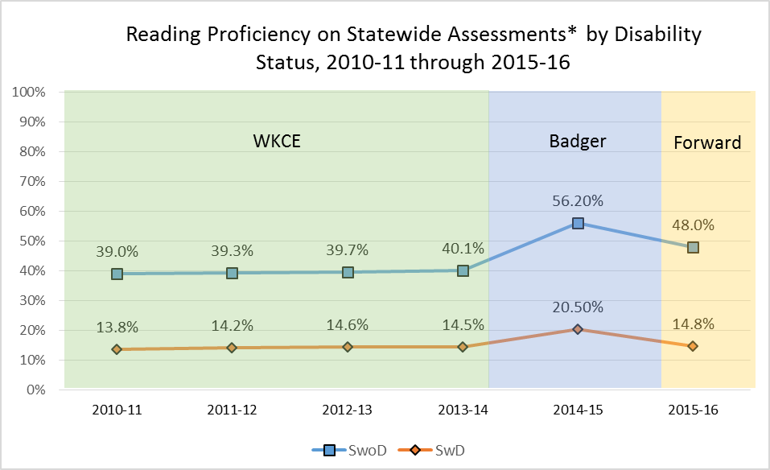
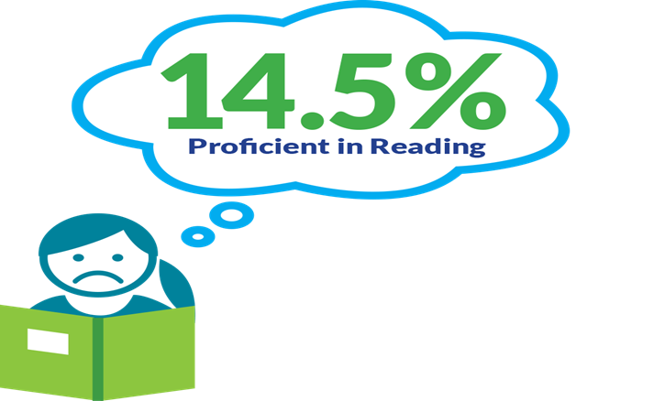
Statewide Reading Proficiency
* WKCE, Badger, & Forward, along with DLM each year. Different tests are expected to produce different results, and are not interchangeable measures.
Notes:
Why all the changes? This graph shows why we selected literacy for our RDA focus*.
The percent of students scoring proficient or advanced in reading for students without IEPs is shown by the top blue line. Reading proficiency for students with IEPs is shown by the bottom red line.
Although state assessments to assess reading proficiency have changed over the last few years, the gaps between students with and without IEPs have remained the same and achievement proficiency levels have remained relatively stagnant with fewer than 15% of students with disabilities meeting proficiency standards in reading. .
The data demonstrates a need to improve reading outcomes for students with IEPs. We need to do more. We need to change what we do with students; need to change practice.
*
Low overall achievement (less than 15% proficient)
Large achievement gaps (25-30% difference)
*Statewide Assessments include the Wisconsin Knowledge and Concepts Exam (through 2013-14), Badger Exam (English Language Arts, 2014-15), or Forward exam (English Language Arts, 2015-16), plus Dynamic Learning Maps (the Wisconsin Alternate Assessment for Students with Disabilities) each year.

Slide 3
Remember What We Want to Accomplish
Focus on procedural compliance alone has not resulted in better outcomes
DPI revised sample IEP forms to promote discussions aimed at improving student outcomes
CCR IEPs focus on improving access, engagement and progress in meeting early childhood/grade level standards based curriculum, instruction, and environments
Notes:
DPI knows our emphasis on compliance with selected IDEA procedural requirements for writing IEPs has not resulted in better outcomes for students with IEPs.
In response, DPI revised the state sample IEP forms and developed guidance for IEP development to promote discussion better aimed at improving student outcomes. This includes addressing literacy and other gaps students with IEPs have with respect to access, engagement, and progress in meeting early childhood and grade level academic standards and functional expectations,
This presentation is not about how to write or review IEPs- We have developed a number of webinars and a full day training workshop to help with those purposes. (See Link to CCR Learning Resources page at the of the presentation). Our goal with this presentation is provide a brief overview of the CCR IEP process and highlight the key points we would like to emphasize with your IEP teams so they can better identify, analyze and support student strengths and needs.
We believe if IEP teams engage in discussion and processes that focus in on “how” and “why” students are having difficulty accessing, engaging, and making progress in early childhood/grade level standards based curriculum, instruction and other activities across educational, we will promote discussions that will lead to the development of IEP goals and services that better support student needs. This, in turn, will make possible, more effective and ongoing analysis of progress toward meeting goals, so each student’s IEP team can know what is working and what may need to be improved, changed or added.

Slide 4
What is a CCR IEP?
CCR IEP = College and Career Ready Individualized Education Program (IEP)
For all public school students ages 3 through 21 eligible under IDEA
An Individualized Education Program developed to
  meet the unique disability-related needs of the student
  help ensure the student graduates ready for further education, work, and living in the community
Emphasis on improving outcomes (compliance and results)
Notes:
CCR IEP stands for College and Career Ready Individualized Education Program.
CCR IEPs are for all students in public school programs ages 3 through 21 who receive special education services; not just for high school students.
CCR IEPs build knowledge, skills, and habits throughout a student’s academic experiences, so when they graduate, they are college and career (and community) ready. This important foundation begins in early childhood.
Simply put, CCR IEPS are Individualized Education Programs (IEP) developed to meet the unique disability-related needs of the student and help ensure the student graduates ready for further education and the workplace
Futhermore, The department’s CCR IEP Framework, based on the 5 CCR IEP beliefs and 5 Step Process, emphasizes both compliance with IDEA requirements AND improved student outcomes
A link to our CCR IEP Overview document is on this slide

Slide 5
The Power of Beliefs
CCR IEP 5 Beliefs
High Expectations
Culturally Responsive Practices
Student Relationships
Family and Community Engagement
Collective Responsibility
Notes:
These 5 beliefs that are at the core of the CCR IEP process.
The 5 core beliefs are essential to developing CCR IEPs that promote college and career readiness. It is foundational for families and educators to embrace these 5 core beliefs. Districts and IEP teams should consider and discuss these beliefs and how they influence practices around IEP development in particular, and the education of students with disabilities, in general.
It is important to keep the 5 Beliefs in mind when completing each step of the IEP development process:
high expectations mean believing students with disabilities can meet preschool/grade level academic standards and functional expectations or, for students with most significantly cognitive disabilities, alternate achievement standards aligned with grade level standards
culturally responsive practices to honor and engage students
positive student relationships between peers and adults to foster access, engagement and progress as well as self-efficacy, self-advocacy and independence;
family and community engagement (will mention Family Engagement later- this is a central focus of DPI)
collective responsibility for working together to support each student in achieving their IEP goals. (including transition goals for older students)
For more information on the 5 Beliefs, please visit our CCR IEP Resources webpage.
Handout- A handout of the 5 beliefs is available on the DPI website at (link on slide)

Slide 6
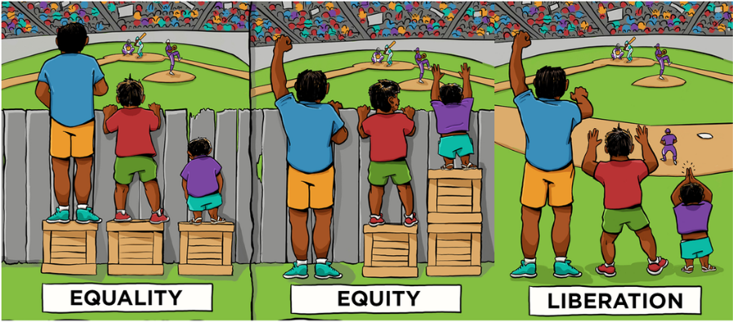
Systems that Support
Equity/Access
No Barriers
Adapted from Center for Story Based Strategy and Interaction Institute for Social Change
Notes:
Many of you may have seen this graphic. It represents all the CCR IEP beliefs and what we hope to achieve w/ the CCR IEP process.
It shows three different scenarios for three students who have their own different attributes and abilities.
In the first, each student is given the same/equal supports. This equal distribution of support works for some students but does not work out so well for others (i.e. equal is not always fair, especially for students with IEPs).
In the second scenario, resources are allocated to each student based on what students needs to address access barriers students face. One might say this is what IEPs typically do for students. They provide students with supports so students can access, engage, and make progress in early childhood/grade level general education curriculum, instruction, and environments. Special ed staff are often the “box builders” for students with IEPs; They give students what they need to deal with the barriers these students often encounter.
In the third scenario, we have identified barriers, that if removed, might provide all students with the same ability to access and engage in instruction and other school activities so they can all benefit and make progress towards meeting early childhood/grade level standards and expectations. While this may not always be fully possible, this is what we should strive to accomplish with the IEP process; We should not only plan to provide “boxes” to allow access to “get around” barriers, but, to the greatest extent possible, we should also identify and provide what is needed to eliminate barriers to achievement and independence. Examples include:
Improve student skills (to address achievement/functional skill gaps) via effective general education instruction and interventions and specially designed instruction
Provide instructional supports that increase independence
Provide environmental supports and make adjustments to increase independence
Change what staff do: teaching and behavior support practices
Within general education classes, consider student needs when selecting materials and designing universal instruction
Deepen understanding of and promote equity and culturally responsive practices
Change beliefs about the capacity of students with IEPs
Resource: Picture Adapted from Center for Story Based Strategy and Interaction Institute for Social Change

Slide 7
Access and Achievement of Grade Level Standards and Expectations
“Research has demonstrated that children with disabilities who struggle in reading and mathematics can successfully learn grade-level content and make significant academic progress when appropriate instruction, services, and supports are provided.”
US Department of Education Dear Colleague Letter, November 16, 2015
Notes:
The 5 Beliefs are supported by recent USDOE Guidance. This is a quote from a November 2015 letter from the United States Department of Education on FAPE and IEPs. This letter highlights the requirement to provide through equal access to grade level standards for students with IEPs. This is at the heart of CCR IEPs
Although students with IEPs may require an individualized and unique pathway for accessing and engaging in grade level standards, curriculum, and instruction, this letter reinforces the idea having an IEP should never deprive students with opportunities for learning and engaging within the general education curriculum.
The quote states:
Research has demonstrated that children with disabilities who struggle in reading and mathematics can successfully learn grade-level content and make significant academic progress when appropriate instruction, services, and supports are provided.
This letter goes on to say that conversely, holding students to lower expectations, such as not allowing them to access in similar content and material as grade level peers, has shown that students do not learn what they need to succeed in the grade they are enrolled.
If you haven’t read this letter and its companion letter on Behavior Supports, We strongly encourage you to do so. Links are on the CCR IEP Learning Resources page.

Slide 8
CCR IEP Five Step Process
Understand achievement of grade-level academic standards and functional expectations to identify the student’s strengths and needs.
First
Understand achievement of grade-level academic standards and functional expectations to identify the student’s strengths and needs
Identify how the student’s disability affects academic achievement and functional performance.
Analyze progress towards goals to evaluate what works and what is needed to close the student’s achievement gaps
Identify how the student’s disability affects academic achievement and functional performance
Then
Develop ambitious but achievable goals that close achievement gaps and support the unique strengths and needs of the student.
Next
Align specially designed instruction, services, supports, and accommodations needed to support the goals and ensure access to the general curriculum.
Align specially designed instruction, services, supports, and accommodations needed to support the goals and ensure access to the general curriculum
Develop ambitious and achievable goals that close achievement gaps and support the unique strengths and needs of the student
Ongoing
Analyze progress towards goals to evaluate what works and what is needed to close the student’s achievement gaps.
Notes:
This graphic emphasizes that the CCR IEP 5 Step Process is not a linear process with a beginning and an ending.
It is intended to be a cyclical process IEP teams use to assist in ongoing planning of future services and supports for the student.
We will quickly walk you through each step, highlighting key points we usually make in our longer trainings with school staff.

Slide 9
CCR IEP Development
Back to Basics
Understand Achievement
Analyze Progress
Identify Effects of Disability
(and disability related needs)
Align Services
Develop Goals
Notes:
The Five Step Process, takes IEP teams through five inter-related requirements IEP teams meetings held for the purpose of developing or reviewing and revising a student’s IEP.
One of the benefits of thinking about IEP meetings using these five steps, reminds us that this is not a new process or a new IEP.
If these steps look familiar, it is not a surprise; this is the IEP as we have always known it.
The 5 steps address the following IEP development questions.
Do we understand the student’s unique strengths and needs in relation to grade level academic and functional expectations.
Have we identified how the student’s disability effects access, engagement, and progress and identified the student’s unique disability-related needs?
Based on those needs, did we develop specific, clear, IEP goals that are ambitious and achievable?
Are IEP services aligned to support goals and needs?
And finally, do we have a system to analyze progress throughout the duration of the IEP to identify what is working and what may need to change to improve access, engagement student and progress in grade level content, instruction, and environments, so to improve student outcomes

Slide 10
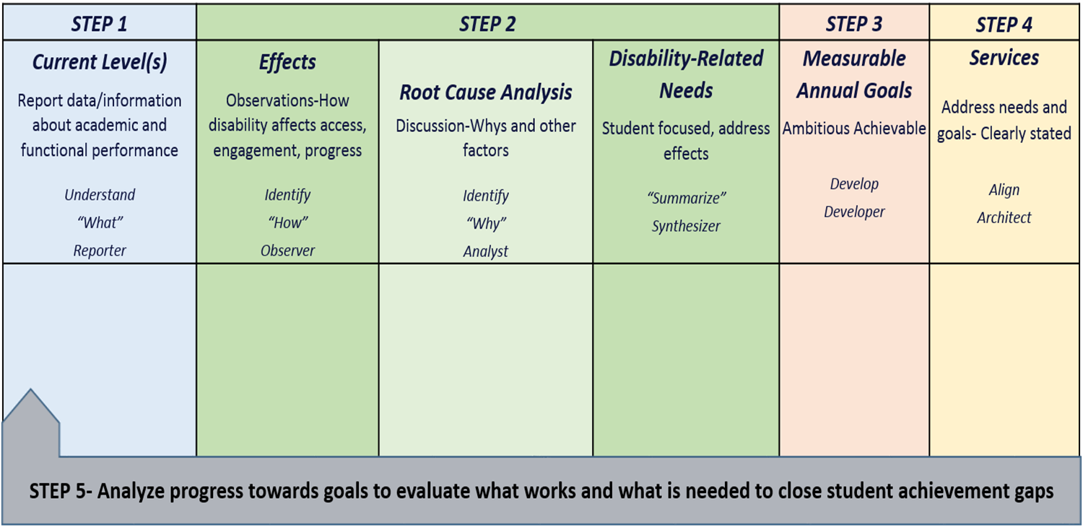
CCR IEP 5 Step Process Chart
Notes:
This chart was developed to clarify the main purposes of each step in the 5 Step process and the linkages between the steps. This chart also highlights the role the IEP team will play in discussing each step.
For example, in Step 1: Understand Achievement, the role of the IEP team is reporter. Everyone from the student, parent, general education teacher, special education teacher, related service providers, and LEA representative, and others report out what they know about the student from assessments, data, and observations.
In step 2, the role of the team switches to one of observer to identify the effects of disability, then to analysts to discuss and begin to determine the root causes or disability-related needs, and synthesizers to record the outcome of those discussions to write a succinct statement of the disability-related need(s).
In step 3, the role of the team becomes that of a developer to develop ambitious and achievable IEP goals including how progress toward goal achievement will be measured.
In step 4, the role of the team is that of an architect who design the special education services that support the student’s disability related needs and IEP goals achievement.
Finally, in step 5, after the IEP has been implemented, the IEP team intermittently analyzes progress to fully understand what is working and what is needed to continue moving the student forward in their education and preparation for college and career.
The chart can be used both as a training tool when explaining the steps as well as a place to take notes when developing or reviewing IEPs.
We have used this chart during some of our trainings and have been told it helped teams review their IEPs by reflecting on and checking if all steps have been covered. Trying to fill in the chart after IEP development can help show gaps in IEP development and may identify the need to hold a meeting to review and revise the IEP.
The chart could also be used to help staff, parents, or students prepare for an IEP team meeting or to take notes on during a meeting. Some districts have adapted this chart for notetaking using PowerPoint or Google slides.

Slide 11
Step 1
Understand Achievement
Understand achievement of grade-level academic standards and functional expectations to identify the student’s strengths and needs
Notes:
Presenter note: REFER to Steps At A Glance one-page handouts Also mention Webinars and Step PPTS available on the DPI for each Step at https://dpi.wi.gov/sped/college-and-career-ready-ieps/learning-resources
Step 1 provides the IEP team with the “big picture” of the student’s current performance. Step 1 is about DATA that documents current levels.
The purpose of Step 1 is to summarize, understand and document the student’s current academic and functional performance related to access, engagement and progress in the general education curriculum, activities and environment(s). Current levels of achievement and functional performance must be understood in relation to early childhood/ grade-level pre-academic/academic content standards and functional expectations.
The IEP team includes areas in which the student is meeting standards and expectations, as well as areas in which the student is not meeting standards. It is very important to document the student’s strengths in academic and functional performance as well as areas of concern during this step.
Consider the student’s interests / talents / passions
Consider strengths in academic, vocational, extra-curricular areas.
Include strengths that are pertinent to engaging the student in their education
It is also important to understand and include information that reflects the family and student’s voices and points of view on strengths, as well as areas in which the student may not be meeting standards and expectations. If the family/student does not volunteer information when reviewing current levels, they should be asked for input.
Step 1 lays the foundation of data and information for the analysis that occurs during Step 2. It is important that the IEP team compiles sufficient data and information in preparation for the discussion about effects and disability-related needs.

Slide 12
Step 1 Key Ideas
Understand early childhood/grade-level academic standards and functional expectations
Identify and document the student’s strengths in relationship to improving student outcomes
Describe student’s current performance compared to standards and expectations
  Consider skills needed to access, engage and make progress
  Consider multiple sources of data
Notes:
It is during Step 1 that the discussion of standards primarily occurs.
To complete this step, IEP team members must be familiar with the academic standards and functional expectations for the grade in which the student is enrolled in order to compare the student’s performance to those standards and expectations.
For early childhood age students, IEP team members should be familiar with the developmental and early learning standards and IDEA preschool outcomes (Indicator 7).
For students with the most severe cognitive disabilities, IEP team members should be familiar with the alternate achievement standards (Essential Elements) that are aligned with grade-level standards.
The student’s current academic and functional performance is then compared to the grade level standards and expectations. IEP documentation for this step incorporates both elements, current performance and the relationship of this performance to grade level academic standards and functional expectations.
When completing this step, be sure data and information are shared in meaningful ways so all IEP team members understand, including parents and the student (as appropriate). For instance, explain test scores in terms that describe what a student knows and is able to do compared to their peers. ( Examples can help) This discussion should be documented on the IEP Linking form (I-4)
As time allows, Ask, “What do you think is the most challenging thing about this step? Do you have suggestions on how to address w/ staff? How would you explain this step to families? to students?

Slide 13
Step 2: Identify Effects of Disability on Access and Achievement
Identify how the student’s disability affects academic achievement and functional performance
Notes:
Lets move to step 2
The purpose of Step 2 is to engage in deeper conversations to identify how the student’s disability affects academic achievement and functional performance. IEP teams are encouraged to pause and reflect during this step.
Deeper level discussions of “why” a student may not be meeting early childhood or grade-level academic standards and functional expectations will lead to more accurate identification of the student’s disability related needs and development of IEP goals and services to address those needs and result in improved outcomes.

Slide 14
Step 2 Key Ideas
Step 2 has three parts
Document observations of the effects of disability
Analyze root causes
Synthesize and summarize disability-related needs
Notes:
There are 3 parts to Step 2:
1.) Identifying the effects of disability (Observations):
What the IEP team sees or hears as a result of the student having difficulty accessing, engaging, and achieving preschool or grade-level academic standards and functional expectations . THESE ASPECTS OF THE STUDENT’S DISABILITY CHARACTERIZE THE STUDENT’S DIFFICULTIES, STRUGGLES re: not meeting standards and expectations…i.e what happens because of the student’s disability; what you can see/hear
2.) Conducting a root cause analysis:
The IEP team asks “why” 5 times and explores additional factors to dig deep into the causes of difficulty in accessing ,engaging, and achieving preschool or grade-level standards and expectations. HELPS EXPLAINS EFFECTS AND CURRENT LEVELS
3.) Summarizing the disability-related needs:
Synthesize the discussion of effects and root causes to summarize areas of academic skill or functional behavior that will address the effects of the disability and improve access, engagement and progress in general education curriculum, instruction and environments– The summary should reflect the “why”. SO WHAT Academic or functional skill AREAS NEED TO BE ADDRESSED?

Slide 15

Effects of Disability
Observe
What do we see?
What are the results?
What are the concerns?
Does it occur everywhere?
Notes:
Part 1- EFFECTS- When discussing Effects of Disability, IEP team participants play the role of “observers”. The team describes “how” the student’s disability affects access, engagement, and progress in the early childhood/grade level standards based curriculum, instruction and environments by sharing observations to answer this question, “In what ways do the characteristics or nature of the student’s disability affect the student’s ability to meet early childhood or grade-level academic standards and functional expectations? In short, how do you see or hear the student’s disability in relation to the current levels?
Begin by reviewing what is understood about the student’s current levels of academic achievement and functional performance from Step 1.
Also review any special factors that may affect access, engagement, and progress (such as does the student’s behavior impede learning, does the student have communication needs, is the student an English Language Learner?).
Make sure you elicit and consider observations and concerns of the student or family.
The primary focus is on areas the student is not meeting standards and expectations, Ask, “What do you see related to the current levels? ; “How do you see or hear the student’s disability in relation to the current levels”?
For example, . if the student is not meeting reading standards, ask “What do we see…
when the student is involved in reading instruction?;
when the student is completing text based assignments?,
and when the student is in classes where significant amounts of reading is expected?
When exploring effects, the team should also consider student strengths and characteristics that may be capitalized upon across environments to bring about success. Ask, “in what subject areas or environments is the student successful?” ; Are there any classes or environments in which the student is not struggling, is actively engaged…?
When documenting “how the disability affects access, engagement and progress,” it is best practice to describe conditions when, where, and how frequently the effect of the disability occurs (or does not occur).
The IEP team must always determine if the student’s disability has an adverse affect on the student’s ability to meet grade-level reading standards, or for preschoolers, if the student’s language development, communication, or early literacy skills are affected. This is a “Yes” or “No” question that gets documented in the IEP Form
If “Yes, the IEP team must include a specific description of how the student’s disability affects access, engagement and progress in the general education reading (or, for preschool students, early literacy) curriculum
If “No,” the IEP team must still describe how the student’s disability affects access, engagement and progress in other areas of the general education curriculum and environment, or age-appropriate activities for preschool children.

Slide 16
Root Cause Analysis
How does asking “Why” multiple times help drill down from higher-level symptoms to the underlying root cause(s)?
Notes:
Here is a video that does a great job of describing root cause analysis
This video provides a good example of how to conduct a root cause analysis using the 5 Whys.
Think about this question as you watch: How does asking “Why?” multiple times help drill down from higher-level symptoms to the underlying root cause(s) of a problem.
Possible answer: by repeating “why” five times, the nature of the problem as well as its solution becomes clear.”

Slide 17

Root Cause Analysis
Analyze:
Why is the student struggling to meet early childhood/grade-level academic standards?
Why is the student struggling to meet early childhood/grade-level functional expectations?
Ask why 5 times
Dig deep into the cause
Dig into one reason at a time
Notes:
During this part of Step 2, The IEP team plays the role of a detective or analyst during root cause analysis. During this part, the IEP team analyzes “why” the student is likely having difficulty accessing, engaging in, or making progress in the general education curriculum, instruction or environments, or for preschool aged children, in age-appropriate activities.
To conduct a root cause analysis:
Select one area of concern to address at a time. This is one of effects of the disability you just identified.
Check for consensus that this is an area of concern
Ask the first question “why”. “Why is this or does this happen?” Why is the student experiencing this struggle? (As you have the “why discussion” it may be helpful to revisit data and observations that illustrate the concern).
Generate possible reasons.
Continue to ask the second “why” and so on.
Also ask “why” about areas or environments in which the student is more successful
For example, why is this less of a problem in some classes or environments, What seems to improve access, engagement or progress related to the area/skill or concern? This is important because there may be aspects that could be capitalized upon and transferred to other subjects or environments. In our example, are there any circumstances when the student does not struggle with independent reading,
It is important to follow a “why” string systematically to it’s conclusion in order to identify the root cause. During the “Why” discussion IEP team members may suggest what seems like unrelated ideas instead of diving deeper into the initial reason. If this happens, jot the ideas down. You may return to them later, as they may provide a branch to two or more root causes of related effects. However, in order to refine root causes, it’s important to dig deeper into one possible effect and reason at a time. A facilitator will need to keep the IEP team on track to drill down into a root cause and then come back to possible branching ideas to conduct another root cause.
Always revisit and consider information you have already reviewed from the current levels, special factors and discussion of context (activities, environments, staff) when analyzing the root cause.
Sometimes the discussion about root causes may lead to a need for additional information in the current levels or lead you to identify new or different effects of disability statements.
Others have found that often there is a pattern and the same/very similar root causes are related to a number of effects and impact more than one area of academic and/or functional performance (identifying patterns can lead to fewer, more targeted needs and goals)

Slide 18
Example of Root Cause Analysis
Effect of Disability “How” (Observer) | Root Cause Analysis “Why” (Detective/Analyst)
Does not independently read grade-level text | Gets frustrated when required to read independently Trouble gaining meaning from grade level written material when reading independently. When text read aloud or using a text reader, can access/comprehend Reading fluency insufficient to efficiently read grade level written material on own Difficulty with decoding affects fluency; makes it hard to read and understand text Difficulty with phonological skills affect decoding
Why?
Why?
Why?
Why?
Why?
Notes:
Here is an example of a root cause analysis (Summarize following notes when presenting depending on audience and time):
In the example, we said one of the effects of the student’s disability is the student not able to independently read grade-level materials.
To conduct a root cause analysis of this effect, the team started by asking, “Why can’t the student independently read grade-level materials”?
First response- because the student gets anxious or frustrated when required to read independently and avoids reading. In exploring this more (are there times when this does not happen?) , it is also noted that the student doesn’t have as much difficulty when text is read to the student tor when using a text reader.
(at this point, the team could decide this is related, but not part of the direct branch of discussion re why the student can not independently read and may save this when discussing other effects (such as the effect the student’s reading skill may have on functional skills of attention and behavior)- and continue on the branch about specific reading skills.
The next “why”, Why does the student get frustrated?
Because student can’t understand what they are reading when have to read grade level text on own, without help
The next why- Whey can’t the student understand why they are reading ?
We know reading fluency is directly related to reading comprehension. Specific to this student, “based on benchmark test scores and running records, we know the student’s reading fluency is not at grade level (meets 3rd vs. 5th grade fluency benchmark and at 3rd gr. independent reading level) and this makes it difficult for the student to read on their own when given grade level text.
Why is reading fluency insufficient?
We know from running records and teacher observation that the student’s fluency is affected by decoding problems. Because the student can’t efficiently decode, it makes it hard for the student to efficiently read and gain meaning from text and thus affects the student’s ability to independently read grade level text.
Why does the student have trouble with decoding?
We also know from information in the Current Level section that the student’s fluency is also affected by phonological processing, one of the foundational skills related to reading decoding..
The team may delve deeper by asking What else do we know about why does the trouble with phonology and decoding make it hard for the student to read and understand?
Based on assessment information and classroom observation, we know the student language comprehension meets grade level standards and expectations and the student is able to understand grade level text and written materials when it is at a level at which the student can decode, or when text is read to the student. We also know the student can use a text reader to decode and understand text.
The team would repeat this analysis for the other effects. In this particular case it is likely there will be some relationship and overlap between the effects of the student’s disability and root causes related to the student’s challenge with reading fluency.
For further discussion if time: How you you know when enough is enough??

Slide 19

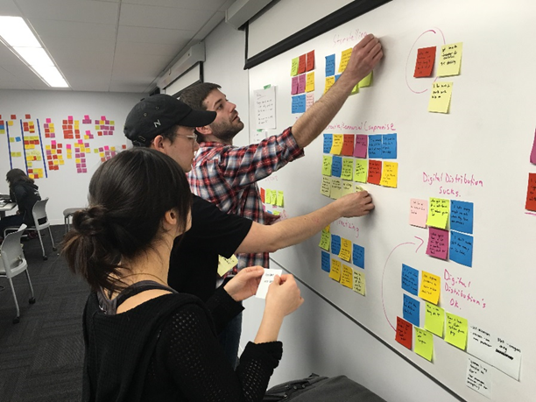
Disability-Related Needs
Synthesize:
Clarify
Summarize
Try to reach consensus
Notes:
During the final part of Step 2, the IEP team takes on the role of a synthesizer, not to make music, but to take complex information and distill it down into clear, succinct and actionable thoughts.
The disability-related needs are identified as a result of this synthesis. This step helps build consensus around “what is needed”. It is the root cause analysis that leads to the identification of the disability-related needs. If the disability-related needs are addressed, then the identified concerns should also be addressed, if not resolved.
To synthesize the disability-related needs,
Review the conclusions from the root cause analysis.
Ask, based on the root cause analysis, “What academic and or functional skill areas need to be addressed so…
the effects of the disability will be addressed and
the student will be better able access, engage and make progress in early childhood/grade level curriculum, instruction and environments so
They can meet preschool/grade level content standards and functional expectations?”.
Document the needs on the IEP form section “Summary of Disability-Related Needs”
DRNs serve as the foundation for developing goals and aligning service during the next two steps
We recommend IEP statements list or briefly describing academic or functional skill areas the student will need to develop or improve so the effects of disability are addressed and the student is able to make gains in access, engagement, and progress in early childhood/ grade level general education curriculum, instruction, and environments. (DNR are related, but not the same as goals)
DRN are related to, but not generally the same as goal statements or short term objectives- Goals and STOs and will include more specificity than need statements.
Goals are developed to address areas of disability related need in the next step. On the form, the needs are numbered for the purpose of easy reference, not prioritization.
A helpful sentence stem for potentially documenting this might be (refer to slide): The student needs to develop/improve/increase, X (target area/skill/behavior related to the root cause), so the student can Y (Y= effect that will be addressed re: access, engagement, progress)
Examples:
The student needs to improve decoding skills (root cause) so the student can fluently read grade-level text (effect)
Improve reading fluency (so student can more independently read grade level text based assignments)
Improve reading fluency (so anxiety and frustration about schoolwork is reduced; attention to reading tasks is improved, and the student remains in class to complete work)

Slide 20

IEP Team Meeting Scenario
You are the LEA representative. The team just reviewed data about the student’s current reading achievement and determined the student’s reading skills are well below grade level expectations. One of the team members says, “Now lets write a reading goal”.
What would you do to facilitate the meeting at this point?
What questions would you ask?
Notes:
5 min turn and talk before go on.
Debrief notes:
Folks seem to find step 2 the most challenging.
It can be very hard for some IEP teams to. resist urge to skip over the discussion of effects, root causes and needs.
There is a tendency to want to move ahead and discuss goals or needed services when they have identified an areas in which the student is not meeting standards or expectations. Unfortunately, doing this can yield IEPs goals that are not directed at the root cause of why the student is not meeting standards/expectations and therefore do not results in the outcomes we desire.
It is important that an IEP team facilitator be assigned to help the team resist this urge and remain focused on the areas of student need that should be addressed before talking about goals and services.
Teams will find that when the Step 2 guidelines are followed, the IEP goals and services will usually be much easier to develop.
It is also not uncommon that when effects, root causes, and DRNs are identified before moving onto developing goals and services, there may be fewer goals as student specific skills/behaviors requiring goals will have been clearly targeted during the Step 2. .
Would be great to follow up with Step 2 Elevator speech if time

Slide 21
Step 3: Develop Ambitious and Achievable Goals
Develop ambitious and achievable goals that close achievement gaps and support the unique strengths and needs of the student.
Notes:
When a team completes step 2, the rest of the IEP should be relatively easy to complete
Step 3: IEP team as developers
In Step 3, IEP teams develop ambitious and achievable annual IEP goals designed with the intent of closing individual achievement gaps. IEP goals also support the unique strengths and needs of the student. IEP teams will use the information they discussed previously and summarized in the disability-related needs section to develop IEP goals.
Highlight two CCR IEP Beliefs:
High Expectations
Goals are ambitious and achievable, aligned with grade-level standards and expectations.
Collective Responsibility
Goals are written as a team to ensure the disability-related needs are being addressed in a collaborative manner across the curriculum and multiple

Slide 22
Step 3 Key Ideas
IEP goals address “why” (i.e. root causes) the student is not meeting early childhood/grade-level standards or expectations
IEP goals address student specific disability-related need(s) that will improve access, engagement and progress toward standards and expectations (i.e., effects)
IEP goals are measurable, ambitious and achievable
Notes:
IEP goals address why the student is not achieving grade-level academic standards or functional expectations. IEP goals specify the skills or behaviors students need to develop or improve so they can better access, engage and make progress in general education curriculum, instruction, or environments.
By connecting IEP goals to the disability-related need, the IEP team ensures the IEP goals address root causes of “why” the student is not meeting early learning/grade-level standards or expectations. Focusing on Root Causes should also limit the number of IEP goal to those really needed to address a student’s individual DRNs
Linking Step 2 with Step 3.
To make sure IEP goals address the student’s disability-related need(s):
The IEP team begins with the disability-related need(s) and then develops a goal specifically to address the need.
In rare instances, the IEP team may decide a goal is not necessary to address the need and the need may only be aligned with a supplementary aid or service or with a related service, such as transportation.
Before the IEP team decides a goal is not needed, it should consider whether the student really has needs that should be addressed by a goal (such those related to self-advocacy and independence).
For example, when a student has mobility needs that require transportation as a related service, the IEP should ask whether the student has developed sufficient mobility skills or may need a self-advocacy goal related to the mobility needs.
Another possible eg: anxiety control supports, use of text reader, etc. BUT….
How to decide if need a goal or just a support/accommodation service? Ask, Does student need to develop/improve or use/apply skill already mastered?)
All goals should be student focused and strength-based. They should address what the student will accomplish…
Goals should reflect the students DRNs, not the entire educational program provided to all students. .
Each goal must be linked to at least one disability-related need. A goal may address more than one disability-related need. Likewise, multiple disability-related needs may be addressed by one goal.

Slide 23
Components of IEP Goals
The “measure” in measurable goals should align all of the following
Baseline
Level of Attainment
Procedures for Measuring Progress
Goal Statement
Notes:
This graphic shows the components of an IEP Goal and how they are aligned.
As has always been the case when developing a measurable annual goal, you must have:
A goal statement: What the student will do (e.g. increase reading fluency, develop organizational skills) --- i.e. reflect the target skill/behavior that needs to be improved, increased, developed (to improve access, engagement, and/or progress)
Baseline: The student’s skill level at the time of the IEP meeting.
Level of Attainment: The amount of growth anticipated within a year (or the specified duration) of special education services.
Procedures for Measuring Progress: The process or methods used to assess a student’s academic and functional performance during the school year for the purpose of analyzing the student’s response to special education services.
Also must determine and document when progress will be reported to Parent
The goal statement, baseline, level of attainment and the procedures for measuring progress should all align to allow those implementing and periodically reviewing the IEP (including the IEP team, at least annually) to decide if the student is making progress towards the goal as well as the extent of progress being made.
As a quick reminder, progress toward achieving the annual goals must be periodically reported to parents. Most LEAs do this on the same schedule as general education progress reports and report cards.

Slide 24
Step 4: Align Special Education Services
Align specially designed instruction, services, supports and accommodations needed to support the goals and ensure access to the general curriculum.
Notes:
Moving on to Step 4-
In step 4 The IEP team discusses what types of special education services are needed by the student.
Services are aligned to address the student’s disability related needs and directly support the student’s ability to meet IEP goals.

Slide 25
Step 4 Key Ideas
Services are aligned to address disability-related needs and support goal attainment
  Reduce barriers and support access, engagement, and progress in early childhood/grade level standards-based curriculum and instruction, other activities, and environments
  All disability-related needs must be addressed by services
Services may include supplementary aids and services, specially designed instruction, related services, and program modifications & supports for personnel
  Specially designed instruction must be included
  If a disability-related need affects reading, there must be at least one goal and service to support that need
Notes:
Special Education and Related services help the student access, engage, and make progress in early childhood/grade level standards-based curriculum and instruction, other activities, and environments.
Services include supplementary aids and services, specially designed instruction, related services, and program modifications and supports for personnel. Specially designed instruction must be included in every IEP.
You will find supplementary aids and services listed first on the I-4 form. This is because IEP teams should always first think about what supports are needed for the student to access and engage in general education instruction and activities before deciding if specially designed instruction is also needed.
All the special education services must align with the goals and/or disability-related needs.
If a disability-related need that affects reading is identified, there must be at least one goal and service to support that disability-related need. Remember, this need could be a specific reading skill or skills OR could be another root cause related to why the student having trouble accessing and engaging in instruction and is not meeting reading standards.
All disability-related needs must be addressed by a service. Each service identifies which needs and/or goals are addressed.
Presenter Note: It may be helpful to re-iterate that a disability-related need may address more than one IEP goal. In addition, more than one goal may address a single disability-related need. Likewise a special education service may address multiple needs.

Slide 26
Guidelines for All IEP Services
Based on the student’s unique needs
Service statements must clearly describe the LEA’s commitment of resources to parents and all involved in developing & implementing IEP
  Each IEP service statement should be clear about type of service to be provided and amount, frequency (or conditions), location and duration
Least Restrictive Environment (LRE) requirements considered when making decisions about the location of services
Notes:
This slide should be a summary for many of you.
As we already mentioned, the student’s unique educational needs drive the IEP team’s determination of the services the student will receive; not course offerings, school/student class schedules, or staff schedules.
The IEP must be written in a way that CLEARLY states the amount of time and resource committed to each service. The level of the LEA’s commitment of resources must be clear to the parent and all involved in developing and implementing the IEP.
When deciding where services will be provided (i.e. the location) , the IEP team must consider the IDEA least restrictive environment (LRE) requirements.
Refer to bulletin 10.07 (link on slide), Describing Special Education Services….

Slide 27
Step 5: Analyze Progress
Towards Goals
Analyze progress towards goals to evaluate what works and what is needed to close the student’s achievement gaps.
Notes:
The last step in our tour of the CCR IEP process is to analyze progress towards IEP goals to determine if the student met the IEP goals

Slide 28
Step 5 Key Ideas
The IEP team analyzes the student’s progress towards the IEP goals to inform future IEP development
The IEP must be reviewed periodically, but at least annually
  The IEP must state when IEP progress will be reported to parents (e.g., quarterly, concurrent with general education report cards, etc.)
When the student is not making sufficient progress towards IEP goals, the IEP should be reviewed and revised, as appropriate
Notes:
In Step 5, The IEP team analyzes the student’s progress towards the IEP goals to inform IEP revision
To do this, the IEP team analyzes progress towards each IEP goal and evaluates what is working and what may not be working as well. i.e. “Has the IEP been effective in addressing the student’s disability related needs and closing gaps in academic achievement and functional expectations at the desired rate?”
The IEP team uses the information collected and already reported to the parent during interim review(s) of progress, and any other relevant information, to determine if IEP goals have been met and if special education services are effectively meeting the student’s needs. If not, what revisions to the IEP are needed to support the student?
During this step the IEP team should identify the goals (or objectives) for which good progress is being made and determine what additional progress may be needed. If a goal has been met, perhaps the goal is no longer needed or a more ambitious goal should be added (i.e., change in level or increased independence of performance; different aspect/higher level skill).
When you analyze progress also discuss how the student’s strengths, areas of success and strategies that are working well may apply to areas in which progress is not so good.
Reminder: This step. Progress made toward goal attainment is part of the current level cycles back to Step 1 discussion for the next IEP.
Other notes:
Two new forms were developed to assist IEP teams with goal reviews: the Annual Review of IEP Goals and the Interim Review of IEP Goals.
The IEP must be reviewed at least annually.
When the IEP team determines the student is not making sufficient progress towards IEP goals, the CCR IEP Five-Step Process provides a good framework for reviewing and revising the IEP.

Slide 29
CCR-5 Step Process and the Sample IEP Forms
What’s the Link?
Notes:
Next we will briefly turn to the DPI Sample CCR-IEP forms

Slide 30
Sample IEP Forms
Revised 2016, 2017
Referral Form (R-1)
IEP Team Meeting Cover Sheet (I-3)
Review of Existing Data (ED-1-replaced EW-1)
Evaluation Report (ER-1)
IEP Linking Form (I-4)- combined old forms for present levels, special factors, annual goals, and program summary
Annual IEP Goal Review (I-5)- New
Interim IEP Goal Review (I-6)-New
Notes:
The forms we made changes to are listed on this slide.
Ask- how many are using the new sample forms?
The Sample IEP Forms became available May 2016. Any future revisions will be made annually.
Contact Anita Castro and Christina Spector if you have specific questions, comments or have input related to the current version of the forms ( See CCR IEP forms page for contact information)

Slide 31
CCR IEP Sample Forms
The revised forms do not add any additional legal requirements
Added sections and prompts promote focus and discussion during IEP development to help ensure
  IEP is procedurally and substantively compliant
  IEP effectively identifies and addresses needs
  Clear linkages between student needs, goals and services = Improved student outcomes
The forms align with RDA and focus on Reading
Notes:
The requirements of IDEA have not changed. And the revised sample forms do not add any new legal requirements.
The new forms go along with the RDA shift in focus to improved student outcomes and follow along with the CCR IEP 5 step process
The forms were revised and prompts added to promote conversations about student disability-related needs and alignment of goals and services---
…and the prompts are aligned w/ the emphasis on college and career readiness and ambitious and achievable expectations promoted by DPI and OSEP
The IEP is not just about documenting compliance. It is a tool for making positive change in the lives of students with disabilities.
The forms are intended to promote discussions about improving outcomes for students and ALSO to help ensure proper documentation of requirements.
The new PCSA checklist are aligned with the new forms.

Slide 32
Feedback Regarding Use of the
Revised Sample IEP Forms
Changes the conversation: emphasis on improving outcomes.
Connections between present levels/needs of the student with goals and services.
Parent involvement / Student involvement
Explanation boxes provide helpful clarification
Notes:
After using the revised sample IEP forms for several months, our pilot districts provided feedback on how the forms were working

Slide 33
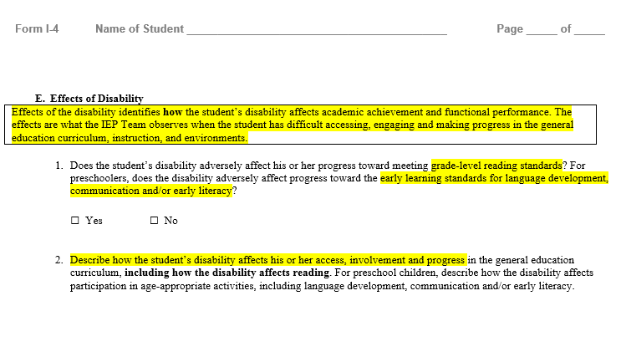
Text Boxes Provide Clarification
Notes:
Lets point out a few highlights of the forms
Text Boxes provide definitions and other important information about the requirements related to the section of the form.

Slide 34
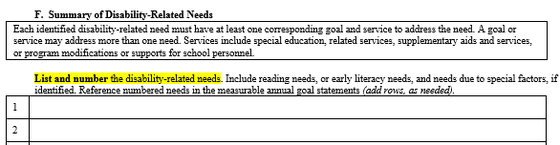
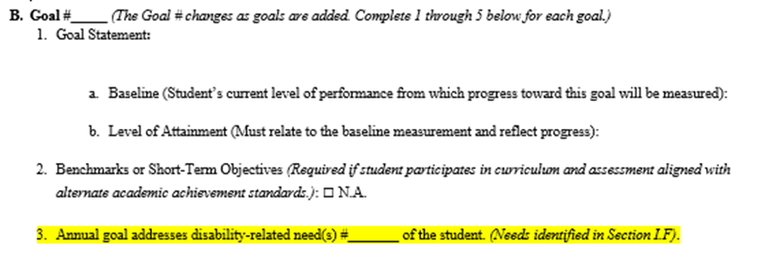
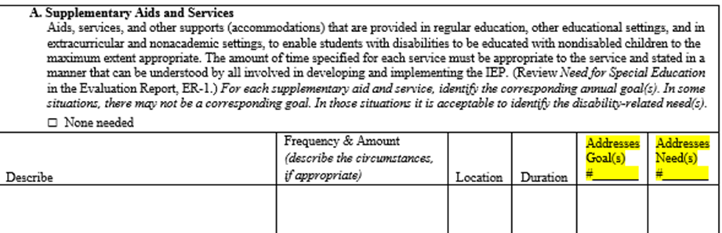
IEP Linkages
Identify Needs
Develop Goals to Address Needs
Align Services with Goals and Needs
Notes:
The sample IEP forms clearly link together student needs, goals, and services.
Identification of disability-related needs is critical to the linking process in the IEP.
The IEP team identifies and numbers each of the student’s disability-related needs.
The IEP team develops goals, as appropriate, to address the Disability-related needs. For each goal, the IEP team identifies which disability-related need is addressed by the goal.
The IEP team aligns special education services so the student can achieve the IEP goals within one year. The IEP team identifies which goals and needs are supported by the service.

Slide 35
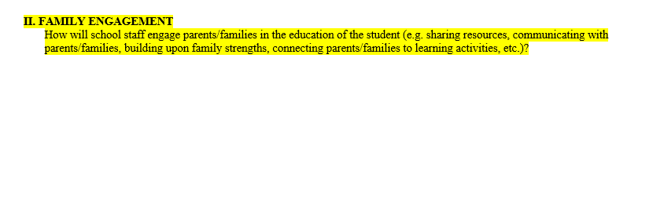
Family Engagement is Emphasized
Notes:
The focus on Family Engagement is also evident in our updated CCR IEP forms.
A Family Engagement question was added to the I-4 to encourage IEP teams to plan ways to engage parents and other family members in the education of the student. Some examples of ways to engage families are included in the prompt. This type of engagement goes beyond reporting progress on goals to the parent. It might include sharing with parents various strategies to support reading instruction in the home.
What is recorded in response to the Family Engagement prompt is a description of what the school district will do to engage families, not what the parents are expected to do**. The IEP documents the district’s commitment of resources.
Parents and families are important members of the IEP team and are encouraged to share information throughout the process. The student should also be included, whenever appropriate, and encouraged to provide input throughout the process.
There is a guidance document available on the DPI Special Education team IEP web site on family engagement in the IEP that can assist in these discussions.
Web site: http://dpi.wi.gov/sped/laws-procedures-bulletins/procedures/sample
**Note: Reminder- a district can not require a family to provide services needed to ensure the student receives FAPE.

Slide 36
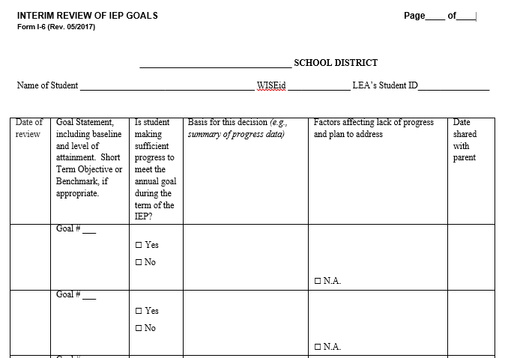
Emphasis on Analyzing Progress and Making Changes to Improve Outcomes
Notes:
The I-6 Form, Interim Review of IEP Goals is a new form to document interim reviews of progress toward the goals.
The form is intended to be used to review and update parents on IEP goal progress on an interim basis.
The I-6 may also be used as a progress report on each goal (or benchmarks/short term objective, as appropriate) in the IEP. It may be appropriate to review completed I-6 forms during an IEP team meeting to review and revise the student’s IEP (depending on the purpose of the meeting), and is definitely recommended to review interim reports when holding an meeting so the IEP team can complete the required annual review of goals.
When completing the interim review, the IEP team reviews the data used to measure progress toward each goal and determines if the student is making sufficient progress to meet the goal in the desired timeline. A summary of the supporting data should be documented on the form.
Space is provided on the form to identify factors affecting any lack of progress and a plan for when progress is determined to be insufficient for the student to meet the goal by the end of the year. The IEP should be revised as necessary.

Slide 37
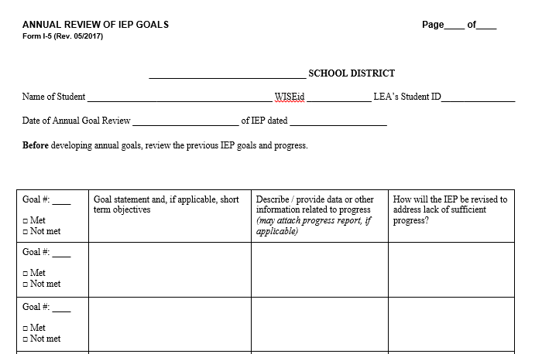
Emphasis on Analyzing Progress and Making Changes To Improve Outcomes
Notes:
The I-5 Form, Annual Review of IEP Goals is a new form for documenting the review of the previous IEP goals prior to developing the IEP as part of an annual IEP team review meeting.
The emphasis is on the link between ongoing progress monitoring and IEP review/revision.
A review of the current IEP goals and progress will help IEP teams consider if changes to goals and services, and/or new goals are needed, to help ensure sufficient progress and close individual achievement gaps for the student.
For the annual review, the IEP team reviews each goal and a summary of the progress data, based on “how progress was measured” consistent with the existing IEP. (i.e.. current achievement of target behavior compared to the baseline and level of attainment).
For each goal, the team will ask, “Did the student achieve the expected level of attainment?
If not, how much progress from baseline was made?
If not, how should we address this?
This analysis will provide some new information about the student’s current level of achievement and functional performance, for using in developing the subsequent IEP.
Describe how the IEP will be revised to address lack of progress, if any. This should correspond to revisions in the new IEP.

Slide 38

How will we help all staff implement the new IEP development process?
How might IEP team meetings be different for parents?
How might IEP team meeting facilitation need to change?
Notes:
For additional discussion

Slide 39
System Considerations
Systemic adoption and implementation of CCR IEP Beliefs, 5 Step Process, and DPI Sample Forms
Staff Preparation and Training
Family Preparation and Engagement
Student Engagement
Ensuring IEP service implementation and collection of progress data as written in IEPs
Others?
Notes:
We encourage districts to review their policies, procedures and resources in place to support the development of CCR IEPs. Here are a few considerations.

Slide 40

Resources
Notes:
The following pages highlight some resources available from links on our website related to this presentation

Slide 41

CCR IEP Webpage https://dpi.wi.gov/sped/college-and-career-ready-ieps

Slide 42
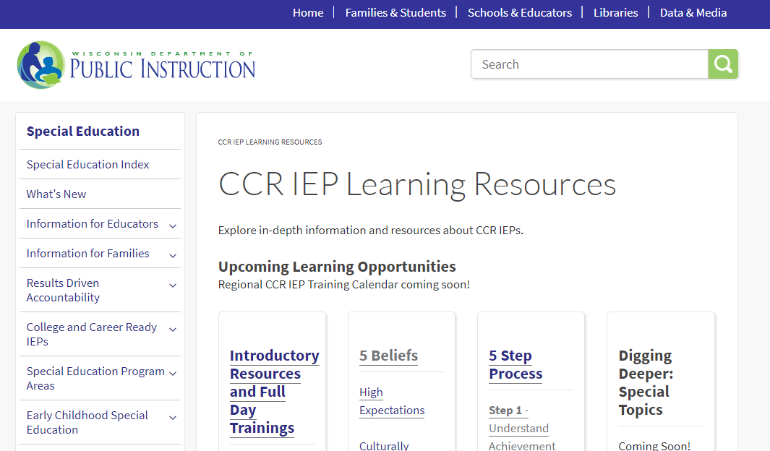
CCR IEP Learning Resources
https://dpi.wi.gov/sped/college-and-career-ready-ieps/learning-resources
Notes:
On this page, you will find links to DPI CCR IEP training resources. Please check this page often as we will be adding new resources regularly

Slide 43
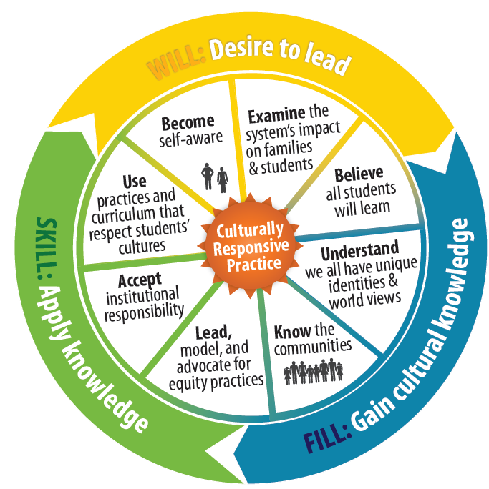
Culturally Responsive Practice
Notes:
The next few slides highlight a few our DPI resources that address the CCR IEP beliefs.
This culture wheel from the Wisconsin RtI center, provides a framework for educators to learn, apply knowledge, and stand up to support the unique identify of each student.
There is a link on slide to RTI center page with more culturally responsive practice resources.
Being Culturally Responsive is one of the CCR IEP Five Beliefs: IEP teams know and respect the unique identity of the student and explore programs, practices, procedures, and policies that meet the diversity of the student’s abilities, race, gender, language, and culture.
We know that every student is unique and for educators to best support students we have to reach out to learn about each and every student’s unique identity.

Slide 44


Family and Community Engagement in Promoting Excellence For All
Report of the State Superintendent’s Parent Advisory Council dpi.wi.gov/pacreport
Wisconsin State Parent Educator Initiative (WSPEI)
http://wspei.org/
WSPEI CCR IEP Family Engagement Resources
http://www.livebinders.com/play/play?id=2191148
Notes:
Agenda 2017 is State Superintendent Tony Evers’ vision for every child in Wisconsin to graduate college and career ready. Within that vision, Promoting Excellence For All recognizes that the education of our students of color requires swift, targeted, and deliberate attention.
In this report, the State Superintendent’s 2014-15 Parent Advisory Council recommended ways for schools to engage families and communities in helping to close student achievement gaps, from the parent perspective.
This report and additional strategies and resources for family engagement are all available on the DPI web site. The Wisconsin Statewide Parent Educator Initiative (WSPEI) also provides family engagement support through a discretionary grant from our Special Education team that focuses on family engagement for families of students with IEPs.

Slide 45

Collective Responsibility
Co-Teaching
https://youtu.be/Xurgvdq3J8s
Notes:
Perhaps one of the most challenging beliefs to realize when supporting students with IEPs is the belief of Collective Responsibility.
DPI’s special education team has begun developing resources that support collective responsibility such as greater outreach to school principals and administrators, stronger collaborations with Title I and other teams at the Department, and guidance on co-teaching, a powerful strategy for achieving collective responsibility.
The department has developed a co-teaching introductory video and is making a Co-teaching toolkit to help educators explore and improve their co-teaching practices. (Link to page on slide)
The co-teaching toolkit contains resources for educators to explore best practices in co-teaching including slide decks, selection tools, resources to improve essential components of co-teaching, and a practice profile that outlines what to look for when entering a co-teaching classroom that can be used to improve co-teaching practices.

Slide 46
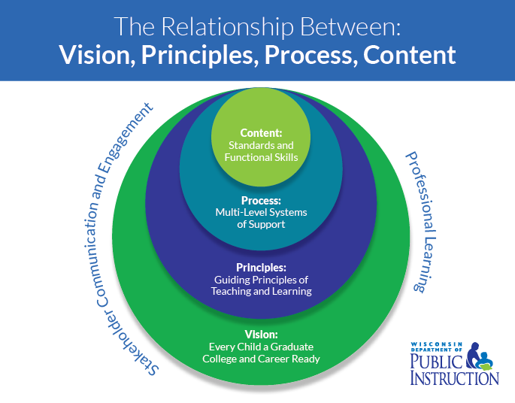
Standards and Expectations
Wisconsin Academic Standards
Early Learning Standards
(WMELS)
Alternate Academic Achievement Standards (Essential Elements )
for students with the MSCD
Social Emotional Learning Competencies
Notes:
Here are links to all Wisconsin standards and expectations
Please note- expected Fall 2017- revisions and new materials being added to the Wisconsin Academic Standards pages – re: ELA Standards 101 and Mathematics Standards 101

Slide 47
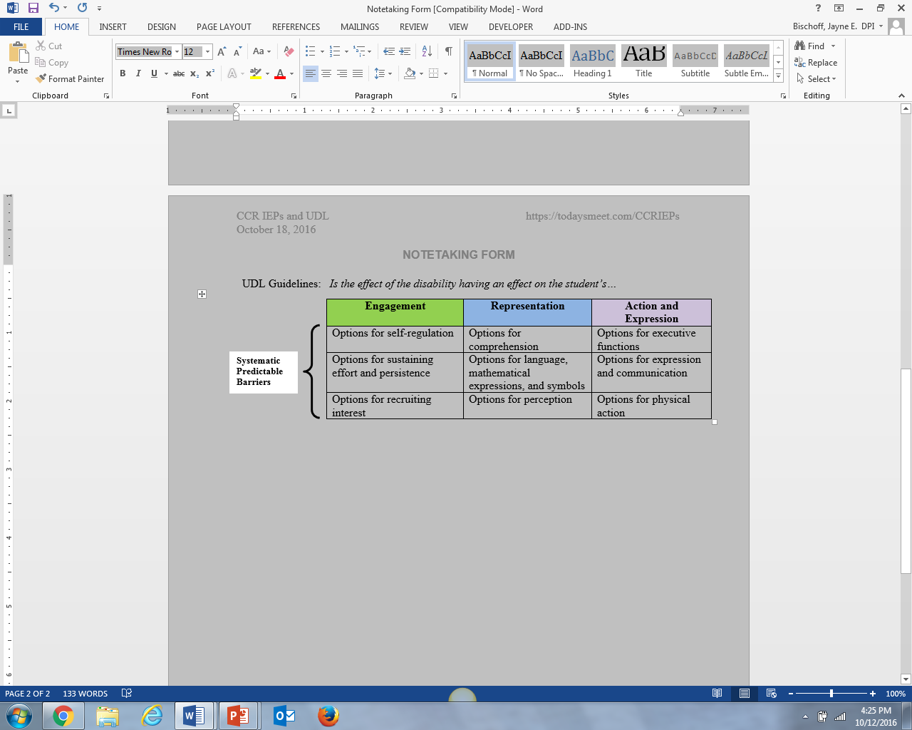
Universal Design for Learning (UDL) and the CCR IEP 5 Step Process
A Lens for Factors Affecting Student Performance
UDL checkpoints can help IEP teams identify and describe effects of disability and guide IEP goal and service planning
Notes:
Universal Design for Learning (UDL) is a key initiative in the department and is particularly important in helping IEP teams identify barriers and ways to address barriers students with IEPs face.

Slide 48
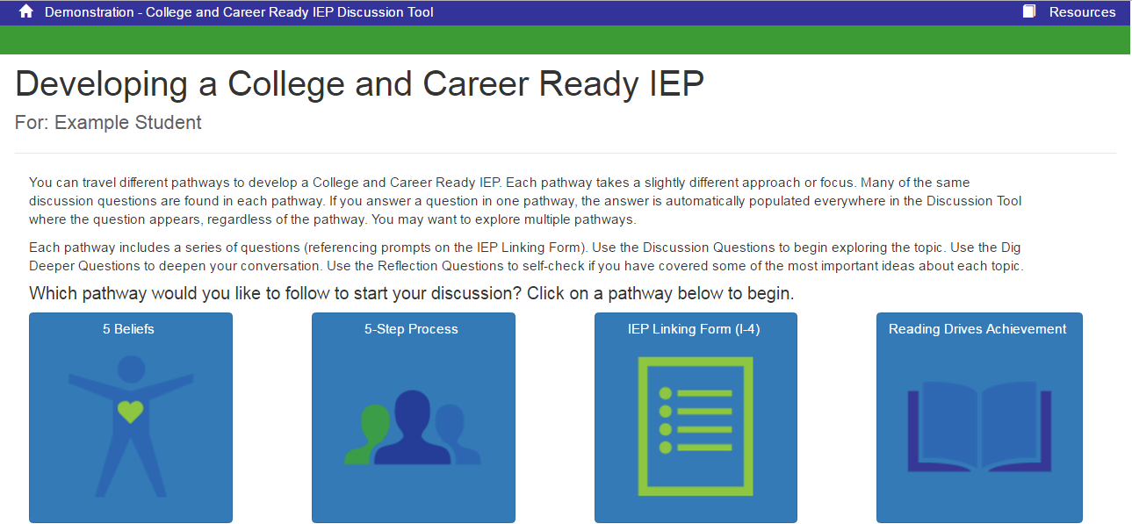
CCR IEP Discussion Tool
Notes:
This discussion tool has been developed to help IEP teams complete the forms- it is aligned with the 5 Step process.

Slide 49
Selected Sample IEP Forms
Resource Links
DPI Special Education Forms Page (includes copies of all sample forms, history of changes to forms, and additional guidance)
Guide to Special Education Forms
Sample IEP Forms Frequently Asked Questions (FAQ)
Notes:
Here are some other resources specific to the forms.
Web site: http://dpi.wi.gov/sped/laws-procedures-bulletins/procedures/sample

Slide 50
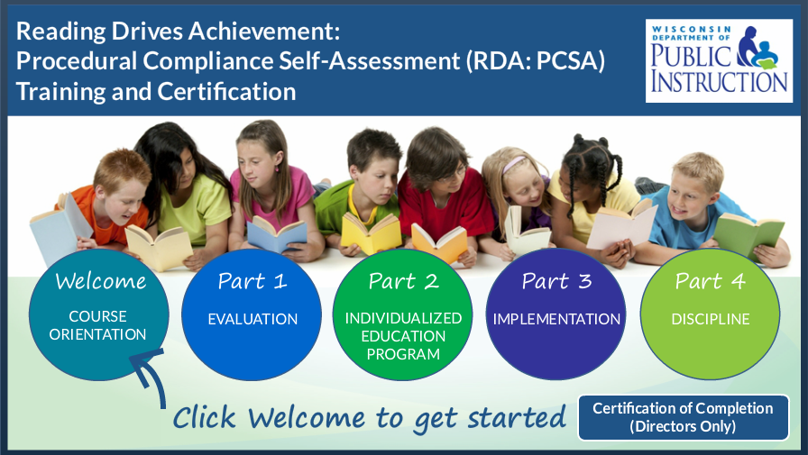
Procedural Compliance Self-Assessment
Notes:
Finally, Here is the training and certification tool for districts who are in the upcoming PCSA cycle. Additional information is available on our PCSA page- link on slide

Slide 51


