Slide 1
Alternate Accountability
Understanding the Alternate Accountability Process in Wisconsin
May 2016

Slide 2

What is Alternate Accountability
Alternate Accountability is a district-supervised self-evaluation process in which schools report and evaluate their performance in three priority areas.
Notes:
Alternate Accountability is a district-supervised self-evaluation process in which schools report and evaluate their performance in raising student achievement in reading and mathematics, and in preparing students to be on-track for success.

Slide 3



What is Alternate Accountability
Schools evaluate their performance in these priority areas: raising student achievement in reading, mathematics, and in preparing students to be on-track for success.

Slide 4
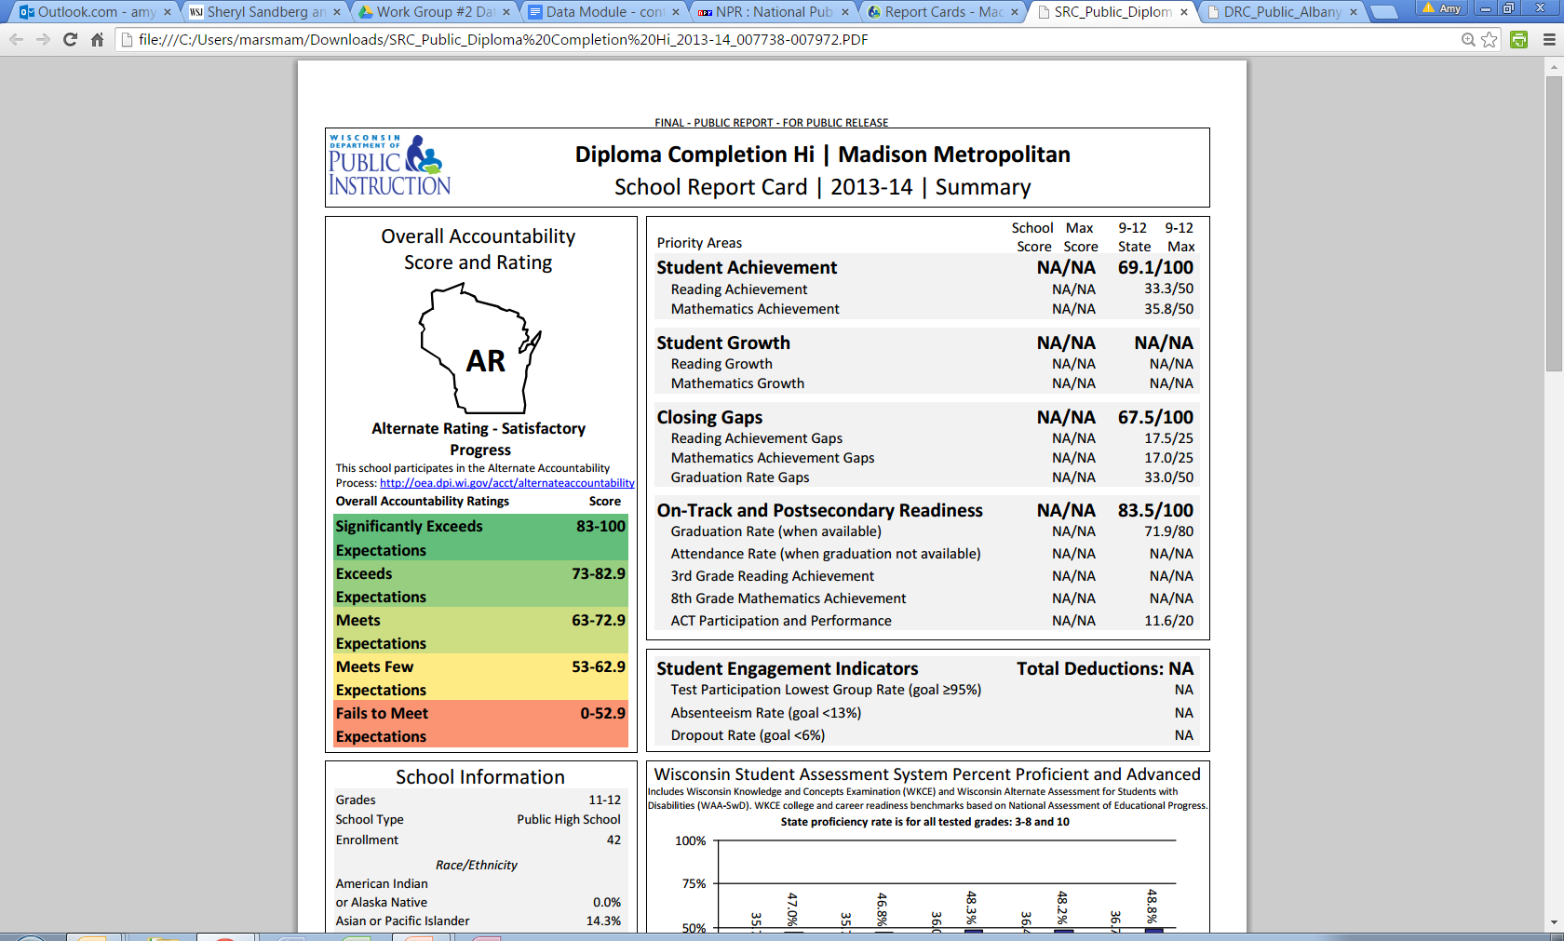

What is Alternate Accountability
These priority areas align to those found in the School Report Cards, but also fulfill federal accountability requirements from the US Department of Education (ED).

Slide 5

Who Participates
Schools that were new in the 2015-16 school year
Schools without tested grades, such as K-2 schools
  Schools with fewer than 20 full academic year (FAY) students tested in grades 3-8, and 11
Schools exclusively serving at-risk students

Slide 6


What Data are Used
Schools may use local data and indicators of their choice to gauge student progress in the priority areas.
Notes:
To complete the self-evaluation process, schools may use local data and indicators of their choice to gage student progress in the priority areas.

Slide 7

What Data are Used
New schools that do not have data from a prior year should select an indicator that can measure student progress from Fall 2015 to Spring 2016.
Schools that have multiple years of data may choose to measure progress from fall to spring, or from the prior school year to the current school year.
Notes:
To complete the self-evaluation process, schools may use local data and indicators of their choice to gage student progress in the priority areas.

Slide 8
What Data are Used
  Reading/ELA
  Schools may choose measures of attainment, growth, and/or gap closing as evidence of achievement.
  Mathematics
  Schools may choose measures of attainment, growth, and/or gap closing as evidence of achievement.
  On-Track for Success
  Schools may choose measures of graduation, attendance, course completion, discipline, or other local measures.

Slide 9
Form Submission
The Alternate Accountability Determination Form is a fillable PDF.
Type responses into the form.
Obtain the necessary signatures certifying the data and documentation.
Scan and email the form to oeamail@dpi.wi.gov.
Forms must be submitted by June 30, 2016.
Notes:
Principals should electronically complete the Alternate Accountability Determination Form (http://oea.dpi.wi.gov/acct/alternateaccountability), obtain superintendent’s signature, and submit to DPI by June 30th, 2016.

Slide 10


Completing the Determination Form
What goal did the school set for this priority area?
How did the school measure progress toward that goal?
Did students meet or make progress towards the goal?
Example:
Our goal was to increase the percentage of students proficient in mathematics.
Example:
We used the MAP test to determine the percent proficient in mathematics in fall and spring.
Example:
The percentage of students scoring proficient in math increased from 54% to 60% from fall to spring.
Notes:
Each of the three performance priority areas asks three questions. Schools need to include information about actual student results on the form, but do not need to submit the data collected.

Slide 11
Performance Ratings
  Reading/ELA
  Maintaining/Improving
  or
  Declining
  Mathematics
  Maintaining/Improving
  or
  Declining
  On Track for Success
  Maintaining/Improving
  or
  Declining
Notes:
Assign each of the three performance priority areas a rating based on the outcomes described on the form.

Slide 12
Accountability Rating
  Reading/ELA
  Maintaining/Improving
  or
  Declining
  Mathematics
  Maintaining/Improving
  or
  Declining
Alternate Rating-Satisfactory Progress
  or
Alternate Rating-Needs Improvement
  On Track for Success
  Maintaining/Improving
  or
  Declining
Notes:
Based on the performance ratings, you then determine the Alternate Accountability Rating. If any performance rating is Declining, the school receives a rating of Alternate Rating – Needs Improvement. If all three performance ratings are Maintaining/Improving, the school receives a rating of Alternate Rating – Satisfactory Progress. Only check one box. This determination satisfies both state and federal accountability requirements for 2015-16.

Slide 13


Certification
Assure data accuracy
Have required documentation
School Principal
District Administrator
Notes:
To document that your school has collected and will maintain evidence that supports the information provided on the back of the form, check all boxes that apply under Documentation of Evidence. Principals should electronically complete the Alternate Accountability Determination Form (http://oea.dpi.wi.gov/acct/alternateaccountability), obtain their Superintendent’s signature, and submit the form to DPI by June 30th, 2016.

Slide 14
Further Information
Resources for Alternate Accountability are online:
http://dpi.wi.gov/accountability/alternate-accountability
If you have questions about Alternate Accountability, please contact in the Office of Educational Accountability:
Alison O’Hara (608-266-5182)
Jason Engle (608-267-1072)

