Slide 1
Academic and Career Planning: 101
Notes:
Intros: Chuck and Darla

Slide 2
§. 115.28(59) ACADEMIC AND CAREER PLANNING. CliffsNotes ™ Version: (a) 2017−18 school year: every school board provides academic and career planning services to ALL students in grades 6 to 12 DPI is to provide: (a) Rule (b) Tool (c) Professional Development
Notes:
Why? Academic and Career Planning (ACP) came about in 2015 and has been required since 2017-18. Your school should have a plan on their website, but in case they don’t or if it hasn’t been updated recently, we’d like to share the Purpose, Process and Product outcome for ACP

Slide 3
.
PURPOSE?
Notes:
What is the purpose of Academic and Career Planning or ACP? Academic and Career Planning has been around in one form or another across WI, but a more focused version was created to assure that every student will graduate career and college ready.

Slide 4
ACP is a student-driven, ongoing process that actively engages students enabling them to:
• Understand their own interests, strengths, values, learning styles,
• Create a vision of their future,
• Develop individual goals, and
• Prepare a personal plan for achieving their vision and goals.
Notes:
Starting in at least 6th grade, school counselors will meet with students to help them identify their personal interests, vision and goals that culminates in a personal plan, guiding students through and to their vision and goals.

Slide 5
PROCESS?

Slide 6
The term ACP refers to both a process that helps students engage in academic and career development activities as well as a product that is created and maintained for students’ academic, career, and personal advancement.

Slide 7
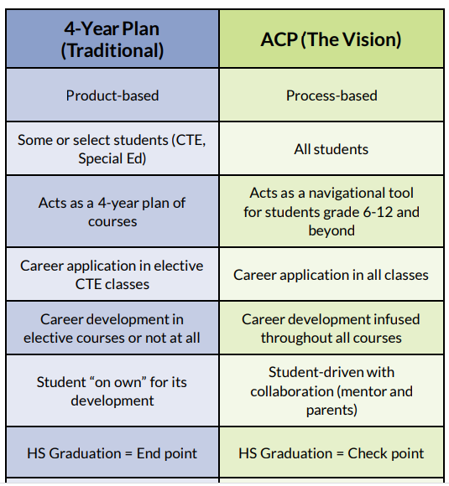
Notes:
The past, traditional, plan had a more student focused outcome that was left up to the individual. The ACP process starts earlier, offers more navigation and focuses on the future rather than graduation as an ending point. This ensures that each student will be more engaged in planning their future as well as the path to follow to get there.

Slide 8
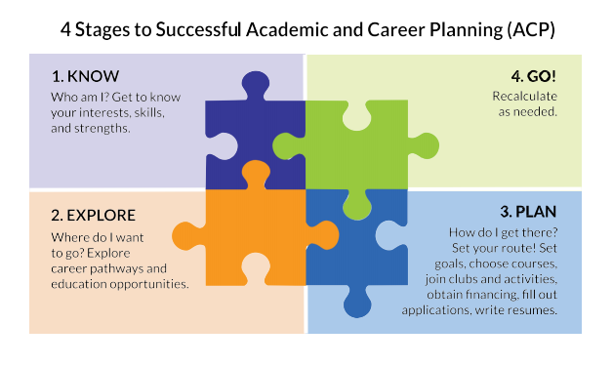
Strong infrastructure, relationships and student awareness are key to successful implementation of ACP.

Slide 9
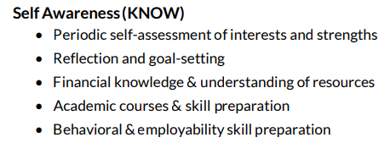

Slide 11
Career Planning (PLAN)
• Planning skills
• The Middle School plan
• The High School plan

Slide 12
Career Management (GO)
• Executing the plan
• Updating the plan with new information & artifacts
• Mentors
• Transitioning ACP Components

Slide 13
PRODUCT

Slide 14
Tools to Use
• Planning Template.
• SMART Goals Sheet.
• Timeline Template.
Once goals are set, districts can begin coordinating action items.
https://dpi.wi.gov/sites/default/files/imce/acp/DPI%20Guide%202016%20FINAL%20web.pdf
Notes:
The Department of Public Instruction provides an ACP Planning Guide, templates, SMART Goal sheets, etc. Click on the link at the bottom of this slide for the ACP Guide and other

Slide 15
Communicate your efforts!
• Acknowledge strengths and obstacles.
• Build your brand and gain support. • Reach all stakeholders.
• Celebrate successes and milestones.
• Share and post your district’s ACP/PI-26 plan on your website.
Each Cooperative Educational Service Area (CESA) has a partner designated by the Department of Public Instruction to lead local collaboration or provide assistance in your area. Find your Coordinator at the link below:
CESA Coordinator Contact Guide

Slide 16
Implementation
How can you show your community and your school board what you plan to implement, the progress you've made toward your goals, and how students are being impacted by ACP in your district?
Notes:
Implementing and delivering ACP services in schools in an integrated manner requires that all school staff know and understand their roles and responsibilities. Training provided by CESA partner trainers and ACP team leadership trainers, either in person or through web site accessible formats, focuses on staff learning their roles in ACP service delivery.

Slide 17
Wrap-Up
Notes:
In order for students and schools to realize the full benefits of ACP, districts must make a shift from the four year plan to being future ready.

Slide 18
“We cannot always build our future for our youth, but we can build our youth for the future.” ~ Franklin D. Roosevelt
Notes:
Thank you for listening

