Slide 1
Orientation for New District Assessment Coordinators (DACs)
Notes:
Welcome to the DAC Orientation. This module will be useful for new DACs as well as those who have been in the position for a while.

Slide 2
Today’s Agenda
Navigating the Web Pages
Assessment and Accountability Webpage
Being the DAC
What is a DAC?
DAC Responsibilities
Other Assessment Roles and Responsibilities
Specifics of the Job
Communication
Collaboration
Trainings
Test Security
Accommodations
Student Data
Reporting
Notes:
Today’s module is designed to orient new DACs into their role and offer a refresher to others who have held the position for some time.
In this module I will be providing a walk through of the assessment web pages,…..and information on the DAC Role and Responsibilities,….

Slide 3
Navigating the Web pages Trainings-Resources-Calendars-Correspondence-FAQs-and More
A look at the organization of the assessment web pages and how to make the most of them.
Notes:
Let's look at the webpages you will be referring to often in your role as a DAC.

Slide 4
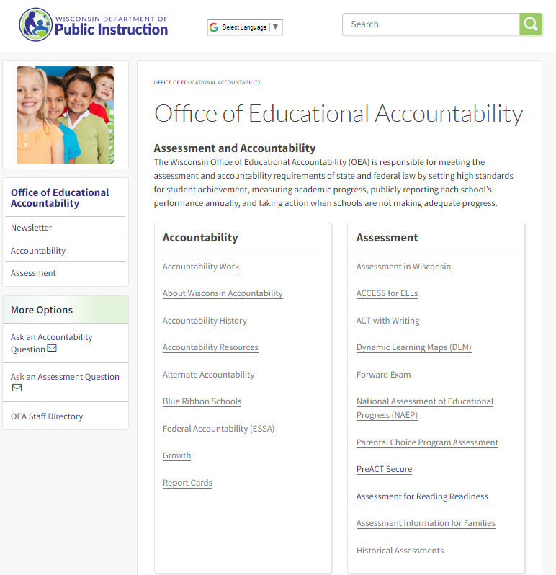
Office of Educational Accountability Home Page
http://dpi.wi.gov/osa-oea
The Office of Educational Accountability (OEA) home page explains the team’s purpose and links to the assessment and accountability homepages.
Notes:
The Office of Educational Accountability home page explains the OEA team’s purpose and links to the main Assessment and Accountability webpages.
Here you can quickly email assessment or accountability a question, access the staff directory, view archived newsletters, and access either team or the specific programs.

Slide 5
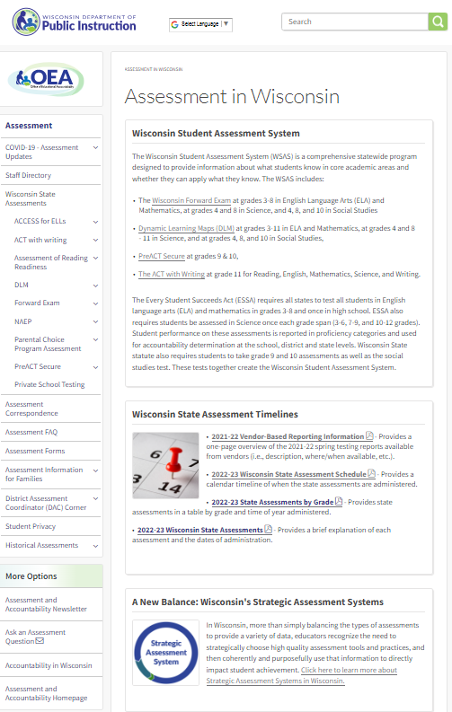
The Assessment Webpage
http://dpi.wi.gov/assessment
State Assessments
Correspondence
Assessment Information for Families
DAC Corner
Timelines
Notes:
The Assessment webpages are frequented by DACs. Here you see in the left navigation bar the State Assessments listed by name, access to the archived correspondence including emails, newsletters, and the DAC Digest, assessment information for families, and the DAC corner.
The Assessment Home page contains a lot of information - starting with the definition of the Wisconsin Student Assessment System’s (WSAS).
This page is also where you will locate the Printable assessment windows for the current administration year.
As you scroll down a bit there are Short descriptions of other important assessments that are not a part of the WSAS.
And quick contact information for each assessment program manager.
Now, Lets dig deeper into the web page and some of these links.

Slide 6
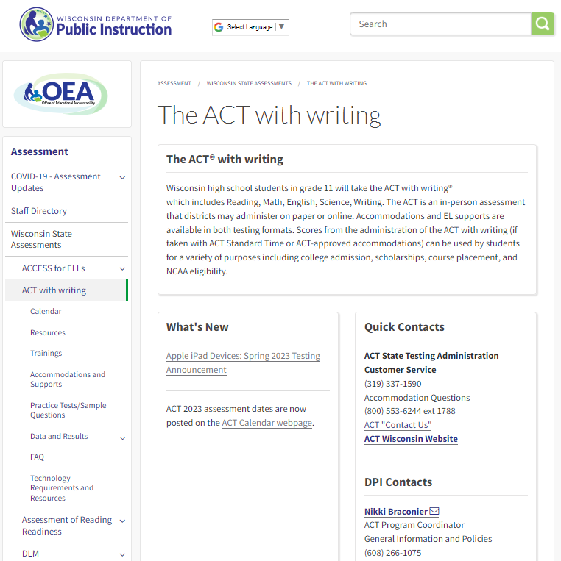
Individual Assessment Web Pages
Each individual assessment has a homepage and almost identical subpages:
In the left navigation bar, under each assessment, you will find
calendar
resources
trainings
accommodations Information
sample items
data and results
technology requirements, and
FAQs
Each assessment’s homepage contains:
Overview of the assessment
“What’s New” section
Quick contacts
http://dpi.wi.gov/assessment/act
Notes:
The ACT homepage contains all information about The ACT with Writing (the name of the test administered, at what grade levels and how). At the bottom of this page, you will find a “what’s new” section, and a quick contacts section which has the program manager’s contact info as well as helpdesk information for the test.
Each State assessment has a similar homepage that gives similar information about each specific assessment. The Forward Exam would have a home page that is very similar to this, as would DLM etc.
As each assessment has similar information to provide, OEA has worked to provide our users consistency across webpages. Therefore, you will find the same subpage headings under each specific assessment including:
Calendar
Resources
Trainings
Accommodations and supports
Practice Tests/Sample Items
Data and Results
Technology Requirements, and
An FAQ
Let's take a closer look at what some of these pages contain.

Slide 7
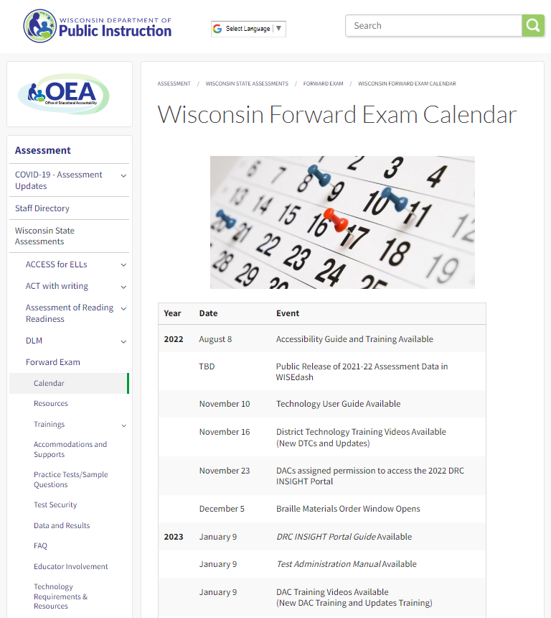
Calendar Webpages
Each assessment has a calendar webpage which contains a list of important dates specific to that assessment.
http://dpi.wi.gov/assessment/forward/calendar
Notes:
Each specific assessment will have a calendar subpage. On this page you will find a timeline for the year, specific to that assessment.
And as we mentioned earlier there is a one-page printable handout with all assessment windows for the school year on the Assessment Home Page.

Slide 8
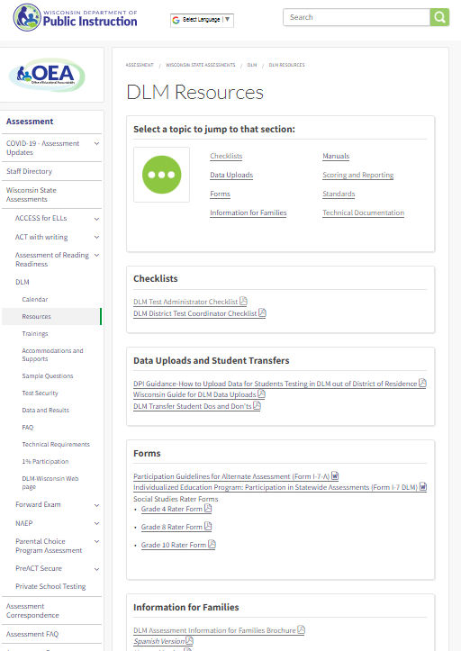
Resources Webpages
Each assessment has a resources webpage with resources specific to that assessment.
Items you will find on an assessment’s resource page include:
Resources for Families
assessment brochures
sample parent/guardian letters
Manuals
Informational handouts
Checklists
http://dpi.wi.gov/assessment/dlm/resources
Notes:
Each Specific Assessment with have a Resources page with resources specific to that assessment.
This is where you will access manuals, handouts, brochures, sample letters, etc.

Slide 9
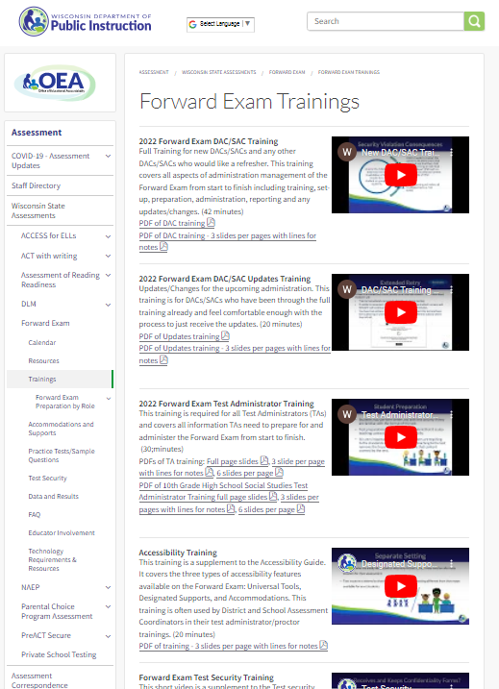
Trainings Webpages
Each assessment has a Trainings webpage has trainings specific to that assessment.
There are different formats for trainings (video, webinar, face-to-face, etc.)
DACs should use these to trainings to prepare staff for test administration.
http://dpi.wi.gov/assessment/forward/trainings
Notes:
As the DAC, you are responsible for training staff throughout the district/schools around appropriate testing procedures. Each specific assessment has a Training web page.
Some of these trainings include topics such as:
Test Administration
Proctoring Guidelines
Test Security
Student Privacy
DACS should make use of these trainings not just for themselves but to training school and district staff.

Slide 10
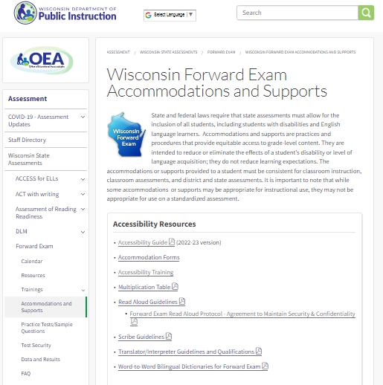
Accommodations and Supports Webpages
Each assessment has an Accommodations and Supports webpage with accommodation information specific to that assessment.
The accommodations and supports pages include accessibility manuals that provide guidance on what accommodations and supports are allowable.
http://dpi.wi.gov/assessment/forward/accommodations
Notes:
Each specific assessment has an Accommodations and supports webpage that will have information specific to that assessment
Here you will find Accommodation/support Guidelines (overall guidelines, scribing guidelines, read aloud guidelines) and trainings.
It is important that all staff know and understand the accommodations and supports that pertain to any assessment they are administering.

Slide 11
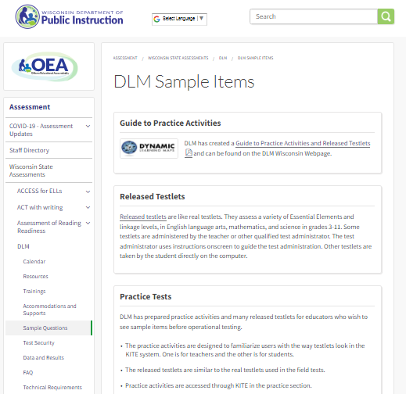
Practice Test/Sample Items Webpages
Each assessment has a practice test or sample items webpage that is specific to that assessment which includes:
links to practice tests/sample items
directions if applicable
scoring guides if available
http://dpi.wi.gov/assessment/act/practice-test
Notes:
Each assessment has its own practice test/sample items page. This page may come in many forms, such as links to a vendor page, downloadable hard copy practice items, online practice items or tools trainings, exemplars etc. It is dependent on what the testing vendor offers as to what is available on this page, but it will be specific to that assessment.

Slide 12
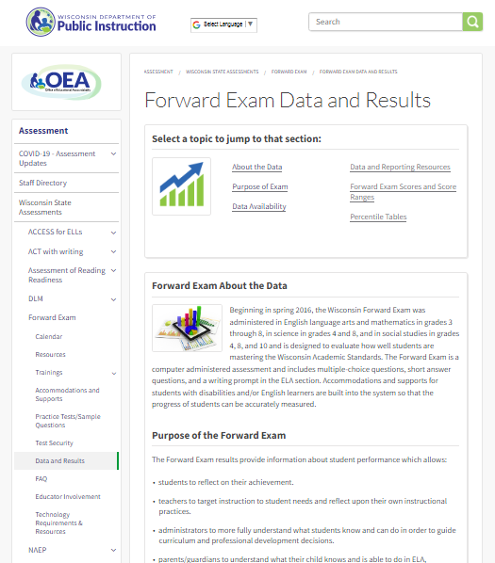
Data and Results Webpages
Each assessment has a data and results webpage that is specific to that assessment.
The data and results page includes:
Overview of scoring and reporting for that assessment
Data will be available timelines
Where to access data
How to access data
Resources to help understand the data
http://dpi.wi.gov/assessment/forward/data
Notes:
Each Assessment has a data and results page. This page will give a brief overview of the data and the exam, the availability of the data and where is can be located, the scoring ranges if available, and any Scoring or reporting resources available for that assessment.

Slide 13
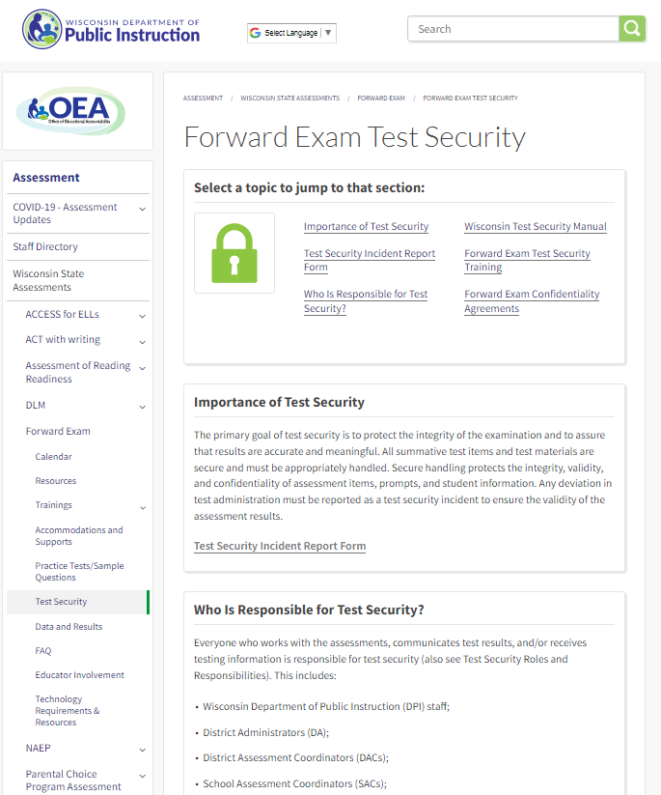
Test Security Webpages
Each assessment has a test security webpage that is specific to that assessment.
The test security page includes:
Test security information for that assessment
Test security manual
Confidentiality forms
Additional test security information
Test security trainings
Test security incident report forms
http://dpi.wi.gov/assessment/forward/security
Notes:
Each Assessment will have a test security web page. These webpages will contain very similar information. There is one Test Security Manual for all assessments, and all staff should become familiar with it.
Other pages may have additional assessment specific policy, forms, trainings etc.
DACs need to ensure all district and school staff are aware of the test security policies around the assessments given.

Slide 14
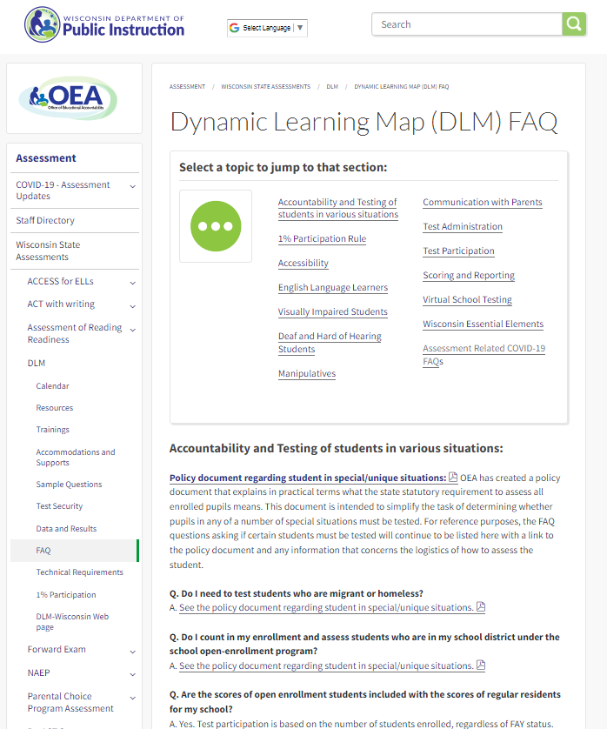
FAQ Webpages
Each assessment has a Frequently Asked Questions (FAQ) webpage
This page is specific to that assessment
The FAQ page includes common questions around:
accountability in various situations
test Participation
test Administration
accommodations
scoring and reporting, etc
http://dpi.wi.gov/assessment/dlm/faq
Notes:
Each assessment has a Frequently Asked Questions (of FAQ) web page that answers questions specific to that assessment. There will be questions that are the same across the assessments, however some answers may very based on the specific assessment.
This is a great first stop for anyone with a question, as many times your answer can be found quickly in the FAQ. Of course you are always welcome to contact DPI for assistance at any time.

Slide 15
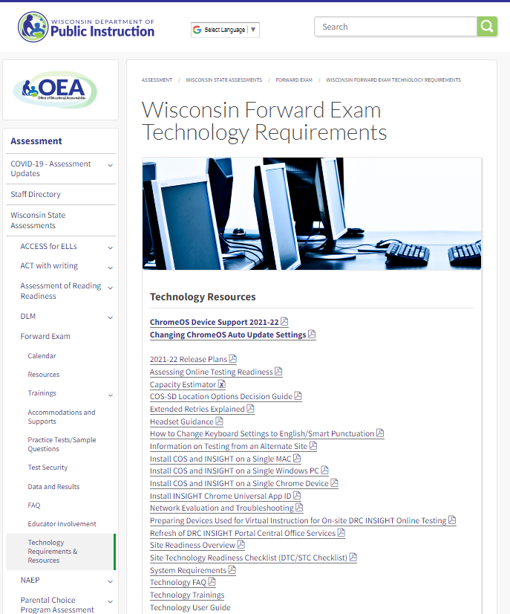
Technology Requirements Web Pages
Each assessment has a Technology Requirements webpage
This page is specific to that assessment
The Technology Requirements page includes:
system requirements
manuals for Technology coordinators if applicable
links to more information
portal information
secure browser information
http://dpi.wi.gov/assessment/forward/technology
Notes:
Each assessment has a Tech requirements webpage, with specifics about that assessment. Here is where you will find technology checklist, system requirements, technology trainings etc.
It is important that your District/School Technology staff are aware of this page and its contents.
Now is a good time to mention, that if you have not provided the name and contact information for your District Technology Coordinator (DTC) please do so. We include them on technology specific communications. DTC Update forms are available in the DAC Corner.

Slide 16
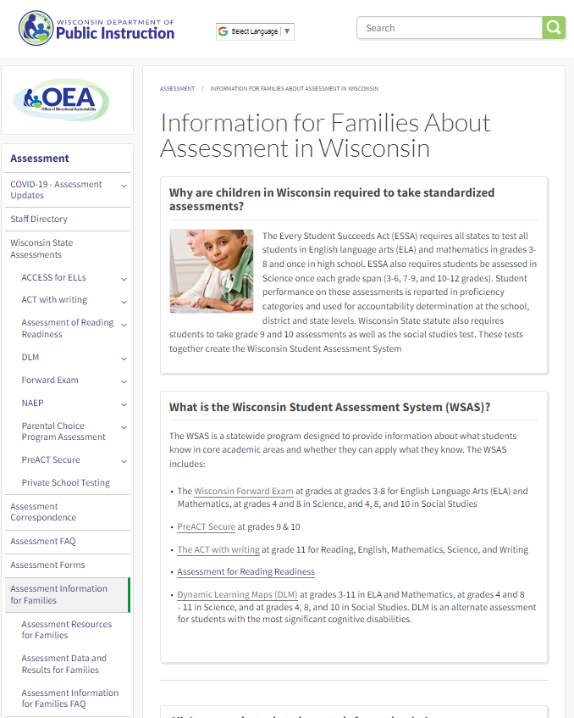
Assessment Information for Families
The Assessment information for Families webpage includes:
Homepage – that describes why students are required to test in Wisconsin, and a short description of the Wisconsin state assessments.
Resources Page – Brochures explaining each assessment, and informational hand outs
Data and Results Page – Links to where parents can see public data, informational handout about student results and where to get more information.
FAQ – Frequently Asked Questions from families about assessment.
http://dpi.wi.gov/assessment/parent-info
Notes:
Assessment Information for Families is a series of pages that are directed at parents/guardians. To answer their frequently asked questions, provide resources they would have interest in, direct them to data and results, and explain the WSAS and a brief overview of all the tests we provide. We are constantly trying to build on these pages to keep Families informed about assessment.

Slide 17
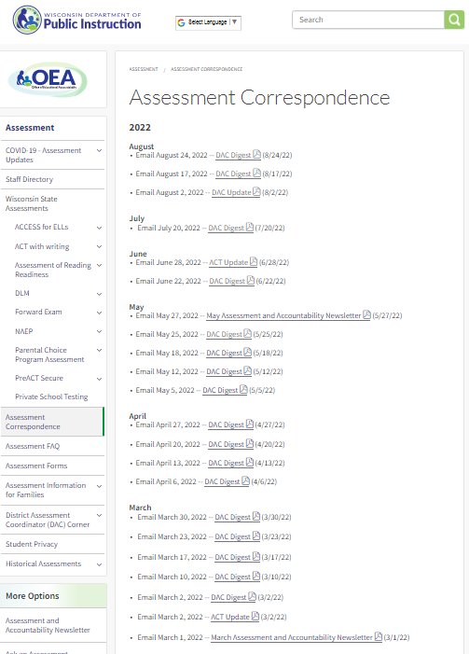
Assessment Correspondence Web Page
The Assessment Correspondence web page archives all information emailed to districts. The main forms of correspondence include:
DAC Digest - weekly email will be sent every Wednesday to all DACs from the Office of Educational Accountability. The contents of the DAC Digest will provide a note from the Director, assessment updates, calendars and action items. While content will vary week-to-week, the general format will remain constant.
OEA News Flash - time sensitive issues that cannot wait until the next DAC Digest, an OEA News Flash will be emailed to DACs immediately.
Assessment and Accountability Newsletter - produced quarterly: early fall, late fall, mid winter, and late spring. The contents of each newsletter will provide relevant information and resources for that portion of the school year. While the content will change throughout the school year, the format will remain the same
http://dpi.wi.gov/assessment/correspondence
Notes:
The Assessment Correspondence Webpage Archives all information emailed to DACs.
All communication from OEA is sent to the DAC list serve which is why it is important to keep the DAC contact information updated at all times. Only one DAC per district is permitted for accountability purposes. The DAC is responsible for ensuring that that communication reaches all district and school staff. We will talk about this in more depth a little later in the training.
Everything sent out (that is not confidential only to the DAC (rare)) is archived for anyone to view at this web page at anytime.
The newsletter is a resource anyone may sign up to receive, you do not have to be a DAC, but all DACs do receive an electronic copy quarterly.

Slide 18
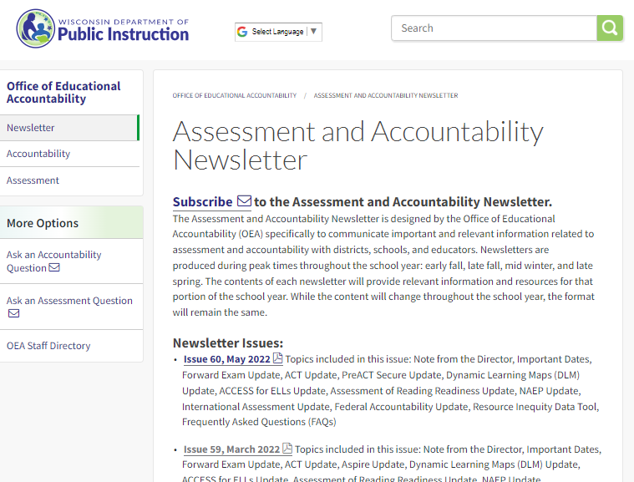
Assessment and Accountability Newsletter
The DAC automatically receives every issue of the Assessment and Accountability Newsletter
All issues are archived at http://dpi.wi.gov/osa-oea/newsletter
Anyone may join the list serve for the newsletter by subscribing at the link provided on the Newsletter webpage
Notes:
The newsletter is a resource anyone may sign up to receive, you do not have to be a DAC, but all DACs do receive an electronic copy quarterly. We recommend DACs forward this resource to staff.
Newsletters contain a high-level calendar for the next 3 months, Note from the Assessment Director, Updates from the Assessment Program Managers and Accountability Team, and FAQs relevant to the time of year.

Slide 19
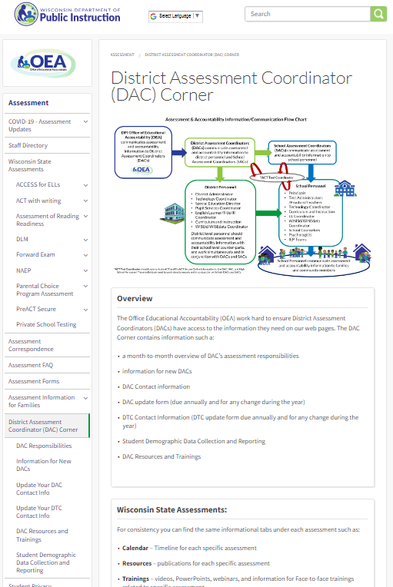
District Assessment Coordinator (DAC) Corner
The DAC Corner includes:
DAC Corner Homepage - The Communication Flow Chart, general DAC overview, and password help
DAC Responsibilities Page – month-to-month overview of tasks to be accomplished by assessment for the school year
Information for new DACs – Page to help orient new DACs to the role
DAC Update – DAC list and update form
DTC update – DTC list and update form
Resources and Trainings –resources and trainings specific to being a DAC
Student Demographic Data Collection and Reporting – information to help DAC understand data collection
http://dpi.wi.gov/assessment/dac
Notes:
The DAC Corner. This is where you will find resources for DACs. A Communication Flow chart, password help information, monthly overview of tasks related to assessment, Update forms and Lists of DACs and DTCs, Information for New DACs, Data Collection and Reporting information, and Resources/trainings. We are working to make the DAC Corner more interactive with tools to help you be the best DAC you can be and hopefully make your job easier to navigate.

Slide 20
Being the District Assessment Coordinator (DAC)
What does it involve?
DAC
Notes:
Now that we all have a good understanding of the web pages we will need to use in our role as the DAC, lets talk about the actual job. What is actually involved in being the DAC?

Slide 21
What is a DAC?
In a nutshell, a DAC is the point person responsible for the successful administration and all other aspects of state assessment in their district
Notes:
The DAC role is usually placed on top of someone’s current or existing role or roles. For instance the school counselor may now be the DAC. The superintendent may be the DAC. The pupil services director may be the DAC. Occasionally someone is hired solely to be a DAC. With new online assessments and additional grades being tested, the DAC job has expanded over the several years to a near full time position.
Unfortunately most districts cannot spare the staff time to have one person be in this role 100 percent of the time.
Basically a DAC is the district’s point person who is responsible for the successful administration and all other aspects of state assessment in the district.
DPI is working hard to try and make this position as easy to manage as possible with transparent information on the web pages, useful communication tools, sample documents for schools and district to adapt and use, clear and concise manuals, and staff available to answer questions needed.
Now let’s jump into the specifics of the DAC role and responsibilities.

Slide 22
What are the DAC’s Responsibilities?
The District Assessment Coordinator (DAC) is responsible for:
Communicating all assessment and accountability information to district and schools (see communication flow chart)
Coordinating testing in their district
Working with
School Assessment Coordinators (SACs)
District Technology Coordinators (DTCs)
ACT Test Coordinator (TC)
District/School Technology Coordinators (STCs) to ensure system readiness (if the district does not have this designated role, it is the DAC’s responsibility to ensure these tasks are completed)
Ensuring that the SACs and Test Administrators (TAs) in their districts are appropriately trained and aware of test administration and security policies and procedures
Ensuring student information/demographics are updated and correct in WISEdata by deadlines
Being aware of assessment accommodations/supports and communicating them to district and school staff
Ensuring district and school staff are training in test security
Reporting test security incidents to DPI
Notes:
This is the general overview of the DAC’s role and their responsibilities. As we move through this training, we will dive deeper into some of these areas.

Slide 23
How does a DAC do all this alone?
DACs should not feel like they are alone. They have many people who work in collaboration with them (from DPI to the classroom level) to ensure each assessment is administered successfully with as little impact on the students as possible.
Assessment staff, technology staff and educators ALL working together.

Slide 24
Other Assessment Roles and Responsibilities
Let’s talk about the others involved in the successful administration of assessments
Notes:
Now lets talk about the others involved in the successful administration of assessment and how their roles works with yours.

Slide 25
School Assessment Coordinator (SAC):
This role is sometimes referred to as the school DAC but is actually a SAC (there is only one official DAC per district.) The SAC works at the school level with assessment. There may be more than one SAC per district.
The SAC manages and oversees all testing in the school and may serve as the contact person between the school and the DAC.
The SAC must communicate all assessment and accountability information to school staff (see communication flow chart )
The SACs must ensure student information/demographics are corrected in the School Information System (SIS) and pushed to WISEdata by the necessary deadlines.
Notes:
Working at each school, especially in the larger districts is a School Assessment Coordinator. This person works in conjunction with the DAC to ensure assessment administration is successful at the school level (go some details from the slide). Smaller districts may not have this role and in that case it is the DAC who is responsible for all of the above.
This position is sometimes referred to as the School DAC but in actuality they are a School assessment coordinator (SAC).
It is very important that the DAC and the SAC work closely with each other and have good communication.

Slide 26
District Technology Coordinator (DTC):
The DTC ensures the district is technologically ready for the Forward Exam.
The DTC must be available during testing to troubleshoot and assist district and school staff with any technology related issues that may arise.
To improve communication OEA has created a listserv for DTC’s. If your district has not designated a DTC please do so and submit the DTC Update form available at http://dpi.wi.gov/assessment/dac/dtc-update
Notes:
The DTC is responsible for the set up of the technology that allows the student’s to test online. This carries from before testing setup, all the way through administration. If a district does not have a DTC, these responsibilities fall to the DAC. The DAC must then work with the people in the district and schools that would best be able to help them achieve these goals (IT staff, etc).

Slide 27
School Technology Coordinator (STC)
The STC ensures the school is technologically ready for the Forward Exam.
The STC must be available during testing to troubleshoot and assist school staff with any technology related issues that may arise.
Notes:
Again if the School does not have this position the responsibilities fall to the SAC. If there is no SAC, both the SAC and STC responsibilities fall to the DAC (and DTC if applicable).

Slide 28
Test Administrator/Proctor (TA)
TAs administer the Exam in a uniform manner that is essential for the integrity of the testing program.
TAs ensure students who have been assigned accessibility features have them prior to starting their exams.
TAs prepare the students and testing environment
TAs monitor students during testing to ensure the security and validity of the exam.
Notes:
Well trained Test Administrators/Proctors are critical to the successful administration of the assessments.
Students are well aware how their teachers feel about what is going on. How teachers approach the assessment sets the stage for the students. If the teacher is unhappy/stressed/confused/angry or calm/happy/relaxed/confident about the assessment, that attitude can transfer to the students.
As the DAC/SAC you need to ensure educators are fully informed about the assessments and their role as proctors so they may present that calm and confident demeanor to the students.

Slide 29
ACT Test Coordinator (TC) (1 of 2)
Responsibilities:
One Test Coordinator per school
Preparing facilities
Selecting and reserving test rooms and preparing them for test day according to ACT guidelines
Assigning and Training Staff
Identifying enough qualified assistants to serve as room supervisors and proctors
Conducting a local training session for all testing staff, including review of the administration manuals and systems
Coordinating Testing Activities
Submitting accommodations requests with the assistance of the Test Accommodations Coordinator
Ordering alternate test formats as needed
Receiving, checking in, and securely storing test materials
Arranging test date with the examinees within the designated testing window
Notes:
ACT has slightly different definitions for their roles as the assessment is specific to the high school level.
However, it is important for the DAC and the TC to remain in constant communication and work together as the DAC is ultimately responsible for assessment in the district.

Slide 30
ACT Test Coordinator (TC) (2 of 2)
Coordinating Testing Activities (continued)
Arranging for examinees to take the non-test portions of the test
Planning seating arrangements for each room
Creating a roster of examinees scheduled to test in each room
Organizing test materials for testing staff
Notifying examinees of the test date, location, and materials needed
Ordering standard time materials for makeup and emergency testing
Arranging for testing staff to apply barcode labels to answer documents
Arrange for transfer of test response to answer documents for examinees approved for alternate response modes
Maintaining Security
Ensuring that tests are administered in strict compliance with all policies and procedures as documented in the manuals and supplements
Returning all test materials to ACT immediately after each test date
Reading and complying with all policies and procedures in the manuals and supplements
Ensure all testing staff remain attentive to testing responsibilities throughout the entire administration
Provide a timely response to requests from ACT when additional information is needed
Ensuring Complete Documentation
Ensuring room supervisors complete all required documentation
Verifying and returning all documentation after testing
Overseeing the documentation of irregularities and consulting with ACT and DPI as needed - Consult directly with ACT regarding actions being taken.

Slide 31
ACT Room Supervisors (1 of 2)
Responsibilities:
One room per supervisor, one supervisor per room
Prepare for test day:
Assist the test coordinator in his or her responsibilities as needed
Attend the training and briefing sessions conducted by the test coordinator
Check-in activities:
Identify and admit examines to rooms; check ID/recognize and mark on roster
Direct examinees to specific, assigned seats
Ensure all examinees admitted to a room are assigned to the same timing
Administer the test:
Prepare room for testing
Take responsibility for a test room and provide an environment conducive to testing
Count test booklets upon receipt from the test coordinator
Distribute test materials, keeping test booklets in sequential, serial number order
Read verbal instructions to examinees verbatim from the manual
Properly time tests, using two reliable timepieces and complete the Testing Time Verification Form

Slide 32
ACT Room Supervisors (2 of 2)
Administer the test (continued):
Complete the Seating Diagram and Test Booklet Count Form
Walk around the test room to ensure examinees are working on the correct sections of the test booklet and answer document
Monitor testing progress
Maintaining security:
Keep test materials secure during testing and breaks
Monitor for prohibited behavior during testing and breaks
Be attentive to examinees and materials at all times
Collect and account for all answer documents and test booklets before dismissing examinees
Ensuring complete documentation:
Complete all information on the appropriate administration forms
Record detailed documentation of any irregularities and, as required, void examinee’s tests
Return all materials and forms to the TC immediately after testing

Slide 33
ACT Proctors (P) (1 of 3)
Responsibilities
Number of Proctors, By Number of Examinees
Preparing for test day:
Assist the test coordinator in his or her responsibilities as needed
Attend the training and briefing sessions conducted by test coordinator
Check-in activities:
Help room supervisors identify and admit examinees
Direct each examinee to his or her seat
Administer the test:
Prepare room for testing
Distribute test materials, keeping test booklets in sequential serial number order
Verify test timing on a separate timepiece than the RS
Monitor testing progress

Slide 34
ACT Proctors (P) (2 of 3)
Maintaining security:
Monitor for prohibited behavior during entire testing and breaks
Be attentive to examinees and materials at all times
Walk around the room during testing to check that examinees are working on the correct test, replace defective materials, respond to illness, and discourage prohibited behavior
Report any irregularities immediately to the RS
Accompany examinees to the restroom if more than one is allowed to leave
Collect and account for all test materials before dismissing examinees

Slide 35
ACT Proctors (P) (3 of 3)
Minimum Proctor Requirements
Standard Testing Rooms
Number of Examinees/Room | Number of Proctors Required
0 – 30 | 0
31-60 | 1
61 – 100 | 2
Accommodation Testing Rooms
Number of Examinees/Room | Number of Proctors Required
21+ | 1

Slide 36
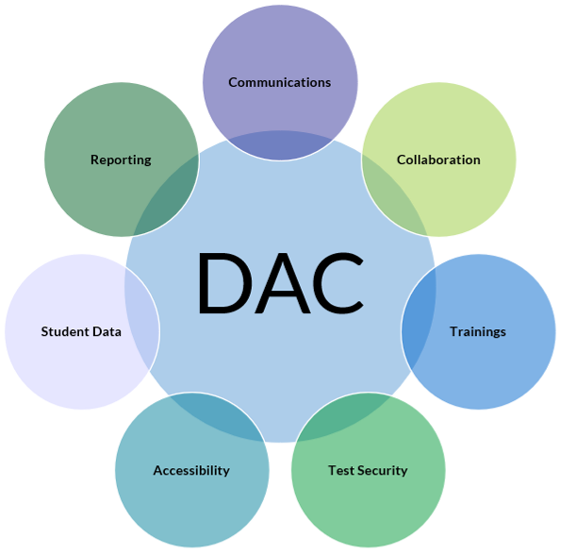
Specifics of the Job
What does a DAC have to do?
Notes:
Let's get down to the specifics of the DAC role now. What exactly do you have to do as a DAC?
As you can see from this diagram there are seven categories into which the role can be divided.
Communication, Collaboration, Training, Accommodations, Test Security, Student Data, and Reporting. We will look at aspect of the job.

Slide 37
Notes:
Communication – Obviously a major part of the DAC role.

Slide 38
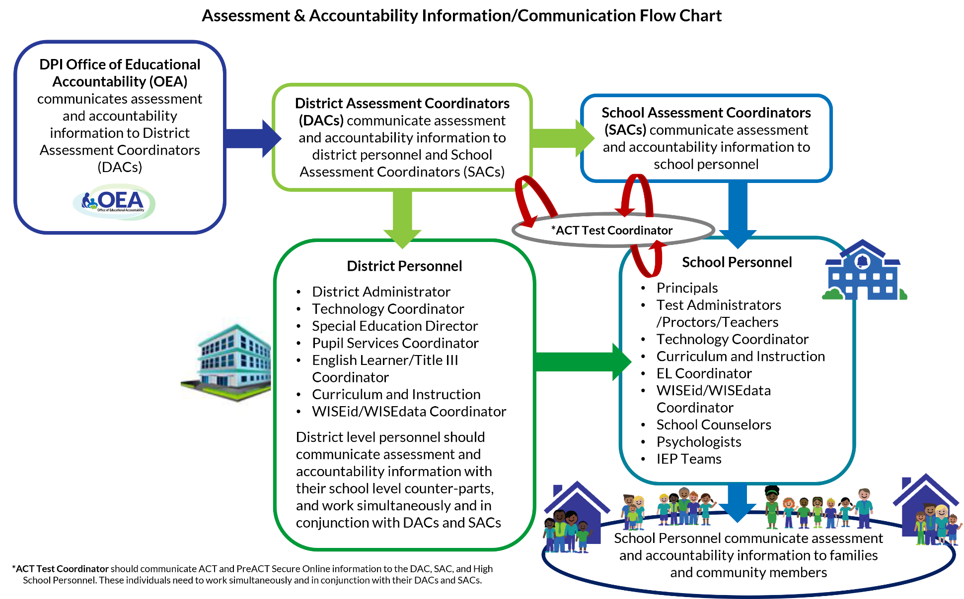
Communication Flow Chart
Notes:
This is the assessment and accountability information/communication Flow chart.
The flow chart shows the path information should take from the office of Educational Accountability (OEA) through the DAC to the stakeholders in the districts , schools, and community.
It is the responsibility of the DAC to ensure all staff are aware of this flow and are working together to get the information to out to everyone. If there is no SAC or STC it is the DAC’s responsibility to fill that gap in the communication flow. It is ultimately the DAC that needs to ensure the information gets all the way through the district, schools, and community. Everyone in your district or school should know (depending on size) who their DAC or their SAC is.

Slide 39
Communication is Key
It is the DACs responsibility to ensure communication about assessment and accountability travels all the way down to the educator level.
OEA communicates with DACs via:
Email (Newsletter, DAC Digest, News Flash Updates)
OEA Webpages – the OEA team believes in transparency and tries to get information out to the field as soon as possible.
Notes:
The DAC needs to make sure this information gets to district/school staff per the communication flow chart. Ensure staff know how to sign up for list serves (newsletter), access the web pages, and contact you, the SAC, the DTC, or STC for help with assessment questions.
For successful administration, everyone must have access to the necessary information. It is the DACs job to ensure that information is communicated.

Slide 41
Collaboration is Vital
DACs must communicate with:
SACs
DTCs
STCs
And TAs (educators)
DACs must establish good communication and work closely with:
EL Coordinators
Special Education Director
NAEP Coordinator
WISEdata Administrator
Notes:
Communication and collaboration go hand in hand.
As mentioned earlier in the presentation DACs must establish a network of assessment personnel and make sure that that network’s communication and collaboration is working like a well oiled machine.
However, just as important is the collaboration with all staff in the district. These individuals (educators, special education staff, EL staff, Data staff) throughout the schools need to know about assessment timelines, accommodation guidelines, administration guidelines, security guidelines, data uploads etc. Not only the DAC but all assessment staff need to work with the staff in their buildings and district to make sure everyone is aware of what needs to be done and the rules/policies around assessment before, during, and after.

Slide 42
Office of Educational Accountability Staff
The OEA team is available to answer questions and talk about any concerns you may have around assessment.
OEA staff may be contacted via:
The staff directory web page https://dpi.wi.gov/osa-oea/staff-directory
The OEA homepage http://dpi.wi.gov/osa-oea
Each specific assessment homepage under “quick contacts”
The Assessment and Accountability Newsletter (last page)
OEA team email address osamail@dpi.wi.gov for assessment related questions or oeamail@dpi.wi.gov for accountability related questions
Notes:
Please contact us with your state assessment-related questions. That is what we are here for and we are happy to help.

Slide 43
Scheduling Assessments is a Team Effort
DACs should work with their schools (SAC, DTC, STC, Principals, etc.) to create appropriate testing schedules for all assessments
all assessments must be scheduled and given per their specific administration instructions
most assessments provide sample test schedules as a guideline to work from
schedule breaks to maintain an unhurried pace and a relaxed atmosphere
be sensitive to students’ fatigue level and attention span, and alter your schedule as necessary
security must be maintained at all times
create a back-up plan for unexpected events
Notes:
Scheduling is very important part of assessment administration. You must look at not only time needed, but resources available (computers, spaces, proctors, etc), student’s attention spans. Work with your schools to create the best schedules based on your resources and needs.

Slide 44
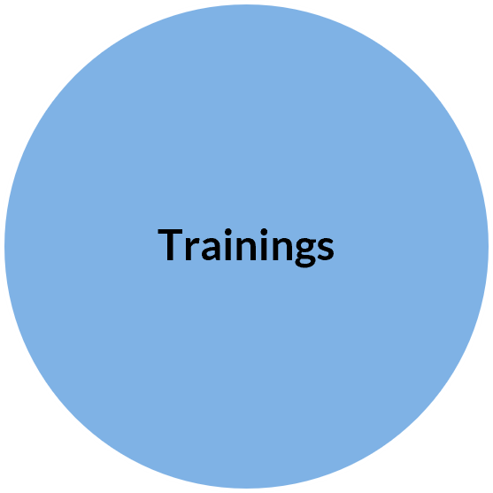
Notes:
Training is a must when working with assessment. Even from year-to-year policy may change and it is therefore important to remain up to date with the most current information available.

Slide 45
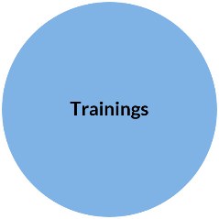
Trainings
The DAC is responsible for ensuring ALL staff are trained on appropriate testing procedures
These trainings include:
test administration
proctoring guidelines
test security
student privacy
communication
using the data
accommodations and supports
accessibility
Notes:
The DAC is responsible for ensuring staff throughout the district and schools are adequately trained in all appropriate aspects of test administration.
SACs and DACs must be aware of all aspects of assessment.
Proctors may only need to be aware of test administration, test security, proctoring, and accommodation and supports appropriate for the assessment they are proctoring. One of the biggest problems we run into is proctor error due to lack of training. They just were not aware they could not do something.

Slide 46
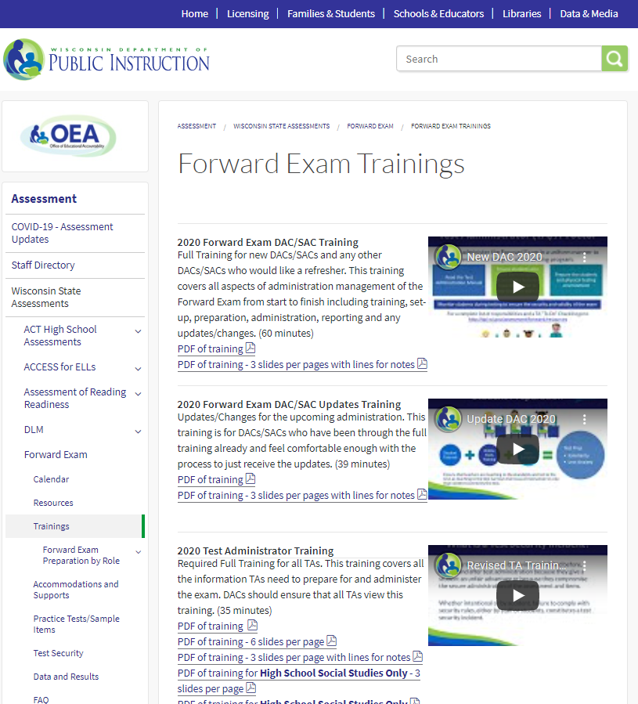
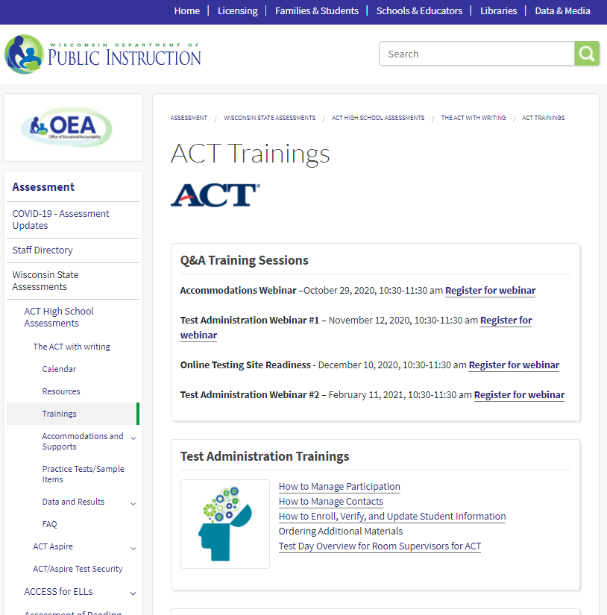
Multiple Training Options
DACs should get to know and utilize the Training webpages
webinars
onsite training information
videos
PowerPoints
training modules
Ensure all staff know how to access trainings
When staff sign the confidentiality form, they are acknowledging they have read and viewed all necessary training materials/documents.
Notes:
As mentioned earlier in the training each assessment has a trainings web page specific to that assessment.
That web page may have direct links to the trainings or take you to the testing vendor portal where trainings are housed. This is also where you will find information about upcoming webinars and Face-to face training.
DACs and SACs should learn to employ these trainings to their maximum benefit.
Use them for group professional development. Have staff view them on their own during free time. Have educators use them in classrooms to educate students about how to use the system (some trainings are designed specifically for students).

Slide 47
Resources
Train staff to locate needed resources on the OEA webpages.
Manuals
Test Administration
Accessibility
Test Security
Technology
Trainings
Test Administration
Accessibility
Test Security
Technology
Misc.
Sample letters
Informational Brochures
Calendars
Newsletters
FAQs
http://dpi.wi.gov/assessment
Notes:
DACs should spread the knowledge.
Train staff not only with professional development about how to administer the assessment and access the testing systems but train them on HOW to access the materials they need. Let them know that the trainings are there if they want to review them again during their own time or want more information. Show them WHERE to access the manuals and information going out to the field so they feel like they are involved and have all the information they want. Some may not go further into the resources available, but some educators want to know much more about the assessment.

Slide 48
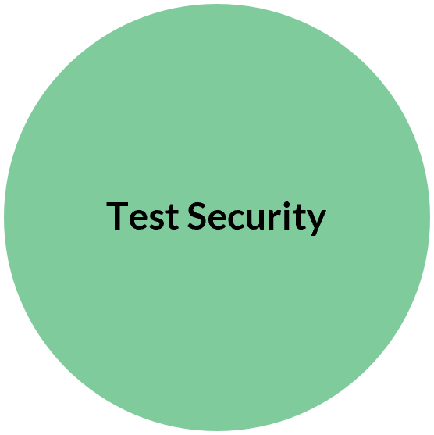
Notes:
Test Security is very important to the validity of the test.

Slide 49
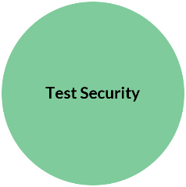
Test Security
DACs are responsible for ensuring test security throughout the district.
Read the Test Security Manual
View the test security trainings
Train ALL staff in test security policies and procedures
Collect signed confidentiality agreement forms from ALL staff involved in any aspect of the testing process
Ensure no part of any assessment is copied, modified, exposed, and/or altered
Ensure test materials are secure at all times (before, during, and after testing)
Report test security incidents to DPI immediately
Ensure ALL staff are aware that any test security incident may result in invalidation of test results
Notes:
DACs must ensure all staff are trained in test security policies for the assessment they are administering. They must communicate to staff that a test security violation could invalidate a test resulting in no score for a student. Students should be made aware that if they violate the test security policies (unauthorized electronics, cheating etc.) this could also result in invalidation of a test.
On the confidentiality form, all staff are signing off saying they have read/viewed the test security training materials and are aware of the policies.
SACs must report violations to the DAC and the DAC must report to DPI right away.

Slide 50
Confidentiality
DACs are responsible for ensuring ALL staff involved in any part of assessment, sign confidentiality forms for each specific assessment they work with
the DAC Confidentiality form is the only form that is submitted to DPI
all other confidentiality forms are housed at the district and school
Notes:
Some confidentiality forms are online and part of the testing system.
For staff that are not part of the online testing system, they will need to complete a hard copy confidentiality form.

Slide 51
A Few Important Security Policies
DACs must ensure all staff are aware and enforcing test security policies. A few examples are:
Proctors are not permitted to administer exams to family members
Any one with a family member participating in the ACT in Wisconsin may not be a test coordinator
Cellular devices/unauthorized electronics are not permitted in testing environments
Unauthorized personnel (anyone not directly involved in test administration) should not be in the testing environment
Contact the DAC right away if a testing incident occurs
Notes:
If one of your proctors has a student who is a family member in their class, the student must be moved to test with another proctor for security purposes.
These are just a few examples of policies that everyone needs to be aware of.

Slide 52
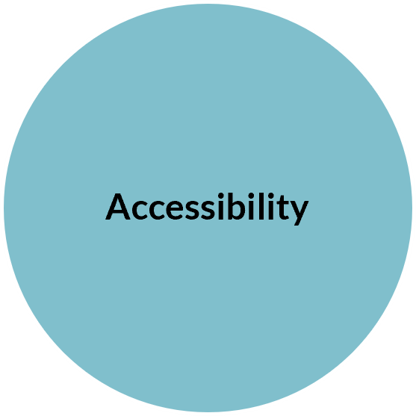
Notes:
Accommodations and Supports vary from assessment to assessment and therefore must be looked at very carefully by those administering the assessment.

Slide 53
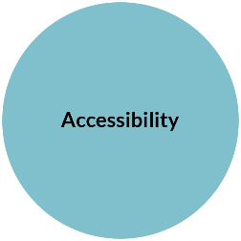
Accessibility
DACs are responsible for ensuring allowable accessibility options are understood for each assessment (by all district and school staff - administrators and educators).
Accessibility options or Accommodations/supports
provide equitable access to grade-level content.
are intended to reduce or eliminate the effects of a student’s disability or level of language acquisition; they do not reduce learning expectations.
must be consistent for classroom instruction, classroom assessments, and district and state assessments.
Each assessment may have unique accessibility policies.
Some accessibility options that are appropriate for instructional use, may not be appropriate for use on a standardized assessment.
Please note:
There are no exemptions or waivers for students with disabilities, regardless of the nature or severity of the disability.
Individualized Education Plan (IEP) or 504 Plan teams determine the appropriate manner for student with disabilities to participate in statewide assessment; teams must document which test each student will participate in (general or alternate) and which accommodations/supports (if any) the student should be provided.
Notes:
Some very important things to note are
Some accommodations/supports that are appropriate for instructional use, may not be appropriate for use on a standardized assessment
An IEP does not trump what is allowable on an assessment.
Each assessment may have unique accommodation/support policies, therefore, it is important to pay attention to each assessment’s policies and what the assessments are trying to measure
All staff should be aware of accommodations and supports, not just special education staff.

Slide 54
Accommodations and Supports for ELs
ELs are administered all assessments that are part of the WSAS for their grade. The WSAS consists of the Forward Exam, DLM, PreACT Secure, and The ACT Plus Writing.
In addition, all ELs are administered the ACCESS for ELLs annually to monitor their growth towards English language proficiency.
ELs with significant cognitive disabilities participate in the alternate assessment, DLM, and the Alternate ACCESS For ELLs.
ELs new in the country (less than 12 cumulative months) are:
permitted a one-time exemption on the Reading/ELA portion of the state content assessment (ACCESS testing counts for their participation).
expected to take all other content area assessments with or without accommodations/supports (mathematics, science, social studies, etc.).
Always view the assessment webpages to determine what is or is not an allowable EL accommodation/support on a specific assessment.
Ensure that supports for ELs are individualized based on each student’s fluency. The goal is to allow ELs to practice their English skills and demonstrate what they can do, and excessive supports can hinder students. Ensure that ELs are familiar with the supports and have practice using them prior to test-day.

Slide 55
Accommodations for Students in Unique Situations
Some students may not have an IEP or 504 plan, but due to unique circumstances at the time of testing may need additional support. These students may be able to demonstrate their learning more accurately through the use of accommodations on an as needed basis only.
In these unique cases, please call OEA at (608) 267-1072
Examples of unique circumstances:
a student with a broken arm may need a scribe
a student who forgot to wear eyeglasses may need a visual magnification device

Slide 56
Request for Accommodations
Occasionally a student requires an accommodation/support that is not on an assessment’s list of allowable accessibility features.
In this situation:
Contact the assessment program manager for the specific assessment to discuss options.
“Request for Accommodation Forms” are available at https://dpi.wi.gov/assessment/forms#accom, that may be submitted for review by OEA staff and/or testing vendor. If the request is approved, the student may use the accommodation/support.

Slide 57
Documenting Accommodations and Supports
All accommodations and supports must be documented in a students’ IEP or 504 plan.
If a student has an accommodation listed on the IEP or 504 plan, it must be offered to them at the time of testing.
Each assessment has a different process for uploading the appropriate accessibility options for an individual student or groups of students.
It is the districts responsibility to ensure that all students have the appropriate accessibility settings activated and made available at the time of testing.
Notes:
Each assessment has a different process for uploading the appropriate accessibility settings for an individual student or groups of students.
DACs must ensure that all student setting are uploaded to the testing portals.

Slide 58
Monitoring the Use of Accommodations and Supports
It is the DAC’s responsibility to ensure that the administration of accommodations and supports:
follow each assessments’ policies and procedures.
are administered with fidelity.
do not invalidate a students test results.
do not violate test security policies.
adhere to a student's IEP/504 or language plan.
Notes:
It is the DACs responsibility to ensure that accommodations and supports are being used appropriately and do not violate test security policy.

Slide 59
Accessibility and Test Security
Test security must be maintained at all times when offering accommodations and supports.
DACs will need to consider:
Accommodations or supports that require one-to-one administrations or special settings
Materials that need to be secured/destroyed before or after use
Materials that need to be checked-in or out from a secure location

Slide 61
Student Demographic Data
The Department of Public Instruction will create student demographic data files for statewide assessments for all students participating in the WSAS exams.
Student Rosters will be pulled from WISEData. Therefore, it is important that districts keep their local student information system (SIS) which transfers student data to DPI up-to-date.
DPI will upload the student rosters to the testing vendors’ online portals.
DACs and district enrollment and data personnel should work together to make sure that enrollment and demographic information for all student in tested grades is kept accurate and up-to-date.
This information is used to create:
Labels for paper/pencil tests
Student data files in DPI and Testing Vendor online systems
Assessment data reporting DPI and Testing Vendor online systems
Accountability and District and School Report Cards
Notes:
DACs must ensure all student demographic information is current in the WSLS. Inaccurate or outdated information may result in confusing and inaccurate student testing information, erroneous reports, and/or invalid accountability determinations.
DACs need to work with district WSLS/WISEdata administrators to ensure all student demographic information is current.
Per FERPA guidelines student privacy must be maintained at all times.
DACs need to work with district and school staff to familiarize them with the reports and data to assist with questions from families, school boards, community members, reporters, etc.

Slide 62
Student Privacy
The DAC must maintain student privacy, per FERPA guidelines, at all times and ensure all school and district staff understand and maintain student privacy
http://dpi.wi.gov/assessment/student-privacy
Notes:
DACs must ensure that FERPA data security requirements are met.

Slide 64
Assessment Reports and Data
The DAC should:
Learn to read, know how to access, and understand the reports and data that accompany each assessment including:
individual student reports (ISRs)
school level summary reports and data
district level summary reports and data
state level summary reports and data
Work with district and school staff to familiarize them with the data and reports at their access level for each assessment.
Ensure staff understand how to access data and read the data and reports for each assessment and how they connect back to the standards.
Ensure staff have access to manuals and additional informational handouts related to the data and reports for each assessment.
Notes:
As reporting data may contain personally identifiable student information. It should not be shared outside of a school or district setting without ensuring that FERPA data security requirements are met.
DACs need to make sure they understand how to access, read, and explain the data for the specific assessments. It is their job to train others to do so and answer questions from district/school staff, parents, and the community around assessment and accountability data.

Slide 65
Assessment Reports and Data
DACs should:
Ensure individual student reports (ISRs) go home to parents/guardians as soon as possible after receipt.
Districts are responsible for ensuring that parents/guardians are provided ISRs in a language they can understand and in a format that is accessible to them.
Districts and schools should take advantage of the reporting resources for parents/guardians on the DPI Assessment webpages.
All parent/guardian resources are available in English, Spanish, and Hmong, including template/sample ISRs.
Work with families to help them understand their student’s reports
Answer questions from families, school boards, community members, reporters, etc. about their district’s assessment data (after embargo/data release)

Slide 66
Please contact:
osamail@dpi.wi.gov with assessment questions
oeamail@dpi.wi.gov with accountability questions

