Slide 1
Child Nutrition (CN) Labels
Notes:
CN labels area voluntary component of Federal labeling program for the child nutrition programs. The label provides a warranty for CN labeled products for auditing purposes if the product is used according to the manufacturer’s directions as printed on the approved CN label. This allows manufacturer’s to state products contribution to the meal requirements on their labels.

Slide 2
Commercially Prepared
Combination Items
Commercially prepared, combination food items can only be credited to the CACFP meal pattern when the amount of content (i.e. meat, bread, etc.) is known and documented
Acceptable documentation includes the actual Child Nutrition (CN) label marked on the product, or a product analysis sheet signed by an official of the manufacturer

Slide 3
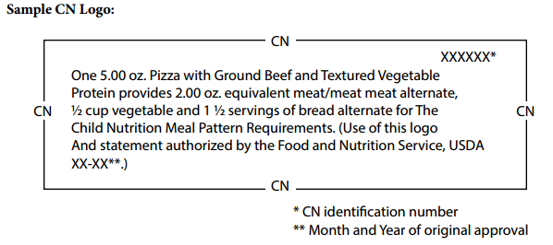
Sample CN Label
Notes:
How can you identify a CN label? The CN label will always contain the following information:
The CN logo, which is a distinct border. (CLICK)
The meal pattern contribution statement. (CLICK)
A unique six-digit product identification number (assigned by the USDA Agricultural Marketing Service) (CLICK)
The USDA/FNS authorization statement. (CLICK)
The month and year of the original FNS Final Approval appearing at the end of the authorization statement.
The remaining required label features: product name, inspection legend, ingredient statement, manufacturer’s name, signature/address line and net weight.
Note: The CN label on the slide is just an example & not valid. So, what type of foods will need CN labels?

Slide 4
Commercially Prepared Combination Items
What are they?
To name a few…
Breaded Chicken Nuggets, patties, tenders
Breaded popcorn chicken and popcorn shrimp
Breaded fish sticks, patties, shapes, nuggets
Corn dogs and mini corn dogs
Pizza (any type)
Canned and frozen ravioli
Breakfast bites
Lasagna
Quesadillas
Salisbury steak
Meatballs
Chili and Chili Mac
Chicken pot pies
Cheese sauce
Frozen soups for any component
Notes:
Any Commercially prepared, combination food items. They can only be credited to the CACFP meal pattern when the amount of content (i.e. meat, bread, etc.) is known and documented.
CN labels must be on file for all combination foods to make them creditable.
A Product formulation statement may be on file in place of the CN label.
Not all commercially prepared, combination food items will have a CN Label & it is your agencies responsibility to obtain a CN label prior to serving the item.
The Nutrition Facts Label found on the package is not sufficient information.
Items without the CN label may be served as an extra component but cannot count towards any of the meal pattern requirements. This is then an added cost for your agency to serve ‘extra’ components.
On the slide are common items we see on menus that will need a CN label. This is not an all inclusive list, just a sample to give you an idea of what products would require a CN label, if purchased & served as part of a reimbursable meal.

Slide 5
CN Labels
NOT
Nutrition Facts Labels or Ingredients Lists
X
X
Notes:
The nutrition facts &/or the ingredients lists are NOT the CN label information. You need to have the label with the distinct CN label (CLICK) & the other items mentioned from the previous slide.

Slide 6
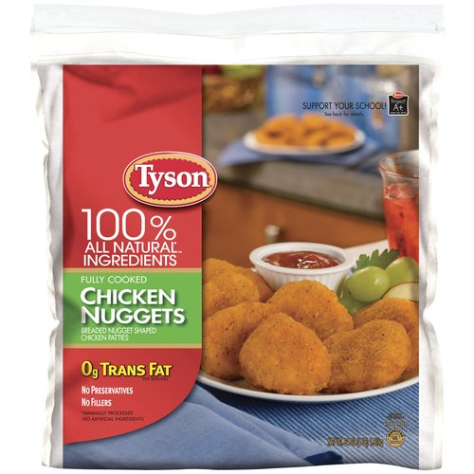
CN Labels = Healthy?
CN labels do NOT indicate that a product is healthy
Used predominately on processed meat and meat alternate products
Healthier options are becoming available
If using CN labeled foods, always read the Nutrition Facts panel to choose healthier options
Notes:
CN labels do NOT indicate that a product is healthy. They are:
Used predominately on processed meat and meat alternate products which are often high in sodium, fat and calories
Healthier options are becoming available, which may be due to child care facilities and schools demanding healthier foods.
If using CN labeled foods, always read the Nutrition Facts panel to choose healthier options.

Slide 7
Sample Product Formulation Statement
Notes:
A combination food may also be credited when a product formulation statement is on file.
It must include a statement of the amount of cooked lean meat/meat alternate, bread/grain, and/or fruit/vegetable components in each serving of the food.
This sheet must be signed by an official of the manufacturer (not a salesperson).
Let’s go over an examples of CN labeled products and determine how they contribute to the CACFP meal pattern.

Slide 8
Child Nutrition (CN) Labels
Two 1.00 oz breaded fish sticks provide 1.00 oz meat equivalent and .50 serving of bread alternate
Meat equivalent calculation:
1-2 year olds (1 oz) = 2 fish sticks
3-5 year olds (1.5 oz) = 3 fish sticks
6-12 year olds (2 oz) = 4 fish sticks
Notes:
Let’s go over some examples of CN labeled products and determine how they contribute to the CACFP meal pattern.

Slide 9
How to use the CN label
This 4 oz Corn Dog provides 2.0 oz equivalent meat and 2 servings bread alternate for Child Nutrition Meal Pattern Requirements.
Meat equivalent calculation:
1&2 year olds (1 oz) = ½ corn dog
3-5 year olds (1.5 oz) = ¾ corn dog
6-12 year olds (2 oz) = 1 corn dog
Notes:
For lunch, we are planning on serving corn dogs. Per the CN label one 4 oz. corn dog contributes 2 oz meat/meat alternate & 2 servings of G/B. To determine the serving size for each age group:
1 & 2 year olds: Take the minimum amount (1 oz) divided by 2 oz=1/2 corn dog
3-5 year olds: Take 1.5 oz divided by 2 oz=3/4 corn dog, round up to 1 corn dog
6-12 year olds: Take 2 oz divided by 2 oz =1 corn dog
(CLICK)
You need to keep in mind that serving 1 corn dog, a 6-12 year old child would be getting twice the amount of bread/grain required (1 corn dog = 2 servings of bread alternate). By serving the same 1 corn dog to 1-5 year olds, they’d be getting 4 times the amount of bread/grain (because they only are required to get ½ serving of bread/grain).

Slide 10
How to document CN products on the Production Record
Corn Dogs (CN)
54.5 oz
31 corn dogs
1 = 2 oz m/ma OR 1 bag (48/bag)
7
13
9
5
Notes:
This slide demonstrates how the production record should list food items with CN labels. Indicate the food to be served has a CN label. In the comment section, you can include how the item contributes to the meal pattern or you can put the number of bags you have prepared along with the quantity in each bag.
Amounts prepared is based on serving 3-5 y/o a whole corn dog, not ¾ of a corn dog.
The adults are included with the 6-12 yr olds.

Slide 11
Sample Cheat Sheet
 | 1-2 year olds | 3-5 year olds | 6-12 year olds
Entrees
Chicken nuggets (name brand) | 3 each | 4 each | 5 each
Fish Sticks (name brand) | 6 | 9 | 12
Corn Dogs (name brand) | 1/2 | 1 | 1
Snack Items, Grain/Breads
Cheese Snack Crackers | 10 | 10 | 20
Graham Crackers | 3 crackers (3/4 sheet) | 3 crackers (3/4 sheet) | 6 crackers (1 ½ sheets)
Saltine Crackers | 3 | 3 | 6
Fruits and Vegetables
Bananas, large (1/2 banana = ¼ cup) | ¼ banana | ½ banana | 1 banana
Grapes (Seedless) (7 large grapes = ¼ cup) | 4 grapes | 7 grapes | 10 grapes
Notes:
Once you buy a CN-labeled product, you only need to cut the CN label off of the 1st box purchased and keep that on file. Or keep the product analysis sheet on file. As long as you continue to buy the same product, you can use that label on file as a reference.
It is recommended to create a “cheat sheet” for the combination food items on the menus based on the CN label for the product you have purchased.. As stated earlier, you may also include other food items like snack foods or even for the common F/V’s served at meals &/or snacks. See the chart above as an example. If your agency does use a cheat sheet for commonly served food items, a copy should be provided to the DPI reviewer during audits
As long as the same products are used, the food preparer could reference the cheat sheet to determine how much total food to prepare at each meal.
So, now that I have covered all of the resources available to assist in the completion of production records we will now complete a production record exercise.

