Slide 1
Crediting foods to cacfp meal pattern

Slide 2
Crediting to CACFP Meal Pattern
Creditable foods are foods USDA allows to be counted toward meeting the requirements of a component
Non-Creditable foods do not meet requirements for any component in the meal pattern
Most non-creditable foods are still allowable CACFP purchases and can be served as extras to a reimbursable meal

Slide 3
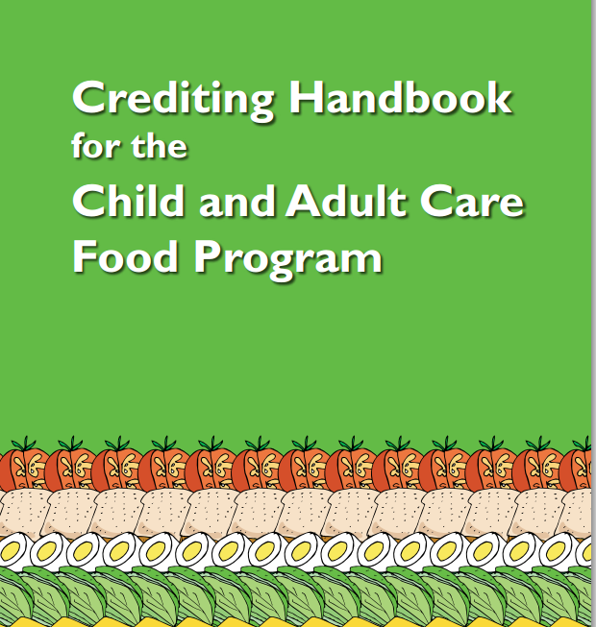
How do you know if it’s creditable?
Foods not indicated as creditable in Crediting Handbook or not listed in the Food Buying Guide are not creditable
Notes:
The Crediting Handbook lists many foods and whether or not it is creditable to the meal pattern. Foods listed in the Food Buying Guide are creditable. If you do not find a food in either of these resources, or if the Crediting handbook indicates the item is not creditable, the food cannot be used to count toward any meal component.

Slide 4
Non-Creditable Foods
Jell-O
Fruit or full strength 100% juice in gelatin salads may be credited if each serving contains a minimum 1/8 cup fruit, vegetable or full-strength fruit juice
Juice that is not 100%, e.g. juice drink, kool-aid, energy drinks
Fruit Snacks
Ice Cream, sherbet, frozen yogurt
Box macaroni and cheese (made with powder cheese)
Tofu and tempeh (without a CN label)
Cheese product, imitation cheese
Velveeta, cheese sauce
Notes:
This slide shows you more foods that are not creditable but that we often see served or on menus.

Slide 5
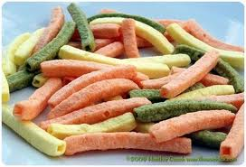
Vegetable Straws or Sticks Not Creditable
Vegetable straws are a snack food made from ingredients that include vegetables (such as tomatoes and spinach), seed oils, grain starches, and flours made from vegetables (potato) and grains, formed into the shape of long square pegs
Vegetable straws cannot be credited as a fruit/vegetable because they are considered a processed food item and are not found in the Food Buying Guide
They may be creditable as a grain/bread when the primary grain ingredient is whole or enriched grain. Some, but not all, vegetable straws are made with whole or enriched grains.
Notes:
On the next few slides we will discuss specific food items that the DPI has been asked about or that USDA has provided additional guidance about.
Vegetable straws or sticks are a snack food made from ingredients that include vegetables. However, these items cannot be credited as a fruit/vegetable because they are considered to be a processed food item and are not found in the Food Buying Guide.
If you find these products and the primary ingredient is a whole grain or the grain product has been enriched with vitamins and minerals, it then may be credited as a grain/bread. Remember though, some but not all vegetable straws are made with whole or enriched grains.

Slide 6
Non-creditable Shelf-stable, dried meat, poultry, and seafood snacks
Non-creditable meat snacks: smoked snack sticks made with beef and chicken; summer sausage; pepperoni sticks; meat, poultry, or seafood jerky such as beef jerky, turkey jerky, and salmon jerky; and meat or poultry nuggets (shelf-stable, non-breaded, dried meat or poultry snack made similar to jerky) such as turkey nuggets
Dried meat, poultry or seafood snacks do not qualify for the CN Labeling Program because they cannot contribute to the meat component; fact sheets or company certified product formulation statements (PFS) cannot be accepted for these products.
USDA Technical Assistance 05-2011
Notes:
This slide lists meat snacks that are not creditable to the meat component of the meal pattern.
Further, dried meat, poultry or seafood snacks to not qualify for the CN label program because they cannot contribute to the meat component; therefore, fact sheets of company certified product formulation statements cannot be accepted for these products.

Slide 7
Creditable meat stick products
Creditable meat snacks: The following are examples of meat stick products that may credit with CN Labels or company certified product formulation statements:
Cooked, cured meat and/or poultry sausages (excluding byproducts, cereals, binders or extenders) such as Bologna, Frankfurters, Knockwurst, and Vienna Sausage as are listed on pages 1-36 and 1-37 of the Food Buying Guide for Child Nutrition Programs;
Extended meat or poultry “patty-like” products shaped into sticks which are usually breaded and either frozen or refrigerated; and
Dried pepperoni when used as a topping on a CN Labeled pizza.
USDA Technical Assistance 05-2011
Notes:
The information on this slide explains examples of meat stick products that may credit as a meat/meat alternate with CN Labels or company certified product formulation statements.

Slide 8
Nutella and other “spreads” Not Creditable
Nutella is a hazelnut spread. Any item labeled as a type of nut “spread” is not creditable towards the meat/meat alternate component; this includes peanut butter spread.
Look closely at the food label of peanut butter or any nut “butters” to assure that they are not labeled as “spreads.”
Only nut “butters” listed in the “Food Buying Guide for Child Nutrition Programs” (page 1-40) are creditable towards the meat/meat alternate component and thus may count towards a reimbursable meal.
Creditable nut butters: almond, cashew nut, peanut, reduced fat peanut, sesame seed, soy nut, and sunflower seed
Notes:
Nutella is a food item that has become more popular in recent years. As delicious as it is, it does not credit to the meal pattern for any component. Nutella is a hazelnut spread, not a nut butter. Sugar is its first ingredient.
Any item labeled as a nut spread is not formulated the same as a nut butter and, because of this, is not creditable as a meat/meat alternate.
When purchasing nut butters, be sure to read the label and verify that you are purchasing a nut butter and not a nut spread. There are many common brands out there selling products labeled as spreads, even though the product is marketed similar to a nut butter and maybe even marketed as a healthier option to a nut butter.
Nut butters that are creditable include almond, cashew nut, peanut, reduced fat peanut, sesame seed, soy nut, and sunflower seed.
Nutella Product Information…FYI
Over 50 Hazelnuts per 13 oz. Jar ingredients: sugar, palm oil, hazelnuts, cocoa, skim milk, reduced minerals whey (milk), lecithin as emulsifier (soy), vanillin: an artificial flavor.

Slide 9
Fruit Smoothies – Homemade Creditable
Milk, fruit/vegetable puree, fruit/vegetable juice and yogurt can credit in a smoothie
Homemade fruit smoothies may be credited for the milk, fruit/juice and/or meat/meat alternate portion if prepared by staff and the amounts meet the meal pattern requirements
The types of milk used in smoothies must be consistent with federal requirements of fluid milk
Grains and meat/meat alternates (such as peanut butter) may not be credited when served as a beverage

Slide 10
Fruit Smoothies - Homemade
Breakfast: pureed fruit or vegetable in a smoothie may be counted as the entire daily fruit/vegetable component
Lunch/supper:
Yogurt may credit as meat/meat alternate
Pureed fruit/vegetable or juice may only count toward half the fruit/vegetable component
Snack: a smoothie containing juice and milk can credit as either juice or milk as long as there is a separate, second component served in addition to the smoothie
The meal pattern states that juice cannot be served when milk is the only other snack component
Yogurt in a smoothie can credit as a meat/meat alternate when prepared in-house
Notes:
The volume of pureed fruit in a beverage can be counted as juice in a smoothie.

Slide 11
Smoothies at Snack, Is it Creditable?
Yogurt | Milk | Fruit/ Vegetable | Juice | Creditable?
X |  | X |  | YES – Fruit/vegetable and yogurt are creditable.
X | X | X |  | YES – Yogurt, milk, and fruit/vegetable are creditable.
 | X | X | X | NO - Fruit/vetgetable/juice and milk are creditable but must be served alongside a 3rd component b/c juice cannot be served when milk is the only other component
X |  |  | X | YES – Yogurt and juice are creditable.
Consider the costs associated with the requirement to serve a 3rd component when deciding to serve smoothies as a snack.
Notes:
Here is a chart showing you how various components used to make a smoothie do not make the smoothie creditable alone.
You should also consider the costs associated with the requirement to serve a 3rd component along with the smoothie.

Slide 12
Commercially prepared smoothies
May only credit toward the fruit or vegetable component
Prepackaged smoothies do not comply with standard of identity for “milk” or “yogurt”
Do not meet the CACFP requirements for “fluid milk” or “yogurt”

Slide 13
Go Gurt and Drinkable Yogurt
Go Gurt
Creditable
It is a coagulated milk product therefore it is creditable as a meat/meat alternate
4 oz yogurt = 1 oz meat/meat alternate
1 tube = 2.25 oz
2 tubes of gogurt = 1 oz meat/meat alternate
Drinkable Yogurt (Danimals, etc.)
Not creditable
Does not meet the definition of yogurt so it cannot credit as a meat/meat alternate
Notes:
Go Gurt is a creditable product
Drinkable Yogurts are not

Slide 14
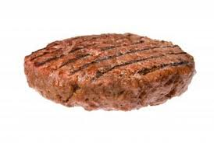
Ground Beef Patty
“Ground Beef Patty, ” “Hamburger,” “100% Beef,” “Pure Beef Patty,” is creditable
“Beef Patty” is NOT creditable without a CN label because it may be made fillers:
Soy Concentrate
Soy Isolate
Soy Flour
Ground Fruit
Ground Chicken
Notes:
For example, when purchasing pre-made/frozen ground beef patties, only those labeled ground beef patty, hamburger, 100% beef, or pure beef patty are creditable. Both hamburger and ground beef can have seasonings added, but no water, phosphates, extenders, or binders may be added.
Any product labeled just “beef patty” is not creditable without a child nutrition label because it may contain ingredients, such as fillers, that decrease the amount of meat/meat alternate and thus, the amount that contributes to the meal pattern. Examples of fillers include but not limited too:
Soy Concentrate
Soy Isolate
Soy Flour
Ground Fruit
Ground Chicken

Slide 15
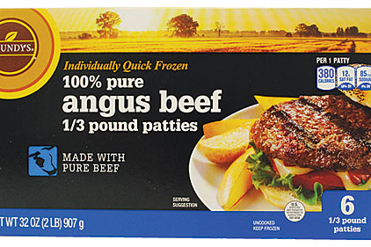
This product is creditable:
This product is not creditable without a CN label:
Ingredients: Beef, water, soy protein concentrate, dehydrated onions, salt, monosodium glutamate, and pepper.
Notes:
Here are a couple products of beef patties, one is creditable & one is not. The non-creditable beef patty has soy protein concentrate which is considered a filler.

Slide 16
Crediting Cheeses A Quiz…

Slide 17
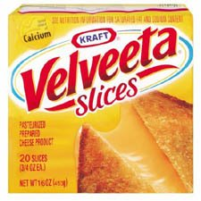
Is this creditable?
No
Pasteurized
Prepared
Cheese
Product
Notes:
The US Food & Drug Administration does not maintain a standard of identity for "Pasteurized Prepared Cheese Product”.

Slide 18
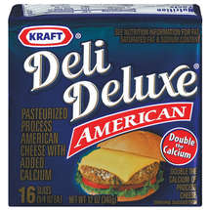
Is this creditable?
Yes
Pasteurized
Process
American
Cheese
Notes:
Pasteurized process cheese, which is made from one or more cheeses (excluding certain cheeses such as cream cheese and cottage cheese but including American cheese), and which may contain one or more specified "optional ingredients" (includes both dairy and nondairy items).

Slide 19
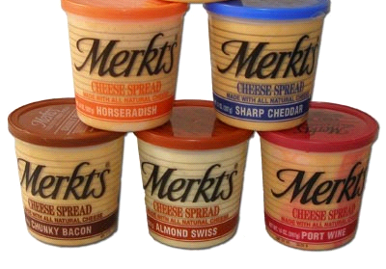
Is this creditable?
Yes
Cheese
Spread
Notes:
A 2oz serving of cheese spread = 1 oz meat alternate

Slide 20
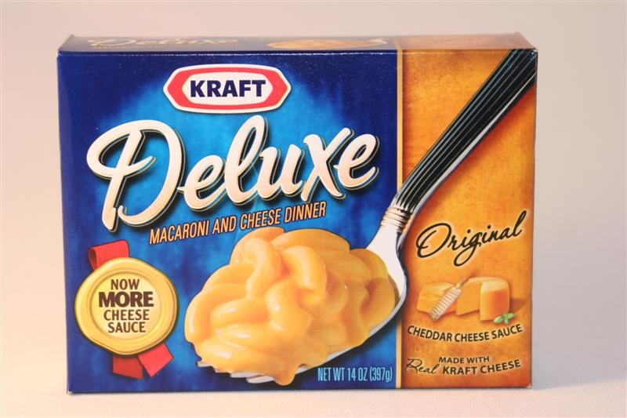
Is this creditable?
Need CN label

Slide 21
Notes:
Sample CN label for cheese sauce. It says that each 4 ounce serving (by weight) of cheese sauce provides 2 ounces of meat alternate.

Slide 22
Is this creditable?
No
Pasteurized Prepared
Cheese Product

Slide 23
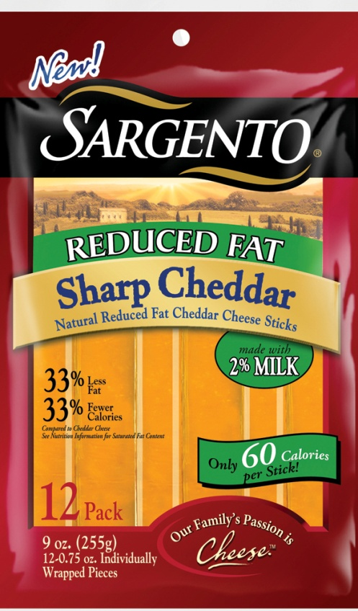
Is this creditable?
Yes
Natural Reduced Fat Cheddar Cheese Sticks

Slide 24
Is this creditable?
Yes
Notes:
Pasteurized process cheese food, which is made from not less than 51% by final weight of one or more "optional cheese ingredients" (similar to the cheeses available for Pasteurized process cheese) mixed with one or more "optional dairy ingredients" (milk, whey, etc.), and which may contain one or more specified "optional ingredients" (nondairy).
A 2oz serving of cheese food = 1 oz meat alternate

Slide 25
Is this creditable?
No
Imitation Mozzarella Cheese

Slide 26
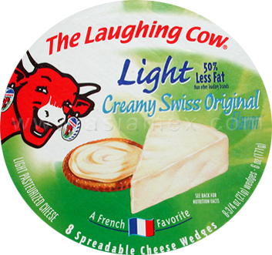
Is this creditable?
Yes
Light
Pasteurized
Cheese

Slide 27
Is this creditable?
No
Pasteurized Prepared
Cheese Product

Slide 28
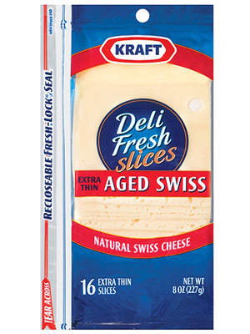
Is this creditable?
Yes

Slide 29
Creditable Cheeses
Cheese Food (contains at least 51% cheese)
Cheese Spread
Natural Cheese
Pasteurized Process Cheese (100% cheese)

Slide 30
Non-Creditable Cheeses
Imitation cheese
Cheese Product (contains <51% cheese)
Velveeta

