Slide 1
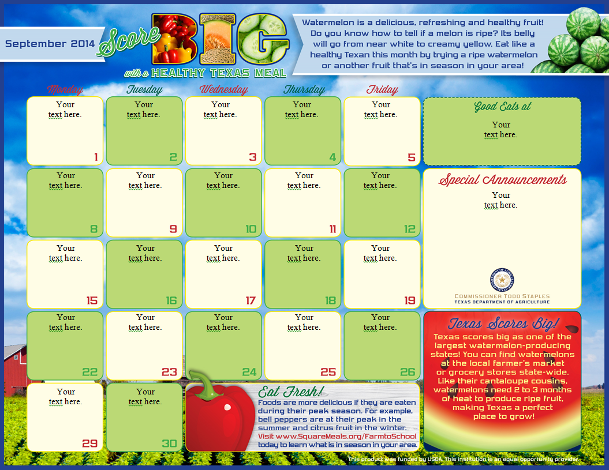
Menu Exercises

Slide 2
CACFP Meal Patterns
Breakfast
Milk
Grain/Bread
Fruit/Vegetable
Snack (2 of 4)
Milk
Grain/Bread
Fruit/Vegetable
Meat/Meat Alternate
Lunch/Dinner
Milk
Meat/Meat alternate
Fruit/Vegetable
2 items required
Grain/Bread

Slide 3
ABC DAY CARE SAMPLE MENU May 2014 - BREAKFAST
Monday | Tuesday | Wednesday | Thursday | Friday
4 Cream of wheat Bananas Milk | 5 Vanilla yogurt w/Fresh blueberries & granola | 6 Corn bread w/ *honey & butter Cantaloupe Milk | 7 Blueberry pancakes w/syrup Sausage Milk | 8 Toast w/peanut & Strawberry jam Milk
11 Scrambled eggs w/ Cheddar cheese Toast Milk | 12 Cinnamon & butter Tortillas Kiwi slices Milk | 13 Waffles Strawberries Milk | 14 Malt-O-Meal w/Apple chunks Milk | 15 Whole wheat English Muffin Strawberries Milk
18 Warm rice w/ Cinnamon & butter Pineapple chunks Milk | 19 Scrambled eggs Hashbrowns Orange Juice | 20 Cheerios Blueberries Milk | 21 Bagels w/cream cheese Fresh strawberries Orange Juice | 22 Bran muffin Apple slices Milk
25 Warm peaches & cinnamon over Shortcake biscuit Milk | 26 Raisin bran Raspberries Milk | 27 Oatmeal Toast Milk | 28 Strawberry yogurt Grapes Milk | 29 Rice Krispies Fresh blueberries Milk
*don’t serve to children <1yr
Need Fruit/
Vegetable
Jam-not creditable-
need F/V
Need Milk
Need Fruit/
Vegetable
Need Milk & Grain/Bread
Need Milk
Need Fruit/
Vegetable
Need Grain/Bread
Notes:
The items in red are the mistakes that need to be corrected in order to meet the meal pattern requirements.

Slide 4
ABC DAY CARE SAMPLE MENU May 2014 - Lunch
Monday | Tuesday | Wednesday | Thursday | Friday
4 Beef BBQ sandwich on kaiser roll Broccoli Mangoes Water | 5 Meatballs & gravy Rice Watermelon Rye Bread Milk | 6 Egg salad sandwiches Pineapple rings Cauliflower Apple juice | 7 Ham & cheese quesadillas Green bean casserole Tropical fruit salad Chocolate milk | 8 *Pepperoni pizza Sliced cucumber salad Cauliflower Milk
11 Grill cheese sandwich Tomato soup Plums Milk | 12 *Chicken nuggets Carrot sticks Baked apples Milk | 13 *Macaroni & cheese Pineapple chunks Broccoli florets | 14 Turkey-n-cheese pitas Steamed broccoli Fresh peach slices Milk | 15 *Breaded fish sandwich Pasta Salad w/ broccoli, carrots, & tomato Peaches & Milk
18 *PB&J sandwich Orange wedges Cucumber slices Milk | 19 Sub sandwiches (turkey, ham, cheese, lettuce, tomato) Carrot/celery sticks Apples & Milk | 20 Tater tot casserole (hamburger & tater tots) Cantaloupe Broccoli & Milk | 21 Grilled ham & Swiss on light rye bread Cauliflower florets Sliced peaches Milk | 22 Baked ham Scalloped potatoes Green peas Buttered noodles Milk
25 *Spaghetti w/meat sauce Sliced zucchini w/dip Milk | 26 Meatloaf Mashed potatoes Honeydew melon Mixed veggies Milk | 27 Tacos w/refried beans (cheese, lettuce, & tomato) Mandarin oranges Milk | 28 Chicken Salad on pita Tomato wedges w/ranch dip Kiwi Milk | 29 *Canned vegetable/beef soup Tomatoes Crackers Milk
Need Fruit/
Vegetable
Need Milk
Need Milk
*Need CN Label
Need Milk
*Need CN Label
*may not creditable as m/ma
*Need CN Label
*additional m/ma
may be needed
Need Grain/Bread
*combination of 3 components
Need Grain/Bread
*Need CN Label
Notes:
The items in red are the mistakes that need to be corrected in order to meet the meal pattern requirements.

Slide 5
ABC DAY CARE SAMPLE MENU May 2014 - SNACK
Monday | Tuesday | Wednesday | Thursday | Friday
4 Cheddar cheese slices Wheat thins Orange juice | 5 Tomato wedges *Cottage cheese | 6 Soft pretzel w/Nacho cheese Milk | 7 Strawberries Oatmeal raisin cookie | 8 Ice cream Strawberries
11 Baked potato w/sour cream Orange Juice | 12 *Fruit Smoothie Water | 13 Ham sandwich quarters Tangerines Water | 14 Vanilla pudding Graham crackers | 15 Cantaloupe and Watermelon chunks Mini bagels
18 Carrot & celery sticks w/ranch dressing Grape juice | 19 Hard boiled egg Saltine crackers Pineapple juice | 20 Frozen yogurt Ice cream cones | 21 Blueberry muffin Saltines Water | 22 Fresh fruit kabobs Yogurt Water
25 Popcorn & Grapes Orange Juice | 26 Triscuits String cheese Pineapple slices | 27 Jell-O Apple slices Water | 28 Pretzel wrap: pretzel rod rolled in 1-2 slices of cheese Milk | 29 Toasted raisin bread Grape juice
*2 oz (1/4 c) serving
= 1 oz of meat
Ice cream is not
creditable
Only the fruit OR the milk in the smoothie is creditable
pudding is not creditable
Both components are Fruit/Vegetable
(not creditable)
Both components are Fruit/Vegetable
Both components
count as a Grain/Bread
Popcorn not creditable; Grapes and OJ-same component
Jell-O not creditable
Notes:
The items in red are the mistakes that need to be corrected in order to meet the meal pattern requirements.

