Slide 1
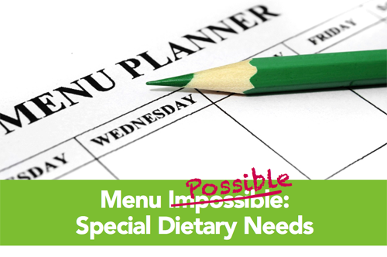
Menu Planning
Notes:
So, lets talk about menu planning for children who may have certain allergies and intolerances.
It is certainly not impossible; it just takes some time and patience.

Slide 2

Planning Meals for Special Dietary Needs
Easy Peasy…
Dairy Free Meals
Vegetarian Meals
Gluten Free Meals
Notes:
We are going to talk about meal planning for children who are vegetarian, who require dairy free or reduced meals, and those who require gluten free meals.

Slide 3
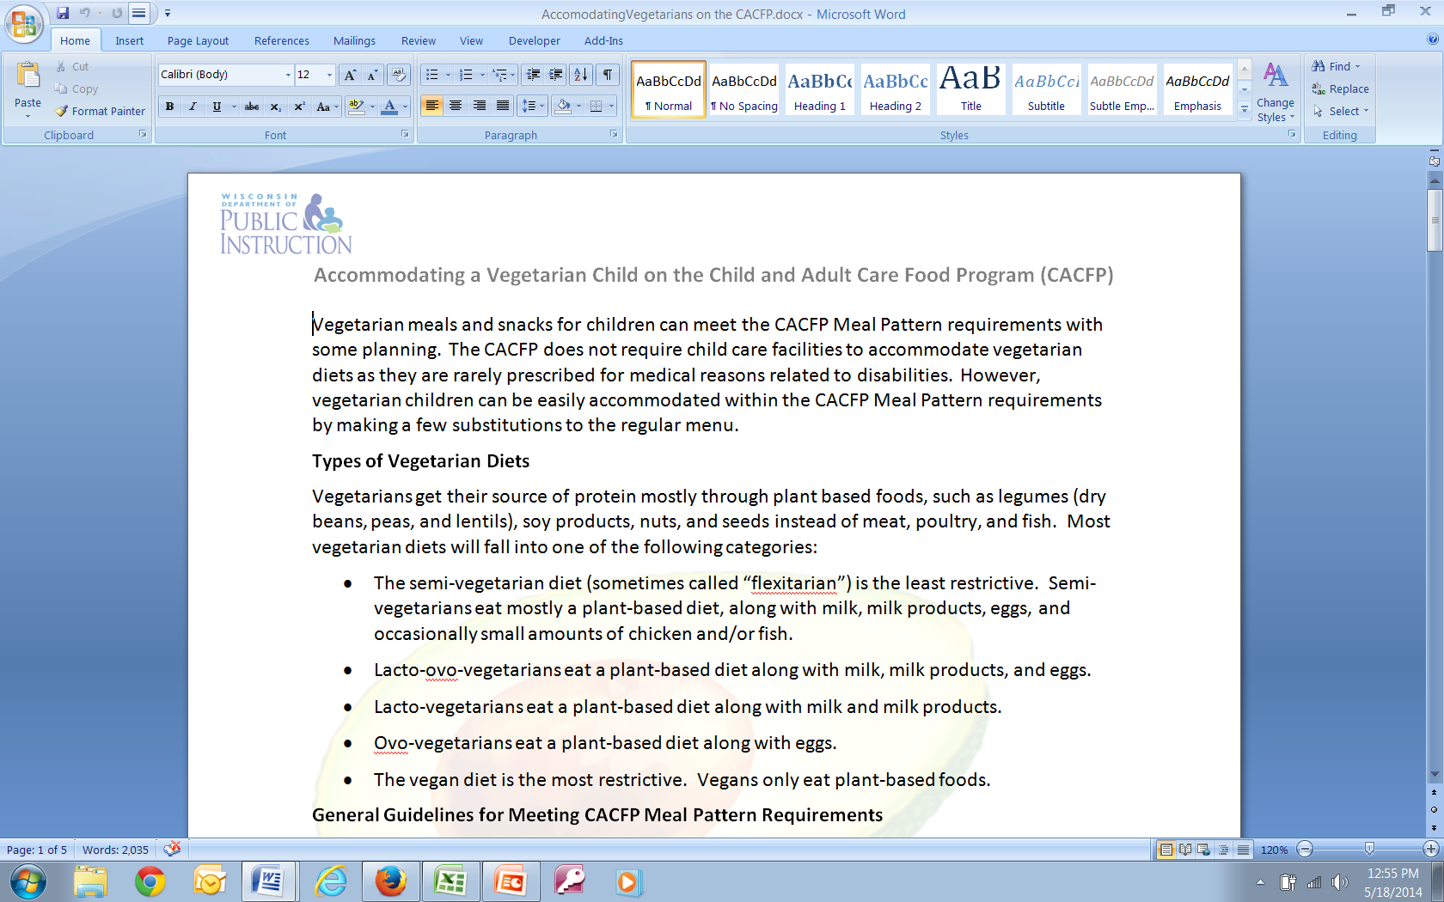
Accommodating a Vegetarian Child on the CACFP
Notes:
Within your hand-outs given to you for this session, there is one titled “Accommodating a Vegetarian Child on the CACFP“. This provides an explanation of the various ways of being vegetarian, what items can be served for the meat/meat alternate in place of animal based foods, lists foods that provide good sources of various nutrients, and then provides sample menus using recipes that are available from the USDA’s Child Care Recipes resource.

Slide 4

Menu Planning for the Vegetarian
Substitutions for milk & meat/meat alternate
Milk
Soy Milk ~ Nutritionally Equivalent to Milk
Meat/Meat Alternate
Dry Beans and Legumes
Nut and Seed Butters
Cheese and Yogurt
Eggs
Notes:
When planning meals for a vegetarian, you may have to make changes mainly for the milk and meat/meat alternate component.
For the milk component, soy milk that is nutritionally equivalent to milk.
For the meat/meat alternate component, dry beans and legumes, nut and seed butters, nuts and seeds, cheese, yogurt, eggs
Fruit/vegetables – only if they are made with dairy or egg sauces (and depending on what type of vegetarian the child is)
Bread/Grains – if made with egg or milk products, depending on what type of vegetarian the child is)

Slide 5

Menu Planning for the Dairy or Lactose Free Diet
Avoid or reduce milk & some processed foods
Milk and Milk Products (yogurt, cheese)
Breads and bread products (pancakes, waffles, grain mixes, instant and dry cereals with added milk products)
Breaded or creamed meats, eggs, fish, and poultry
Luncheon meats, sausage, hot dogs
Instant potatoes, soups, processed snack items, margarine
Notes:
When, planning for a dairy or lactose free meal, you have to consider anything that contains milk from an animal. Keep in mind, for children who are lactose intolerant, they may be able to consume some dairy products, and many grow out of this. So, some may be able eat cheese and yogurt, and drink small amounts of milk. Each person is a little different.
You may need to avoid or reduce some of the following foods listed on this slide.
Milk and milk products (yogurt, cheese)
Breads and bread products (pancakes, waffles, grain mixes, instant and dry cereals with added milk products)
Breaded or creamed meats, eggs, fish, and poultry
Even Luncheon meats, sausage, hot dogs that may contain dairy ingredients
Instant potatoes, soups, processed snack items, margarine

Slide 6
Menu Planning for the Dairy or Lactose Free Diet
Avoid food items with the following ingredients – especially for dairy allergies (not all inclusive)
Anything with the word “milk”, “butter”, “yogurt” “cheese”, “cream”, or “dairy”
Casein or caseinates
Whey
Rennet or rennet casein
Hydrolysates
Any word that begins with “lact” (lactate solids, lactalbumin, lactulose)
**Rice and soy cheeses may contain milk products
Notes:
You want to avoid food items with the following ingredients listed on this slide which is not all inclusive; this is especially for dairy allergies:
Anything with the word “milk”, “butter”, “yogurt” “cheese”, “cream”, or “dairy”
Casein or caseinates
Whey
Rennet or rennet casein
Hydrolysates
Any word that begins with “lact” (lactate solids, lactalbumin, lactulose)
Rice and soy cheeses may contain milk products

Slide 7
Menu Planning for the Dairy or Lactose Free Diet
Substitutions for Milk & Processed Foods
Milk
Lactaid or lactose-free milk
Soy milk (that is nutritionally equivalent to milk)
Meats
Meats without added milk products
Bread/Grains
Fruits and vegetables without added milk products
Water-based breads (Italian, French, Jewish Rye, cereals without added milk products)
Fruits and Vegetables
Notes:
For dairy free meals, you will need to make substitutions for milk & processed foods
Serve:
Lactaid or lactose-free milk
Soy milk (that is nutritionally equivalent to milk)
Fruits and vegetables without added milk products
Meats without added milk products
Water-based breads (Italian, French, Jewish Rye, cereals without added milk products)

Slide 8

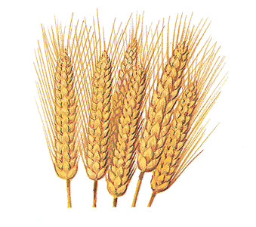
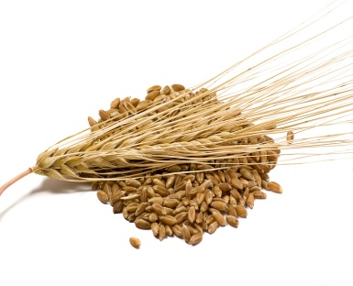
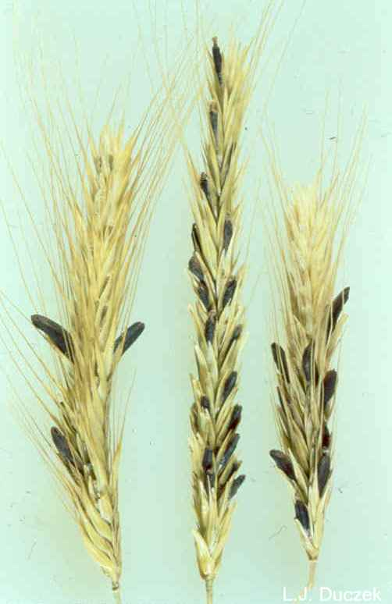
Menu Planning for the Gluten Free Diet
Avoid
Wheat
Barley
Rye
Processed foods containing these grains
Soups, cold cuts, hot dogs, salami, sausage, French fries, soy sauce, sauces, vegetables in sauce, rice mixes, tortilla chips
Notes:
When planning gluten free meals,
Avoid:
Wheat, Barley, and Rye
Processed foods containing these grains, and foods listed here (which is not all inclusive)
Soups, cold cuts, hot dogs, salami, sausage, French fries, soy sauce, sauces, vegetables in sauce, rice mixes, tortilla chips

Slide 9
Menu Planning for the Gluten Free Diet
Other terms for wheat to avoid (not all inclusive)
bulgur, durum, farina, kamut, seitan, spelt, flour, graham flour,
semolina, wheat berries, triticale, bran, germ, gluten, malt, starch
Notes:
Some other terms for wheat to avoid (not all inclusive) are listed on this slide
Bulgur, durum, farina, kamut
Seitan, spelt, flour, graham flour
Semolina, wheat berries, triticale
Bran, germ, gluten, malt, starch

Slide 10
Menu Planning for the Gluten Free Diet
Avoid food items with the following ingredients (not all inclusive)
Hydrolyzed vegetable protein
Modified food starch
Vegetable starch or vegetable protein
Gelatinized starch
Natural flavoring
Notes:
You also want to avoid food items with the following ingredients ( which is not all inclusive):
Hydrolyzed vegetable protein
Modified food starch
Vegetable starch or vegetable protein
Gelatinized starch
Natural flavoring

Slide 11
Menu Planning for the Gluten Free Diet
Substitutions
Bread/Grain
Rice
Quinoa
Millet
Amaranth
Whole corn (not fresh corn)
Buckwheat
Kasha
Items labeled as “Gluten Free”
Notes:
You can make substitutions for the
bread/grain component by serving any of these grains listed here:
Rice
Quinoa
Millet
Amaranth
Whole corn (not fresh corn)
Buckwheat
Kasha
And then items labeled as “Gluten Free”. For any processed foods as previously discussed, you will want to make sure they are labeled as Gluten Free, or do not have any of the gluten based ingredients.

Slide 12
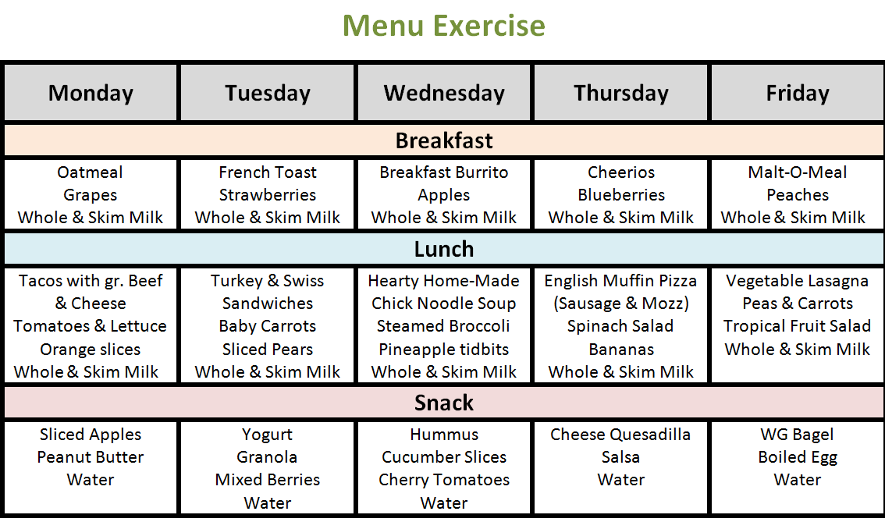
Menu Exercise
Notes:
Now we are going to a menu planning exercise.
You will need to break up into three groups this time.
Group 1 is going to make menu changes for a vegetarian child.
Group 2 is going to make menu changes for a dairy free child.
Group 3 is going to make menu changes for a gluten free child.
We will take 5 minutes to do this and then come back to discuss them as a group. Each group will share what changes they made.

Slide 13


Thank you!
The U.S Department of Agriculture prohibits discrimination against its customers, employees, and applicants for employment on the bases of race, color, national origin, age, disability, sex, gender identity, religion, reprisal, and where applicable, political beliefs, marital status, familial or parental status, sexual orientation, or all or part of an individual’s income is derived from any public assistance program, or protected genetic information in employment or in any program or activity conducted or funded by the Department. (Not all prohibited bases will apply to all programs and/or employment activities.)
If you wish to file a Civil Rights program complaint of discrimination, complete the USDA Program Discrimination Complaint Form, found online at http://www.ascr.usda.gov/complaint_filing_cust.html, or at any USDA office, or call (866) 632-9992 to request the form. You may also write a letter containing all of the information requested in the form. Send your completed complaint form or letter to us by mail at U.S. Department of Agriculture, Director, Office of Adjudication, 1400 Independence Avenue, S.W., Washington, D.C. 20250-9410, by fax (202) 690-7442 or email at program.intake@usda.gov.
Individuals who are deaf, hard of hearing or have speech disabilities may contact USDA through the Federal Relay Service at (800) 877-8339; or (800) 845-6136 (Spanish).
USDA is an equal opportunity provider and employer.

