Slide 1
Serving Sizes vs. Portion Sizes

Slide 2
Serving Sizes vs. Portion Sizes
A serving size is a unit of measure that describes a recommended amount of a certain food.
A portion size is the amount of a food that you choose to eat.
For example, ½ cup of spaghetti (just the pasta) is one serving. If you eat 2 cups (your portion size) of spaghetti for dinner, you are actually eating 4 servings.
Notes:
a serving size of cereal is ¾ cup. Your portion size, however, might be more like 1 ½ cups to fill one of those big cereal bowls. Portion sizes aren’t necessarily always larger than serving sizes.

Slide 3
Larger Portion Sizes
The portion sizes of a majority of foods sold for immediate consumption far exceed the recommended serving sizes
Our perception of what a serving size is has been altered by the increasing availability and marketing of larger food portions
Added value and added calories
Notes:
The portion sizes of a majority of foods sold for immediate consumption far exceed the MyPyramid serving sizes.
Our perception of what a serving size is has been altered by the increasing availability and marketing of larger food portions. Meal combos or extra-value meals have become increasingly popular. Fast food chains offer more food for only a slight increase in cost which encourages people to eat more food because they’re getting a good value. For only 29 – 49 cents more, a fast food meal is supersized by as much as 400 calories.

Slide 4
Serving Sizes
Serving sizes are found on a Nutrition Facts label (otherwise known as a food label)
All of the nutrients listed on that label, such as fat, carbohydrate, and sodium, are based on the serving size
If you end up eating two or three times as much as the serving size, the amount of calories and fat will double or triple, and can affect your weight
Notes:
Again, in this supersized nation, no doubt you’ve read a label and shook your head thinking, “There’s no way that just one cookie is a serving size,” or “Who eats just 1/2 a cup of ice cream?” While these serving sizes can certainly seem unrealistic, it’s very important that you always look at the serving size on a Nutrition Facts label because all of the nutrients listed on that label, such as fat, carbohydrate, and sodium, are based on the serving size. If you end up eating two or three times as much as the serving size, the amount of carbohydrate (along with calories and fat) will double or triple, thereby affecting your blood glucose levels and possibly your weight too.

Slide 5
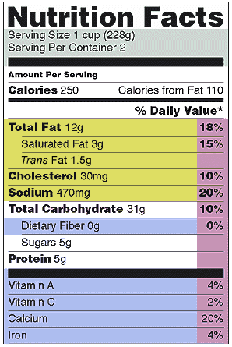
Sample for Macaroni and Cheese
Calories:
250 x 2 = 500
Fat:
12g x 2 = 24 g (36% DV)
Notes:
Let’s look at a sample Nutrition Facts Label.
Serving size = 1 cup, but right underneath it tells you how many servings are in a container. In this example, there are 2 servings in a container. Therefore, if you eat the full container, you’d be doubling the amount of calories and fat. You’d be eating 500 calories and 24 grams of fat.

Slide 6
Portion Sizes for Children
Children need adequate calories to meet their needs for growth.
On the other hand, portions that are too large could lead to overeating or seem overwhelming.
Providing smaller servings to young children is often the best way for them to learn to eat only until satisfied, instead of overeating.
Start kids off with less and encourage them to ask for more if they're still hungry.
Notes:
The CACFP meal pattern provides USDA recommended serving sizes for children.

Slide 7
Portion Control Through Photography
Post a picture of a plate of food with the proper serving sizes in the kitchen and/or in the classrooms
Teachers and/or cooks can visualize how much food should be on children’s plates
Notes:
As a way to help teachers and/or cooks visualize how much food that needs to be on children’s plates, you could take a picture of a plate of food with the proper serving sizes and post in the kitchen and/or in the classrooms. This will also help children to know how much food to put on their plates if doing family style.
So, let’s take a look at some examples of serving sizes.

Slide 8
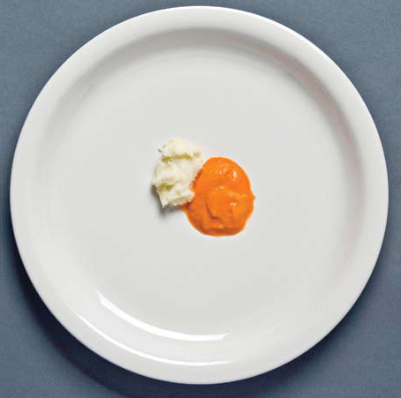
Portion Control Through Photography
Meal Size:
4-7 months
On a 10” dinner plate
1 ½ T IFIC and 1 ½ T Vegetable

Slide 9
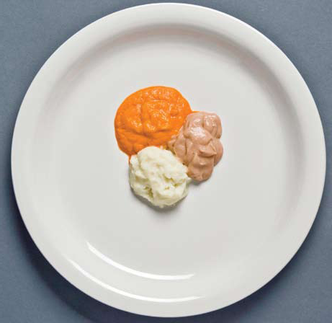
Portion Control Through Photography
Meal Size:
8-12 months
On a 10” dinner plate
3 T IFIC, 2 T vegetable, 2 T Meat

Slide 10
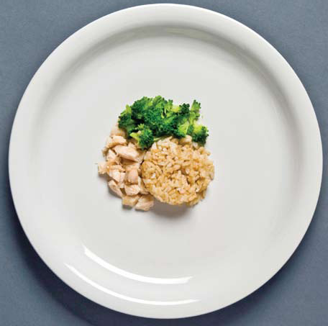
Portion Control Through Photography
Meal Size:
1-2 years
On a 10” dinner plate
1 oz Meat, ¼ cup vegetable, ¼ cup G/B
Notes:
Remember for lunch you need to serve 2 different fruits or vegetables to total the minimum amount of F/V in the CACFP meal pattern. The picture here shows ¼ cup of vegetable, but you would need to serve 2 F/V’s that equal ¼ cup (1/8 cup each).

Slide 11
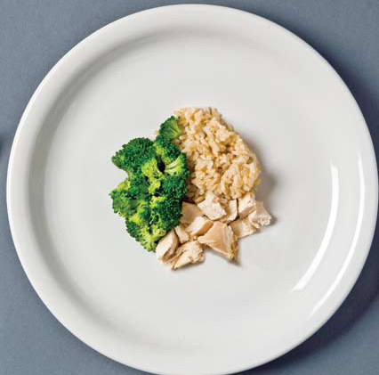
Portion Control Through Photography
Meal Size:
3-5 years
On a 10” dinner plate
1 ½ oz Meat, ½ cup vegetable, ¼ cup G/B

Slide 12
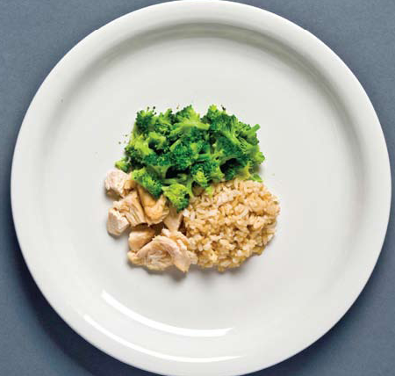
Portion Control Through Photography
Meal Size:
6-12 years
On a 10” dinner plate
2 oz Meat, ¾ cup vegetable, ½ cup G/B

Slide 13
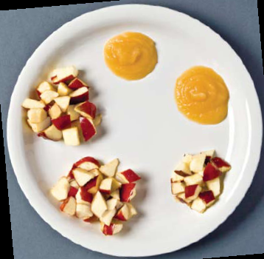
Fruit Serving Sizes
On a 10” dinner plate
4 -7 months
1 ½ Tablespoons
6 - 12 years
3/4 cup
2 Tablespoons
8 -12 months
¼ cup
1 -2 years
½ cup
3 -5 years
Notes:
4-7 months (0-3 T F/V)
8-12 months (1-4 T FV)

Slide 14
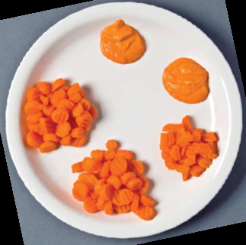
Vegetable Serving Sizes
On a 10” dinner plate
4 -7 months
1 ½ Tablespoons
6 - 12 years
3/4 cup
8 -12 months
2 Tablespoons
¼ cup
1 -2 years
½ cup
3 -5 years
Notes:
4-7 months (0-3 T F/V)
8-12 months (1-4 T FV)

Slide 15
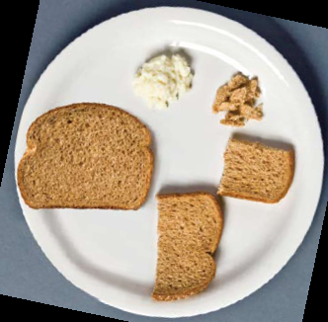
Grain/Bread Serving Sizes
On a 10” dinner plate
6 -12 years
1 slice
8 -12 months
¼ slice
½ slice
1 -5 years
Notes:
8-12 months (0 - 1/2 slice) – snack only

Slide 16
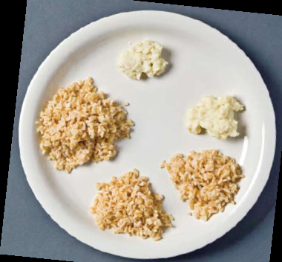
Grain/Bread Serving Sizes
On a 10” dinner plate
6 - 12 years
½ cup
¼ cup
1 -2 years
¼ cup
3 -5 years

Slide 17
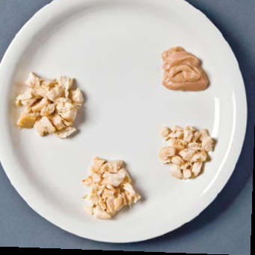
Meat Serving Sizes
On a 10” dinner plate
4 -7 months
1 ½ Tablespoons (IFIC)
2 Tablespoons
(IFIC or meat)
6 - 12 years
8 -12 months
2ounces
1 ounce
1 -2 years
1 ½ ounces
3 -5 years
Notes:
4-7 months (0-3T IFIC)
8-12 months (1-4 T IFIC or meat)

Slide 18
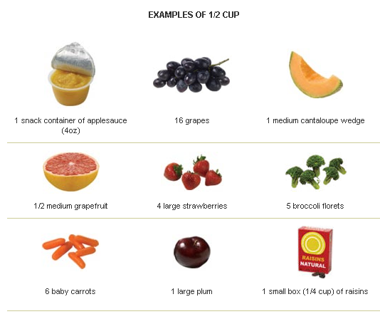

Slide 19
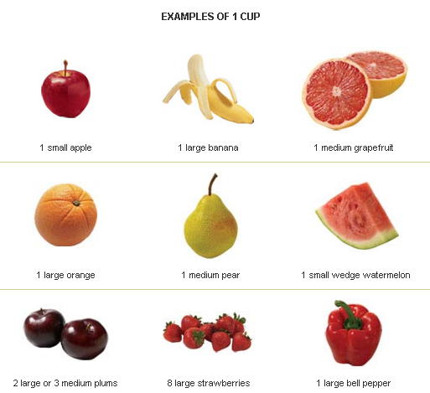

Slide 20
Examples of 1 cup

Slide 21
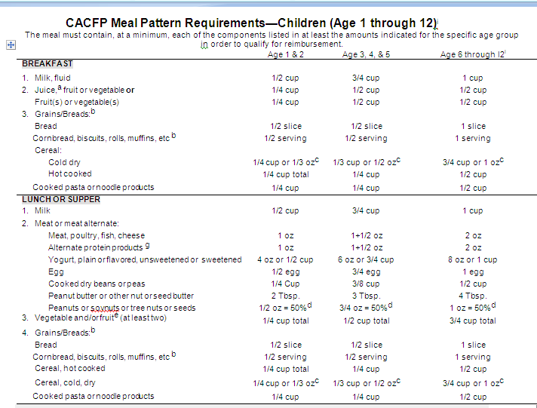
CACFP Meal Pattern Meat/Meat Alternate
Notes:
So, we just talked about how we as a society are serving larger portion sizes than we should, but now we need to discuss some of the foods that centers usually don’t prepare enough of. You need to be sure you’re feeding the children at least the minimum serving sizes according to the CACFP meal pattern.
Here is the CACFP meal pattern chart. We’re going to specifically look at meat/meat alternate for lunch. As you can see, 1-2 year olds need 1 ounce of meat each at lunch, 3-5 year olds – 1 ½ ounces and 6-12 year olds 2 ounces.
Now, let’s go over some examples of different meat/meat alternates and see if we’re making enough.

Slide 22
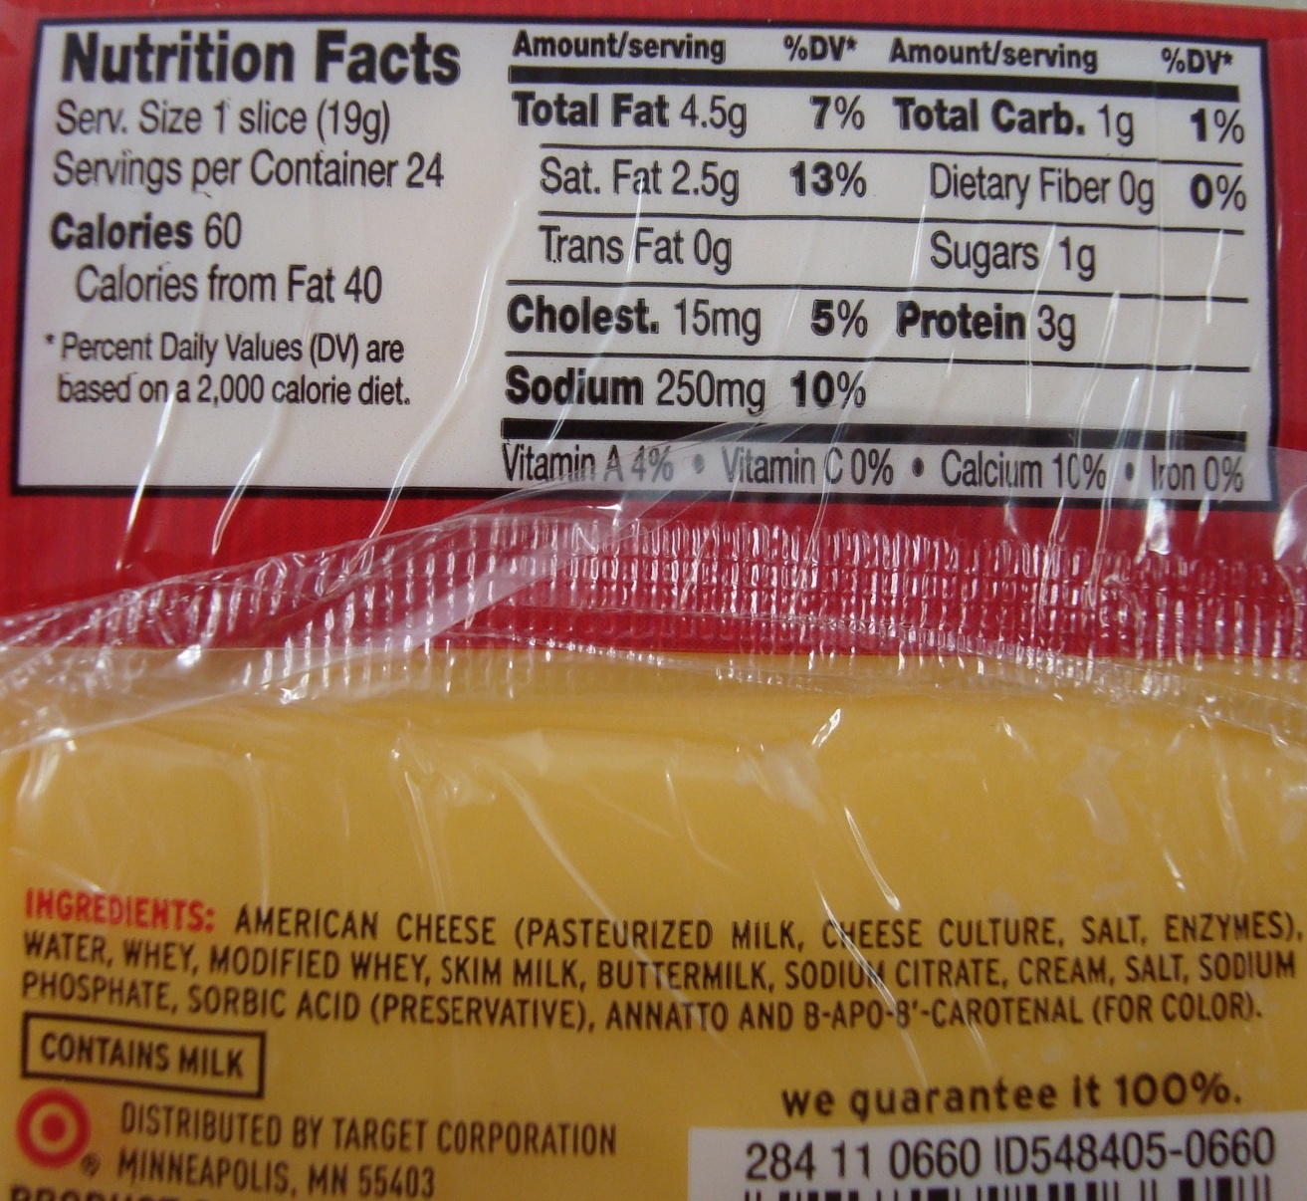
Cheese Slices
1 slice of cheese is 19g
From the Food Buying Guide
(p. I-40),
1 ounce = 28.35g
So, is 1 slice of cheese enough to put on a sandwich for 1-2 year olds?
Notes:
1 slice of cheese is 19g. Does anyone know how many grams are in an ounce?
A metric conversion chart can be found in the Food Buying Guide (p. I-40),
There is tells us that 1 ounce = 28.35g
So, is 1 slice of cheese enough to put on a sandwich for 1-2 year olds? We know that they need 1 ounce of meat alternate at lunch (from the CACFP meal pattern).

Slide 23
Cheese Slices
NO!
1 ounce = 28.35g, but 1 slice of cheese is only 19g
28.35g divided by 19g = 1.49 or 1 ½ slices of cheese on each sandwich for 1-2 year olds
3-5 year olds would need 2 ½ slices
6-12 year olds need 3 slices
Notes:
No, since 1 ounce is 28.35g, then each 1-2 year old would need 1 ½ slices of cheese on each sandwich.
3-5 year olds would need 2 ½ slices. When calculating how much to serve to 3-5 year olds, it comes to 2.2 slices, – so round up to 2 ½ slices (28.35 x 1.5 = 42.525 ÷ 19 = 2.23)
and 6-12 year olds need 3 slices.
And when determining the size of sandwich to make, you also need to look at the amount of bread for each sandwich.

Slide 24
CACFP Meal Pattern – Bread/Grain
Notes:
So, if you’re making a grilled cheese sandwich, how much bread do you have to plan for?
According to the CACFP meal pattern chart, 1-5 year olds need ½ slice and 6-12 year olds need 1 slice.
So, to make a sandwich for a 1-2 year old, you’d take ½ slice of bread and add 1 ½ slices of cheese. (1/4 of a sandwich)
3-5 year olds – ½ slice of bread with 2 ½ slices of cheese (1/4 of a sandwich)
6-12 year olds – 1 slice of bread with 3 slices of cheese (1/2 sandwich)
Demonstrate each sandwich with cheese and bread.

Slide 25
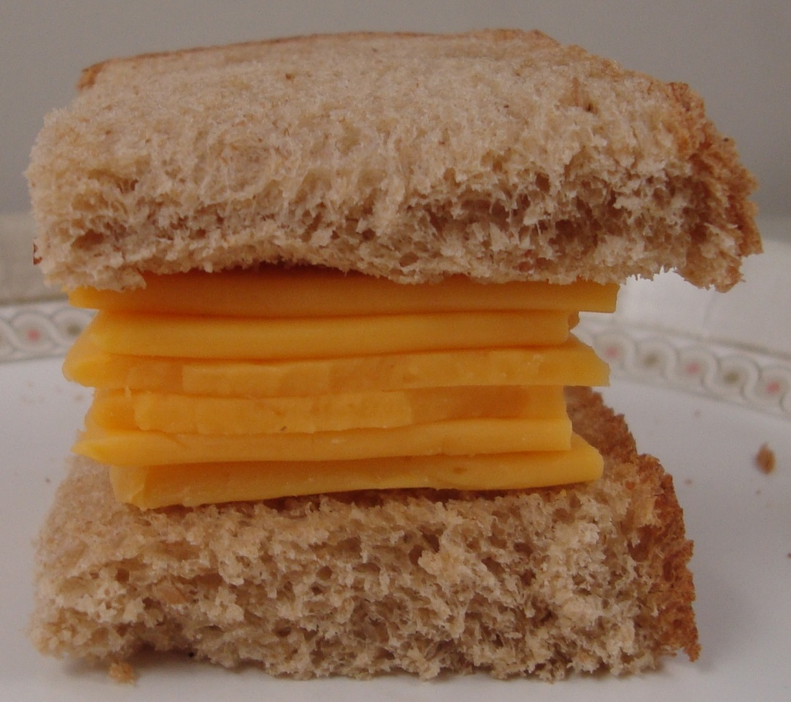
Cheese Sandwich for 1-2 year olds
1 ½ slices of cheese = 1 oz
½ slice of bread

Slide 26
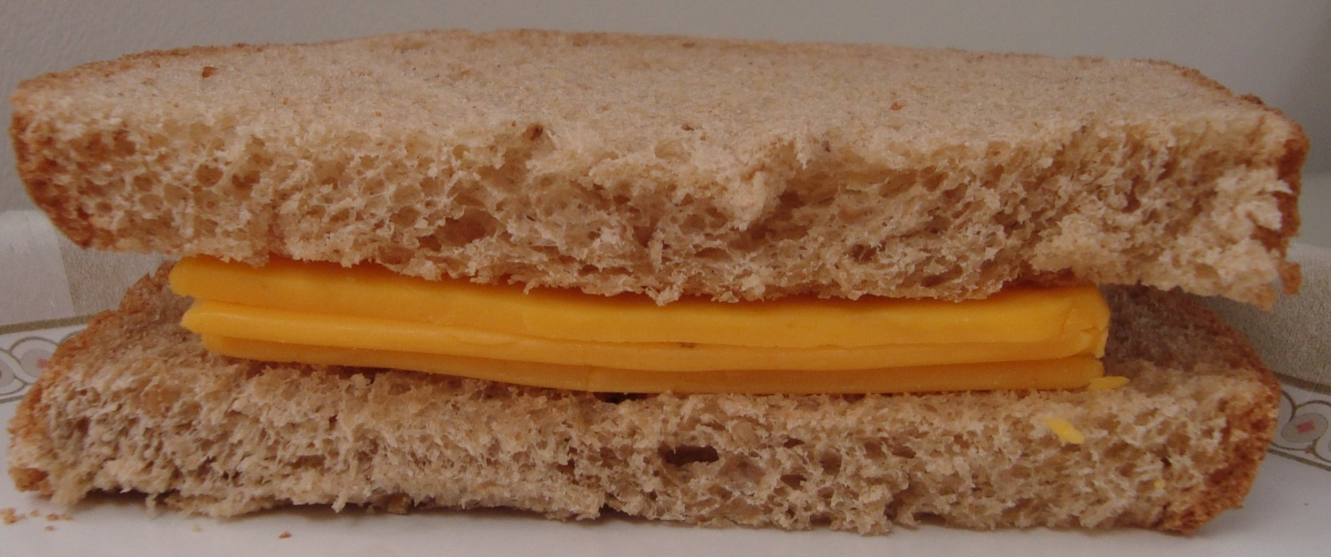
Cheese Sandwich for 1-2 year olds
1 ½ slices of cheese = 1 oz
1 slice of bread (2 grain/bread servings)
Notes:
So, a lot of you might serve 1 slice of bread or a ½ sandwich to 1-2 year olds. So, this is what that would look like. Still a lot of cheese.

Slide 27
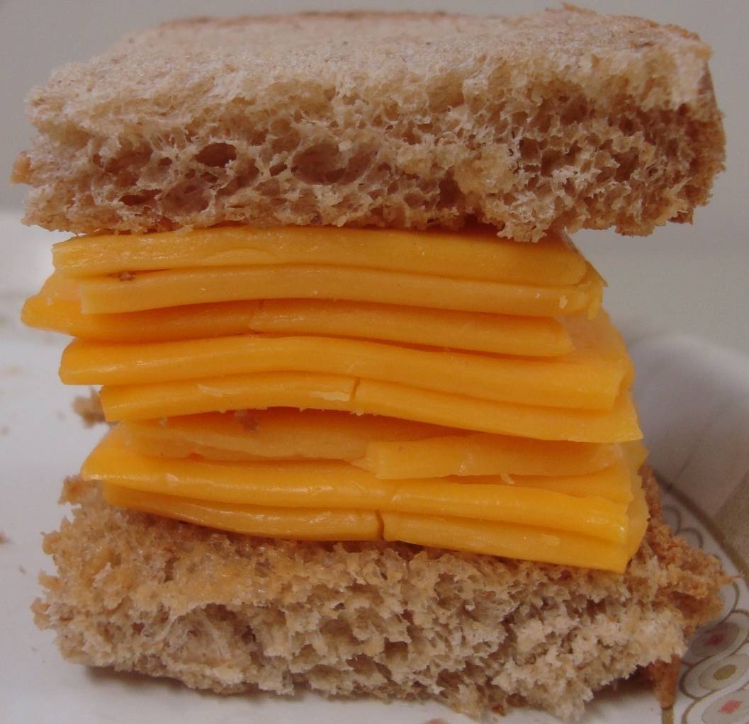
Cheese Sandwich for 3-5 year olds
2 ½ slices of cheese = 1 ½ oz
½ slice of bread

Slide 28
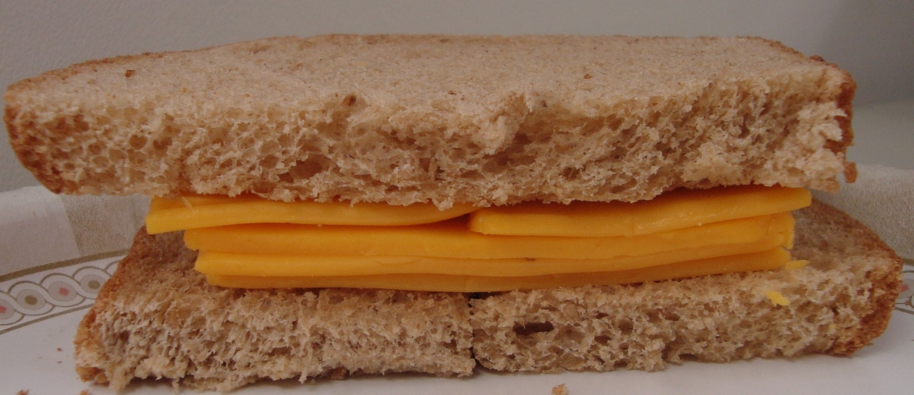
Cheese Sandwich for 3-5 year olds
2 ½ slices of cheese = 1 ½ oz
1 slice of bread (2 grain/bread servings)

Slide 29
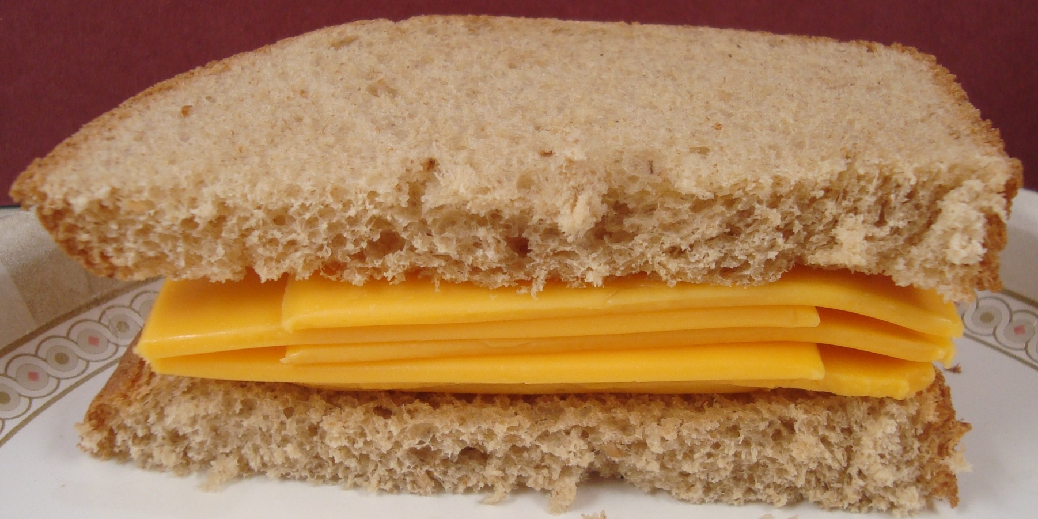
Cheese Sandwich for 6-12 year olds
3 slices of cheese = 2 oz
1 slice of bread

Slide 30
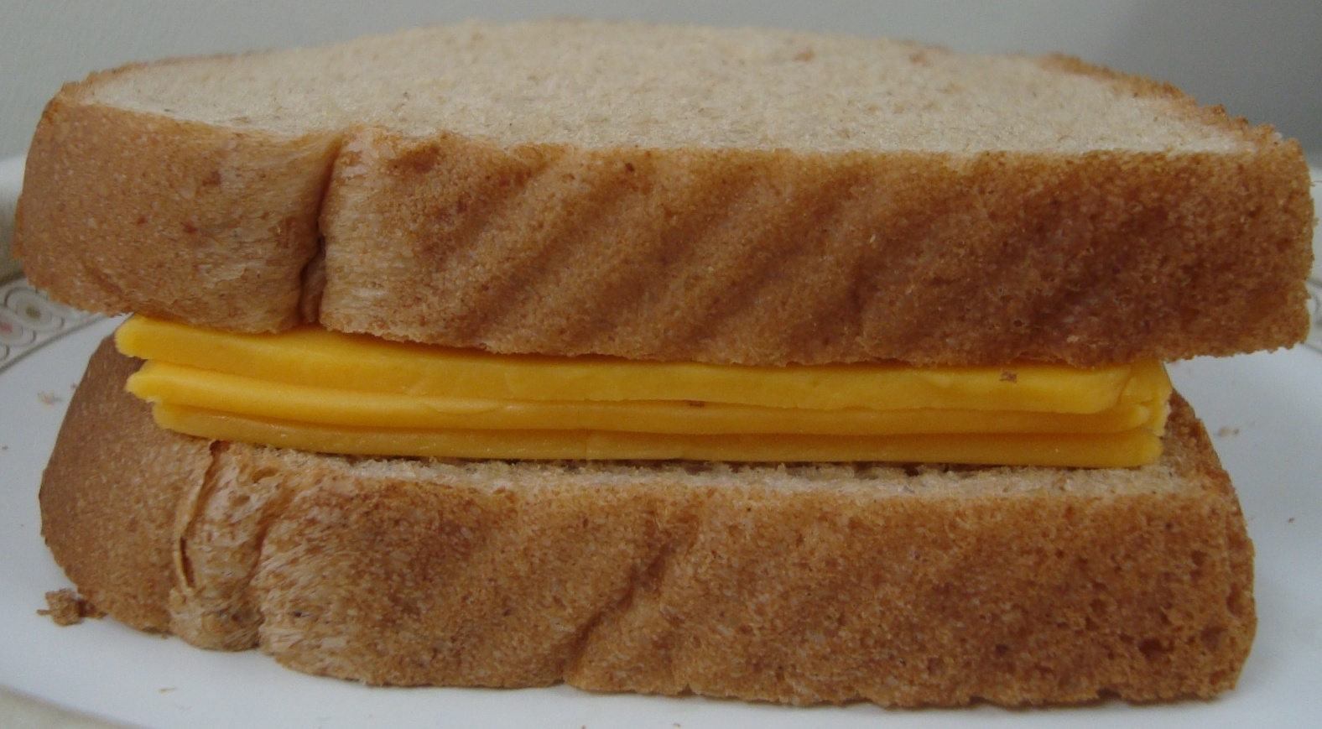
Cheese Sandwich for 6-12 year olds
3 slices of cheese = 2 oz
2 slices of bread (2 grain/bread servings)
Notes:
So, it might be a good idea to serve another meat/meat alternate along with the cheese sandwiches like meat and cheese sandwiches or yogurt, beans, cottage cheese, nuts, peanut butter, etc.

Slide 31
CACFP Meal Pattern – Peanut Butter
Notes:
Here’s another popular food we see on menus served by itself: peanut butter. As you can see from the CACFP meal pattern chart that 1-2 year olds need 2 tablespoons (1 oz) of peanut butter each at lunch, 3-5 year olds – 3T (1 ½ oz) and 6-12 year olds 4T (2oz).
Demonstrate each sandwich with PB and bread.

Slide 32
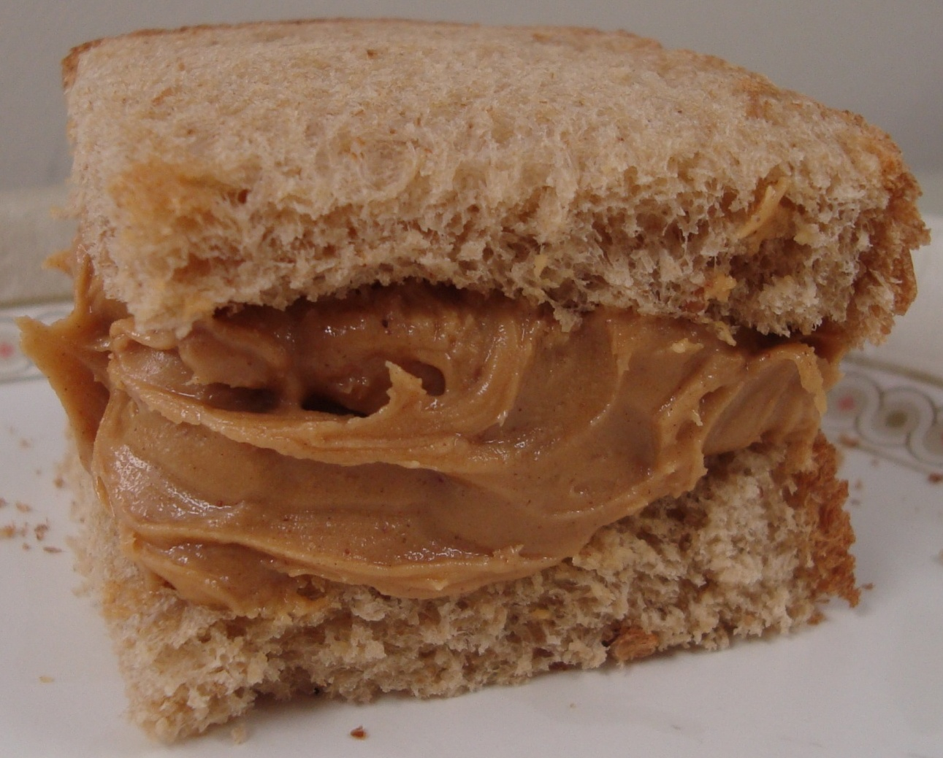
Peanut Butter for 1-2 year olds
2 Tablespoons = 1 oz
½ slice of bread

Slide 33
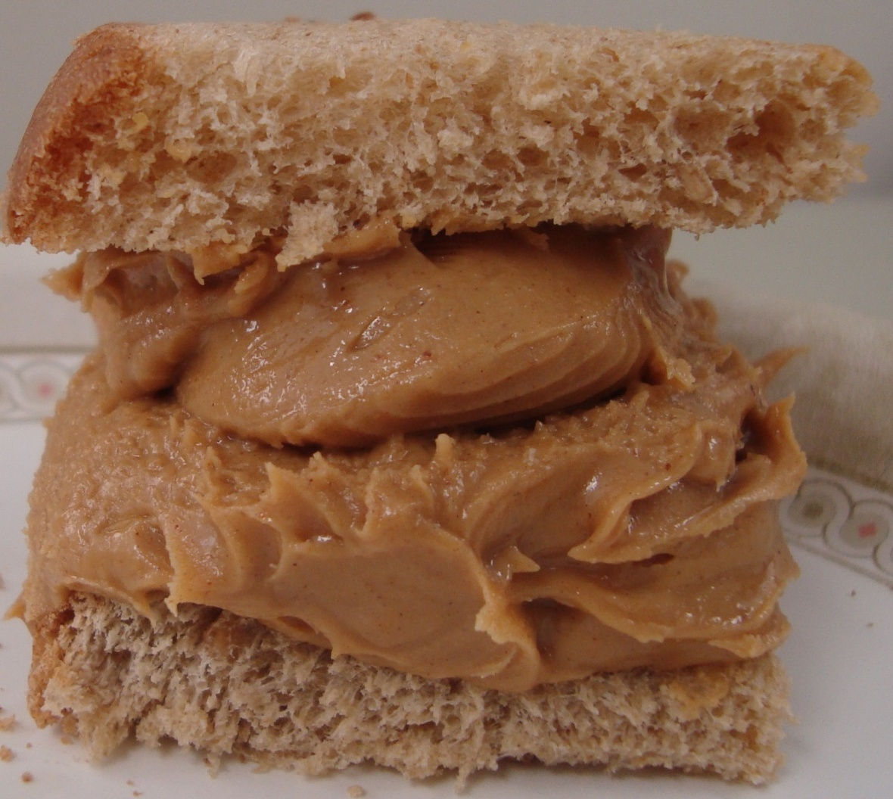
Peanut Butter for 3-5 year olds
3 Tablespoons = 1 ½ oz
½ slice of bread

Slide 34
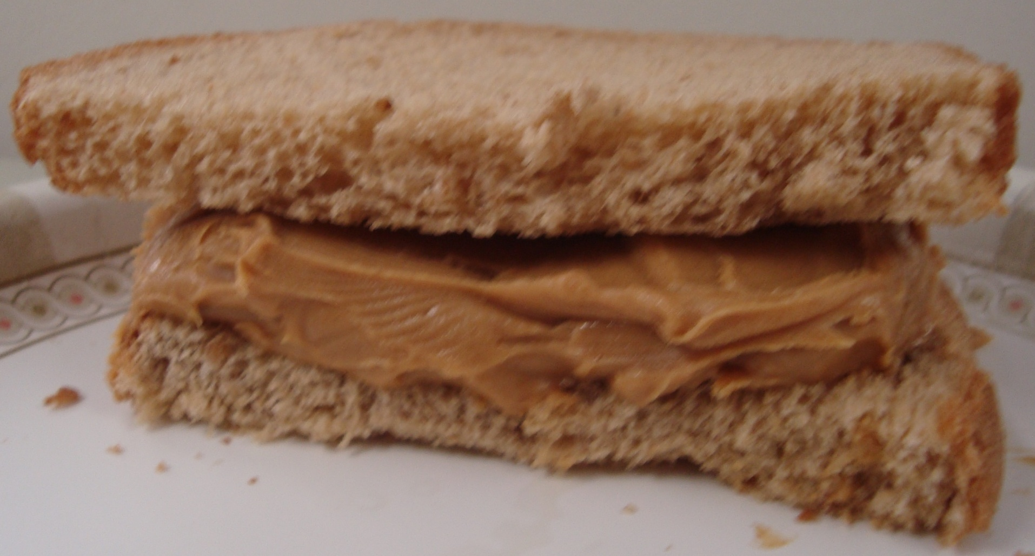
Peanut Butter for 3-5 year olds
3 Tablespoons = 1 ½ oz
1 slice of bread (2 grain/bread servings)

Slide 35
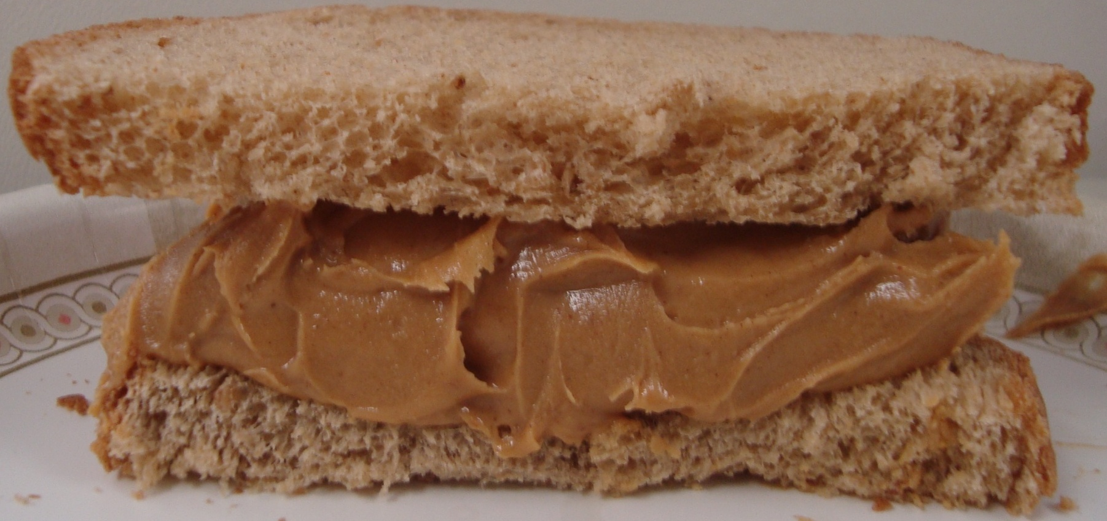
Peanut Butter for 6-12 year olds
4 Tablespoons = 2 oz
1 slice of bread

Slide 36
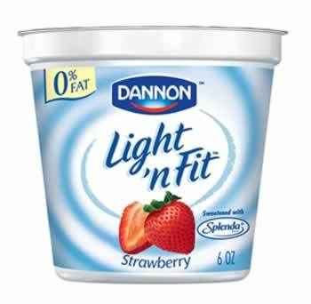
Other Meat Alternates
Cottage Cheese:
2 oz serving (about ¼ cup) = 1 oz meat alternate
Yogurt:
½ cup or 4 oz yogurt = 1 oz meat alternate
6 oz = 1 ½ oz MA
8 oz = 2 oz MA
Note: Drinkable and frozen yogurts are NOT creditable.
Notes:
Add supplemental source of meat/meat alternate along with the PB – like a slice of cheese, cottage cheese, yogurt, etc.

Slide 37
CACFP Meal Pattern – Milk
Notes:
Lastly, let’s talk about how much milk should be served at lunch.
½ cup for 1-2 year olds, ¾ cup for 3-5 year olds and 1 cup for 6-12 year olds.
Show models of ½ cup (1-2 year olds) and 1 cup (6-12 year olds). Talk about Dixie cups and how they don’t hold very much (3-5 oz).

