Slide 1
WISEstaff (PI 1202 Fall Staff Report) & Educator Licensing Online (ELO)
2015 Skyward User Group Conference
April 28th, 2015
Presented by:
Kari A. Tenley
David P. DeGuire

Slide 2
Topics
2014-2015 Staff Data Submission
Review WISEid steps
Get WAMS account
Set up application security access using ASM
Create WISEids for Historical records
Create WISEids for new staff
Current Status of new WISEstaff application
Starting the WISEstaff data collection
Staff data collection documentation
2014-2015 Assignment Table
2014-2015 Assignment Related Questions Matrix
2014-2015 Usage of 0000 as the working school by assignment for Working LEA's
Data Definitions
Educator Licensing Online (ELO)
Questions and Answers

Slide 3
Review WISEid Steps

Slide 4
Review WISEid Steps
First: Set up security for access to the application
Purpose: Use WAMS ids and ASM to login vs. passwords.
ASM / Security Resources
Application Security Manager
WAMS Logins (http://wise.dpi.wi.gov/wise_securehomedetail)
ASM Administrator Lookup Tool (https://apps2.dpi.wi.gov/ldsutil/admin/lookup)
Secure Home
(https://apps2.dpi.wi.gov/secure/)
Secure Home Info Page (http://wise.dpi.wi.gov/wise_securehomeinfo)

Slide 5
Review WISEid Steps
Give security access to WISEid/WISEstaff application using ASM.
Each Agency should have a DSA (district security manager) who can grant access to the WISEid/WISEstaff application.
WISEid/WISEstaff roles
Agency Admin
Agency Data Entry
Agency Support
Agency View
Master Roles Spreadsheet
(https://docs.google.com/a/dpi.wi.gov/spreadsheets/d/1wKXZ-u30I_9_ihYpyzBnDBjhY-fT5swJcUN-P79le1I/edit#gid=0)

Slide 6
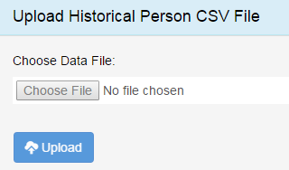
Review WISEid Steps
Next: Complete the Historic Bridge Process
Purpose: 1. Removes the SSN from 4 years of historical data which in turn allows us to put data 4 years of historical staff data into WISEdash. Year-over-year longitudinal data analysis!! 2. Enables the ability to copy records (copy forward) from last year.
Historic Person Download.
Download Historic Person file. Must have AgencyAdmin role(ssn’s in file). Located in the WISEid application under Reports/Validations > Manage Staff Data.
Correct Data in download file
Missing Birthdates and Race keys required to upload. Please do not remove or change the Staff Key column. DPI needs this to match records.
Upload the corrected Historic Person file
Upload for this file located on the
Reports/Validations > Manage Staff Data.
Upload the Person List by Local Id into Skyward*optional
After 3–5 days, WISEid’s should have been created by DPI for historical records. You can check on this by running the Historical Person’s without WISEid’s report and see if the report is blank or minimal records appear in it.

Slide 7
Review WISEid Steps
Last: Create WISEid’s for new staff or all staff
Purpose: The WISEid is a unique, permanent identifier for people in the education system in the State of Wisconsin. Staff working in Wisconsin educational agencies will be required to have a WISEid. Agencies use WISEid instead of Social Security numbers to submit data such as staff assignments and salaries
Manually add persons or Upload file from Skyward.
File Tasks/Upload
Reviewing Upload Results.
Errors, Potential Matches, and Committed records. Errors must be corrected and Potential Matches must be resolved.
Download the “Person List by Local Person ID” file. This is the file that is in the correct format for Skyward.
Upload the Person List by Local Id into Skyward

Slide 8
Create WISEids for New Records
WISEid Resources
User Guide
First link on Help URL, pgs 16 - 32
Race/Ethnicity Crosswalk
General Racial and Ethnic Data

Slide 9
WISEstaff Data Collection

Slide 10
Current Status of the new WISEstaff application
Where DPI is in completing the application
Set up new securtiy for application (Done)
Create new programming to generate WISEid’s (Done)
Update of District Contact Information (Done)
Loading Data - Creation of Staff & Assignment Records (Done)
Copy Forward Records from last year
Uploading Contract and Assigment files
Adding records using the online application screens
Get Staff File Numbers (In Progress - we are currently working on integration)
Verify that no Validation Errors Exist (In Progress - Do not change your systems)
Create “All Staff” report/download for agencies to verify and validate all data reported prior to certifing the data collection (Not started)
Create 5 reports requiring approval (Not started)
Create Draft Salary Report for approval
Create Draft Salary Report by Position, Ethnic Group and Gender
No Teachers at School Report
No Principal at School Report
No Reading Specialist at School Report (new 2015)
Certify and submit (lock and submit) prior to running the audit.
License Auditing integration (In Progress - Do not change your systems)
Licensing Audit Reports (4) (Not started)
Perform final Audit and determine HQ

Slide 11
Getting started on the WISEstaff Data Collection

Slide 12
WISEstaff data collection
Steps to complete the WISEstaff data collection.
Update of District Contact Information
Upload or Create Staff & Assignment Records
Verify that no Validation Errors Exist
Get Staff File Numbers Review of the Missing/Invalid Staff File Numbers (need to be corrected)
Approval of Salary Report
Approval of Salary Report by Position, Ethnic Group and Gender
Approval No Teachers at School Report
Approval of No Principals at School Report
Approval of no Reading Specialist Report
Certify / Ready for Audit
Review Audit reports
Make necessary corrections or get staff licensed
Certify staff data collection for publication

Slide 13
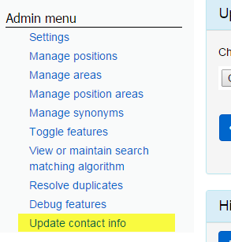
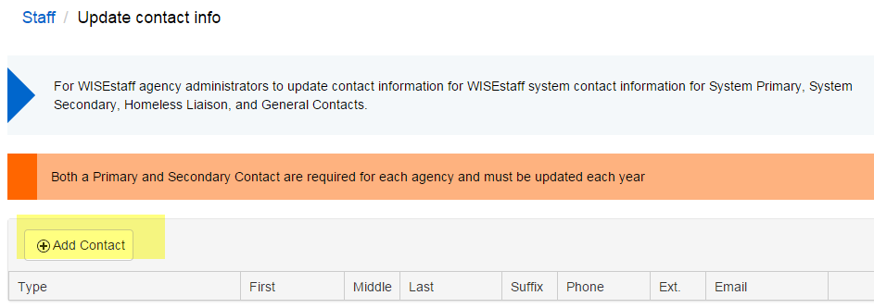
WISEstaff data collection
1. Update of District Contact Information

Slide 14
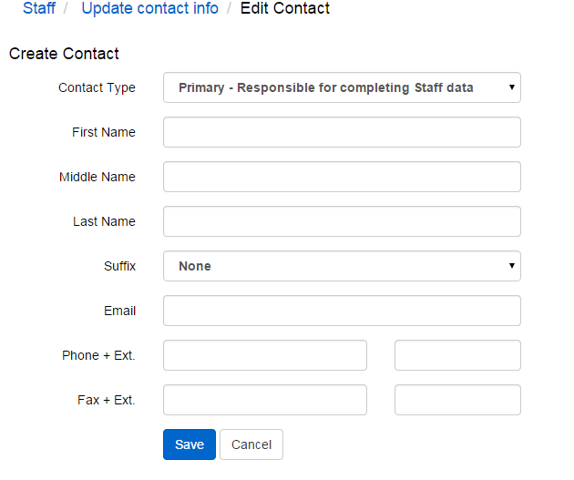
WISEstaff data collection
1. Update of District Contact Information
Primary
Secondary
General
**New to 2015 addition of Homeless Liaison** will be required 2015-2016

Slide 15
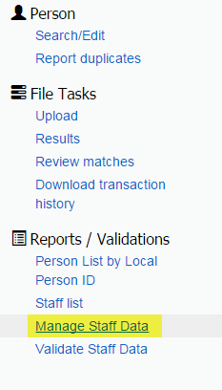
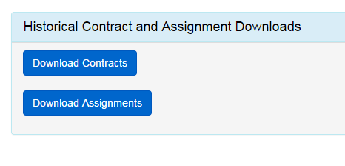
WISEstaff data collection
2. Upload or Create Staff & Assignment records
Creating records (copy forward) from last year
Download files
Make any changes (optional)
Note: DPI automatically adds one year to both the local YOE and the Total YOE

Slide 16
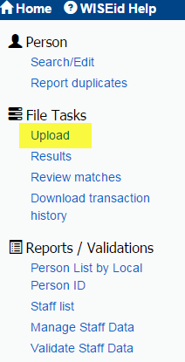
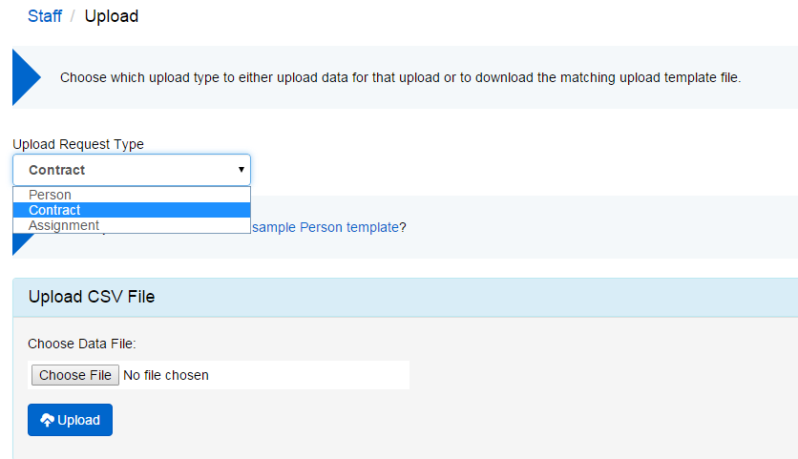
WISEstaff data collection
2. Upload or Create Staff & Assignment records
Upload files
Contract
Assignment

Slide 17
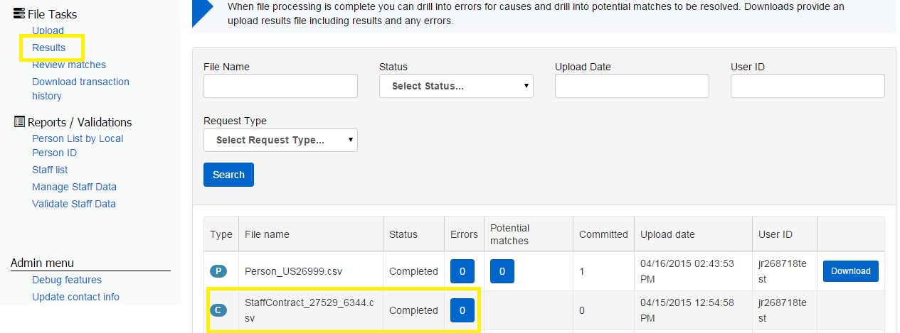
WISEstaff data collection
2. Upload or Create Staff & Assignment records
Review the Results queue for file errors.

Slide 18
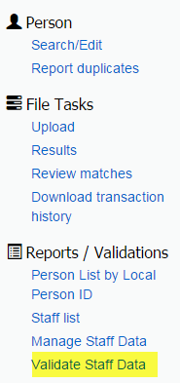
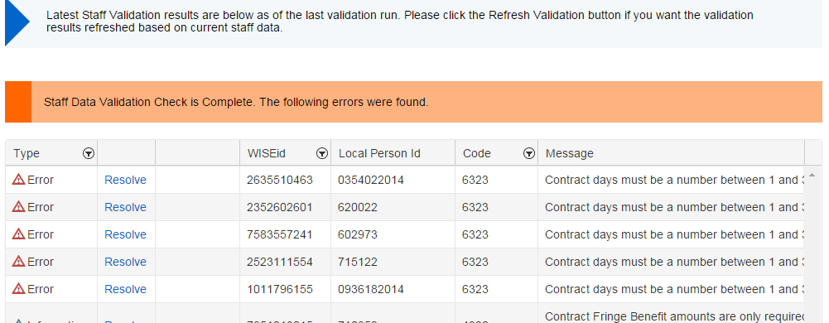
WISEstaff data collection
3. Verify that no Validation Errors Exist
Note: 3 types for messages are now in the system.
Errors – need to be resolved
Warnings – some need to be acknowledged
Informational – most regarding data that will be removed.

Slide 19
Staff data collection documentation

Slide 20
WISEstaff data collection
Staff data collection documentation
2014-2015 Assignment Table
2014-2015 Assignment Related Questions Matrix
2014-2015 Usage of 0000 as the working school by assignment for Working LEA's
2014-2015 Draft Data definitions

Slide 21
WISEstaff data collection
Staff data collection documentation
Reporting requirements for: for subcontracted individuals and
staff with assignment type codes of: 2(Short-Term Substitute/Extra Curricular Activities),
3(Support-Regular Education), and 4(Support-Special Education).
Field
WISEid | Required for all staff
Last Name | Required for all staff
First Name | Required for all staff
Gender | Required for all staff
Year of Birth | Required for all staff
Highest Degree | Not Required for subcontracted individuals and staff with assignment type codes of: 2, 3 or 4.
Local Years Experience | Not Required for subcontracted individuals and staff with assignment type codes of: 2, 3 or 4.
Total Years Experience | Not Required for subcontracted individuals and staff with assignment type codes of: 2, 3 or 4.
Contract Salary | Not Required for subcontracted individuals and staff with assignment type codes of: 2, 3 or 4.
Contract Fringe Benefits | Not Required for subcontracted individuals and staff with assignment type codes of: 2, 3 or 4.
Name Suffix | Optional
Final Salary Code | Not Required for subcontracted individuals and staff with assignment type codes of: 2, 3 or 4.
Former Last Name | Optional
Middle Initial or Name | Optional
Contract Days | Not Required for subcontracted individuals and staff with assignment type codes of: 2, 3 or 4.
File Number | Required for all staff with assignments that are licensed assignments. See the Assignment table where DPI Licensed = Y.
Local Use | Optional
Race Key | Required for all staff

Slide 22
WISEstaff data collection
Staff data collection documentation
WISEstaff Resources
http://dpi.wi.gov/wisedata/help
http://lbstat.dpi.wi.gov/fallstaff
FAQ: Online Help Desk Application (Change Category to WISEid or WISEstaff)
Contact CESA Representative.

Slide 23
Educator Licensing Online (ELO)

Slide 24
PI 1202 Audit
How does the audit work?
WISEStaff (1202) assignments are compared to licenses educators have in ELO
Most educators are appropriately licensed but this audit is used to make a determination one way or the other.

Slide 25
PI 1202 Audit
Who gets reported from the staff data collection and passed to the Audit?
All staff working in assignments that require a license must be reported and checked in the audit process for appropriate licensing. The staff data collection consists of all staff working at the agency including support staff, subcontracted staff and virtual school teachers.
Note, this means that all of these staffers in licensed assignments must have an Entity Number in ELO.
This is NOT true for staffers in assignments that do not require a license (e.g. cafeteria worker)

Slide 26
PI 1202 Audit
When a school district’s audit is completed by DPI, what will be included?
All staff with licensed assignments
All audit exceptions (i.e. errors)
All special education audit exceptions
Staff with licenses that are due to expire on June 30th

Slide 27
PI 1202 Audit
If there is an exception/error, what steps must the district take?
Confirm that the person’s assignment was correctly reported in WISEStaff:
Position
Subject
Grade level
If it was correctly reported…

Slide 28
PI 1202 Audit
What if someone does not hold a DPI license for their reported assignment?
If the educator was accurately reported, they will be an audit exception and that educator must get licensed as soon as possible.
Note, categorical aid for special education and bilingual education can be severely affected if an educator is not appropriately licensed.

Slide 29
PI 1202 Audit
Why is the data reported important?
In addition to categorical aid, after the data is finalized, it is reported on both federal reports and on the DPI website (via WINSS/WISEData).
There are also open records requests from media or the general public.

Slide 30
Questions?/ Answers
Thanks

