Slide 1
WISEstaff Business Rules
Wisconsin Skyward User Group Conference
October 18th, 2016
Presented by: Kari Tenley and Josh Roy

Slide 2
Topics
Assignment Code Spreadsheet and Related Questions.
Who Should be reported
Guidance Document
Federal Spec
FTE Guidance
Data Definitions
Questions and Answers

Slide 3
WISEstaff data collection
Assignment Code and Related Questions
2016-2017 WISEstaff Reporting Information
http://dpi.wi.gov/cst/data-collections/staff/data-collection/staff
Technical Documentation
WISEstaff Reporting Instructions (User Guide)
2016-2017 Summary of Assignment Code Changes
2016-2017 WISEstaff Assignment Code List
2016-2017 Assignments and Assignment Related Questions
​WISEstaff and WISEid - File layouts and upload templates

Slide 4
WISEstaff data collection
Who Should be reported
2016-2017 WISEstaff Reporting Information
http://dpi.wi.gov/cst/data-collections/staff/data-collection/staff
Guidance Documentation
Who should be reported? Decision Tree Diagram
FTE guidance (updated 10/11/2016)
Grade Level guidance
Number of Classes & NCLB guidance
Working School Number guidance

Slide 5
WISEstaff data collection
Who Should be reported
C059 — Staff FTE v13.0 Word
How should contracted staff be reported?
Include contracted staff for work that is considered part of the regular operations.
Include individuals who contract directly with a school district; this is not limited to cases in which the individual receives retirement and other benefits from the district or state. Examples may include bus drivers, school nurses, psychologists, physical therapists.
Include staff employed by another entity that is contracted to provide work that can be considered part of the district’s regular operations. These staff work within the district but are employees of the entity with which the district contracts. The district does not pay retirement or other benefits. Examples may include staff of the school; school security personnel provided by a private firm; or charter school teachers who are employees of a charter school operator
Do not include employees of contractors who provide a non-regular service; these are staff furnished by the contractor, on- or off-site, to provide the service. Examples may include carpenters, electricians, etc. working for a firm hired to refurbish a school building, or cooks and truck drivers who prepare and deliver meals once a week to schools under a contract with a food-service firm.
The distinction between staff reported and not reported is whether the service is part of the district’s regular operation or if it is a non-regular service. For example, if a district contracts with a company for a school bus driving service (where the buses are used regularly), the drivers should be reported. If a district contracts with a company for lunchroom services onsite, the food servers who serve the students on daily basis should be reported as well. Employees of a construction company hired to build an addition to the school should not be reported

Slide 6
WISEstaff data collection
FTE Guidance
2016-2017 WISEstaff Reporting Information
http://dpi.wi.gov/cst/data-collections/staff/data-collection/staff
Guidance Documentation
Who should be reported? Decision Tree Diagram
FTE guidance (updated 10/11/2016)
Grade Level guidance
Number of Classes & NCLB guidance
Working School Number guidance

Slide 7
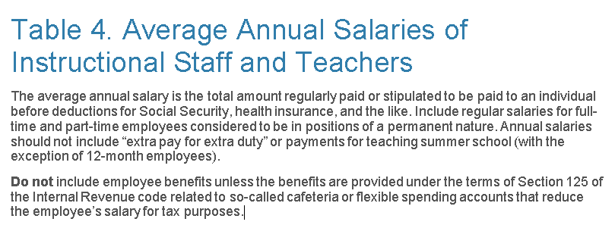
WISEstaff data collection
Data Definitions

Slide 8
Questions?/ Answers
Thanks

