Slide 1
Perkins Grant CLNA
Focus Area: Educator Recruitment Retention and Training
September 2023
Chris Lenske
Grant Specialist CTE Team
christine.lenske@dpi.wi.gov
Notes:
Welcome to the webcast series on conducting the Comprehensive Local Needs Assessment.
Today’s topic focuses on your analysis of Educator Recruitment, Retention and Training, one of the focus areas of the CLNA and your Perkins application.

Slide 2
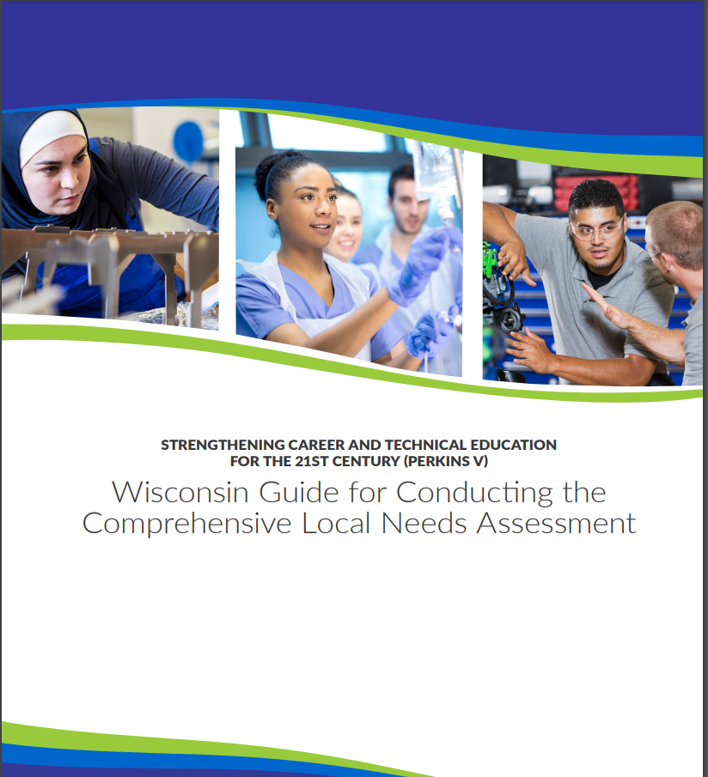
Wisconsin’s CLNA Guide
CLNA Training Series
I. Introduction and Overview of the CLNA requirement
II. Focus Area: Performance on Accountability Indicators
III. Career Pathway Evaluation (including LMI and SSQ)
IV. Educator Recruitment, Retention and Training
V. Focus Area: Equity and Access
V. Putting it all together in preparation for the Perkins application
https://dpi.wi.gov/cte/carl-perkins/grants/formula-grants
Notes:
We will be focusing on pages 20-22 of the Wisconsin Guide for Conducting the CLNA, which focuses on Educator Recruitment, Retention and Training data, questions you’ll want to explore, and stakeholders to involve.
The guide can be found on the Perkins CLNA and application websites

Slide 3
Data Driven Decision Making
The Purpose of the CLNA requirement: Data-driven decision making
CLNA Steps:
Determine team
Determine and gather data for the review and format
Determine stakeholders and outreach/engagement strategies
Analysis of data and determine root causes of gaps
Create plan for closing data gaps by addressing the root cause
Identify goals and develop strategic plan
Identify impactful strategies/activities that will close the data gaps. (Which activities will be supported with Perkins funds?)
Notes:
The purpose of the needs assessment is to facilitate and guide data-driven decision making related to equity in CTE and the use of Perkins funds to achieve that goal of the law.
This means that any decisions related to district priorities, activities, and Perkins grant spending must be driven by the most pressing needs observed through your analysis of your data gaps, and exploring the root causes of those gaps.
Since closing the data gaps, is the ultimate goal of Perkins funding, consider the gaps that exist related to your teachers and other school personnel. We’ll take a close look at what that data consists of in this presentation.
You’ll then want to target activities that have the sole purpose of reducing the gaps over the next two years of the grant cycle. These are the only activities that will be allowed to be paid for with Perkins grant dollars. For this focus area, it means that any training or support for educators being paid for with Perkins, must address a need reflected in your CLNA results.
There must be a deliberate focus to develop a strategic plan for closing gaps. Your plans will include goals, the identification of your desired measurable outcomes, and specific activities that will lead to accomplishing the goals and desired outcomes. Perhaps the gaps are related to other focus areas you’ve already assessed. How will they be addressed through ERRT?

Slide 4
Educator Recruitment Retention and Training (ERRT)
Perkins V Section 134(c)(2)(D)
A description of how the eligible recipient will improve recruitment, retention, and training of career and technical education teachers, faculty, specialized instructional support personnel, paraprofessionals, and career guidance and academic counselors, including individuals in groups underrepresented in such professions.
Notes:
In this section of the law, you are required to assess and develop goals and activities to improve the quality of your faculty and staff through recruitment, retention, and professional development, with particular attention paid to diversity in the profession (or classroom).
A good way to ground your evaluation of this focus area is to look at district hiring, incentives, and professional development policies and practices. Note that the Perkins V, definition of “professional development,” emphasizes sustainability, relevance, and quality of these experiences. Therefore, general PD (such as attendance at a conferences), that is not focused on an area of need, would not be an allocable activity.
Likewise, this section of the law encourages that leadership, support personnel, paraprofessionals, and counselors be brought aboard the CTE train so to speak; ensuring that all district personnel understand CTE, the benefits of CTE and can advocate CTE experiences to students, the family and community, and provide relevant support when needed.

Slide 5
Data
Quantitative
Personnel demographics (particularly in CTE)
Turnover (demographic and CTE)
How long do they stay?
Licenses (types)
Credentials (types)
Evaluations
PD Opportunities available for personnel
Participation in PD
Qualitative
Recruitment and hiring process
In-house support (mentoring)
External support
Quality of PD
District climate
CTE Capacity
The DPI Educator Preparation Program and Workforce Analysis Report https://dpi.wi.gov/sites/default/files/imce/education-workforce/pdf/2021-wi-epp-annual-report.pdf
Notes:
So what are the data points to explore?
Here are some examples of quantitative and qualitative data points.
The quantitative points such as district personnel demographics, licenses held, turnover patterns, participation in PD, findings from evaluations are often able to be pulled from district records. Engage your HR personnel in the process.
Qualitative data can be obtained from an observation and analysis of what is available, who is participating, recruitment and hiring practices, support provided to new employees, climate, and CTE capacity as the team looks to the future.
The DPI Educator Preparation Program and Workforce Analysis Report can help your agency compare some data points across the state.
https://dpi.wi.gov/sites/default/files/imce/education-workforce/pdf/2021-wi-epp-annual-report.pdf

Slide 6
Exploring the Data
There is a system of procedures and protocols for recruiting, evaluating, and rewarding personnel - If not, why? What needs to be done?
There are highly qualified and diverse personnel recruited and retained - If not, why?
There is ongoing supports for new teachers is provided - If not, why?
There is professional learning to meet individual needs is provided - If not, why?
Professional learning is aligned with identified needs based on staff evaluation and student performance - If not, why?
Teachers possess skill set for individualized instruction based on learning styles - If not, why? What needs to be addressed? How?
Teachers know what each student needs and has flexibility to provide it - If not, why?
Teachers use a variety of instructional modes - If not, why?
Notes:
Once you’ve collected your data whether it be quantitative or qualitative, look for personnel gaps in areas of recruitment, employment, retention, training. Take a comprehensive view of what you know about educators, administrators, staff, and academic and career counselors across your program as well as procedures and practices related to personnel.
The questions or considerations presented on this slide are those topics that should be explored for greater understanding.
First, related to recruitment and incentivizing personnel:
• What processes are in place to recruit and induct new teachers and staff? Are these processes efficient and effective, especially for teachers coming from industry?
• In what subject areas do you need to develop or recruit more educators?
• What aspects of recruitment processes need to be improved to reach a more diverse applicant pool? Are you exploring EBL for certain teachers or professionals in your area.
• Are there applicant requirements that may be preventing diverse applicants from being considered? Compare the demographics of your teachers and staff to the makeup of your student body. To what extent are students learning from educators who reflect the demographics of students themselves and the community.
• Are there clear avenues to leadership positions and targeted incentives and ways to be involved? Then, are the incentives, rewards and celebrations things that actually motivate personnel?
• How diverse is the staff? Does it reflect the demographic makeup of the student body?
• How qualified are teachers in the subjects they teach?Are they adequately credentialed? What else is needed?
Related to skill sets and PD:
• Are regular, substantive professional learning opportunities offered and are personnel able to take advantage of opportunities?
• How are educators, staff, and administrators prepared for their responsibilities, particularly new educators coming from an industry background.
• What type of professional learning is most desired by personnel? For example, what types of support or professional development is provided for those with experience-based licenses? For them is PD targeted to address the gaps and specific needs of EBL personnel?
• Are there learning needs, specifically to support being knowledgeable about what supports students need to be successful?

Slide 7
Exploring the Data (cont…)
Personnel understand and support CTE and career pathways - If not why, what can be done?
Why do personnel stay? Why do they leave?
To what extent to personnel feel valued?
Capacity of CTE educators aligns with agency CTE goals.
How can retired teachers, the technical college, local partners, and neighboring districts be leveraged to provide support in CTE classroom?
Notes:
Also consider:
The extent to which personnel understand and support CTE and career pathways - If not why, what is needed?
Why do personnel stay? And why do they leave?
When broken out demographically, do retention rates vary across staff roles and/or identities? For instance, are staff of color retained at a similar rate as white staff? If disparities exist, what are the underlying causes?
To what extent do personnel feel valued? Why? Why not? What needs to be done?
Look for gaps in expertise within and across career pathways.
To take this analysis further, compare your current staff capacity to your future plans for CTE programming - what is needed to credential up or support personnel to move in the direction of providing career pathway opportunities?
Is there a climate of support that meets educator needs; a climate of teamwork and accessibility of leadership?
Consider how retired teachers, the technical colleges, local partners, and neighboring districts can be leveraged to provide support in the CTE classroom
Look at which activities were successful in closing gaps in the last CLNA, and which were not? What do you want to change or expand upon?

Slide 8
Stakeholders
What do you want to learn from stakeholders? Have your objectives in mind prior to reaching out.
Surveys
Focus groups
Leading Forward: WI Education Workforce Initiative https://dpi.wi.gov/education-workforce
Notes:
As with the other focus areas, stakeholder engagement is the key to understanding the strengths and weaknesses of educator supports and needs in the district.
Once you’ve synthesized your data, consult, particularly with teachers, building administrators, school counselors, and other employees of the district as to what appears to be the most pressing gap or need. What solutions, initiatives or activities can be implemented in the next two years to mitigate the gap and achieve your ERRT goals?
Even students, parents, local business and industry, and postsecondary institutions can be of assistance in understanding and bringing clarity to the needs and strategizing around solutions.
Leading Forward: WI Education Workforce Initiative https://dpi.wi.gov/education-workforce can provide some food for thought on your analysis and strategic planning around preparation, license options, recruitment, retention and educator effectiveness.

Slide 9
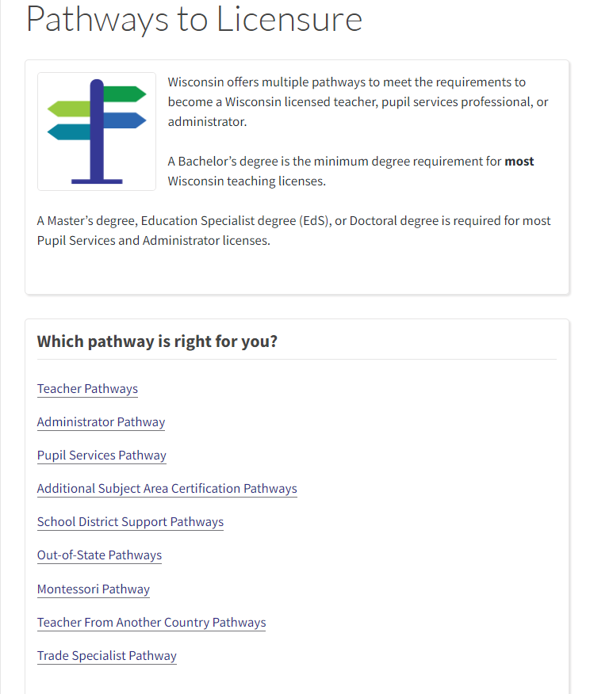
Licensing
Notes:
The DPI Pathways to Licensure website is another resource for exploring creative ways to obtain teacher licenses for those who are interested.
<pause>
That concludes the Educator Recruitment Retention and Training focus area webcast.
If you have questions, please reach out to me or one of the DPI content consultants for more information on assessing Educator Recruitment Retention and Training needs.

