Slide 1
Perkins Grant CLNA
Putting the Pieces Together - Part 1
November 2023
Chris Lenske
Grant Specialist CTE Team
Notes:
https://dpi.wi.gov/sites/default/files/imce/cte/CPA/CLNA_Guide_v5.pdf ]
Welcome to the webcast series on conducting the Comprehensive Local Needs Assessment, for the upcoming two-year grant application cycle.
Over the last 6 months agencies who wish to apply for Perkins funds have been embarking on a robust CLNA process, looking at data and engaging many stakeholders in your district and community.
Today’s presentation is about organizing your CLNA results in preparation for your Perkins grant application. It is being recorded so that you can refer back to it later, but we’ll stop the recording at the end for the Q&A portion.

Slide 2
Wisconsin’s CLNA Guide
CLNA Training Series
I. Introduction and Overview of the CLNA requirement
II. Focus Area: Performance on Accountability Indicators
III. Career Pathway Evaluation (including LMI and SSQ)
IV. Educator Recruitment, Retention and Training
V. Focus Area: Equity and Access
VI. Putting the Pieces Together Pt 1: Preparation for the Perkins application
https://dpi.wi.gov/cte/carl-perkins/grants/formula-grants
Notes:
Since this summer, you’ve been undertaking the important process of engaging stakeholders to help you determine the root cause behind any data gaps you’ve found in the various focus areas of the CLNA. In other words, the “why” behind the data.
With your application due date just 4 months away, it’s time to consider how you’ll pull your information together, prioritize the needs you wish to address, and report what you’ve learned.
TODAY’S PRESENTATION WILL FOCUS ON HOW TO SYNTHESIZE YOUR FINDINGS, PRIORITIZE NEEDS, AND DEVELOP A STRATEGIC PLAN FOR IMPLEMENTING ACTIVITIES AND STRATEGIES THAT WILL CLOSE THE GAPS IN EACH OF THE CLNA FOCUS AREAS.

Slide 3
Agenda
Purpose of the CLNA Process
Compiling CLNA Results
Strategic Planning
Considerations
Required use of funds
Tying the CLNA results to your application
Notes:
We’ll briefly review the purpose of the CLNA requirement.
Then talk about compiling your assessment results in a way that tells a story of the gaps, reflecting where you currently are and where you want to be for the quality education of all your students.
Essentially, putting together a strategic plan for a two year Perkins application cycle.

Slide 4
Purpose of CLNA process
•Identify strengths and gaps
•Conduct root cause analysis to determine cause of gaps.
•Data driven decision-making/Strategic planning
Identified career pathway and equity needs drive Perkins grant application priorities
Notes:
Perkins V requires one comprehensive local needs assessment for each eligible recipient (or applicant).
The CLNA process gives Perkins grant applicants an opportunity to do an in-depth analysis of program outcomes.
This analysis takes a look at the local CTE landscape as a whole, and in parts, in order to identify areas where targeted improvements are needed. If done well, this will lead to increased opportunities for student success.
The needs assessment for a consortium must be representative of all LEAs and CTE programs that are provided by the member districts as a whole.
In short, the CLNA process is the process by which applicants determine their greatest needs for CTE instruction through stakeholder input.

Slide 5
Purpose of CLNA Process
Data-driven decision making
Identify data gaps
Engage stakeholders to understand the root cause of the data gaps
Create plan for closing data gaps
Identify goals and develop strategic plan
Identify impactful strategies/activities that will close the data gaps. (Which activities will be supported with Perkins funds?)
What positive outcomes will you see as a result of your efforts?
Notes:
The purpose of the needs assessment is to facilitate and guide data-driven decision making related to equity in all focus areas and meeting labor market needs.
This means that any decisions related to district priorities, activities, and Perkins grant spending must be driven by the most pressing needs observed through analysis of your data gaps, and exploring the root causes of those gaps.
Targeted activities are identified for the sole purpose of reducing the gaps over the next two years of the grant cycle. These are the only activities that will be allowed to be paid for with Perkins grant dollars. As you know by now, this is a change from how spending decisions were made under Perkins IV.
Over the last four months you’ve been focused on gathering your disaggregated data, putting it in understandable formats, and having discussions with stakeholders about what the data is saying about student learning, educator needs and career pathway access and quality instruction. You’ve gotten input from a broad range of stakeholders that has shed light on the deeper reasons for gaps in the data, and perhaps even some discussions on the activities needed to close those gaps.
Now is the time to look at the overarching trends and consider where there are common themes.
And, if you’ve started identifying activities to move the bar, have you vetted those activities with your stakeholders - including parents, students, and community members.

Slide 6
Notes:
As reflected in this graphic, your goals, priorities and resources are determined by the CLNA process that you’ve just undertaken.
The CLNA is intended to be the driver of your strategic plan over the next two years.
In many ways your Perkins application, including your CLNA results should show the connection or the through line between your data gaps, the root causes that reflect needs, and your goals, intended outcomes and activities, and finally… resources that will help support those activities.

Slide 7
Summary
Notes:
So, where are you at in your CLNA process?
Hopefully you’ve already gathered your data and have begun discussions with stakeholders about the data.
Now: Do you have your tasks and meetings charted out for the next three months so that you’re ready to draft your application in spring?
Creating your action plan/ or strategic plan for CTE should create a vision for the next two-year grant cycle.
Vet your action plan with stakeholders from inside and outside of your agency to make sure you haven’t missed the mark and that there is support from administration and your school board

Slide 8
Compiling CLNA Results
Strategic Planning Decisions based on CLNA
Narrowing of gaps (between what is and should be)
Equity in CTE pathways for all students (9th-12th grade)
Removing barriers
Equitable practices
Expand career pathway quality elements
PD and training
Purchasing priorities
Notes:
Strategic Planning Decisions based on your CLNA results will likely revolve around the following:
the Narrowing between any of your data gaps (in other words narrowing the chasm between what is and what you want your data to reflect).
Equity in CTE for all students; making for more equitable educational experience for students, whereby every student sees their place in CTE;
Removing barriers that might prohibit engagement;
Equitable teaching practices, which may require specific PD based on the needs of a certain population of students;
Expand career pathway quality elements;
Any needed PD or training targeted to reducing a gap; and of course
Purchasing priorities aligned with your most pressing needs.

Slide 9
Compiling CLNA Results
Focus Areas:
Student Performance on Accountability Indicators
Career Pathway Evaluation of Progress (LMI&SSQ)
Equity and Access
Educator Recruitment, Retention and Training
Notes:
Once you’ve analyzed your data for each focus area, identified the data gaps, identified the root causes of those gaps, and obtained consensus as to the activities or strategies that will lead to closing the gaps, it’s time to pull that information and develop your two-year plan.
A summary of your results will need to be included in the application for each of the focus areas. The question at hand is how to compile or synthesize your results in a way that tells a story, and that can address the overlap between focus areas in a coherent way.
To do this effectively, you’ll need to combine a number of variables, observations, and findings into a coherent whole; and figure out how best to communicate that in the CLNA results portion of your Perkins application.

Slide 10
Compiling CLNA Results
Explore:
What are your greatest needs? What needs impact needs in another area?
Which needs are you going to address to close your gaps? Is it realistic to address everything or will you focus on certain aspects?
Do certain needs cross over from one focus area to another?
Focus Areas:
Student Performance on Accountability Indicators
Career Pathway Evaluation of Progress (LMI & SSQ)
Equity and Access
Educator Recruitment, Retention and Training
Notes:
As you look at the results of your CLNA, start with identifying your greatest needs to close the data gaps you discovered. Ask your team, “Do these needs also impact other focus areas”? If so, what are the connections and how does one impact another?
Further, consider which needs you’re going to address through the Perkins grant or other local resources.
Is it realistic to address everything or will you focus on those things that will make the greatest impact? Who will make those decisions? Hopefully you have stakeholders engaged in this process of prioritization.
You probably can’t address everything, and some things may take longer to see results. What will you focus on in year one and in year two? Do your goals and activities build on each other?
Some activities are “nice to have” or “we've always done it this way” activities, but will they actually reduce the gap between where you are and where you want to be and move the bar on student outcomes? That is what your team is tasked with determining.

Slide 11
Compiling CLNA Results
Needs may overlap in multiple focus areas
Examples:
Performance Indicator (for ACT Reading / Eng Lang Arts) and
Educator Recruitment, Retention Training
Performance Indicator (for WBL), Equity and Access, and
Career Pathways Evaluation of Progress
Notes:
As mentioned, you may find that certain needs overlap or cross between focus areas
For example…
In Example 1: You could find that your EL students have a gap in proficiency on the ACT Reading/English Language Arts (which is a performance indicator). Your analysis tells you that the gap is attributed to an increase in EL population and that there is a lack of built in supports at school to meet Reading/Language Arts learning. This could also be an overlap with the equity and access focus area. Going deeper though - through discussion you learned that the reason supports aren’t provided is that teachers lack the understanding of how to best support EL students in the classroom. Your stakeholders determine that this is the actual root cause, of the data gap. It’s determined that there is a need for educator training on how to provide appropriate supports in the classroom.
**An activity to address this may include the requirement of PD for all school personnel in Equitable Multi-Level Systems of Supports during the spring in-service day.
.
In Example 2: WBL enrollment is low for students of color (Student Performance on Accountability Indicators or Equity and Access focus areas). You learn that WBL is only offered in a pathway that few students of color enroll in (say, manufacturing), so this could also be a need to be addressed in the Career Pathway. After digging deeper as to why students of color do not enroll in manufacturing, you learn there is a bias against manufacturing with families of color due to reduction of manufacturing jobs in the 80s in urban areas. In this case it might be determined that there is a need for the agency to inform families about LMI around manufacturing in order to tackle both the perception of manufacturing as not being a reliable source of employment, as well as opening up opportunities for WBL. (Which is Career Pathways Evaluation of Progress). Regardless of the focus area you choose to focus on for this need, they will all have an impact on each other. Where do you think the best fit is?
You need to be clear about the ultimate root cause of a need, your goals related to that root cause, and the activities that best align with the focus area.

Slide 12
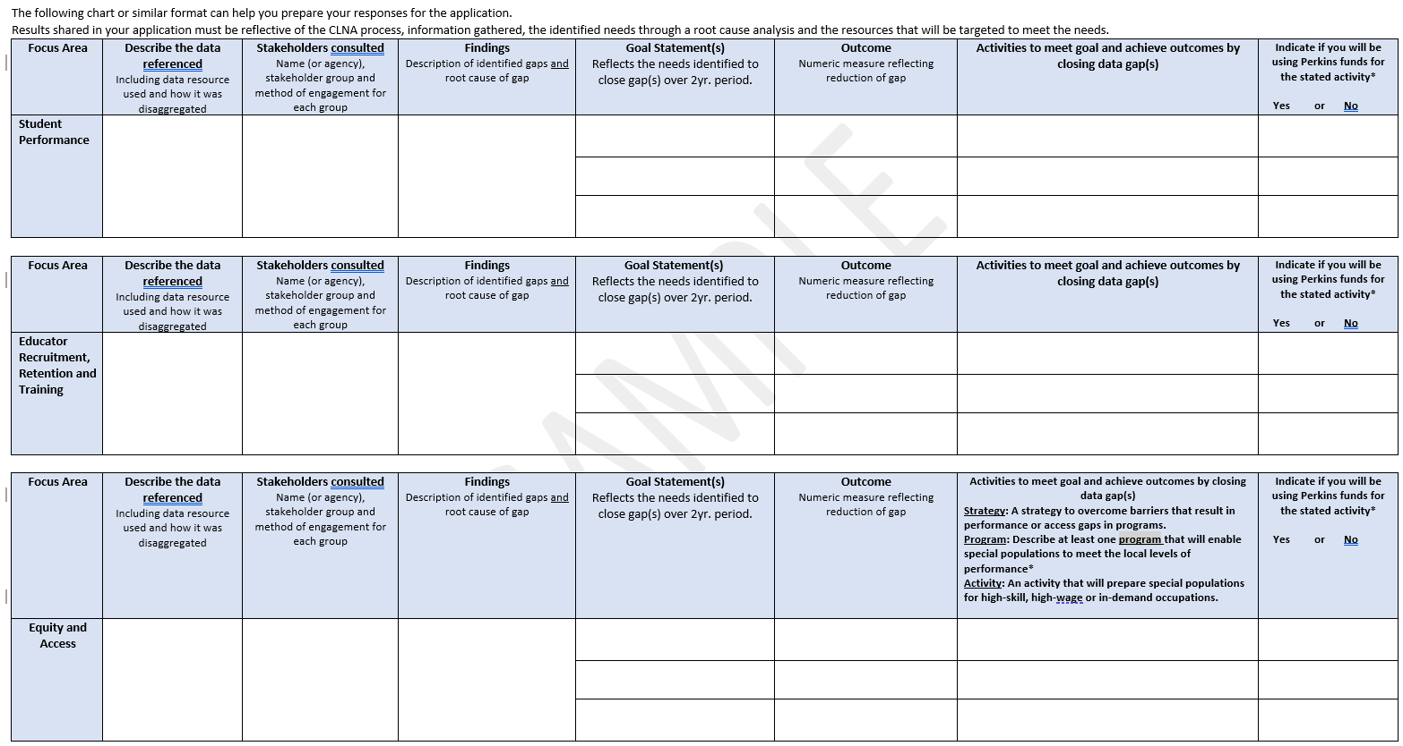
Notes:
Putting together a worksheet similar to this example, is a good way to record your findings. Most of you have seen and even used this before.
It can also help you organize your plan in preparation for the CLNA results section of the application.
Your meetings, agendas, notes, who was in attendance should all be captured somewhere and kept for your records.
How this sheet is organized, is that each column represents a data field on the CLNA results section of the application for the three focus areas of Student Performance on Accountability Indicators, ERRT and Equity and Access
Let’s review the columns for each focus area.
For the data field, summarize the type of data sets you analyzed, where you obtained the data from and how it was disaggregated. The information could be from WISEdash, WISEdata , surveys or focus groups of identified stakeholders can all make up your data. Record what you used for that particular focus area and how you compared data sets - but not the data itself.
You’ll also be asked to share who the stakeholders were. You’ll recall from the first webcast that you must have broad stakeholder input from both inside and outside of your organization. The stakeholders listed are not optional, they are required. Where we’ve seen agencies fall short is in the broad range from outside of the agency. They will count a special education teacher for special education AND as a representative of SpEd students. Representatives of each SpPop groups are advocates best found from outside of your agency. If you’re still not sure who should be included, see the links in the CLNA guide for suggestions and links on how to get in touch with agencies in your area.
[Community member complaint from a few years ago for an assessment that had no SpEd involvement]
The findings section, is where you explain the data gaps observed through your analysis and the root cause of those gaps as determined by broad stakeholder input. Your root cause of the data gap will point your agency to the needs to be mitigated. For every gap you indicate there must be a root cause associated with that gap. Remember, a root cause is not the first thing that comes to mind when you ask “why” there is a data gap. You must dig deeper to understand the why behind the reason that first comes to your team’s mind. For example, a root cause is NOT that “parents of __XYZ_ population aren’t open to their kid’s participating”, you have to look at the reason behind that to uncover what YOUR agency needs to do to change a perception or lack of engagement. That is why you need parent and student stakeholders at the table to help guide you to see what is really going on.
Once you determine the need, the next field asks for your goals related to the need as well as the measure that will be used to reflect a positive change in your data. In essence, a SMART goal.
For example, if a certain demographic of your student population of concentrators is disproportionately low, you might say that the goal is to increase XYZ population as concentrators. The outcome you wish to see is a 3% increase.
of XYZ demographic moving from “participant” to “concentrator”. The measure should be the data improved as a result of your interventions.
Then, going across to the next column, what are the activities you’ll engage in to achieve the goal and outcome measure, and finally, will you use Perkins funds to support that activity or use other resources. For example, an agency may be bringing in training for Multi-level Systems of Support for the whole district to address equity in learning. It’s something that could address a Perkins gap, but the district is supporting it through the in-service.
In the bottom row, for the Equity and Access focus area, you should be prepared with at least one strategy, one program and/or activity that will be implemented to provide equitable access to specific special population groups for whom you’ve found gaps. Essentially, explaining which demographic group has a disproportionate data gap and explaining a specific intervention to address it.
When you use a chart like this, you can see where there may be overlapping gaps, findings and goals. When it comes time to do your application, you’ll organize your information to what fits best.

Slide 13
Notes:
For your Career Pathways Evaluation you’ve determined which career pathways need bolstering; which ones are fine as they are; and which one’s you may sunset due to not aligning with labor market needs or the required high-wage, high-skill or in-demand sectors.
For the Career Pathway Section, you’ll want to organize your information similar to this worksheet
As you know, to be approved for funding, a pathway must:
Align with local or state Labor Market and skill needs (either current or projected);
Meet the SSQ requirements and
Has at least one data gap that needs to be addressed to improve or expand that pathway experience for students
Here too, you’ll indicate the stakeholders involved in your discussions and what LMI and your Regional Economic Development Organizations have to say about the employment needs related to the pathway.
Your Regional Career Pathways Collaboratives can help you with this - connect with them if you have not already done so.
A career pathway may be a locally developed pathway or a regionally developed career pathway, for which you have a Regional Career Pathway map.
The pathway may be indicated at the cluster level or be more specific. For example, if you have two different agriculture related pathways you may generalize it at the cluster level, or you may enter each curricular focus separately for example: Animal Systems and Plant Systems, especially if your programs are robust enough to meet SSQ elements on their own - we love to see that.
For consortia, you need to reflect the name of the career pathways the consortium has, and just those member agencies who meet the SSQ requirements for that pathway.

Slide 14
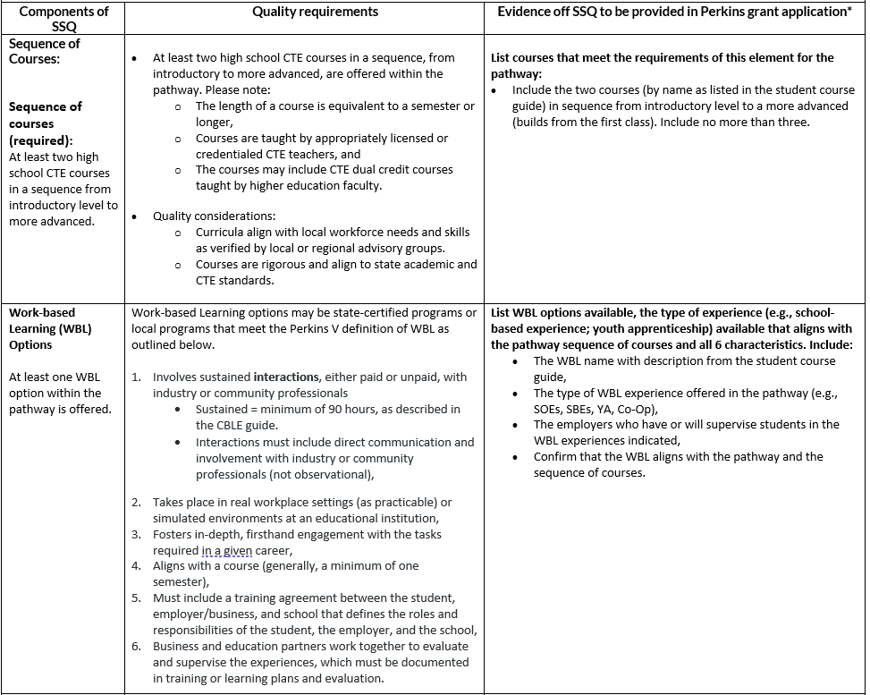
Notes:
The purpose of the Career pathways Evaluation of Progress section is to
Reflect on status of your pathways. Does the pathway have gaps related to the quality elements or are there other data gaps related to enrollment, instruction, or student outcomes?
Does the pathway meet the required elements to use Perkins funds? You should NOT provide information on any career pathway that doesn’t meet the requirements for funding in your application.
This chart, referred to as Appendix A, tells you what you need to include to meet SSQ. The components are listed in the left column; the quality requirements are in the middle column; and the evidence you’re expected to provide in the application is in the right column. The top section there focuses on sequence of courses: You have to have at least two CTE courses, taught by a CTE teacher, in a sequence from introductory level for the specific pathway to a more advanced course.
(The introductory course must be specific to the pathway, not general, encompassing many pathways) If that’s reflective of your introductory course, you’ll need to state the next level course and the advanced course.
Then you must meet at least two quality elements of either WBL, IRCs, Dual Credit or CTSO membership tied to the pathway through the curriculum.

Slide 15
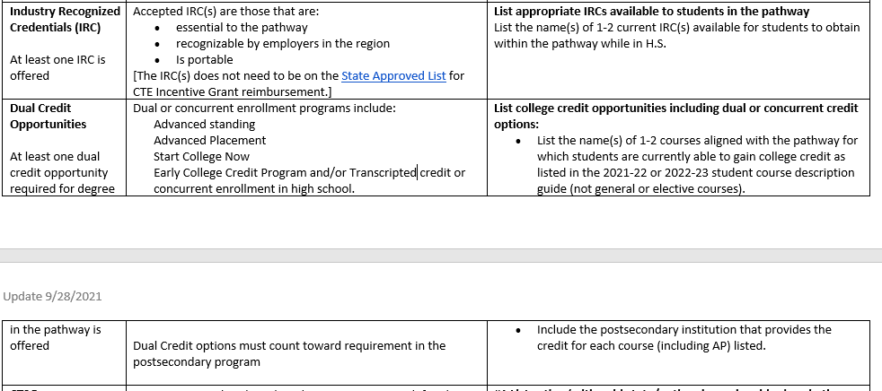
Notes:
Here IRCs and dual credit are spelled out.
If you want to show that you meet one of these quality elements the IRC must be essential to the pathway, recognizable by employers in the region (meaning they know of it and required it for employment), and it’s portable, meaning it meets requirements not only locally but statewide.
It does not need to be on the state approved list for certification reimbursement, and some IRCs on the state approved list do not qualify.
For example, OSHA is an IRC that meets SSQ even though it is not on the DWD state approved list for reimbursement.
Whatever you list, must be certificates or credentials that your students have actually received; certificates that your agency has worked to help students attain in the last 1-2 years, NOT random certificates that are out there that a student finds and does on their own.
Dual Credit must also be a required course, not a nice to have course, or a random course of interest to the student.

Slide 16
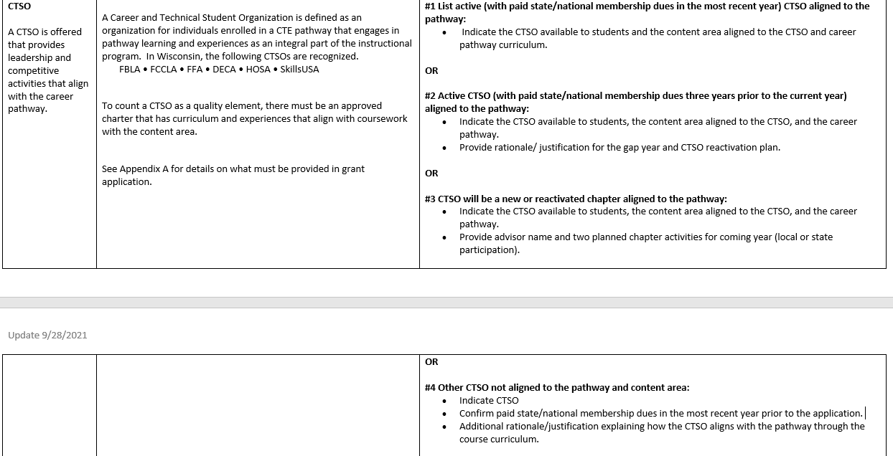
Notes:
What qualifies a CTSO to be considered a quality element for a career pathway?
It must be a Wisconsin recognized CTSO. Wisconsin recognizes the CTSOs listed because they are Nationally recognized and supported as CTSOs by the National Coordinating Council for Career and Technical Student Organizations.
Second, the CTSO must have an approved national charter that is tied to curriculum and experiences that align with coursework in the content area. Therefore the CTSO must align with the pathway and:
Have either active membership
Or
Had membership for three years prior to the current year (for example, had active membership, but due to a staffing change or some anomaly, you don’t currently have membership)
Or
The CTSO is going to be a new or reactivated chapter at the start of the school year. You verify this by providing the advisors name and two planned chapter activities for the upcoming year. TBD won’t be an accepted response.
Or
the CTSO is not necessarily aligned to the pathway content, you MUST have membership, and provide the rationale and justification as to how the CTSO aligns with the pathway through course curriculum.
Saying, “we don’t have an advisor” or “we don’t have enough interest in a more appropriate pathway” is not acceptable. There must be curricular overlap.

Slide 17
Pathway Example
Notes:
Again, related to the Career Pathway CLNA portion,
what is the data you referenced and how did you disaggregate it?; For example, did you look at enrollment and from where? Did you look at concentrators or outcomes after graduation; was it the number of quality elements you offer and those qualified to teach; or feedback surveys from students?
Who are the stakeholders you consulted with on various aspects of this pathway?
Record the gaps found in your data. For example, If you don’t have all of the quality elements, why is that? Is there something you want to work toward over the next two years of your grant cycle?
As with the other focus areas, your findings should reflect the noted data gaps and the root cause of those gaps, with goals to overcome gaps and meet the needs. What will the outcome data be and what are the activities or interventions that will be done to meet the goal?

Slide 18
Strategic Planning Considerations
Data gaps
Root Cause (s)/Needs = Your Findings
Goals with Outcome Measure that will show a decrease in the gap
Activity for Goal #1
Activity for Goal #2
$ purchase/budget line item
$ purchase/budget line item
$
purchase/budget line item
Notes:
Here is a flow chart that reflects the worksheets we just went over and how ultimately your spending is connected to the data gaps.
There can be many causes to why there is a data gap. But your application is only concerned with the root causes.
When you find the root cause, you can feel confident that your goals, activities and interventions will result in reduced gaps. Your root cause points to what your needs are and everything flows from there. We often see causes, that are not root causes. Agencies are then frustrated that they don’t see change. That’s because an obvious cause was addressed, but the real underlying problem or root cause was never addressed.
Then identify your goals related to the meeting the needs identified. They should be a SMART goal that includes the outcome measure you seek to have.
From there flows the activity that will be implemented to achieve the goal and the outcome.
That activity could be supported with Perkins funds (if an allowed activity or cost) or may be addressed with local funds or other support.
Any Perkins spending must align and tie back to improving your findings, thus reducing the data gaps within two years.

Slide 19
Tying the CLNA results to your Perkins application
Notes:
One problem we’ve seen consistently in the last two cycles of the CLNA and the Perkins application, is that what is entered into the application is often not a clear reflection of your results.
In other words, there hasn’t been a clear connection between the data you say you’ve reviewed, and the gaps expressed.
There has also been a lack of connection between what is stated as a need and the activities that will supposedly address that need in order to close the gap.
The disconnect has left your reviewers wondering if a true CLNA process occurred, and what is driving spending.
In some cases, after discussion, we’ve found that there have been good practices related to the CLNA process, but that it just wasn’t communicated effectively in the application.
To help you understand what is and is not helpful to your reviewer, I’ve put together some examples (for you to chew on), of issues we’ve seen and how to avoid them.
This will help minimize frustration on both sides related to returned applications.

Slide 20
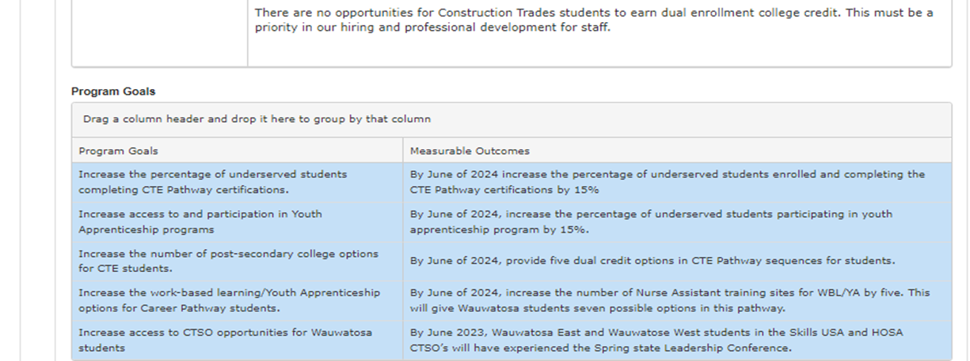
Findings
Notes:
Next we’ll go through an example of documentation that is problematic.
This screenshot of the CLNA results for the Student Performance on Accountability Indicators section is completely inconsistent. There is no through line between the gap expressed in the finings and the goals, desired outcomes and activities.
What’s not good:
Issues with this section are that:
1) The one gap in the findings field of the application, identified for this focus area, is related to dual enrollment. The problem here is that dual enrollment is NOT a performance indicator, so that gap should not be listed under this focus area to begin with. Further, there’s root cause pointing to a need to hire or provide PD for staff. So it’s unclear where the stated need for PD or hiring is stemming from.
2) When we look at the program goals we see a lot of things that don’t relate to the stated need. All of the goals seem to have to do with career pathways rather than student performance on indicators. Even if DC was an indicator, none of the goals or outcomes deal with dual enrollment.
The good:
Outcomes measures are okay, as they indicate a numerical measure of improvement. But again, the problem is that it doesn’t matter, because none of the goals or outcome measures are tied to the need.

Slide 21
Notes:
Here are the activities that were listed, which are to integrate academic skills into pathways instruction and engaging special populations in STEM fields.
However, there was no data and these activities do not support the needs of dual credit or the goals we saw on the previous slide.
I don’t have the purchases here to show you, but they were even further removed and were not aligned to the needs.
Again, I stress that there must be a common thread all the way across from data gap, to the root cause, to the need, to the goals/outcomes/activities and the purchase to support the activity.
Do NOT simply copy what you put in your last application. Follow the guidance provided here and throughout the training series to improve the quality of your application, as expectations for a complete and compliant application increase annually.

Slide 22
Office Hours
November 30th: 3-4
December 14th: 2:30-3:15
Thursday Jan 18th: 2:30-3:15
February 8th: 2:30-3:15
March 14 3-3:45
April 11th: 3-3:45
Best Practices for Engagement of Learners in the CLNA: January 4 @ 2pm
Putting the Pieces Together Webcast #1 focused on the Perkins application: February 8th: 1-2:30
Notes:
On a positive note, you are not in this alone. I will start offering office hours if you have anything you want to talk through any questions. Note there are some time differences. Links will be provided in Perkins Updates emails
There will be a live webcast on the Best Practices for engagement of learners in the CLNA process on January 4 @ 2:00 and will be a live presentation.
We will have Putting the Pieces Together Webcast #2, focusing on completing the application on February 8th from 1-2:30

Slide 23
Additional Tools and Resources
Conducting a Data Walk
Worksheets
https://dpi.wi.gov/sites/default/files/imce/cte/CPA/2022_01_19_CLNA_results_Pathway_SAMPLE_worksheet_FINAL_1.14.22.docx.pdf
CLNA other focus areas
SSQ Requirements and Options
https://dpi.wi.gov/sites/default/files/imce/cte/CPA/2021_10_05_Edits_Appendix_A_Career_Pathway_SSQ.pdf
Notes:
Before we go into the Q&A portion of today’s presentation, I want to share resources that can help you in your analysis and synthesizing your results.
With that, I’ll stop recording and provide an opportunity for you to ask questions.

