Slide 1
Perkins Application Narrative Section
January 2024
Chris Lenske, Grant Specialist
Karin Smith, Education Consultant
Notes:
[Share: Narrative Guide link]
Welcome to this webcast on completing the Narrative Section of the Perkins application.
This section is in WISEgrants, as are the other sections of your application. However, this section is only completed every 4 years to align with the Perkins State Plan. So, it warrants some special attention.
The last time you completed this section was spring of 2020.
The main focus will be on how to approach answers to the questions for the next four-year period.
I’ve put a link to the guide in the chat.

Slide 2
Perkins Narrative
Section 134 (a)(b)(1-9)
The local application shall cover the same period of time as the period of time applicable to the State Plan (4 years)
The local application contents shall contain descriptions of the following…
Notes:
Section 134 of Perkins V law states that the local application (what we call the Narrative Questions) covers the same period of time as the state plan and that the contents must contain specific descriptions of your CTE implementation.
The questions remain the same as the first time you completed this, however, today we’ll walk through how to be more targeted in your responses.
Well walk through the questions one, by one.

Slide 3
Narrative Questions
Highlight HOW you plan to meet different required aspects of CTE to meet Perkins V
IAC codes
ACP/E4E
Career Pathways that meet SSQ
Notes:
One thing you’ll notice as we walk through the guidance, is that a good number of the questions and responses are very similar to what is required in your district ACP/E4E plans, your course coding, and the career pathways pathway size, scope and quality. So, you will be able to reference a number of resources for your responses to the Narrative questions.
You’ll also notice that the questions get at the how of what you’re going to do, not What. So your responses should go a little deeper than simply what is being done.
Another way of looking at this Narrative Section is that it essentially provides your strategic plan for how your going to deliver effective career readiness and overarching CTE learning to ALL students.
We will go through each question of the Narrative in this presentation and explain what your responses should be focused on.
We will not be discussing other parts of the Perkins application today. For that, stay tuned for the Putting the Pieces Together Webcast on February 8th.

Slide 4
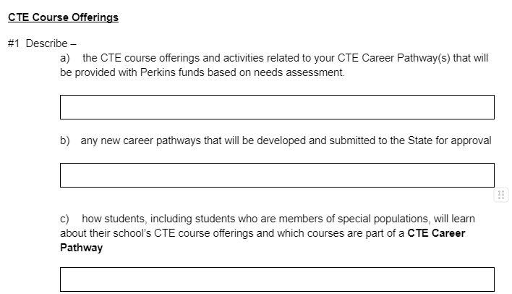
Course Offerings
Notes:
So, in the WISEgrants system, you will see narrative fields for each grouping of questions outlined in the law.
The first group of questions are related to your pathway course offerings…
First,under a) which career pathways that meet SSQ and their aligned courses will be supported with Perkins funds (over the next four years)?
Then b), any new pathways that you anticipate will meet SSQ within the next four years, and
c) how you will ensure that special population students will learn about each career pathway you offer and how to take advantage of the courses and other opportunities.
These questions, particularly the first one may require some work to compile the data your district has. The next slide outlines how to go about responding to question a.

Slide 5
Notes:
When you look at the guide, you’ll see red text under each question. This directs you to what information should be entered and where you may be able to find existing information to inform your response.
For this first question, we have created a spreadsheet, for you to use to compile the information and then upload. Many of you probably notice that the cells closely resemble the roster work plan spreadsheet your agencies use to setup course data.
This table is an example of how you’ll approach filling in the spreadsheet for every career pathway (or cluster) that meets size, scope and quality along with the aligned courses and codes.
The IAC codes represent a career pathway title. Remember, a career pathway is composed of two or more CTE courses, and at least two other quality components (either DE, IRC, WBL or CTSO).
If you look at the third column, you’ll see how the CTE courses that may be paid for with Perkins are grouped together in alignment with the pathway.
You’ll then align the quality components with the course its associated with (as you can see in the 4th-7th columns).
Jessie has been working over the last couple years with districts on collecting this information, as part of the Roster Work Plan.
The recent Roster Work Plan webcast walked through how to lay out the information for accurate data collection, so your agencies already have this laid out in their district Roster Work Plan. We know that this has been a work in progress for some agencies, so if not fully completed, you’ll be helping your agency to get this in order for the current year’s reporting.
spreadsheet workbook

Slide 6
Career Pathway Sequence of CTE Courses
Spreadsheet
Notes:
Here is a screenshot of the spreadsheet. Screenshots don’t always work well on slides, but hopefully you can basically see that the first cell to the left is for the
Cluster name, then the Career Pathway title with IAC code that aligns with the cluster, then in the 3rd column, the CTE course title with the roster code?
If there is Dual Enrollment, IRC, WBL or CTSO that aligns with the course, just indicate the name in each box.
Perkins V - CTE Career Pathways - Google Sheets
With that, I’m going to hand it over to Karin who will provide background information on ACP/E4E plans and how that plan can help inform responses to a number of the other questions.

Slide 7
Use Your Education for Employment Plan (sometimes referred to as your Academic & Career Plan)
Wisconsin's Guide to Publishing Your District's ACP/E4E Plan
LABOR MARKET INFORMATION
POSTSECONDARY EDUCATION AND WORKFORCE PREPARATION
PROFESSIONAL DEVELOPMENT FOR STAFF
FAMILY ENGAGEMENT
COMMUNITY PARTNERSHIPS
ACP CURRICULUM, SUPPORT, AND SERVICES
INDIVIDUALIZED ACP SUPPORT
ACCESS FOR ALL STUDENTS
FORMAL ACP PROCESS
ACCESS TO ACP SOFTWARE TOOL
CURRENT PROGRESS AND FUTURE GOALS FOR IMPLEMENTATION
Notes:
Karin
Other sections reference your ACP/E4E plans. Let’s take a minute to talk about those plans…
Reach out to your district ACP Coordinator for help finding the plan or answers to questions.
It is possible that some district plans may still be in the writing phase.
Your ACP coordinator should be able to point you in the direction of where to find the answers to these and other questions in the narrative or if not completed yet, could have a discussion with you as to how the district is or plans to address these things.

Slide 8
Notes:
So, we’re still on question 1
The response for (b) is pretty straightforward. It asks if you plan to add any career pathways. Simply name the pathway and if it will be locally or regionally developed.
Question (c) is asking how students, including those who are members of special population groups, will learn about the different types of CTE course offerings and career pathways.
The red, font highlights different resources for you to reference to inform your response.
Listed 1st the district ACP/E4E plan
Two sections of the plan may help your response; the
The Postsecondary Ed and Workforce preparation section or the
Access for All students section.
Or,
2nd: Your district may have other policies and procedures in place that ensure the sharing of CTE course and pathway offerings with traditionally marginalized groups of students.
When you use the references, regardless of what they are, please do not simply copy and paste what you find. Rather, Your responses should be thought out and crafted using the information that exists, and directly answers the question.
What I’m saying is: for example, if you go to the ACP Plan - Access for all Students section, but what you find, doesn’t exactly answer this question, don’t just copy and paste the information as is, if it doesn’t make sense.
You may need to go clarify the information you find.
Remember, your entire application is subject to Open Records laws, so you want your responses to align with the question and be clear and thoughtful.
------------------------------------------------------------------------------------------------------------------------------------------------------------------------------------------------------------------------------
For Consortia:
So how should consortia complete these and other questions? You will likely need to scan your member districts for the most common practices throughout the consortium. This is a good opportunity for members to learn from one another how these things are approached in other districts.
For question (b), simply indicate pathways that are on the horizon for your consortium over the next four years.
As for question (c) provide an overarching summary as to how this is being addressed as a consortium or the general trends you are seeing in your member districts ACP/E4E plans).
We have a couple ACP and CTE Coordinators here today, who will address their approach to a number of these questions later in the presentation.

Slide 9
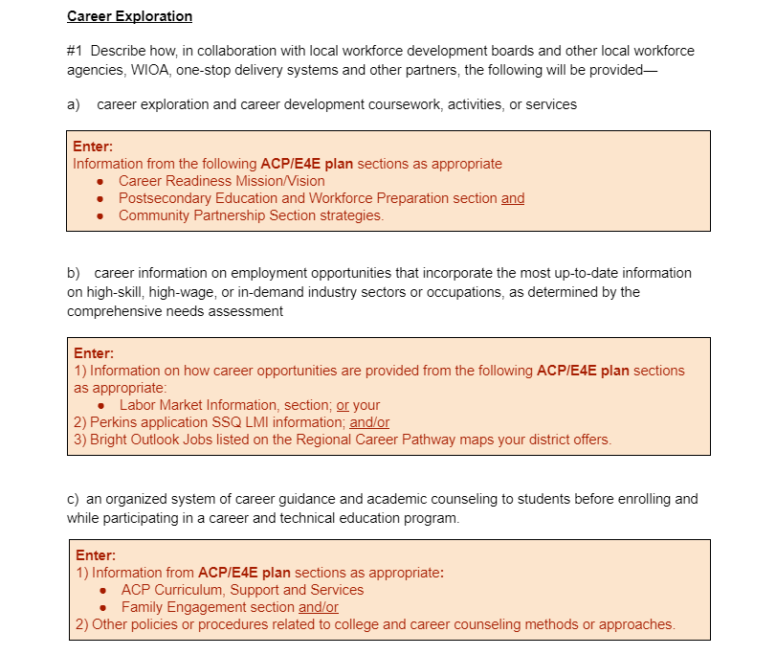
Notes:
The next set of questions deals with Career Exploration, in other words, your College and Career Readiness process…
For question (a), enter your description of how you’ll collaborate with DWD, and other partners such as Regional Economic Development Organizations or the Regional Career Pathway Collaborative in your area, to provide career exploration and career development opportunities, activities and services.
As noted, The response to this question may be gleaned from your ACP/E4E plan Career Readiness Mission/Vision Section; Postsecondary Ed and Workforce Prep section; and the Community Partnership Section strategies.
Again, don’t simply cut and paste your information. Look at the plan sections and craft your response to include the applicable information related to this question.
For question (b), the way in which you’ll provide the most up do date career information… enter information from either the LMI section of the ACP/E4E plan or from your Career pathways section of the application IF you’ve addressed HOW information will be shared there. Another option is the to explain how you'll use the Bright Outlook Jobs information on your regional career pathways maps.
Finally for question (c), Again the E4E plan or other agency policies or procedures not yet captured may be referenced for your response.
You may use one or all of these references to craft your response to the question.

Slide 10
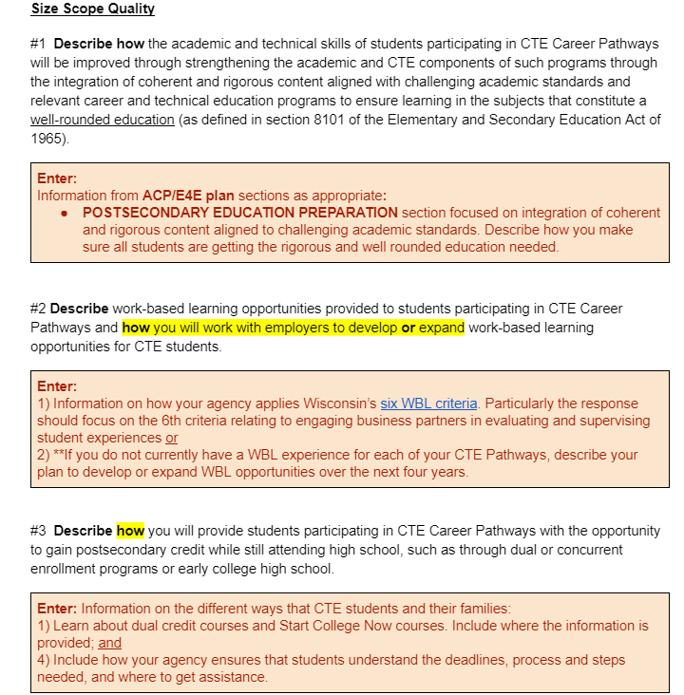
Notes:
The next set of questions focuses on SSQ.
Question #1 asks for a description of how the academic and technical skills of students participating in career pathways will be improved through strengthening the academic and CTE components of the programs through integration of coherent and rigorous content that is aligned to challenging academic standards.
As stated in red, you may be able to inform your response from the ACP/E4E plan section, “Postsecondary Education Preparation”.
for Question #2, it’s asking for a description of how you work with employers on providing WBL opportunities. Use the six WBL criteria to guide your response.
If you don’t currently offer WBL, describe how you will work with employers to create an opportunity and the kind of opportunity you plan to offer. **For example, you may decide to partner with an employer to create a school based enterprise or other on-site work in the community within the next four years.
Then Question #3 focuses on how students will be provided with the opportunity to gain DC.
Your response should include how students and their families are told about DC courses available within your pathways, and how your agency ensures that students know about and understand the steps,
deadlines and where to get assistance, so that they can plan early on in their high school career.

Slide 11
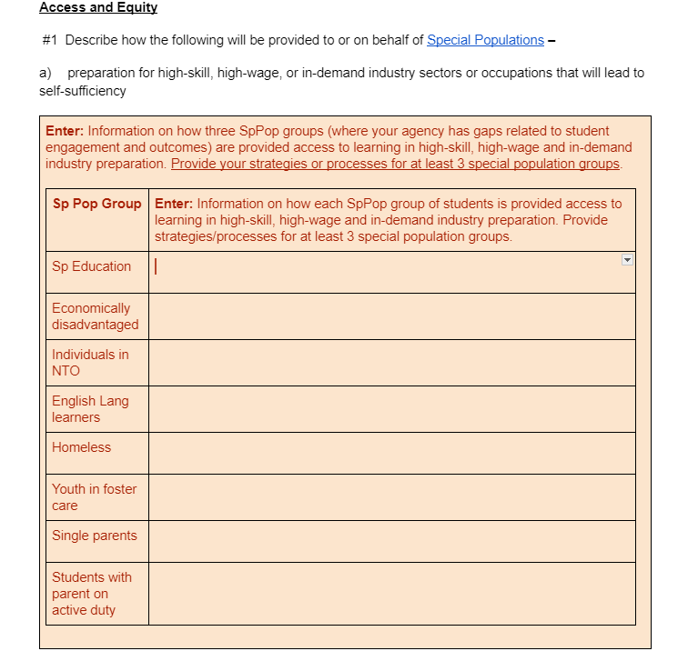
Notes:
The next section focuses on four Access and Equity Questions
The first question (question a); asks you to describe how you will prepare special population groups (those we know need additional support of some kind), for preparation for high skill, high wage or in demand industry sectors.
Rather than focus on every special population group for this question, the guidance in the red asks you to focus on three special population groups where you saw data gaps in your CLNA data analysis.
For example, you could focus on special population group where you noted a gap in the number who become concentrators or lack of participation in a certain quality component of a pathway (such as work-based learning), compared to other students.
In WISEgrants, you’ll will be able to pick your three groups from a drop down menu and then enter the information as to how you will address the needs of that special population group. This presumes you have spoken to students and representatives of the groups your targeting, and have developed an understanding of the specific roadblocks and needs of the population groups you’ve selected to focus on for your response.

Slide 12
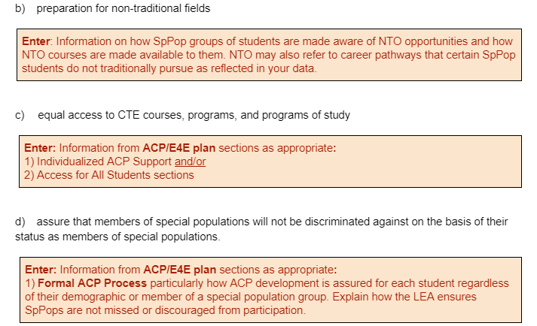
Notes:
For question b)... As you did for the previous question, enter 3 special population groups who are not participating in NTO opportunities and how you will support engagement in NTO. One way to approach this it to look at your NTO career pathways and note gaps in participants or concentrators of a group and then identify what is needed and what you will do to address the need.
For question c) How will you provide equal access to CTE courses, programs and programs of study (or career pathways). This can likely be found in the agency ACP/E4E plan under Individualized ACP Support or the Access for All Students sections of the plan.
For question d), on how you’ll assure that members of special populations will not be discriminated against based on their status as members of a special population group, you may find information in the ACP/E4E plan or your Perkins CLNA results, goals and activities.
Essentially - What this question is looking for, is how your agency (through policies, procedures or activities) assure that SpPopulation groups are not missed or discouraged from participation in career and college planning activities or certain career pathways.

Slide 13
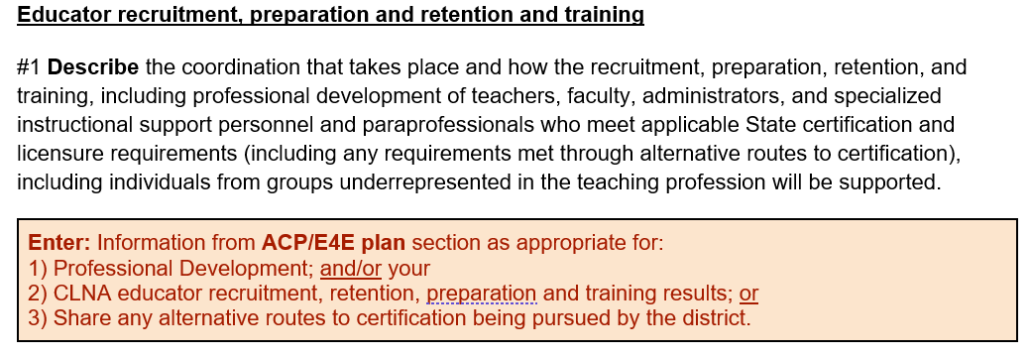
Notes:
The Educator Training and Retention question wants you to describe any coordination, pd, and recruitment efforts that will be undertaken in your agency.
The ACP/E4E plan also addresses PD. Your Perkins CLNA ERRT section may be a resource for you depending on the identified needs in this area, and how you plan to address it. One aspect may include how non CTE personnel are educated about CTE opportunities for students and how they can be involved.
You may use any of those resources to inform your response to this question.
Note: We are not looking for a list of all PD your teachers are participating in. The response should be more overarching in nature.

Slide 14
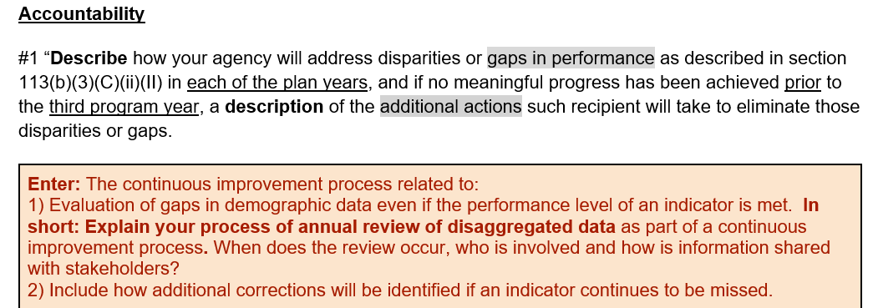
Notes:
The last question asks how you will ensure that if you missed a Perkins Indicator level of performance, how you’ll go about addressing it..
Enter what your continuous improvement process looks like related to the perkins indicators. Specifically explain your process of annual review of your disaggregated data, when that review will occur and how information is shared with stakeholders.
ALSO include the additional steps your agency will take if an indicator is missed for 2 consecutive years to make sure it is not missed a 3rd year.

Slide 15
Compiling Information for the Narrative
Guest Panel
CTEC and ACP Coordinators
Kayla Correll, CESA 1
Chris Daniels, South Milwaukee
Amanda Langhrer, CESA 4
Notes:
2:30-2:40
I’d like to introduce a few of our colleagues who have agreed to serve as panelists for a brief discussion. Each of them either serve as an ACP Coordinator or CTE Coordinator or both.
Kayla Correll, from CESA 1
Chris Daniels, from the South Milwaukee Consortium
and
Amanda Langhrer from CESA 4
They’ve offered to share with you how they plan to compile the information for the questions and particularly how the ACP/E4E plan can be useful in answering many of the Narrative questions.

Slide 16
Resources
Wisconsin’s Guide to Publishing your District’s ACP/E4E Plan
Career Pathway Sequence of CTE Courses spreadsheet
IAC Code Types
CTE Career and Education Data Appendix C: Roster Work Plan for WISEdata Portal (course data elements)
Roster Work Plan development webcast: CTE Programs and Roster Work Plan
Narrative Guide
Notes:
Here are links to the various resources mentioned today, that both set the context for various parts of the Narrative or that can help guide your responses to questions.
Attendance at the in-person WISEdata conference with your data personnel, on March 6th and 7th (at Kalahari) is open to CTECs. You should have received communication about this conference via email from DPIs customer service team. One of the topics Jessie Sloan will be speaking on is developing your agency’s Roster Work Plan

Slide 17
Important Dates
Putting the Pieces Together Webcast #2 (focused on Perkins application):
February 8th: 1-2:30
Office Hours
February 8th: 2:30-3:15
March 14 3-3:45
April 4th 2:30-3:15
April 11th: 3-3:45
Application Available in WISEgrants
March 5: Fund Management Selection and Assurances/Authorizations
April 30th: Due Date
Notes:
We have a lot of support for you in the coming months! PLEASE take advantage of the opportunities.
We will have Putting the Pieces Together Webcast #2, focusing on further connecting your CLNA results to the application on February 8th.
Office Hours will follow that presentation and continue on into March and April. Links will be provided to you in the next Perkins Updates email.
Preliminary Allocations planned to be released by March 1st.
The application fund management functionality is targeted to be available March 5th. Once the fund management has been completed, the parts of the application will be unlocked.
The Perkins Application Instructions will be posted to the application website sometime between Feb 8-15th. Updates to the functionality of the WISEgrants system and guidance for your responses for year 1 of the 2-yr application cycle will be outlined to help you craft your responses prior to entering them in the system.
Do you have any questions about any of that?
Okay, I hope you have a wonderful remainder of your day!

