Slide 1
Putting the Pieces Together Part 2
The CLNA Results and the
Perkins Application
Christine Lenske
CTE Grant Specialist
February 8, 2024
Notes:
Chris
[smile]
Hello Everyone and welcome to this webcast on Putting the Pieces Together Part 2, which will focus on how to enter your CLNA results in the various sections of the application.
[smile]
We will cover specifics of entering your information. A good percentage of applicants have incorrectly entered information in the past. So we are going to walk through this step by step, so that you can start fresh and not replicate what was done in past applications.

Slide 2
Agenda
Application timeline
WISEgrants
Application sections
Career Pathways section
Budget planning
Notes:
Today’s agenda includes a review of
The timeline of the grant, which is now posted to the Perkins grant website. And, you’ll see some adjustments to past years.
A walk through the application sections, including where and how you will enter your CLNA results,
The Career pathways section and
Finally, we will spend a chunk of time on entering budget information.

Slide 3
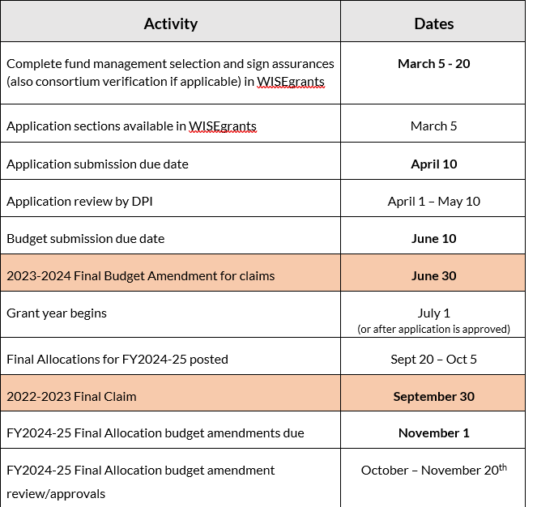
Timeline
Activity
Due Date
Complete fund management task and sign assurances. | March 5th - 15th
Application sections available as soon as fund management and assurances are completed | March 5th - 30th
Application sections due (minus the budget) | March 30th
DPI Review of application sections | March 15th - April 30th
Budget function available in WISEgrants | March 15 - April 30th
Budgets Due | May 20th
DPI Budget Review and approval | May 20th - June 10th
Notes:
First, let’s take a look at the timeline. There are some slight changes. The new timeline dates basically reflect the budget being separated out from the application.
Bold dates are application deadline dates that you need to pay attention to.
The colored in dates are deadlines related to the current grant, as you look to close it out.
So let’s talk a bit about the application and budget process for this year. It follows other grant deadlines in WISEgrants.
What’s going to happen is that the application, consisting of your CLNA results, pathway evaluation section, and the narrative section will be submitted in advance of the budget.
Why the change? The change will:
Allow your reviewer to assess your CLNA results section, to determine if the information provided, meets requirements and that all of the results and your goals, outcomes and activities align with your data, gaps and root causes. If there is something that needs correction or more information, you’ll simply be notified by your reviewer and you can make any adjustments. There will not be the back and forth of returns and resubmissions and having to jump through hoops with budget items being tied to an activity that doesn’t align with anything.
Once all of the information provided is “Accepted” by your reviewer, your budget section will be “opened” (or made accessible) for you to make your budget entries the same as you always have. What is great is that you’ll have the full confidence of knowing that your activities have already been approved.
Once your budget is completed, your reviewer will check to make sure that appropriate coding has been applied and that the purchase aligns with the stated goals and activities. If a budget line item does not align or is not approved, only the budget will be returned for corrections.
So in short, the review will be more dynamic and streamlined; less clunky when edits have to be made. It is the same process other grants use. Fewer chances for glitches with numerous returns of the entire application.
So let’s walk through the timeline:
The Fund Management Selection and Assurances need to be completed by your Agency Authorizer prior to gaining access to the Perkins application.
Anyone who had access to the application last year, that automatically carries over. If someone new needs access, the district’s System Security Administrator will need to provide access.
Once the Fund Management has been completed you will have access to the application.
The application can be submitted any time prior to April 10th. Some reviewers have time blocked off for reviews as early as March 15th to begin the review process. Reviews are completed on a first submitted, first reviewed basis.
If there are clarifications or edits that your reviewer needs, they’ll reach out through a message.
The ultimate goal is that all applications are approved by the start of the State Fiscal Year, which is July 1st. Naturally if applications are late or there are a lot of corrections, that will delay your final approval.

Slide 4
Application Sections
Stakeholders Engaged
CLNA results for Focus Areas
Career Pathways Evaluation of Progress
Narrative
Budget
Notes:
The FY2024-25 application has five sections for you to complete in the WISEgrants portal.
The first three sections of the application highlighted in yellow are completed the first year of every 2-year CLNA application cycle. They include information on the stakeholders that were engaged in the CLNA, the CLNA results for the focus areas and the Career Pathways evaluation of progress. We are in the first year of the cycle.
The Narrative is completed according to the state plan cycle which is just every 4 years, (which is also this year and is good for 4yrs), and the
The Budget which is entered annually

Slide 5
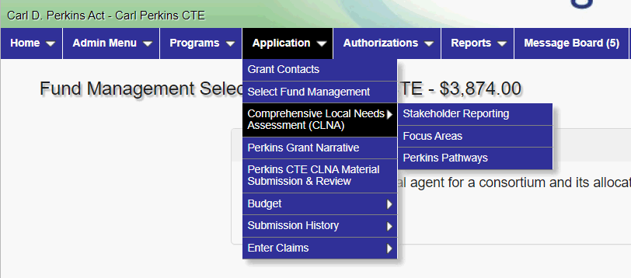
Notes:
This is a screenshot of the portal. You will access everything that needs to be completed, from the top menu bar.
As mentioned the pre-application task of fund management selection, is there in the menu.
In the drop down you can see that the CLNA results is selected. This includes:
Your stakeholder engagement information,
The CLNA results for each focus areas and
pathways,
In the main menu you can see the Grant Narrative just below it and the Budget.

Slide 6
WISEgrants Technical Assistance
https://dpi.wi.gov/wisegrants/technical-assistance
Notes:
The WISEgrants portal and technical assistance link can be found on the WISEgrants webpage.
https://dpi.wi.gov/wisegrants/technical-assistance

Slide 7
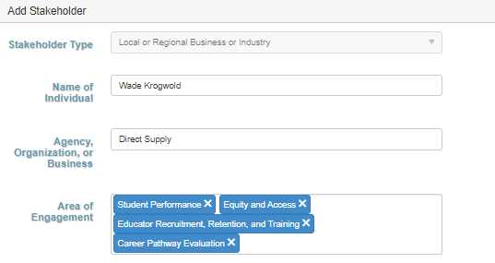
Application Sections
Stakeholder Engagement
Notes:
Let’s look at the stakeholder section:
For each required stakeholder, you will provide information on who your stakeholders were, and which focus areas of the CLNA the individuals participated in. We do not need you to list everyone (for some of you that would be in the 100s), but we would like to see good representation.
All required stakeholders must be represented.
Please Note that you cannot have one person represent 3 different stakeholder groups. For example, a special education teacher cannot also represent a teacher, a parent, and representative of a special population group. That would defeat the spirit and purpose of broad stakeholder engagement as required. So hopefully no-one did that.

Slide 8
Application Sections: CLNA Focus Areas
Year 1 of CLNA Application Cycle
Application Fields
Student Performance on Accountability Indicators
Equity and Access
Educator Recruitment, Retention and Training
PROCESS:
Data Reviewed > Findings > Goals/Measurable Outcomes > Activities > Budget
CLNA
Budget planning
$$$
Data analysis
drives
Identification of gaps/root cause/needs
drives
Goals/Outcome Measures/ Activities
drives
Notes:
So let’s start with the CLNA Results Section.
The three focus areas specifically under this section of the application are:
Student Performance on Accountability Indicators
Equity and Access
Educator Recruitment, Retention and Training
The results of each focus area CLNA must include:
the data you evaluated, not the actual data, but rather, a description of the disaggregated data sets you evaluated and where you obtained the data from.
your findings, which includes your identified gaps in data, the root cause of those gaps and needs for addressing the root cause and mitigating the gaps.
then your goals and measurable outcomes related to closing the data gap and
Your activity that will be implemented to close the gap and achieve the goal.
Under the heading Process - is a reminder of the CLNA process that you just completed and ow it aligns with what your application asks of you.

Slide 9
Application Sections
Notes:
Here is a screenshot of what the you’ll see when you open up the CLNA focus areas.
You’ll be able to click on the focus area that you want to enter information for.
When you click on it, the fields I just went over will open up for you.

Slide 10
Application Sections: CLNA Focus Areas
Student Performance on Accountability Indicators
Data: Indicate the data-sets used for analysis.
Example: WISEdata information for students who are concentrators vs. who participants. Who goes on to become a concentrator and who does not; demographic breakdown of ACT proficiency results; demographic breakdown of WBL participation; etc.
What demographics did you break out and where do you see gaps.
Findings: Explain the data gaps (between groups of students) and the root cause of those data gaps and the needs based on stakeholder input.
Goals with measurable outcomes: Tied to correcting gaps by addressing the root cause(s)
Activities: Strategies, programs or activities that will accomplish the goal and ultimately close the data gap. Typically curriculum development or alignment activities.
Notes:
Let’s talk about each field in detail.
What you enter into each of the fields, should be comprehensive in nature, reflecting clear connections between the data, the findings, goals and outcomes, and activities. We’ve seen some pretty disconnected information over the last few years. Sometimes what’s been entered haven't been complete sentences; making it difficult to see connections. You don’t want your reviewer to have to read between the lines.
Keep in mind that what you submitted is subject to open records requests, so be mindful that many people may have access to the application other than your reviewer.
Okay, so let’s spend just a few minutes on what should be entered in the fields for each focus area.The blue text represents a blank text field in the application.
For the Student Performance on Accountability Indicators section…
Data field, you’ll enter the data-sets you reviewed for the Student Performance on Accountability Indicators. For example (read)
The Findings field should include a summary of gaps in data you found; the reason or root cause of those data gaps and what is needed to close the gaps.
Then the goals field should include your goals, and the measurable outcomes, which is a number or percent that will tell you the gap has been reduced.
Your Activities are those things that will be implemented to accomplish the goal (and mitigate the data gap(s)0. You will have a drop down menu of Perkins activities outlined in the law, but you can narrow them down to be more specific or stated as a program or strategy.
Keep in mind that your budget items are the purchases you’ll need to implement the activity you select and will ultimately reduce the gap and achieve the goal/outcome desired.
So as an example let’s say a gap you saw was that CTE students on average score lower in math on the ACT, compared to your general population. In this case, your goal might be to increase math scores on the ACT by two points. Perhaps the activity that you identified to do that is, incorporating math rigor into CTE courses. The budget item that could be tied to that is a stipend for the math and CTE teachers to build stronger curriculum over the summer months. Another district may find that their gap is related to low WBL participation by students of color compared to other populations. The district would enter the findings, goals, outcomes and activities related to that gap.
Two common errors we find in this section:
First - There are data references, goals and activities that do not related to the indicators. For example, references to CTSO participation, dual credit, IRCs or equipment purchases not directly impact indicator levels.Those are more likely tied to growing the quality of a specific career pathway.
Second - An agency will say they didn’t miss any indicator levels. That is not the question here. You were to look at your indicator data to see if there are gaps for any of your populations and to address those gaps.

Slide 11
Application Sections: CLNA Focus Areas
Accountability Indicators
Four-year graduation rate
Extended-year graduation rate
Academic proficiency in reading/language arts (Jr. year ACT)
Academic proficiency in mathematics (Jr. year ACT)
Academic proficiency in science (Jr. year ACT)
Post-program placement (postsecondary education, training, military, volunteer, employment.)
Non-traditional program concentration
Program quality – Participation in work-based learning (4yr look back)
Notes:
Here is a reminder of the Perkins indicators.
Most of your needs for this focus area will likely be around rigorous curriculum development, making sure students are enrolled in the correct classes, PD around multi-level systems of support, so that all students can achieve, developing your WBL opportunities (which could also be highlighted in your pathways section).

Slide 12
Application Sections: CLNA Focus Areas
Equity and Access
Data: Example: CTE engagement (participators vs. completers)
Disaggregated by special populations, gender, race, ethnicity. Proportionate or disproportionate?
Could include specific career pathway data-sets
Findings: Data gaps, the root cause of those gaps and needs.
Goals: Relate to gaps in participation or completion of demographic
Activity: Relate to a strategy, activity, and program that will close gaps.
Budget: Purchases for overarching activities to close gaps found participation and success rates of specific student groups.
Notes:
The Equity and Access focus area asked you to take a deep dive into your CTE disaggregated data to identify specific student groups who are not accessing or succeeding in CTE.
So your data may have focused on the demographic breakdown of CTE engagement (participators vs. completers) and broken down by each SpPop and race group.
In the data field you’ll share the various datasets you looked at, for example:
Disaggregated concentrator data from WISEdata, disaggregated pathway concentrator data broken down by Special Pop groups. Explain the data sets you compared to each other.
One thing I want to mention here, is that you should NOT simply copy and paste your data sets from one focus area into all of the others. Focus areas are different and your data should relate accordingly.
Your Findings for equity and access will be an explanation of the disproportionality (or gaps) you found in your data. Your findings must also include the root cause of that disproportionality based on feedback from stakeholders and what the root cause points to as a need in order to close the gaps.
Your Goal and Outcome measures are what you want to see 1-2 years from now; what do you want your data to reflect, instead of what it is currently reflecting?
Activities are those things related to closing the gaps and achieving your goals, which might include:
PD for CTE teachers (or perhaps all school personnel) in Multi System Level of Support
Or, maybe you’ll have a “CTE day” for all personnel to learn about CTE, tour the high school facilities, and have discussions on ways everyone has a role in linking ALL students to career pathway opportunities.
In another example, you may have determined that there is a gap related to NTO enrollment and that the root cause is a lack of intentionality on the part of teachers and counselors to bring NTO pathways to student’s attention in a deliberate way. Given this, the goal may be to increase NTO participation of females by 20%.
With a corresponding activity being training for teachers and counselors in Micro-Messages, and positive NTO outreach
OR Updating pathway communication materials to reflect female participation
Whatever you enter must be dependent on the data you reviewed and what your root cause findings are.

Slide 13
Application Sections: CLNA Focus Areas
Educator Recruitment, Retention, and Training
Data: Turnover, retention rates, demographics of teachers; available training opportunities provided; turnover rate (who);
Findings: Explain the gaps between what is and what should be and the root cause of those gaps? Example: How well do demographics of personnel align with student demographics?
Goals and measurable outcomes: The goals and aligned outcomes that will reflect progress in mitigating data gaps.
Activities: Relate to activities that will impact gaps and meet goals.
Budget: Purchases for overarching activities aimed at teachers in order to close gaps.
Notes:
The Educator Recruitment, Retention, and Training focus area is school personnel focused. It’s about making sure you have teachers who are:
appropriately licensed and trained to teach a CTE subject,
are demographically representative of the student body,
understand pedagogy and educational standards, and
receive the support they need to be successful in the classroom.
Common data sets may include demographics between your student population and personnel; or retention rates of CTE teachers, or PD available vs. PD that is desired, etc.
Your findings; are the gaps observed in your data. Such as disproportionate turnover; or disproportionate student to teacher ratio, disproportion in who gets PD. As with the other focus areas, you’ll include the root cause of those data gaps and what is needed to mitigate the gaps.
You’ll enter the district’s goals and outcome measures for the change in data you seek
Activities for this focus area will likely be targeted to PD that will address gaps and may include things like training in teaching methodologies or sharing of current technology or industry information. If recruitment is a gap, perhaps there will be activities that reflect a new approach.
It’s possible that you could see some overlap here for Equity and Access or the Career Pathways focus area.
Decide on the focus area bucket that is most appropriate to share your findings and planned activities there.
This wraps up the CLNA focus area section. Any questions before we move on to the Career Pathways section?

Slide 14
Application Sections: Career Pathways
Evaluation of Progress
Notes:
The Career Pathway Evaluation Section of the application addresses your size, scope, and quality for each pathway as well as the CLNA results for each pathway.
First, you’ll choose your pathway from a drop down menu consisting of clusters or RCPs. The last item on the menu is “other” where you will be able to enter a specific career pathway that may not be listed.

Slide 15
Application Sections: Career Pathways
Evaluation of Progress
Career Pathways Evaluation
Labor Market Information (LMI)
Sufficient Size, Scope, and Quality (SSQ)
Meets 3 out of the 5 quality components (AppendixA)
CLNA Results
Data
Findings
Goals/Measures
Activities
Notes:
Once the pathway is entered, the first thing you need to address in this section, information about your pathway that includes the extent to which the pathway meets Labor Market Needs, and SSQ requirements.
Only pathways that meet SSQ will be approved for funding, so do not enter information for any pathway you have that does not meet SSQ.
And then, the CLNA portion is the same as the other focus areas. You’ll enter information on the data sets you evaluated, your findings, goals with outcome measures, and your activities.
Data sets likely include things like disaggregated student enrollment in the quality components of the pathway, surveys of business and industry related to industry standards, the number of quality components offered vs. what is desired.
Typically activities for this focus area are dependent on the gaps, root causes and needs. This may include updating equipment to align with industry standards, curriculum development, or PD for teachers.

Slide 16
Which focus area is it?
Notes:
In the Webcast Putting the Pieces Together Part 1, which focused on your strategic planning we talked about potential overlap of the focus areas.
When entering the information into your application, choose the focus area that makes the most sense based on your findings and the activities you’ve identified. There is a lot of flexibility for this.
A good rule of thumb, is that if something is specific to a pathway, it should probably be coded there.
Gaps that are more general in nature may be better tied to equity and access and educator recruitment retention and training.

Slide 17
Focus Area Budget Connection
“Select That Focus Area” challenge
Transportation to and from WBL site for economically disadvantaged students.
Training for teachers to offer dual credit
Equipment purchase (to upgrade lab to industry standards)
Training for district personnel in equitable multi-level system of supports
Teacher stipend to develop curriculum rigor (over the summer)
Notes:
Okay, now you try…
Which focus area do each of these purchases likely align to? Type into the chat which focus areas you think are the best fit (either student performance on indicators; equity and access, ERRT or career pathways... So take a look at #1, which focus area bucket does that belong to?
Number 1: Equity and Access (or career pathway if you see a need for this in a particular pathway)
Number 2? This is probably specific to career pathway but could also be ERRT depending on the root cause.
Number 3? Equipment will always be a specific career pathway expense as long as it’s needed to fill a gap in expanding opportunities or aligning with updated industry standards. The same for any purchase of supplies, textbooks, and other materials.
Number 4? Equity and Access or could also be ERRT. Is the data gap more related to an equity gap or a training gap? What did root cause reveal?
Number 5? Could relate to a career pathway need or Student Performance on Accountability Indicators. Again, it will depend on the root cause of your data gap.

Slide 18
Narrative Section Webcast
https://dpi.wi.gov/cte/perkins-technical-assistance/perkins-webinars
Notes:
We will not cover the Narrative Section of the Application today since that has its own webcast.
https://dpi.wi.gov/cte/perkins-technical-assistance/perkins-webinars

Slide 19
Application Sections: Budget
Resources
Perkins Finance Webpage https://dpi.wi.gov/cte/carl-perkins/finance
Uniform Grant Checklist
Perkins Budgeting with Crosswalk
Perkins Finance Webpage: Supplanting, equipment, consortia, etc.
WUFAR (Wisconsin Uniform Financial Accounting Requirements)
Notes:
Now we’ll dig into your budget planning and important things to keep in mind as you prepare for the aligned coding of budget items in the system.
There are many resources to help you with budget planning. Don’t ignore them and just make guesses.
The Uniform Grant Checklist, is a good starting point on federal allowability of purchases. Your business office if very familiar with this and what the stipulations mean.
Perkins Budgeting rules with Purchase Crosswalk, is great because it gives you guidance as to purchases that are allowed with the grant and what the parameters are.
The crosswalk demonstrates how certain focus areas, activities and budget purchases tie together.
supplanting, equipment purchases and information specific to consortia on the Perkins Finance Webpage.
On the School Financial Services Webpage, you’ll find the WUFAR guide that explains the correct coding for items you want to purchase.
WUFAR codes apply to any purchases made with funds from DPI. We have most of the appropriate codes already coded into the system, but you can use the guide as a resource.
Again, your business office can help you as they have already worked within the same rules for other grants.

Slide 20
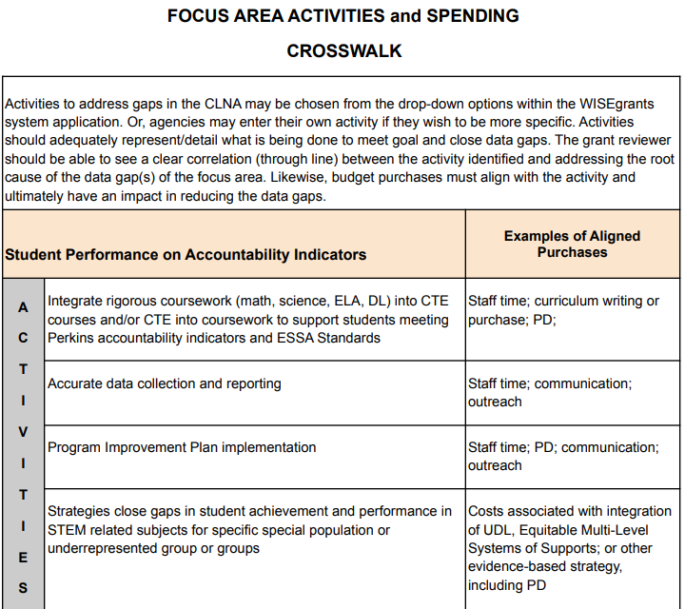
Budget Crosswalk - Student Performance on Accountability Indicators
Notes:
Here is a clip from the budget planning with crosswalk guidance document I referenced. You can see that this is for the Student Performance on Accountability Indicators. It lists possible activities and the allowed purchases that align with the activities. There is a page dedicated to each focus area within the guide to help you make sure you’re on the right track.

Slide 21
Budget
#1: That the WUFAR coding is correct for the purchase.
#2: That the purchase clearly aligns with the results of your CLNA focus areas.
#3: That the purchase is allowable according to Uniform Grant Guidance and the Education Department General Administrative Regulations (EDGAR)
Notes:
Related to the budget, there are three things that reviewers check for (read)
Incorrect budget coding or lack of alignment to the CLNA results, are the top two reasons that budgets are returned for corrections.
It's always good to check your budgeting decisions with your business office personnel who is familiar with EDGAR and UGG rules as well as WUFAR.

Slide 22
Application Sections: Budget
Budget Sections
Personnel
Purchase services
Non-capital objects
Capital objects
Other objects
Notes:
There are five main budget areas that everything you purchase fits into:
Personnel
Purchase services
Non-capital objects
Capital objects
and
Other objects
We’ll look briefly at each of these, but before we get there…

Slide 23
Application Sections: Budget
Type Code:
Administrative line items (direct or indirect)
Applies to management of grant funds and reports
Limited to 5% of grant
CTE program line items
CTE program oversight, communication, training, instruction-related purchases
Notes:
Every single item you purchase will be type-coded.
The type code indicates if the purchase is as an administrative expense or a CTE program expense.
Administrative costs are limited to 5% of your grant subaward. Administrative costs are those costs necessary for the proper and efficient implementation of requirements.
Admin costs do not need to align to CLNA results because administration refers to management expenses.
Admin costs are direct or indirect related costs.
Examples of direct administrative expenses include: time dedicated to completing the grant application, data submission and reports.
Examples of indirect, are costs that are overarching and proportionate operational costs such accounting, or supplies or internal technology support (as examples).
CTE program expenses apply to everything else in your budget and are connected to the CLNA including program development, instruction, professional development and so forth, all which need to be aligned to your CLNA results.

Slide 24
Application Sections: Budget
Personnel
Salary and Fringe:
Admin or CTE program type
Part-time/full-time salary or stipend
Include: Title of person(s), purpose, duties, dollar amount, and percentage of time (FTE) allocated.
Stipends may be paid to CTE-licensed teachers for approved career pathways activities beyond contracted time.
Notes:
Personnel costs are a portion of positions funded with the grant. The amount allocated to a position needs to be proportionate to the work tied to the grant.
As the third bullet notes, funds may only be used for CTE-licensed teachers for extended contracts or stipends for a project. There are limited situations in which non-CTE teachers may be permitted, such as for joint professional development or curriculum development opportunities connected to CTE.
A question has come up as to whether or not CTE Coordinator pay is allowable through the grant. When we see coordinators covered by the grant, usually a certain percentage is admin and a percentage is CTE program related.
Depending on the Personnel purchases it may or may not be tied to a need in the CLNA results. For example, costs related to managing and planning are not required to be tied to the CLNA, but stipends for curriculum development would.

Slide 25
Application Sections: Budget
Purchased Services
Travel: Field trips (tied to curriculum for pathway that meets SSQ)
Travel for professional development that is sustained, intensive, collaborative, job-embedded, data-driven, tied to curriculum
Registration for conferences (registration is not travel)
Contracted consultants or trainers to advance initiatives, or professional development to improve teaching strategies, and course integration.
Software licenses (if includes service)
Notes:
Purchased Services are those things that are service related. These can include:
Travel for field trips, or travel for PD,
conference registration or
Contracted services or software licenses that include a service component.
One thing to note related to contracts, is that an agency cannot contract with themselves to provide a service. For example, if you want to use a room at your district for stakeholder meetings after school, you would not be able to contract with your school district to rent the room.
Any budget item under Purchase Services MUST be tied to a CLNA activity that is needed to mitigate a particular data gap.

Slide 26
Application Sections: Budget
Non-Capital Objects
Supplies: Instructional materials, textbooks
Lifespan of a year
Include the unit cost and number to be purchased (sufficiently detailed)
Equipment or appliances: Items that are permanent or enduring with lifespan of more than one year
Instructional software (that is not a service)
Notes:
Non-Capital Ojects are those things that are under capital threshold cost of $5,000.
Examples of non-capital objects include things like instructional materials, textbooks or small appliances with costs under $5K that your CLNA reflects are needed to close a data gap and move your career pathways forward to be in alignment with industry standards.
Typically they are items that have a life expectancy of less than one year. These items do not need to be recorded as a fixed asset or tracked in inventory.

Slide 27
Application Sections: Budget
Capital Objects
Equipment:
Has an acquisition cost of $5,000 or more per unit
Useful life of more than one year.
https://dpi.wi.gov/sites/default/files/imce/cte/CPA/2020_02_21_Equipment_Purchases_Perkins.pdf
Notes:
Capital Equipment has an acquisition cost of $5,000 and a useful life of more than a year. (per item)
Equipment, must follow equipment management requirements.
The link will take you directly to our equipment purchase document located on the Perkins finance website.
And of course, any capital purchases must once again be tied to a CLNA focus area or career pathway activity that is needed to mitigate a data gap.

Slide 28
Application Sections: Budget
Other Objects
Membership to professional organizations
Entrance fees for tours
Notes:
Other objects
Just a few things would be coded here such as
membership to a professional organization or
entrance fees for a particular field trip tour
These purchases must also align with your CLNA results

Slide 29
Purchase of instructional equipment
Capital Equipment | CTE Instruction | Lab Equipment | 1 | Vocational Curriculum | Haas Wireless Intuitive Probing System for Haas CNC Mini Mill | Pathway Evaluation of Progress | Manufacturing | Update outdated equipment to match Industry & dual credit standards. | $5,000.00
Purchase of transportation
Pupil Transportation | Instructional Field Trip | Pupil Transportation | Field Trips - Contracted | Visit to clinic and to FVTC to observe industry settings and postsecondary learning. | Pathway Evaluation of Progress | SERCP-Nursing | Ensure hands on pathway exploration. | $300.00
Notes:
These are budget line items from the perspective of what your reviewer sees.
When you enter an item, you will identify via drop down menus, what your purchasing.
For example, if you look at the top one. The item was coded for a capital object / it’s equipment / it’s for CTE instruction/ one item is being purchased / it’s for vocational curriculum / Theres a description of the item being purchased (it is for the career pathway focus area of Manufacturing) / The Activity is to purchase equipment that matches industry and dual credit standards and will cost $5,000.
In the second example, it’s a purchased service of transportation for a field trip, it’s contracted (likely a bus service), the description includes where the transportation is going (visits to Fox Valley Tech) for nursing instruction, the pathway is indicated, and it will cost a total of $300.

Slide 30
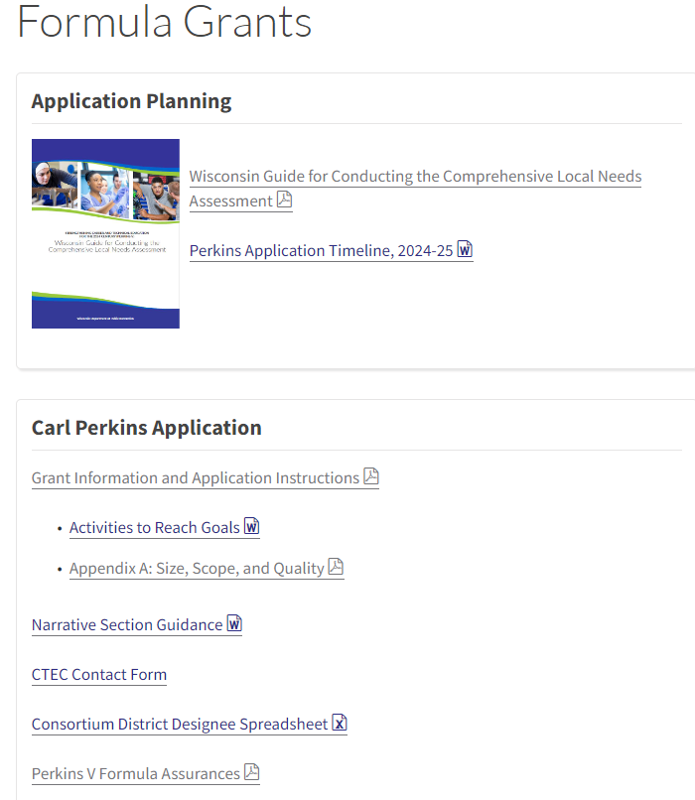
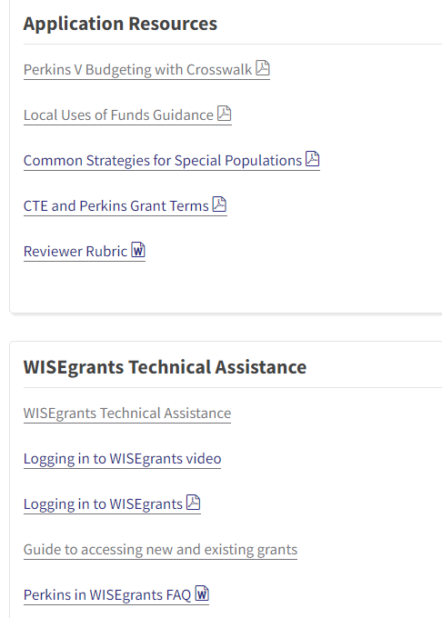
https://d
Notes:
There are other resources on the Perkins application website to help you https://dpi.wi.gov/cte/carl-perkins/grants/formula-grants
On the website you’ll find links to resources and documents needed for completion of your application.
The updated instructions and timeline have been posted.
The activities document has many of the activities you’ll see listed as options in various focus areas.
Appendix A to the instructions is information on what you are required to enter for the SSQ evidence of each career pathway you enter into the application.
You should already be familiar with the Narrative Section Guidance that was shared with you in the last webcast. If you haven’t formulating your responses, you’ll want to start on that now.
The CTE Contact form will be updated by next week for CTE Coordinators contact information. It’s updated every year as well as consortium member district designees for which there is a spreadsheet there that you complete and upload.
As Coordinators you should all be aware of the Perkins Assurances that are signed by your district administrator in WISEgrants and are part of the Fund Management task.
Other resources for you include:
The budgeting crosswalk we spoke of
Required and Permissible uses of funds - both with the caveat that your data and root cause reflects a need for the activity.
Common Strategies for supporting Special Populations
And then links to a wide array of WISEgrants Technical Assistance.

Slide 31
FY2024-2025 Grant Application
Sneak Peak
New WISEgrants Functionality
Consortium Fund Management Monitoring
Application drop-down menu
Acceptance and approval process
Narrative section Q1 upload function
Budget submission
Notes:
WISEgrants will have some New Functions that we’ll walk through in a demonstration. Information on that will come out in an update early next week.
The updates include
the ability of consortium fiscal agents to enter member agency names. This will allow the CTEC to monitor the fund management selection and signed assurances.
The new drop down menu for the different parts of the application along with the ability to save and come back to sections at a later time.
The ability of reviewers to “Accept” different parts of the application prior to you accessing your budget.
The ability to upload the required spreadsheet in the Narrative section.
The budget submission process

Slide 32
?? Questions ??
Notes:
FAQ
Q: When there is overlap between focus areas is there a wrong way that could be documented? For example, demographic a student performance indicator would that be for equity and access or student performance.
A: There can be overlap, but in most cases, you’ll want to choose one bucket to put your information in (or code your budget to). This may be best determined by what the root cause is or how you want to organize your information. Generally, anything having to do with a Career Pathways is it’s own bucket, so most career pathway needs should be reflected there. Also, gaps in DC, IRCs or CTSOs would be coded to the career pathway and not student performance, because those quality components are not tied to any indicators.
Q: When can we expect preliminary allocations
A: The last week in February
Q: Regarding an agency not being able to contract with themselves, what if the CESA who is a fiscal agent is also offering a training or a conference that a member LEA wants to purchase from the CESA.
A: We need clarification from School Financial Services. For the time being, the description should clearly state that the purchase is in addition to what would normally be expected of a CTEC and FA. Meaning, there can be no charge to member agencies for belonging to the consortium and any fees for services, must be something provided to a larger group of LEAs.
Q: What if a consortium has some member districts from different regions which may or may not have a regional career pathway? Would you do both the RCP and the local cluster?
A: You could put them all in the local. Or, if they all have the same RCP, just in different regions, that is okay, you can select that one RCP for all the LEAs that have it.
Q: Do consortia and single districts have the same application?
A: Yes, however career pathway SSQ information does not need to be entered for a consortium. The information required for SSQ (in Appendix A), must be kept by the FA, in the event of “Monitoring”, as the FA will be asked to supply the required evidence that member districts meet SSQ for the career pathway entered.
Q: What is the reason for having to provide course code information and alignment in the career pathways course spreadsheet (workbook)? https://docs.google.com/spreadsheets/d/1Xl42g0xS0bP9qwLz8lXfC3U7Hg1FWf0JJbsgp6yZNSU/edit#gid=996239751
A: Perkins law requires that the CTE course offerings and activities related to your CTE Career Pathway(s), that will be provided with Perkins funds be listed. Information previously provided by applicants for this question was not accurate or comprehensive. Providing code information on the courses, including which ones align to each pathway is the best way to capture the information.

