Slide 1







Career and Technical Education State Standards
Notes:
Welcome
Introductions
Purpose of Presentation

Slide 2
Family and Consumer Sciences/Health Science
CTE Standards Development Workshop Agenda https://dpi.wi.gov/cte/standards/standards
Attendees should complete the Pre-Workshop Information Sheet
Return to registration to receive standards book

Slide 3
Family and Consumer Sciences/Health Science
CTE Standards Development Workshop Agenda https://dpi.wi.gov/cte/standards/standards
8:30 Continental Breakfast and Registration
9:00 Welcome and Introductions
9:20 Review Wisconsin State Standards (Sections 1 & 2)
10:00 Break
10:15 Wisconsin Common Career Technical Standards (Section 3)
11:00 Connecting Career and Technical Education to the Common Core State Standards (Section 5)
12:00 Lunch-Professional Organizations and CTSO’s
12:45 Group Activity: Examining Content Area Standards (Section 4)
2:30 What’s Next: Resources & Advocacy
2:40 Curriculum Update/Feedback Survey
3:15 Departure

Slide 4
Timeline
New accountability system begins & AYP ends (ESEA waiver)
New proficiency benchmarks for WKCE reading & mathematics established
Title I Priority & Focus schools identified
Educator Effectiveness system design continues; Act 166 passed
SMARTER Balanced
assessment field testing
Educator Effectiveness statewide system pilot
Roll out of Revised CTE State Standards
ASSETS for ELL assessment in use
All districts on SSIS
2011-12 | 2012-13 | 2013-14 | 2014-15 | 2015-16 | 2016-17
New school report cards first issued
(2011-12 accountability reports)
New system of support for Title I
Priority & Focus schools begins
New kindergarten literacy screener
administered statewide
DPI provides curricular resources
for Common Core State Standards implementation
First districts using State Student Information System (SSIS)
First districts begin developmental
pilot of Educator Effectiveness system
Higher graduation requirements (targeted –needs legislation)
Common Core State Standards fully incorporated into school/district curricula
Smarter Balanced & Dynamic Learning Maps replace WKCE & WAA-SwD in mathematics and English/Language Arts, including reading and writing
Educator Effectiveness system implemented statewide

Slide 5
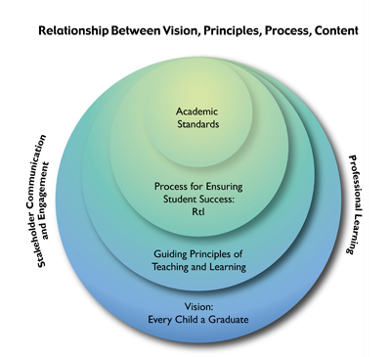
Wisconsin’s Vision
for ALL Learners
“Every child must graduate
ready for future education
and the workforce. We must
align our efforts so all our
students are prepared to
succeed in college or a
career.”
- State Superintendent Tony Evers
Notes:
The vision of these nested circles illustrates how the various education initiatives in Wisconsin fit together to ensure every child a graduate, college and career ready.

Slide 6
Agenda 2017
Standards & Instruction
  What and how should kids learn?
Assessments and Data Systems
  How do we know if they learned it?
School and Educator Effectiveness
  How do we ensure that students have highly effective teachers and schools?

Slide 7
Guiding Principles of
Teaching and Learning
Every student has the right to learn.
Instruction must be rigorous and relevant
Purposeful assessment drives instruction and affects learning.
Responsive environments engage learners.
Learning is a collaborative responsibility.
Notes:
Making a connection to CTE
1. CTE, along with all of education has the collective responsibility as a community to make certain each child receives a high-quality, challenging education.
2. What students learn is fundamentally connected to how they learn, and successful instruction blends the content of a discipline with processes of an engaging learning environment that changes to meet the dynamic needs of all students.
3. Purposeful assessment practices help teachers and students understand where they have been, where they are, and where they might go next. No one assessment can provide sufficient information to plan teaching and learning. Using different types of assessments as part of instruction results in useful information about student understanding and progress.
4. Teaching and learning are both collaborative processes. Collaboration benefits teaching and learning when it occurs on several levels: when students, teachers, family members, and the community collectively prioritize education and engage in activities that support local schools, educators, and students.
5. Although no two students come to school with the same culture, learning strengths, background knowledge, or experiences, and no two students learn in exactly the same way, every student’s unique personal history enriches classrooms, schools, and the community. This diversity is our greatest education asset.
6. Meaningful learning happens in environments where creativity, awareness, inquiry, and critical thinking are part of instruction.
In section V, we’ll unpack and repack the standards.

Slide 8
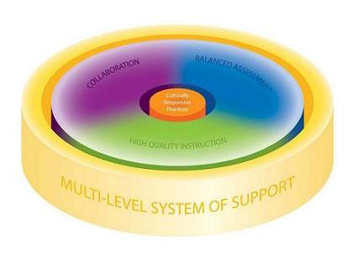
Response to Intervention
Notes:
The Wisconsin Response to Intervention (RtI) framework helps to organize the components of a system designed to support student learning. The three essential elements of high quality instruction, balanced assessment, and collaboration interact within a multi-level system of support to ensure each student receives what he or she needs to access higher levels of academic and behavioral success. At the school or district level, programs, initiatives and practices related to high quality instruction, balanced assessment, and collaboration can be more powerful when organized or braided to function systemically to support all students. The focus must be on a comprehensive approach to student learning.
Connecting to Content: The Common Core State Standards
Within this vision for increased student success, rigorous, internationally benchmarked academic standards provide the content for high quality curriculum and instruction, and for a balanced assessment system aligned to those standards.
The CCSS articulate what we teach so that educators can focus on how instruction can best meet the needs of each student.
When implemented within a multi-level system of support, the CCSS can help to ensure that every child will graduate prepared for college, work and a meaningful life.
CTE ought to be a the heart of these types of discussions. It’s not as if we are separate to a K-12 comprehensive education.
To ensure that every child in Wisconsin graduates prepared for college and career, schools need to provide high quality instruction, balanced assessment and collaboration reflective of culturally responsive practices. The Wisconsin Response to Intervention (RtI) framework helps to organize the components of a system designed to support student learning. Below, the three essential elements of high quality instruction, balanced assessment and collaboration interact within a multi-level system of support to ensure each student receives what he or she needs to access higher levels of academic and behavioral success.
The center point of the image, culturally responsive practices, needs to be a focus for our work in implementing standards.

Slide 9
Wisconsin CTE Standards
Notes:
On June 2, 2010, Superintendent Evers formally adopted the Common Core State Standards for Mathematics and English Language Arts, including the Literacy in History/Social Studies, Science, and the Technical Subjects for Wisconsin. Wisconsin led the nation as it extended the adoption of the literacy standards to all content areas – music, art, math – and to all grade levels. Adoption of the standards, however, is the easy task. Implementing them through engaging instruction coupled with rigorous learning activities and assessment is the hard work. The Common Core State Standards was a collaborative initiative of the National Governor’s Association and the Council of Chief State School Officers intended to raise student achievement.
(Any of the Wisconsin Standards can be inserted into this section. Personalize as needed.)

Slide 10
Wisconsin’s Approach to Academic Standards
Provides a vision for student success and guiding principles for teaching and learning.
Improves Career and Technical Education for students and for communities.
Assists Wisconsin educators and stakeholders in understanding and implementing the CTE content standards.
Notes:
Reference section or pages in standards booklet.
CTE standards are part of the Wisconsin’s academic standards and meet the same objectives as all other standards that come out of the Wisconsin Department of Public Instruction.

Slide 11
The Shift
Model Academic Standards to Wisconsin Standards for CTE
 | Old 1998 | New Revised 2013
Which students? | ALL | Students taking CTE courses
Specificity & Structure | Broad Grades 4, 8, and 12 | Specific By Grade band
How developed? | Focus groups to develop first set of state standards | Practitioners using multiple resources
Connection to other standards | Limited connection | Purposeful in connecting to multiple standards & initiatives
Notes:
All1998 standards were developed by DPI around this time, and were developed as the first set of state standards in Wisconsin. You could say this was the start of the “standards movement.”
The standards were broad and global. There wasn’t a lot of depth with the standards, and is something the field emphasized in feedback to DPI.
Grade bands for grades 4, 8, 12
1998 Standards…
Broad and Global by Design
All DPI Model Academic Standards From This Time Period are Similar in form
Developed for grades 4, 8, 12
Content Area and broad Performance Standards
Revision of Wisconsin Standards for CTE…
Current movement towards national and more specific standards
ELA
Literacy in All Subjects
Math Common Core
NGSS
The Design of the new standards provides programs the opportunity to develop course(s) for exploring a Career Pathway
Shift from Model Academic Standards to Now
1998 standards highlight what every student should know and be able to do
New standards provide CTE programs an opportunity to develop a single course for exploring a career pathway
Chart to show side by side comparison-needs to be developed
Have hard copies or bring up online to show 1998 standards
Screen shot/image of cover

Slide 12
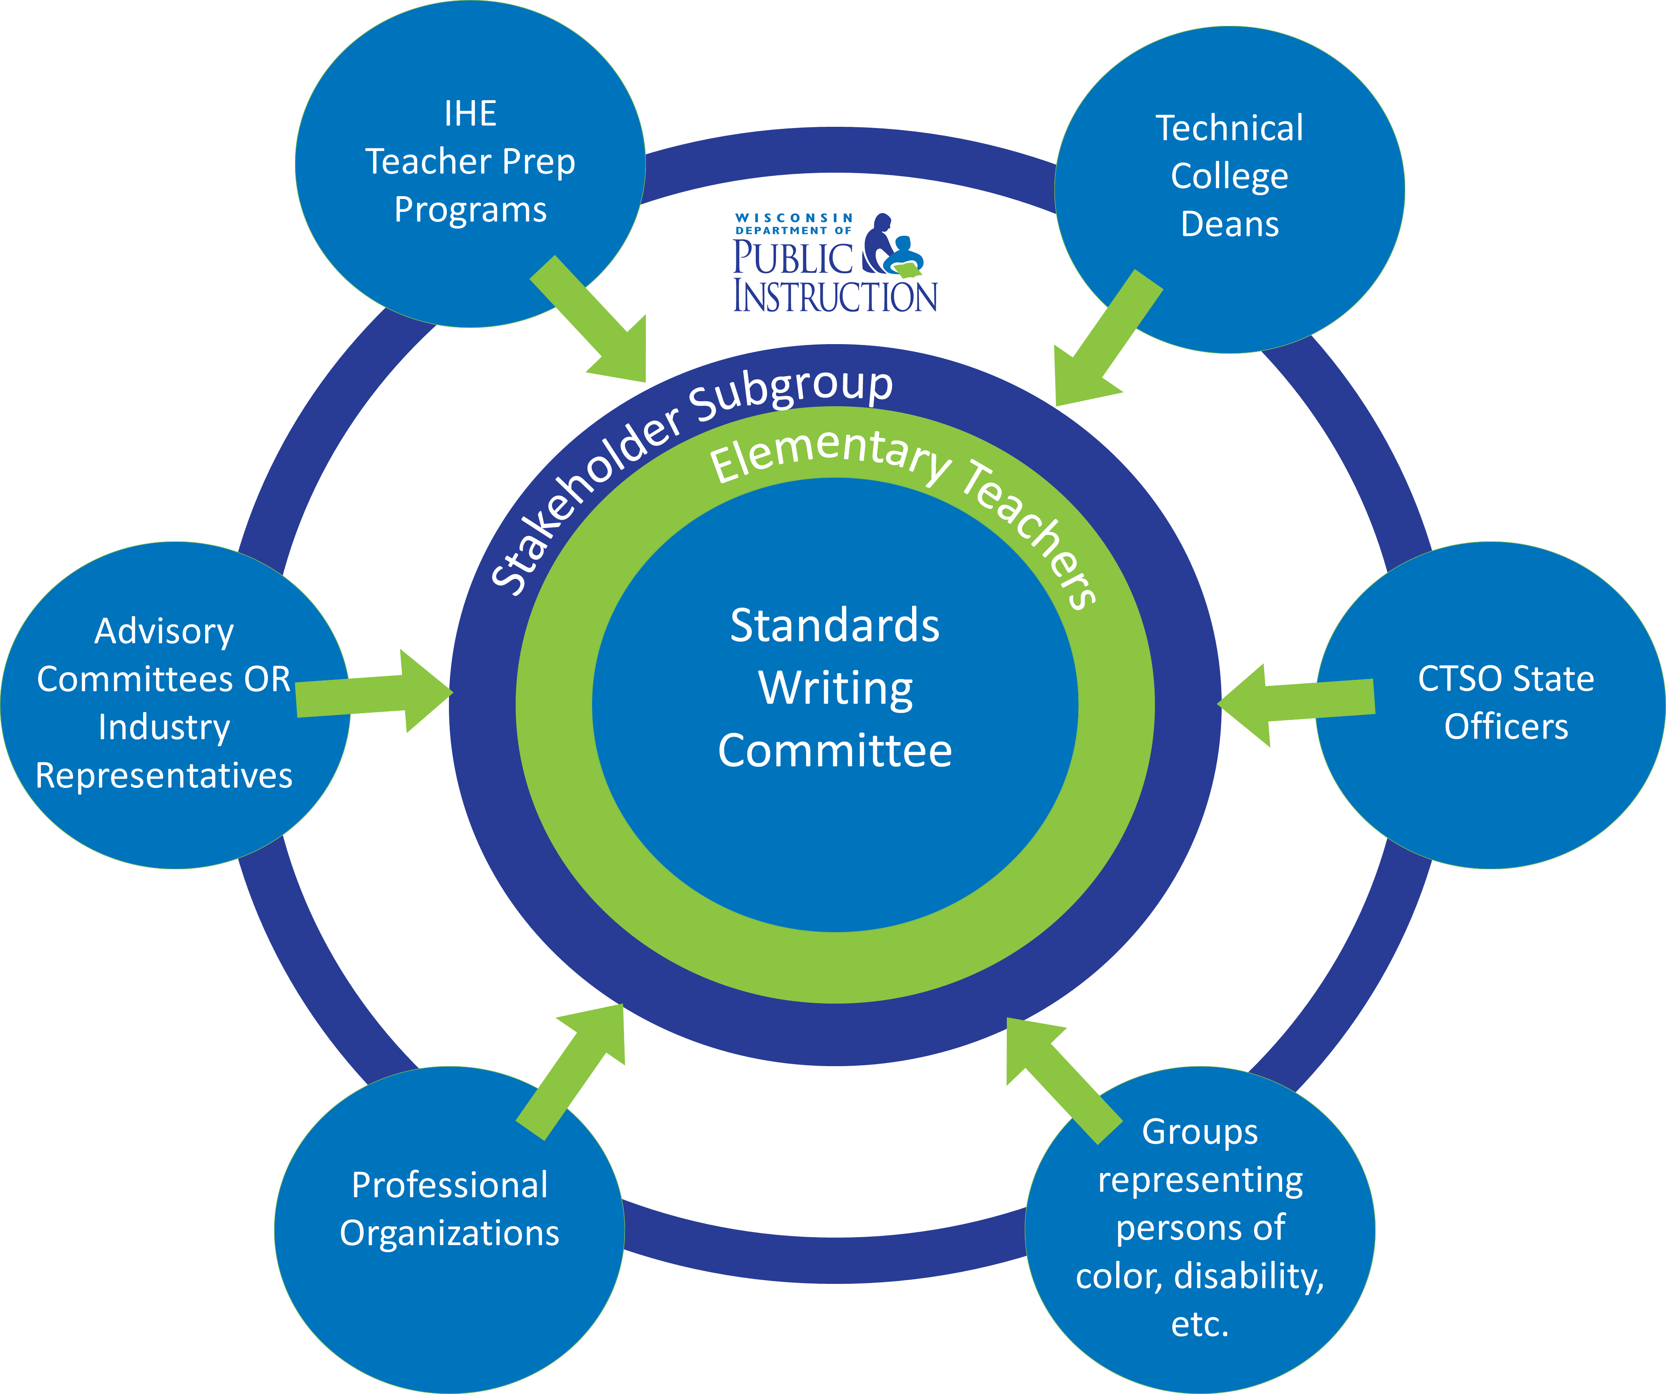
Who Was Involved?
Notes:
Who was involved?
As the revision process began, we were purposeful in who we would ask for input.
The graphic illustrates the stakeholder groups involved along the way. Everyone’s standards writing committee was made up of middle school, and high school teachers, professors from our teacher preparation programs, and others. Elementary teachers were key in providing input into the K-5 grade band.
Vetting Questions we asked:
Is this document easy to use?/Is the standards set up easy to understand?
Are the performance indicators realistic for the age group?
What would you add/remove?
Do our standards lead to post-secondary and industry (college and career ready)?
What standards do you currently use?
Would you use these standards?
Is the scope and sequence appropriate?
Are the standards representative of the skills and knowledge necessary to be college and career ready?
Do these standards strike a good balance between current practice and future trends?

Slide 13
Purpose of the Revised CTE Standards
Program leaders will find the Revised CTE Standards valuable for making decisions about:
program structure and integration;
curriculum redesign;
staffing and staff development;
scheduling and student grouping;
facility organization;
learning spaces and materials development;
resource allocation and accountability; and
collaborative work with other units of the school, district, and community.
Notes:
The aim of this guide is to improve CTE for students and for communities.
This document/book is targeted to help Wisconsin educators and stakeholders in understanding and implementing the CTE content standards, the DPI has developed in the areas of; Ag ed. B&IT, FACS, Health Science, Marketing, and TEE.
This book is intended to provide direction in the development of course offerings and curriculum in school districts across the state.

Slide 14
CTE Standards 101
1. CTE Standards 101: Standards provide a scope of what students should know and be able to do within a discipline.
2. Enduring Understandings: Enduring Understandings frame the big ideas central to a discipline and can be written as Essential Questions to generate inquiry.
4. Course Development: A course consists of a coherent series of units where concepts and/or skills advance and deepen over time.
3. Performance Tasks: Performance tasks present students with a robust, real-world challenge in which the scenario, role, process, and product allow students to apply their skills and knowledge to complete the task.
5. Unit Plan Development: A unit consists of a coherent series of lessons where concepts and/or skills advance and deepen over time.
6. Universal Design for Learning: Universal Design for Learning ensures access and engagement for all learners, reduces barriers in instruction and assessment, provides appropriate supports and challenges, and maintains high expectations for all.
7. Lesson Plan Development: A lesson articulates daily instruction, can vary in length, is recursive in nature, and allows students several opportunities for practice.
Notes:
Use CTE Standards 101 document
Use activities/worksheets that team members have developed
These can be used on separate slides for ease in delivery.
From this point forward, content needs to be developed for your standards PD delivery and needs to be shared with your DPI colleagues, saved in a shared drive for future use.

Slide 15
What is Contemporary CTE?
National Vision of CTE
CTE in Wisconsin
Quality Components of CTE in Wisconsin
Notes:
This slide provides an overview of how Section II is organized.
Wisconsin’s approach to CTE aligns with the National Vision of CTE
CTE in Wisconsin is very important! We will look deeper at how CTE is Wisconsin is defined and organized.
We will also look at the components of a CTE program that are indicators of “quality.”

Slide 16
National Vision of CTE
Career and Technical Education is:
  critical to ensuring that the United States leads in global competitiveness;
  actively partnering with employers to design and provide high-quality, dynamic programs;
  preparing students to succeed in further education and careers;
  delivered through comprehensive programs of study aligned to The National Career Clusters framework; and
  a results-driven system that demonstrates a positive return on investment.
https://careertech.org/
Notes:
A National Vision for CTE
The National Association of State Directors of Career and Technical Education Consortium (NASDCTEc) has identified five guiding principles that should drive the development of quality CTE programs.
Wisconsin supports these principles as spelled out in the NASDCTEc’s Reflect, Transform, Lead: A New Vision for Career and Technical Education. These principles provide that Career and Technical Education is:
critical to ensuring that the United States leads in global competitiveness;
actively partnering with employers to design and provide high-quality, dynamic programs;
preparing students to succeed in further education and careers;
delivered through comprehensive programs of study aligned to The National Career Clusters framework; and
a results-driven system that demonstrates a positive return on investment.

Slide 17
Wisconsin Vision of CTE
CTE is both a collection of educational programs or content areas as well as a system of preparing students to be career and college ready.
Contemporary CTE programs are delivered primarily through six specific content areas.
Notes:
CTE in Wisconsin
Career and Technical Education is both a collection of educational programs or content areas as well as a system of preparing students to be career and college ready. Contemporary CTE programs are delivered primarily through six specific content areas; these include:
Agriculture, Food and Natural Resources
Business and Information Technology
Family and Consumer Sciences
Health Science
Marketing, Management and Entrepreneurship
Technology and Engineering
Not all Wisconsin school districts offer programs in all of these content areas, but all should be offering CTE through a systemic approach that prepares students to be college and career ready.

Slide 18
Wisconsin’s Approach to CTE
What is Contemporary CTE?
  Quality Components of CTE
  Delivering CTE through Career Clusters & Pathways
  CTE Advocacy Resources
    Importance of CTE
    Work-Based Learning
    CTSO
Notes:
This slide introduces the 3 main components of Section II.
What is Contemporary CTE?
This section provides detailed narrative of the updated Quality Components of Career & Technical Education
Rigorous Academics and Technical Skill Attainment
Work-Based Learning
Leadership and 21st Century Skills through CTSOs
Delivering CTE through Career Clusters & Pathways
This extremely important section provides the foundation and correlation between the new CTE standards and Career Clusters & Pathways.
In addition, there is an effective graphic that depicts the continuum or progression that students travel in their PK-12 career. This graphic strategically illustrates how all of the different standards fit into a student’s PK-16 learning experience.
Finally, this section introduces the Wisconsin Common Career Technical Standards (WCCTS)
The WCCTS are introduced in this section; however, Section III will provide a detailed description and importance of the new WCCTS.
CTE Advocacy Resources
These 3 resources are unique in each of the 6 Wisconsin Standards for CTE. The 3 different advocacy resources should be strategically distributed to internal and external CTE stakeholders.

Slide 19
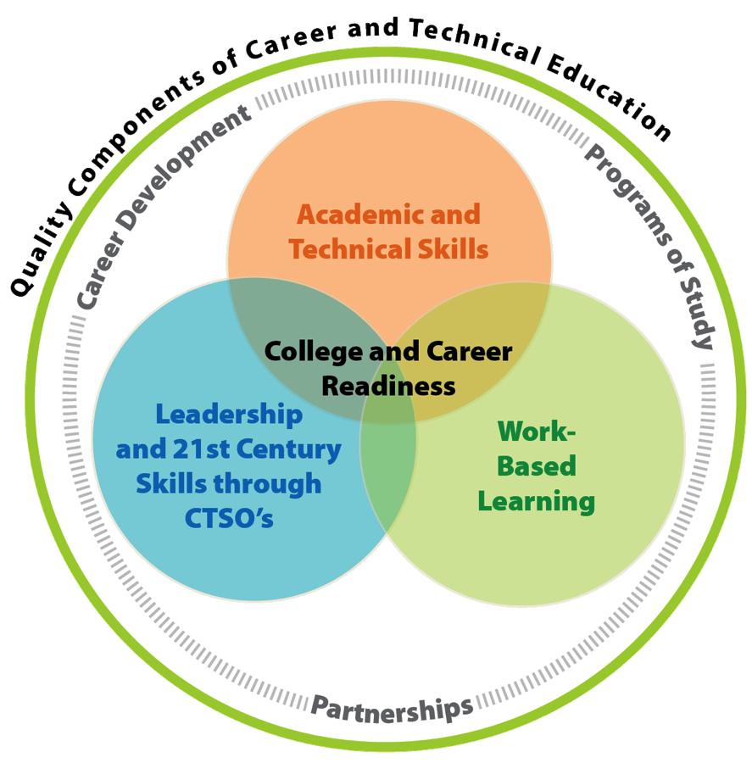
Quality Components of CTE
Notes:
This updated graphic illustrates the Quality Components of CTE in Wisconsin:
Rigorous Academics and Technical Skill Attainment
Work-Based Learning
Leadership and 21st Century Skills through CTSOs
The first component we will review is the Rigorous Academics and Technical Skill section.

Slide 20
Quality Components of CTE:
Academic & Technical Skills
College and Career Readiness
Notes:
Rigorous Academics and Technical Skill Attainment
CTE programs prepare students for high-skill, family-sustaining jobs that typically require high levels of core academic skills as well as various technical skills. Consequently, CTE students must be held to high academic standards; often this includes course and performance expectations exceeding typical graduation requirements. CTE students benefit from a source of relevance for their academic instruction. They see the connection between their academic knowledge and skill instruction and their future occupational and career goals.
Of course, at the heart of CTE is the attainment of technical skills that are required for potential high-skill, high-wage jobs. Where circumstances and resources allow, CTE programs provide opportunities for high school students to attain the highest level of skills possible within their desired career pathway. This is done through courses taught by high school CTE teachers and/or through partnerships with neighboring districts, employers, technical colleges and postsecondary institutions or other organizations.
Some of the specific means of achieving rigorous academics and technical skill attainment include:
Partnerships/Advisory Committees – These typically include representatives of area businesses within the given program’s career area as well as representatives from related postsecondary training and education programs. They may also include parents, students and program alumni.
They can provide recommendations on program changes and improvements, as well as serve as advocates for the program.
Transcripted or Dual Enrollment Options – Opportunities such as these allow students to earn both high school and college credit concurrently. Various options are available for CTE students include advanced standing and transcripted coursework taught at the student’s high school, as well as Youth Options and Advanced Placement (AP) courses.
Equivalency Credit Options – These provide opportunities for students to earn credits required for high school graduation through CTE courses proven to have sufficient academic content and will be discussed later on in the presentation on slide 38.

Slide 21
Quality Components of CTE:
Work-Based Learning
College and Career Readiness
Notes:
Work-Based Learning
A vital part of comprehensive career and technical education programs is a structured work-based learning experience. One goal of education is preparing students to successfully enter the workforce. The best way to achieve this goal is for students to spend time in a work setting. Many factors will influence the work-based learning options that can be offered.
Work Place Visits, Employer/Employee Dialogues and Job Shadowing – At the very least, students should participate in work place visits and tours as well as hear presentations and have a dialogue with employers and employees to see how their school-based learning is relevant to the work place. Job shadowing – during which students spend several hours observing one or more employees at a work place – is an even better way to expose students to the work place.
Paid Work Experience – Ideally, students will have opportunities for paid work experience in a job related to their program of study and connected with one or more courses in which the student is currently enrolled. Such experiences should include a training agreement that spells out the expectations for everyone involved including the student, employer, teacher and parents. One of the critical elements of the training agreement is a list of the skills and knowledge the student is expected to develop through their paid work experience. Examples of structured, existing work experience programs in Wisconsin are the Employability Skills Certificate, State Certified Skills Coop programs and Youth Apprenticeship.
Leadership Certificate – An option for many students includes the Wisconsin Youth Leadership Certificate. This certificate is comprised of leadership skills and attitudes that are honed through community and school volunteer or service experiences, leadership positions and volunteer or unpaid workplace encounters.
The more time students spend in the workplace and the broader the experiences, the better prepared they will be. These students will also be better prepared to plan and make decisions about their futures. Work-based learning allows students to put into action the knowledge and skills learned at school.

Slide 22
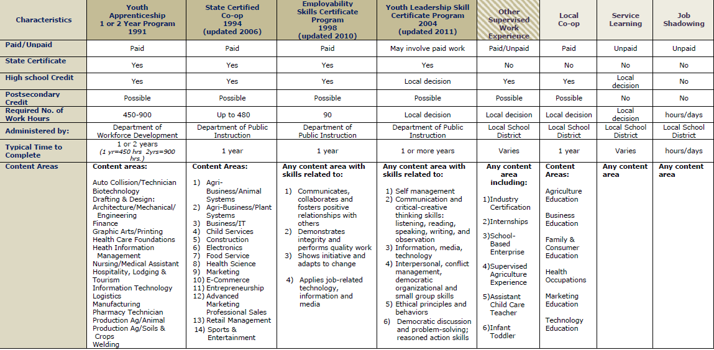
Work-Based Learning Brochure
Notes:
Make a statement on the value and use of this brochure and who the audience(s) might be. Data on state certified skill standards, etc.

Slide 23
Quality Components of CTE:
CTSOs
College and Career Readiness
Notes:
Career and Technical Student Organizations
Career and Technical Student Organizations (CTSOs) are the third critical element found in the best contemporary CTE programs. Through CTSOs, students match their skill level against those of other students and established industry standards. In addition, CTSOs allow students to develop civic responsibility, leadership and 21st century skills.
Wisconsin has six state and nationally recognized CTSOs that are intra-curricular in that they are connected directly to the classroom through curriculum, activities and community resources. All CTSOs include leadership development elements and competitive events where students demonstrate technical and leadership skills. CTSOs prepare young people to become productive citizens and leaders in their communities and their careers. This is done through school activities as well as regional, state and national leadership conferences and competitions. Students grow and develop through these events and receive recognition for the work they have done and the skills they have developed. CTSOs provide an exceptional extension of CTE instruction. Wisconsin’s recognized CTSOs include:
DECA An Association of Marketing Students
SKILLS USA An Association of Technology and Engineering Students
FBLA An Association of Business Students
HOSA An Association of Health Science Students
FCCLA An Association of Family and Consumer Students
FFA An Association of Agricultural Education Students

Slide 24
Quality Components of CTE
Activity
With a partner, identify how a specific CTE course or department reinforces:
  Academic & Technical Skills
  Work-Based Learning
  Leadership & 21st Century Skills
Notes:
Depending on the number of attendees/district, the group can be divided by school or even program within a school district. After discussing specific examples within small groups, if time permits, each group could share specific details reinforcing the quality components of CTE.
Quality Program Standards documents can be mentioned as another resource. These can be found on the CTE DPI website.

Slide 25

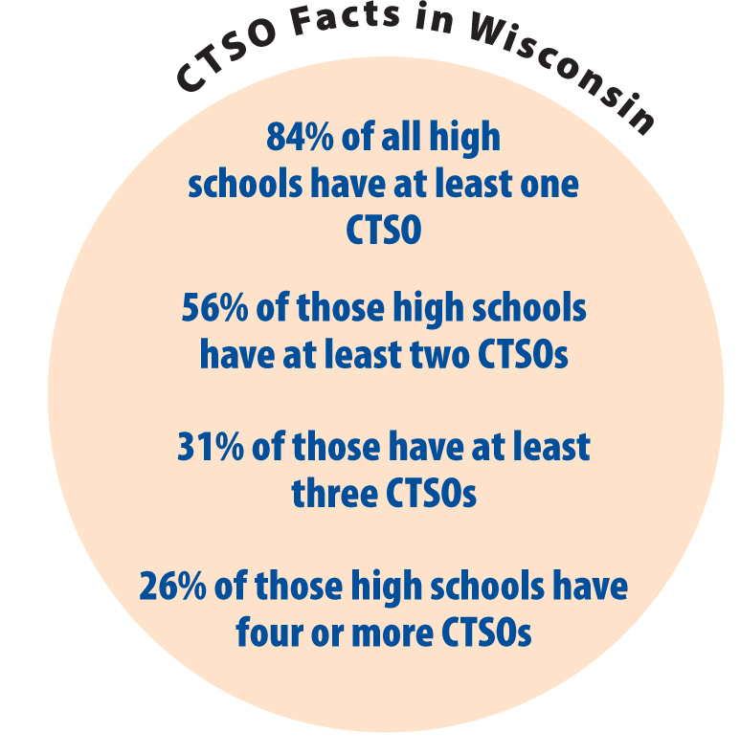
Notes:
Ask Meri to give us each CTSO graphic separately to make hyperlinks to each website.
Elements of CTSOs
Wisconsin has six state and nationally recognized CTSOs that are intra-curricular (connected directly to the classroom through curriculum, activities, and community resources) in nature. All CTSOs include leadership development elements as well as competitive events in related technical skills and leadership.
CTSO Competitive Events
The competitive events program directly supports the student organization’s mission. CTSOs evaluation process involves students in both a written component such as an exam or report and an interactive component with an industry professional serving as a judge. The CTSOs competitive events directly contribute to every student being college and career ready when they graduate from high school.
Wisconsin CTSO members have the opportunity to experience the competitive events program at a variety of levels.
District or regional competitions range from 50 – 800 students and are located throughout Wisconsin
State Conference range from 500-1,000+ members have the opportunity to compete, network and broaden their professional interests
National Conference range from 5,000-15,000+ students, advisors, businesspersons and alumni gather for several days of competitions, leadership training and career academies

Slide 26
The Powerful Outcomes of CTE
2/3 of Wisconsin Students take 1 or more CTE course
Higher Graduation Rates
CTE prepares College & Career-Ready
*Statistics from 2011 Wisconsin Career and Technical Education Enrollment Report (CTEERS) data.
Notes:
Beyond the technical knowledge and skills developed by CTE students, the overall outcomes of students who have enrolled in a CTE course – and in particular students who have taken a sequence of courses in a CTE program of study (called CTE concentrators) – are exceptionally positive. Approximately two-thirds of Wisconsin students have taken at least one CTE course. These students have a higher graduation rate (84.2%) than students who have not taken a CTE course (81.8%). CTE concentrators have an even higher graduation rate (95.7%). In addition, within a year after graduation, CTE concentrators report overwhelming positive outcomes with approximately 95% either working, attending postsecondary education or engaged in training programs.*
Students who select and pursue a program of study through CTE, based on identified career goals, will be in the best position for all job and career opportunities that arise in their future, including those they have never considered or those not yet in existence. Quality CTE programs are at the forefront of preparing college and career ready graduates.
___________
*Statistics from 2011 Wisconsin Career and Technical Education Enrollment Report (CTEERS) data.

Slide 27
Delivering CTE through Career Clusters & Pathways
  Career Clusters Framework
  Common Career Technical Core (CCTC)
  Career Ready Practices (CRP)
  Wisconsin Common Career Technical Standards (WCCTS)
  Wisconsin Standards for CTE
Notes:
Does this slide contradict with the shift in our standards? Do we truly use the CC framework to deliver CTE? What does our standards book say? There must be a relationship between clusters and pathways, specifically through Programs of Study.
This slide introduces the 3 main components of Section II.
Delivering CTE through Career Clusters & Pathways
This extremely important section provides the foundation and correlation between the new CTE standards and Career Clusters & Pathways.
In addition, there is an effective graphic that depicts the continuum or progression that students travel in their PK-12 career. This graphic strategically illustrates how all of the different standards fit into a student’s PK-16 learning experience.
Finally, this section introduces the Wisconsin Common Career Technical Standards (WCCTS)—p. 21
The WCCTS are introduced in this section; however, Section III will provide a detailed description and importance of the new WCCTS.

Slide 28
Career Clusters Framework
Links school-based learning with knowledge and skills in workplace.
Developed by NASDCTEc
16 Career Clusters & 79 Career Pathways
http://www.wicareerpathways.org
http://cte.dpi.wi.gov/cte_implementcc
Notes:
Career Clusters Framework
One of the keys to improving student achievement is providing students with relevant contexts for studying and learning. Career Clusters do exactly this by linking school-based learning with the knowledge and skills required for success in the workplace. The National Career Clusters Framework was developed by the National Association of State Directors for Career and Technical Education Consortium (NASDCTEc). This framework is comprised of 16 Career Clusters and related 79 Career Pathways to help students of all ages explore different career options and better prepare for further education and career. Each Career Cluster represents a distinct grouping of occupations and industries based on the knowledge and skills they require. They provide an important organizing tool for schools to develop more effective programs of study (POS) and curriculum.
Link showcases: Implementing Programs of Study requires an understanding of the 10 components of the national framework.

Slide 29
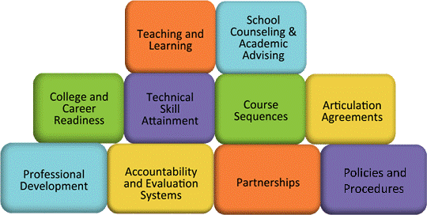
Career Clusters
10 Components Framework
Notes:
Career Clusters & Pathways
It’s for more than just Carl Perkins Grant funding--It’s a reflection of your program and how you guide students to college and career readiness.
Complete a 10 minute POS Action Plan to plan goals for district (PK-12) and building (grade levels you are most closely associated).
Quality Programs (Self Evaluation of your Department)
Showcase quality program standards self-evaluation process (add hyperlink)
Interdependence of Standard Content Areas Within a Department-Emphasizes the need to collaborate both within a department and across CTE departments to identify alignment to standards to clarify areas of replication and potential gaps. Example: How a strong technology POS and improve your Business courses by bringing in cybersecurity issues into accounting and finance classroom conversations.
Program Scope and Sequence: Creating your best Poker Hand? Worksheet with Poker Hands listed—what would each hand look like to illustrate your scope and sequence and the value that your program brings to your school. When complete—compare it to our answer key. This activity could be replicated to showcase the strength of aligning to standards, developing a quality content area program, or building a CTE program.

Slide 30
Break- 15 Minutes
Coming up :
PK-16 Learning Continuum &
Wisconsin Common Career Technical Standards

Slide 31
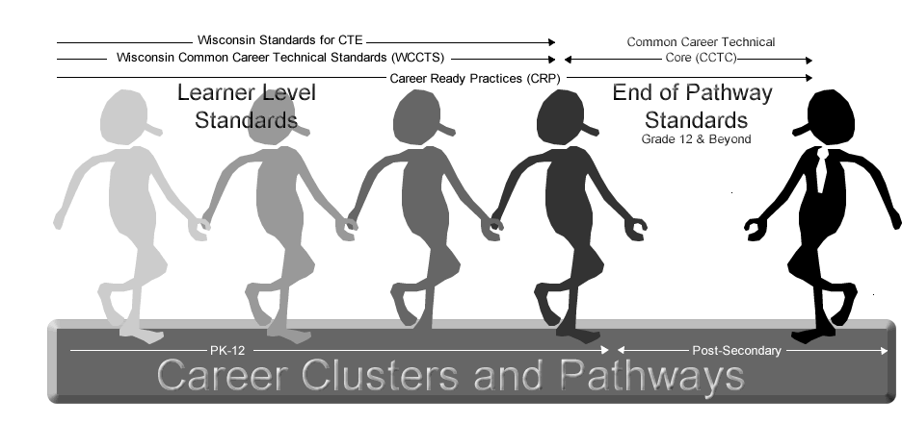
PK-16 Learning Continuum
Notes:
As depicted in this graphic, there is a continuum or progression that students travel in their PK-16 career.
The path begins with learner-level standards such as the Wisconsin Common Career Technical Standards and the Wisconsin Standards for CTE.
As students graduate from high school and move seamlessly into postsecondary options, the focus moves to the end-of-pathway standards such as the Common Career Technical Core (CCTC-national).
The Career Ready Practices (CRP-national) act as overarching concepts that students need to know and be able to do throughout their educational experiences.

Slide 32
Common Career Technical Core (CCTC)
The Common Career Technical Core (CCTC) is a state-led initiative to establish a set of rigorous, high-quality standards for Career Technical Education (CTE) that states can adopt voluntarily.
The standards have been informed by state and industry standards and developed by a diverse group of teachers, business and industry experts, administrators and researchers.
The CCTC includes a set of standards for each of the 16 Career Clusters™ and their corresponding Career Pathways that define what students should know and be able to do after completing instruction in a program of study.
Notes:
Recognizing the need for more consistency in today’s global marketplace, in the spring of 2010, NASDCTEc united around a vision to develop a shared set of standards that meet a quality benchmark for students in CTE programs, regardless of where they live or which delivery system they use.
The Common Career Technical Core (CCTC) has been developed to align with other college and career ready standards efforts, such as the Common Core State Standards in English Language Arts and Mathematics, while also articulating industry expectations for each of the 16 Career Clusters. The CCTC begins with a set of overarching Career Ready Practices (CRP) that apply to all programs of study. The Career Ready Practices include 12 statements that address the knowledge, skills and dispositions that are important to becoming career ready.
Wisconsin adopted the Common Career Technical Core standards in/on NEED DATE HERE.

Slide 33
PK-16 Learning Continuum

Slide 34
Career Ready Practices (CRP)
The Career Ready Practices (CRP) component of the CCTC provides a framework for the developmental experiences necessary to becoming career ready; experiences that can be “practiced” using many different approaches in a variety of settings.
A student refines these practices throughout their full continuum of learning: through their journey in school, college, the workforce and when they return to advance their education.
Notes:
Each Career Ready Practice includes an overarching statement along with a more detailed description. Below are the 12
overarching statements:
• Act as a responsible and contributing citizen
and employee.
• Apply appropriate academic and technical skills.
• Attend to personal health and financial well-being.
• Communicate clearly and effectively and with reason.
• Consider the environmental, social and economic
impacts of decisions.
• Demonstrate creativity and innovation.
• Employ valid and reliable research strategies.
• Utilize critical thinking to make sense of problems
and persevere in solving them.
• Model integrity, ethical leadership and effective
management.
• Plan education and career paths aligned to
personal goals.
• Use technology to enhance productivity.
• Work productively in teams while using cultural
global competence.

Slide 35
PK-16 Learning Continuum
Notes:
.

Slide 36
Wisconsin Standards for CTE
Wisconsin Common Career Technical Standards
Agriculture, Food and Natural Resources
Marketing, Management & Entrepreneurship
Technology & Engineering
Family & Consumer Sciences
Health Science
Business & Information Technology
Notes:
The six content areas are depicted here with the Wisconsin Common Career Technical Standards at the center. The WCCTS ought to serve as a foundation to all good teaching within each content area.
Wrap up…WCCTS are part of all discipline specific standards…

Slide 37
Wisconsin’s Common Career Technical Standards (WCCTS)
Development began with variety of national standards and related documents
  Partnership for 21st Century Skills (P21)
  States' Career Cluster Initiative Essential Knowledge and Skill Statements
  Career Readiness Partner Council Elements of Career Readiness
  NASDCTEc Common Career Technical Core
  Others
Notes:
The Common Career Technical Core (CCTC), mentioned in previous slides, was developed nationally to address what students ought to know and do in each career cluster and it’s pathways.
At the same time, work was being done on the development of Wisconsin standards for each area of Career and Technical Education.
Agriculture, Food and Natural Resources
Business and Information Technology
Family and Consumer Sciences
Health Science
Marketing, Management and Entrepreneurship
Technology and Engineering
It was evident that CTE program areas have many similarities and that certain concepts ought to be taught in all CTE classrooms.
A committee was established to determine standards that are not pathway specific, but that are common to all CTE areas in Wisconsin.
They became known as Wisconsin Common Career Technical Standards (WCCTS).
While developing these standards, the committee explored many resources (listed on slide).

Slide 38
Common Career Technical Standards (WCCTS)
Set of six standards that transcend CTE state-wide and across all CTE content areas
Provide a strong foundation for students to complete a POS
Vetted by workgroups from all CTE content areas and various other stakeholder groups
Notes:
While many of these standards would be of value outside of CTE, they were developed and are meant to be assessed through a workplace lens; though students may demonstrate the related skills in various settings, the students’ ability and proficiency should be considered in the context of the workplace
The intended outcome of the WCCTS revolves around creating a set of standards that transcend CTE across the state and across all CTE content areas. To read more about the WCCTS, see Wisconsin’s Approach to Common Career Technical Standards in Section III of this document. The WCCTS, along with the Wisconsin Standards for CTE form a strong foundation by which students move toward the completion of a program of study.

Slide 39
Wisconsin Common Career Technical Standards (WCCTS)
Career Development
Creativity, Critical Thinking, Communication, and Collaboration
Environment, Health and Safety
Global and Cultural Awareness
Information, Media and Technology
Leadership
Notes:
These standards that are shared by all Career and Technical Education content areas are:
Career Development;
Creativity, Critical Thinking, Communication and Collaboration;
Environment, Health and Safety;
Global and Cultural Awareness;
Information, Media and Technology;
Leadership

Slide 40
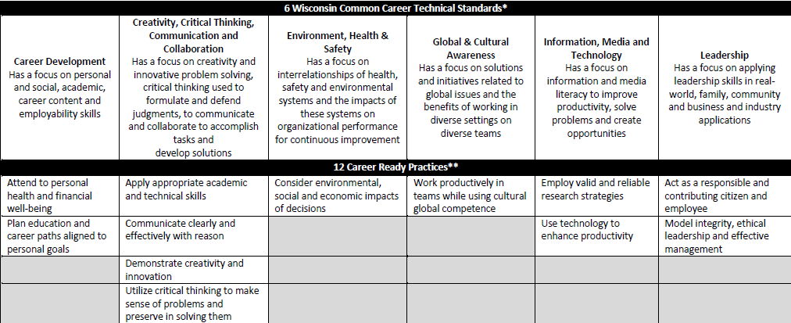
Wisconsin Common Career Technical Standards (WCCTS)
Notes:
Transition between Section II and Section III…
Wisconsin Common Career Technical Standards
Let’s take a closer look at the focus of each Wisconsin Common Career Technical Standard. (refer to slide)
You will notice that the WCCTS and the Career Ready Practices in the CCTC, as mentioned earlier, correlate as shown on the slide. (refer to slide)

Slide 41
WCCTS
Sample Activity
Connection with Skills Standards-General Employability
Connection with FCS/HS
The broad connection to the six standard titles and content areas

Slide 42
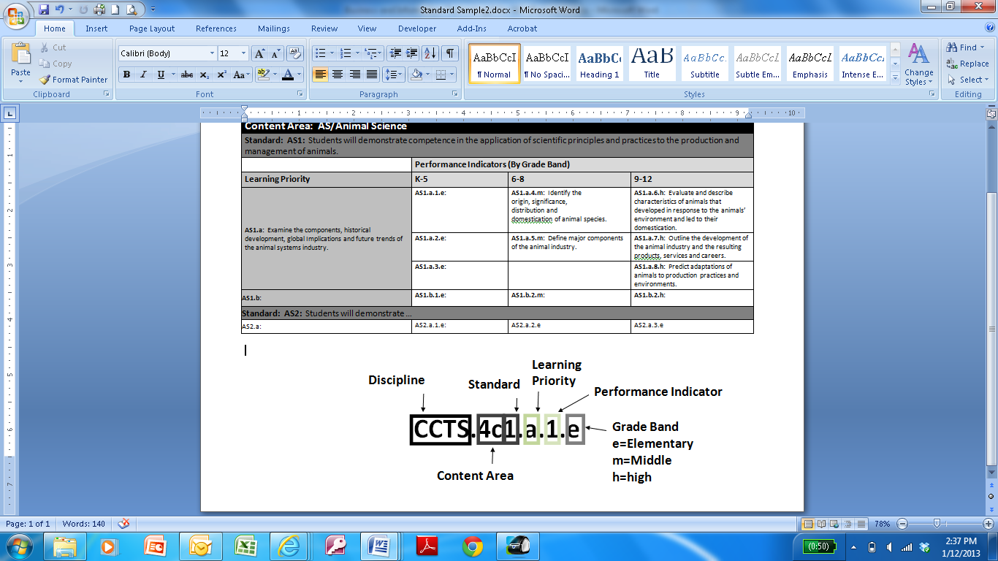
Standards Formatting

Slide 43
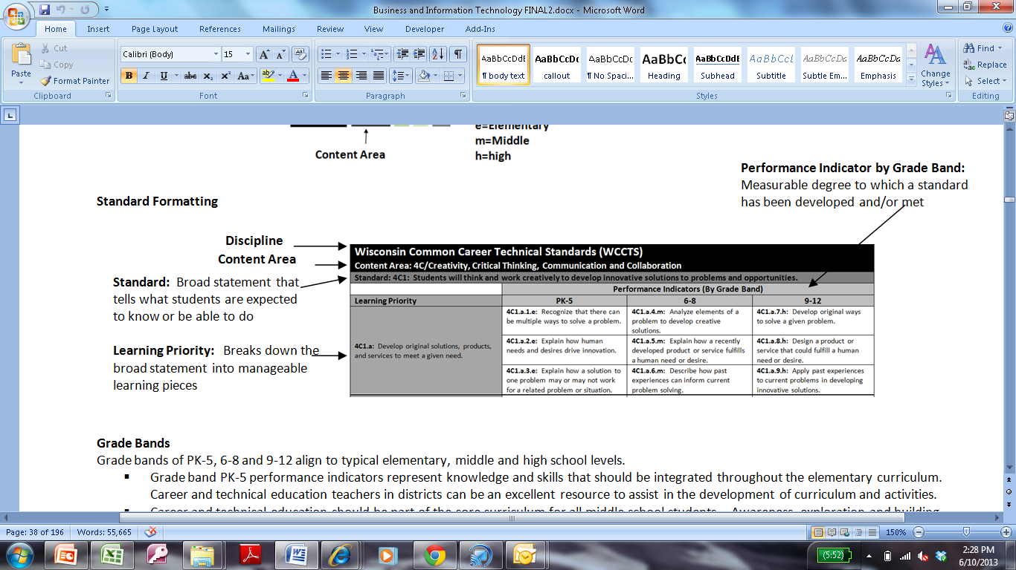
Standards Formatting
Notes:
Why numbered the way they are?
Building from K-5 6-8 9-12
Activity to introduce WCCTS
Looking at course and aligning which of the 6 big areas are addresses.

Slide 44
WCCTS
Course or Unit Activity
Using the Matrix, identify the standard that applies based upon your review of the WCCTS Content Area Standard, Learning Priority and Performance Indicators with a course or unit.
Pair & Share Your Alignment to the WCCTS

Slide 45
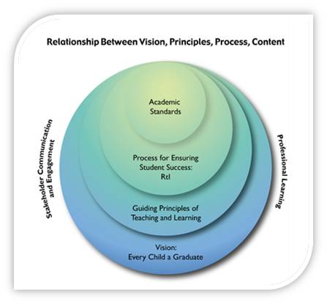
Connecting CTE and CCSS
A Vision for Every Child A Graduate
Guided by Principles
Ensuring a Process for Student Success
Connecting to Content: The CCSS
Notes:
Connecting CTE and CCSS
You have your new academic standards that we will unpack and repack, but prior to that process we need to take some time to understand the relationship between vision, principles, process, and content.
Agenda 2017 (video and handout)
The Guiding Principles for Teaching and Learning emerge from research and provide the touchstone for practices that truly affect the vision of every child a graduate prepared for college and career. When made transparent, these principles inform what happens in the classroom, the implementation and evaluation of programs, and most important, remind us of our own beliefs and expectations for students
Change in practice is about standards, instruction, and assessment which translates to…
Literacy has been a strong “push” in local schools to close achievement gaps and improve student outcomes over time. Specifically, think about the data CTE teachers have at their fingertips through project rubrics, industry credentials and daily quiz scores and begin to think about how these items teach students your content area, but can also assist them in their reading, writing, speaking, listening and vocabulary.
Standards, Instruction, and Assessment—say something about this and the shift in how we teach, that the standards must be the basis for our curriculum and that assessment, no matter if tested or not, is important.
Professional Learning & Stakeholder Communication and Engagement are CRITICAL to the success of high quality teaching and learning. Having a support network among colleagues allows an opportunity to grow professionally as an educator. A professional learning community has to be a priority in our schools. Building relationships with people (school board members, administration, parents, school counselors, colleagues who teach other subjects, etc.) and organizations (i.e., WTCS, Universities, Chambers of Commerce, Community-Based Organizations, CTSOs, AmeriCorps, industry, etc.) who can ensure students graduate college and career ready.

Slide 46
Connecting CTE and CCSS
WCCTS + CTE [Insert Content]
College and Career Ready Students
Other Content Standards
Standards for Mathematical Practice
Literacy in All Subjects Standards
Notes:
Put hyperlink on slide.
Define College and Career Ready: http://www.careerreadynow.org/docs/CRPC_4pager.pdf A career-ready person effectively navigates pathways that connect education and employment to achieve a fulfilling, financially-secure and successful career. A career is more than just a job. Career readiness has no defined endpoint. To be career ready in our ever-changing global economy requires adaptability and a commitment to lifelong learning, along with mastery of key knowledge, skills and dispositions that vary from one career to another and change over time as a person progresses along a developmental continuum. Knowledge, skills and dispositions that are inter-dependent and mutually reinforcing.
Show equation. Tell what each circle says and then…
Play with graphics.
Define college and career readiness. Use research.

Slide 47
Career-Ready Person
How do you define “career-ready?”
Career Readiness Partner Council http://www.careerreadynow.org/
Notes:
What are some key attributes of a career-ready person? How do students demonstrate being career-ready?
Use the Career Readiness Partner Council handout found at http://www.careerreadynow.org/

Slide 48
Career-Ready Person
A career-ready person effectively navigates pathways that connect education and employment to achieve a fulfilling, financially-secure and successful career. A career is more than just a job. Career readiness has no defined endpoint. To be career ready in our ever-changing global economy requires adaptability and a commitment to lifelong learning, along with mastery of key knowledge, skills and dispositions that vary from one career to another and change over time as a person progresses along a developmental continuum. Knowledge, skills and dispositions that are inter-dependent and mutually reinforcing.
Career Readiness Partner Council http://www.careerreadynow.org/
Notes:
What are some key attributes of a career-ready person? How do students demonstrate being career-ready?
Use the Career Readiness Partner Council handout found at http://www.careerreadynow.org/

Slide 49
Classroom Connection
CTE & CCSS
Be part of a CTE community
Be part of a bigger conversation
Know who’s teaching what
WCCTS +
[CTE Content Area Standards]
Notes:
List and discuss briefly the six standards in the WI Common Career Technical Standards and their connection to YOUR content area standards.
The WCCTS is the core of each individual set of content standards and needs to be viewed as such. For example, leadership standards were not included in some standards because they are in the WCCTS. We want to be clear that both sets of standards, at a minimum, must be used when building curriculum. When CTE content areas are asked to align to CCSS it must be done collaboratively. First, all CTE teachers within a building and/or district must see themselves as part of a larger CTE community and be part of a bigger conversation about how the WCCTS is or can be incorporated into local curriculum.

Slide 50

Classroom Connection
CTE & CCSS
Literacy in All Subjects Standards
Notes:
Get better graphic? Or hyperlink.
Classroom connection between CTE and CCSS
Literacy in All Subjects—Reading in Science and Technical Subjects—be sure you are working with the science and technical subjects standards for grades 6-12.

Slide 51
Essential Questions
Disciplinary Literacy Suitcase
  Disciplinary Literacy is NOT the New Name for Content Area Reading
  “Cheat Sheet” Literacy Anchor Standards
  “Cheat Sheet” English Language Arts Standards by Grade Band
    Note: Reading Standards specific to Technical Subjects
Notes:
Discuss the need to connect CTE programs to student success. The intent is not to convert everyone into a English or Math teacher—but rather support your local conversations regarding what you may already be doing to support student academic growth or improve your instructional practices to make your learning relevant to instruction in other aspects of a students learning day.
Regardless of the political winds associated with the Common Core, instructors must support students to be college and career ready. Students must be proficient in basic academic knowledge and skills and CTE instruction provides a critical educational environment to apply knowledge and skills toward career goals as part of a Program of Study. Discuss and identify other standards that may be considered for alignment (national standards, industry standards, other educational standards) and the value that this may bring to a course/program/department.
Activity: Have the group read and discuss the blog statement from Timothy Shanahan titled “Disciplinary Literacy is NOT the New Name for Content Area Reading” http://standards.dpi.wi.gov/files/cal/pdf/dl-not-reading.pdf. It may also be helpful to have this handout available as they identify the differences between approaches to instruction http://standards.dpi.wi.gov/files/cal/pdf/literacy-discipline-day.pdf
and
text types http://standards.dpi.wi.gov/files/cal/pdf/text-types.pdf to better understand how they may approach disciplinary literacy.
Review resources available to support teachers to learn more about the ELA and Mathematical Practices using the “Cheat Sheets” and “Quick Tips”. Note: When using the “Cheat Sheet” ELA Standards by Grade Band be sure to reference the RST page versus the RH page (RST represents reading standards as applied to science and technical subjects versus reading standards as applied to History).
Challenge staff in attendance to determine methods that they may use to better understand the educational shift that is occurring in English and Math. How can they developing a better understanding of how these standards are being implemented in their local communities. For example, did you know that elementary students are instructed and assessed on their technical reading abilities? (this emphasis was not present previously—the common core has created an applied learning atmosphere in English and Math classroom across the state)—the video link on slide 10 may reinforce their role in the educational shift.
If necessary (due to conversations challenging the CCSS), then clarifications of myths and facts may be useful. http://commoncore.dpi.wi.gov/news_common-core-team_0312.

Slide 52
Classroom Connection
CTE & CCSS
Standards for Mathematical Practice
Notes:
Standards for Mathematical Practices—have a conversation with Ken. Ask him, “how do you want CTE to incorporate math into their curriculum?” and “how do you want other content areas to talk about CCSS for Mathematics?”

Slide 53
Essential Questions
Mathematical Practices (7 ½ minute video intro)
  Characteristics of Mathematical Proficient Students
  “Quick Tips”
  CCSS-CTE Classroom Tasks (Achieve)
  Additional Resources
    Wisconsin Guiding Principles for Teaching & Learning: What do they look like in Mathematics
    The Illustrative Mathematics Project
    Inside Mathematics
Notes:
Note: Alignment to the Mathematical Practices level is a good place to start versus digging deeper into the finer details of the standards. The math instructional field is still working to understand the significance of their academic standards. Aligning to the base level within math is likely sufficient for the near future.
This video introduces the concept, goals, and outcomes of a Common Core-CTE Task Alignment Workshop to state, district, or school leaders who want to replicate such an effort in their communities and want to learn more. More information can be found at achieve.org/ccss-cte-classroom-tasks

Slide 54
Creating Performance Tasks Connecting Content to ELA/Math
(6 Step Process)
Work the Task Thoroughly
Compare Your Work
Identify Content and Performances
Compare Task Performances to CCSS for ELA Anchor Standards & Math Practices
Compare content & performances to grade-level CCSS
Compare content & performances to content standards.
Notes:
Step 1: Each person reads and works the task as if they were students assigned to do so. Reading and fully understanding the scope and nature of the task is key. The first-hand experience is critical for the group to understand the skills and concepts used in solving the task – and which are not. It opens a discussion about how well the task reflects a real-world scenario.
Step 2: The working group then compare their work and experience with others in the group. This step helps ensure the accuracy and validity of the task itself. And, the sharing process begins to generate ideas for alignment to Math, ELA, CTE and real-world examples.
Step 3: With the task complete, groups turn attention to listing out the content (knowledge, concepts, etc) and performances (skills) required by students to complete the task.
Step 4: Here, everyone in the group will use their professional judgement in rating the alignment of the task expectations to the CCSS standards for ELA and Mathematical Practice. They need to come to consensus on a rating of 0 (no alignment) to 3 (excellent alignment) for each practice. If there are few and/or weak alignments, it’s an indication that the task may need to be improved or not used.
Step 5: The faculty will need to use their professional judgement in rating the alignment of the task expectations to the grade-level standards in the CCSS. First, they will need to identify the CCSS most likely to align to the task. Have the group consider both high school and middle school CCSS, as both may be appropriate. This will not be an easy process the first time through. Teachers aren’t asked to consider these questions often.
Step 6: Now it’s time for the faculty to apply their professional judgment in rating the alignment of the task expectations to CTE standards. Work with your CTE specialists to identify the standards used in Wisconsin and have these standards available to groups. Again, their first step will be to identify the standards most likely to align to the task. And, just as with the math practices and content standards, a rating is given for the strength of alignment to the task content and performances.
A 7th step may be added if alignment to other content standards is desired such as in the case of equivalency agreements in science for numerous CTE content areas.
(step explanations taken from http://vivayicsolutions.com/Achieve/ModuleFinal/story_html5.html)

Slide 55






Classroom Connection
CTE & CCSS
Other Content Standards
Notes:
Science:
Health:
EE:
PFL:
Entre:

Slide 56
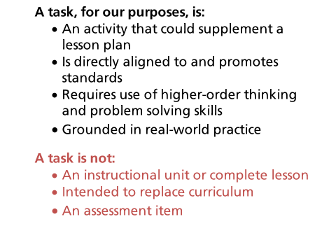
Performance Task Reminders

Slide 57

Alignment of CTE & CCSS
Elements of a Performance Task
Performance Task Sample (See Handout)
Connection of ALL standards
Value of Alignment
Notes:
Supplemental graphics
ELA cheat sheet
Standards map for Mathematical Practices
Definition of CCR from ACTE/Achieve/NASDCTEc—Career Readiness Partnership
Examples of how CTE is currently connected to CCSS
Math in CTE--NRCCTE
Literacy in CTE
Use RPOS summer institute (Math and Tech Ed)
Elements of a Performance Task
Sample Performance Task
Connecting the standards using a cheat sheet
What’s different today? Taking a serious look at all types of standards vs. just paying homage to them. “we’ve past the point of being able to say we teach math standards in our Ag courses.” We need to show it. The performance task allows us to bring together multiple sets of standards in order to prove the connection.
You don’t need to create another “reading course” to improve student’s reading scores. CTE must begin to realize our role in improving student’s reading scores which then align to the school and district goals. We must see ourselves as contributors to how schools are being measured. We have the ability to deliver math, science, English, and Social Studies in an engaging, relevant manner so student’s are able to imagine their future.

Slide 58
Process of Alignment
CTE & CCSS
CTE + Other Content Standards
Literacy in All Subjects Standards
College and Career Ready Students
Standards for Mathematical Practice
BC5.b.18.h;
BC5.b.23.h;
AF2.b.9.h
A performance task: complex, real-world challenge that is an authentic demonstration of K&S
Anchor Standard for Reading 2; Writing 2; Writing 4
Mathematical Practices,
2, 3, 5, and 6
Notes:
Again, this is an example. You can choose to use this example or take the one from your standards booklet.
When district administrators and teachers alike ask for “an alignment of CTE to the CCSS” there is uncertainty about what that means or looks like. It will take time for CTE and core teachers to review their standards before beginning to work collaboratively to see connections between sets of standards. The reality is that there is no easy “one-to-one” match between CTE and CCSS and other content standards—it is about changing the role of the teacher to not only be experts in their content area, but to engage in deep conversations with colleagues across all content areas to make strong connections for students.
Business and Information Technology
BC5.b.18.h: Develop direct, indirect, and persuasive messages for appropriate situations.
BC5.b.23.h: Compose a business letter.
AF2.b.9.h: Forecast revenue and costs.
Literacy Standards
Anchor Standard for Reading 2: Determine the central ideas or conclusions of a text; summarize complex concepts, processes, or information presented in a text by paraphrasing them in simpler but still accurate terms.
Anchor Standard for Writing 2: Write informative/explanatory texts, including the narration of historical events, scientific procedures/ experiments, or technical processes.
Anchor Standard for Writing 4: Produce clear and coherent writing in which the development, organization, and style are appropriate to task, purpose, and audience.
Mathematical Practices
Reason abstractly and quantitatively.
Construct viable arguments and critique the reasoning of others.
Use appropriate tools strategically.
Attend to precision.
Other Content Standards Alignment
Mathematics
English language arts

Slide 59
Performance Task Template
Consider a classroom activity.
Complete performance task sentence frame template.
Align your performance task to standards.

Slide 60
CTE Equivalency Credit
Agriculture Science Equivalency - resources for applying for agriculture science equivalency credit
Family and Consumer Sciences Science Equivalency - resources for applying for family and consumer sciences science equivalency credit
Technology and Engineering Science Equivalency - resources for applying for technology and engineering science equivalency credit
Technology and Engineering Mathematics Equivalency - resources for applying for technology and engineering math equivalency credit
Business & Information Technology Equivalency Options - resources for applying for English/language arts and social studies
Notes:
Equivalency credit is an option created by legislature and written into state statute (§ 118.33, Wis. Stats., and Chapter PI 18, Wis. Admin. Code) to expand opportunities for students to meet graduation requirements.
In conformity with the equivalency statute, this is an option for career and technical education courses that prove to have sufficient academic content. These approved career and technical education courses have proven to contain the academic content and are taught in a technical and applied setting.
Chapter PI 18.02, Wis. Admin. Code, defines "equivalent graduation policy" as "a board policy which meets the credit requirements specified (§ 118.33, Wis. Stats.) for each subject area, but which permits selected equivalent courses as long as such courses contain the time allotment and substantially the same objectives to develop the knowledge, concepts, and skills of the course for which an equivalency is proposed.“

Slide 61
Lunch
Curriculum Share
  Share Activity
  Share Performance Tasks
  If time permits, begin to align your performance task to Wisconsin Common Career Technical Standards at the Content Area Standard Level.

Slide 62
Structure of FCS/HS
Programs & Standards
Let’s Take a Closer Look:
Family and Consumer Sciences
Health Science
Notes:
Career Clusters & Pathways
It’s for more than just Carl Perkins Grant funding--It’s a reflection of your program and how you guide students to college and career readiness.
Complete a 10 minute POS Action Plan to plan goals for district (PK-12) and building (grade levels you are most closely associated).
Quality Programs (Self Evaluation of your Department)
Showcase quality program standards self-evaluation process (add hyperlink)
Interdependence of Standard Content Areas Within a Department-Emphasizes the need to collaborate both within a department and across CTE departments to identify alignment to standards to clarify areas of replication and potential gaps. Example: How a strong technology POS and improve your Business courses by bringing in cybersecurity issues into accounting and finance classroom conversations.
Program Scope and Sequence: Creating your best Poker Hand? Worksheet with Poker Hands listed—what would each hand look like to illustrate your scope and sequence and the value that your program brings to your school. When complete—compare it to our answer key. This activity could be replicated to showcase the strength of aligning to standards, developing a quality content area program, or building a CTE program.

Slide 63
Standards Formatting

Slide 64
Standards Formatting
Notes:
Why numbered the way they are?
Building from K-5 6-8 9-12
Activity to introduce WCCTS
Looking at course and aligning which of the 6 big areas are addresses.

Slide 65

Structure of
Programs & Standards
Notes:
Career Clusters & Pathways
It’s for more than just Carl Perkins Grant funding--It’s a reflection of your program and how you guide students to college and career readiness.
Complete a 10 minute POS Action Plan to plan goals for district (PK-12) and building (grade levels you are most closely associated).
Quality Programs (Self Evaluation of your Department)
Showcase quality program standards self-evaluation process (add hyperlink)
Interdependence of Standard Content Areas Within a Department-Emphasizes the need to collaborate both within a department and across CTE departments to identify alignment to standards to clarify areas of replication and potential gaps. Example: How a strong technology POS and improve your Business courses by bringing in cybersecurity issues into accounting and finance classroom conversations.
Program Scope and Sequence: Creating your best Poker Hand? Worksheet with Poker Hands listed—what would each hand look like to illustrate your scope and sequence and the value that your program brings to your school. When complete—compare it to our answer key. This activity could be replicated to showcase the strength of aligning to standards, developing a quality content area program, or building a CTE program.

Slide 66
CTE Standards 101
1. CTE Standards 101: Standards provide a scope of what students should know and be able to do within a discipline.
2. Enduring Understandings: Enduring Understandings frame the big ideas central to a discipline and can be written as Essential Questions to generate inquiry.
4. Course Development: A course consists of a coherent series of units where concepts and/or skills advance and deepen over time.
3. Performance Tasks: Performance tasks present students with a robust, real-world challenge in which the scenario, role, process, and product allow students to apply their skills and knowledge to complete the task.
5. Unit Plan Development: A unit consists of a coherent series of lessons where concepts and/or skills advance and deepen over time.
6. Universal Design for Learning: Universal Design for Learning ensures access and engagement for all learners, reduces barriers in instruction and assessment, provides appropriate supports and challenges, and maintains high expectations for all.
7. Lesson Plan Development: A lesson articulates daily instruction, can vary in length, is recursive in nature, and allows students several opportunities for practice.
Notes:
Use CTE Standards 101 document
Use activities/worksheets that team members have developed
These can be used on separate slides for ease in delivery.
From this point forward, content needs to be developed for your standards PD delivery and needs to be shared with your DPI colleagues, saved in a shared drive for future use.

Slide 67
Align Performance Tasks to Standards
Complete alignments to the Wisconsin Common Career Technical Standards at the Content Area Standard Level.
Begin alignment to the FCS/HS Standards at the Content Area Standard Level
Explore and attempt ELA and Math standards.
If time permits, extend to Learning Priority and Performance Indicator.

Slide 68
Align Performance Tasks to Standards
Sample Spreadsheet that may be used at the Unit or Course Level

Slide 69
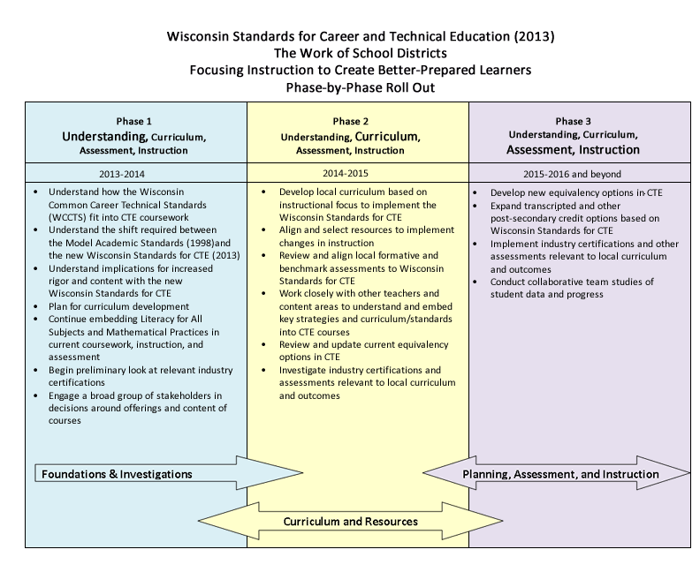
The dynamic world of the revised CTE Standards…
Notes:
This is the phase-by-phase roll out on the CTE standards web page.
Shows timeline and illustrates an understanding of a multi-year process for understanding and implementing the standards.

Slide 70
Break- 15 Minutes
Coming up:
Resources & Advocacy
Curriculum Update
Feedback Survey
Conclusion

Slide 71
Stay Connected to WI CTE
CTE Homepage (bookmark it!)
https://dpi.wi.gov/cte
CTE Standards
https://dpi.wi.gov/cte/standards/standards
CTE Calendar
https://dpi.wi.gov/cte/events/upcoming
CTE Data Resources
https://dpi.wi.gov/cte/resources
CTE Branding
https://dpi.wi.gov/cte/promote
Like Wisconsin Career & Technical Education
Facebook

Slide 72

CTE Advocacy Resources:
Importance of CTE in Wisconsin
Notes:
** Picture illustrates MME; however, the picture can/should be adjusted to meet the needs of the audience.
CTE Advocacy Resources
The Importance of XYZ in Wisconsin is an outstanding resource that should be strategically distributed to internal and external CTE stakeholders.
Each content standard includes specific data supporting their importance in the following areas:
CTE area is relevant and engaging
CTE area is important to the economy
CTE area prepares for college and careers
CTE area goes beyond the classroom
CTE area is interdisciplinary and collaborative
CTE area creates students who care
Group Activity—Ask attendees to brainstorm and share ONE or more specific examples from their school districts that reinforces these 6 statements

Slide 73

CTE Advocacy Resources:
Work-Based Learning
Notes:
The WBL section is almost identical in each of the 6 content standards. This section reinforces the different WBL options and how they specifically relate to the content area. For example, MME has additional information reinforcing the School Based Enterprise component.
Activity: Have attendees discuss current WBL trends within their districts. Ask the question—what could be done to create a larger presence of WBL within their CTE departments and entire department.

Slide 74

CTE Advocacy Resources:
Career and Technical Student Organizations (CTSOs)
Notes:
The CTSO resource is an outstanding document to educate and reinforce the components of a CTSO. Encourage attendees to share this resource with parents, administration, school counselors, school board, community partners, etc.
Activity—If the attendee has a CTSO, ask the question—”How might this resource be beneficial to their upcoming year?” In addition, who would they select to share the resource.

Slide 75
What’s Next? Questions?

Slide 76
Career and Technical Education State Standards
Congratulations on taking a big step today to gain a better understanding of the revised CTE standards. Look for additional professional development opportunities online at https://dpi.wi.gov/fcs and https://dpi.wi.gov/hs .
Notes:
Welcome
Introductions
Purpose of Presentation

