Slide 1
WI Early Childhood Longitudinal Data System (EC LDS)
Data Governance Orientation Workshop
June 27, 2013

Slide 2
Welcome & Introductions
Missy Cochenour – State Support Team
Jeff Sellers – State Support Team
June Fox – Portfolio Manager for EC LDS Projects
Rich Jorgensen – Data Governance Specialist
Workshop Participants: DCF, DHS, DPI, DWD and Post-Secondary Partners – common ground = Statewide LDS

Slide 3
Objectives for the Day
Workshop Objectives:
  Why is Data Governance important to the EC LDS Projects?
  What is involved with Data Governance?
  Let’s brainstorm!!
  What does Data Governance look like once up and going?
  Let’s eat!!
  Let’s discuss Data Governance!!
  What to do next with our EC LDS Data Governance?

Slide 4
Data Governance
Why is data governance important?
  Balance the need to share quality data to answer important policy and research questions, while protecting personal identity
What is data governance?
  Treating your data as an asset and making data decisions to support your interests.

Slide 5
Instructions on how to use polling software
Step one: Select your method of sending your polling answers.
  SMS TXT from your phone (your carrier rates for texting will apply)
  Web based from a web browser (you must have internet access)
Step two: Read the polling question in the presentation
Step three: Answer the poll with the corresponding code

Slide 6
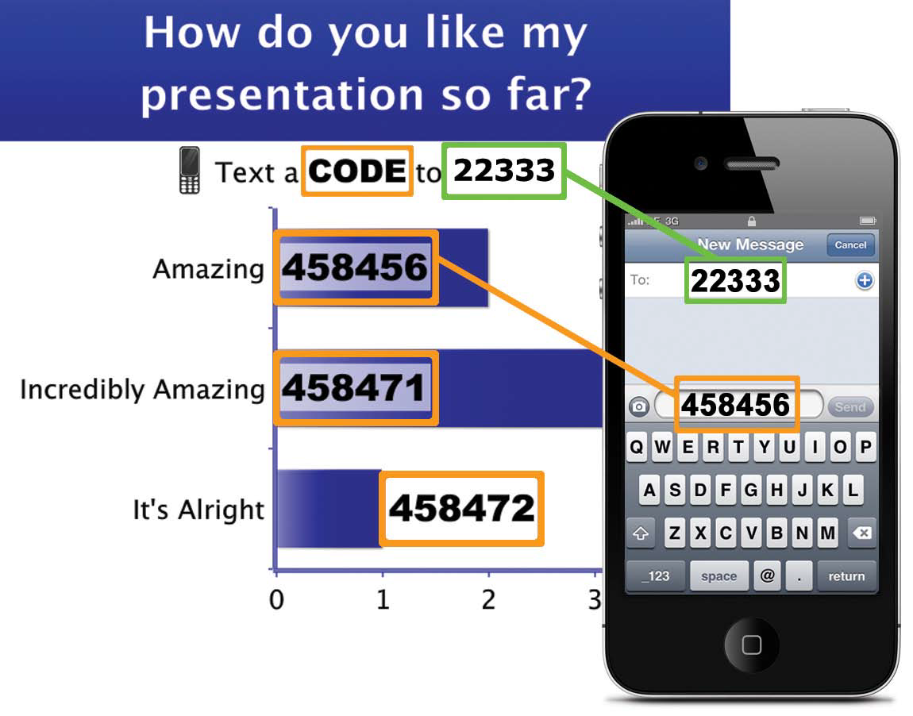
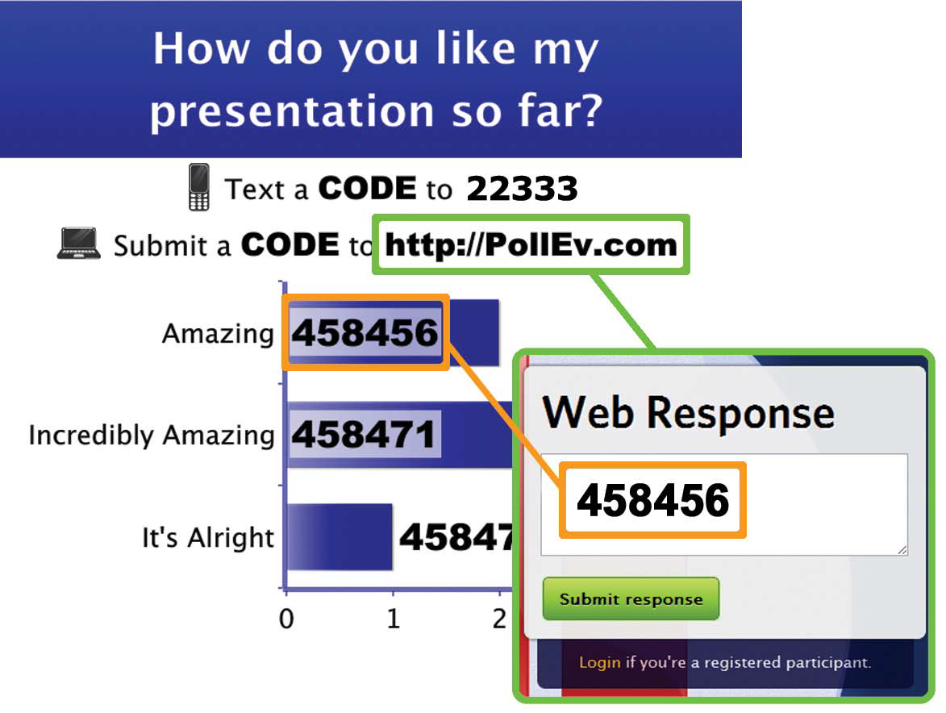
Instructions to use Polling Software – Answer Multiple Choice
SMS TXT from Phone
Web Browser

Slide 7
What is your favorite season?
Winter
Spring
Summer
Fall

Slide 8
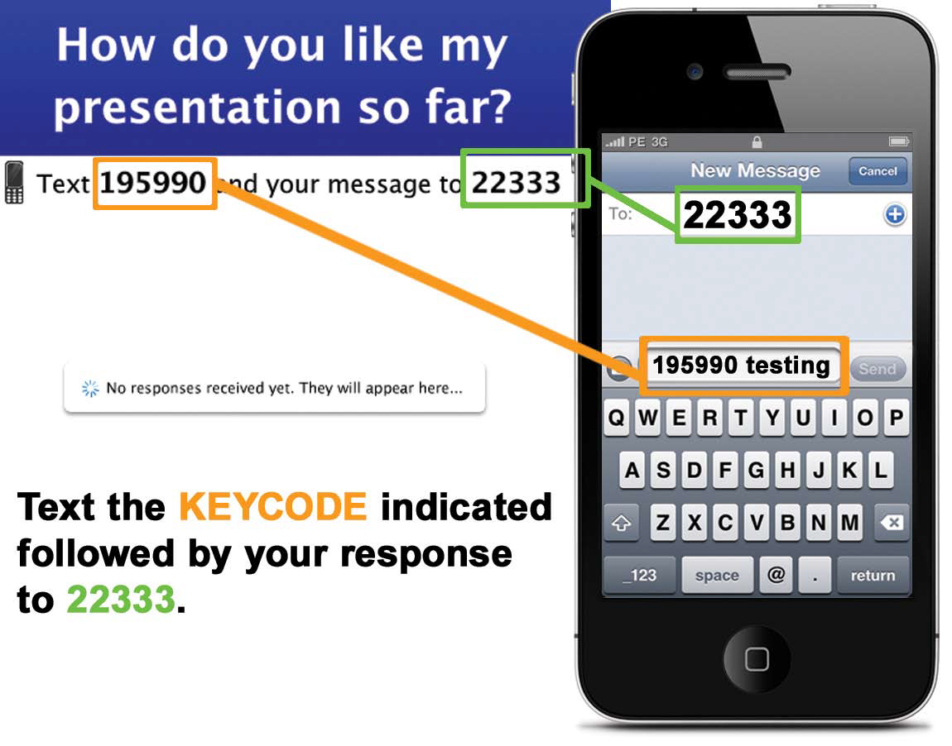
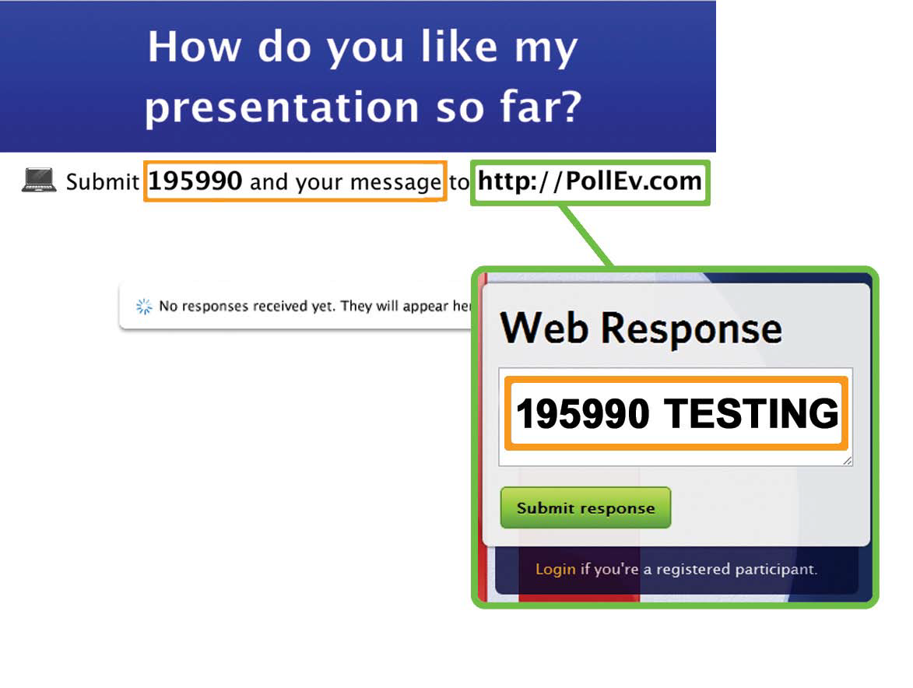
Instructions to use Polling Software – Answer Free Form Text
SMS TXT from Phone
Web Browser http://PollEv.com/

Slide 9
Enter your name

Slide 10
What are you most hoping to get out of this workshop today?
1. General Data Governance Info
2. Specific Information for EC LDS Data Governance Work
3. Chance to discuss Data Governance with Colleagues
4. Something entirely different from the above

Slide 11


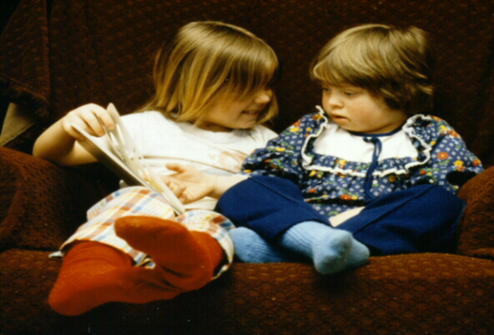

WISCONSIN EARLY CHILDHOOD LONGITUDINAL DATA SYSTEM
(WI EC LDS)
Project Overview
Presented at:
The EC LDS Data Governance Orientation Workshop
The Madison Concourse Hotel
June 27, 2013 by June Fox, PMP

Slide 12

Presentation Overview
History of the EC LDS effort
2011-2012 Accomplishments
Current Project: EC LDS Build (2013-2016)
  Status and Plans
How is Data Governance important to the success of the EC LDS?

Slide 13










How are the youngest children of Wisconsin doing?
Notes:
The key question we really care about…..how do we answer it?

Slide 14
EC DATA: Where We Were
The 2010 Wisconsin Early Childhood System Assessment Report (Dr. Katherine Magnuson):
  “While the state collects many types of data related to early childhood, we don’t have the capacity to connect it, track children’s progress, or use it to assess the system.”

Slide 15
EC DATA: Where We Are Going
  A unified data system would
    collect information about children, personnel, and programs, with an individual identifier for each.
    allow information about children, personnel, and programs to be linked through those individual identifiers.
    include mechanisms for reporting and analysis that make its data accessible to those who need it while respecting important privacy considerations.
    Allow for future vision of “cradle to career” LDS data concept (EC & K12 & post-secondary & workforce)

Slide 16
2011- 2012 Feasibility Study
  American Recovery and Reinvestment Act (ARRA) Grant
  Support from the Governor’s Early Childhood Advisory Council (ECAC)
    Conduct research and a feasibility study of early childhood data in relation to the LDS

Slide 17
Early Childhood Feasibility Study – 2011-2012
Outcome #1: Analyze the current early childhood data environment
Outcome #2: Make best practice recommendations on data-sharing methodologies
Outcome #3: Develop a work plan to realize data sharing process

Slide 18
EC LDS Feasibility Study Highlights
Collaborative Effort between the Department of Public Instruction (DPI), the Department of Children and Families (DCF) and the Department of Health Services (DHS), with input from the Department of Workforce Development and the WI Council On Children and Families
A Project Charter was created and signed in September, 2011.
The Charter was signed by Secretary Dennis Smith from DHS, Secretary Eloise Anderson from DCF, and Dr. Tony Evers, State Superintendent for DPI.

Slide 19
EC LDS Feasibility Study Highlights (continued)
Our Charter directed the Project Team To:
    Identify key questions an EC LDS should answer
    Identify the programs and data elements to answer those questions
    Identify where (if anywhere) those elements are tracked
    Identify how to add and link data to answer the key questions needed
    Make Best Practice Recommendations

Slide 20
The “BIG” Questions We Want to Answer*
Are children, birth to 5, on track to succeed when they enter school and beyond?
Which children and families are and are not being served by which programs/services?
Which children have access to high-quality early childhood programs and services?
What characteristics of programs are associated with positive child outcomes for which children?
What are the educational and economic returns on early childhood investments?

Slide 21
Data Roundtable – 2/22/2012
A Data Roundtable - diverse group of stakeholders
    To identify the numerous questions underlying the “big five” questions---what are all the questions we must answer to really know how children are doing?
    To include key partners in these processes to ensure cross system collaboration and create consensus.
WI Data Roundtable Report

Slide 22
Data: Identifying Existing Sources: 37 programs in our WI Data Survey Summary Report – (small sample below)
  Subsidized Child Care (WI Shares, YoungStar)
  Licensed Child Care
  Individuals with Disability Education Act: (IDEA) Part B and
  Part C
  Wisconsin Student Number Locator System (WSLS)
  Individual Student Enrollment System (ISES)
  Head Start/Early Head Start
  Home Visiting
  Health (immunization, Vital Records, etc)
  Tribal Health Data Collection
  AFCD/TANF (CARES)
  Child Support (KIDS)
  SNAP/Food Stamps (CARES)
  Child Protective Services (WiSACWIS)
  Medicaid/Badgercare (CARES)
Notes:
22

Slide 23
Recommendation Papers:
Identifying Capacity
    What is the capacity of our current data to answer important underlying questions?
Unique Identifiers
    What are the options for uniquely identifying children, workforce providers and programs across agency systems/programs and providing linkages?
Data Governance
    Compliance with federal, state and local privacy laws
    Data governance policy and committee structure
    Restricted access and authorized users
    Transparency policy to inform public
Potential System Architecture
Stakeholder Involvement
Sustainability

Slide 24
End of 2012 Focus
Last deliverable for Feasibility Study was
    a work plan which would suggest the steps to build an EC LDS
    Suggestions for funding this EC LDS build
Serendipity! (see next slide)

Slide 25
Race To The Top – Early Learning Challenge Grant Awarded!
Although WI did not receive the 1st award, we are one of 4 other states that qualified for round 2 applications.
WI invited to submit a Round 2 application in the fall of 2012
Application was submitted and grant was awarded –
  $22.7 million – total grant
  approx. $9 million is allocated to EC LDS – 4 year grant
WI is ready to build the EC LDS

Slide 26
Overall Project Structure (RTTT-ELC)
RTTT-ELC Leadership Team
(DCF-Judy Norman-Nunnery,
DPI-Sheila Briggs,
DHS-Karen McKeown)
RTTT-ELC Grant Manager
(DCF-Andrew Turner)
RTTT-ELC Project Management Team
EC LDS State Lead
(DPI-June Fox)
DCF EC LDS
Projects
EC LDS DCF Lead
(Hilary Shager)
DPI EC LDS
Projects
EC LDS DPI Lead
(Melissa Straw)
DHS EC LDS
Projects
EC LDS DHS Lead
(Oskar Anderson)

Slide 27
2013 – 2016 Build and Implementation Phase
Year 1 Highlights:
  Enhance DHS and DCF Data Environments
  Establish Sustainable Data Governance
  Select and Implement Entity Resolution Software (Matching Tool)
Year 2 Highlights:
  Build and Implement Presentation Layer (Analysis Tools, Dashboards and Reports) For First Set of Data Selected to Answer Key Questions
  Hire Research Analysts at DPI, DCF and DHS to collaborate on EC LDS
Year 3 Highlights:
  Enhance Presentation Layer With Next Set of Data Selected to Answer Key Questions
  Presentation Layer Training of Agency Staff
Year 4 Highlights:
  Enhance Presentation Layer With Next Set of Data Selected to Answer Key Questions
  Presentation Layer Training of Districts, County Partners, Others

Slide 28
RTTT - ELC EC LDS Portfolio of Nine Projects
Sustainable WI EC LDS Data Governance Structure
  Data Governance Orientation Workshop during year one
  Structures and policies to identify and implement first crucial essential data elements and linkages
  Data Governance Charter, structures and policies to identify and implement data system oversight requirements
  MOUs between DPI, DCF, and DHS re: data sharing, data governance, and data quality assurance
Enhanced DCF Enterprise Warehouse
DHS Department of Public Health (DPH) Customer Hub
Entity Resolution Solution (Matching Tool)
Programming and infrastructure upgrades as needed across three agencies

Slide 29
RTTT - ELC EC LDS Portfolio of Nine Projects (cont.)
Early childhood data added to presentation layer
Research agenda, reporting processes and analytical capacity, to answer key policy questions
  Intra- and inter-departmental
Training for system users (secured data)
  State employees (DCF, DHS, DPI)
  External stakeholders ( ex: school district, other partners )
Access to some data at general public level

Slide 30
Programs and Data Involved In First Year EC LDS Projects
Enhancements to DCF Enterprise Warehouse:
  YoungStar (Wisconsin’s TQRIS)
  Wisconsin Shares (Wisconsin’s childcare subsidy program)
  Infrastructure for including other programs
    (examples: Child Welfare, W-2, Child Support)
DHS Division of Public Health Customer Hub:
  Vital Records
  Immunization Registry
  Public Health (e.g. Home Visiting)
Entity Resolution Tool (ERT) Project:
  Testing of tool requires matching of ID’s across agencies to find unduplicated counts of the children involved in multiple programs
  Programs involved in ERT testing are: Vital Records, YoungStar, WI Shares, 4K-12 and IDEA Part B (Special Education)

Slide 31
Why Is Data Governance Important to the Success of the EC LDS?
The foundation for all of the work of the EC LDS
  Best Practice: Establish Data Governance structure and processes up front
  Focus:
    EC LDS as an ENTITY
    NOT EC LDS as a PROJECT

Slide 32
Why Is Data Governance Important to the Success of the EC LDS?
Benefits of Data Governance
  Allows each agency control of their own data
  Increased communication/collaboration across program areas and between program areas and IT
  EC LDS built according to program area needs – not just an IT project – Focus: How do we best answer policy and research questions?

Slide 33
Contact Information and Website:
June Fox, EC LDS Portfolio Manager
  June.Fox@dpi.wi.gov
Check our website for all reports mentioned here and for progress and updates:
http://wise.dpi.wi.gov/wise_p20ec

Slide 34
“The simple act of describing something can galvanize action. What gets counted gets noticed. What gets noticed, gets done.”
--Glenn Fujiura, University of Illinois

Slide 35
“Governance happens, whether you want it to or not”.
“So, let’s do it right:
up front!”
--Richard V. Jorgensen, EC LDS Data Governance Specialist

Slide 36
What other information would you like related to RTTT-ELC EC LDS?

Slide 37
Wisconsin
Early Childhood
Data Governance

Slide 38
Overview of Presentation
Definition of data governance
Intended outcomes
Roles and responsibilities
Initial steps to establish data governance
Share examples from other states

Slide 39
What is EC Data Governance?
Data governance is both an organizational process and a structure.
It establishes responsibility for data, organizing program area staff to collaboratively and continuously improve data quality through the systematic creation and enforcement of policies, roles, responsibilities, and procedures.
DG can be structured to support one sector (e.g., EC) or span across sectors (e.g., P-20W) – but there are key differences between the two.

Slide 40
Central Principles for EC
Inter-agency/program approach to managing information, from collection through use
Clear, distinct roles for and relationships among program areas, IT, and leadership
All programs and/or agencies contributing data to the effort are represented
Program area ownership of information –
it’s NOT an IT initiative
Common definitions across programs and/or agencies
Inter-agency/program data governance coordinator

Slide 41
Intended Outcomes of Data Governance
for EC Sector
Defined key policy and program questions about early childhood
Coordination between state agencies and programs administering early childhood services and collecting data
Improved understanding and quality of data collected, reported, and used by multiple agencies and early childhood programs
Reduced agency and program staff burden
Improved communication, collaboration, and relationships between:
Programs/agencies ↔ IT
Agencies ↔ Programs

Slide 42
Proposed WI EC LDS
Governance
Department and EC Program Executive Leadership
Data Policy Committee
Data Management
Committee
Information Technology
Data Stewards
Divisions, Program(s), IT, Researchers
Escalation
Implementation
EC Program Staff
Responsible for infra-structure that collects, stores & reports data
DPI DCF DHS

Slide 43
Initial Steps to Establish
EC Data Governance
Identify participating agencies/programs
Establish executive sponsors and data policy committee
Develop and enact data governance policy
Identify data governance coordinator
Identify data stewards/managers for each agency or program
Identify other members of data management committee (e.g., IT representation)
Notes:
This will serve as an introduction for the afternoon session.

Slide 44
Other state examples
This slide will present the common characteristics of the other states
The other states approach
The lessons learned
(will have 3-4 state examples- likely one per slide)

Slide 45
Other state examples-
Minnesota
Common characteristics:
Another RTT-ELC state
Multiple agencies providing services to children
Lessons learned:
Too early to tell ☺

Slide 46
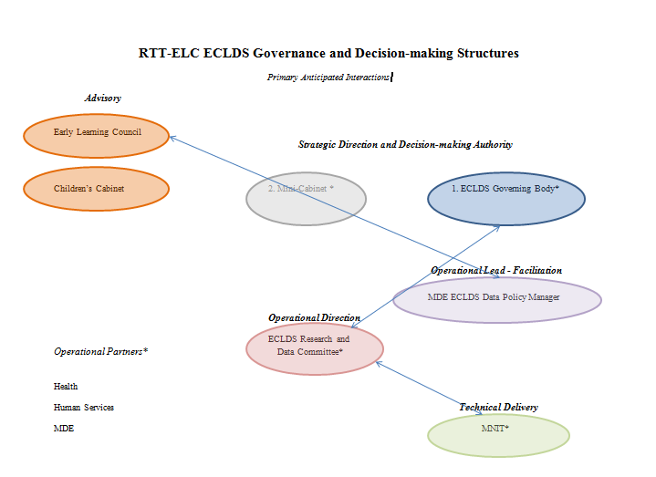
Other state examples-
Minnesota Approach
Notes:
Still building their triangle but these are the related bodies involved and some of their responsibilities- entity relationships

Slide 47
The Roles of Within Sector & Cross Sector Governance
P20+ Data Governance
Statewide perspective
Determine integration and data element authority
Driven by state policy
Early Childhood
Data Governance
K-12 Data Governance
Postsecondary
Data Governance
Workforce
Data Governance
Other Outcomes Data
Sector centric
Determine data elements, definitions, collections
Driven by sector essential questions

Slide 48
Mississippi – P-20W Example

Slide 49
Washington – P-20W Example
Organized consensus-based approach to data governance
Recognition that de-identified data is sufficient for most purposes
Master data-sharing agreement template covering release of de-identified data
Standard request process that applies to all

Slide 50
Kentucky – P-20W Example
Legal Authority
Collaborative established through an MOA in 2009 for agencies participating in the grant.
P-20 Shared Repository established in 2010 by an Executive Order with authority to match data across collaborative and other agencies.
Fiscal Authority
Kentucky’s 2010/11-2011/12 budget allocated an ongoing budget for the project to the Education and Workforce Development Secretary’s Office – which is where the project is housed for administrative purposes.
Data Ownership
Each participating agency is a member. Each member owns and maintains control of its own data within the central warehouse.

Slide 51
Are you involved in data governance in your current role?
Yes
No
I don’t know

Slide 52
Does the content just presented align to your current understanding of data governance?
Yes
No
This is a new topic for me

Slide 53
How comfortable do you feel with the data governance overview just presented?
Extremely comfortable
Comfortable
Uncomfortable
Unknown

Slide 54
WI Governance Deliverables
Rich Jorgensen

Slide 55
Data Governance Deliverables
Data Governance Program Charter
Memo of Understanding
Data Governance Policy
Data Governance Manual
Research Agenda

Slide 56
Data Governance Deliverables
Data Governance Program Charter
  Summary of problem statement, objectives and expected results.
Memo of Understanding
  Establishes the common purpose between the participating agencies
  Establishes the ground rules for engagement
  Set of technical/operational and financial capabilities required
  Law, Privacy and Confidentiality Protections
  Timeframes agreement is active
  How to amend the agreement

Slide 57
Data Governance Deliverables
Data Governance Policy
  Strategic high level document establishing priority
  Assigns stewardship responsibilities
  Establishes overarching standards for the management of the data
  Empowers the data governance committee to establish detailed interagency standards and processes
  Establishes the role of early childhood data governance within the scope of LDS data.

Slide 58
Data Governance Deliverables
Data Governance Manual
  Defines the scope, vision, decision making authority, membership, and expectations for the individuals involved in Data Governance.
  Details each level of the Data Governance structure
    Executive Committee
    Data Governance Committee
    Data Steward Workgroup

Slide 59
Data Governance Deliverables
Research Agenda
  Statement of prioritized research topics and activities guided by strategic goals.
  May include different kinds of knowledge-building activities, including basic and applied research questions, program evaluation needs, and opportunities to develop and test new interventions and strategies.
  Helps map out questions of interest, data and methodology needed to answer these questions, research roles and responsibilities, and timelines.

Slide 60
Do you feel you have the right people in your agency available to support and participate in EC LDS data governance?
Yes
No

Slide 61
Do you think that it is reasonable for these deliverables to be completed by June 2014?
Yes
No
Uncertain

Slide 62
Table Talk Activity
Missy Cochenour & Jeff Sellers

Slide 63
Table Talk- Discussion Questions
On your four by four piece of paper please address the following questions:
Discuss initial concerns and opportunities regarding Wisconsin EC LDS Data Governance. | How will the Data Governance structure presented this morning help make data decisions better for the three Wisconsin agencies?
How do you see agency program area personnel interacting with their Data Governance team representatives? | What critical agency topics (e.g. data restrictions, data requirements, HIPAA, FERPA, capacity, agency regulations, state statutes, etc.) do we need to consider while creating a sustainable Wisconsin Data Governance structure?

Slide 64
Break

Slide 65
Table Talk Activity Report Out

Slide 66
Table Talk- Discussion Questions
On your four by four piece of paper please address the following questions:
Discuss initial concerns and opportunities regarding Wisconsin EC LDS Data Governance. | How will the Data Governance structure presented this morning help make data decisions better for the three Wisconsin agencies?
How do you see agency program area personnel interacting with their Data Governance team representatives? | What critical agency topics (e.g. data restrictions, data requirements, HIPAA, FERPA, capacity, agency regulations, state statutes, etc.) do we need to consider while creating a sustainable Wisconsin Data Governance structure?

Slide 67
Governance in Action!

Slide 68
Data Governance –
Common Indicators
Organizational structure – including leadership, functional committee and data stewardship
Operational plan – including decision-making process, and definition of roles and responsibilities
Documented policies – authority, data access, privacy, sustainability, data definitions, data integration business rules

Slide 69


Data Request
May re-submit with changes
Initial screen of data request by independent researcher
Data Request Approved
Review of data request by Data Research Committee
Data Request Denied
Review of data request by UDOH IRB
Data Request Denied
Data Request Approved
Data for all Non Education and External recipients reviewed by independent researcher to protect PII
Data is released
Data is collected
Research results are reported to DPC & DRC
Results are published or made public
Data Policy Committee review of publication proposal
Yes
Yes
Results made public or published?
NO
NO
Publication proposal may be re-submitted with changes
No further action required

Slide 70
Data Resolution Process
Issue Corrected
Data User
Can solve
issue?
Yes
Data Steward
Identifies
Data Issue
Tier 1
No
Single
Category
Can solve
issue?
What type
of issue?
Multiple
Category
Yes
Data Management Working Group
No
Tier 2
Data Quality Director
Application
Issue
No
Can solve
issue?
Data Policy Committee
(Leadership Team)
Application Sponsor
Tier 3
Yes

Slide 71
Virginia
Governance Structure | Roles & Responsibilities
Executive Board | Responsible for ensuring continued commitment of resources, providing vision and direction for the Governance Council, and serves as the authority for escalation of issues
Governance Council | Establishes general policy for the data system; identifies appropriate policy questions and sets the research agenda for the data system
Data Steward Workgroup | Responsible for monitoring the quality of data going into the federated system; relays information to and from respective agencies
Individual Partner Agencies | Provides input to the Data Steward Workgroup related to respective agency data governance policies, requirements, and priorities

Slide 72
Washington
Office of Financial Management
Education Research and Data Center
    ERDC Guidance Committee
  Data Steward Committee
  Data Custodian Committee
  Research Coordination Committee

Slide 73
South Carolina

Slide 74
Transition to activity
Different Scenarios for each table-
For each scenario determine what the role of each of the following groups:
Data policy committee
Data management committee
Data stewards
Information technology

Slide 75
Situation 1- Data request for legislative purposes: Governor asks for a new report on the number of children enrolled in programs in the state of WI.

Slide 76
Situation 2- Data request process for external purposes: External researcher makes a request for child-level data for research purposes.

Slide 77
Situation 3- Accommodating new data from state leadership: One program asks to add a new data element in based on new program or policy question.

Slide 78
Would you be interested in discussing the data governance process flow further?
Yes
No

Slide 79
Would you be interested in discussing the data governance roles and responsibilities further?
Yes
No

Slide 80
Are you hungry?
Yes, if the food is good
Yes
No, I want to keep talking about data governance!

Slide 81
Lunch

Slide 82
This afternoon…
Break Out Sessions

Slide 83
Breakout sessions

Slide 84
Breakout Session Descriptions
For those broadly interested in data governance and what it means for your work (Missy Cochenour & June Fox)
  Session 1- Going deeper- what does data governance mean for me and how can I interact with the data governance group to help inform data decisions in Wisconsin
For those that will either be on the data governance body or be working with your agency to determine the appropriate person to assign (Jeff Sellers & Rich Jorgensen)
  Session 2- Data Governance Group: Jumping into Action! (again we will look at examples and discuss what is important to Wisconsin)
    Options for the structure
    Options for data coordinator
    Options for charter models
    Creating MOUs
    Options for decision making models
Notes:
(Note: the group will self-select)
Speaker: June and Rich will provide the overview.

Slide 85
Programs and Data Involved In First Year EC LDS Projects
Enhancements to DCF Enterprise Warehouse:
  YoungStar (Wisconsin’s TQRIS)
  Wisconsin Shares (Wisconsin’s childcare subsidy program)
  Infrastructure for including other programs
    (examples: Child Welfare, W-2, Child Support)
DHS Division of Public Health Customer Hub:
  Vital Records
  Immunization Registry
  Public Health (e.g. Home Visiting)
Entity Resolution Tool (ERT) Project:
  Testing of tool requires matching of ID’s across agencies to find unduplicated counts of the children involved in multiple programs
  Programs involved in ERT testing are: Vital Records, YoungStar, WI Shares, 4K-12 and IDEA Part B (Special Education)

Slide 86
Session 1- Going deeper for a broad audience
“An application for all”

Slide 87
Session Objective
Objective: better understand how you as a ‘governance user’ fit into the work and to share ideas with those on the governance group.
Product: compilation of ideas to share with the governance group.

Slide 88
Governance Users
The who?
Who are governance users?
What is the difference between a governance user and a governance representative?

Slide 89
Governance Users
Receive and respond to communications
    Will include communication frequency
Become involved at appropriate time
    When decisions are needed with your data
    When changes are made in the system
    When the data you use change
Ensure you advocate data governance

Slide 90
Governance Users
What is your specific role?
Are there other roles needed for governance users?
How would you suggest you play a role in WI regarding data governance?
What do you suggest as the governance user’s responsibility?

Slide 91
Governance Users
What do you want data governance to be able to help you do?
Enable better decision-making
Reduce operational friction
Protect the needs of data stakeholders
Build standard, repeatable processes
Reduce costs and increase effectiveness through coordination of efforts
Ensure transparency of processes

Slide 92
Governance Users
How else would you like to see data governance help you?
How does it apply to your work everyday? (their data is used appropriately; they get the data they need; communication planning; revisiting the plan)

Slide 93
Governance User
As a governance user, what do you need?
Assurance of data accuracy
Consistency in data definitions
Confidence in data linkages
Timeliness in reporting/access
Responsiveness to concerns/issues

Slide 94
Governance Users
Prioritize the following items in the most to least important.
  Having an efficient process to retrieve inter-agency data for research requests.
  Ensure matched data between the three agencies are accurate.
  Data privacy and confidentiality laws are practiced.
  An inter-agency technical infrastructure setup to accommodate data sharing.
  A decision making structure to look out for your agency’s best interest.
  A joint research agenda.

Slide 95
Governance Users
Recommendations: What would you like to see from the WI EC LDS Governance?

Slide 96
Thank you for joining this session!

Slide 97
Session 2- Jumping into action

Slide 98
Jumping Into Action Objectives
The objective for this session is for participants to walk away with enough information to decide who should participate and the basic information need to begin to make data governance happen in WI, including:
  Options for the structure
  Options for data coordinator
  Options for charter models
  Creating MOUs
  Options for decision making models
  How to include broader stakeholders in governance

Slide 99
The Who-
Options for structure
What is a “data governance structure?”
Why do we need any more “structures?”
What are our options for “structures?”

Slide 100
Proposed WI EC LDS
Governance
Department and EC Program Executive Leadership
Data Policy Committee
Data Management
Committee
Information Technology
Data Stewards
Divisions, Program(s), IT, Researchers
Escalation
Implementation
EC Program Staff
Responsible for infra-structure that collects, stores & reports data
DPI DCF DHS

Slide 101
The Who to the How-
Establishing EC DG Committees
  Questions Each Group Should Answer and Document:
  What is the mission of this group?
  What are the goals and objectives of this group?
  What is the membership of this group?
  What are the expectations of the member?
  What is the decision making process for this group?

Slide 102
The Who-
Options for a data governance
coordinator
What does it mean to coordinate data governance?
Why does WI need a data governance coordinator or a self-directed group?
What are the options regarding data governance coordinators or a self-directed group?
Notes:
Options: a single gov. coord. across agencies;
a few coordinator – one from each agency which is = the data management group subset (consensus model)
A designee or a chair from the data management committee with specific

Slide 103
The How-
Options for charter models
What is a data governance charter?
Why do we need a data governance charter?
How does a charter differ from the data governance manual?
What are other states doing regarding charters?
What are our options for developing a charter?
Notes:
Not many options for charter they are simple summaries.

Slide 104
The What-
Options for decision making models
What are the various decision making models?
Why do we need a decision making model?
Examples of what sorts of decisions a data governance body might make.
What are the pro/cons of these decision making models?
Notes:
Consensus
Democratic – everyone has one vote
VA- Consensus Bottom Line Approach- I can live with it (discuss it and people raise it. If tehre is no resolution then they ask “can you live with it?” and then if it is no they say way and they don’t move forward

Slide 105
The What-
Creating MOUs
What is an MOU?
Why do we need an MOU?
What are the next steps for WI in MOU development?
What will the role of governance play in MOU development and management?
Notes:
Usually a role on the governance group that put it together or the approve it (or both) so it includes all agency development
Share examples from the data sharing work group lessons learned and examples that are recent and related to early learning

Slide 106
The How-
Options for governance manual
(Look at the committee worksheet)
Share ideas of how other have use the worksheet.

Slide 107
The What-
So what do you want me to do?
Who needs to represent your agency/programs?
Kick off data governance as we move the process to creating an early childhood integrated data system, linked with P-20W SLDS.

Slide 108
Workshop Wrap Up
Jeff Sellers and Missy Cochenour

Slide 109
Wrap Up
Summary

Slide 110
Next Steps
June Fox and Rich Jorgenson

Slide 111
Programs and Data Involved In First Year EC LDS Projects
Enhancements to DCF Enterprise Warehouse:
  YoungStar (Wisconsin’s TQRIS)
  Wisconsin Shares (Wisconsin’s childcare subsidy program)
  Infrastructure for including other programs
    (examples: Child Welfare, W-2, Child Support)
DHS Division of Public Health Customer Hub:
  Vital Records
  Immunization Registry
  Public Health (e.g. Home Visiting)
Entity Resolution Tool (ERT) Project:
  Testing of tool requires matching of ID’s across agencies to find unduplicated counts of the children involved in multiple programs
  Programs involved in ERT testing are: Vital Records, YoungStar, WI Shares, 4K-12 and IDEA Part B (Special Education)

Slide 112
From a Project Perspective
Activities, Tasks and Milestones | Start Date | End Date | Deliverable | Responsible Agency/ Office | Responsible Individual
Establish regular Data Governance Committee Meeting schedule | 6/28/13 | 8/1/13 | Meetings scheduled for 2013 | DPI, DCF, DHS | Data Governance Specialist
Finalize EC LDS Data Governance committee structure, roles & responsibilities and members | 8/2/13 | 10/1/13 | Structure and members in place | DPI, DCF, DHS | Data Governance Specialist
Get separate testing MOU in place for Testing of Entity Resolution Tool | 10/2/13 | 1/31/14 | document vetted with agency lawyers and signed off | DPI, DCF, DHS | Data Governance Specialist

Slide 113
From a Project Perspective (cont.)
Activities, Tasks and Milestones | Start Date | End Date | Deliverable | Responsible Agency/ Office | Responsible Individual
Determine common Data Governance collaboration tools and infrastructure to be agreed to and used across DPI, DCF and DHS | 10/2/13 | 12/1/13 | tool(s) selected | DPI, DCF, DHS | Data Governance Specialist
Establish collaboration tool/infrastructure and provide training for Data Governance Committee members in collaboration tool | 12/2/13 | 12/31/14 | members trained and collaborating | DPI, DCF, DHS | Data Governance Specialist

Slide 114
From a Project Perspective (cont.)
Activities, Tasks and Milestones | Start Date | End Date | Deliverable | Responsible Agency/ Office | Responsible Individual
Complete Universal Interagency Agreement (Universal MOU), Technical Service Agreement, Service Level Agreements | 2/1/14 | 6/1/14 | document vetted with agency lawyers and signed off | DPI, DCF, DHS | Data Governance Coordinator(s)
Create and adopt Data Governance Charter | 2/1/14 | 6/1/14 | document signed off | DPI, DCF, DHS | Data Governance Coordinator(s)
Set Initial Data Governance Policies | 2/1/14 | 6/1/14 | initial policies signed off | DPI, DCF, DHS | Data Governance Coordinator(s)

Slide 115
With the basic structures, policies and agreements in place…
The EC LDS Data Governance Committees will be ready to
  Consider questions the EC LDS should answer
  Where the data is to answer those questions
  Create an MOU Addendum, if necessary
  Begin work on a Research Agenda

Slide 116
Do you feel you have enough knowledge to go back to your organization and participate in creating a EC LDS data governance body?
Yes
No

Slide 117
Do you feel you have the right individuals involved in your agency to create the EC LDS data governance body?
Yes
No

Slide 118
Do you think today’s data governance workshop was beneficial?
Yes
No

Slide 119
State Support Team
Contact Info:
June Fox, (608) 267-9154, june.fox@dpi.wi.gov
Richard Jorgensen, (608) 266-3108, richard.jorgensen@dpi.wi.gov
Missy Cochenour, (909) 214-4264, missy.cochenour@sst-slds.org
Jeff Sellers, (850) 544-4191, Jeff.Sellers@sst-slds.org
State Support Team Resources:
http://nces.ed.gov/programs/slds/techassistance.asp

Slide 120
Thank you for joining us today!

