Slide 1


Wisconsin Education Challenges
2015 Federal Funding Conference
Jeff Pertl, Senior Policy Advisor

Slide 2

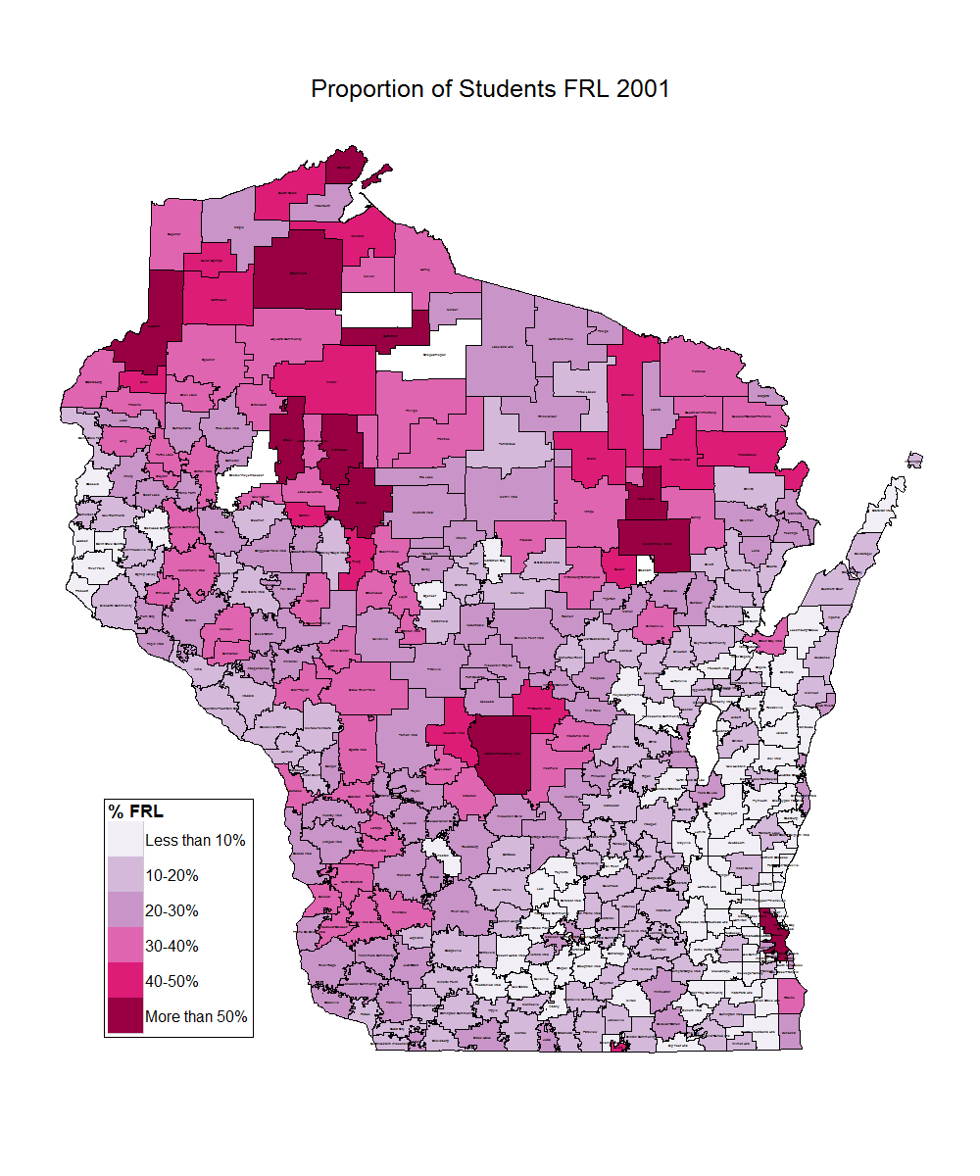
Poverty is Growing in Wisconsin
Change in Free & Reduced Lunch (2001-2012)
Wisconsin
FRL Rate Doubles
2001: 21%
2012: 43%
In many rural districts, more than half the students are eligible for free-and-reduced lunch.
Source: Wisconsin Department of Public Instruction. School Finance Maps. http://dpi.wi.gov/sfs/maps.html
Notes:
This is how we were.

Slide 3
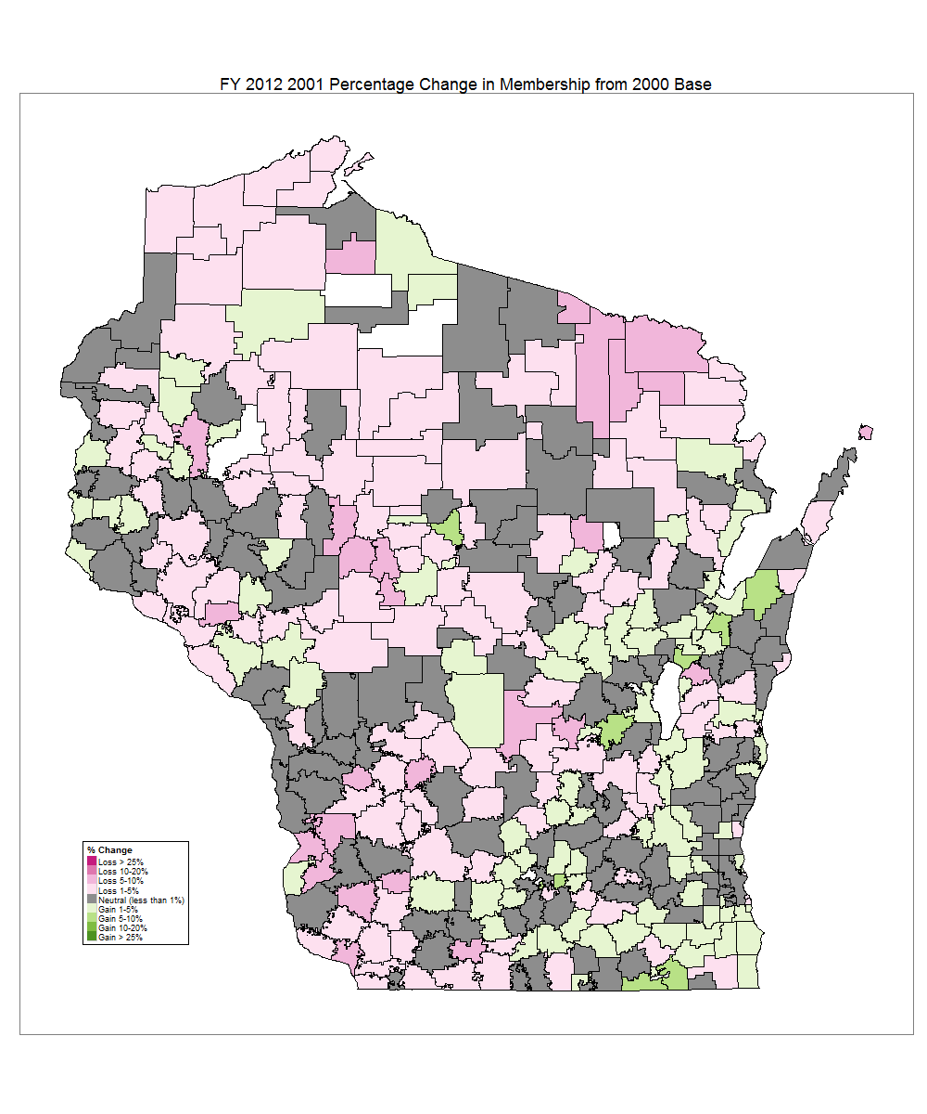
Students are in Fewer Districts
Change Student Membership (2001-2012)
In 2001, 1/3rd of districts were in declining enrollment.
By 2012, over 2/3rds districts were in declining enrollment.
Today, 75% of our students are located in just 30% of our districts.
Wisconsin
FRL Rate Doubles
2001: 21%
2012: 43%
Cumulative Enrollment | Percentile | # of Districts | % of Districts
209,535 | 25% | 8 | 2%
419,387 | 50% | 41 | 11%
626,834 | 75% | 114 | 30%
871,551 | 100% | 424 | 100%
District Enrollment | % of Districts
Under 1,000 | 55%
Under 3,000 | 83%
Under 10,000 | 98%
Source: Wisconsin Department of Public Instruction. School Finance Maps. http://dpi.wi.gov/sfs/maps.html
Notes:
This is how we were.

Slide 4
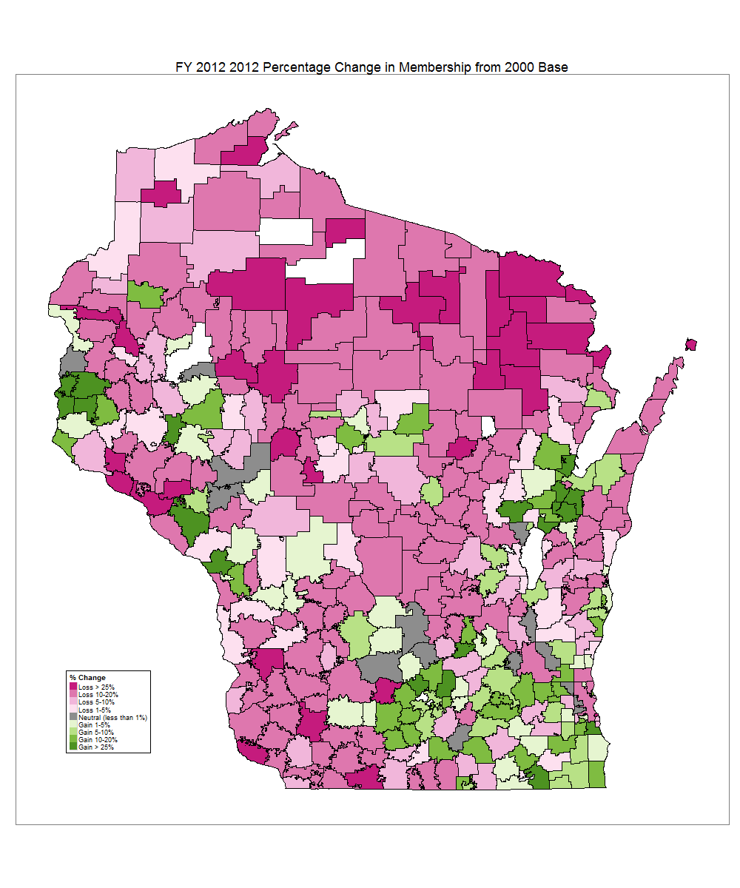
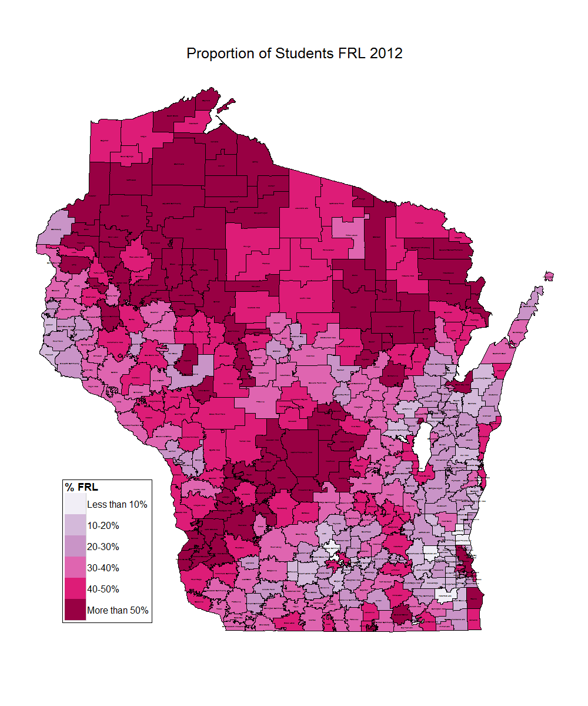
Which Means Rural Districts Have Fewer Kids & Greater Poverty
Wisconsin
FRL Rate Doubles
2001: 21%
2012: 43%
Source: Wisconsin Department of Public Instruction. School Finance Maps. http://dpi.wi.gov/sfs/maps.html
Notes:
This is how we were.

Slide 5

Changing Faces of Wisconsin

Slide 6


Schools are leading indicators of population changes…
In 2013…
12% | of Wisconsin’s overall population identified as people of color.

Slide 7

…and school are much more diverse than the general population
That same year…
28% | of Wisconsin’s public school population identified as students of color.

Slide 8
25 Most Diverse Districts
These districts enroll 1/4th of all Wisconsin students.
Nine are “majority-minority”
districts.

Slide 9
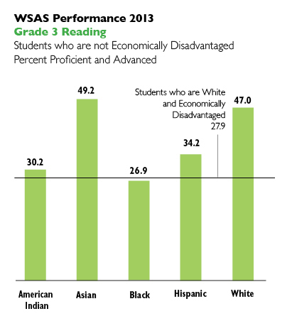
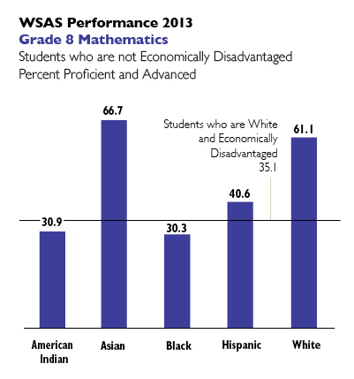
Poverty Can’t Explain All of the Racial Achievement Gap
Notes:
Many have tried to tie achievement gaps solely to poverty. Wisconsin has experienced a decade long increase in childhood poverty. However, achievement gaps for some racial and ethnic groups cannot be explained by poverty alone.
For example, 3rd grade students from Black families with higher incomes – that is, those who do not qualify for free or reduced-price lunch – have lower reading proficiency rates than low-income White students.

Slide 10
And Students of Color are More Likely to Attend a Low-Performing School
Source: Wisconsin Department of Public Instruction. School and District Report Cards http://reportcards.dpi.wi.gov/

Slide 11

Vouchers & Charters Expansion

Slide 12
Most Kids Attend Public School
Wisconsin has almost
1 million K-12 students.
Over 96% of publicly-funded students attend a school overseen by a local school board.
(traditional public, district charter or virtual charter)
Source: Department of Public Instruction. Public School Enrollment Data http://lbstat.dpi.wi.gov/lbstat_pubdata3
Private School Enrollment Data http://lbstat.dpi.wi.gov/lbstat_privdata

Slide 13
Voucher Programs Started Small,
But Have Grown Over Time
In 1998, the State Supreme Court ruled that religious schools could participate in the voucher program.
In 1990-91, the Voucher Program cost ≈ $734,000
In 2014-15, the Voucher Program will cost: ≈ $212,000,000
Source: Department of Public Instruction. Private School Choice Programs - Facts & Figures. http://sms.dpi.wi.gov/choice_facts_statistics

Slide 14
Most Students in Voucher Schools are Publicly-Funded
Milwaukee PCP average: 79%
Racine PCP average: 44%
Wisconsin PCP average: 4%
All PCP schools average: 64%
The % of voucher-funded students in participating schools
(particularly K-8 schools) tends to grow over time.
Source: Department of Public Instruction. Private School Choice Programs - Facts & Figures. http://sms.dpi.wi.gov/choice_facts_statistics

Slide 15
A Voucher in Every Backpack?
What would universal vouchers with public school funding parity cost? Let’s do the math…
New Cost for Tuition-Paying Students
Number of Private Pay Students | X | Public School Revenue Limit | = | Marginal Cost for Universal Vouchers
93,000 | X | $10,000 | = | $930,000,000
Increased Cost for Current Voucher Students (2013-14)
Grade | Public School Revenue Limit | Voucher Amount | Difference | X | Voucher Enrollment | = | Marginal Cost
K-8 | $10,000 | $7,210 | $2,790 | X | 23,616 | = | $65,888,700
9-12 | $10,000 | $7,856 | $2,144 | X | 5,184 | = | $11,114,500
 |  |  | Total |  | 28,800 |  | $77,003,200
Total additional (marginal) cost for universal vouchers:
$ 1,007,003,200 ($1 billion)
Source: Department of Public Instruction. 2013-15 State Budget Information. http://news.dpi.wi.gov/news_2013-15-state-budget-information
Note: calculations are updated to determine marginal, rather than total program costs.

Slide 16

School Finance Challenges

Slide 17
School Funding – Simplified!
Property Tax Levy
State Equalization Aid
Revenue Limit
Outside the Revenue Limit
Per Pupil Aid
Other Revenue
Federal Funds
Categorical Aid

Slide 18
During the Great Recession,
Revenue Limits Were Cut …
Source: Department of Public Instruction. 2011-13 State Budget. http://pb.dpi.wi.gov/pb_11-13_budget
2013-15 State Budget. http://news.dpi.wi.gov/news_2013-15-state-budget-information

Slide 19
Wisconsin Lost 3,000 Educators
During the Great Recession
Wisconsin schools cut more than 3,000 educators
during the Great Recession.
Source: Department of Public Instruction. 2011-13 State Budget. http://pb.dpi.wi.gov/pb_11-13_budget
2013-15 State Budget. http://news.dpi.wi.gov/news_2013-15-state-budget-information

Slide 20
And an Increased Reliance on Referenda
Overall | Passed | 1,423 | 52%
 | Failed | 1,328 | 48%
 | Total | 2,751
Debt | Passed | 955 | 54%
 | Failed | 800 | 46%
 | Total | 1,755
Non- recurring | Passed | 314 | 56%
 | Failed | 242 | 44%
 | Total | 556
Recurring | Passed | 154 | 35%
 | Failed | 286 | 65%
 | Total | 440
Overall 2012-14 | Passed | 151 | 64%
 | Failed | 85 | 36%
 | Total | 236
There have been almost 2,800 referenda since the 1990s.
80% of referenda are in rural schools.
Over the last few years, the pass rate has increased.
Source: Legislative Fiscal Bureau

Slide 21
Challenges to the Finance System
Poverty Not Addressed in the System
Special Ed and ELL Flat Funding
Declining Enrollment
No Aid Districts (10%)
Increased Reliance on Referendum
Multiple Education Options
  Choice, Charter, Open Enrollment, Virtual
  Timelines for General Aid, Enrollment Counts, etc. varies

Slide 22

2015-17 State Budget

Slide 23
Small Per Pupil Aid Increase;
General Aids Reduce Property Taxes
School Finance (change to base)
  Revenue Limit (no change)
  General School Aid (+$0 FY16/ +$108M FY17)
  Per Pupil Aid (+$0 FY16/ +$100 FY17)
Categorical Aids (small increase)
  Sparsity Aid
  Pupil Transportation Aid
  High Cost Transportation Aid
  Host Cost Special Education Aid
  Special Education Transition Grants
  Library Aid
  Funding for TEACH 2.0
General Policy
    Whole grade sharing

Slide 24
Special Education & Bilingual Reimbursement Rates are Falling
Special Education & Bilingual/Bicultural (BLBC)
  This budget would mean 9 years of flat funding for students with special needs and ELL students
  Reimbursement rates dropped 10 percentage points since 2000-01
    Special Education (36% to 26%) Bilingual-Bicultural (18% to 8%).
Source: Department of Public Instruction. 2011-13 State Budget. http://pb.dpi.wi.gov/pb_11-13_budget
2013-15 State Budget. http://news.dpi.wi.gov/news_2013-15-state-budget-information

Slide 25



Vouchers & Charter Expansion
School Choice
  New funding mechanism
  (“open enrollment”)
  Special Needs vouchers
Independent Charter School
  Expanded operators
Opportunity Schools Partnership Program (OSPP)
  Similar to a “recovery district” model or other state takeover
  Up to 3 schools per year converted
  District must be in the lowest performance category

Slide 26
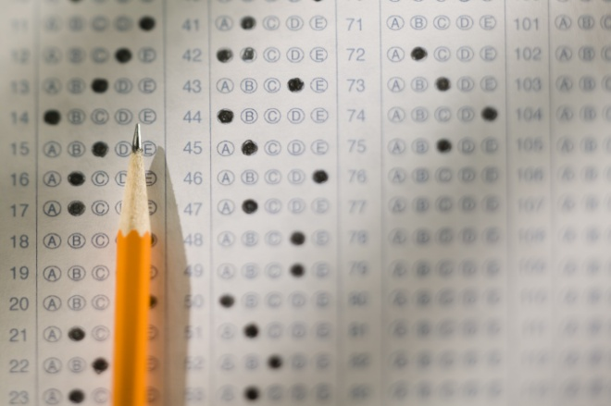
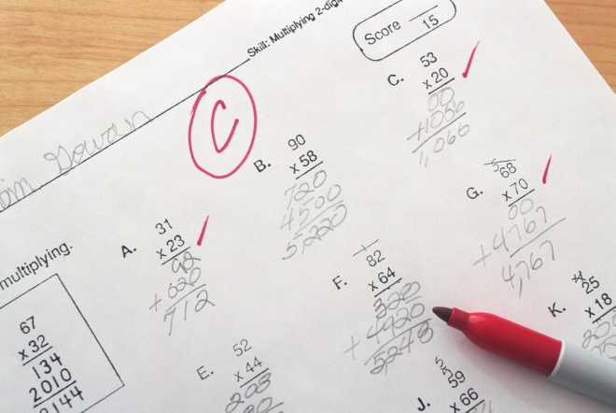
New Test; Different Report Cards
New Assessments
  Eliminate SBAC (Badger Exam) in 2015-16
  District choice on reading screener (PALS)
  Civics test required for graduation
Different Report Cards
  Modifies state report cards
  Star ratings (similar to YoungStar)
  Poverty weighting
  Length of enrollment
  2/3rd will do better; 1/3rd will do worse
  Virtual students will not count in District Report Cards if 50% or more are open enrollment

Slide 27


Policy Changes Stir Controversy
New “alternative” licenses
  Experience-based licensure for technical education
  Industrial arts subjects (Tech College Instructors)
  Montessori license
  Reciprocity
Miscellaneous
  Districts much notify parents of academic standards and educational options
  Career & Technical Education Incentive
  Grants moved to DWD
  Home school students in sports (Tim Tebow provision)
  CESA membership optional

Slide 28

The function of education is to teach one to think intensively and to think critically. Intelligence plus character - that is the goal of true education.
- Martin Luther King, Jr.

