Slide 1
Creating successful facilitated eLearning to enhance instruction for English learners in school contexts

Slide 2
Why facilitated eLearning to enhance instruction for English learners
In the presentation we highlight approaches that have been successful in increasing participation hybrid eLearning course that have been specifically designed to build school capacity to support English learners (ELs). These approaches compliment the Wisconsin’s Digital Learning Plan. For additional knowledge and access to resources on how to support technology professional learning and capacity building see: https://dpi.wi.gov/digital-learning/professional-learning.

Slide 3
Why facilitated eLearning to enhance instruction for English learners
Nearly 10% of the nation’s K-12 students are English Learners. The majority of regular classroom teachers have not received bilingual or ESL courses as part of their professional training (Menken & Antunez, 2001,Menken, K. and Antunez, B. 2001. An overview of the preparation and certification of teachers working with limited English proficiency (LEP) students, Washington, DC: National Clearinghouse for Bilingual Education. Having more EL students in their classrooms, increasing numbers of regular classroom teachers have sought professional development to better prepare themselves for the linguistic and cultural diversity they experience in their day‐to‐day teaching.
Researchers such as Ester DeJong and Harper have demonstrated that needs of ELs goes beyond “just good teaching”. They emphasize that regular classroom teachers need to enhance their understanding of language and cultural domains in teaching and be equipped with skills to effectively integrate this knowledge into their daily interactions with EL students.
Not all teachers have the ability to attend ongoing education and professional learning opportunities outside their school or community. While professional learning through universities may be beneficial, hybrid eLearning offer some benefits of building a local supportive community and an opportunity to work directly with colleagues, and school and class curriculum.

Slide 4
Successful facilitated eLearning to support ELs
Have clearly recognized:
Goals
Team Organization
Professional Learning Structures
Lead facilitators
Tangible Incentives
Fact: An analysis of online national professional learning MOOCs, online interactive courses designed to support English learner provided by Understanding Language in 2015 showed completion rates by participants in Professional Learning Communities as follows:
Incentives 70% completion for team, facilitator, time, and stipend
30% no support
38% with team
48% team and facilitators
Team facilitator and stipend nearly 58 %
Team, facilitator and time. – 68%
2% completion for registrants with no community.

Slide 5
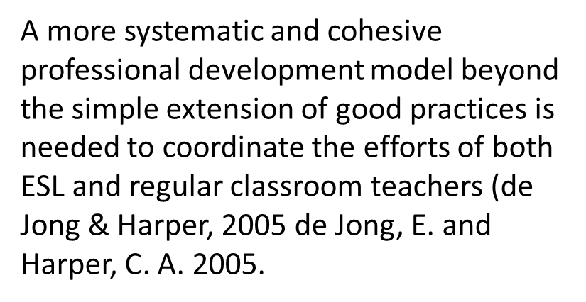
Connecting to Goals
Participants in facilitated eLearning benefited the most when the professional learning had a clear purpose and outcome.
The eLearning aims at addressing the identified priority needs determined through data review, teacher surveys, and districts overall learning plan.
Participants understand how the learning fits within the district’s overall professional learning goals for teachers and students, and the learning supports district’s overall goals.
Teachers benefit too when the goals align with educators Student Learning objectives or their personal growth goals.

Slide 6
Successful Team Structures:
Share common ground such as working together in the same school or district
Consist of 2-8 members, and ideally 4-6 members
Include EL leaders and content teachers from across contents when the goal is to improve EL outcomes
Lead by staff knowledgeable about ELs such as a ESL teacher, coordinator or specialist
- Leads can be administrator who learn along with the team.
Provided technology support as needed

Slide 7
Successful Facilitated eLearning:
Successful facilitated eLearning around support for EL involve integrated team structures organized around a common learning format.
The next slide describes organization of successfully implemented facilitated eLearning to support ELs

Slide 8
Setting up for Successful Hybrid Professional Learning:
Participants attend 1 pre-session before engaging in the online learning and affirm the format:
Example 1:
The PLC holds several sessions 2-4 weeks apart focused on watching the instructional eLearning modules together. The number of sessions depends on the subject. For examples, the WIDA eWorkshops range from 2 to 10 hours.
Participants prepare for individual assignments together and meet in groups to complete any team tasks such as completing an eLearning assignment, drafting school-based lessons, or revising curriculum units.
Example 2:
Sessions are held 2-4 weeks apart for a set period of time.
Participants complete the instructional videos before meeting and come together for group discussion.
Participants complete individual assignments independently such as student observations and share out about their learning with the group.
Participants collaborate during the sessions on team projects such as drafting school-based lessons, or revising curriculum units.

Slide 9
Facilitators
Hybrid Professional Learning benefits from Real-life facilitators who:
Lead the face-to-face meetings
Become familiar with the course materials ahead of time.
Track participants’ progress
Assist with technology
Are instructional coach or EL Coach, or teacher leaders
Have administration’s support
Provide opportunities for participants to share their knowledge with colleagues

Slide 10
Administrator Support
School administrators can support hybrid learning to support English learners by:
Sharing information about the opportunity with teachers
Prioritizing topics for learning
Allocating grade level time
Taking eLearning course themselves
Asking teachers who take the eLearning to present instructional strategies to colleagues.

Slide 11
Administrator Support
District administrators can support hybrid learning to support English learners by:
Promoting district-level professional development and creating a buzz
Providing time for coaches to create a curriculum to support the hybrid elearning.
Working with coaches and administrators to schedule in person workshops that teachers can attend.
Investigating options for incentives for staff to participate in hybrid professional learning to support multilingual learners.
Districts may have access to targeted professional learning funds through federal ESEA Title II, III, or IV to support this work.
A more systematic and cohesive professional development model beyond the simple extension of good practices is needed to coordinate the efforts of both ESL and regular classroom teachers (de Jong & Harper, 2005 de Jong, E. and Harper, C. A. 2005.

Slide 12
Incentivizing Learning
Examples of beneficial incentives include used to support hybrid eLearning to support English learners includes:
Common planning time or release time within the school day for teams to meet and work
Stipends made available through the district for completion of modules or for hours of study (e.g. $1500 for 30 hours of in-house and onsite learning)
Grant credit or continuing education credits via district or local educational institutions.
Options to use of materials developed through the online learning community such as creating common curriculum and assessments designed through the eLearning experience
Opportunities for participants to share their learning with peers at staff meetings or other forums. e.g. rollout new ELD standards or adapt curriculum to better support ELs.

Slide 13
Planning for Hybrid Professional Learning to Support ELs
Questions | Option 1 | Option 2
How is this part of the district’s overall learning plan?
What are the possible incentives?
Who are potential facilitators
Who are potential participants?
How will this work within the school PD sessions?

Slide 14
Getting Started
To access eLearning to support ELs, check out the DPI webpage:
Additional learning opportunities available through WISElearn

Slide 15
Sample Text + Image Slide
Insert picture to the right
This is Lato bold, size 16
For best readability, this is the maximum amount of text on a slide
Keep text and images within the white space

