Slide 1
Membership audit Session
Brian Kahl, C.P.A., School Finance Auditor
Wisconsin Department of Public Instruction

Slide 2
The Importance of Membership
One of the three local factors in determining General Aid
A determining factor in calculating a district’s revenue limit
Factor in determining some categorical aid program aid payments and program eligibility
  Per Pupil Aid
  High Cost Transportation
  Sparsity Aid

Slide 3
Legal Requirements and audit selection

Slide 4
What is Required?
Wisconsin Statute 115.28 (18)
  Pupil Membership Audits. Annually require at least 25% of school boards to audit the number of pupils reported for membership purposes under statute 120.14 (1)
Wisconsin Administration Code PI 17.04(3)
  If an audit is required under s. 115.28 (18), Stats., the audit shall include an examination of summer school membership under this chapter.

Slide 5
What is Required?
    Wisconsin Administrative Code, PI 14
      The auditor shall submit to the school board the following reports and shall supply copies for transmittal to the department and other agencies as may be required under applicable statutes or rules.
        Membership audit report, if required by the department under statute 115.28 (18)
    Optional audits performed must be filed with DPI

Slide 6
Membership Audit Selection
Districts are selected for membership audit as follows:
  1. Random Selection:
    A. Four year cycle pool. All districts are selected for an audit at least once every four years.
    B. Annual selection pool. A selection of 5% of those districts not selected above.
  2. Districts audited in the prior year having a net error rate in excess of 1% from the reported membership for either count date and not selected by previous procedures.
  3. The January pupil count reported was not received by January 31 and not selected by the procedures listed above.
  4. Membership audit findings are reviewed
    Summer School
    Pupil Count Reconciliations
  5. Districts with other issues
    Multiple corrections or errors in previous reports

Slide 7
Counting the Students

Slide 8
ELIGIBLE STUDENTS TO BE INCLUDED IN COUNT
Resident Students
  In attendance for instruction on the count date
  - OR -
  If absent, present any day before and any day after the count date without breaking residency during the time of absence
  (present to enroll or withdraw does not constitute a day of attendance for count purposes)

Slide 9
PUPIL COUNT REPORTING
Districts Report thru the School Finance Reporting Portal at http://dpi.wi.gov/sfs/reporting/safr/overview.
  3rd Friday in September Pupil Count
    PI-1563 Report
  2nd Friday in January Pupil Count
    PI-1563 Report
  Summer School Report
    PI-1804 Report
  Youth Challenge Academy Pupil Count
    PI-1563 YCA Report
    •September and January

Slide 10
PUPIL COUNT REPORTING
How districts compile the September and January membership counts in the portal
  Start with Headcount (who is receiving instructional services)
  Reductions – Non-Residents (included in headcount but not eligible)
  Reductions – Residents (included in headcount but not eligible)
  Additions – Residents (resident students receiving instruction elsewhere and district is paying cost of service or tuition)

Slide 11
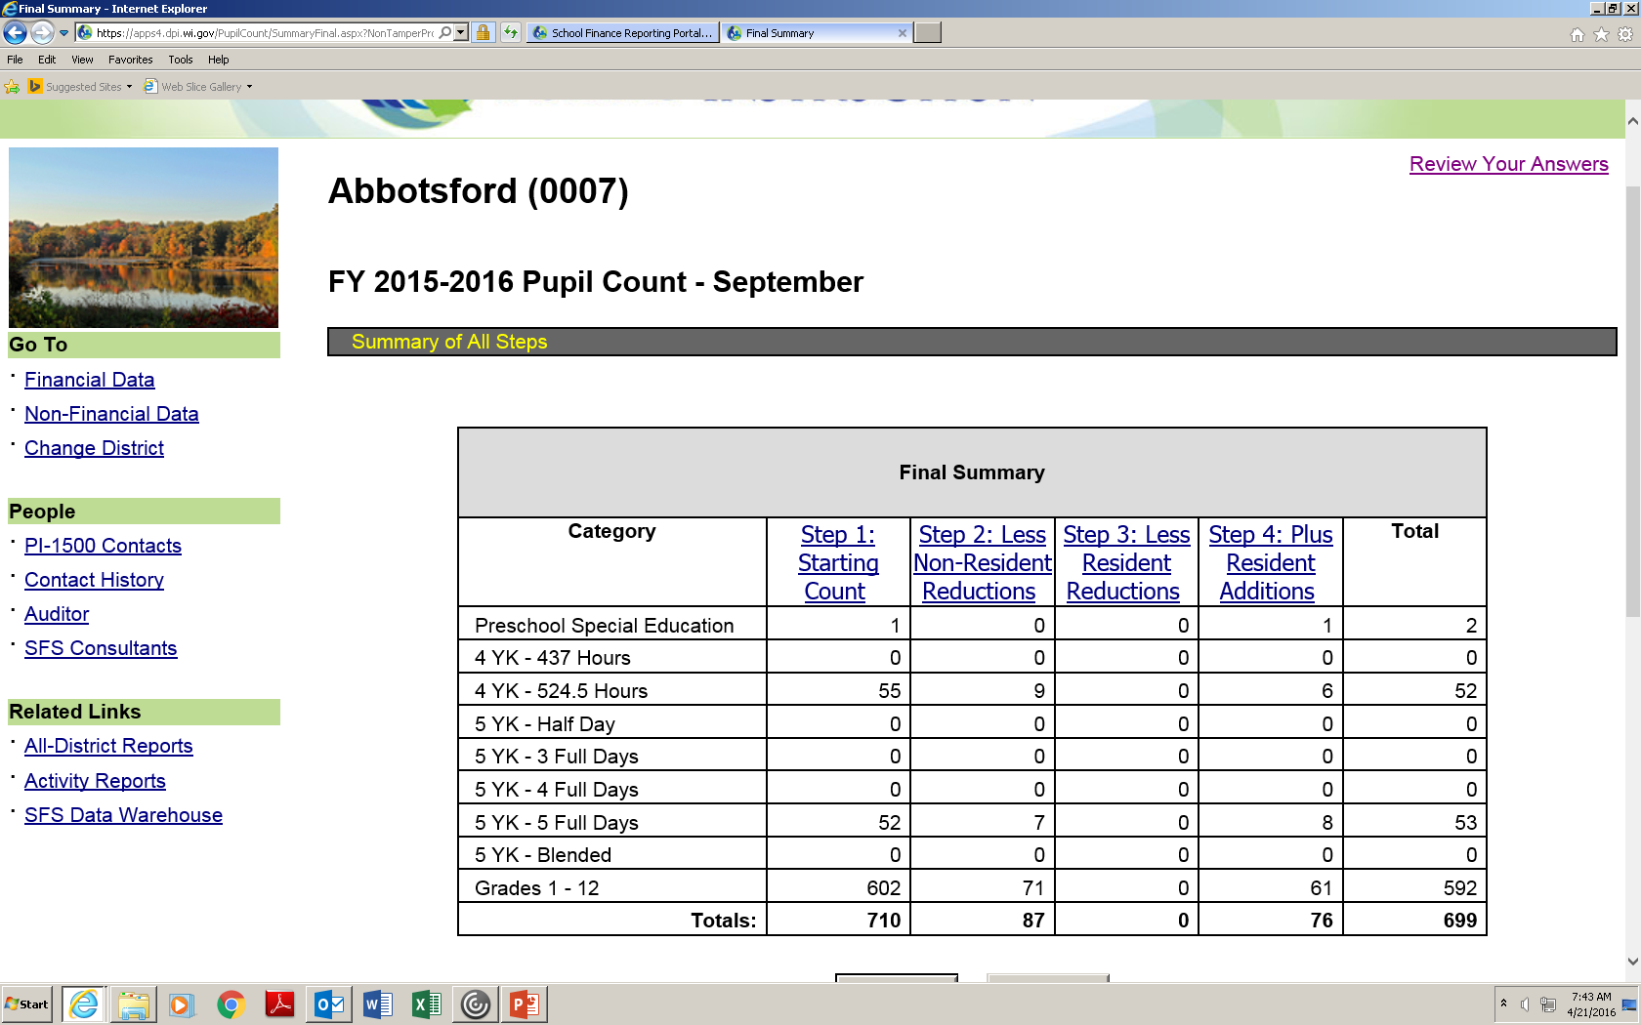
PUPIL COUNT REPORTING
Final Summary

Slide 12
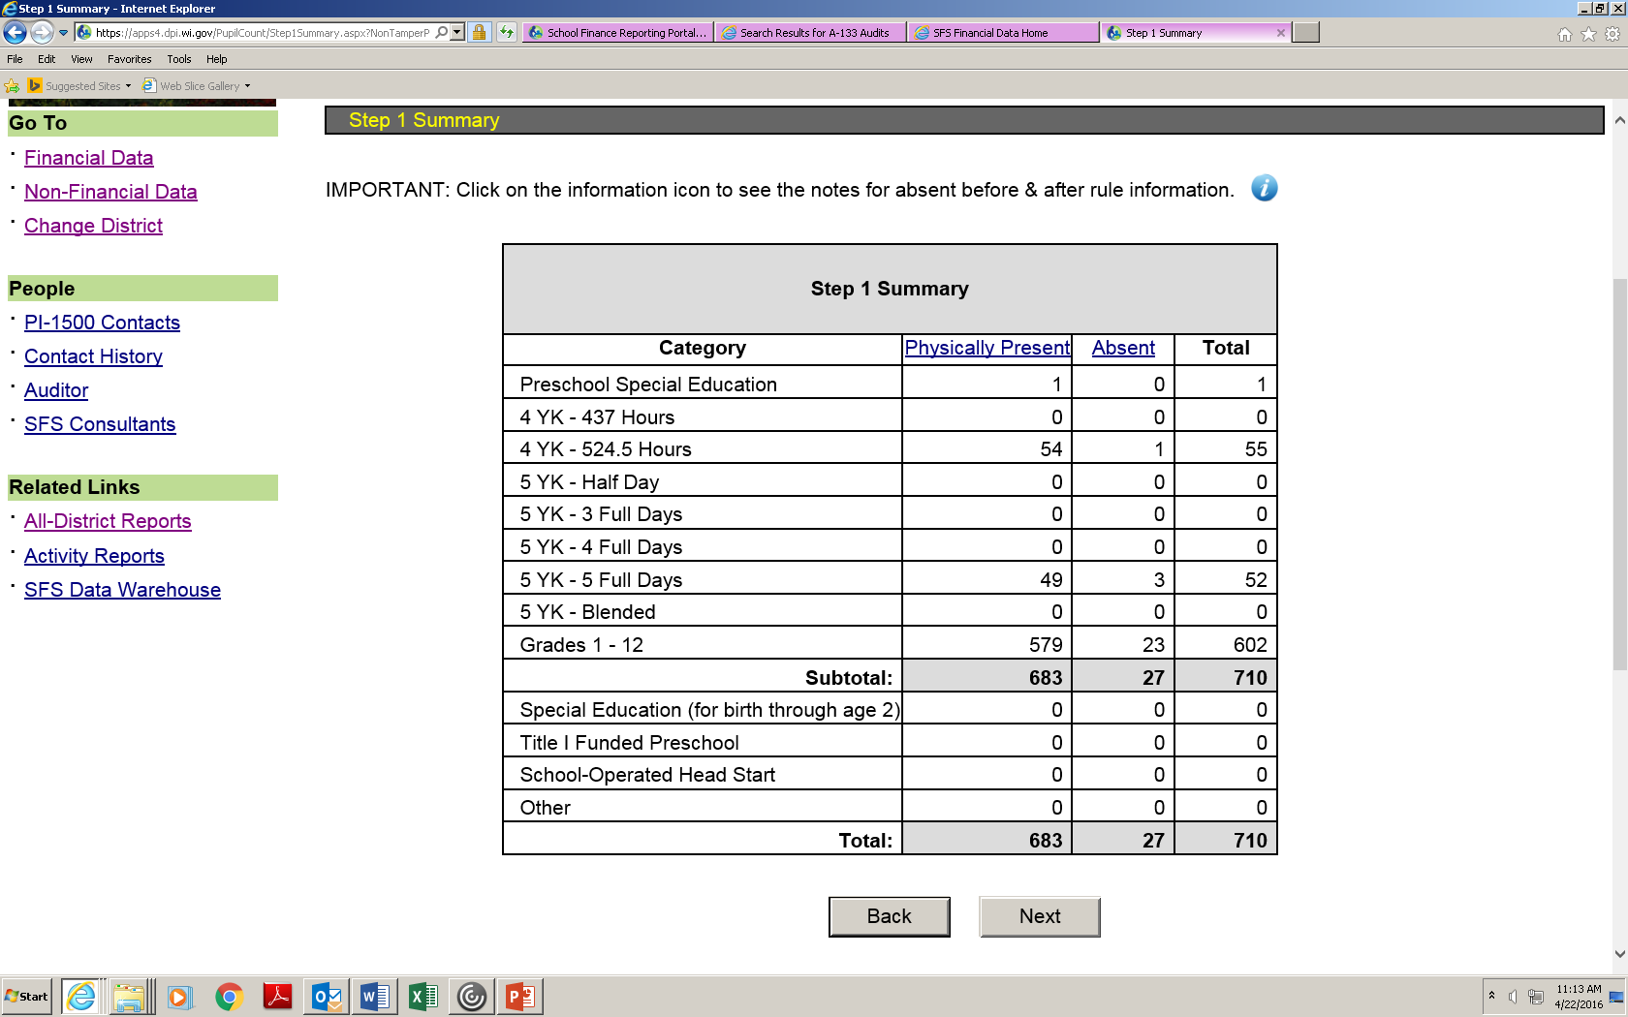
PUPIL COUNT REPORTING
Head Count

Slide 13
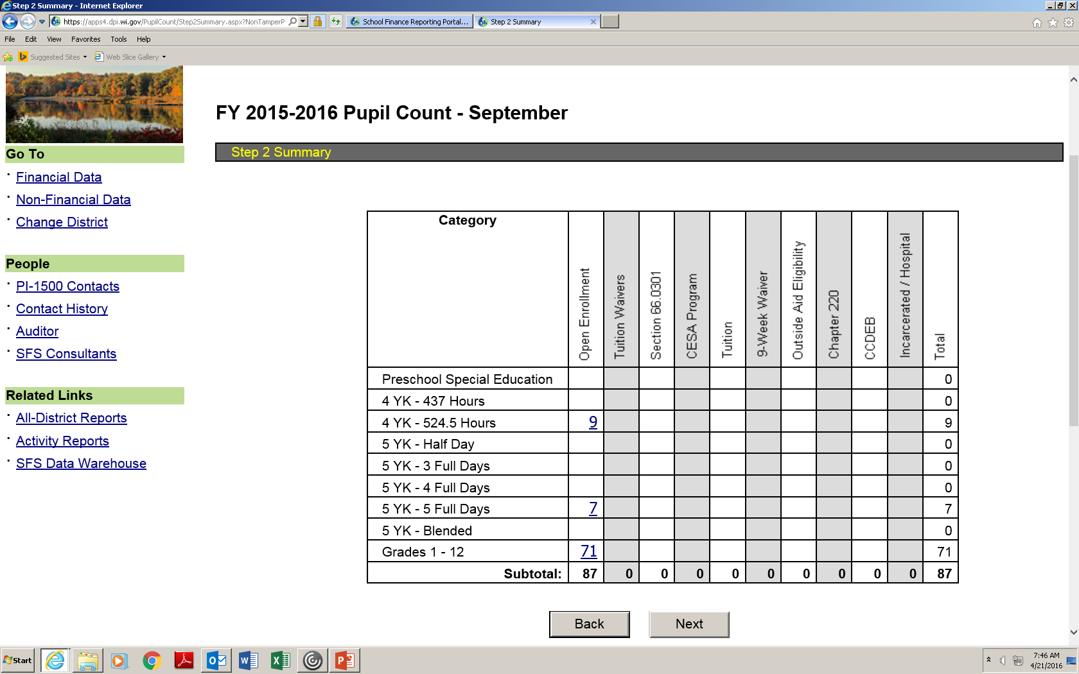
PUPIL COUNT REPORTING
Non-Resident Reductions

Slide 14
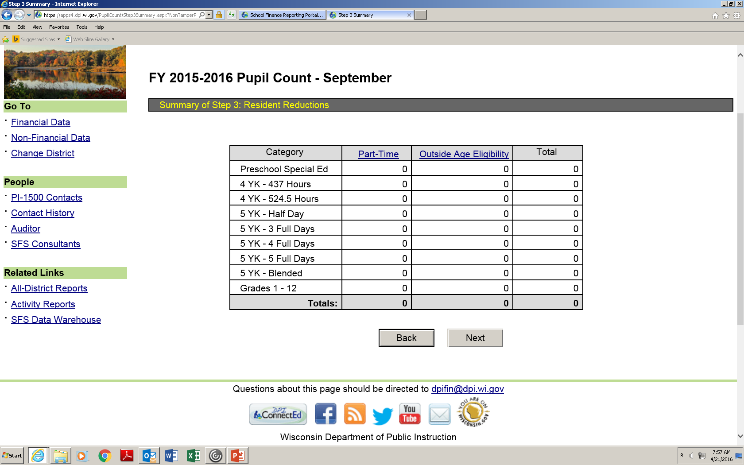
PUPIL COUNT REPORTING
Resident Reductions

Slide 15
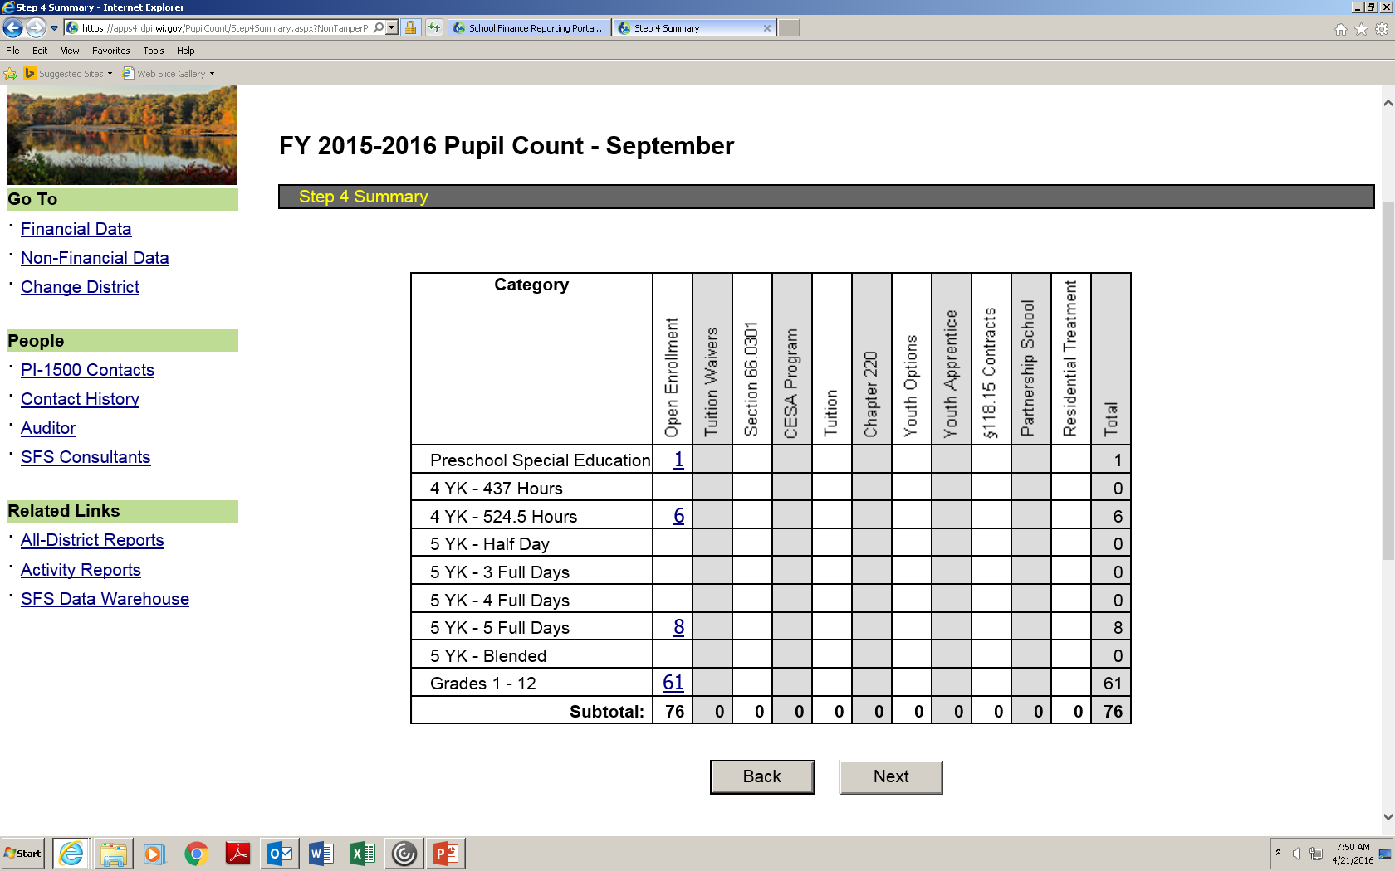
PUPIL COUNT REPORTING
Resident Additions

Slide 16
Membership Report Amendments/
Audit Exceptions
Prior to Membership Audits Being Announced
  Districts may go into either the September, January, or Summer Pupil Count Reports and make any necessary changes.
After membership audits have been announced
  Districts make changes thru the auditor if having a membership audit
    Will show as an audit change and is reported as an exception
  Contact the School Finance Team to make changes if not having a membership audit (membership reports will be closed for these districts and SFS will have to open the report)

Slide 17
Auditing Membership

Slide 18
2015-16 Membership Audit Findings
16 of 164 Districts with Pupil Count Reconciliation Issues
16 of 147 Districts with Summer School had Student Fee Findings
Other Issues
  Clerical Errors – District not properly tabulating school level counts when calculating district totals.
  Students reported in wrong count category with emphasis on early childhood programs, including four and five-year old kindergarten.
  Districts not properly following the PI-1563 instructions in counting resident and non-resident students.
  September to January pupil count reconciliation not properly reconciled by district management.
Other Summer School Membership Issues
  Summer School Classes Excluded
  Summer School Minutes Not Correctly Computed

Slide 19
Auditor Workpaper Reviews
Criteria: The Wisconsin Department of Public Instruction (DPI) requires that all late enrollments and early withdrawls to the date of the audit be tested for the following criteria:
      In attendance for instruction (including homebound instruction) on count date OR any day before and any day after while remaining a resident during the period of absence.
      Resident of school district.
      Meets age requirements.
      Full time per district policy.
      Not enrolled in private school or home-based instruction.
Comments: The School District was required to have a membership audit performed during 2014-15. Documentation to support the required testing of the late entries and early withdrawls was not included in the workpapers.

Slide 20
Auditor Workpaper Reviews
Criteria: The Wisconsin Department of Public Instruction (DPI) requires that the auditor document district-wide procedures used to compile the counts. The auditor is also required to document an understanding of the overall enrollment data collection system.
Comments: Documentation of the district wide procedures to compile the counts and the documentation of the understanding of the enrollment data collection system was not found in the workpapers.

Slide 21
Auditor Workpaper Reviews
Criteria: The Wisconsin Department of Public Instruction (DPI) requires a sample of thirty pupils be tested at each selected attendance center. Additional pupils should be selected in increments of 30 if errors are found in the sample. The auditor needs to determine that those counted were eligible at the September count date according to specific criteria listed in the membership audit program.
Comments: The auditor did test students from a student listing dated March 20, 2013. This list was not sorted by site and a determination if the correct sample size was used could not be obtained during the site visit.

Slide 22
Auditor Workpaper Reviews
Criteria: Flat fees cannot be charged by districts unless a detailed analysis of costs incurred by class can substantiate that the fee charged is not in excess of consumable supplies for each class.
Comments: The membership audit program step which requires the testing of summer school fees charged noted that the district charges a flat fee for summer school plus additional fees for certain summer school courses. No auditor testing of fees was performed.
Recommendation: We recommend that testing of summer school include the required testing of fees to ensure that fees charged do not exceed the cost of consumable supplies provided for each summer school class.

Slide 23
MEMBERSHIP AUDIT RESOURCES
Review and have available:
  Guidelines for Counting Students (General Count Guidelines for the PI 1563 Worksheet) located at
    http://dpi.wi.gov/sfs/children/enrollment/membership-info-reporting
  Or directly
    http://dpi.wi.gov/sites/default/files/imce/sfs/doc/guidelinesforcounting_Sep_15.docx
  Includes a description of the count categories

Slide 24
Audit Procedures – Head Count
Obtain supporting documentation for the reported headcount
  listings of students by attendance center
  a summary of the attendance centers
  these students will either be in attendance for instruction on the count date or absent on the count date but in attendance one day before and one day after without change in residency
Trace the supporting documentation obtained to the head count reported in the portal
The supporting documentation should be the basis for further sample testing

Slide 25
Audit Procedures – Testing
Select attendance centers for which pupil enrollment and attendance records are to be examined for eligibility for inclusion in the membership count in accordance with the following criteria:
  High schools and junior high or middle schools:
          Total district enrollment under 5,000; each attendance center to be examined.
          Total district enrollment over 5,000; at least half of high school and half of middle school attendance centers to be examined. Selection of attendance centers is to be made on a random basis.
  Elementary schools (all districts):
          A minimum of three attendance centers to examined.
          Selection of attendance centers is to be made on a random basis.

Slide 26
Audit Procedures – Testing
For each attendance center selected for examination of pupil enrollment and attendance records:
  For ALL late enrollments and early withdrawals to the date of audit, determine that pupils included in the count were eligible at each count date according to the following count criteria:
      In attendance for instruction (including homebound instruction) on count date OR any day before and any day after while remaining a resident during the period of absence.
      Resident of school district.
      Meets age requirements.
      Full time per district policy.
      Not enrolled in private school or home-based instruction.

Slide 27
Audit Procedures – Testing
Select a sample of at least 30 additional pupils at each selected attendance center and determine that those included in the count were eligible at the September count date according to count criteria:
  In attendance for instruction (including homebound instruction) on the count date OR any day before and any day after while remaining a resident during the period of absence.
  Resident of school district.
  Meets age requirements.
  Full time per district policy.
  Not enrolled in private school or home-based instruction.

Slide 28
Audit Procedures – Testing
An extended sample is required if exceptions are found in the sample of 30
  Select additional samples of 30 pupils until no additional errors are found or the entire population is examined
  (Additional 30 totaling 60, 90, 120, etc.).
An auditor may use alternative procedures if an exception identified is an isolated incident.
  Alternative procedures must be well documented.
    (i.e. a high school senior graduates prior to the January count date. The District fails to remove all early graduates from the class list and erroneously counts them on the count date. An alternative procedure might be to verify that all seniors graduating prior to the January count date have not been included in the count)

Slide 29
Comparison to Prior Data
A comparison to prior data can be obtained from the September pupil count report by clicking on “Review Your Answers” and then “Comparison to Prior Data.”
Audit Procedure: Review the comparison of the current September count to the prior year September count for reasonableness.
Make inquiries regarding any significant or unexpected changes.
Comparison to prior data should be included in the auditor workpapers with documentation that the comparison was reviewed.

Slide 30
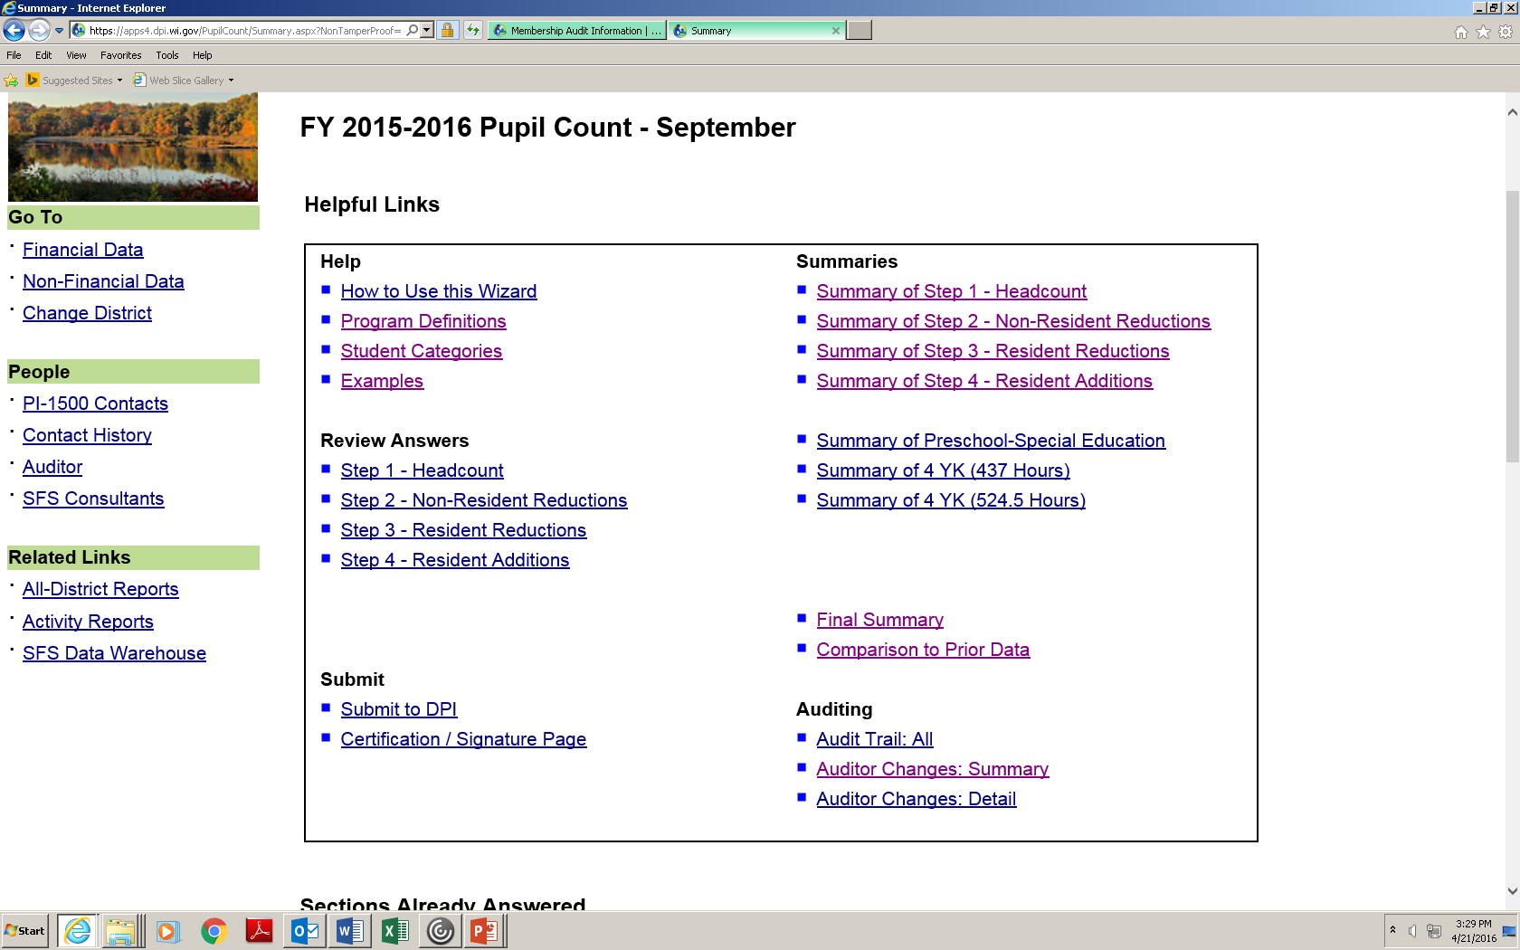
Comparison to Prior Data

Slide 31
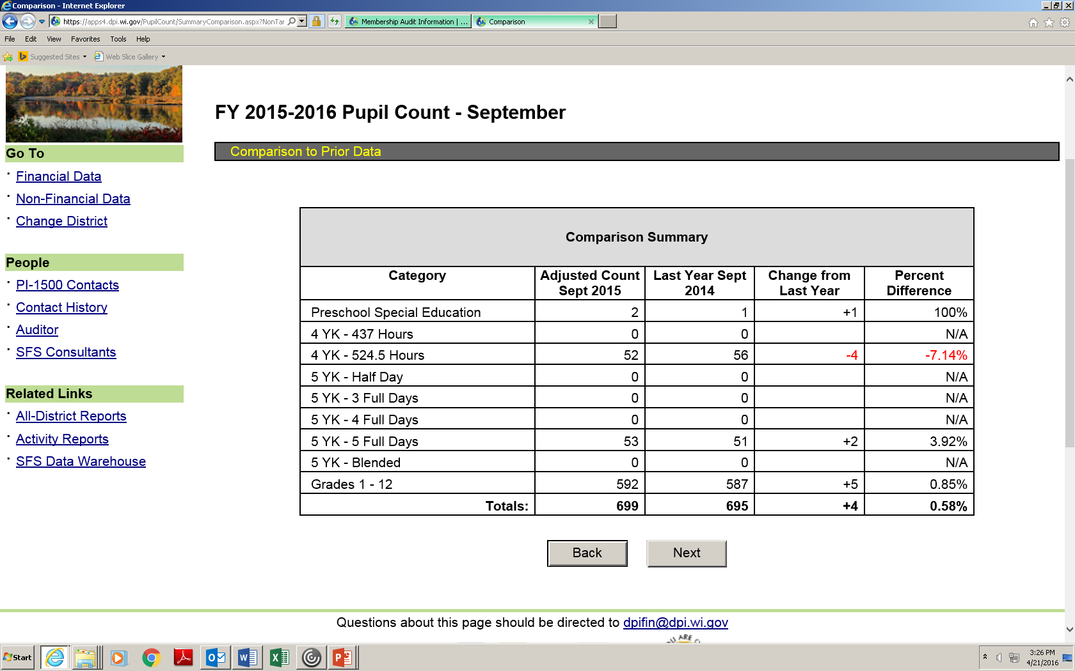
Comparison to Prior Data

Slide 32
Reconciliation of September to January Count
An excel spreadsheet can be found at http://dpi.wi.gov/sfs/children/enrollment/membership-info-reporting to assist the district in completing the reconciliation.
  The September and January columns in the excel reconciliation is pulled from the PI 1563 pupil count report on file with DPI
If the district has not performed the reconciliation prior to the audit, it is required to be performed during the audit process and a finding should be disclosed in the January pupil count schedule of the membership audit report.

Slide 33
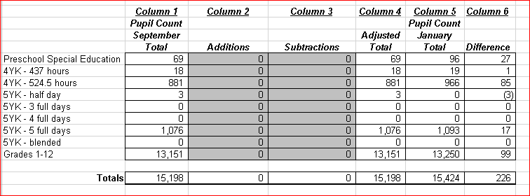
Reconciliation of September to January Count

Slide 34
Reconciliation of September to January Count
Obtain from the district a copy of the reconciliation
  Verify that the data for September and January agree to the pupil counts on file with DPI
  Obtain from district all supporting documentation to the reconciliation
      Early Withdrawals
      Late Enrollments
      Other adjustments
  Verify the accuracy of the reconciliation by tracing additions and subtractions to supporting documentation

Slide 35
Summer School Fees
Audit Example
1)-Request the schedule of course fees for the classes in the summer school program.
SAMPLE
Wisconsin School District
Summer School 2015 Programs
Elementary Soccer Class $20
Youth Summer Theater $50
Baking Made Easy $50

Slide 36
Summer School Fees
Audit Example
2)-Select a sample of programs (classes) and request the associated course expenses for these classes in the summer school program.
SAMPLE
Summer School 2015 Programs
Function Object Expenditure
Elementary Soccer Class 162000 400 $1150.00
Youth Summer Theater 122000 400 $1500.00
Baking Made Easy 135000 400 $4740.00

Slide 37
Summer School Fees
Audit Example
3)-Review Information regarding fees available from the DPI School Financial Services website at http://dpi.wi.gov/sfs/finances/budgeting/school-fees .
  Districts may only charge a minimal material fee if the district is claiming membership for state aid or revenue limit purposes for the course
  There shall be no cost to the resident student beyond individual use supplies (towels, gym clothes, notebooks, pencils), textbooks, or similar items (workbooks) if the district claims state aid under Wisconsin Statute 121.14
  Items for which fees are charged must be legally permitted and actually purchased for summer school use
  Summer school fees may not be used to subsidize other classes or students

Slide 38
Summer School Fees
Audit Example
4)-Inspect the detail expenditure listing provided by the district and determine that the costs associated with the fees are eligible cost
SAMPLE
Detail of the Elementary Soccer Class
Item Amount
Towels $225.00
Pens/Pencils $75.00
Uniforms $750.00
Water Bottles $75.00
Handouts $25.00
Totals $1150.00

Slide 39
Summer School Fees
Audit Example
SAMPLE
Detail of the Baking Made Easy
Item Amount
Wardrobe $1500.00
Teacher $2950.00 Not Allowable
Lighting $50.00 Not Allowable
Programs $240.00
Total $4740.00
Not Allowable $3000.00
Allowable Cost $1740.00

Slide 40
Summer School Fees
Audit Example
5)-Determine that fees received for summer school courses do not exceed the cost of personal use items (towels, gym clothes, uniforms, consumable supplies, materials, and books) used in these courses. The comparison of fees with course expenses should be done on a course by course basis.
SAMPLE
Students Cost per Fee Per
Class Cost PI-1804W Student Student
Elementary Soccer Class $1150.00 50 $23.00 $20.00 OK
Youth Summer Theater $1500.00 33 $45.45 $50.00 Not Okay
Baking Made Easy $1740.00 22 $79.09 $50.00 OK

Slide 41
Summer School Fees
Audit Example
6)-Report a finding if fees charged each student exceed the cost per student per class
  Identify the class
  Identify the total fee charged for the class
  How much was charged over cost (total and per student)
  Identify total participants
    Report resident and non-residents separately
  Total resident minutes computed for the class
    Can be obtained from the PI-1804 excel worksheet
7)-Fee findings often result in summer FTE reductions and more audits

Slide 42
Membership Audit Reporting

Slide 43
Membership Audit Report
Agreed on Procedures Format
AICPA Audit & Accounting Guide for State and Local Governments
  Attendance Reporting (Chapter 12 paragraph 16)
    Most school districts receive financial assistance from state governments based on some measure of attendance
    Some states may require auditors to audit or otherwise perform procedures on attendance data
    Those engagements should be performed under the provisions of Statements on Standards for Attestation Engagements (See AT section 601)

Slide 44
Agreed-Upon Procedures Engagements (AT section 601)
  Types of Audits
    Financial
    Attestation
    Performance
  Attestation engagements are designed to provide assurance on matters other than financial reports
The objective of the practitioner’s agreed-upon procedures is to present specific findings to assist users in evaluating and entity’s compliance with specified requirements or the effectiveness of an entity’s internal control over compliance based on procedures agreed upon by the users of the report.
See AT Section 201 (Agreed Upon Procedure Engagements)
  The Standards for Attestation Engagements can be found at http://www.aicpa.org/Research/Standards/AuditAttest/Pages/SSAE.aspx.

Slide 45
Membership Audit Report
Agreed on Procedures Format
Revised to reflect an Agreed-Upon Procedures Format
Table summarizes the audit procedures and any related findings
  Essentially the same procedures (just a different report format)
Note: The practitioner should establish an understanding with the client regarding the services to be performed. When the practitioner documents the understanding through a written communication with the client (an engagement letter)

Slide 46
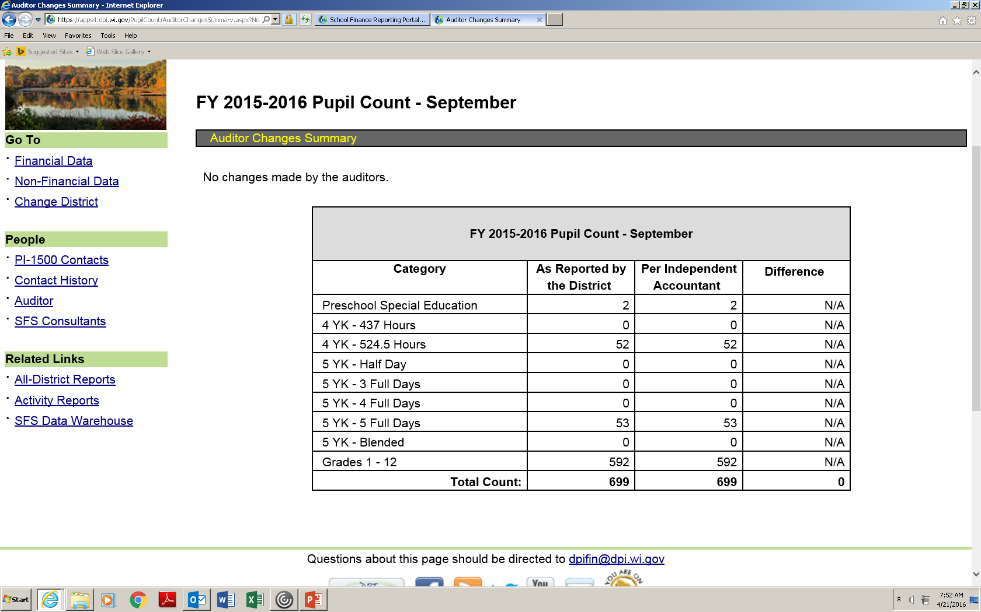
Membership Audit Report
Auditor Changes: Summary

Slide 47
Other issues

Slide 48
Reporting Part Time Home-School, Non-Resident Pupils
Non-resident, part time attendance home-schooled pupil information is not be collected in the wizard.
Districts should report information by using the Non-Resident Part Time Attendance spreadsheet found at: http://dpi.wi.gov/sfs/children/enrollment/membership-info-reporting.
A school district counts for General Aid (but not Revenue Limit) purposes a non-resident, home-school pupil (but not a non-resident private-, parochial- or tribal-school pupil) taking courses in the district under §118.53 in an amount equal to 0.25 FTE per course, up to two courses per semester (i.e., district could count a maximum of 0.50 FTE per non-resident, home-school pupil).

Slide 49
Part Time Home-Schooled, Resident Pupils
2013 Wisconsin Act 20 permits a resident, home-school pupil who has met the standards for admission to the course under §118.53 (2) to enroll in up to two courses at a public school, per semester, if the school board determines that there is sufficient space in the classroom. Enrollment in courses at the public school by the home-school pupil is open to all grade levels (i.e., not limited to grades 9 through 12); formerly, they were permitted to take courses at only the high school level.
FTE count will be equal to the aggregate number of hours attended by these part-time, home-school pupils divided by the full-time hours of attendance at each grade level.

Slide 50
Part Time Home-Schooled, Resident Pupils
Part Time Home-Schooled Pupils should be included in head count (Step 1 of the wizard).
Then in Step 3, Resident Reductions, the pupil count wizard will direct districts to enter the number of resident part-time home-school pupils, the number of hours attended by these pupils, and the hours of full time attendance for each grade level.
The FTE for this set of pupils will be calculated automatically from this data and added to the district’s membership count for General Aid purposes.

Slide 51
Membership Audits
Further Information
Chapter 6 of the Audit Manual at http://dpi.wi.gov/sfs/finances/auditors/audit-manual.
Membership Audit information including the audit programs at http://dpi.wi.gov/sfs/finances/auditors/membership/overview.
Membership Information and Reporting including the pupil count reconciliation at http://dpi.wi.gov/sfs/children/enrollment/membership-info-reporting.
Summer school membership information at http://dpi.wi.gov/sfs/children/enrollment/membership-info-reporting.

Slide 52
SFS Contact Information (Area Code: 608)
Bruce Anderson, Consultant 267-9707
Carey Bradley, Consultant 267-3752
Dan Bush, Consultant 267-9212
Karen Kucharz, Consultant 266-3464
Victoria Chung, Accountant 267-9205
Brian Kahl, Auditor 266-3862
Gene Fornecker, Auditor 267-7882
Vacant, Auditor 267-9218
Debi Towns, Assistant Director 267-9209
Bob Soldner, Director 266-6968
School Financial Services http://dpi.wi.gov/sfs

