Slide 1
School Board Boundary Appeal Board Petition
Request to detach from the West Allis – West Milwaukee (WAWM) School District and join the New Berlin (NB) School District

Slide 2
Virtual Schooling vs In-Person Schooling
WAWM School District was not back to full in-person learning for over a year while NB School District started the 2020-2021 school year with in-person learning.
I wanted my 1st and 3rd grade daughters back to in-person learning during these crucial developmental years.
The WAWM School Board failed to lead by example and were holding virtual school board meetings when students finally did return to the classroom.
The CDC provided recommendations and evidence of in-person learning months before WAWM was able to return to in-person learning.
Waukesha County health data was not used to make decisions regarding in-person learning even though the elementary school is in Waukesha County.

Slide 3
Sense of Identity
The West Allis – West Milwaukee School District does not recognize the New Berlin residents in the school district.
This is evident in the name of the school district that recognizes West Allis and West Milwaukee but not New Berlin.
Lack of WAWM SD engagement with the City of New Berlin.
Property taxes pay for the New Berlin Recreation Department and the WAWM Recreation Department.
Tax rate discrepancies between New Berlin residents and the rest of the SD residents.

Slide 4
Procedure under WI State Statute 117.12
Population of West Allis is 60,000 and New Berlin is 40,000.
Many years ago, while both communities were mostly undeveloped it made sense for the school district to have students from both municipalities.
The only way to realign the school district boundaries is through this appeal process.
The WAWM SD is the 2nd largest SD in Milwaukee County only behind the Milwaukee SD. Therefore, they are able to easily accommodate our detachment.
WAWM SD brought up concerns about my property not being contiguous to the school district boundary.

Slide 5
School District Boundaries

Slide 6
WI Supreme Court Case Stockbridge SD v. DPI
Stockbridge SD took the ruling of the School District Boundary Appeal Board to the Supreme Court.
The Supreme Court allowed the detachment of “island” parcels from school districts that adjoin.
The Supreme Court stated that a detached parcel need not adjoin the school district to which it is attached.
This is clear guidance to the School District Boundary Appeal Board, and it can be applied directly to my appeal.

Slide 7
Open Enrollment
I was approved for Open Enrollment through the NB SD at the beginning of this school year.
Family disability and transportation issue.
NB SD was willing to discuss transportation options with us since their school bus already drives by our house.
But the WAWM SB has a policy that does not allow other school districts to provide transportation to anyone within the WAWM SD.
Our family disability and transportation issue also precludes us from sending our children to a private school.

Slide 8
2018 – 2019 DPI School District Report Card

Slide 9
2018 – 2019 DPI Elementary School Report Card

Slide 10
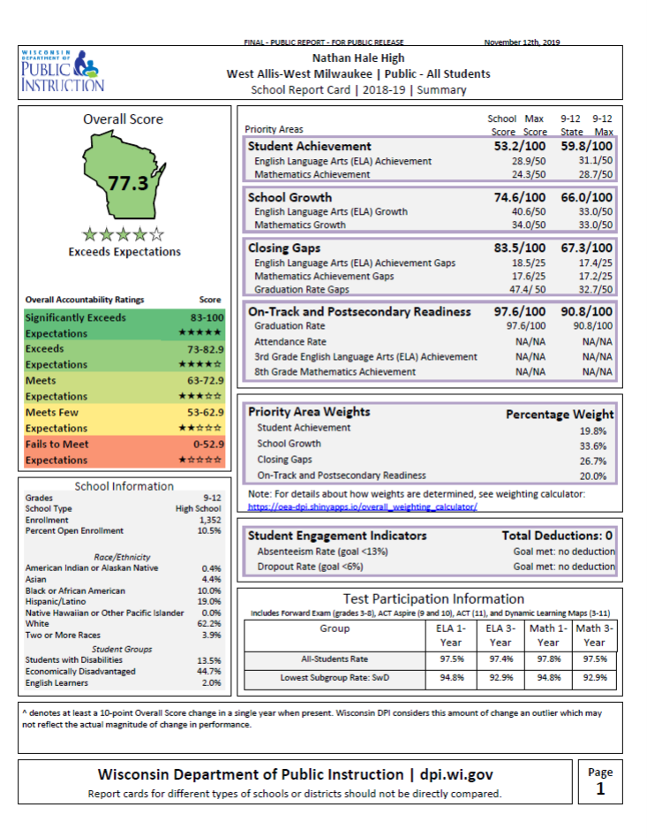
2018 – 2019 DPI Middle/High School Report Card

Slide 11
Social Justice

Slide 12
Values
School Board Clerk Gary Schultz told the rest of the WAWM SB that they should resign to the fact that they are a steppingstone SD for schoolteachers.
The WAWM Superintendent informed the SB that I should not be allowed to join the NB SD due to my children’s race.
The Superintendent also states that I should not be allowed to join the NB SD because it MAY result in the WAWM SD schools seeing a higher concentration of students with disabilities.
The Superintendent implies negative impacts to the NB SD if I was allowed to join the NB SD, but if that was the case why would the NB SB approve my petition?

Slide 13
Thank You for Your Time and Consideration
See Exhibit titled “Attachment to Resolution February 22, 2021” that was drafted by the WAWM SD.
I provided a long list of reasonable explanations to have my children attend the SD in which they reside, identify with, and has their best educational interests in mind.
Please take my appeal into consideration as it applies to me and my family and do not let the 2nd largest SD in Milwaukee County tell you that the tax levy lost from my children will negatively impact their operations. My children’s transfer would go unnoticed by the WAWM SD when the 2021-2022 school year begins.

