Slide 1
DPI Update
WICPA School District Audit Conference
May 22, 2018 -- Stevens Point, WI
May 23, 2018 -- Milwaukee, WI

Slide 2
Today We Will Cover …
    Audit Program Changes
    Community Programs and Services – Fund 80
    Restricted Fund Balances
    Energy Efficiency Exemption
    Premium on the Issuance of Debt
    Charter School Authorizer reporting
    Auditor Workpaper Reviews
    Auditor Questions/Issues
    Due Dates
    WUFAR Update
    Federal ESSA - School Level Financial Transparency

Slide 3

DPI Audit Manual Updates
Audit Program Changes & State Single Audit Guidelines

Slide 4
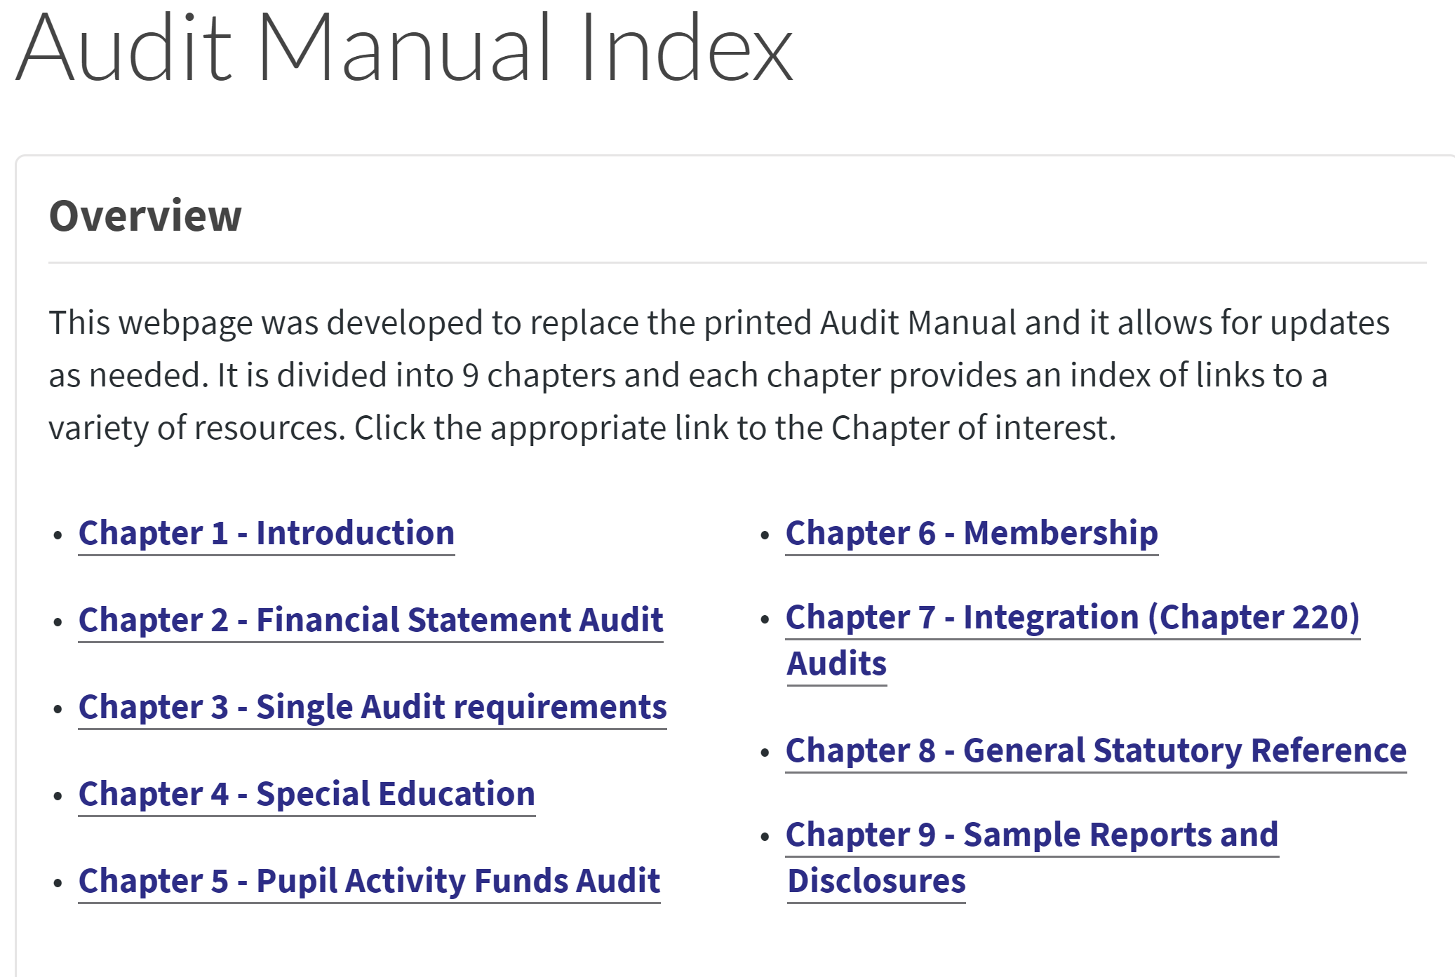
Audit Program Changes & State Single Audit Guidelines

Slide 5
DPI Audit Manual
DPI Audit Manual Web page at https://dpi.wi.gov/sfs/finances/auditors/audit-manual.
Items that have been updated or that are new in 2018 include:
  Chapter 1 - Wisconsin Administrative Code PI 14.03
  Chapter 3 - Additional Audit and Reporting Requirements
  Chapter 3 – Department of Public Instruction Audit Programs (look for those with updates)
  Chapter 9 – Sample Reports on Compliance

Slide 6
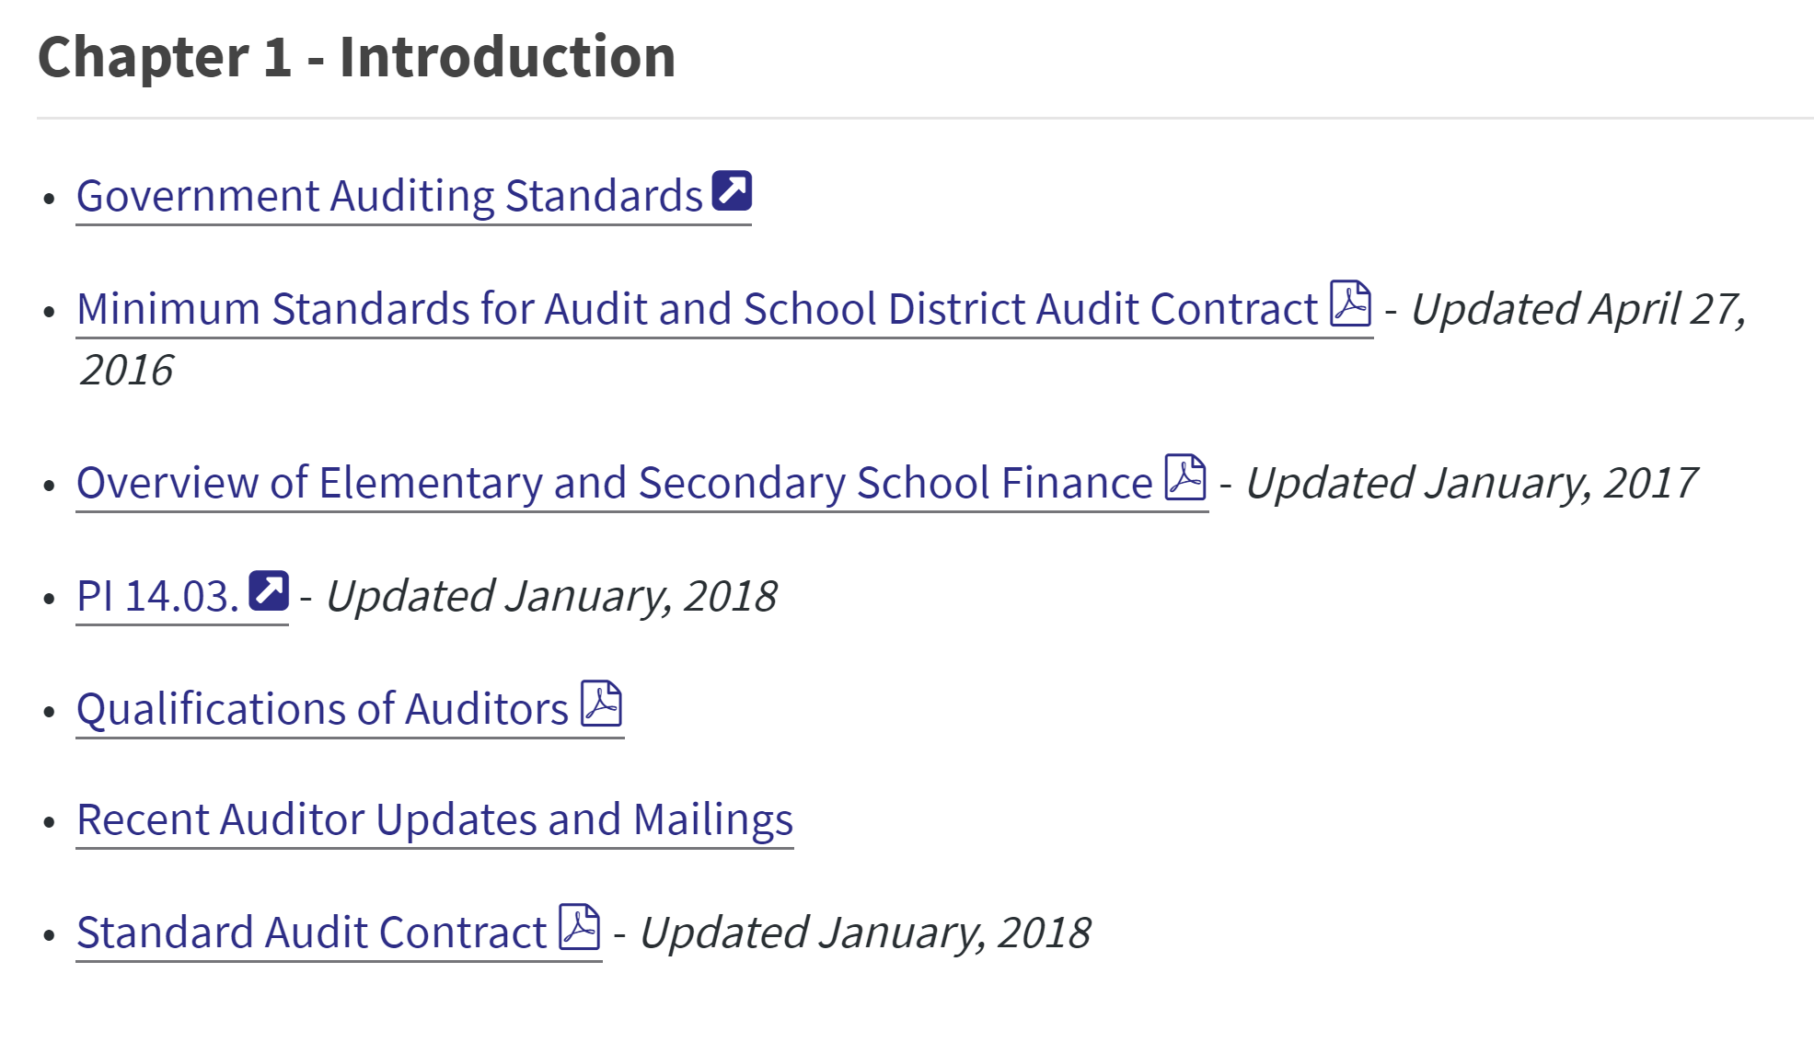
Audit Program Changes & State Single Audit Guidelines

Slide 7
Wisconsin Administrative Code
Chapter PI 14 – School Finance
January, 2018 Revision
PI 14 has three main sections:
  PI 14.01 – Official Enrollment
  PI 14.02 – Minimum Uniform Provisions for District Contracts Per 66.0301
  PI 14.03 – Minimum Standards for Audit and District Audit Contract
Notes:
Chapter PI 14 discusses school financial matters including determining the official pupil enrollment of each school, specifying how school districts can contract with each other for services, and the standards for auditing school district accounts. There was a need to update based on recent federal guidance, generally accepted accounting principles, and regulations regarding minimum audit standards and standard contracts. This rule change aligns Department work to current requirements.

Slide 8
PI 14.03 Minimum Standards For Audit and District Contract
PI 14.03 (1) Definitions
PI 14.03 (2) Minimum Standards For Audit
PI 14.03 (3) Standard School District Audit Contract
PI 14.03 (4) Noncompliance With The Minimum Standards For Audit
Notes:
PI 14.03 - Minimum Standards For Audit and District Contract has four sections. We want to cover changes that were made to (1) and (2) and the PI14 A appendix. Again they were changed to reflect federal guidance, generally accepted accounting principles, and regulations regarding minimum audit standards and standard and align with DPI work to current requirements.

Slide 9
Wisconsin Administrative Code
Chapter PI 14.03
PI 14.03 (1) (c) is created to read:
“Uniform grants guidance” means the provisions of the United States office of management and budget, uniform administrative requirements, cost principles, and audit requirements for federal awards under 2 CFR, part 200.
Notes:
Again they were changed to reflect federal guidance,

Slide 10
Wisconsin Administrative Code
Chapter PI 14.03
PI 14.03 (2) (a) 1., 2. care amended to read:
PI 14.03 (2) (a) Minimum standards for audit. Under s. 120.14 (1), Stats., at the close of each fiscal year, the school board of each common or union high school district shall employ a licensed accountant to audit the school district accounts and certify the audit. The minimum requirements for the audit are as follows
PI 14.03 (2) (a) 1. The auditor shall conduct an examination of basic financial statements including the respective financial position of the governmental activities, each major fund, and the aggregate remaining fund information of the school district for the fiscal year.
PI 14.03 (2) (a) 2. c. Uniform grants guidance.
Notes:
Again they were changed to reflect federal guidance, generally accepted accounting principles, and regulations regarding minimum audit standards and standard.

Slide 11
Wisconsin Administrative Code
Chapter PI 14.03
PI 14.03 (2)(c) 3.is amended to read:
PI 14.03(2)(c)3. The auditor shall observe on school district premises the adequacy of the systems of internal control for all funds of the school district, including those concerned with maintaining compliance with legal provisions related to finance. If material weaknesses are noted, the auditor shall review appropriate recommendations with the appropriate administrator and shall include them in a separate letter to the school board.
Notes:
Again they were changed to align with DPI work to current requirements.

Slide 12
Wisconsin Administrative Code
Chapter PI 14.03
Reports. The auditor shall submit to the school board the following reports and shall supply copies for transmittal to the department and other agencies as may be required under applicable statutes or rules:
  PI 14.03(2)(d)1. Auditor's report on the school district's financial statements prepared according to generally accepted accounting principles, as promulgated by the governmental accounting standards board, with supplemental information as required by the department or requested by the district.
  PI 14.03(2)(d)2. Financial audit statement for the fiscal year.
  PI 14.03(2)(d)3. Management letter, commenting on material weaknesses in internal control and identifying possible noncompliance with any legal provisions related to finance with appropriate recommendations.
  PI 14.03(2)(d)3m. Auditor's communication with those charged with governance, including any significant findings or issues from the audit.
  PI 14.03(2)(d)4. Federal program audit reports and schedules, as appropriate.
  PI 14.03(2)(d)5. State program audit reports and schedules, as appropriate.
  PI 14.03(2)(d)6. Membership agreed upon procedures report, prepared in accordance with standards for attestation engagements promulgated by the American institute of certified public accountants, if required by the department under s. 115.28 (18),
Notes:
PI 14.03 (2)(d) describes the reports to be submitted to the DPI (Changes in Bold italics)
Updated to reflect generally accepted accounting principles, and regulations regarding minimum audit standards and standard and align with DPI work to current requirements. PI 14.03(2)(d)3m. Created, PI 14.03(2)(d)6. Modified “audit” replaced with “agreed upon procedures”. (Note: this is an original slide, important to talk about all reports not just changes.)

Slide 13
Wisconsin Administrative Code
Chapter PI 14 Appendix
The language changes found in the rule are reflected in the Standard School District Audit Contract found in the PI-14 Appendix
Notes:
Contract reflects the current rule, including changes.

Slide 14
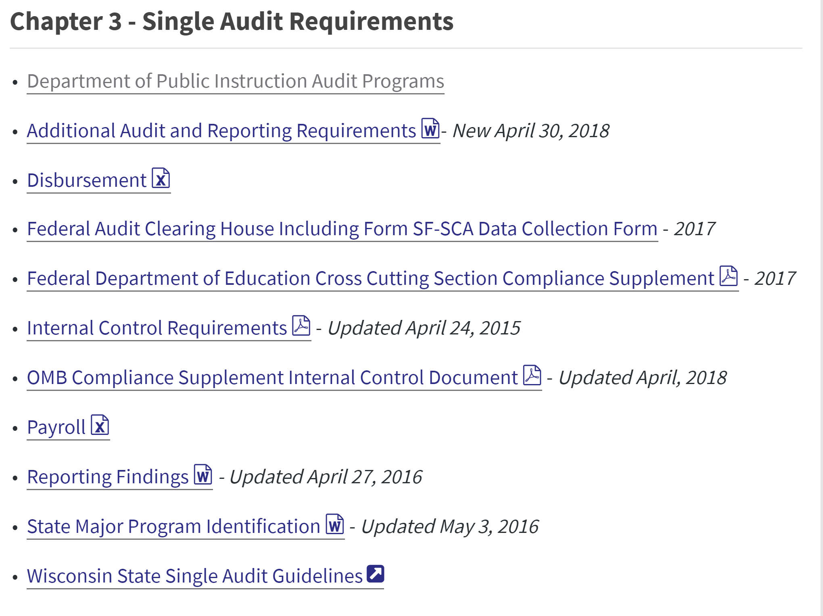
Audit Program Changes & State Single Audit Guidelines
Notes:
New Compliance Supplement Issued on May 17, 2018 (Added by Tim C)
Use the 2018 Supplement when testing the following programs: 84.000 (cross-cutting section),
84.010, Title I grants to LEA
84.011, Migrant Education - State Grant Program
84.282, Charter Schools
84.365, English Language Acquisition Grants (Title III, Part A)
84.367, Supporting Effective Instruction State Grant (Title II Part A)
84.424, Student Support Effective Instruction State Grant (Title IV, Part A)
The AICPA has issued some additional guidance and tools for using Supplement see the AICPA website (May 18, 2018)

Slide 15
Additional Audit and Reporting Requirements (New Document )
Compliance with State Statutes Checklist
  The Department of Public Instruction requires that the compliance with state statutes checklist be completed as part of all audits involving funding from the department.
Schedule of Expenditure of Federal Awards and Schedule of Expenditures of State Awards
  Required to be presented as Supplementary Information as part of all audits involving funding from the department.
State Summary of Auditor Results
  The schedule of findings and questioned costs must include a Summary of Auditor Results for state programs.

Slide 16
State Summary of Auditor Results
Required: The Summary of Auditor Results for state programs (to be included in audit report when no single audit is required)
Should include the following:
  1)-An identification of state major programs by listing each individual state major program.
  2)-A statement about whether significant deficiencies or material weaknesses in internal control over major state programs were disclosed.
  3)-The dollar threshold used to distinguish between Type A and Type B state programs.
  4)-Type of report the auditor issued on compliance for state major programs (i.e., unmodified opinion, qualified opinion, adverse opinion, or disclaimer of opinion).
  5)-A statement as to whether the audit disclosed any audit findings that the auditor reported under the State Single Audit Guidelines or the Wisconsin Public School District Audit Manual
Notes:
Required to be included in audit report when no single audit is required.

Slide 17
Reports on Compliance
Sample Reports on Compliance
  Additional sample Auditor’s Reports on Compliance included in Chapter 9 of the Audit Manual
    No Single Audit and No Major Programs
    Limited Required Procedures on Non-major Programs
    Special Education Only
  Comments can be submitted to dpifin@dpi.wi.gov by June 1st

Slide 18
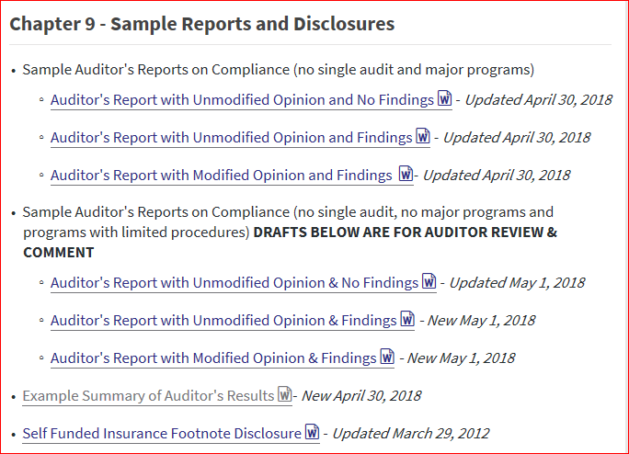
Reports on Compliance
Notes:
Please review and provide comments by June 1st to dpifin@dpi.wi.gov

Slide 19
General Aids Audit Program -Reminder
2015 Wisconsin Act 55 has created a new transfer amount of $12,000 for open enrolled pupils with disabilities, as defined by IDEA and Wis. Stats. § 115.76 (5).
2017 Wisconsin Act 59 adjusted the transfer amount to $12,207 for 2017-18
Nonresident school districts will NO longer bill the resident district for the open enrollment basic transfer amount plus any actual, additional costs to provide special education for open enrolled pupils with disabilities.
The Department of Public Instruction (department) will make the aid transfer payments for all open enrolled pupils with disabilities in the same manner as open enrolled non-disabled pupils.
Notes:
Fund 10 costs only. DPI makes aid transfers.

Slide 20
Annual Report – Edit Change for 2017-18
Open Enrollment amount reported must equal the DPI on Record amount for:
  Account 10E-435000-382
  Account 10R-000000-345
Notes:
Both regular and special education aid transfers are recorded the same for open enrollment.

Slide 21
Compliance with State Statutes
Wisconsin Act 59 (2017-19 Budget)
  School boards prohibited from considering a resolution to utilize the Energy Efficiency exemption to the revenue limit after December 31, 2017, until after December 3018.
    School Boards have the authority to adopt EEE resolutions after October 1, 2017 and before January 1, 2018 that are applicable beginning in 2018-19 and thereafter.
    A School Board may issue debt after December 31, 2017, to fund the energy efficiency exemption project(s) that were approved by the School Board prior to December 31, 2017.
Notes:
School boards may no longer pass or amend EEE resolutions

Slide 22
Compliance with State Statutes
Charter School Authorizer Reporting Requirements
  A schedule of operating costs (administrative costs) incurred must be included in the audited financial statements if the LEA has costs applicable to the solicitation or evaluation of charter school applications, review and approval of those contracts or other operating costs incurred during the year.

Slide 23
Pupil Transportation Aid
2017 Wisconsin Act 59 eliminated the reduction of state aid for pupils riding for fewer than 90 days during the regular school year.
  Therefore, the pupil enrollment information for regular transportation does not need to be collected.
Pupils are required to be classified in the PI-1547-SS transportation tables by days enrolled.
  The number of pupils enrolled 15 days or less for summer and/or interim session transportation is reported separately from pupils enrolled in excess of 15 days for summer and/or interim session transportation.

Slide 24
Per Pupil Aid
2017 Wisconsin Act 59
  The Per Pupil Aid program will provide $450 multiplied by the current three-year average membership from the district's 2017-18 Revenue Limit worksheet in 2017-18.
    $654 multiplied by the current three-year average membership in the 2018-19 school year
    $630 multiplied by the current three-year average membership in each school year thereafter
Notes:
Per Pupil Aid is calculated based on a point in time. See the per pupil aid webpage (https://dpi.wi.gov/sfs/aid/categorical/per-pupil-aid) for the Revenue Limit worksheet used to calculate the aid payment.

Slide 25
Per Pupil Aid
Type A program if the district receives over $250,000 in aid
New Audit Program in 2016-17 (Audit Procedures)
  Obtain the Wisconsin Department of Public Instruction’s Per Pupil aid eligibility worksheet. The aid eligibility worksheet can be found at https://dpi.wi.gov/sfs/aid/categorical/per-pupil-aid.
  Trace the membership information per the DPI eligibility worksheet to the revenue limit worksheet. The pre-populated revenue worksheet used for this computation can be found at https://dpi.wi.gov/sfs/aid/categorical/per-pupil-aid .
  Recalculate the district’s Per Pupil aid eligibility amount.

Slide 26
Membership Audits
What is new?
  Summer & Interim Session Membership Audit Frequently Asked Questions
    Available at https://dpi.wi.gov/sfs/finances/auditors/membership/overview.
  Pupil Count Reconciliation Online Course
    Available at https://dpi.wi.gov/sfs/finances/auditors/membership/overview.
  Inter-district Transfer Program
    Chapter 220 Reporting Tool
  PI-1804 Workbook Changes
    Fee Worksheets are Required

Slide 27
Integration Program - Chapter 220 Reporting Tool
Chapter 220 Reporting Tool can be found on the following web page: https://apps4.dpi.wi.gov/sfsCombined .
  List of Eligible inter-district students
    The receiving and sending districts have agreed on the data information entered into the Chapter 220 Reporting Tool.
    Need a WAMS account to access the reporting tool and only select district personnel have access, obtain the list from the district.
  Compare the student counts obtained from the district (DPI’s Chapter 220 reporting tool) to the PI-1563.

Slide 28
PI-1804 W Fee Spreadsheets
The PI-1804-Workbook has two additional spreadsheets that are used by districts to document summer and interim session school fee information.
  The spreadsheets are used by district staff to identify excess fee revenue on a per student per course basis.
  The spreadsheets used to identify excess fee revenue are required to be completed by district staff.
  Report a finding in Attachment 4 of the Independent Accountant’s Report on Applying Agreed Upon Procedures if the spreadsheets are not completed.

Slide 29
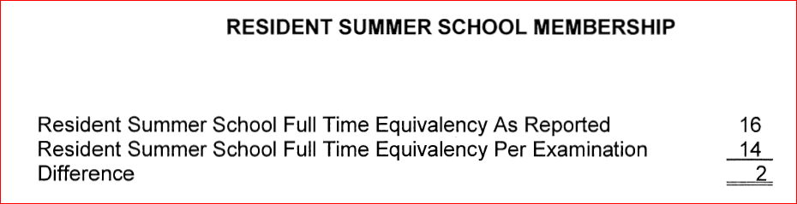
Summer/Interim FTE Findings
FTE Difference – Report a Finding

Slide 30
Community Programs and Services
Community Service Fund
Fund 80

Slide 31
Community Service Fund
State Law Defines - Wisconsin Statute 120.13 (19)
Fund 80 Levy - Outside Revenue Limits.
WUFAR establishes the Community Service Fund 80.
  This fund is used to account for activities such as adult education, community recreation programs such as evening swimming pool operation and softball leagues, elderly food service programs, non-special education preschool, day care services and other programs which are not elementary and secondary educational programs but have the primary function of serving the community.
  All district residents (regardless of school enrollment).

Slide 32
Community Service Fund
Districts must comply with Wisconsin Statute 120.13 (19) which allows the School Board to establish and maintain community education, training, recreational, cultural or athletic programs and services, outside the regular curricular and extracurricular programs for pupils.
  All instructional functions have been eliminated from the allowed Fund 80 accounts.
  Since 2015-16, audit procedure requires review of community programs and services.

Slide 33
Community Service Fund
Wisconsin Statute 120.13 (19):
  The school board may not expend moneys on ineligible costs, as defined by the department by rule. Costs associated with such programs and services shall not be included in the school district's shared cost under s. 121.07 (6).
PI 80 has been created to define ineligible Fund 80 costs.
  Costs must be the actual, additional cost to operate the community program and service.
Notes:
PI 80 became a permanent rule on May 1, 2015.

Slide 34
Community Service Fund
PI 80.02 Ineligible Costs [four basic defining requirements]
A school board may not expend moneys on ineligible costs for community programs and services. The following are ineligible costs:
  [1] Costs for any program or service that is limited to only school district pupils.
  [2] Costs for any program or service whose schedule presents a significant barrier for age-appropriate school district residents to participate in the program or service.
  [3] Costs that are not the actual, additional cost to operate community programs and services under s. 120.13 (19), Stats.
  [4] Costs that would be incurred by the school district if the community programs and services were not provided by the school district.

Slide 35
Community Service Fund
What does “actual” and “additional” costs mean to a school district?
Every Fund 80 expense is for services provided or materials purchased related to the Community Program or Service (CPS).
  Payroll for a worker - by the hour or by a limited contract
  Bus contracted to take a group of district residents to a specified site for a special event organized by the CPS staff.
  Supplies for a program that are clearly restricted to CPS activities. An auditor may ask the district to explain how purchased supplies are not being used for PK-12 programs.
Each Fund 80 expense will need to be documented within the district’s accounting system.
  Supporting documentation is part of the audit process.
Notes:
Every district with a Fund 80 will have an annual audit of the expenses. Depending on the process used by the auditor, if something was not checked last year this could be a question this year or in the future.

Slide 36
Community Service Fund
Community Programs and Services 80 Eligible Costs
Framework of review: Each function, program or service operated by a school district is a part of the district’s general school operations (normally Fund 10 costs);
  Unless documented to be part of the school board’s established community programs or services offered under Wis. Stat. 120.13(19).
Notes:
Determining if the program belongs in Fund 80 is not without limitations. A few standard examples are:
Adult Education,
Community recreation programs, such as summer softball/baseball
Day care service
If a CPS program or activity is using a school owned location who is pay for the utilities and related operational costs; Fund 80 or Fund 10?
If you are not sure, ASK us!

Slide 37
Community Service Fund
Community Programs and Services 80 Eligible Costs
The program or service offered by the school board is either a school cost (Fund 10) or a community program or service cost (Fund 80).
  Staff can be jointly funded, but job duties must be distinct and separate.
Fund 80 costs must be the actual, additional cost to operate community programs and services.

Slide 38
Community Service Fund
School Resource Officer/School Liaison Officer : Cost Analysis
Every position within the school district needs a job description.
The actual duties an individual performs will be the key to determining if the position is a school cost (Fund 10) or a community service cost (Fund 80).
School building security is a board responsibility and included in the district’s general fund (Fund 10).
  Absent a real and immediate threat to student, teacher, or school safety, and absent the situations described herein where formal law enforcement intervention is deemed appropriate, building-level school administrators shall have final authority in the building.

Slide 39
Community Service Fund
School Resource Officer/School Liaison Officer : Cost Analysis
Responsibilities of this position is not confined to the walls of the public school;
Communicates with service groups, churches, other municipal teams, local businesses and citizens to assist them in understanding the student issues in the community;
The work schedule of this position is NOT limited to the work hours of the school day (e.g. 7:30 a.m. to 3:30 p.m.);
Accessible to all school aged residents and serves as a community resource both on and off public school property;
Documentation must exist to demonstrate officer is a community-wide resource; and
Independent verification by district auditor and DPI.

Slide 40
Community Service Fund
Public Information and Community Engagement/Public Relations: Cost Analysis
Every district position needs a job description.
The actual duties an individual performs will be the key to determining if the position is a school cost (Fund 10) or a community service cost (Fund 80).
If staff member will focus on non-school Community Programs and Services that are of direct benefit to the community = Fund 80.

Slide 41
Community Service Fund
Public Information and Community Engagement/Public Relations: Cost Analysis
Every district position needs a job description.
The actual duties an individual performs will be the key to determining if the position is a school cost (Fund 10) or a community service cost (Fund 80).
School duties and responsibilities (Fund 10):
  Manage the district website and social media communications.
  All endeavors that will promote the district to the district residents.
  The gathering of feedback for district activities, through surveys, focus groups, etc.

Slide 42
Restricted Fund Balances

Slide 43
Common School Fund
Wisconsin Statute 43.70(3)
  Moneys distributed under this section may be expended only for the purchase of instructional materials from the state historical society for use in teaching Wisconsin history and for the purchase of library books and other instructional materials for school libraries, but not for public library facilities operated by school districts under s. 43.52, in accordance with rules promulgated by the state superintendent. In addition, a school district may use the moneys received under this section to purchase school library computers and related software if the school board consults with the person who supervises the school district's libraries and the computers and software are housed in the school library.

Slide 44
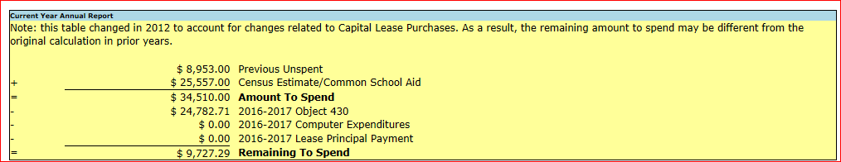
Common School Fund
New Restricted Fund Balance - Account 936130
New Edit in the Annual Report Comparing the Remaining to Spend Amount to Account 936130
Annual Report Addenda A82

Slide 45
Energy Efficiency Exemption
Wisconsin Statute 121.91(4)(o)1.
  A school board may adopt a resolution to increase the revenue limit otherwise applicable to a school district under s. 121.91 (2m), Stats., in any school year by an amount spent by the school district in that school year on a project to implement energy efficiency measures or to purchase energy efficiency products.
  Exemption could be used for single year projects or to repay debt taken out to finance the projects.
2017 Wisconsin Act 59 implemented a moratorium on new resolutions until after December 3018

Slide 46
Energy Efficiency Exemption
PI-1506-AC Auditor Reporting Expectations
  Single Year Projects
    Of the resolution amount, how much was actually spent on Energy Efficiency projects during the year
  Debt
    Confirm resolution amounts reported on the PI-1506-AC match the Energy Efficiency Reporting portal
    Of the resolution amount, how much was spent on debt related to Energy Efficiency projects for the periods identified

Slide 47
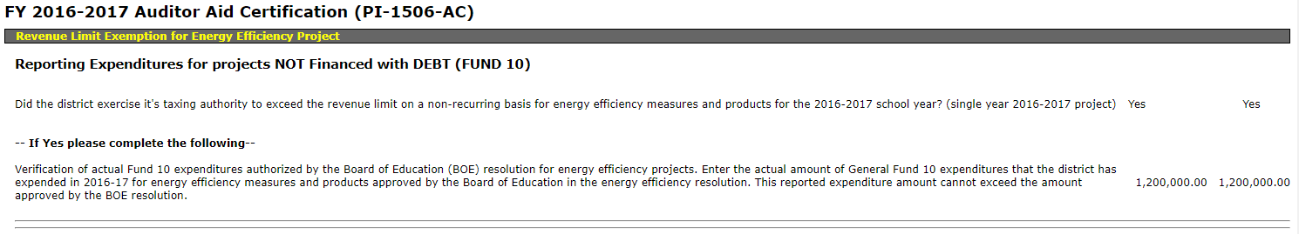
Energy Efficiency Exemption
Example PI-1506-AC - Single Year

Slide 48
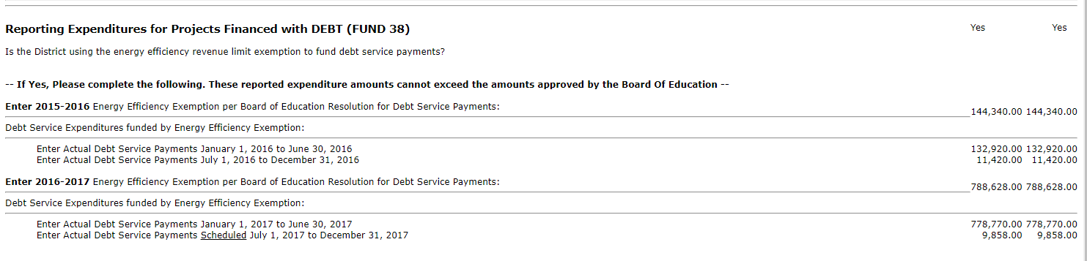
Energy Efficiency Exemption
Example PI-1506-AC - Debt

Slide 49
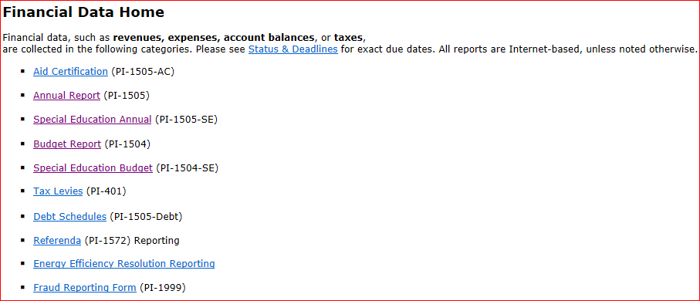
Energy Efficiency Exemption
Resolution Amounts and Measured Utility Savings

Slide 50
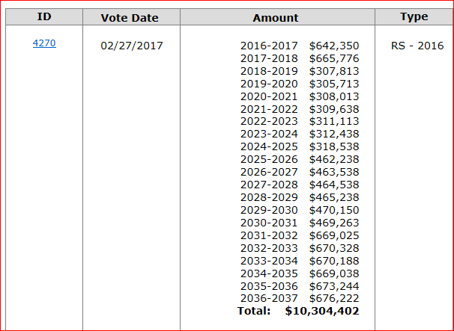
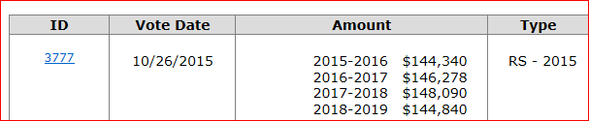
Energy Efficiency Exemption – Debt with Multiple Resolutions

Slide 51
Premium on the Issuance of Debt
Wisconsin Statute 67.11 Debt service fund.
  67.11(1)(1) Each municipality that issues municipal obligations under this chapter, except obligations issued under s. 67.12 (1), (8) and (8m), shall establish and maintain a debt service fund in accordance with generally accepted accounting principles. The fund may include a separate account for each outstanding municipal obligation issue. Revenues from the following sources shall be recorded to the fund accounts as appropriate:
  67.11(1)(a) (a) All moneys accruing to the borrowed money fund prescribed by s. 67.10 (3) which at any stage are not needed and which obviously thereafter cannot be needed for the purpose for which the money was borrowed.
  67.11(1)(b) (b) All moneys raised by taxation under s. 67.05 (10) or 67.12 (12) (ee) for the purpose of making principal and interest payments on municipal obligations.
  67.11(1)(d) (d) The premium, if any, for which the municipal obligations have been sold above par value and accrued interest.
  67.11(1)(e) (e) Such further sums raised by taxation or otherwise, as may be necessary to make all interest and principal payments due in any year. The levying and collection of the taxes or other revenues are authorized; but the governing body may, in its discretion, levy and collect larger sums than the sums so authorized, in order to speed the payment of municipal obligations.
Notes:
District has option to record premium as deferred revenue in the year received, but must record as revenue in the subsequent year.

Slide 52
Premium on the Issuance of Debt
Historically bid premiums have been recorded as a revenue in Source 968, in Funds 38 or 39 in the fiscal year received
Issue:
  Large bid premiums received but not expended within the same fiscal year can significantly impact a district’s shared cost calculation
Solution:
  DPI will allow a district to record bid premiums as ‘Deferred Revenue’ in the year of receipt in Balance Sheet account 816900.
  The bid premium, however, must be recorded as revenue in Source 968 in the subsequent year
  This will be at the discretion of the district
Notes:
District has option to record premium as deferred revenue in the year received, but must record as revenue in the subsequent year.

Slide 53
Charter School Authorizer Reporting

Slide 54
New Charter School Authorizer Reporting
Requirement 2016-2017
Wisconsin Statute 118.40(3m) Authorizing entity duties. A school board, an entity under sub. (2r) (b), and the director under sub. (2x) shall do all of the following:
  118.40(3m)(a) (a) Solicit and evaluate charter school applications.
  118.40(3m)(b) (b) When contracting for the establishment of a charter school under this section, adhere to the principles and standards for quality charter schools established by the National Association of Charter School Authorizers.
  118.40(3m)(c) (c) Give preference in awarding contracts for the operation of charter schools to those charter schools that serve children at risk, as defined in s. 118.153 (1) (a).
  118.40(3m)(d) (d) Approve only high-quality charter school applications that meet identified educational needs and promote a diversity of educational choices.
  118.40(3m)(e) (e) In accordance with the terms of each charter school contract, monitor the performance and compliance with this section of each charter school with which it contracts.

Slide 55
New Charter School Authorizer Reporting
Requirement 2016-2017
Wisconsin Statute 118.40(3m)(f) Annually, submit to the state superintendent and to the legislature under s. 13.172 (2) a report that includes all of the following:
  1. An identification of each charter school operating under contract with it, each charter school that operated under a contract with it but had its contract non-renewed or revoked or that closed, and each charter school under contract with it that has not yet begun to operate.
  2. The academic and financial performance of each charter school operated under contract with it.
  3. The operating costs the school board, entity under sub. (2r) (b), or director under sub. (2x) incurred under pars. (a) to (e), detailed in an audited financial statement prepared in accordance with generally accepted accounting principles.
  4. The services the school board, entity under sub. (2r) (b), or director under sub. (2x) provided to the charter schools under contract with it and an itemized accounting of the cost of the services.

Slide 56
Authorizer Operating Costs to Include
Examples of the types of costs that should be reported in the schedule of authorizer operating costs include but are not limited to:
    costs incurred by the authorizer to oversee and monitor its charter schools (i.e. salary and fringe for individuals who assume these duties)
    costs incurred soliciting, receiving and reviewing applications for new charter schools (i.e. salary and fringe for individuals who assume these duties which may include administrative staff, business office staff, legal staff, etc.)
    costs incurred completing and analyzing charter school data for the purpose of making renewal and revocation decisions

Slide 57
Authorizer Operating Cost Not Included
Costs that should not be included in the schedule of authorizer operating costs include:
  salary and fringe for the teachers at the charter school
  costs of charter school transportation
  curriculum services
  food service, etc

Slide 58
New Charter School Authorizer Reporting
Requirement 2016-2017
(Insert authorizing entity name)
Schedule of Charter School Authorizer Operating Costs
Fiscal Year Ending (insert date)
Operating Activity | WUFAR Object Code | Cost
Employee Salaries | 100
Employee Benefits | 200
Purchased Services | 300
Non-Capital Objects | 400
Capital Objects | 500
Insurance & Judgements | 700
Other (replace Other with an activity name) | 900
Other (replace Other with an activity name) | 900
Total
Notes:
Auditors need to include this operator schedule, if costs were incurred.
For FY 2016-17:
97 school districts had charter schools as of January 1 only 65 districts had submitted a report
82 districts included the statement that was to be audited in their Financial Statement Audit report
The statement costs ranged from $0 Authorizer costs to over $2.0 million. They answer lies somewhere in-between.

Slide 59
New Charter School Authorizer Reporting
Requirement 2016-2017
Information for Charter School Authorizers is located at https://dpi.wi.gov/sms/charter-schools/information-authorizers including the following information on the annual report:
  1)-Annual Report Template for Authorizers
  2)-Annual Report Technical Assistance Document
The report for the 2017-18 school year is due December 1, 2018.
Added Optional Function account 235000, Charter Authorizer Operating Costs
Please contact Latoya Holiday at latoya.holiday@dpi.wi.gov or 608-266-5880 with questions.

Slide 60
Auditor Workpaper Reviews
2018 Audit Firm Site Visits

Slide 61
Evaluating Deficiencies
Criteria: AU-C section 265 Paragraphs .09-.10 provides a discussion of the factors affecting the evaluation of deficiencies to determine if they are significant deficiencies or material weaknesses.
Finding: The financial statements presented for two districts reviewed presented financial statement findings that were classified as significant deficiencies. The workpapers for these two districts did not document the evaluation of the deficiencies.

Slide 62
Internal Controls Over Compliance
Paragraph 9.13 of the GAS/Single Audits Audit Guide explains that the “auditor should obtain an understanding of the five elements of internal control sufficient to assess the risks of material noncompliance with each direct and material compliance requirement for each major program.”
Notes:
COSO Framework
Control Environment. Integrity and Ethical Values. ...
Risk Assessment. Company-wide Objectives. ...
Control Activities. Policies and Procedures...
Information and Communication. ...
Monitoring.

Slide 63
Pass-Through ID Numbers
Criteria: §200.510 of the Uniform Grant Guidance requires that the name of the pass-through entity and the identifying number assigned by the pass-through entity be included in the Schedule of expenditures of Federal awards.
Finding: The Schedule of expenditures of Federal awards for the School District did not include the pass-through identifying numbers.

Slide 64
Risk Assessment for State Programs
The State Single Audit guidelines require that the auditor use the risk based approach from the Uniform Grant Guidance with certain modifications to identify which programs will be tested as state major programs. Workpaper documentation should include:
  the name of the program
  the amount of expenditures
  whether the program is Type A or Type B
  the factors considered in the risk assessment
  the auditor’s assessment of the risk for each factor
  the overall risk assessment

Slide 65
Auditor Questions/Issues

Slide 66
PI-1804-W Fee Reconciliation Worksheets
Question: What should be reported if the district has not completed the fee reconciliation worksheets in the PI-1804-Workbook?
Answer: A finding should be reported in Attachment 4 of the Membership Report. The auditor should include the following:
  identify the class course title, the fees charged for the course, the total supply cost, and the excess revenue.
  the course’s instructional time in total minutes which can be located on column 6c of the worksheet.

Slide 67
Licensing Changes
The 2017-2019 Wisconsin state budget, also known as Act 59, contains major changes to licensure rules.
  This includes language creating a lifetime license for educators (teachers, administrators and pupil services professionals).
  Anyone, who holds a current professional or master educator license, will automatically have their license converted to a lifetime license.
  This will be done by the department removing the expiration date from these licenses.

Slide 68
Licensing Changes
Does the District still have to obtain the following?
  Wisconsin Statute 118.21(2). Any person who contracts to teach in any public school shall file in the office of the school district administrator, within 10 days after entering into such contract, a statement showing the date of expiration, if any, and the grade and character of certificate or license held.

Slide 69
Licensing Information – Online License Lookup
You can use the online license lookup to:
  Review a licensee's Wisconsin education licensure information.
Webpage located at https://dpi.wi.gov/tepdl/license-lookup or directly at https://elo.wieducatorlicensing.org/datamart/publicSearchMenu.do.

Slide 70
Due Dates

Slide 71

Let's review the report due dates ...

Slide 72
2017-18 Report Due Dates
Reports Filed by the School District
  PI-1505 AC
    Due Friday, August 31
    Opens July 16
  PI-1505 and PI-1505 SE (Full Annual and Special Education Annual Report)
    Due Friday, September 21
    Opens July 16

Slide 73
2017-18 Report Due Dates
  Reports Filed by the Auditor
    Auditor Certification PI-1506 AC
      Due Friday, September 14
      Opens July 16
    Audited Fund Balance PI-1506 FB
      Due Friday, September 14
      Opens July 16
    Special Education No Valid License Worksheet
      Due Friday, September 21
      Send completed Excel document to: dpisfsreports@dpi.state.wi.us
    Audited Financial Statements
      Due by December 1, 2018

Slide 74
Report Filing with DPI
Audit reports for the fiscal year ended June 30, 2018 must be filed to DPI in PDF format by December 1:
  dpiauditreports@dpi.wi.gov
Please Include the following:
  Audited financial statements
  Management letters and Auditor's communication with those charged with governance
  Single Audit reports if issued separately
  Data Collection Form (YES! WE WANT IT!)

Slide 75
WUFAR Update

Slide 76
WUFAR Changes FY2018
Allow an interfund operating transfer from Fund 21 to 50 to account for gifts being made to Fund 50 for purposes of reducing the required Paid Lunch Equity (PLE) meal price increase
  21E 850 411000
  50R 121 411000
Allow Object 420, Apparel, with Function 219000, Other Pupil Services, for expenditures of Title IA for clothing purchased for homeless students
New Balance Sheet Account, 936130, Fund Balance Restricted for Unspent Common School Fund Revenues, to restrict the use of any Common School Fund revenue carried over to future years

Slide 77
ESSA – FINANCIAL TRANSPARENCY
Federal Law - ESSA
School Level Financial Transparency

Slide 78
ESSA – FINANCIAL TRANSPARENCY
Every Student Succeeds Act (ESSA)
Federal law reauthorizing the Elementary and Secondary Education Act (ESEA). Previously referred to as No Child Left Behind (NCLB), the newly reauthorized ESEA is being referred to as the Every Student Succeeds Act (ESSA).

Slide 79
ESSA Title I, Section 1111
The per-pupil expenditures of Federal, State, and local funds, including actual personnel expenditures and actual nonpersonnel expenditures of Federal, State, and local funds, disaggregated by source of funds, for each local educational agency and each school in the State for the preceding fiscal year.

Slide 80
IMPLEMENTATION OVERVIEW
2018-19 School Year
New supplemental Budget Report with school level details per student. Due in December 2018.
New supplemental Annual Report with school level expenditure details per student. Due in September 2019.
Department of Public Instruction publishes school level expenditure details in June 2020.

Slide 81
METHODOLOGY of DATA Collection
WASBO is working with the School Financial Services Team via the Financial Transparency Work Group.
Our goal is to develop recommendations to assist LEAs in reporting these new school level details.
Develop and test the new budget report in Summer 2018.

Slide 82
13 Minimum School Level Criteria: A-M
 | District 1
 | Elementary School #11 | Middle School #12 | High School #17
A: Enrollment (School Report Cards) | 375 | 511 | 992
School Level B: Federal C: State/Local D: School site total
 | $456 | $209 | $164
 | $6,111 | $4,756 | $5,998
 | $6,567 | $4,965 | $6,162
School Share of District Total E: Federal F: State/Local G: LEA total
 | $161 | $161 | $161
 | $5,378 | $5,378 | $5,378
 | $5,539 | $5,539 | $5,539
H: Total Per Pupil (Student) Expenditures | $12,106 | $10,504 | $11,701
I: Total School Expenditures | $4,539,750 | $5,367,544 | $11,607,392
J: Total District Expenditures | $23,931,672
K: Total District Exclusions | $2,416,986
L: Excluded Expenditures | Debt, capital, equipment, tuition paid to private schools accepting vouchers, adult education
M: Enrollment Count Procedure | WISEdata 3rd Friday in September (School Report Cards)
These are the 13 minimum criteria currently identified for the data collection of School Level Reporting.

Slide 83
A & M: Enrollment
 | District 1
 | Elementary School #11 | Middle School #12 | High School #17
A: Enrollment (School Report Cards) | 375 | 511 | 992
School Level B: Federal C: State/Local D: School Site total
 | $456 | $209 | $164
 | $6,111 | $4,756 | $5,998
 | $6,567 | $4,965 | $6,162
School Share of District Total E: Federal F: State/Local G: LEA total
 | $161 | $161 | $161
 | $5,378 | $5,378 | $5,378
 | $5,539 | $5,539 | $5,539
H:Total Per Pupil (Student) Expenditures | $12,106 | $10,504 | $11,701
I: Total School Expenditures | $4,539,750 | $5,367,544 | $11,607,392
J: Total District Expenditures | $23,931,672
K: Total District Exclusions | $2,416,986
L: Excluded Expenditures | Debt, capital, equipment, tuition paid to private schools accepting vouchers, adult education
M: Enrollment Count Procedure | WISEdata 3rd Friday in September
Non-weighted student enrollment. So, a 4-year old kindergarten student counts as 1.0, not 0.6.
Only reflects students served in that school.
Student count procedures vary across states. In Wisconsin, the 3rd Friday in September count is used on the School Report Cards. List the count procedure under “M”.

Slide 84
B,C,D: School Site Level Expenditures
 | District 1
 | Elementary School #11 | Middle School #12 | High School #17
A: Enrollment (School Report Cards) | 375 | 511 | 992
School Level B: Federal C: State/Local D: School Site total
 | $456 | $209 | $164
 | $6,111 | $4,756 | $5,998
 | $6,567 | $4,965 | $6,162
School Share of District Total E: Federal F: State/Local G: LEA total
 | $161 | $161 | $161
 | $5,378 | $5,378 | $5,378
 | $5,539 | $5,539 | $5,539
H:Total Per Pupil (Student) Expenditures | $12,106 | $10,504 | $11,701
I: Total School Expenditures | $4,539,750 | $5,367,544 | $11,607,392
J: Total District Expenditures | $23,931,672
K: Total District Exclusions | $2,416,986
L: Excluded Expenditures | Debt, capital, equipment, tuition paid to private schools accepting vouchers, adult education
M: Enrollment Count Procedure | WISEdata 3rd Friday in September
At a minimum, costs for teachers (and school based staff) assigned at the site level (using actual salaries).
Summary data will be reported to DPI.
LEAs maintain details.
Federal project codes.
Notes:
The reported financial data will be available in an online database.
At a minimum, LEAs will report 4 cost categories for each school site: (1) School Level Federal; (2) School Level State/Local; (3) School Share of District Total Federal; and (4) School Share of District Total State/Local. Plus, district wide Exclusions for a total of 5 categories of costs.

Slide 85
E, F, G: School Site Share of District or LEA
 | District 1
 | Elementary School #11 | Middle School #12 | High School #17
A: Enrollment (School Report Cards) | 375 | 511 | 992
School Level B: Federal C: State/Local D: School Site total
 | $456 | $209 | $164
 | $6,111 | $4,756 | $5,998
 | $6,567 | $4,965 | $6,162
School Share of District Total E: Federal F: State/Local G: LEA total
 | $161 | $161 | $161
 | $5,378 | $5,378 | $5,378
 | $5,539 | $5,539 | $5,539
H:Total Per Pupil (Student) Expenditures | $12,106 | $10,504 | $11,701
I: Total School Expenditures | $4,539,750 | $5,367,544 | $11,607,392
J: Total District Expenditures | $23,931,672
K: Total District Exclusions | $2,416,986
L: Excluded Expenditures | Debt, capital, equipment, tuition paid to private schools accepting vouchers, adult education
M: Enrollment Count Procedure | WISEdata 3rd Friday in September
Includes all remaining costs (except exclusions per K) that were not captured at the school site level (B, C, D).
No federal or interstate requirements on what counts as shared/central costs or how to apportion costs.
Federal law allows LEAs flexibility to decide. Goal is to offer WI Guidance.

Slide 86
H: Total Per Pupil (Student) Expenditures
 | District 1
 | Elementary School #11 | Middle School #12 | High School #17
A: Enrollment (School Report Cards) | 375 | 511 | 992
School Level B: Federal C: State/Local D: School Site total
 | $456 | $209 | $164
 | $6,111 | $4,756 | $5,998
 | $6,567 | $4,965 | $6,162
School Share of District Total E: Federal F: State/Local G: LEA total
 | $161 | $161 | $161
 | $5,378 | $5,378 | $5,378
 | $5,539 | $5,539 | $5,539
H:Total Per Pupil (Student) Expenditures | $12,106 | $10,504 | $11,701
I: Total School Expenditures | $4,539,750 | $5,367,544 | $11,607,392
J: Total District Expenditures | $23,931,672
K: Total District Exclusions | $2,416,986
L: Excluded Expenditures | Debt, capital, equipment, tuition paid to private schools accepting vouchers, adult education
M: Enrollment Count Procedure | WISEdata 3rd Friday in September
Sum of D and G.
All costs (except exclusions in K) are captured here such that the sum of the school totals plus the exclusions = LEA’s or District’s total expenditures.
PPE (Per Pupil Expenditures) is the number that will be compared for schools.

Slide 87
I: Total School Expenditures
 | District 1
 | Elementary School #11 | Middle School #12 | High School #17
A: Enrollment (School Report Cards) | 375 | 511 | 992
School Level B: Federal C: State/Local D: School Site total
 | $456 | $209 | $164
 | $6,111 | $4,756 | $5,998
 | $6,567 | $4,965 | $6,162
School Share of District Total E: Federal F: State/Local G: LEA total
 | $161 | $161 | $161
 | $5,378 | $5,378 | $5,378
 | $5,539 | $5,539 | $5,539
H:Total Per Pupil (Student) Expenditures | $12,106 | $10,504 | $11,701
I: Total School Expenditures | $4,539,750 | $5,367,544 | $11,607,392
J: Total District Expenditures | $23,931,672
K: Total District Exclusions | $2,416,986
L: Excluded Expenditures | Debt, capital, equipment, tuition paid to private schools accepting vouchers, adult education
M: Enrollment Count Procedure | WISEdata 3rd Friday in September
Total school expenditures for each location is equal to Total Per Pupil Expenditures (Line H) multiplied by the student enrollment count (Line A).

Slide 88
J: Total Districts Expenditures
 | District 1
 | Elementary School #11 | Middle School #12 | High School #17
A: Enrollment (School Report Cards) | 375 | 511 | 992
School Level B: Federal C: State/Local D: School Site total
 | $456 | $209 | $164
 | $6,111 | $4,756 | $5,998
 | $6,567 | $4,965 | $6,162
School Share of District Total E: Federal F: State/Local G: LEA total
 | $161 | $161 | $161
 | $5,378 | $5,378 | $5,378
 | $5,539 | $5,539 | $5,539
H:Total Per Pupil (Student) Expenditures | $12,106 | $10,504 | $11,701
I: Total School Expenditures | $4,539,750 | $5,367,544 | $11,607,392
J: Total District Expenditures | $23,931,672
K: Total District Exclusions | $2,416,986
L: Excluded Expenditures | Debt, capital, equipment, tuition paid to private schools accepting vouchers, adult education
M: Enrollment Count Procedure | WISEdata 3rd Friday in September
Total District Expenditures will be reported by each school district or LEA.
The sum of the school totals plus the exclusions = LEA’s or District’s total expenditures.

Slide 89
K and L: Exclusions
 | District 1
 | Elementary School #11 | Middle School #12 | High School #17
A: Enrollment (School Report Cards) | 375 | 511 | 992
School Level B: Federal C: State/Local D: School Site total
 | $456 | $209 | $164
 | $6,111 | $4,756 | $5,998
 | $6,567 | $4,965 | $6,162
School Share of District Total E: Federal F: State/Local G: LEA total
 | $161 | $161 | $161
 | $5,378 | $5,378 | $5,378
 | $5,539 | $5,539 | $5,539
H:Total Per Pupil (Student) Expenditures | $12,106 | $10,504 | $11,701
I: Total School Expenditures | $4,539,750 | $5,367,544 | $11,607,392
J: Total District Expenditures | $23,931,672
K: Total District Exclusions | $2,416,986
L: Excluded Expenditures | Debt, capital, equipment, tuition paid to private schools accepting vouchers, adult education
M: Enrollment Count Procedure | WISEdata 3rd Friday in September
WASBO Financial Transparency Work Group meeting to determine statewide guidance.
Exclude: adult education, capital expenditures, equipment, debt, tuition paid to private schools accepting vouchers, food service, revenue transits.
Report sum of all exclusions (K).
Report what was excluded (L).
Notes:
The report will require the LEA to select the categories of costs to be excluded.

Slide 90
Exclusions From Allocated Costs (Lines K & L)
Preliminary WASBO Workgroup Exclusions From Expenditures
Description | WUFAR Account(s)
Open Enrollment or Tuition Waivers | Function 435000
General Voucher Amount—Parental Choice Private School Payments | Function 438000
Transfer to another Fund (Exclude Fund 10 Transfer to Fund 27 and Include Fund 27 Costs) | Function 411000 all objects except 899, Function 418000, Function 419000
Long-Term Capital Debt Capital Leases- Principal and Interest | Objects 678/688 with Function 281000

Slide 91
Exclusions From Allocated Costs (Lines K & L)
Preliminary WASBO Workgroup Exclusions From Expenditures
Description | WUFAR Account(s)
Revenue Transits to Others | Function 491000
Facilities Acquisition & Remodeling | Function 255000
Capital Equipment | Object 500

Slide 92
Exclusions From Allocated Costs (Lines K & L)
Preliminary WASBO Workgroup Exclusions From Expenditures
Description | WUFAR Account(s)
TEACH Program Funds | Fund 23
Debt Service Fund | Fund 30
Capital Project Fund | Fund 40
Food Service Funds | Fund 50
Student Activity Funds | Fund 60
Trust Funds | Fund 70
Community Service/Program Fund | Fund 80
TEACH Program Funds/COOP Funds | Fund 93, 99

Slide 93
Supporters of financial transparency hope that the school level financial data will: (Choose all those that apply)
  Prompt district leaders to be more intentional/equitable in deploying funds across schools.
  Enable school leaders to benchmark how well they are able to leverage resources for outcomes.
  Encourage leaders to explore spending and outcomes patterns across like-peers and adopt strategies that have been successful elsewhere.
  Prompt healthy dialogue within communities about tradeoffs.
bscpcenter.org

Slide 94


Credit Given to Edunomics Lab:
Marguerite Roza mr1170@georgetown.edu
Katie Hagan
Katie.Hagan@georgetown.edu
By:
Marguerite Roza
Edunomics Lab at Georgetown University

Slide 95
Spring 2018 – LEA NEXT STEPS
Assign staff (teachers, aides, support staff, principals, custodians, etc.) to the extent possible to a specific school location. Will allow you to begin tracking actual personnel expenditures by location.
Determine which program costs can or cannot be assigned to a specific school location. If not, report as District Share or Exclusions.
Review the list of recommended Exclusions, if you agree exclude the costs. If you do not agree, costs are school level or district share.

Slide 96

QUESTIONS OR COMMENTS

Slide 97
School Financial Services Team Contacts dpifin@dpi.wi.gov
VISIT OUR WEBSITE…… http://dpi.wi.gov/sfs
Bruce Anderson, Consultant 608-267-9707
Roselynn Bittorf, Consultant 608-267-9212
Terry Casper, Accountant 608-267-9218
Vacant, Auditor dpifin@dpi.wi.gov
Vacant, Auditor dpifin@dpi.wi.gov
Roger Kordus, Consultant 608-267-3752
Derek Sliter, Consultant 608-266-3464
Carey Bradley, Assistant Director 608-267-9209
Bob Soldner, Director 608-266-6968

