Slide 1
Getting Ready for ESSA School Level Expenditure Reporting
Daniel Bush, Director, School Financial Services
October 5 and 7, 2020

Slide 2
ESSA Title I, Section 1111
[State reporting shall include] the per-pupil expenditures of Federal, State, and local funds, including actual personnel expenditures and actual nonpersonnel expenditures of Federal, State, and local funds, disaggregated by source of funds, for each local educational agency and each school in the State for the preceding fiscal year.

Slide 3
So What Does That Mean?
Your responsibility: Report per-pupil federal & non-federal costs for each school to DPI
Our responsibility: Collect this data and report it to the public through WISEdash

Slide 4
Why School Level Reporting?
Goal: Financial transparency of resource allocation on a per student basis
Idea: Use data to drive improvements and promote greater fairness and equity for all students

Slide 5
Basic Process
Identify costs by 1 of 3 types
Identify costs by school or with the district/LEA as a whole
Report costs & enrollments to DPI
We do the per-pupil math

Slide 6
3 Types of Costs
Federal: Costs funded with federal program dollars
Does not include federal Impact Aid, which is basically a “payment in lieu of taxes”

Slide 7
3 Types of Costs
State/Local: Costs funded with property taxes, state aids and grants, or other local sources (fees, gifts, interest, etc.)

Slide 8
3 Types of Costs
Exclusions: Costs your district/LEA can choose to exclude from your per-pupil amounts for each school

Slide 9
Exclusion Examples
Debt Service
Building & Other Capital Projects
Food Service
Community Programs and Services

Slide 10
Data Reporting Format
DPI worked with 38 other states, over 20 districts, and experts at Georgetown University
Result was the Interstate Financial Reporting framework for ESSA School Level Reporting
edunomicslab.org/2018/03/28/interstate-financial-reporting/

Slide 11
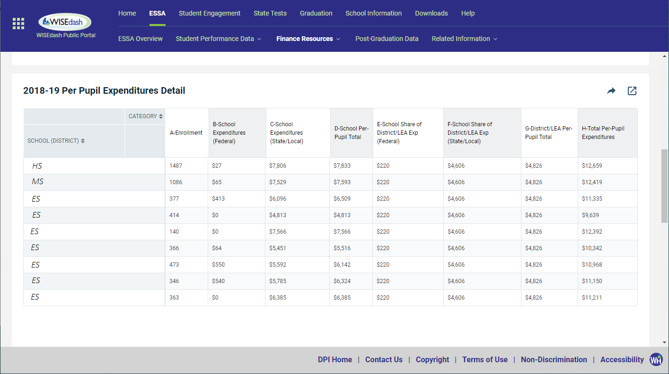
Preview – Not Final
Enrollments are WISEdata Third Friday of September 2018 snapshot counts
Matches your WISEdash public data, with one exception…
Multi-district virtual charter schools show all students at the host district, other partici- pant districts will show zero enrollment

Slide 12
Preview – Not Final
Per-pupil expenditures for each school are specific to that school, shown in total and with the federal and state/local portions split out

Slide 13
Preview – Not Final
District/LEA expenditures are divided by total enrollment, so the per-pupil amount is the same for every school

Slide 14
Preview – Not Final
The school total (C) plus the district/LEA total (G) equals each school’s total per-pupil expenditures (H)
This total will be the focus of public discussion and any comparisons made

Slide 15
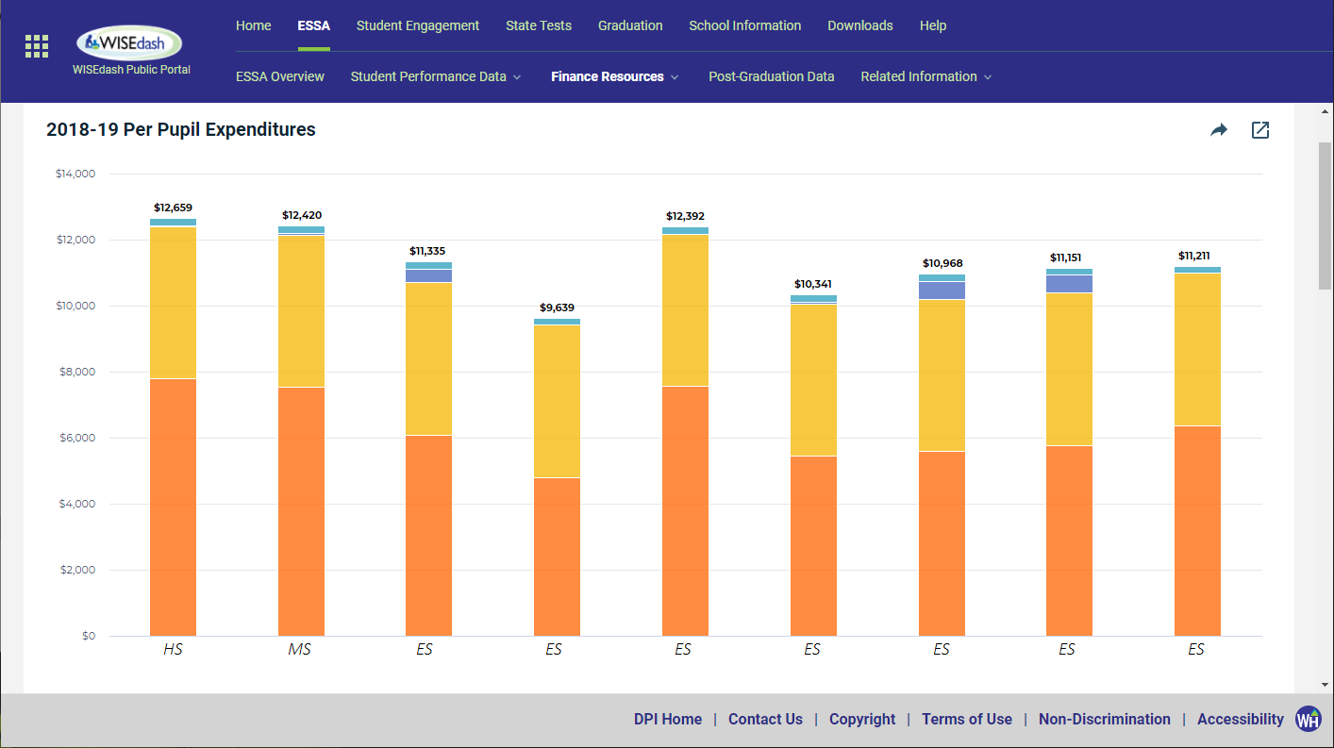
Preview – Not Final
State/local costs are gold & orange Federal costs are blue & teal
School costs are blue & orange District/LEA costs are gold & teal

Slide 16
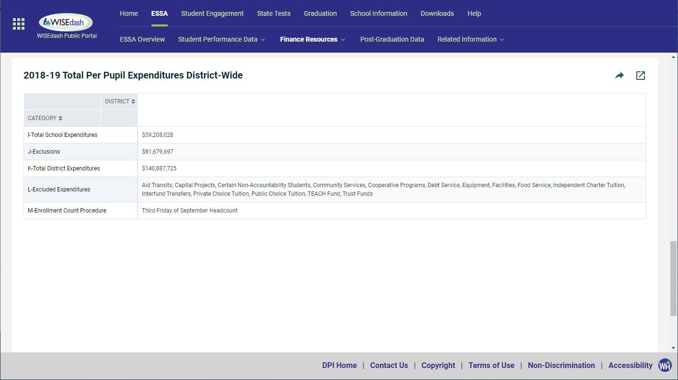
Preview – Not Final
Other information is shown at the bottom
Total dollar amount reported for all school- and district/LEA-level expenditures (I)
Total amount of exclusions (J)
All-funds total expenditures (K = I + J)
List of excluded expenditures (L)
Enrollment count procedure (M)

Slide 17
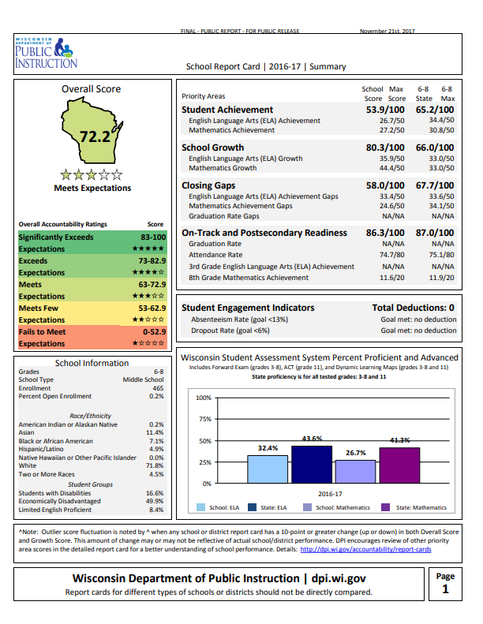
Talking About School Level Data
School level achievement data has been around for a long time
School level finance data is a whole new dimension
$12,608 per pupil

Slide 18
Talking About School Level Data
Dollar amounts aren’t going on the Report Card
But people will try to connect them once the data goes public
…yet
$12,608 per pupil

Slide 19
Talking About School Level Data
How do you prepare for that conversation as school leaders?
$12,608 per pupil

Slide 20
Talking About School Level Data
Answer: Know Your School and Student Stories to Explain Your Numbers
$12,608 per pupil

Slide 21
Financial Transparency Fact #1
Most school leaders do not have a good sense of the true financial resources allocated to specific schools in their districts/LEAs.
Source: Edunomics Lab, Georgetown University. “Financial transparency: What’s your number?” Presentation, Council of Chief State School Officers, 2017.

Slide 22
Financial Transparency Fact #1
Why is this the case?
How does your current budgeting process divide responsibilities?
CLASSROOMS
CURRICULUM
STAFFING
GRANTS
INFRASTRUCTURE

Slide 23
Financial Transparency Fact #1
School Level Reporting is a new requirement…
But it’s also an opportunity to bring more transparency and focus on students
CLASSROOMS
CURRICULUM
STAFFING
GRANTS
INFRASTRUCTURE

Slide 24
Financial Transparency Fact #2
Most school leaders do not have a good sense of how well their schools are able to leverage dollars and maximize outcomes.
Source: Edunomics Lab, Georgetown University. “Financial transparency: What’s your number?” Presentation, Council of Chief State School Officers, 2017.

Slide 25
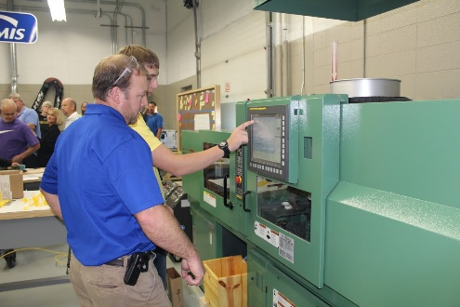
Financial Transparency Fact #2
Are your budget initiatives improving learning and college & career readiness?
How would you determine your return on investment?

Slide 26
Using the Numbers
School level per-pupil spending will be used to compare schools…
…but there is no perfect apples-to-apples method for doing so

Slide 27
How Might Someone Compare?
 | Dairyland High | Whitetail High
 | Dairyland High | Whitetail High
Per-Pupil Spending | $15,622 | $12,096
School Report Card | Meets Exp. | Exceeds Exp.
Enrollment | 217 | 635
CESA | 10 | 5
Title I Program? | Yes | No
Health Insurance | Traditional POS | High Ded. HMO
 | Dairyland High | Whitetail High
Per-Pupil Spending | $15,622 | $12,096
School Report Card | Meets Exp. | Exceeds Exp.
Enrollment | 217 | 635
CESA | 10 | 5
Title I Program? | Yes | No
 | Dairyland High | Whitetail High
Per-Pupil Spending | $15,622 | $12,096
School Report Card | Meets Exp. | Exceeds Exp.
Enrollment | 217 | 635
CESA | 10 | 5
 | Dairyland High | Whitetail High
Per-Pupil Spending | $15,622 | $12,096
School Report Card | Meets Exp. | Exceeds Exp.
Enrollment | 217 | 635
 | Dairyland High | Whitetail High
Per-Pupil Spending | $15,622 | $12,096
School Report Card | Meets Expectations | Exceeds Exp.
 | Dairyland High | Whitetail High
Per-Pupil Spending | $15,622 | $12,096

Slide 28
How Might Someone Compare?
 | Dairyland High | Whitetail High
 | Dairyland High | Whitetail High
Per-Pupil Spending | $15,622 | $12,096
School Report Card | Meets Expectations | Exceeds Exp.
…but this is all you’re likely to see in the paper.
It’s up to YOU as leaders to add context.

Slide 29
Moving Forward
2018-19 per pupil school-level expenditure data for Wisconsin public schools will be released on November 19, 2020

Slide 30
Moving Forward
Data will be in secure WISEdash for Districts from October 13 to November 16, 2020 for a formal data quality review period

Slide 31
Data Quality Review
Where did the data come from?
Expenditures: 2018-19 School Level Reporting financial collection
This is where your staff identified school, district/LEA, and excluded costs

Slide 32
Data Quality Review
Where did the data come from?
Enrollments: 2018-19 WISEdata certified Third Friday 2018 student counts
These were certified by districts before the WISEdata snapshot in winter 2018-2019

Slide 33
Data Quality Review
Where did the data come from?
Per-pupil expenditures: Calculated by DPI from district-reported expenditures and enrollments

Slide 34
Data Quality Review
How expenditures are identified between schools, district/LEA, and exclusions can be modified
Update and re-finalize the 2018-19 Annual Report in the School Level Reporting application at sfs.dpi.wi.gov/WiSFiP

Slide 35
Data Quality Review
Enrollment numbers themselves cannot be modified unless there is a significant data error
You will be required to submit a WISEdata Data Errata letter

Slide 36
Data Quality Review
Specific enrollment denominators can be adjusted for school-level expenditure reporting purposes
Must be tied to an expenditure numerator

Slide 37
Data Quality Review
To request a modification, email dpifin@dpi.wi.gov by Nov. 16 with:
District/LEA and schools affected
Requested enrollment modification by school
Explanation for the request

Slide 38
Resources to Get Ready
dpi.wi.gov/sfs/essa-slr-resources
CCSSO School-Level Spending Toolkit
Principal PPE Resources
Videos and definitions
…and more to come!

Slide 39
Your #1 Takeaway
Total Per-Pupil Expenditure (Line H) is the critical data point
Know and share why each of your schools’ numbers are what they are
Tell your school level stories
Talk about your student successes!

Slide 40
Contact
Daniel Bush Director DPI School Financial Services Team daniel.bush@dpi.wi.gov 608-266-6968
ESSA School Level Reporting webpage: dpi.wi.gov/sfs/reporting/slr

Slide 41
Questions? Comments?

