Slide 1
WUFAR 101
Wisconsin Uniform Financial Accounting Requirements
Wisconsin Department of Public Instruction
Notes:
This session will provide the audience with an overview of the Wisconsin Uniform Financial Account Requirements and how these requirements are used within the framework of federal grants, such as ESEA/ESSA, IDEA and others.

Slide 2
Wisconsin Uniform Financial
Accounting Requirements
It is a multi-dimensional reporting system that can also be used as an accounting system.
Not required accounting, but required for reporting and claims to DPI.
Always used in conjunction with the state Budget and Annual Reports (full and special education).
Used for LEA internal use in order to track costs.
Wisconsin Department of Public Instruction
Notes:
You have heard the word “WUFAR” thrown around – in addition to being a funny name, WUFAR is a very convenient method for everyone to report fiscal data to DPI in a consistent manner. LEAs are not required to use WUFAR for general ledger use, but must use WUFAR when submitting any reports to DPI, including the special education annual and budget reports, as well grant budgets and claims. Most of the accounting vendor software sold to LEAs incorporate WUFAR and make updates when as WUFAR is updated.

Slide 3
WHY WUFAR?
We need a consistent system for reporting LEA activity for:
Reporting purposes (both state and federal)
Calculating general and categorical aid
Determining compliance with federal regulations
Comparing activity between LEAs
State budget building
Wisconsin Department of Public Instruction

Slide 4
WHY WUFAR?
You need a consistent system and common language:
Purchasing and expenditures
Plan and monitor local budgets
Budget development and decision making authority
Local budget accountability
To create local budget / expense history
Wisconsin Department of Public Instruction

Slide 5
WUFAR Sequence of Dimensions
Fund
Location
Object of Expense
Function
Project
This sequence is what you would normally see when looking at an expense report.
Wisconsin Department of Public Instruction
Notes:
There are five components of the WUFAR account string. Fund, Location, Object (of expense), Function, and Project

Slide 6
WUFAR Account Format
Fund Location Object Function Project
XX XXX XXX XXXXXX XXX
Most of the commercial software used in districts will display account codes in this order. Local reports may be set up to change the order of the dimensions and include descriptions. In DPI reporting you will see the function number preceding the object or source. DPI reporting does not require location detail.
Activity and Ledger printouts are used to build and manage budgets
Wisconsin Department of Public Instruction
Notes:
Most commercial software used in districts will display account codes in this order. WISEgrants uses WUFAR as the basis for its budgeting and claims functionality, and includes this information along with additional details.
Local reports may be set up to change the order of the dimensions and include descriptions. In DPI reporting, you will see the function number preceding the object or source. DPI reporting does not use or require you to report Location.
We’ll not cover the individual pieces in this order.

Slide 7
WUFAR Account Format
Fund 10
Most typically used for general education costs funded by a combination of local, state and federal funds.
Day to day operations
Instructional activities
Instructional staff support
Pupil support activities
Other support activities
Fund
10
Wisconsin Department of Public Instruction
Notes:
The first number is “Fund.”
A fund is a fiscal and accounting entity with a self-balancing set of accounts…which are segregated for the purpose of carrying on specific activities in accordance with special regulations, restrictions, or limitations.
Most commonly, there is Fund 10, which covers general education costs funded by a combination of local, state, and federal funds, used for day to day operations, including, instructional activities, instructional staff support, pupil support activities, and other support activities.

Slide 8
WUFAR Account Format
Fund 27
Used to account for the excess cost of providing special education and related services for students with disabilities.
Separated for Special Education Categorical Aid calculation and IDEA Maintenance of Effort (MOE) calculations.
Also includes School Age Parent costs.
Fund
27
Wisconsin Department of Public Instruction
Notes:
Special Education has its own fund, which is 27. If it is a special education activity or expense, it should be coded to Fund 27.
Fund 27 is used to account for the excess cost of providing special education and relates services for students with disabilities. It is separated out for calculating categorical aid and maintenance of effort and includes School Age Parent costs.

Slide 9
WUFAR Account Format
Location
Where?
DPI doesn’t generally collect
Used for internal tracking by district
Future possibility of school level tracking
Fund
Location
10
--
27
123
Wisconsin Department of Public Instruction
Notes:
The next number is “Location.”
DPI does not collect this number in reports or budgets. LEAs often use it to identify buildings or sites at which the expenditures is happening. This number may become important as LEAs track federal funds spent at the school level.

Slide 10
WUFAR Account Format
Object
What?
Fund
Location
Object
10
--
27
123
300
Object identifies the type of cost by category, such as salaries, materials, supplies or contracted services.
Wisconsin Department of Public Instruction
Notes:
Next up, Object. This code identifies the different types of expenses. What is being paid for?
Think of the WUFAR string as going from super general to super detailed. The Fund is the broadest piece, followed by the Object, which identifies if the cost is salaries, or a purchased service, a non-capital, or capital expense.

Slide 11
Types of Objects
Salaries & Fringe (100 / 200 Objects)
Purchased Services (300 Objects)
Non-Capital Objects (400 Objects)
Capital Objects (500 Objects)
Insurance (700 Objects)
Other (900 Objects)
Wisconsin Department of Public Instruction
Notes:
The Object is a three-digit code hierarchical classification. On the largest level, broken into categories that are indicated by the first digit of the code. Additional detail is indicated by the second and third digits.

Slide 12
WUFAR Account Format
Function
Why?
For what area or purpose?
Fund
Location
Object
Function
10
--
27
123
300
110 000
--
158 000
Function describes the purpose for which a service or materials are acquired.
100000 level functions are instructional
200000 level functions are support services
Wisconsin Department of Public Instruction
Notes:
Next up is Function. The Function code indicates the purpose of the purchase. What are the services or materials being acquired being used for? If Object is What, then is Why (or for what reason).
The function code is a six-digit code, and similar to the Object code, is hierarchical in nature. The digits correspond to increasing levels of detail. Most of the Functions we will look at today will fall within two levels. Instructional functions, beginning with 1 and Support Services functions beginning with 2.

Slide 13
Types of Functions
Instruction – 100 000
110 000 Undifferentiated Curriculum
120 000 Regular Curriculum
130 000 Vocational Curriculum
140 000 Physical Curriculum
150 000 Special Education Curriculum
160 000 Co-curricular Activities
170 000 Other Special Needs
Wisconsin Department of Public Instruction
Notes:
Additional categories of Instructional functions under 100000.

Slide 14
Types of Functions
Support Services – 200 000
210 000 Pupil Services
220 000 Instructional Staff Services
230 000 General Administration
240 000 School Building Administration
250 000 Business Administration
260 000 Central Services
270 000 Insurance and Judgements
Wisconsin Department of Public Instruction
Notes:
Additional categories of Support Services functions under 200000.
-----
There are also Functions coded to 400000s, which indicate non-program transactions, such as transfers to another fund and other transactions and disbursements. But also payment for instructional services provided by another entity, which are coded under
436000-Special Education Contracted Instruction or Additional/Excess Cost Tuition—Non-Open Enrollment
And
431000-General Contracted Instruction or Base Cost Tuition—Non-Open Enrollment

Slide 15
Types of Functions
Non-Program Transactions – 400 000
431 000 General Education Contracted Instruction
436 000 Special Education Contracted Instruction
Instructional functions (100 000 series) flip to a 400 000 function when the instruction is purchased.
156 700 – Visual Impairment Teacher Salary / Benefits
436 000 – Contracted Visual Impairment Instruction
Wisconsin Department of Public Instruction
Notes:
Additional categories of Support Services functions under 200000.
-----
There are also Functions coded to 400000s, which indicate non-program transactions, such as transfers to another fund and other transactions and disbursements. But also payment for instructional services provided by another entity, which are coded under
436000-Special Education Contracted Instruction or Additional/Excess Cost Tuition—Non-Open Enrollment
And
431000-General Contracted Instruction or Base Cost Tuition—Non-Open Enrollment

Slide 16
Example - Instructional Function Detail
110 000 Undifferentiated Curriculum
Teaches two or more curricular areas to the same group of students.
Language arts/social studies program
First grade teacher
Wisconsin Department of Public Instruction
Notes:
110000 is Undifferentiated Curriculum, which is used when it applies to the teaching of two or more curricular areas to same group of students.

Slide 17
Example - Instructional Function Detail
120 000 Regular Curriculum
Teaches one curricular area
122 000 - English Language
124 000 - Mathematics
124 100 - Algebra
124 300 - Calculus
124 600 - Geometry
Wisconsin Department of Public Instruction
Notes:
Regular curriculum is coded to 120000 and applies to the teaching of one curricular area.

Slide 18
Example - Instructional Function Detail
Other instructional functions include:
136 000 – Vocational Curriculum - Technology Education
139 000 – Other Vocational Curriculum
171 000 – Culturally/Socially Disadvantaged
Wisconsin Department of Public Instruction
Notes:
Some others you will see include functions related to vocational curriculum in the 130000s, used in Perkins, Title I, and Title I-D (Neglected and Delinquent), and 171000- Culturally/Socially Disadvantaged used for Bilingual/ESL combinations under Title III and Title I.

Slide 19
Example - Instructional Function Detail
150 000 Special Education Curriculum
152 000 – Early Childhood
156 000 – Physical/Sensory
156 100 – Deaf and Hard of Hearing Impairment
156 600 – Speech/Language
159 000 – Other Special Curriculum
159 100 – Special Education Program Aide
159 200 – Special Education Short Term Sub Teacher
159 300 – Special Education Specialty Teachers
Wisconsin Department of Public Instruction
Notes:
There are specific functions for Special Education that are used under IDEA.

Slide 20
Example - Support Services Function Detail
210 000 Pupil Services
211 000 – Direction of Pupil Services
212 000 – Social Work
213 000 – Guidance
214 000 – Health
215 000 – Psychological Services
220 000 Instructional Staff Services
221 000 – Improvement of Instruction
221 300 – Staff Training
Wisconsin Department of Public Instruction
Notes:
Commonly used support services functions related to pupil services and instructional staff services. 221300-Instructional Staff Training is frequently seen used as it relates to professional development.

Slide 21
WUFAR Account Format
Fund
Location
Object
Function
Project
10
--
27
123
300
110 000
--
158 000
141
--
341
Project
How is it paid for?
Project is designed to identify a funding source.
Wisconsin Department of Public Instruction
Notes:
And then, for the final number, we go broad again. The project number represents the funding source.

Slide 22
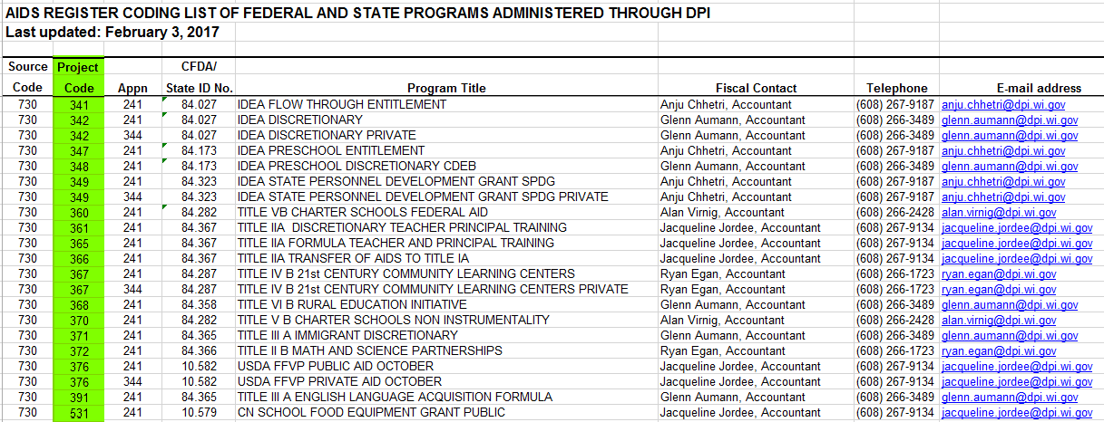
Project Codes
Federal Grants
Federal grants have been assigned a DPI project number
See Aids Register Codes
(http://dpi.wi.gov/sfs/finances/aids-register/aids-register-coding)
Wisconsin Department of Public Instruction
Notes:
As this is the federal funding conference, the role the project code may be the most important thing you learn today. You need to collect/report financial data which is translates your educational plans/objectives into financial plans for the use of federal money.

Slide 23
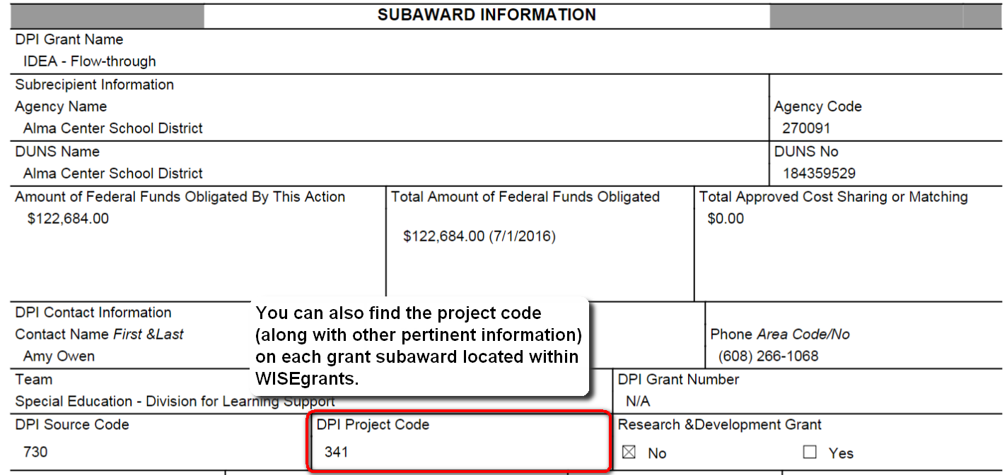

Slide 24
Fund 10 Project Codes
ESEA
IDEA
141 - Title I-A
365 - Title II-A
391 - Title III-A
367 - Title IV-B
(21st Century CLC)
341 - IDEA Coordinated Early Intervening (CEIS)
341 - IDEA Title I Schoolwide Set- Aside
400 - Carl D. Perkins - 400
Wisconsin Department of Public Instruction

Slide 25
Fund 27 Project Codes
Fund 27 – Special Education Cost Claims
ALL special education expenditures must have a project code.
Local (IDEA Maintenance of Effort)
011 - State Special Education Categorical Aid
019 - Non-aidable Special Education Cost
Federal
341 - IDEA Flow-through
347 - IDEA Preschool
Wisconsin Department of Public Instruction
Notes:
All special education expenditures must have a project code.

Slide 26
Claiming Costs
Expenditure reports sorted by project code are used to collect data necessary to claim grant costs.
Special Education Categorical aid is calculated by the project numbers on the district’s PI-1505-SE Special Education Annual Report.
PROJECT NUMBERS ARE IMPORTANT
Wisconsin Department of Public Instruction
Notes:
Special Education Categorical aid is calculated by the project numbers on the district’s PI-1505-SE Special Education Annual Report

Slide 27
Examples
The salary and fringe benefits of a speech and language teacher charged to local costs (but are eligible for state categorical aid).
Where?
What?
Why?
How?
Fund
Location
Object
Function
Project
27
XXX
100 / 200
156600
011
Wisconsin Department of Public Instruction
Notes:
Personnel combinations are typically split into to separate accounting strings, one under 100 for Salary and one under 200 for Benefits, which includes Fringe benefits as well as insurance, credit reimbursement, etc.

Slide 28
Examples
The salary and fringe benefits of a reading teacher charged to the Title I grant.
Where?
What?
Why?
How?
Fund
Location
Object
Function
Project
10
XXX
100 / 200
122000
141
Wisconsin Department of Public Instruction

Slide 29
Examples
Travel and hotel costs for special education teachers to attend a statewide autism training. The costs will be charged to the IDEA preschool grant.
Where?
What?
Why?
How?
Fund
Location
Object
Function
Project
27
XXX
342
221300
347
Wisconsin Department of Public Instruction

Slide 30
Examples
The purchase of reading intervention instructional media that will be used district-wide for all students. The costs will be paid with local funds.
Where?
What?
Why?
How?
Fund
Location
Object
Function
Project
10
XXX
430
122000
XXX
Wisconsin Department of Public Instruction

Slide 31
WUFAR Use
Failure to use WUFAR appropriately could result in:
Incorrect calculation of state or federal aid.
Failure to meet federal regulations such as MOE.
Single audit findings for failure to track grant expenditures separately.
Fiscal monitoring findings for failure to track and support grant expenditures.
Wisconsin Department of Public Instruction

Slide 32
WUFAR Use
Important to become familiar with WUFAR as account elements are used throughout various applications at DPI.
School Financial Services Team – Financial Reports
WISEgrants
IDEA Maintenance of Effort reports
Wisconsin Department of Public Instruction

Slide 33
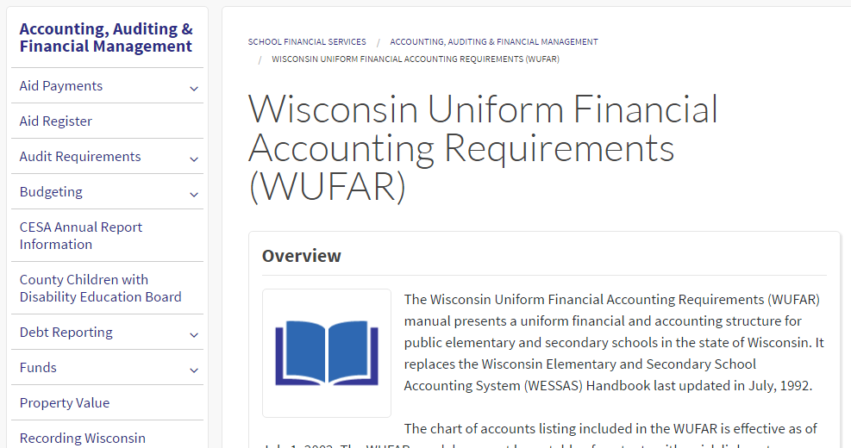
Technical Assistance
http://dpi.wi.gov/sfs/finances/wufar/overview
Wisconsin Department of Public Instruction

Slide 34
Time to Practice
WUFAR 101 Scenarios
(the game)
Wisconsin Department of Public Instruction

