Slide 1
WUFAR 201
Wisconsin Uniform Financial Accounting Requirements

Slide 2
WUFAR & WISEgrants
Reporting system that can also be used as an accounting system.
Not required accounting, but required for reporting and claims to DPI.
Always used for the State Budget and LEA Annual Reports.
Single web-based portal for federal grants administered by DPI.
Creates consistency in federal grant accounting across DPI programs.
Utilizes WUFAR as the foundation for budgets and claims.

Slide 3
WISEgrants Terminology – Program Type
WISEgrants
What It Is
Drives WUFAR…
Program Type
Classification
None
Public School Cost
Private School Cost
Administration Cost
Schoolwide Cost
Educator Initiatives Cost
Parent Involvement Cost

Slide 4
WISEgrants Terminology – Purchase Item
WISEgrants
What It Is
Drives WUFAR…
Purchase Item
Broad Category of Cost
Object
Employee Travel
Communications
Property Services
Supplies
Contract with Vendor
Pupil Transportation
Equipment

Slide 5
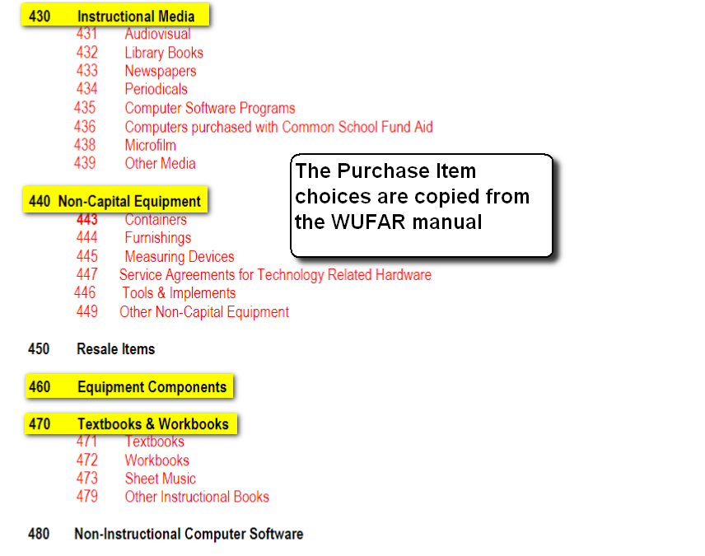

Slide 6
Purchase Items in Purchased Services
WISEgrants
WUFAR Object
For contracted services, you must first select the vendor type before choosing the service provided.
CESA Contract
386 – Payment to CESA
LEA Contract
382 – Payment to WI School District
WTCS Contract
386 – Payment to WTCS District
Employee Travel
342 – Employee Travel

Slide 7
Purchase Items in Purchased Services
WISEgrants
WUFAR Object
Private Vendor Contract for Support Services
310 – Personal Services
Private Vendor Contract for Instructional Services
370 – Payment to Non-Gov Agency
IT Private Vendor Contracts
360 – Information Tech Services

Slide 8
WISEgrants Terminology – Purchase Detail
WISEgrants
What It Is
Drives WUFAR…
Purchase Detail
Specific cost tied to a broad category
Function and / or Object
Curriculum Development
Professional Development
Remodeling
Placement Tuition
Computer Software
Field Trip Fees
Transition Services

Slide 9
Purchase Detail Driving Function / Object
Purchase Item
Purchase Detail
Function
Object
Property Services
Remodeling
255300
320
Communication
Postage
XXXXXX
353
CESA Contract
Curriculum Devlp.
221200
386
Supplies
Food
XXXXXX
415

Slide 10
WISEgrants Personnel Section
Each budget item requires a “Position” and “Area”
Matches the position and area available in WISEstaff.
License validation is built into WISEgrants for certain full- or part-time positions.
Each budget item requires a “Position Activity”
“Standard (Default)” means full-time or part-time and may require a license number or a staff name. If a license number or name is required, only one individual’s salary and benefits should be included in the budget entry.

Slide 11
WISEgrants “Staff” Position
Position
Area
Position Activity
Staff
No Description Beyond Position
Staff Roll-Up
Credit Reimbursement
IEP Activities
Other Improvement of Instruction
Other Instructional Staff Services
Extended Contract-Family Engagement
Student Work Stipends
Transition Services

Slide 12
WISEgrants Personnel Screenshot

Slide 13
Instructional or Non-Instructional
Functions that begin with 1 are “instructional”
Functions tied to teachers
122 000 – English Language; 158 000 – Cross Categorical
Functions that begin with 2 are “non-instructional”
Functions tied to pupil- and related services staff
212 000 – School Social Worker; 215 000 – School Psychologist; 211 000 – Dean of Students; 218 200 – Physical Therapist

Slide 14
Instructional or Non-Instructional
Reading Teacher
221 300 – Instructional Staff Training
122 000
Cost:
Professional Development
Guidance Counselor
264 400 – Noninstructional Staff Training
213 000

Slide 15
Instructional and Non-Instructional
Regular Curriculum
Instructional Media
Instructional Materials
120 000
Cost: Materials
Professional Development
Other Non-Capital Items
Staff Training Materials
221 300
or Supplies
General Supplies

Slide 16
Instructional and Non-Instructional
Cross Categorical
Instructional Media
Computer Software (Object 435)
158 000
Cost: Computer Software
School Psychologist
Software, Non-Instructional (Object 480)
215 000

Slide 17
Different Non-Capital Objects
Items given out, consumed, or disposable
Supplies
410
XXXXXX
Materials related to Instruction
Instructional Media
430
1XXXXX
Computer Software for Instruction
Instructional Media
435
1XXXXX
Textbooks & Workbooks
Textbooks/Workbooks
470
1XXXXX
Other Computer Software
Software, Non-Instructional
480
2XXXXX
Periodicals / Prof. Library
Other Non-Capital Items
490
XXXXXX

Slide 18
Purchasing from a CESA
Unless the item is a non-capital or capital object, the cost will be associated with the purchase item “CESA Contract”
Maintenance of Special Education Equipment
Library Media
Information Technology Services
Supplies, Software or Instructional Materials purchased through a CESA must be coded as non-capital objects and not as CESA contracts

Slide 19
Purchasing Instruction
Instruction purchased from a CESA (386), LEA (382), or Private Vendor (370)
Elem. – All Subjects
110 000
431 000 – General Contracted Instruction
Mathematics
124 000
English Language
122 000
Speech / Language
156 600
436 000 – Special Education Contracted Instruction
Orientation & Mobility
156 700
Educational Interpreter
156 100

Slide 20
Professional Development
Salary / Benefit Functions for Staff Attending Training During Regular Work Schedule
Teacher
110 000
110 000
Social Worker
212 000
212 000
Special Ed Director
223 300
223 300
Salary / Benefit Functions for Staff Attending Training Outside of Regular Schedule
Teacher
110 000
221 300
Social Worker
212 000
264 400
Paraprofessional
159 100
221 300

Slide 21
Professional Development
Employee Travel – Mileage, Lodging, Meals
Teacher
158 000
221 300
Physical Therapist
218 200
264 400
School Nurse
214 000
264 400
Substitute Costs
Professional Devl.
159 200
221 300
Sick Leave
159 200
159 200
Maternity Leave
110 000
110 000

Slide 22
Professional Development
Conference or workshop registration costs are always a purchased service with a function 221300 or 264400.
Object is based on who is providing the training – CESA, Private Vendor, etc.
Object 900 – “Dues and Fees” – is never used for conference or workshop registration costs.

Slide 23
SCENARIOS

Slide 24
Scenarios
Scenario #1
A math teacher at a Title I Targeted Assistance school, who is paid out of Title I, Part A, is attending an RtI conference hosted by a private vendor in a different city. All costs related to the conference are being charged to the Title I-A grant.
Provide the accounting string including Fund, Location, Object, Function and Project Codes for the expenses below:
Teacher’s salary and benefits while attending the conference
Conference registration cost
Mileage
Lodging/Meals
District substitute covering the teacher’s classes

Slide 25
Scenarios
Scenario #1
Provide the accounting string including Fund, Location, Object, Function and Project Codes for the questions below:
How would you code a district employed substitute teacher covering classes for a cross categorical teacher charged to the IDEA grant who was on paternity leave?
How would you code a contracted substitute teacher covering classes for a cross categorical teacher charged to the IDEA grant who was on maternity leave?
Hint: It does not relate to the type of leave used in the example.

Slide 26
Scenario #1 Answers
Title I math teacher’s salary / benefits while attending the conference
Fund
10
Location
XXX
Object
100
Function
124 000
Project
141
Fund
10
Location
XXX
Object
200
Function
124 000
Project
141

Slide 27
Scenario #1 Answers
Conference Registration Costs
Fund
10
Location
XXX
Object
310
Function
221 300
Project
141

Slide 28
Scenario #1 Answers
Mileage, Lodging and Meals
Fund
10
Location
XXX
Object
342
Function
221 300
Project
141

Slide 29
Scenario #1 Answers
District substitute teacher covering the Title I math teacher’s classes
Fund
10
Location
XXX
Object
100
Function
221 300
Project
141
Fund
10
Location
XXX
Object
200
Function
221 300
Project
141

Slide 30
Scenario #1 Answers
A district employed substitute teacher covering classes for a cross categorical special education teacher charged to the IDEA flow-through grant who was on paternity leave
Fund
27
Location
XXX
Object
100
Function
158 000
Project
341
Fund
27
Location
XXX
Object
200
Function
158 000
Project
341

Slide 31
Scenario #1 Answers
A contracted substitute teacher covering classes for a cross categorical special education teacher charged to the IDEA flow-through grant who was on maternity leave
Fund
27
Location
XXX
Object
370
Function
436 000
Project
341

Slide 32
Scenarios
Scenario #2
The school district is purchasing two software programs, Read 180 for reading interventions and behavioral progress monitoring software for the school psychologist. Both are charged to the IDEA CEIS grant.
Provide the accounting string including Fund, Location, Object, Function and Project Codes for both software types.

Slide 33
Scenario #2 Answers
Reading intervention software charged to IDEA - CEIS
Fund
10
Location
XXX
Object
435
Function
122 000
Project
341
Behavioral progress monitoring software charged to IDEA - CEIS
Fund
10
Location
XXX
Object
480
Function
215 000
Project
341

Slide 34
Scenarios
Scenario #3
How would you code the following, paid for using local funds only:
Purchasing visual impairment instruction from CESA
Maintaining FM system maintenance from CESA
Purchasing speech and language testing supplies from CESA
Provide the accounting string including Fund, Location, Object, Function and Project Codes.

Slide 35
Scenario #3 Answers
Visual Impairment Instruction purchased from CESA (local funds)
Fund
27
Location
XXX
Object
386
Function
436 000
Project
019
FM System Maintenance purchased from CESA (local funds)
Fund
27
Location
XXX
Object
386
Function
254 410
Project
019

Slide 36
Scenario #3 Answers
Speech / Language testing supplies purchased from CESA (local funds)
Fund
27
Location
XXX
Object
411
Function
156 600
Project
019

Slide 37
Scenarios
Scenario #4
Provide the accounting string including WISEgrants Purchase Item, Fund, Location, Object, Function and Project Codes for each of the Title I-A grant expenses below:
Reading A to Z - computer based instructional software
Picture books handed out at a parent literacy night for families to take home
Books for teacher book study on RtI
Math intervention workbooks
Universal Screener software
Phonics sound cards for Kindergarten

Slide 38
Scenario #4 Answers
Reading A to Z - computer based instructional software
Purchase Item: Instructional Media
Fund
10
Location
XXX
Object
435
Function
122 000
Project
141

Slide 39
Scenario #4 Answers
Picture books for parent literacy night for families to take home
Purchase Item: Supplies
Fund
10
Location
XXX
Object
410
Function
219 000
Project
141

Slide 40
Scenario #4 Answers
Books for teacher book study on RtI
Purchase Item: Other Non-Capital Items
Fund
10
Location
XXX
Object
490
Function
221 400
Project
141

Slide 41
Scenario #4 Answers
Math intervention workbooks
Purchase Item: Textbooks / Workbooks
Fund
10
Location
XXX
Object
470
Function
124 000
Project
141

Slide 42
Scenario #4 Answers
Universal Screener Software
Purchase Item: Software, Non-Instructional
Fund
10
Location
XXX
Object
480
Function
221 900
Project
141

Slide 43
Scenario #4 Answers
Phonics sound cards for Kindergarten
Purchase Item: Instructional Media
Fund
10
Location
XXX
Object
430
Function
122 000
Project
141

