Slide 1
DPI Update
WICPA School District Audit Conference
May 17, 2017 Green Bay, WI May 18, 2017 Pewaukee, WI

Slide 2
How We Can Help You
Latest Information on SFS Home Page
https://dpi.wi.gov/sfs
Listserv - If you are not already subscribed, you can do so at the following website: https://dpi.wi.gov/sfs/finances/auditors/listserve/overview
Prior Presentations
https://dpi.wi.gov/sfs/outreach/team-presentations
https://dpi.wi.gov/sfs/outreach/auditor-presentations

Slide 3
Today We Will Cover …
Audit program changes & State Single Audit Guidelines
Charter School Authorizer reporting
Auditor workpaper reviews
Auditor questions
Due Dates
State program and Financial Statement findings
WUFAR Update
Special Education Issues
ESSA—Local Expenditures by Location
Debt Service Tax Levies/Fund 39 Balances

Slide 4
DPI Audit Program Updates

Slide 5
General Aids Audit Program
Listing of Programs Included as General Aids
State ID # 255.201 - Equalization Aids
State ID # 255.203 - Special Adjustment Aid
State ID # 255.204 - Integration Transfer Non- Resident
State ID # 255.205 - Integration Transfer Resident
State ID # 255.926 - Aid for High Poverty School District

Slide 6
General Aids Audit Program
Transfers to Debt Service Fund from Community Services Fund
Districts may transfer funds from the Community Services Fund to the Debt Service Fund (Fund 38) to the extent needed to make current year fiscal debt payments for buildings and equipment purchased strictly for use by the Community Service programs.

Slide 7
General Aids Audit Program
Deleted The Capital Property Sale Paragraph
Authorization at the Annual Meeting is required for the sale of property not needed by the district (Statute 120.10(12). Proceeds from such sales are required to be credited to the General Fund unless the annual meeting has authorized deposit in another fund.

Slide 8
General Aids Audit Program
2015 Wisconsin Act 55 has created a new transfer amount of $12,000 for open enrolled pupils with disabilities, as defined by IDEA and Wis. Stats. § 115.76 (5).
Nonresident school districts will no longer bill the resident district for the open enrollment basic transfer amount plus any actual, additional costs to provide special education for open enrolled pupils with disabilities.
The Department of Public Instruction (department) will make the aid transfer payments for all open enrolled pupils with disabilities in the same manner as open enrolled non-disabled pupils.
Starts with the 2016-17 school year (the February – April 2016 regular application period).

Slide 9
Compliance with State Statutes
120.13 School board powers. The school board of a common or union high school district may do all things reasonable to promote the cause of education, including establishing, providing and improving school district programs, functions and activities for the benefit of pupils, and including all of the following:
19m) Sale of property. Sell any property belonging to and not needed by the school district. If a school site or other lands are to be abandoned which were acquired or are held upon condition that they revert to the prior owner when no longer used for school purposes, the school board shall sell any school buildings thereon or move them to another site within 8 months after the school buildings cease to be used for school purposes or the site ceases to be maintained as a school district playground or park.

Slide 10
Compliance with State Statutes
120.10 Powers of annual meeting. The annual meeting of a common or union high school district may:
School debt service fund. Vote a tax to create a fund for the purpose of paying all current bonded indebtedness for capital expenditures. All money raised through taxation or otherwise collected pursuant to this subsection shall be deposited by the school district treasurer in a segregated fund. Such money shall not be used for any other purpose, except as provided by s. 67.11 (1), or be transferred to any other fund except by authorization by a two-thirds majority vote of the total number of electors of the school district.

Slide 11
Sparsity Aid
2015 Wisconsin Act 305 (signed into law on March 30, 2016)
changes the membership cap of the school district from 725 to 745 pupils beginning with aid distributed in the 2016-17 school year.
Reminder
The computation uses prior-year membership data. Aid for 2015-16 uses district membership from the 2014-15 school year.

Slide 12
Per Pupil Aid
2015 Wisconsin Act 55, the 2015-17 Biennial Budget provides for 2016-17 Per-Pupil Aid in the amount of$250 multiplied by the Current 3-Year Average Membership from the district's 2016-17 revenue limit worksheet. State law specifically excludes students attending:
the Special Needs Scholarship Program (special needs private school vouchers) under Wis. Stat. sec. 115.7915;
certain new independent 2r charter schools (new charter school authorizers created in 2015 Act 55) under Wis. Stat. sec. 118.40(2r)(b)1.e to h.; and
the Office of Educational Opportunity charter schools (UW System authorizer) under Wis. Stat. sec. 118.40(2x).
2016-17 payments returned to the fourth Monday in March and will be considered current-year revenue.

Slide 13
Per Pupil Aid
Type A program if the district receives over $250,000 in aid
New Audit Program for 2016-17 (Audit Procedures)
Obtain the Wisconsin Department of Public Instruction’s Per Pupil aid eligibility worksheet. The aid eligibility worksheet can be found at https://dpi.wi.gov/sfs/aid/categorical/per-pupil-aid.
Trace the membership information per the DPI eligibility worksheet to the revenue limit worksheet. The pre-populated revenue worksheet used for this computation can also be found at https://dpi.wi.gov/sfs/aid/categorical/per-pupil-aid.
Recompute the district’s Per Pupil aid eligibility amount.

Slide 14
Per Pupil Aid
Governor’s Budget Proposal
Certification to Receive Per Pupil Aid
There are two conditions districts must meet and certify each year to receive the increase in Per Pupil aid:
That their employees are paying at least 12% of all costs and payments associated with their health care coverage for that year.
That they will distribute this increased per pupil aid to each individual school in the district based on their number of pupils.

Slide 15
Reports on Compliance
Sample Reports on Compliance
An additional sample Auditor’s Report on Compliance included in Chapter 9 of the Audit Manual
No Single Audit and No major programs
Limited Procedures
CESAs Only

Slide 16
Membership Audits
What is new?
Clarified Attestation Standards
Effective for practitioners’ reports dated on or after May 1, 2017
Wisconsin Administrative Code Chapter PI 17
Summer and Interim Session Rules
PI-1804 W Changes
Wisconsin State Statute 121.85
Interdistrict and Intradistrict Transfer Agreements

Slide 17
Integration Membership Audits
121.85(3) Transfer agreements. In accordance with sub. (2) and with the approval of the parents or guardian of the pupil:
121.85(3)(a) (a) Interdistrict.
121.85(3)(a)1.1. Subject to subd. 2., the school board of the district of residence and the school board of the district of attendance may enter into annual written agreements to permit a pupil to attend a public school outside the school district of residence.
121.85(3)(a)2. 2.
a. Except as provided in subd. 2. b., c., and d., beginning on July 14, 2015, no school board may enter into a written agreement with another school board under subd. 1.
b. A school board may continue to enter into an annual written agreement with another school board under subd. 1. on behalf of a pupil that attended a public school under a written agreement under subd. 1. in the 2015-16 school year.
c. A school board may enter into a written agreement with another school board under subd. 1., and may continue to enter into that written agreement, on behalf of a pupil that will attend a public school under that agreement in the 2015-16 school year.
d. The school board of a school district operating grades kindergarten through 8 and a school board operating a unified high school district may enter into an annual written agreement under subd. 1. on behalf of a pupil that attended a public school in the school district operating grades kindergarten through 8 in the 2015-16 school year.

Slide 18
Integration Membership Audits
121.85(3)(b) Intradistrict.
121.85(3)(b)1.1. Except as provided in subd. 2., the school board of a district may not permit a pupil to attend a public school under this section that is within the district but that is outside the pupil's attendance area.
121.85(3)(b)2. 2. The school board of a school district may permit a pupil to attend a public school under this section that is within the pupil's district of residence but that is outside the pupil's attendance area if the pupil attended a public school under this section that is within the pupil's district of residence but that is outside the pupil's attendance area in the 2015-16 school year.

Slide 19
Summer and Interim Sessions
Chapter PI 17 Revised
Year round schools may now claim summer membership for interim sessions (courses held outside the regular calendar year)
No longer a limit of 270 minutes per student per day
A school district may operate a summer or interim session program in cooperation with a CESA or another school district under an agreement as provided in s. 66.0301, Stats.

Slide 20
Summer and Interim Sessions
Chapter PI 17 Revised
PI 17 specifies the summer classes or laboratory periods that may be counted for membership
Includes online classes offered to high school pupils and pupils in grades 7 and 8 that meet the requirements of s. 121.004 (8) (b), Stats., and s. PI 36.11 (1) and in which at least 8,100 minutes of direct instruction are required to earn one credit.
Attend Virtually
Count Non-resident Open Enrollment Students for Membership
PI-1804 W includes a tab for online membership and a tab for online fees

Slide 21
PI-1804 W Changes
The PI-1804-W has two additional spreadsheets that are used by districts to document summer school fee information.
The spreadsheets are used by district staff to identify excess fee revenue on a per student per course basis.
The PI-1804-W has an additional spreadsheet for reporting certain online classes

Slide 22
PI-1804 Fee Reconciliation
Academic Courses FEE Reconciliation
 | Fee Charged for Course | Number of Fee Waivers Granted | Number of Residents charged a Fee | Number of Non- Residents charged a Fee | Enter Value of Each Individual Use Supply or Material Provided (per Student per Class) |  |  |  |  | Total Individual Supplies Cost | Individual REFUND DUE | EXCESS FEE REVENUES (Rounded)
Course Title |  |  |  |  | Item 1 | Item 2 | Item 3 | Item 4 | Item 5
 | - |  |  |  |  |  |  |  |  | $ - | $ - | $ -
 | - |  |  |  |  |  |  |  |  | $ - | $ - | $ -
 | - |  |  |  |  |  |  |  |  | $ - | $ - | $ -

Slide 23
Clarified Attestation Standards
The attestation standards establish requirements for performing and reporting on examination, review, and agreed-upon procedures engagements that enable practitioners to report on subject matter ordinarily other than financial statements.
SSAE No. 18 contains the following AT-C sections applicable to the membership engagements:
AT-C section 105, Concepts Common to All Attestation Engagements
AT-C section 215, Agreed-Upon Procedures Engagements

Slide 24
Clarified Attestation Standards
SSAE No. 18 requires the practitioner to request a written representation letter in all attestation engagements.
SSAE No. 18, Attestation Standards: Clarification and Recodification. SSAE No. 18 is effective for practitioners’ reports dated on or after May 1, 2017.
Attestation Standards can be found at https://www.aicpa.org/InterestAreas/FRC/AuditAttest/Pages/AttestClarityProject.aspx.

Slide 25
Clarified Attestation Standards
A21 To avoid vague or ambiguous language, the procedures to be performed are characterized by the action to be taken at a level of specificity sufficient for a reader to understand the nature and extent of the procedures performed. Examples of acceptable descriptions of actions are the following:
Inspect
Confirm
Compare
Agree
Trace
Inquire
Recalculate
Observe
Mathematically check

Slide 26
Clarified Attestation Standards
Conversely, the following descriptions of actions (unless defined to indicate the nature, timing, and extent of the procedures associated with these actions) generally are not acceptable because they are not sufficiently precise or have an uncertain meaning:
Note
Review
General review
Limited review
Evaluate
Analyze
Check
Test
Interpret
Verify
Examine

Slide 27
State Single Audit Guidelines

Slide 28
2016 Revision & DPI Audit Appendix
State Single Audit Guidelines
2016 Revision Available
DPI Appendix
Appendix G – Federal Program Listing
Appendix H – State Program Listing
Web page at https://doa.wi.gov/Pages/StateFinances/State-Single-Audit-Guidelines.aspx

Slide 29
Summary of Auditor Results for State Awards
Chapter 4 of the State Single Audit Guidelines Main Document
Internal Control over State Major Programs - Material Weaknesses or Significant Deficiencies
Type of auditors’ report issued (Unmodified or Modified)
Any audit finding that are required to be reported under the State Single Audit Guidelines?
Auditee Qualified as Low Risk?
Dollar threshold used to distinguish between Type A and Type B programs
Identification of Major State Programs

Slide 30
Charter School Authorizer Reporting

Slide 31
New Charter School Authorizer Reporting Requirement 2016-2017
Wisconsin Statute 118.40(3m) Authorizing entity duties. A school board, an entity under sub. (2r) (b), and the director under sub. (2x) shall do all of the following:
118.40(3m)(a) (a) Solicit and evaluate charter school applications.
118.40(3m)(b) (b) When contracting for the establishment of a charter school under this section, adhere to the principles and standards for quality charter schools established by the National Association of Charter School Authorizers.
118.40(3m)(c) (c) Give preference in awarding contracts for the operation of charter schools to those charter schools that serve children at risk, as defined in s. 118.153 (1) (a).
118.40(3m)(d) (d) Approve only high-quality charter school applications that meet identified educational needs and promote a diversity of educational choices.
118.40(3m)(e) (e) In accordance with the terms of each charter school contract, monitor the performance and compliance with this section of each charter school with which it contracts.

Slide 32
New Charter School Authorizer Reporting Requirement 2016-2017
Wisconsin Statute 118.40(3m)(f) Annually, submit to the state superintendent and to the legislature under s. 13.172 (2) a report that includes all of the following:
1. An identification of each charter school operating under contract with it, each charter school that operated under a contract with it but had its contract non-renewed or revoked or that closed, and each charter school under contract with it that has not yet begun to operate.
2. The academic and financial performance of each charter school operated under contract with it.
3. The operating costs the school board, entity under sub. (2r) (b), or director under sub. (2x) incurred under pars. (a) to (e), detailed in an audited financial statement prepared in accordance with generally accepted accounting principles.
4. The services the school board, entity under sub. (2r) (b), or director under sub. (2x) provided to the charter schools under contract with it and an itemized accounting of the cost of the services.

Slide 33
New Charter School Authorizer Reporting Requirement 2016-2017
Information for Charter School Authorizers is located at https://dpi.wi.gov/sms/charter-schools/information-authorizers including the following information on the annual report:
1)-Annual Report Template for Authorizers
2)-Annual Report Technical Assistance Document
The report for the 2016-17 school year is due December 1, 2017.
Added Optional Function account 235000, Charter Authorizer Operating Costs
Please contact Latoya Holiday at latoya.holiday@dpi.wi.gov or 608-266-5880 with questions.

Slide 34
New Charter School Authorizer Reporting Requirement 2016-2017
(Insert authorizing entity name)
Schedule of Charter School Authorizer Operating Costs
Fiscal Year Ending (insert date)
Operating Activity | WUFAR Object Code | Cost
Employee Salaries | 100
Employee Benefits | 200
Purchased Services | 300
Non-Capital Objects | 400
Capital Objects | 500
Insurance & Judgements | 700
Other (replace Other with an activity name) | 900
Other (replace Other with an activity name) | 900
Total

Slide 35
Auditor Workpaper Reviews

Slide 36
Evaluating Deficiencies
Criteria: AU-C Section 265, Communicating Internal Control Related Matters Identified in an Audit, requires auditors to evaluate identified deficiencies in internal control to determine on the basis of the audit work performed, whether individually or in combination they constitute significant deficiencies or material weaknesses.
Paragraph 9.49 of the GAS/Single Audits Audit Guide explains that “management may inform the auditor or the auditor may otherwise become aware of the existence of compensating controls that if effective may limit the severity of the deficiency and prevent it from being a significant deficiency or material weakness in internal control over compliance. In these circumstances, although the auditor is not required to consider the effects of compensating controls, the auditor may consider the effects of compensating controls related to a deficiency in operation provided the auditor has tested the compensating controls for operating effectiveness. Compensating controls can limit the severity of the deficiency but do not eliminate the deficiency.”
Comments: The financial statements presented for the School District presented two financial statement findings. The auditor evaluated one finding as a material weakness and one finding as a significant deficiency. However, the evaluation of the deficiencies was not documented.

Slide 37
Internal Controls Over Compliance
Criteria: SAS No. 117, Compliance Audits, requires auditors to document the risk assessment procedures performed, including those related to gaining an understanding of internal control over compliance. The auditor should also document the procedures to test compliance with the applicable compliance requirements and the results of those procedures, including any tests of controls over compliance.
2 CFR section 200.514 requires auditors to obtain an understanding of the non-Federal entity’s internal control over Federal programs sufficient to plan the audit to support a low assessed level of control risk of noncompliance for major programs and unless internal control is likely to be ineffective, plan the testing of internal control over major programs to support a low assessed level of control risk for the assertions relevant to the compliance requirements for each major program and perform testing of internal control as planned. The auditor needs to not only be concerned with obtaining an understanding of internal control over the financial statements as a whole but also the internal control pertaining to the compliance requirements for each major federal program.
The auditor must report a significant deficiency or material weakness in accordance with §200.516, assess the related control risk at the maximum, and consider whether additional compliance tests are required because of ineffective internal control when internal control over some or all of the compliance requirements for a major program are likely to be ineffective in preventing or detecting noncompliance.
Paragraph 9.09 of the GAS/Single Audits Audit Guide explains that the “auditor should obtain an understanding of the five elements of internal control sufficient to assess the risks of material noncompliance with each direct and material compliance requirement for each major program.”
Comments: Documentation of internal controls over compliance was included in the School District ’s workpapers. However, the internal control documentation was not specific to the major program tested. The documentation required should include internal control documentation for all applicable compliance elements for the major federal program.
The auditor tested the Child Nutrition Cluster as a major program for the District. Eligibility is a direct and material compliance requirement for this program. Controls over this compliance requirement should also be identified and tested.

Slide 38
Risk Assessment for State Programs
Criteria: The State Single Audit guidelines require that the auditor use the risk based approach from the Uniform Grant Guidance with certain modifications to identify which programs will be tested as state major programs. Workpaper documentation should include the name of the program, the amount of expenditures, whether the program is Type A or Type B, the factors considered in the risk assessment, the auditor’s assessment of the risk for each factor, and the overall risk assessment.
Comments: The risk assessment required by the State Single Audit guidelines was not included in the audit workpapers for the School District. The auditor should document the risk assessment criteria as required.

Slide 39
Auditor Questions/Issues

Slide 40
Pass-Through ID Numbers
Uniform Grant Guidance §200.510 (b) At a minimum, the Schedule of Federal Awards must:
For Federal awards received as a subrecipient, the name of the pass-through entity and identifying number assigned by the pass-through entity must be included.
DPI pass-through ID numbers can be found at https://dpi.wi.gov/sms/fedaids.
Includes Independent Charter Schools, CESAs, and CCDEBs

Slide 41
Wisconsin Department of Employee Trust Funds GASB Information and Audit Opinion
Calendar 2016 Information Available By August 31, 2017
ETF Web page at https://etfonline.wi.gov/ETFGASBPublicWeb/gasb68.do.
ETF Contacts
Daniel Gopalan
Daniel.Gopalan@etf.wi.gov
Cindy Klimke-Armatoski, CPA
cindy.klimke@etf.wi.gov

Slide 42
Peer Review Letters
Wisconsin Statute 442.087(2) Renewal of firm licenses. After January 1, 2005, the department may not renew the license of a firm unless, at least once every 3 years, the firm undergoes the peer review that is specified in the rules promulgated under sub. (3) and that is conducted by a person, approved by the examining board under the rules, who is not affiliated with the firm or members of the firm undergoing review.
Submit the Peer Review Letter to DPI

Slide 43
Chapter PI 14 Currently Being Reviewed
PI 14 has three main sections:
PI 14.01 – Official Enrollment
PI 14.02 – Minimum Uniform Provisions for District Contracts Per 66.0301
PI 14.03 – Minimum Standards for Audit and District Audit Contract
Any suggestions can be sent to Brian or Gene

Slide 44
Fund 21 vs Fund 60
AICPA Auditing & Accounting Guide for State and Local Governments
Chapter 12 Paragraph 18 : Student activity funds should be reported in a district’s financial statements as, for example, special revenue or agency funds, depending on the nature of the requirements concerning the use of the moneys.

Slide 45
Fund 21 vs Fund 60
Fund 60 - Pupil Organizations
Funds are held by the district for the benefit of the student organizations
District has a fiduciary responsibility
Students are the decision makers on how to raise money and how to spend it
Staff advisers only advise, do not decide
Examples
Student Council - Class of 20XX
Drama Club - Other Clubs

Slide 46
Fund 21 vs Fund 60
Fund 21 - Special Revenue Fund
Account for monies or funds that can be used for district operations
Activity groups where staff decides how to raise funds and how to appropriate them
District or staff controlled “activity” accounts
Examples:
Athletics - Musical
Band Uniforms - Field Trips
Shop Class

Slide 47
Substitutes
Special Education Staff – Eligible for Categorical Aid
Long-term (20 days or more) substitute teachers have the same license requirements as permanent teachers.
Short-term (less than 20 days) substitute teachers are eligible with any valid DPI educator license.
Exception – Not Eligible for Categorical Aid
The Cost of Substitutes for Instructional Staff Training
Coded to Function 221300
DPI has considered the cost of the substitute as the additional cost of providing the instructional staff training

Slide 48
Due Dates

Slide 49
Let's review the report due dates ...

Slide 50
2016-17 Report Due Dates
Reports Filed by the School District
PI-1505 AC
Due Friday, September 1
Opens July 14
PI-1505 and PI-1505 SE (Full Annual and Special Education Annual Report)
Due Friday, September 22
Opens July 14

Slide 51
2016-17 Report Due Dates
Reports Filed by the Auditor
Auditor Certification PI-1506 AC
Due Friday, September 15
Opens July 14
Audited Fund Balance PI-1506 FB
Due Friday, September 15
Opens July 14
Special Education No Valid License Worksheet
Due Friday, September 22
Send completed Excel document to: dpisfsreports@dpi.wi.gov
Audited Financial Statements
Due December 1, 2017

Slide 52
Report Filing with DPI
Audit reports for the fiscal year ended June 30, 2017 must be filed to DPI in PDF format by December 1:
dpiauditreports@dpi.wi.gov
Please Include the following:
Audited financial statements
Management letters and SAS 114 Communication with Those Charged with Governance
Single Audit reports if issued separately
Data Collection Form (YES! WE WANT IT!)

Slide 53
State Program and Financial Statement Findings

Slide 54
Audit Findings
Federal Findings:
These will be discussed in a separate session later today
State Findings:
State Special Education Aid
62 Findings this year; Most related to individuals reported on No Valid License Listing
Common School Fund Library Aid
5 Findings; Districts not spending entire allocation

Slide 55
Audit Findings
State Findings:
Pupil Transportation Aid
18 Findings this year; prior year had over 50 Findings
Students being included in multiple categories
All students being counted
Students included in wrong mileage categories
Students receiving specialized transportation are being included in regular transportation tables
Students included in 0-2 mile category but no Unusually Hazardous Transportation Plan exists

Slide 56
Audit Findings
Financial Statement Findings:
101 Districts with Lack of/Limited Segregation of Duties
63 Districts with Auditor preparing the Financial Statements
12 Districts with Material Year end Audit Adjustments
Corrective Action Plans:
More specificity for fiscal 2016 resulting in fewer follow up letters
The more detail the better

Slide 57
Bank Reconciliations
Condition: A bank reconciliation was not being performed on a monthly basis. Cash receipts were not recorded timely during the fiscal school year.
Example of Corrective Action Plan:
District will provide more oversight.
Does it address the condition that exists? If not, does it provide mitigating controls?
DPI Monitoring:
Will most likely result in the district being placed on monitoring status and could result in district submitting monthly bank recs to DPI before grant claims are approved for payment

Slide 58
WUFAR Update

Slide 59
WUFAR Updates
New Revenue:
Source 695, Per Pupil Aid (Fund 10)
Source 696, High Cost Transportation Aid (Fund 10)
Source 697, Aid for Special Education Transition Grant BBL (Fund 27)
Operating Transfer from Fund 80 to 38:
38R 180 411000
80E 838 411000

Slide 60
WUFAR Updates
New Expenditure accounts:
72E 310 230000, legal costs associated with scholarship fund
72E 940 252000, investment related fees
2 New Optional Accounts added:
Function 235000, Charter Authorizer Operating Costs
Object 436, Computers Purchased with Common School Fund Aid

Slide 61
Future WUFAR Updates
To comply with Federal reporting requirements, a significant update will be made to the WUFAR manual effective July 1, 2017. New coding for the following:
Technology-Related Supplies and Purchased Services
Data Processing and Coding Services
Other Technical Services
Technology Related Repairs and Maintenance
Rentals of Computers and Related Equipment
Communications
Supplies—Technology Related
Technology-Related Equipment
Technology Related Hardware
Technology Related Software

Slide 62
Future WUFAR Updates
Account changes will be provided to District software vendors in mid summer to allow them enough time for programming changes
DPI will provide sufficient guidance for District staff

Slide 63
Special Education Open Enrollment and WUFAR Coding

Slide 64
Special Needs Scholarship Program (Special Education Vouchers)
Beginning in 2016-17, allow a child with a disability to attend a participating private school of their choice, if that child has previously been rejected from attending a school in a nonresident school district under the public open enrollment program. State provides a $12,000 voucher to private school.
Funding
DPI:
Pays $12,000 to the private school for each child participating in the program.
Reduces the resident district’s equalization aid amount by a corresponding amount. If insufficient equalization aid, DPI will reduce other state aids received.
Increases a school district’s student membership for revenue limits and general school aid purposes.
School Boards:
Prohibited from “back filling” the aid reduction with property tax levy increase.

Slide 65
Special Education Open Enrollment
Law changed by 2015 Act 55 (the 2015-17 biennial budget)
Changes took effect Fall 2016
Applies to new & continuing students with disabilities in Open Enrollment
Applies to tuition waivers as well
Can only deny for lack of space or service
No more undue financial burden

Slide 66
Spec Ed Open Enrollment Funding
$12,000 general aid transfer by DPI from resident to nonresident district
Fund 10 expense/revenue
Coded as 10E 435000 382 / 10R 345
Part of June payment reconciliation
Student counted by resident district for state aid & Revenue Limit
Resident district may not use IDEA funds for aid transfer
No Transfer of Service eligibility

Slide 67
Spec Ed Open Enrollment Funding
Nonresident district receives & retains all state special education categorical aids
Nonresident district may use its IDEA funds for open enrolled students
Students in nonresident district’s MOE
Nonresident district assumes all fiscal responsibility
Resident district still represented on the IEP team

Slide 68
June/July Aid Payment Reconciliation

Slide 69
June/July Aid Payment Reconciliation

Slide 70
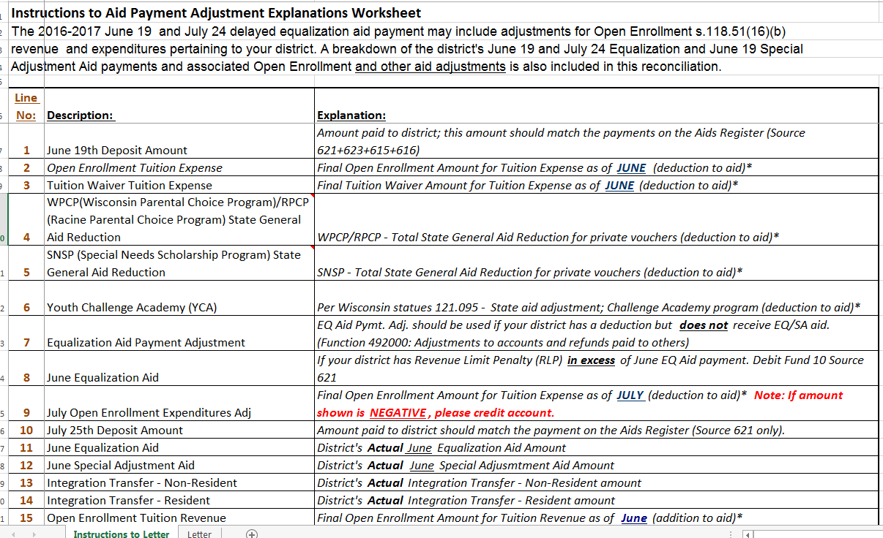
June/July Aid Payment Reconciliation

Slide 71
Special Education Audit Program
Part 1: No Valid License Reporting and Ledger Verification
For all individuals reported on NVL listing:
Provide amounts paid for Salary, Fringe Benefits and Ledger Coding including project numbers even if coded to Project 019
Report information even if a valid license has been issued since the NVL listing was run by DPI
Attach copies of any supporting documentation related to individuals on the listing
Representation letter
Copies of license certificate

Slide 72
Special Education Audit Program
Findings:
Report findings related to individuals on the NVL listing if total aggregate costs identified on the NVL worksheet charged to Projects 011 and 340 are greater than $25,000
Reported costs less than $25,000 on the NVL worksheet do not need reporting as a compliance finding on the Schedule of Findings and Questioned Costs

Slide 73
Special Education NVL worksheet

Slide 74
Special Education NVL worksheet

Slide 75
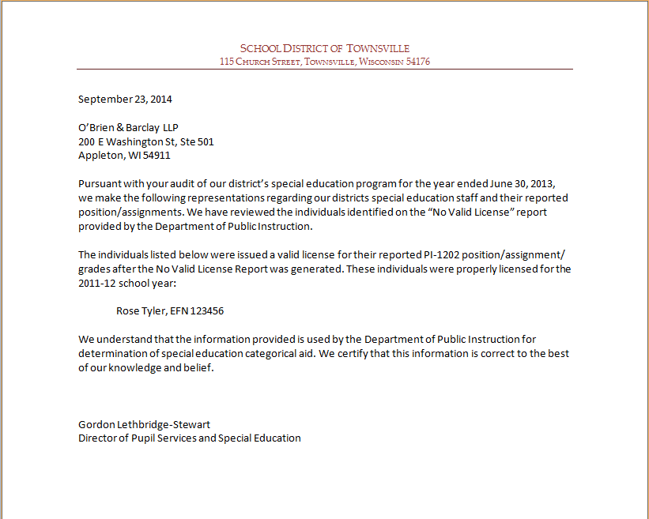
District Representation Letter
Used to correct NVL report when
Position/area incorrect on district’s PI-1202
License issued after NVL check run in June

Slide 76
NVL/QC Reporting
Email to: dpisfsreports@dpi.wi.gov
Completed NVL/QC worksheet—submit actual Excel workbook, not PDF or scan
List all “Educators Without Valid Licenses”
Any additional questioned costs
Reflect account coding after any corrections

Slide 77
ESSA Update

Slide 78
Every Student Succeeds Act (ESSA)
On December 10, 2015 President Obama signed the “Every Student Succeeds Act” into law which replaced the No Child Left Behind Act from 2002
Most notable fiscal provision effective for the 2017-18 year:
Include in both State (SEA) and District (LEA) report cards “per pupil expenditures of federal, state and local funds, disaggregated by district and school”
‘School’ means building location

Slide 79
Every Student Succeeds Act (ESSA)
Proposed Regulations were issued to help SEAs and LEAs implement the law but President Trump enacted the Congressional Reform Act which stopped final adoption of the Regulations
We are waiting for the Department of Education to release guidance as to implementation of the new requirements including due dates for fiscal data
Proposed regulations allowed for a one year extension of providing fiscal data—12/31/19 but law as it stands has a due date of 12/31/18

Slide 80
Every Student Succeeds Act (ESSA)
Questions:
Does the data included in the LEA and SEA report cards have to be audited?
Does the SEA have to collect all expenditure/revenue data by building location?
How will data collection occur if the SEA and LEAs don’t have a system set up to track data by locations?

Slide 81
Fund 39 Balances

Slide 82
Fund 39 Balances
School Districts must levy sufficient amounts to meet all principal and interest payments as they become due. Additional sums may be levied per Wis Stats 67.11(1)(e) if the district intends to make a prepayment on the debt.
Historically, the SFS Team has advised districts against increasing their current debt service tax levy for amounts that will not be spent before setting the tax levy for the next year. However, it is important to note, state law does allow a district to increase its tax levy above the amounts to pay current debt, “in order to speed the payment of municipal obligations.”
Notes:
Every district with a Fund 80 will have an annual audit of the expenses. Depending on the process used by the auditor, something was not checked last year could be a question this year or in the future.

Slide 83
Fund 39 Balances
Debt Service levy [Wis Stats 67.11(1) (e)]: Such further sums raised by taxation or otherwise, as may be necessary to make all interest and principal payments due in any year. The levying and collection of the taxes or other revenues are authorized; but the governing body may, in its discretion, levy and collect larger sums than the sums so authorized, in order to speed the payment of municipal obligations.
The SFS Team is very close to finalizing the new guidance related to Fund 39 revenues and expenditures. The guidance will clarify the consequences of residual fund transfers and impacts to the district’s revenue limit.
Notes:
Every district with a Fund 80 will have an annual audit of the expenses. Depending on the process used by the auditor, something was not checked last year could be a question this year or in the future.

Slide 84
VISIT OUR WEBSITE or CALL US (all 608 Area Code):
Bob Soldner, Director 266-6968
Bruce Anderson, Consultant 267-9707
Carey Bradley, Assistant Director 267-9212
Victoria Chung, Accountant 267-9205
Gene Fornecker, Auditor 267-7882
Brian Kahl, Auditor 266-3862
Derek Sliter, Consultant 266-3464
https://dpi.wi.gov/sfs

