Slide 1
ESSA School Level Expenditure Reporting: The Real Deal
Daniel Bush, Director, School Financial Services
DPI/WASDA State Superintendent’s Conference September 16, 2020

Slide 2
Background
1965: Elementary & Secondary Education Act establishes how the federal government funds education in the states
2001: No Child Left Behind (NCLB) ties federal funding to accountability by student group
2015: Every Student Succeeds Act (ESSA) replaces NCLB
Notes:
Before starting, ask for shows of hands: First, “who’s heard of the Every Student Succeeds Act, ESSA?” Second, “who’s heard of No Child Left Behind?”

Slide 3
Every Student Succeeds Act (ESSA)
Reverses “a trend toward greater federal control”
States “in charge” of accountability
Focuses on state plans and reporting requirements
Source: Libby Nelson, “Congress is getting rid of No Child Left Behind. Here’s what will replace it.” Vox.com, Dec. 9, 2015, https://www.vox.com/policy-and-politics/2015/12/2/9836014/every-student-succeeds-act.

Slide 4
ESSA Title I, Section 1111
[State reporting shall include] the per-pupil expenditures of Federal, State, and local funds, including actual personnel expenditures and actual nonpersonnel expenditures of Federal, State, and local funds, disaggregated by source of funds, for each local educational agency and each school in the State for the preceding fiscal year.

Slide 5
So What Does That Mean?
Your responsibility: Report per-pupil federal & non-federal costs for each school to DPI
Our responsibility: Collect this data and report it to the U.S. Department of Education

Slide 6
Why School Level Reporting?
Goal: Financial transparency of resource allocation on a per student basis
Idea: Use data to drive improvements and promote greater fairness and equity for all students

Slide 7
Basic Process
Identify costs by 1 of 3 types
Identify costs by school or with the district/LEA as a whole
Report costs & enrollments to DPI
We do the per-pupil math

Slide 8
3 Types of Costs
Federal: Costs funded with federal program dollars
Does not include federal Impact Aid, which is basically a “payment in lieu of taxes”

Slide 9
3 Types of Costs
State/Local: Costs funded with property taxes, state aids and grants, or other local sources (fees, gifts, interest, etc.)

Slide 10
Question and Answer
Q: What about costs that aren’t directly associated with educating your students year after year?
A: Create “exclusions” to account for these

Slide 11
3 Types of Costs
Exclusions: Costs your district/LEA can choose to exclude from your per-pupil amounts for each school

Slide 12
Exclusion Examples
Debt Service
Building & Other Capital Projects
Food Service
Community Programs and Services

Slide 13
Interstate Financial Reporting
 | Category | Forward School District
 |  | Schurz El | Phillips Mid | Forward Hi
A | Enrollment | 375 | 511 | 992
School Expenditures
B | Federal | $456 | $209 | $164
C | State/Local | $6,111 | $4,756 | $5,998
D | School Per-Pupil Total | $6,567 | $4,965 | $6,162
School Share of District/LEA Expenditures
E | Federal | $161 | $161 | $161
F | State/Local | $5,378 | $5,378 | $5,378
G | District/LEA Per-Pupil Total | $5,539 | $5,539 | $5,539
H | Total Per-Pupil Expenditures | $12,106 | $10,504 | $11,701
I | Total School Expenditures | $19,097,700
J | Exclusions | $2,416,986
K | Total District Expenditures | $21,514,686
L | Excluded Expenditures | Capital projects, community services, debt service, equipment, food service, interfund transfers, public choice tuition, trust funds
M | Enrollment Count Procedure | Third Friday of September headcount
DPI worked with 38 other states, over 20 districts, and experts at Georgetown University
Result was the Interstate Financial Reporting framework for School Level Reporting

Slide 14
Enrollment
 | Category | Forward School District
 |  | Schurz El | Phillips Mid | Forward Hi
A | Enrollment | 375 | 511 | 992
School Expenditures
B | Federal | $456 | $209 | $164
C | State/Local | $6,111 | $4,756 | $5,998
D | School Per-Pupil Total | $6,567 | $4,965 | $6,162
School Share of District/LEA Expenditures
E | Federal | $161 | $161 | $161
F | State/Local | $5,378 | $5,378 | $5,378
G | District/LEA Per-Pupil Total | $5,539 | $5,539 | $5,539
H | Total Per-Pupil Expenditures | $12,106 | $10,504 | $11,701
I | Total School Expenditures | $19,097,700
J | Exclusions | $2,416,986
K | Total District Expenditures | $21,514,686
L | Excluded Expenditures | Capital projects, community services, debt service, equipment, food service, interfund transfers, public choice tuition, trust funds
M | Enrollment Count Procedure | Third Friday of September headcount
Third Friday enrollment count
Based who educates a student (headcount) rather than where they live (membership)

Slide 15
School Expenditures
 | Category | Forward School District
 |  | Schurz El | Phillips Mid | Forward Hi
A | Enrollment | 375 | 511 | 992
School Expenditures
B | Federal | $456 | $209 | $164
C | State/Local | $6,111 | $4,756 | $5,998
D | School Per-Pupil Total | $6,567 | $4,965 | $6,162
School Share of District/LEA Expenditures
E | Federal | $161 | $161 | $161
F | State/Local | $5,378 | $5,378 | $5,378
G | District/LEA Per-Pupil Total | $5,539 | $5,539 | $5,539
H | Total Per-Pupil Expenditures | $12,106 | $10,504 | $11,701
I | Total School Expenditures | $19,097,700
J | Exclusions | $2,416,986
K | Total District Expenditures | $21,514,686
L | Excluded Expenditures | Capital projects, community services, debt service, equipment, food service, interfund transfers, public choice tuition, trust funds
M | Enrollment Count Procedure | Third Friday of September headcount
Per-pupil amounts for teachers, support staff, supplies and other costs at the school level
Split by funding source into Federal and State/Local

Slide 16
District/LEA Expenditures
 | Category | Forward School District
 |  | Schurz El | Phillips Mid | Forward Hi
A | Enrollment | 375 | 511 | 992
School Expenditures
B | Federal | $456 | $209 | $164
C | State/Local | $6,111 | $4,756 | $5,998
D | School Per-Pupil Total | $6,567 | $4,965 | $6,162
School Share of District/LEA Expenditures
E | Federal | $161 | $161 | $161
F | State/Local | $5,378 | $5,378 | $5,378
G | District/LEA Per-Pupil Total | $5,539 | $5,539 | $5,539
H | Total Per-Pupil Expenditures | $12,106 | $10,504 | $11,701
I | Total School Expenditures | $19,097,700
J | Exclusions | $2,416,986
K | Total District Expenditures | $21,514,686
L | Excluded Expenditures | Capital projects, community services, debt service, equipment, food service, interfund transfers, public choice tuition, trust funds
M | Enrollment Count Procedure | Third Friday of September headcount
Per-pupil amounts for administra- tion, central services, and other costs at the district/LEA level
Also split by funding source
Divided by district/LEA enrollment—will be the same numbers for every school

Slide 17
Total School Expenditures
 | Category | Forward School District
 |  | Schurz El | Phillips Mid | Forward Hi
A | Enrollment | 375 | 511 | 992
School Expenditures
B | Federal | $456 | $209 | $164
C | State/Local | $6,111 | $4,756 | $5,998
D | School Per-Pupil Total | $6,567 | $4,965 | $6,162
School Share of District/LEA Expenditures
E | Federal | $161 | $161 | $161
F | State/Local | $5,378 | $5,378 | $5,378
G | District/LEA Per-Pupil Total | $5,539 | $5,539 | $5,539
H | Total Per-Pupil Expenditures | $12,106 | $10,504 | $11,701
I | Total School Expenditures | $19,097,700
J | Exclusions | $2,416,986
K | Total District Expenditures | $21,514,686
L | Excluded Expenditures | Capital projects, community services, debt service, equipment, food service, interfund transfers, public choice tuition, trust funds
M | Enrollment Count Procedure | Third Friday of September headcount
The per-pupil total for costs specific to each school…
Plus the district/LEA-wide per-pupil total for costs at that level…
Equals per-pupil total school expenditures

Slide 18
Total School Expenditures
 | Category | Forward School District
 |  | Schurz El | Phillips Mid | Forward Hi
A | Enrollment | 375 | 511 | 992
School Expenditures
B | Federal | $456 | $209 | $164
C | State/Local | $6,111 | $4,756 | $5,998
D | School Per-Pupil Total | $6,567 | $4,965 | $6,162
School Share of District/LEA Expenditures
E | Federal | $161 | $161 | $161
F | State/Local | $5,378 | $5,378 | $5,378
G | District/LEA Per-Pupil Total | $5,539 | $5,539 | $5,539
H | Total Per-Pupil Expenditures | $12,106 | $10,504 | $11,701
I | Total School Expenditures | $19,097,700
J | Exclusions | $2,416,986
K | Total District Expenditures | $21,514,686
L | Excluded Expenditures | Capital projects, community services, debt service, equipment, food service, interfund transfers, public choice tuition, trust funds
M | Enrollment Count Procedure | Third Friday of September headcount
This will be the number people focus on and use for comparisons

Slide 19
Exclusions & Total Expenditures
 | Category | Forward School District
 |  | Schurz El | Phillips Mid | Forward Hi
A | Enrollment | 375 | 511 | 992
School Expenditures
B | Federal | $456 | $209 | $164
C | State/Local | $6,111 | $4,756 | $5,998
D | School Per-Pupil Total | $6,567 | $4,965 | $6,162
School Share of District/LEA Expenditures
E | Federal | $161 | $161 | $161
F | State/Local | $5,378 | $5,378 | $5,378
G | District/LEA Per-Pupil Total | $5,539 | $5,539 | $5,539
H | Total Per-Pupil Expenditures | $12,106 | $10,504 | $11,701
I | Total School Expenditures | $19,097,700
J | Exclusions | $2,416,986
K | Total District Expenditures | $21,514,686
L | Excluded Expenditures | Capital projects, community services, debt service, equipment, food service, interfund transfers, public choice tuition, trust funds
M | Enrollment Count Procedure | Third Friday of September headcount
These are district/LEA totals, not per-pupil numbers
Also includes a list of all the exclusions being reported

Slide 20
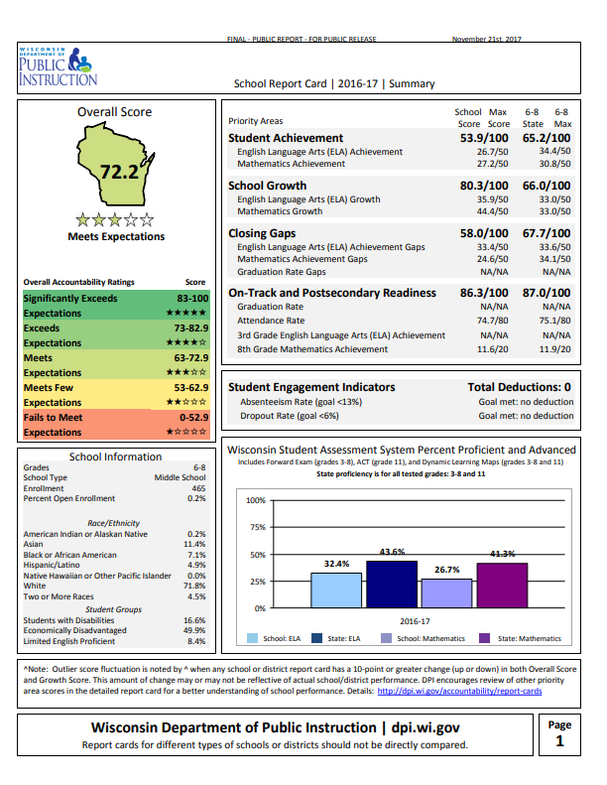
Talking About School Level Data
School level achievement data has been around for a long time
School level finance data is a whole new dimension
$12,608 per pupil

Slide 21
Talking About School Level Data
Dollar amounts aren’t going on the Report Card
But people will try to connect them once the data goes public
…yet
$12,608 per pupil

Slide 22
Talking About School Level Data
How do you prepare for that conversation as district administrators?
$12,608 per pupil

Slide 23
Talking About School Level Data
Answer: Know Your School and Student Stories to Explain Your Numbers
$12,608 per pupil

Slide 24
Financial Transparency Fact #1
Most school leaders do not have a good sense of the true financial resources allocated to specific schools in their districts/LEAs.
Source: Edunomics Lab, Georgetown University. “Financial transparency: What’s your number?” Presentation, Council of Chief State School Officers, 2017.
Notes:
Finding by Edunomics in their fieldwork interviewing and surveying school leaders.

Slide 25
Financial Transparency Fact #1
Why is this the case?
How does your current budgeting process divide responsibilities?
CLASSROOMS
CURRICULUM
STAFFING
GRANTS
INFRASTRUCTURE
Notes:
Discuss how the traditional budgeting process can be siloed – different people make different decisions about the different resources that all go into educating the kids in a school.

Slide 26
Financial Transparency Fact #1
School Level Reporting is a new requirement…
But it’s also an opportunity to bring more transparency and focus on students
CLASSROOMS
CURRICULUM
STAFFING
GRANTS
INFRASTRUCTURE

Slide 27
Financial Transparency Fact #2
Most school leaders do not have a good sense of how well their schools are able to leverage dollars and maximize outcomes.
Source: Edunomics Lab, Georgetown University. “Financial transparency: What’s your number?” Presentation, Council of Chief State School Officers, 2017.
Notes:
Also finding by Edunomics.

Slide 28
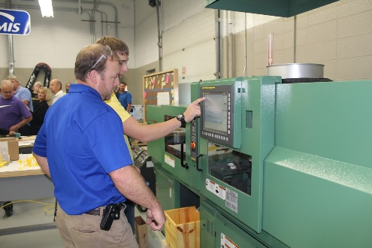
Financial Transparency Fact #2
Are your budget initiatives improving learning and college & career readiness?
How would you determine your return on investment?
Notes:
Discuss how a district/LEA might evaluate the effectiveness of the examples shown: Manufacturing Technology Lab, Service Learning, 1-to-1 Devices.

Slide 29
Using the Numbers
School level per-pupil spending will be used to compare schools…
…but there is no perfect apples-to-apples method for doing so
Notes:
School spending and “return on investment” comparisons were an explicit purpose of ESSA’s authors.

Slide 30
How Might Someone Compare?
 | Dairyland High | Whitetail High
 | Dairyland High | Whitetail High
Per-Pupil Spending | $15,622 | $12,096
School Report Card | Meets Exp. | Exceeds Exp.
Enrollment | 217 | 635
CESA | 10 | 5
Title I Program? | Yes | No
Health Insurance | Traditional POS | High Ded. HMO
 | Dairyland High | Whitetail High
Per-Pupil Spending | $15,622 | $12,096
School Report Card | Meets Exp. | Exceeds Exp.
Enrollment | 217 | 635
CESA | 10 | 5
Title I Program? | Yes | No
 | Dairyland High | Whitetail High
Per-Pupil Spending | $15,622 | $12,096
School Report Card | Meets Exp. | Exceeds Exp.
Enrollment | 217 | 635
CESA | 10 | 5
 | Dairyland High | Whitetail High
Per-Pupil Spending | $15,622 | $12,096
School Report Card | Meets Exp. | Exceeds Exp.
Enrollment | 217 | 635
 | Dairyland High | Whitetail High
Per-Pupil Spending | $15,622 | $12,096
School Report Card | Meets Expectations | Exceeds Exp.
 | Dairyland High | Whitetail High
Per-Pupil Spending | $15,622 | $12,096
Notes:
Starts with the per-pupil number and then adds one data point at a time. With each step, discuss whether any conclusions can be drawn about the comparison. No right or wrong answers here – this is to get the audience thinking about how they’d build their own story.

Slide 31
How Might Someone Compare?
 | Dairyland High | Whitetail High
 | Dairyland High | Whitetail High
Per-Pupil Spending | $15,622 | $12,096
School Report Card | Meets Expectations | Exceeds Exp.
…but this is all you’re likely to see in the paper.
It’s up to YOU as leaders to add context.

Slide 32
The Real Deal
2018-19 per pupil school-level expenditure data for Wisconsin public schools will be released on November 19, 2020

Slide 33
The Real Deal
Data will be in secure WISEdash for Districts from October 13 to November 16, 2020 for a formal data quality review period

Slide 34
Data Quality Review
Where did the data come from?
Expenditures: 2018-19 School Level Reporting financial collection
This is where your staff identified school, district/LEA, and excluded costs

Slide 35
Data Quality Review
Where did the data come from?
Enrollments: 2018-19 WISEdata certified Third Friday 2018 student counts
These were audited and certified by districts in winter/spring 2019

Slide 36
Data Quality Review
Where did the data come from?
Per-pupil expenditures: Calculated by DPI from district-reported expenditures and enrollments

Slide 37
Data Quality Review
NOTE: Per-pupil spending numbers in WISEdash may not match the School Level Reporting application exactly
SLR application calculates live when you view reports for your district, the reporting app does the rounding
WISEdash uses a single statewide snapshot compiled and calculated from the database with a different program

Slide 38
Data Quality Review
How expenditures are identified between schools, district/LEA, and exclusions can be modified
Update and re-finalize the 2018-19 Annual Report in the School Level Reporting application at sfs.dpi.wi.gov/WiSFiP

Slide 39
Data Quality Review
Enrollment numbers themselves cannot be modified
Data were audited and certified by districts and are the basis for public reporting in WISEdash and on School/District Report Cards

Slide 40
Data Quality Review
Specific enrollment denominators can be adjusted for school-level expenditure reporting purposes
Must be tied to an expenditure numerator
Email dpifin@dpi.wi.gov for more information

Slide 41
Resources to Get Ready
CCSSO School-Level Spending Toolkit
District-level communication resources, templates, and more
Download from DPI Google Drive link

Slide 42
Resources to Get Ready
NAESP/NASSP Principal PPE Resources
Overview, FAQ, and fact sheets for principals
nassp.org/policy-advocacy-center/ principal-ppe-resources/

Slide 43
Resources to Get Ready
American Institutes for Research ESSA Key Resources
Links to AIR’s Action Guide and other key resources on this topic
air.org/resource/essa-key-resources-improving-fairness-school-funding

Slide 44
Resources to Get Ready
More from DPI over the next two months…follow the School Finance Bulletin for details!
dpi.wi.gov/sfs/communications/bulletins

Slide 45
Your #1 Takeaway
Total Per-Pupil Expenditure (Line H) is the critical data point
Know and share why each of your schools’ numbers are what they are
Tell your school level stories
Talk about your student successes!

Slide 46
Contact
Daniel Bush Director DPI School Financial Services Team daniel.bush@dpi.wi.gov 608-266-6968
ESSA School Level Reporting webpage: dpi.wi.gov/sfs/reporting/slr

