Slide 1
College and Career Ready IEPs
(CCR-IEPs)
Improving Outcomes for Students 3 through 21
Training Day
Presenters:
Date:
Notes:
Possible schedule
Time Slides Topic Time Needed
1-14 Housekeeping, Intros 30 min.
Overview
Beliefs/Video
15-25 Step 1 (w/ out activity) 20 min (add 15-20 min for activity)
26- 63 Step 2 100 min
26-33 Intro (10min)
34-37 Effects/Activity(20min)
BREAK (10min)
38-50 Root Cause, Video (30min)
51-63 Disability Related Needs (30min) + questions
Lunch (30-45)
64-87 Step 3 80 min
Examples, Activity
BREAK (10 min)
88-106 Step 4 20 min
107-116 Step 5 10 min.
117-124 Resources/general Questions 10 min.
College and Career Ready IEPs Training Day–Generic Description (adapt as appropriate to group)
This interactive workshop will increase participant understanding of the CCR-IEP Process. The focus will be on the application of Steps 1, 2 and 3. Participants are strongly encouraged to attend in groups of at least two from the same district. Each district team must bring a copy of a student’s IEP* to use as reference or have access to an IEP online to use during the training.
Learning Objectives:
Participants will increase their understanding of the CCR IEP 5 Step Process and how to use it to develop IEPs
Participants will build their capacity to apply Step 1 (Understand Achievement), Step 2 (Identify Effects of Disability and Disability Related Needs, and Step 3 (Develop Ambitious and Achievable Goals) so they can develop IEPs designed to improve access, engagement, and progress for students with IEPs
Participants will increase their awareness of CCR-IEP resources available to support the development of CCR-IEPs
*Workshop participants are reminded of FERPA protections and are highly encouraged to redact personally identifiable information from IEPs they may happen to share with participants from other districts during workshop activities.
This is from last training- Timings and slide numbers will need to be updated when presentation finalized

Slide 2
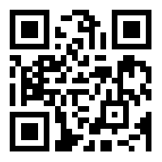
Learning Expectations
By the end of the day you will:
increase your understanding of the CCR IEP 5 Step Process and how to use it
build your capacity to apply Steps 1, 2, and 3 so you can help develop IEPs designed to improve access, engagement, and progress for students with IEPs
identify strategies for preparing for and participating in IEP team meetings
increase your awareness of CCR IEP resources available to support the development of CCR-IEPs
Notes:
The key to developing an IEP that fulfills the intent of IDEA and IDEA procedural and substantive requirements is the IEP team’s discussion about how to address an individual student’s needs so the student can better access, engage and make progress in preschool/general education curriculum, instruction, and other activities across educational environments. This hinges upon thoughtfully linking all 5 steps of the CCR IEP process, with step 2 being the most important. While we touch upon all 5 steps today, our main focus will be step 2 and the linkages between Steps 1, 2, and 3.
We understand you may have been concentrating on using the updated IEP forms. Our focus today is on how to prepare for and support IEP team discussion. You will get many ideas about how to develop IEP documentation, but filling in the forms is not the primary purpose of our day.
Review learning objectives. Then Go over handouts available in Online Folder (may personalize -See Sample DPI Resource list for suggested handouts: REFER to Steps At A Glance one-pagers (in handouts) Also mention Webinars and Step PPTs available on DPI site
ASK/Remind PARTICIPANTS TO PULL UP A COPY OF AN IEP ON THEIR LAPTOPS (OR TAKE OUT COPY IF THEY BROUGHT A PAPER ONE)
Suggest use this IEP for reflection throughout the day. Not intending for them to revise or rewrite existing IEPs. Found it is helpful to look at IEP of a familiar student in the context of today’s content.
Trainer recommendation- Have participants work in pairs or very small groups during activities. Participants can work as individuals if they prefer.
Remind participants about FERPA protections if they share an IEP with someone who is not a teacher of the student during activities (i.e. may not discuss or disclose disability status outside of room). Parent participants not employed by a district, CESA or WSPEI may not view IEPs brought by other participants unless it is of their child.
Trainer: Add QR code or Link to handouts

Slide 3


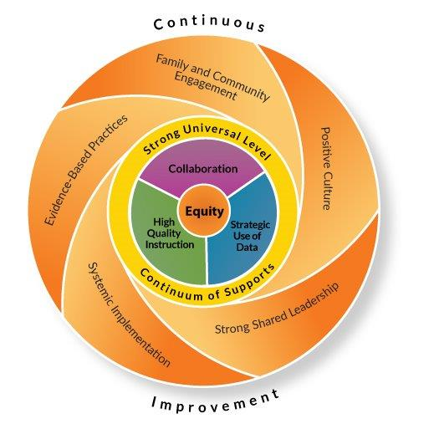
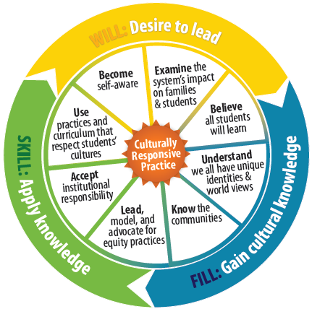
What We Want to Accomplish
Notes:
This training day was created to reinforce and support the purposes of the IEP process.
On this slide are links to a number of the DPI initiatives aimed at these intents. each has a link to click on- see copy of slides in their folder
DPI Vision
RDA
MLSS
Culturally Responsive Practices

Slide 4
What is a CCR IEP?
CCR IEP = College and Career Ready IEP
An Individualized Education Program (IEP) developed to :
meet the unique disability-related needs of a student
and
help ensure the student graduates ready for further education, work, and living in the community
Notes:
Presenter: Survey audience for prior knowledge/training of CCR IEP- How many received training last school year? this school year? First time? Adjust accordingly
--------------------------------------------------------------------------------------------------
Before we start, lets think about why we likely went into this field. When we think about why we have Individualized Education Programs (IEPs) for students identified as having a disability, we need to remember the basic purposes/ intents of IDEA and what we hope to accomplish with IEPs.
students have what they need to be successful and increase their opportunities to access, engage, and make progress in grade level academic content and functional expectations.
improve reading and literacy outcomes so they can become life long learners (Improving reading outcomes is our RDA Focus (federal special education monitoring requirement– see link to DPI Initiatives supporting RDA and CCR IEPs in Resources section).
Students provided with culturally responsive practices and given the same opportunities to show success as students without IEPs,
And students with IEPs graduate with the self determination and independence needed to be successful in adult life; college or career and community.
CCR IEP stands for College and Career Ready Individualized Education Program.
CCR IEPs are for all students in public school programs ages 3 through 21 who receive special education services; not just for high school students.
CCR IEPs build knowledge, skills, and habits throughout a student’s academic experiences, so when they graduate, they are college and career (and community) ready. This important foundation begins in early childhood.
Simply put, CCR IEPS are Individualized Education Programs (IEP) developed to meet the unique disability-related needs of the student and help ensure the student graduates ready for further education the workplace, and the community.
Presenter note- Point out icon on slide. Icons can be found on a number of the slides. They provide links to handouts or other resources related to the slide topic.

Slide 5
Which Students Should Have a CCR IEP?
All Students with Disabilities
  The IEP development process is the same for all students
The Only Substantive Difference is the Standards Used:
  For students in the general education curriculum
    General education standards (e.g., Wisconsin Academic Standards)
    Participate in the Wisconsin Forward Exam or ACT
  For students with significant cognitive disabilities:
    Alternate achievement standards (e.g. Essential Elements)
    Participating in Dynamic Learning Maps (DLM) Assessment
  For preschool children:
    Preschool standards (e.g., Wisconsin Model Academic Learning Standards).
Notes:
CCR IEP all for all students with disabilities. The 5-Step process should be used when developing all IEPs, even in early childhood when foundational skills are being developed.
The main difference is the standards used:
For students in the general education curriculum
General education standards (e.g., Wisconsin Academic Standards)
Participate in the Wisconsin Forward Exam or ACT
For students with significant cognitive disabilities:
Alternate achievement standards (e.g. Essential Elements)
Participating in Dynamic Learning Maps (DLM) Assessment
For preschool children:
Preschool standards (e.g., Wisconsin Model Academic Learning Standards).

Slide 6
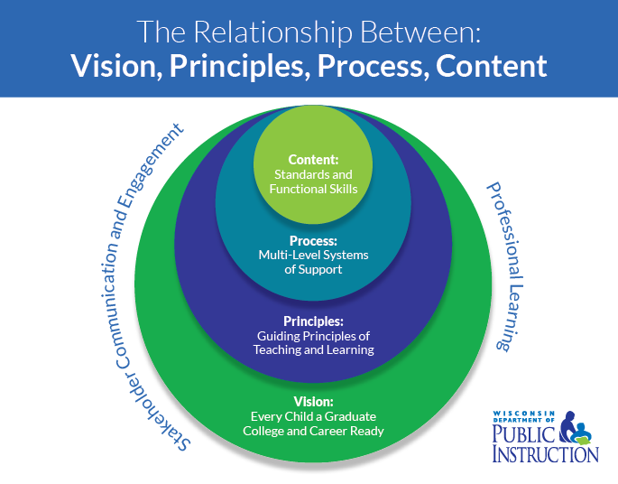
Standards and Expectations
Wisconsin Academic Standards
Early Learning Standards
(WMELS)
Alternate Academic Achievement Standards (Essential Elements )
for students with the MSCD
Social and Emotional Learning Competencies
Notes:
Here are links to all Wisconsin standards and expectations
Please note:
revisions and new materials being added to the Wisconsin Academic Standards pages – re: ELA Standards 101 and Mathematics Standards 101
The Social and Emotional Learning competencies are currently in draft form. A final version is expected during the 2018-19 school year.
Trainer Note: May want to make the following content into a supplemental slide or discussion activity.
These are some additional notes from discussion with participants in recent CESA trainings to help clarify Step 1
What does it mean “to meet grade level standards/expectations”? Think:
What are the skills that relate to the standard?
What are the criterion/criteria for proficiency?
What would “meet the standards/expectation”?
What would not “meet standards/expectation?
How do you know the student is/is not meeting the standards/expectation?
Is the data you have specific enough?

Slide 7
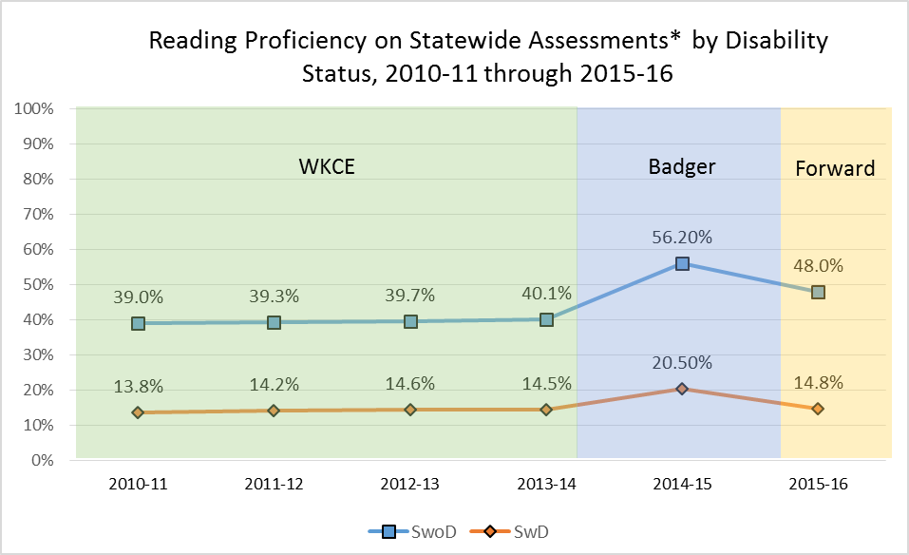
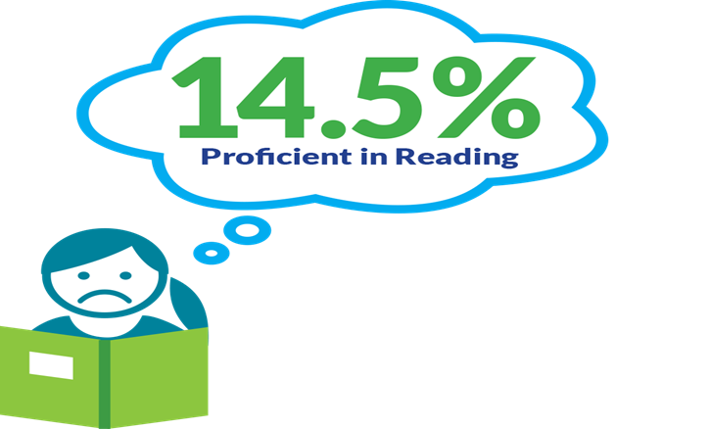
Why is this Important?
* WKCE, Badger, & Forward, along with DLM each year. Different tests are expected to produce different results, and are not interchangeable measures.
Notes:
Presenter Note: Audience very likely already aware of these statistics. This slide is just a reminder about why this is important. Key points to highlight here:
Focus on procedural compliance alone has not resulted in better outcomes
DPI revised sample IEP forms to promote discussions aimed at improving student outcomes and meeting standards
CCR IEP 5 Step process developed to help IEP teams focus on improving access, engagement and progress in early childhood/grade level curriculum, instruction, and environments
Goal: College, Career, Community Ready
Why all the changes? This graph shows why we selected literacy for our RDA focus. Reading achievement has been relatively stagnant over the years. Neither the achievement of students with or without IEPs is acceptable. Even though the vast majority of students with IEPs have the ability to learn to read as well as their non-disabled peers, fewer than 15% of students with disabilities meet proficiency standards in reading. Performance on curriculum based measures support the validity of these scores. While there may be a number of reasons for these low test scores, it is clear that all students can do better. We need to do more to reflect on current practice and make changes in what we do with students. We should expect higher achievement.
DPI knows our emphasis on compliance with selected IDEA procedural requirements has not resulted in better outcomes for students with IEPs. In response, DPI revised the state sample IEP forms and developed guidance to promote IEP team discussion better aimed at improving student outcomes and reducing literacy and other achievement gaps so students can meet early childhood and grade level academic standards and functional expectations, These changes are all part of the CCR IEP Framework.
We believe if IEP teams focus in on “how” and “why” students encounter barriers to access, engagement, and progress in early childhood/grade level standards-based curriculum, instruction and other activities, across educational environments, we will develop of IEP goals and services that better support student needs. The CCR IEP 5 Step process was developed to help IEP teams focus on these intents.

Slide 8
The Power of Beliefs
CCR IEP 5 Beliefs
High Expectations
Culturally Responsive Practices
Student Relationships
Family and Community Engagement
Collective Responsibility
Notes:
Before we get to the steps, I want to briefly mention the 5 beliefs that are at the core of the CCR-IEP process.
The 5 core beliefs are essential to developing IEPs that promote college and career readiness. It is foundational for families and educators to embrace these 5 beliefs. We hope you go back to your schools and talk with teachers, families and students about how they influence practices around IEP development in particular, and the education of students with disabilities, in general.
Staff may look to you to model and provide direction regarding how these beliefs are understood and realized in your districts. (insert role in district - e.g. special educators. Leadership staff, educators, family engagement leaders, related services staff, etc.) Some discussion slides may need to be revised for group,
It is important to keep the 5 Beliefs in mind when completing each step of the IEP development process:
high expectations mean believing students with disabilities can meet preschool/grade level academic standards and functional expectations or, for students with most significantly cognitive disabilities, alternate achievement standards aligned with grade level standards
culturally responsive practices to honor and engage students;
positive student relationships between peers and adults to foster access, engagement and progress as well as self-efficacy, self-advocacy and independence;
family and community engagement (will mention Family Engagement later- this is a central focus of DPI)
collective responsibility for working together to support each student in achieving their IEP goals. (including transition goals for older students)
For more information on the 5 Beliefs, please visit our CCR IEP Resources webpage. A handout of the 5 beliefs is available on the dpi website at (link on slide)

Slide 9
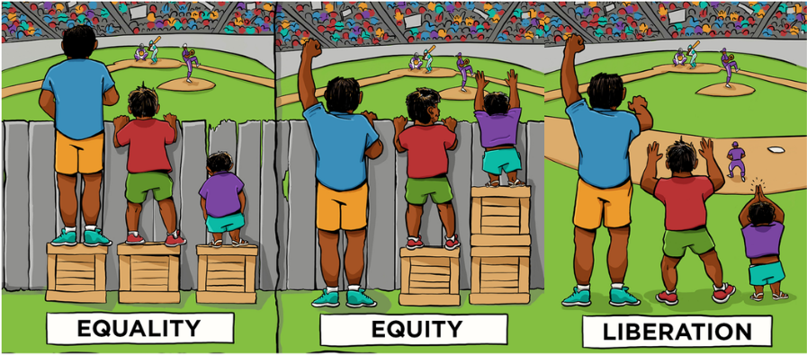
Systems that Support
No Barriers
Adapted from Center for Story Based Strategy and Interaction Institute for Social Change
Notes:
Some of you may have seen this graphic. It is often used to talk about culturally response practices. Today we will use it to talk about CCR-IEPs. It represents the CCR-IEP beliefs and what we hope to achieve w/ the CCR-IEP process.
In the first scenario, each student is given the same/equal supports. This is the world without IEPs. This works for some students but not so well for others. Equal is not always fair, especially for students with IEPs.
In the second scenario, resources are allocated to each student based on individual needs, to address the effects of the student’s disability. One might say this is what current IEPs most often do for students. They help students get around barriers, by outlining supports that improve the student’s access, engagement, and progress in grade level curriculum, instruction, and environments. Special education staff are often the “box builders” for students with IEPs; They give students what they need to deal with the barriers the students often encounter. But, providing boxes to get around barriers is not enough.
In the third scenario, we have identified the barriers, that if removed, may provide each student with the capacity to access and engage in their education so they can benefit and make progress. While this may not always be fully possible, this is what we should strive to accomplish with the IEP process, figuring out what is needed to remove barriers; not just building boxes. For some students, barriers are skill-related; for some, the greatest barriers are other’s beliefs,; for some the greatest barriers are environmental, and for others, there are barriers in multiple domains: We can remove barriers by:
Increasing student skills to address academic /functional skill gaps) by providing instruction/intervention/specially designed instruction matched to student strengths and needs
Providing Instructional supports that promote full participation and independence and change or fade supports that do not do not promote access and engagement. This may include instructional strategies, adult supports/supervision, environmental modification or other supports and accommodations.
What staff do /change in staff behavior/practices
Expectations and Beliefs about student ability/change staff, student, family beliefs and expectations
Picture Adapted from Center for Story Based Strategy and Interaction Institute for Social Change

Slide 10


Notes:
Isaiah’s story illustrates the CCR IEP beliefs clearly. Think about the 5 beliefs as you watch the video. What kinds of beliefs do you think the people who worked with Isaiah had about him?
Remember to show w/ Closed Captioning on
After video, allow 1 minute Turn and talk :
How have beliefs influenced Isaiah’s educational program and his progress towards ambitious, achievable goals designed to prepare him for college, career and community?
Ideas for Debriefing:
How have barriers been addressed for Isaiah?
What kind of goals, over time, do you think were needed to get Isaiah to this point?
How might the outcomes for Isaiah be different if those involved in Isaiah’s education had different beliefs?
e.g., moving around school and familiar neighborhood using only white cane vs. needing adult guide all the time- If we didn’t believe he could do this, we might have provided 1:1 aid for entire school career- If this had happened, how might this have affected him as he moved into post secondary environments?
e.g., able to read braille
e.g., recent update, Isaiah is working at McDonalds
Presenter note: The following icon on the slides indicates a planned time to stop and have a small or large group conversation

Slide 11
Engaging Families
“Achievement gap” is “opportunity gap”
Definitions of terms used
Clear explanation of the step discussion and linkages
Family contribution is valued and essential
Active listening helps to address concerns, answer questions, and elicit input
Notes:
Family engagement is an integral philosophy of College & Career Ready IEPs.
As IEP team members, parents are engaged in all parts of the process:
Identifying the student’s strengths and current levels of performance.
Identifying the student’s disability-related needs.
Developing the goals; understanding what meeting the goal can “look like.”
Supporting their student in meeting IEP goals.
Reviewing progress
So how do we prepare families and support their participation in the process?
On this slide there are some suggestions developed in conjunction w/ the Wisconsin State Parent Education Initiative WSPEI) in response to input we have received about parent experiences during IEP team meetings and feedback re: what they would like to have happen during meetings re: their meaningful input and participation.
There is a link on this slide to a number of resources on Family Engagement, including a link to the WSPEI site where you can find a number of resources, including family and student snapshots, which we will refer to a bit later.
Valued-- remember parents are their child’s first teachers and it may be hard for them to trust others. Parents need to know their input is acknowledged, needed, and valued
Families need:
Understanding at what level their child is performing. Families and students are aware there are gaps. They want to know that educators do not see Achievement gaps as just representing their child’s deficits, but as representing opportunity gaps in planning for growth and improvement.
Concrete examples such as a book at student’s instructional level and independent level
Understanding the services and strategies provided to address needs.
Training note: Remind participants that we would like them to think about family engagement as we go through each step. Remember to prompt participants during debriefing discussions asking for how they would involve families/students in preparing for and during IEP team meetings.

Slide 12
Engaging Students
Have a system in place to engage students in the IEP process
  Explain purpose of the IEP and IEP development process
    Consider using the 5 Step Process graphic organizer
  Explain IEP terminology using language the student understands
  Encourage student to share input/give examples appropriate to each step
  Provide participation options
    Consider student led IEPs
    Encourage Principle of Partial Participation (as appropriate)
Notes:
Before we move on, one more review piece to keep in mind. It may be good to spend some time talking about how this is addressed in your districts.
Involving students in the development of their IEPs leads to greater student ownership and understanding of their educational program and its outcomes.
This applies to students of all ages and developmental levels. All students can and should have some role in their IEP.
On this slide, there are a few ideas for engaging students in the IEP process. You may have others: (Share following as appropriate to audience)
Have a system for preparing the student to participate in the IEP team meeting
Provide explanations of IEP terminology using language the student understands
Encourage student to describe/give examples appropriate to each step
How their disability affects their access, engagement, and progress across environments
What may trigger anxiety (or other emotions/behaviors), or make things more difficult for them
What supports and services are helpful
Provide participation options
Consider student led IEPs
Encourage Principle of Partial Participation (as appropriate)
Even students with “the most significant cognitive disabilities’ can participate in their IEP meeting in a meaningful way and provide information. The IEP team should consider the Principle of Partial Participation. It is better to work to try to include the student as much as possible than not to include them in the process at all.
For example, a student who uses a picture based communication system as a primary mode of communicating with others, can be asked questions related to their interests and ideas and then respond based on the choices provided. (The choices might be picked by someone who knows the student well, based on previous experiences the student has had, or based on age appropriate things their peers may be interested in).
Training note: Ask participants to reflect on how they might involve students in each step as we go through the day.

Slide 13
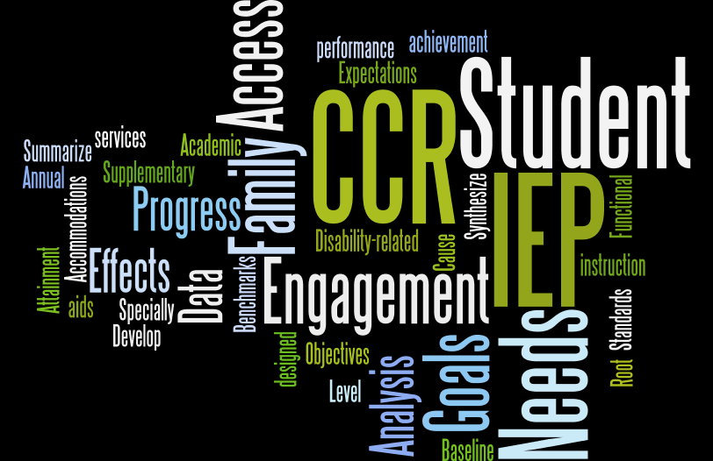
Notes:
This slide shows many of the terms used in the CCR IEP process
It is a reminder that family members and students, (and sometimes general educators who do not frequently attend IEP team meetings), can become overwhelmed with the terminology used in the special education process and on IEP forms and notices
The IEP process can be really confusing to parents. The number of special terms and acronyms used on the IEP forms and CCR IEP 5 Step process is sizable.
Not understand the terminology used during meetings can significantly limit family and student engagement in the process.
Trainer notes, add the following as appropriate to audience:
For groups of mostly educators: When we present to families, we tell parents they should try to become familiar with these terms and should always feel free to ASK if they don’t understand
For groups of mostly families/family engagement liaisons: When we present to educators, we remind school staff that they should use descriptive language that families and students can understand as much as possible. When technical terms are used, they should explain them to parents and students and encourage parents to ask questions as part of the usual meeting process.

Slide 14

CCR IEP 5 Step Process
Back to Basics
Understand achievement of grade-level academic standards and functional expectations to identify the student’s strengths and needs.
Analyze progress towards goals to evaluate what works and what is needed to close the student’s achievement gaps
Identify how the student’s disability affects academic achievement and functional performance
(and summarize disability related needs)
Align specially designed instruction, services, supports, and accommodations needed to support the goals and ensure access to the general curriculum
Develop ambitious and achievable goals that close achievement gaps and support the unique strengths and needs of the student
Notes:
Now let’s move on to today’s main training content
The Five Step Process, takes IEP teams through five inter-related requirements of an IEP team meeting held to develop a student’s IEP .
One of the benefits of thinking about IEP meetings using the frame of these five simple steps, reminds us that this is not a new process or a new IEP.
Ask (Raise hands) - Are these steps familiar to you? If these steps look familiar, it is not a surprise; this is the IEP as we have always known it.
The 5 steps address the following IEP development questions:
Do we understand the student’s unique strengths and needs in relation to grade level academic and functional expectations?
Have we identified how the student’s disability effects access, engagement, and progress and identified the student’s unique disability-related needs?
Based on those unique needs, what specific, clear, measurable, ambitious and achievable goals are needed to support the student in meeting standards and expectations?
What IEP services should be aligned to support goals and needs?
And finally, do we have a system to analyze progress throughout the duration of the IEP to identify what is working and what may need to change to improve access, engagement and progress in grade level content, instruction, and environments to improve student outcomes?
Link to CCR IEP Resources webpage- 5 Steps on this slide and at the end of the presentation. https://dpi.wi.gov/sites/default/files/imce/sped/pdf/rda-ccr-iep-five-step-process.pdf

Slide 15
College and Career Ready IEP
5 Step Process
Understand Achievement
Analyze Progress
Identify Effects of Disability
(and disability related needs)
Align Services
Develop Goals
Notes:
Lets start with step 1. The information about achievement and functional performance summarized during step 1 serves as the foundation for step 2
We will briefly go over step 1 now, and will return to it during our step 2 discussion.
It will be easier for you to reflect on your IEPs and what kind of information you may want to be bring to the meeting for Step 1 discussion after we have spent some time talking about Step 2.

Slide 16
Step 1
Understand Achievement
Understand achievement of grade-level academic standards and functional expectations to identify the student’s strengths and needs
Notes:
Step 1 is all about Data and Preparation. Step 1 provides the IEP team with the “big picture” of the student’s current performance. It provides the DATA that documents current levels and the degree to which a student is meeting standards and expectations.
The purpose of Step 1 is to summarize, understand and document the student’s current academic and functional performance related to access, engagement and progress in the general education curriculum, activities and environment(s). Current levels of achievement and functional performance must be understood in relation to early childhood/ grade-level pre-academic/academic content standards and functional expectations.
It is also important to understand and include information that reflects the family and student’s voices and points of view on strengths, as well as areas in which the student may not be meeting standards and expectations. If the family/student does not volunteer information when reviewing current levels, they should be asked for input. Share WSPEI Student Snapshot and My Snapshot Resources. (Family Engagement IEP Process resources : For Families: Student Snapshot; For Students: My Snapshot ) Link to page on slide.
Some teams may want to start the meeting with “Celebrations” of the students successes and strengths.
Step 1 lays the foundation of data and information for the analysis that occurs during Step 2. It is important that the IEP team compiles sufficient data and information in preparation for the discussion about effects and disability-related needs.
When completing this step, be sure data and information are shared in meaningful ways so all IEP team members understand, including parents and the student (as appropriate). For instance, explain test scores in terms that describe what a student knows and is able to do compared to their peers. ( Examples can help) This discussion should be documented on the IEP Linking form (I-4)

Slide 17
Step 1 Key Ideas
Identify and document student strengths in relationship to improving student outcomes
Understand early childhood/grade-level academic standards and functional expectations (to identify areas of strength and concern)
Document current performance compared to standards and expectations
  Consider skills needed to access, engage and make progress in general education curriculum, instruction, other school activities and environments
  Consider multiple sources of data
Notes:
It is during Step 1 that the discussion of standards primarily occurs. This is how we ensure the IEP is standards-based. To complete this step, IEP team members must be familiar with the academic standards and functional expectations for the age/grade in which the student is enrolled.
For early childhood age students, IEP team members should be familiar with the developmental and early learning standards and IDEA preschool outcomes (Indicator 7).
For students with the most severe cognitive disabilities, IEP team members should be familiar with the alternate achievement standards (Essential Elements) aligned with grade-level standards.
IEP documentation for this step incorporates both elements: current performance AND the relationship of this performance to grade level academic standards and functional expectations. Multiple sources of information should support current levels. Data on reading performance must always be included.
This section should not just reference areas in which the student is not meeting standards or expectations. Areas in which the student is meeting standards should also be documented. If a student is meeting all standards/expectations in a domain, brief statements to that effect are sufficient. i.e. it not necessary to provide specific data for all skill areas/domains in which student is meeting expectations. We will show you some examples when we review Step 2.
E.g. it is fine to say that a student is meeting all academic or functional skill expectations in an academic or functional skill domain (e.g. reading, social skills).
E.g. it is fine to note that the student is meeting or not meeting some standards in a domain such as literacy (e.g. comprehension vs. decoding). When a student is not meeting some standards in a content area domain, data should be provided to highlight the specific skill areas related to the standards the student is not meeting
And don’t forget to talk about student strengths in relation to academic and functional expectations. This will be particularly important when we talk about the effects of the student’s disability, define student needs, and then develop goals and link services to address the needs. Consider:
Students interests, passions, talents
Strengths in academic, vocational, extra curricular areas
Strengths pertinent to engaging the student in their education.
Family/Student engagement. Ask parents/students whether the descriptions of current performance seem consistent with performance they see at home. Make sure you have explained what the data summarized in this section means.

Slide 18
Step 1 Key Ideas
Collaborate with general and special educators to ensure expectations and current performance are understood
  General educators are usually the best source of information about “standards-based” performance
Grade-level standards are not intended to be reviewed in full during an IEP team meeting
  Highlight specific standards/expectations during Step 1 discussion
IEPs become standards-based because of what you do in Step 1.
  Completing Steps 1 and 2 leads to development of goals aligned with standards and expectations during Step 3
Notes:
PREPARATION is key to this step.
General education teachers are typically knowledgeable about the standards for which they are responsible and about how a student is performing in relation to the standards in their class(es). (Presenter note: may want to ask if anyone is using standards based report cards). Their input is invaluable to developing an accurate understanding of a student’s performance. General education teacher(s) should be asked for information, observations and other input regarding the degree to which a student is or is not meeting standards and expectations. This includes teachers who may not be part of the student’s IEP team for an upcoming meeting.
Current level information is best summarized and brought to the meeting rather than trying to review each standard for all areas during the meeting. The latter would not be reasonable. Specific standards can be highlighted during the meeting. It is good, however, to have a copy of the standards at the meeting as a reference, particularly for parents. It may also be helpful for parents to have some examples handy (e.g. writing samples (student/grade level example, books at student’s level and grade level, etc.)
By focusing on early childhood/grade level standards and expectations during Step 1 and then discussing related observed effects and summarizing student’s needs during step 2, the IEP will, by default, be standards-based. IEP goals developed using this process will reflect skills and behaviors the student needs to develop or improve so they can meet early childhood/grade level academic standards and functional expectations.
From federal guidance, “An IEP that focuses on ensuring the student is involved in the general curriculum for the grade in which the student is enrolled, will necessarily be aligned with the academic content standards for the grade in which the student is enrolled.”
Notes for additional clarification as appropriate:
The standards drive curriculum and instruction- the standards are not a measure, per se--- Must use assessment tools to measure the skills associated with the standards. Often educators determine what is “proficiency”
The “standards” in one domain (e.g. ELA) represent multiple skills
Students often meet some grade level standards in some skills areas within a domain and not others (e.g. may be meeting grade level standard in some areas of reading comprehension, but not others.)
For this reason, IEP goals are related to why the student is not meeting specific standards and are not a restatement of the standards that apply to all students.

Slide 19

Step 1 Key Ideas Activity
What is missing in these current level statements?
The student…
  struggles with math and science
  is not meeting grade level standards in reading
  exhibits behaviors that interfere with their learning and the learning of others
  needs supervision to safely navigate the building
Notes:
Step 1 is about the data
Without supporting data, the following are not adequate current level statements.
On the old version of our forms, IEP teams documented current level and effect statements in the same section. What we found was that there was often insufficient data included when this was done.
The statement of current levels must include enough data-based information to use for the discussion of effect and root causes and to serve as the basis for the annual goals. This will become more clear when we talk about the Effects of Disability in the next segment. If not, we will return to this slide again later. For now, I want you just to think about having Step 1 focus on current data about student performance.
Turn and Talk, then Debrief- Discuss why the statements listed on this slide might not be adequate current level statements and what kind of data might be needed.
(SUMMARY- NOTES In case presenter feels need to emphasize any of these again:
Main points are really that
Step 1 is about Data
Step 1 is about standards and expectations Step 1 is about sharing Data representing the student’s current performance in relation to academic standards and functional expectations-
includes data on access and engagement skills/behaviors related to participations and achievement
Includes both strengths and areas of concern
Much of the documentation for step 1 should be compiled and brought to the meeting
Documentation should be sufficient to serve as foundation for Step 2 discussion (there needs to be enough data)
There needs to be enough data to identify areas student is and is not meeting standards/ expectation and to determine gaps when student is not meeting expectations.
For areas in which the student is not meeting standards/expectations, there needs to be enough DATA about skills/behaviors related to meeting the standards/expectations.
Step 1 is NOT about making decisions about goals and services.

Slide 20
Example of Understanding Achievement
Information Current Levels- Step 1 “What” (Reporter)
Grade level standard: Read 5th gr texts with sufficient accuracy and fluency to support comprehension. Reading fluency benchmark = 102, mid 3rd grade (expected = 130, mid 5th) Errors in decoding, miscues, substitutions. Running Record-Independent level M /end 2nd gr. /early emergent reader (expected Level T /mid 5th /fluent reader) Demonstrates comprehension of 3rd gr level text when reading independently by answering literal and inferential questions with 95% accuracy. Accuracy drops to 25% when given 5th gr level text. Comprehends gr level text when using text reader (listening comprehension). Has 25% avg on weekly classroom reading comprehension quizzes. Peers are averaging 95%. Requires an average of 5 verbal prompts a day to stay on task when reading. 1 or fewer prompts is expected. Off-task behavior includes talking, leaving classroom, daydreaming. Excels in hands-on classes: Received A’s and B’s in computer class, science labs, specials
Notes:
These are examples of data you might see in a present level of academic performance.
Use the Step 1 Check to see if all the components are included.

Slide 21
Example of Understanding Achievement
Information Current Levels- Step 1 “What” (Reporter)
“Initial precursor level” for main idea- identifies objects when named -90% of trials; target expectation-identify general topic of brief text 95% of trials “Distal level” for word meaning-identifies familiar words with similar and different meanings using communication system 80% of trials; target expectation- provide definition of words with clear meanings 95% of trials Expressive & receptive language well below age expectations; Is essentially non verbal. Communicates through facial expressions, gestures, pointing. Follows simple one step directions 50% of time. Use of picture based communication tools at initial emergent level Sits and attends to group reading for avg. of 5 min: gr. level expectation 15-20 min. Meets expectation for engagement in reading activity when 1:1 with teacher or peer
Notes:
Here is another example of data you might see in a present level of academic performance.
Use the Step 1 Check to see if all the components are included.

Slide 22

Step 1 Check
Are data on reading achievement & other academic areas included?
  Is achievement related to grade-level content standards?
Are data on functional performance included?
  Is performance related to grade-level functional expectations?
Are data understandable to all IEP team members?
  Are standardized test scores/other formal test scores explained?
Are student’s strengths identified?
  Are there academic and functional strengths that can be used to improve access, engagement, and progress?
Is there sufficient information about academic and functional achievement to use for discussion about effects and needs?
  In what areas is the student performing at, above, or below grade-level standards and expectations?
Notes:
If you have not done so already- take out the At A Glance handouts for Steps 1
Here is the step-check for Step 1. You can use this step check when you develop and/or review the first section of your IEP document, “Student Strengths and Current Levels of Academic and Functional Performance”.
The step check asks you
If all the required information is included (strengths, current academic achievement and functional performance data);
if the information is documented in a way to it can be understood by all IEP team participants, including the student’s family;
if it is clear how the student’s performance compares to grade level or as appropriate, early childhood standards and expectations;
Note- when in meeting may be helpful to bring examples to show what data means/and what is expectation)
and finally whether there is enough current information provided to develop the rest of the IEP.
We will address the final step check later ( in smaller print on slide) . For now, lets use the rest of the step check items to reflect on your IEPs
(Transition to activity)

Slide 23
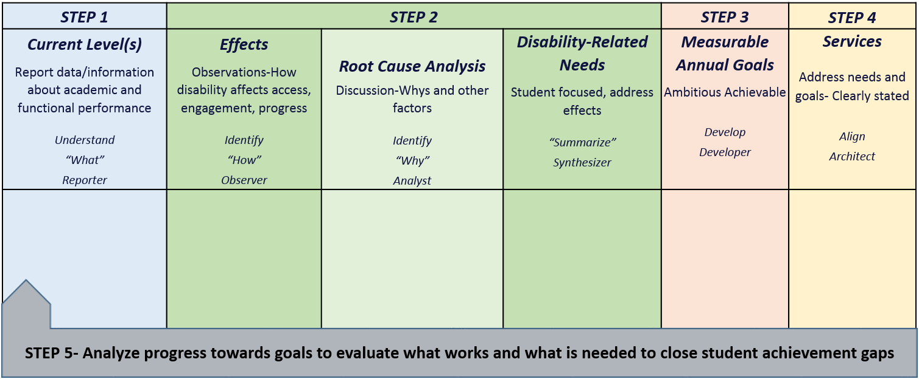
Skills Required to Write and Implement IEPs
CCR-IEP 5 Step Process Chart
Notes:
This chart was developed, in collaboration with school district staff, to clarify the main purposes of each step in the 5 Step process and the linkages between the steps. This chart also highlights the roles IEP team participants play during each step.
The chart can be used both as a training tool when explaining the steps as well as a place to take notes when developing or reviewing IEPs.
We have been told it can helps teams review their IEPs by reflecting on and checking if all steps have been covered.
Some districts have adapted the sections of this chart as an agenda and note-taking format used for individual preparation and during IEP team meetings
EXAMPLE: One district described how they complete the IEP forms documentation during this process- The district has the policy of providing a copy of the completed IEP at the end of each IEP team meeting. They have adapted the sections of this chart and put it on slides on which they take notes. They project the slides on a smartboard during the meeting. Someone else in the room is assigned responsibility for integrating the slide notes and refining IEP documentation using the IEP forms as the discussion unfolds. The IEP form is not projected during the discussion and does not drive the conversation. (Note that participation in meeting discussion may be limited for the person translating the conversation onto the IEP form because of this role)
For those who review IEPs: Using the chart to review completed IEPs by trying to fill it in after IEP development can help show gaps in IEP discussion and/or documentation, and may identify the need to hold a meeting to review and revise the IEP. You will have time at the end of the day if you would like to try this with the IEP you brought with you.
We will use this chart today as we work through the steps
You have a copy of the chart in your handouts. Please take it out to refer to and, take notes on as you wish. There is a copy in the online folder and on the CCR IEP website for you to reproduce as you wish.

Slide 24
Step 1 What do I see?
Activity #1: Understand Achievement
Look at the section(s) of your IEP that document the student’s strengths and current academic achievement and functional performance (Sections I A& B on Sample I-4 form)
  Fill in Step 1 of the Process Chart
  Use the Step 1 Check to decide if the IEP includes the necessary and pertinent information, or if more information is needed.
Notes:
Trainer note: You may chose to do this activity now or wait and combine it with the Effects of Disability Activity. Some participants find it more helpful to wait to review Step 1 documentation after gaining an understanding of Step 2. This is particularly true when a substantial number of participants in your audience do not have much prior knowledge of the CCR IEP process
Use the IEP you brought with you/have online access to.
You may do this activity on your own, or with a partner or small group using 1 IEP.
Look at the Section(s) that include the statements of the student’s strengths and current academic achievement and functional performance. On the new I-4 form this would be Section I A and B.
Review the Step 1 At Glance document and Use the Step to reflect on whether your IEP includes current information about academic achievement (including reading), functional skills and student strengths.
You will return to this section again during a later activity to reflect on whether you believe you have sufficient information to serve as the foundation for the discussion that occurs during Step 2.
Allow 10 minutes for the activity with additional time for debriefing

Slide 25

Step 1- Understand Achievement
What Do you See?
Reflect on the present levels of performance data and information in your IEP.
If you were having this IEP team meeting next week, what data or information would you gather in advance of the meeting so that you could talk about the student’s access, engagement and progress in your class?
How might you help other IEP team members come prepared to the meeting?
Notes:
ACTIVITY- Pair (recommended), Small group, or individual
Reflect on the effect statements in your IEP using the information we just shared. Can you find specific observations that relate to the current levels of performance vs. inferences (e.g. what “struggle” or “difficulty with” looks like for this student). If no, how might you revise one of your effect statements?
For example If there is current data about student’s reading comprehension, can you find statements that connect these data to the characteristics of the student’s disability?
e.g. the student has trouble understanding academic text and responding to questions after assigned independent reading, Or
the student has difficulty staying on task, sometimes refuses to complete assignments and may walk out of class when expected to complete assignments requiring reading text passages above his independent reading level.
Similarly, if there is current data about a student’s behavior (e.g. removals, time on task, behavior incidents, etc.) can you find stated observations that connect this data to the effect of the student’s disability on access, engagement or progress?
Is there evidence of consideration of what helps remove barriers caused by the effects?
Any information about when you don’t see the effects as much?
If you didn’t do so already, also skim the Strengths and Current Levels in your IEP; Can you find necessary and pertinent information?
When debrief: Suggestion we got during a training (at CESA 2): You can link Step 2 explicitly to Step 1 by using terminology, “As evidenced by…” when writing effect statements.
GIVE 10 min stretch BREAK AT END OF ACTIVITY
-------------------------------------------------------------------------------------------
Alternate/Additional questions for this activity as appropriate
What about the student’s disability might explain the student’s present levels of achievement and functional performance?
What might affect the student’s ability to access and make progress in the curriculum or participate in general education activities and environments
What is the relationship of special factors to effects of disability?
What are the consequences of the student not meeting standards or expectations? Are these creating additional barriers for the student? E.g. if students are frequently removed from instruction because of behavior concerns, are they missing key instruction, which in turn, is affecting their academic achievement?
How do the student’s current levels affect the student’s ability to access and participate independently in general education classes and activities?

Slide 26
College and Career Ready IEP
5 Step Process
Understand Achievement
Analyze Progress
Identify Effects of Disability
(and disability related needs)
Align Services
Develop Goals
Notes:
Now let's move to step 2

Slide 27
Step 2: Identify Effects of Disability
Identify how the student’s disability affects academic achievement and functional performance
Notes:
The purpose of Step 2 is to engage in deeper conversations to identify how the student’s disability affects academic achievement and functional performance. IEP teams are encouraged to pause and reflect during this step.
Deeper level discussions of “why” a student may not be meeting early childhood or grade-level academic standards and functional expectations will lead to more accurate identification of the student’s disability related needs and development of IEP goals and services to address those needs and result in improved outcomes.
In accordance with the most recent Supreme Court case related to special education, Endrew F., the court reminded us that “the IDEA’s focus on the individual needs of each child with a disability is an essential consideration for IEP Teams”. Step 2 gets to the heart of a student’s individual needs. (Source https://www2.ed.gov/policy/speced/guid/idea/memosdcltrs/qa-endrewcase-12-07-2017.pdf )
Step 2 is the most important step. It is a time to Stop and think about the 3rd scenario in the equity graphic I showed you earlier (the world of access and engagement without barriers)--- It is a time to Stop-Talk-Think about the student’s strengths and disability related needs before moving forward to discuss goals and services.

Slide 28


Step 2
Burning Questions? Greatest Challenges?
Notes:
To Trainer:
Before moving on, it is good to be aware of the questions participants have about Step 2- effects and disability related needs.
This step has been the most challenging for the field and is the focus of the training day.
Some options here include:
As part of registration process, ask participants to share questions before the training (e.g. use google format shared with RSNs) . Summarize the questions on this slide. Provide brief answers and note that they will be addressed in more detail during the rest of the day
Provide 2 minutes for participants to think quietly about the questions they may have. Ask for volunteers. Type questions on the slide. Provide brief answers and note that they will be addressed in more detail during the rest of the day
Provide a second computer at back of room with a backchannel or google form up on another screen . Encourage participants to type questions as they think about them. Stop intermittently to address questions. Co-presenter or facilitators can assist with this.

Slide 29
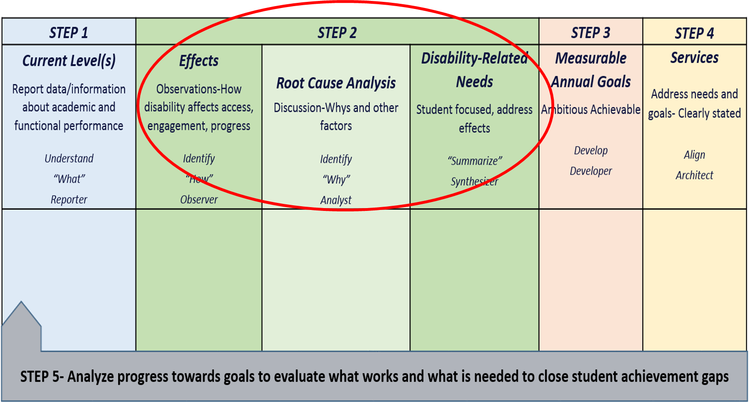
CCR-IEP 5 Step Process Chart
Notes:
There are 3 parts to Step 2. It is important to think about these separately when you are teaching or learning about the process:
I will go over key ideas related to completing each component, provide an example of each part, and then give you with an opportunity for practicing each part with the IEP you brought with you.
(If time is an issue, presenter can skip the following. Each part is explained on subsequent slides. This information is redundant, but provided here as summary information)
1.) Identifying the effects of disability (Observations):
What the IEP team sees or hears as a result of the student having difficulty accessing, engaging, and achieving preschool or grade-level academic standards and functional expectations. THESE ASPECTS OF THE STUDENT’S DISABILITY CHARACTERIZE THE STUDENT’S DIFFICULTIES, STRUGGLES re: not meeting standards and expectations…i.e what happens because of the student’s disability; what you can see/hear
2.) Conducting a root cause analysis:
The IEP team asks “why” 5 times and explores additional factors to dig deep into the causes of difficulty in accessing, engaging, and achieving preschool or grade-level standards and expectations. HELPS EXPLAINS EFFECTS AND CURRENT LEVELS
3.) Summarizing the disability-related needs:
Synthesize the discussion of effects and root causes to summarize areas of academic skill or functional behavior that will address the effects of the disability and improve access, engagement and progress in general education curriculum, instruction and environments– The summary should reflect the “why”. SO WHAT AREAS NEED TO BE ADDRESSED?

Slide 30

Effects of Disability
Observe
What do we see?
What are the results?
What are the concerns?
Does it occur everywhere?
Notes:
Part 1- EFFECTS- During this first part, the team describes “how” the student’s disability affects access, engagement, and progress in the early childhood/grade level standards based curriculum, instruction and environments by sharing observations to answer this question, “In what ways do the characteristics or nature of the student’s disability affect the student’s ability to meet early childhood or grade-level academic standards and functional expectations?
Begin by reviewing what is understood about the student’s current levels of academic achievement and functional performance from Step 1.
Also review any special factors that may affect access, engagement, and progress (such as does the student’s behavior impede learning, does the student have communication needs, is the student an English Language Learner?).
Make sure you elicit and consider observations and concerns of the student or family.
The primary focus is on areas the student is not meeting standards and expectations, Ask, “What do you see related to the current levels? ; “How do you see or hear the student’s disability in relation to the current levels”?
For example, . if the student is not meeting reading standards, ask “What do we see…
when the student is involved in reading instruction?;
when the student is completing text based assignments?,
and when the student is in classes where significant amounts of reading is expected?
When exploring effects, the team should also consider student strengths and characteristics that may be capitalized on, across environments, to bring about success. Ask, “in what subject areas or environments is the student successful?”; “Are there any classes or environments in which the student is not struggling, is actively engaged?”
When documenting “how the disability affects access, engagement and progress,” it is best practice to describe conditions when, where, and how frequently the effect of the disability occurs (or does not occur).
The IEP team must always determine if the student’s disability has an adverse affect on the student’s ability to meet grade-level reading standards, or for preschoolers, if the student’s language development, communication, or early literacy skills are affected. This is a “Yes” or “No” question that gets documented in the IEP Form
If “Yes, the IEP team must include a specific description of how the student’s disability affects access, engagement and progress in the general education reading (or, for preschool students, early literacy) curriculum
If “No,” the IEP team must still describe how the student’s disability affects access, engagement and progress in other areas of the general education curriculum and environment, or age-appropriate activities for preschool children instruction

Slide 31
Example of Effects of Disability
Information Current Levels- Step 1 “What” (Reporter) | Effects of Disability “How” (Observer)
Grade level standard: Read 5th gr texts with sufficient accuracy and fluency to support comprehension. Reading fluency benchmark = 102, mid 3rd grade (expected = 130, mid 5th) Errors in decoding, miscues, substitutions. Running Record-Independent level M /end 2nd gr. /early emergent reader (expected Level T /mid 5th /fluent reader) Demonstrates comprehension of 3rd gr level text when reading independently by answering literal and inferential questions with 95% accuracy. Accuracy drops to 25% when given 5th gr level text. Comprehends gr level text when using text reader (listening comprehension). Has 25% avg on weekly classroom reading comprehension quizzes. Peers are averaging 95%. Requires an average of 5 verbal prompts a day to stay on task when reading. 1 or fewer prompts is expected. Off-task behavior includes talking, leaving classroom, daydreaming. Excels in hands-on classes: Received A’s and B’s in computer class, science labs, specials | Does not independently read grade-level materials. Difficulty independently completing assignments that involve reading in school and when doing homework. Off-task behavior when expected to read silently or aloud in class.
Notes:
Let’s try walking through this first part of Step 2:Identifying the Effects of the Disability with an example (complete example on handout- Example 1)
Remember, the effect of disability is the nature, characteristics or result of the disability.
The effects of the disability are behaviors that are seen or heard (observations).
Here is an example of what an effect of disability might look like based on some selected current level of performance information for a student.
Please keep in mind that we have excerpted these data pieces from the current level section on the IEP. In the actual document we would see more explanation of what the data means so that parents understand.
When we discuss strengths, successes and effects of disability in Steps 1 and 2, we should identify barriers that are not present or were removed in settings that most effectively support student’s success.
In this example, the student’s disability is affecting the student’s ability to read grade-level materials and complete assignments when reading is involved. This is also noted by the parents at home, when the student is doing homework.
The student is also exhibiting off-task and disruptive behavior when asked to read on their own. NOTE: the team should describe specific examples of what “off-task” and “disruptive behavior” looks/sounds like for this student. This may be different than what “off-task” or “disruptive” behavior looks/sounds like for other students.
When asked if there were any subject areas, conditions/situations or environments where the student does not struggle with reading or engagement, the team noted that the student does not struggle as much or exhibit off-task and disruptive behaviors when text is read or in classes that do not have a heavy text load. This helped clarify the effects of the disability and provides a link to root causes (which is the next part of this step) .
.

Slide 32
Example of Effects of Disability
Information Current Levels- Step 1 “What” (Reporter) | Effects of Disability “How” (Observer)
“Initial precursor level” for main idea- identifies objects when named -90% of trials; target expectation-identify general topic of brief text 95% of trials “Distal level” for word meaning-identifies familiar words with similar and different meanings using communication system 80% of trials; target expectation- provide definition of words with clear meanings 95% of trials Expressive & receptive language well below age expectations; Is essentially non verbal. Communicates through facial expressions, gestures, pointing. Follows simple one step directions 50% of time. Use of picture based communication tools at initial emergent level Sits and attends to group reading for avg. of 5 min: gr. level expectation 15-20 min. Meets expectation for engagement in reading activity when 1:1 with teacher or peer | Does not read or understand grade-level text/materials independently or with support Has difficulty understanding unfamiliar & multi-step instructions & completing tasks involving “text” Essentially non-verbal: Understanding vocabulary and responding improves when using picture based communication tools Needs adult support and reminders to engage in text based activities
Notes:
This example takes the data from Step 1 and documents the effects of the disability.

Slide 33
Step 2 - Effects of Disability
Step-Check
Do the effects of the student’s disability directly relate to the areas in which the student is not meeting early childhood/grade-level standards or expectations?
Do the effects statements describe what one can see or hear as a result (effect) of the student’s disability on access, engagement, and progress in general education?
Have special factors been considered?
Have the observations and concerns of the family and student been considered?
Notes:
Do the effects of the disability directly relate to areas in which the student is not meeting preschool/grade level standards or expectations? ◻ Do the effects of disability statements describe what one can see or hear as a result (effect) of the student’s disability on access, engagement, and progress in general education curriculum, instruction and environments? ◻ Have observations of student success been shared and discussed? ◻ Have special factors and the observations and concerns of the family been considered? We have developed one page documents that highlight important concepts of each of the 5 CCR IEP steps. Each At-a-Glance document includes what to look for and avoid as well as a step-check to help you review key components of the step. Available on the CCR IEP Learning Resources Pages for each step (link on slide) .
Here is the step check for the first part of Step 2- Effects of disability.
Remember:
The effects of a student’s disability often creates or reflects barriers to the student accessing, engaging and meeting standards and expectations (think about the scenario graphic from begin of training).
“Effects” are observable rather than simply inferences or interpretive statements
If need more explanation or example-- e.g. from an IEP:
Current statement: “The student struggles with all academics”
Ask- Can you see “struggle” or is this an inference or interpretation of what you see?
Ask- What does this student’s “struggle” look like?
Either rephrase or add more specific examples to explain what it means for this particular student to “struggle”
EMPHASIZE THAT EFFECT STATEMENTS ARE NOT ABOUT the SERVICES needed to support the student
When you prepare for an IEP team meeting, spend some time thinking about the observed effects of a student’s disability before you finalize the data you are a preparing for Step 1. Thinking about effects may help you refine what data is important to have available for the IEP team discussion.

Slide 34
Step 2 Effects of Disability
Activity
Look at the section(s) of your IEP that documents how the student’s disability affects access, engagement and progress in the general education curriculum. (Section I E on Sample I-4 form)
  Use the Step Check to determine if the IEP includes the necessary information.
  Fill in Step 2 – Effects on the Process Chart
Notes:
Trainer note: You may chose to do this activity now or wait and combine it with the Effects of Disability Activity. Some participants find it more helpful to wait to review Step 1 documentation after gaining an understanding of Step 2. This is particularly true when a substantial number of participants in your audience do not have much prior knowledge of the CCR IEP process
Use the IEP you brought with you/have online access to.
You may do this activity on your own, or with a partner or small group using 1 IEP.
Look at the Section(s) that include the statements of the student’s strengths and current academic achievement and functional performance. On the new I-4 form this would be Section I A and B.
Review the Step 1 At Glance document and Use the Step to reflect on whether your IEP includes current information about academic achievement (including reading), functional skills and student strengths.
You will return to this section again during a later activity to reflect on whether you believe you have sufficient information to serve as the foundation for the discussion that occurs during Step 2.
Allow 10 minutes for the activity with additional time for debriefing

Slide 35
Skills Required to Write and Implement IEPs
CCR-IEP 5 Step Process Chart
Notes:
Use the IEP you brought. Find the effects of the student’s disability of access, engagement and progress. List the effects in the chart.

Slide 36
Step 1 Check
Are data on reading achievement & other academic areas included?
  Is achievement related to grade-level content standards?
Are data on functional performance included?
  Is performance related to grade-level functional expectations?
Are data understandable to all IEP team members?
  Are standardized test scores/other formal test scores explained?
Are student’s strengths identified?
  Are there academic and functional strengths that can be used to improve access, engagement, and progress?
Is there sufficient information about academic and functional achievement to use for discussion about effects and needs?
  In what areas is the student performing at, above, or below grade-level standards and expectations?
Notes:
We also are sharing the Step-Check for Step 1 here. Now that we have described the concept of “effect statements” it might be more clear what kind of information may be important to include in the current level section. As you reflect on the effect sections of the IEP you brought with you, this would be a good time for you to also reflect on the current level data you included and how it serves as a foundation for Step 2 discussion.
Here is the step-check for Step 1. You can use this step check when you develop and/or review the first section of your IEP document, “Student Strengths and Current Levels of Academic and Functional Performance”.
The step check asks you:
If all the required information is included (strengths, current academic achievement and functional performance data);
If the information is documented in a way to it can be understood by all IEP team participants, including the student’s family;
If it is clear how the student’s performance compares to grade level or as appropriate, early childhood standards and expectations;
Note- when in meeting may be helpful to bring examples to show what data means/and what is the expectation (e.g. such as student work samples, leveled books, etc.)
and finally whether there is enough current information provided to develop the rest of the IEP.
---------------------------------------------
If you have not done so already, take out the At- A- Glance handouts for Steps 1 and 2. You may find them helpful for our next activity.

Slide 37
Step 2- Effects
What Do you See?
Reflect on the effect statements in your IEP
If you were having this IEP team meeting next week, what one thing would you do to be prepared to talk about the effects of this student’s disability on accessing, engaging, and making progress to meet early childhood/grade level standards and expectations?
What questions might you ask to help the team focus on the effects of the student’s disability?
Notes:
ACTIVITY- Pair (recommended), Small group, or individual
Reflect on the effect statements in your IEP using the information we just shared. Can you find specific observations that relate to the current levels of performance vs. inferences (e.g. what “struggle” or “difficulty with” looks like for this student). If no, how might you revise one of your effect statements?
For example If there is current data about student’s reading comprehension, can you find statements that connect these data to the characteristics of the student’s disability?
eg. the student has trouble understanding academic text and responding to questions after assigned independent reading, or
the student has difficulty staying on task, sometimes refuses to complete assignments and may walk out of class when expected to complete assignments requiring reading text passages above his independent reading level.
Similarly, if there is current data about a student’s behavior (e.g. removals, time on task, behavior incidents, etc.) can you find stated observations that connect this data to the effect of the student’s disability on access, engagement or progress?
Is there evidence of consideration of what helps remove barriers caused by the effects?
Any information about when you don’t see the effects as much?
If you didn’t do so already, also skim the Strengths and Current Levels in your IEP; Can you find necessary and pertinent information?
When debrief: Suggestion we got during a training (at CESA 2): You can link Step 2 explicitly to Step 1 by using terminology, “As evidenced by…” when writing effect statements.
GIVE 10 min stretch BREAK AT END OF ACTIVITY
-------------------------------------------------------------------------------------------
Alternate/Additional questions for this activity as appropriate
What about the student’s disability might explain the student’s present levels of achievement and functional performance?
What might affect the student’s ability to access and make progress in the curriculum or participate in general education activities and environments
What is the relationship of special factors to effects of disability?
What are the consequences of the student not meeting standards or expectations? Are these creating additional barriers for the student? E.g. if students are frequently removed from instruction because of behavior concerns, are they missing key instruction, which in turn, is affecting their academic achievement?
How do the student’s current levels affect the student’s ability to access and participate independently in general education classes and activities?

Slide 38
CCR-IEP 5 Step Process Chart
Notes:
Now, Let’s move on to the next part of step 2- Root Cause Analysis

Slide 39


Root Cause Analysis
Step 2 Part 2
How does asking “Why” multiple times help drill down from higher-level symptoms to the underlying root cause(s)?
Notes:
This video provides a good example of how to conduct a root cause analysis using the 5 Whys.
Let’s watch it before we apply this strategy to the IEP process.
Think about this question as you watch: How does asking “Why?” multiple times help drill down from higher-level symptoms to the underlying root cause(s) of a problem?
Possible answer: by repeating “why” five times, the nature of the problem as well as its solution becomes clear.

Slide 40

Root Cause Analysis
State the concern selected from the discussion about effects (e.g. The student has difficulty understanding written instructions)
Check for consensus that this is a concern
Seek information and data that illustrate the concern
Ask “Why” is this happening? (e.g. Why is the student having difficulty understanding written directions?)
Generate possible reasons . . .
Ask the second “Why” is this happening?
Continue asking “Why” until root cause(s) (vs. symptoms) are clear and disability related need(s) can be identified
Notes:
The 5 Whys strategy helps to identify why the student is not accessing, involved in, or making progress in early childhood or grade level standards based curriculum so the team can more clearly identify the areas of student need to address with IEP goals and services.
During this part, the team’s main task is to analyze “Why is the student struggling to meet early childhood/grade-level academic standards or functional expectations”?
The steps in this process include:
State the concern or issue that the IEP team members are trying to resolve.
Check that there is consensus that this is the concern.
Seek any data you can use to illustrate and help explain the concern.
Ask the first question “why”. “Why do you think this is happening?” or “Why did this happen?”
Generate possible reasons.
Continue to ask the second “why” and so on.
Don’t forget to ask “why” about areas/environments in which student is more successful
For example, Why is the concern less of a problem in some classes or environments? What seems to improve access engagement or progress related toe the area/skill or concern? This is important to identify aspects that can be capitalized upon and transferred to other subjects or environments. In our example, are there any circumstances when the student does nto struggle with independent reading?
During the “Why” discussion IEP team members may suggest what seems like unrelated ideas instead of diving deeper into the initial reason. If this happens, jot the ideas down and return to them later. They may provide a branch to root causes of related effects. A facilitator should help keep the IEP team on track.
Always revisit and consider information you have already reviewed from the current levels, special factors and discussion of context (activities, environments, staff) when analyzing the root cause. Sometimes the discussion about root causes may lead to a need for additional information in the current levels or lead you to identify new or different effects of disability statements.
Many people are finding that often there is a pattern and the same/very similar root causes are related to a number of effects and impact more than one area of academic and/or functional performance (identifying patterns can lead to fewer, more targeted needs and goals)

Slide 41
Example of Root Cause Analysis
Effect of Disability “How” (Observer) | Root Cause Analysis “Why” (Detective/Analyst)
Does not independently read grade-level text | Gets frustrated when required to read independently. Trouble gaining meaning from grade level written material when reading independently. When text read aloud or using a text reader, can access/comprehend. Reading fluency is stilted; does not read quickly with accuracy and expression. Struggles with word recognition. Difficulty decoding (sounding out) words in grade level text. Lacks phonological skills. Has difficulty segmenting words into syllables and blending syllables into words.
Why?
Why?
Why?
Why?
Why?
Notes:
Here is an example of a root cause analysis (Summarize following notes when presenting depending on audience and time):
In the example, we said one of the effects of the student’s disability is the student not able to independently read grade-level materials.
To conduct a root cause analysis of this effect, the team started by asking, “Why can’t the student independently read grade-level materials?”
First response- because the student gets anxious or frustrated when required to read independently and avoids reading. In exploring this more (Are there times when this does not happen?) , it is also noted that the student doesn’t have as much difficulty when text is read to the student tor when using a text reader.
At this point, the team could decide this is related, but not part of the direct branch of discussion re why the student can not independently read and may save this when discussing other effects (such as the effect the student’s reading skill may have on functional skills of attention and behavior)- and continue on the branch about specific reading skills.
The next “why”, Why does the student get frustrated?
Because the student does not demonstrate understanding of what they are reading when they read grade level text on their own, without help
The next why- Why doesn’t the student demonstrate understanding of what they are reading ?
We know reading fluency is directly related to reading comprehension. Specific to this student, “based on benchmark test scores and running records, we know the student’s reading fluency is not at grade level (meets 3rd vs. 5th grade fluency benchmark and at 3rd gr. independent reading level) and this makes it difficult for the student to read on their own when given grade level text.
Why is reading fluency insufficient?
We know from running records and teacher observation that the student’s fluency is affected by decoding problems. Because the student is not able to efficiently decode, it makes it hard for the student to efficiently read and gain meaning from text and thus affects the student’s ability to independently read grade level text.
Why does the student have trouble with decoding?
We also know from information in the Current Level section that the student’s fluency is also affected by phonological processing, one of the foundational skills related to reading decoding..
The team may delve deeper by asking What else do we know about why does the trouble with phonology and decoding make it hard for the student to read and understand?
Based on assessment information and classroom observation, we know the student language comprehension meets grade-level standards and expectations and the student is able to understand grade level text and written materials when it is at a level at which the student can decode, or when text is read to the student. We also know the student can use a text reader to decode and understand text.
The team would repeat this analysis for the other effects. In this particular case it is likely there will be some relationship and overlap between the effects of the student’s disability and root causes related to the student’s challenge with reading fluency.
For further discussion if time: How do you know when enough is enough??

Slide 42
Example of Root Cause Analysis
Effect of Disability “How” (Observer) | Root Cause Analysis “Why” (Detective/Analyst)
Student is failing math class. | Student has difficulty understanding concepts Student is missing instruction. Student is late to class. Student is having difficulty moving from class to class. Student walks slowly and has difficulty navigating busy hallways and stairs.
Why?
Why?
Why?
Why?
Notes:
OT Example

Slide 43
Documenting Root Cause Analysis
Not required, but encouraged, and certainly should be considered in the conversation
Possible options
  Go back and refine effect statement… e.g. The student (observed effect(s) related to an area) … because (root cause/s)
    E.g. The student does not independently read grade-level text (effect) because has difficulty segmenting words into syllables and blending syllables into words (root cause).
  Other places in IEP?
Notes:
Analyzing root causes can help you clarify and refine your understanding both of the effects of the student’s disability, and why the student may be demonstrating current levels of academic (or early academic for EC) and functional performance.
We have been asked how and where teams might document their root cause analysis on the IEP forms. Here is what we came up with in collaboration with district level participants from one of our earlier workshops:
Teams can efficiently document the root cause analysis on the IEP form, by going back and refining the effect statements (Section 1 E on DPI sample I-4 form)
You might find this sentence stem helpful: The student (observed effects) because…. .
This helps connect the root cause and the effect.

Slide 44
Refining Effects of Disability after Root Cause Analysis
A few examples
Effects of Disability (“How”) because of Root Cause (“Why”)
Does not independently read grade-level materials (effect) because has difficulty segmenting words into syllables and blending syllables into words.
Has difficulty independently completing assignments that involve reading in school and when doing homework (effect) because has difficulty segmenting words into syllables and blending syllables into words.
Exhibits off-task behavior when expected to read silently or aloud in class because has difficulty segmenting words into syllables and blending syllables into words.
Notes:
The point here is that a single root cause may have multiple effects.
Here are some examples of how you might refine the effect statements to document the root cause analysis.
The example assumes you have completed the root cause analysis for all effects related to access, engagement and progress in grade level reading curriculum, instruction, and environments.
This example includes an analysis of the effects of the student’s disability on both reading skill and related functional skills including effects on social emotional functioning and behavior.
This example also demonstrates a single root cause can effect the student in multiple ways (have multiple effects).
You could even chose to further refine your effect statement to tie back to step 1! (Suggestion from CESA 2)
For example–
Because phonological skills affects decoding (root cause)
….they do not read grade-level materials independently and efficiently (effect)
...and is therefore not meeting all grade level ELA standards in reading [standards areas/domain(s)]
** Note: re last example--- remember during conversation to adequately describe what effects “look like”. For example, when using terms such as “struggle with”, “difficulty with”, “Disruptive” etc. , you need to ask, what does this look like for this student? What does the student do when they are struggling, or being off-task?

Slide 45
Root Cause Analysis
Additional Practice
Effect of Disability “How” (Observer) | Root Cause Analysis “Why” (Detective/Analyst)
Student is removed from the classroom and misses instruction for short periods of time. Think of a student who has this effect of disability . . . | To understand “why” the student is being removed use the 5 Why’s to better identify root cause(s) of the student being removed from classroom. 1) Why is this student being removed from the classroom? 2) Why . . . ? 3) Why . . . ? 4) Why . . . ? 5) Why . . . ?
Notes:
Try this example yourself or with a partner/small group. (give 5-7 minutes)
Debrief as group
Ask for one example
Ask for another example with a different root cause or brainstorm other potential root causes w/ group.
Point out that there can be several different root causes for the same “effect” . i.e. the effect of a student’s disability is unique to every student. The student’s eligibility label is not sufficient to determine the reason why a particular student may be experiencing difficulty with access, engagement and progress in meeting early childhood/grade-level academic standards and functional expectations
Any questions before we move on?

Slide 46
Step 2 - Root Cause Analysis
Step-Check
Has the IEP team…
  Identified “why” student has difficulty meeting academic standards or functional expectations?
  Explored (dig deep) reasons related to the effect of the disability on access, engagement and progress in general education curriculum, instruction and environments?
  Considered why the student may have less difficulty in certain classes or under certain conditions?
Does the analysis go beyond impairment category?
Notes:
Here are the step-check questions for this part of Step 2.
We recommend you use these questions when developing and reviewing IEP statements about disability related need. Has the IEP team identified “why” the student is not meeting academic standards or functional expectations? Has the IEP team considered multiple reasons “why” the student is having difficulty accessing and engaging in grade-level instruction, activities and environments? ◻ Has the IEP team explored how special factors or other influences relate to the observed effects such as teaching methods and materials, group size, environmental factors, etc.? ◻ Does the analysis go beyond impairment criteria?

Slide 47
Root Cause Analysis
Activity
Pick one effect statement in your IEP.
Ask why the student is struggling in that area?
Ask why the student is struggling in that area?
Ask why the student is struggling in that area?
Ask why the student is struggling in that area?
Ask why…
Record your Why questions and answers on the process chart.
Use the Step Check to determine if you have the necessary information.
Notes:
Pick one effect statement in your IEP.
Ask why the student is struggling in that area?
Ask why the student is struggling in that area?
Ask why the student is struggling in that area?
Ask why the student is struggling in that area?
Ask why…
Record your Why questions and answers on the process chart.
Use the Step Check to determine if you have the necessary information.

Slide 48
CCR-IEP Process Chart
Notes:
Record your responses on the CCR IEP Process Chart.

Slide 49
Applied Practice
Documenting Root Cause Analysis
Go back and review your effect statements again
Can you use the sentence stem to refine (or develop) one effect statement that reflects your root cause analysis?
  The student (observed effect(s) related to an area) … because (root cause).
    E.g. The student does not independently read grade-level text (effect) because has difficulty segmenting words into syllables and blending syllables into words (root cause).
Then, discuss the questions on the next slide
Notes:
Now go back and look at your effect statements again, discuss how you might refine these statements to document your root cause analysis.
Consider using the sentence stem shared a few slides back: The student… (observed effects) because…. .
It helps connect the root cause and the effect.
Give 3 minutes then direct them to next slide

Slide 50
For Discussion
What do you see as the most challenging aspects of root cause analysis?
What questions might you ask to help prompt all IEP team participants to address the key ideas of this step during an IEP team meeting?
  How would you engage the family and student?
Notes:
Let them talk in small groups or their pairs for additional 5 minutes. Ask the participants to jot down at least one question.
Make sure to include prompt re: how would you engage families and students in this step
-------------------------------------------------------------------------------------------
Presenter note: As appropriate, during debrief, this might also be a good time to address how to deal with the tendency to assign root cause to “because of the student’s impairment. Circling back to a student’s “label” as the root cause may reflect beliefs and biases about the abilities and expectations for students with certain types of impairments. Instead, encourage participants to focus on descriptions of “why”
Non-Examples: These statements are not helpful as root causes because they do not provide an avenue for progress.
The student does not read grade level text fluently, because the student is SLD
The student can’t decode and understand written text because they are deaf
The student can’t get around the school environment independently because they are quadriplegic?
Example Reflections re: label and effects/root causes
Does having SLD preclude the development of reading fluency? No-
Why is this student who has SLD having difficulty reading text fluently? (more appropriate: (The student does not read grade level text fluency because of inadequate decoding skills)
Do some students who are deaf learn to read and understand grade level text?
Why is this student who is deaf, having trouble reading and understand text?
Can some students who are quadriplegic get around school independently?
Why is this student not independently mobile?

Slide 51
CCR-IEP Process Chart
Notes:
Now, let’s move on to the last part of Step 2, synthesizing and summarizing the student’s unique disability-related needs.
Step 2 of the IEP development process is complete when the IEP team synthesizes the discussion of the root cause analysis of the effects of the student’s disability to outline the individualized disability-related needs of the student.

Slide 52

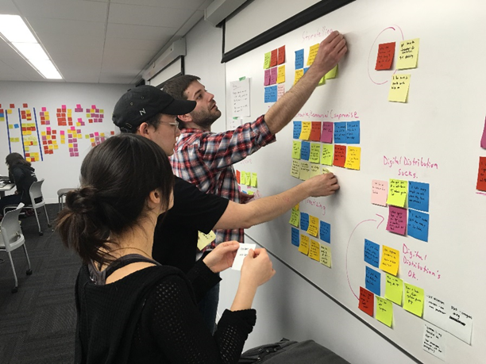
Disability-Related Needs
Synthesize:
Clarify
Summarize
Try to reach consensus
Notes:
During the final part of Step 2, the IEP team takes on the role of a synthesizer, not to make music, but to take complex information and distill it down into clear, succinct and actionable thoughts.
The disability-related needs are identified as a result of this synthesis. This step helps build consensus around what areas of student skill/behavior need to be addressed. It is the root cause analysis that leads to the identification of the disability-related needs.
To synthesize the disability-related needs:
Review the conclusions from the root cause analysis.
Ask: based on the root cause analysis, “What academic and or functional skill areas need to be addressed so…
the effects of the disability will be addressed AND
the student will be better able access, engage and make progress in early childhood/grade level curriculum, instruction and environments SO
They can meet preschool/grade level content standards and functional expectations?”
Document the needs on the IEP form section “Summary of Disability-Related Needs”
DRNs serve as the foundation for developing goals and aligning service during the next two steps
We recommend IEP statements list or briefly describing academic or functional skill areas the student will need to develop
DRN are related to, but not the same as goal statements. Goals will likely be more detailed than need statements and may specify multiple subskills related to the area of need.
Goals are developed to address areas of disability related need in the next step. On the form, the needs are numbered for the purpose of easy reference, not prioritization.

Slide 53
Disability-Related Need Affecting Reading
A disability-related need that affects reading reflects characteristics of the student’s disability that have an effect on access, engagement, and progress in reading in relation to grade level standards and instruction. This may include:
  needs related to the acquisition of reading skills such as phonemic awareness, phonics/decoding, reading fluency, vocabulary development, reading comprehension, as well as
  functional skill needs such as social-emotional, behavioral, self-regulation, mobility, sensory and others that affect access and engagement in literacy curriculum, instruction and other activities
The IEP team determines if the student has a disability-related need affecting reading
Notes:
IEP teams must always consider whether the student’s disability affects reading achievement. (Early literacy skills are considered for EC age students.)
We have been frequently asked to clarify what we mean by a DRN “affecting” reading.
A DRN AFFECTING reading may have root cause related to reading skill attainment OR functional skills that affect access and engagement in text based earning activities OR both.

Slide 54
Disability Related Needs
This sentence stem may be helpful:
The student needs to develop/improve/increase X area/skill/behavior (related to root cause), so the student can Y (effect to address re: access, engagement, progress) …and outcomes will improve
Example:
  Effect (Y): The student does not fluently read grade-level text
  Root Cause (X): because has difficulty segmenting words into syllables and blending syllables into words.
Disability-related need: The student needs to improve ability to segment words into syllables and blend syllables into words. (root cause) so the student can fluently read grade-level text (effect)
Notes:
While not required, we suggest a well- developed disability related need incorporates both the effect (the how) and the root cause (the why).
If the disability related need is addressed:
the identified concerns (effect) related to the student’s disability will be addressed, barriers will be diminished or removed (think about the 3rd scenario in beliefs picture), AND
we should see a positive change in student outcomes (current levels) i.e. gaps between expected and current levels will be reduced or eliminated
A helpful sentence stem for thinking about might be, “If the student develops or improves the skills/behaviors related to root causes, then the effect of their disability on access, engagement and progress needed to meet preschool/grade level standards and expectations will be diminished or resolved.
A helpful sentence stem for potentially documenting this might be (refer to slide): The student needs to develop/improve/increase, X (target area/skill/behavior related to the root cause), so the student can Y (Y= effect that will be addressed re: access, engagement, progress)
Example:
Effect (Y= how the disability effects access, engagement or progress): The student does not fluently read grade-level text
Root Cause (X= why we see the effect): … because of inefficient decoding skills
Disability-related need: The student needs to improve decoding skills (root cause) so the student can fluently read grade-level text (effect)
Other Examples of DRNs:
Improve reading fluency (so student can more independently read grade level text based assignments)
Improve reading fluency (so anxiety and frustration about schoolwork is reduced; attention to reading tasks is improved, and the student remains in class to complete work)
Increase independent use of anxiety reduction strategies so social and academic stressors are reduced and the student remains in class and engaged in instruction or social activities with other students.

Slide 55
Example of Disability-Related Needs
Root Cause Analysis “Why” (Detective/Analyst) | Disability-Related Needs “Summarize” (Synthesizer)
Gets frustrated when required to read independently. Trouble gaining meaning from grade level written material when reading independently. When text read aloud or using a text reader, can access/comprehend. Reading fluency is stilted; does not read quickly with accuracy and expression. Struggles with word recognition. Difficulty decoding (sounding out) words in grade level text. Lacks phonological skills. Has difficulty segmenting words into syllables and blending syllables into words | The student needs to improve ability to segment words into syllables and blend syllables into words. The student needs to learn how to use a text reader to independently access grade level text.
Notes:
Here is an example of a summary of our student’s disability-related needs. In this example, the IEP team determined, based on the root cause analysis, that the student needs to improve phonology and decoding skills and develop and use strategies that will allow the student to better access text. If these needs are addressed, the student will be able to read grade level text and not get frustrated.
Based on the root cause analysis, The IEP team decided if the student is able to develop phonology and decoding skills, then there is a high likelihood the student’s reading fluency and comprehension will improve and the student will make accelerated progress toward meeting grade level reading standards.
However, because the student’s struggle with reading is causing behavior concerns, the IEP team has decided it is also important for the student to develop and use strategies so that frustration can be minimized and the student is able to gain information from text and better access curriculum content and classroom instruction.
To summarize, during the synthesis, the IEP team reviews the answers to the 5-Whys (the root causes we talked about a few minutes ago ) and summarizes the student’s disability related needs.
If these needs are addressed, then the student will be better able to independently access grade level reading materials and gain meaning from the text.

Slide 56
Example of Disability-Related Needs
(refined with link to effects)
Root Cause Analysis “Why” (Detective/Analyst) | Disability-Related Needs “Summarize” (Synthesizer)
Gets frustrated when required to read independently. Trouble gaining meaning from grade level written material when reading independently. When text read aloud or using a text reader, can access/comprehend. Reading fluency is stilted; does not read quickly with accuracy and expression. Struggles with word recognition. Difficulty decoding (sounding out) words in grade level text. Lacks phonological skills. Has difficulty segmenting words into syllables and blending syllables into words | The student needs to improve ability to segment words into syllables and blend syllables into words (so the student can more fluently read and gain meaning from grade level text). The student needs to learn how to use a text reader to independently access grade level text (so the student can more fluently read and gain meaning from grade level text).
Notes:
Here is the example refined using the sentence stem
The student needs to develops or improve X skill/behavior (related to root cause analysis), so they can do Y ( access, engage and/or make progress toward meeting a standard/expectations related to an effect of the disability that will be diminished or removed )
You could refine these further by specifying the standards/expectations that the student will meet if the needs are addressed (as demonstrated by changes in current levels)
When you think about the DRNs- think about tracking them back through effects and special factors as well as the current levels that should be improved if the needs are addressed.
In our example, the student will need to improve ability to segment words and blend syllables in order to improve reading fluency and comprehension.
In addition, the IEP team decided the student also needs to develop and use strategies and supports (both academic and functional skill related) to access, engage, and make progress in the general education level curriculum.

Slide 57
Example of Disability-Related Needs
Root Cause Analysis “Why” (Detective/Analyst) | Disability-Related Needs “Summarize” (Synthesizer)
Student has difficulty understanding concepts Student is missing instruction. Student is late to class. Student is having difficulty moving from class to class. Student walks slowly and has difficulty navigating busy hallways and stairs. | Move from class to class throughout the school (so the student can arrive at class on time and not miss instructional time).
Notes:
PT example

Slide 58
Example of Disability-Related Needs
Root Cause Analysis “Why” (Detective/Analyst) | Disability-Related Needs “Summarize” (Synthesizer)
Concern: Student makes errors when reading and writing. Why: Student has an intellectual disability. Why: Student is not reading fluently from textbook. Why: Student has frequent miscues when reading. Why: Student does not accurately copy information from the board. Why: Student is not visually tracking across the page or when looking up and down. | Develop smooth visual tracking movements (so the student can read texts fluently and copy from the board).
Notes:
OT example

Slide 59
Step 2 - Disability‐Related Needs
Step-Check
Does each need identified relate to an effect of the disability and the root cause?
If addressed will the student be able to access, engage and make progress in early learning/grade level curriculum and activities?
Will the identified disability‐related need(s) lead to specific IEP goal(s) and services?
Are they student-centered (the student needs to…)?
Notes:
Here are the step-check questions to consider during this final part of Step 2.
Read slide.
Do the disability-related need statements directly relate to one or more effect and address one or more root cause - i.e. addressing these needs will improve the student’s access, engagement, achievement (link to effects and Step 1)
Will the identified disability‐related need(s) lead to specific, clear, and measurable IEP goal(s) and/or services?
Are they student-centered? (about skills not services)
Reminder: There is often a tendency to want to move ahead and discuss needed services during this step. It is important for the IEP team facilitator to help the team remain focused on clearly defining the areas of student need that should be addressed before talking about goals and services. Teams will find that when the Step 2 guidelines are followed, the IEP goals and services will usually be much easier to develop.

Slide 60
Disability-Related Needs
Activity
Select a root cause of one of the effects of the student’s disability.
Identify what the student needs to be able to do (related to the root cause) in order to access, engage and make progress in the general education curriculum and environment.
Record the student’s disability-related need on the process chart.
Repeat as needed.
Use the Step Check to determine if you have all the necessary information.
Notes:
If you haven’t done so already, reflect on the effect statements in your IEP based on the information we just shared.
Can you find specific observations that relate to the current levels of performance?
For example: If there is current data about a student’s reading comprehension, can you find statements that connect this data to the characteristics/nature of the student’s disability?
eg. the student has trouble understanding academic text and responding to questions after assigned independent reading
Or
the student has difficulty staying on task, sometimes refuses to complete assignments and may walk out of class when expected to complete assignments requiring reading text passages above his independent reading level.
Similarly, if there is current data about a student’s behavior (e.g. removals, time on task, behavior incidents, etc.) can you find stated observations that connect this data to the effect of the student’s disability on access, engagement or progress?
-------------------------------------------------------------------------------------------
Alternate/Additional questions for this activity :
Check your IEPs for documentation of the following. IF you don’t find it talk about how you might revise, rewrite, add
What might explain the student’s present levels of achievement and functional performance?
What might affect the student’s ability to access and make progress in the curriculum or participate in general education activities and environments
Consider the effect of special factors as well as the current levels of academic achievement and functional performance
What are the consequences of the student not meeting grade level academic standards or functional skill expectations?
How does what you know about the student’s present levels affect the student’s ability to access and participation independently in general education classes and activities?

Slide 61
CCR-IEP Process Chart
Notes:
Using the IEP you brought, fill in the disability-related needs on the CCR-IEP Process Chart.

Slide 62
Step 2- Disability-Related Needs
Reflect and Discuss
What do you see as the most challenging aspects of this step?
Knowing what you know now, might you make any changes?
  Try to refine or develop one DRN statement using the sentence stem: The student needs to develop/improve/ increase area/skill/behavior (related to root causes), so the student can Y (effect to address re: access, engagement, progress) …and outcomes will improve
What questions might you ask to help prompt all IEP team participants to address the key ideas of this step during an IEP team meeting?
Notes:
In Pairs or small groups:
Lets stop and Reflect on the IEPs you brought
Do stated DRN(s) reflect a link between effects and current levels?
Do the stated DRN(s) reflect sufficient discussion about root causes?
It is ok if you can’t find documentation of root causes in the IEPs you brought with you.
However, think about your IEP team discussion. Did you talk about root causes when you met?
If not, consider how you might approach this the next time you have an IEP team meeting.
Can you refine or develop 1 DRN statement using the stem?

Slide 63
IEP Team Meeting Scenario
The team just reviewed data about the student’s current reading achievement and determined the student’s reading skills are well below grade level standards. One of the team members says, “Ok, now let’s write a reading goal”.
What would you do to facilitate the meeting at this point?
What questions would you ask to keep the IEP team on track?
Notes:
Introduce Activity
This scenario will help you review what you learned so far today- You may want to discuss it while you have lunch. We will start here when we return.
LUNCH
Debrief
Follow up with Step 2 Elevator speech if time

Slide 64
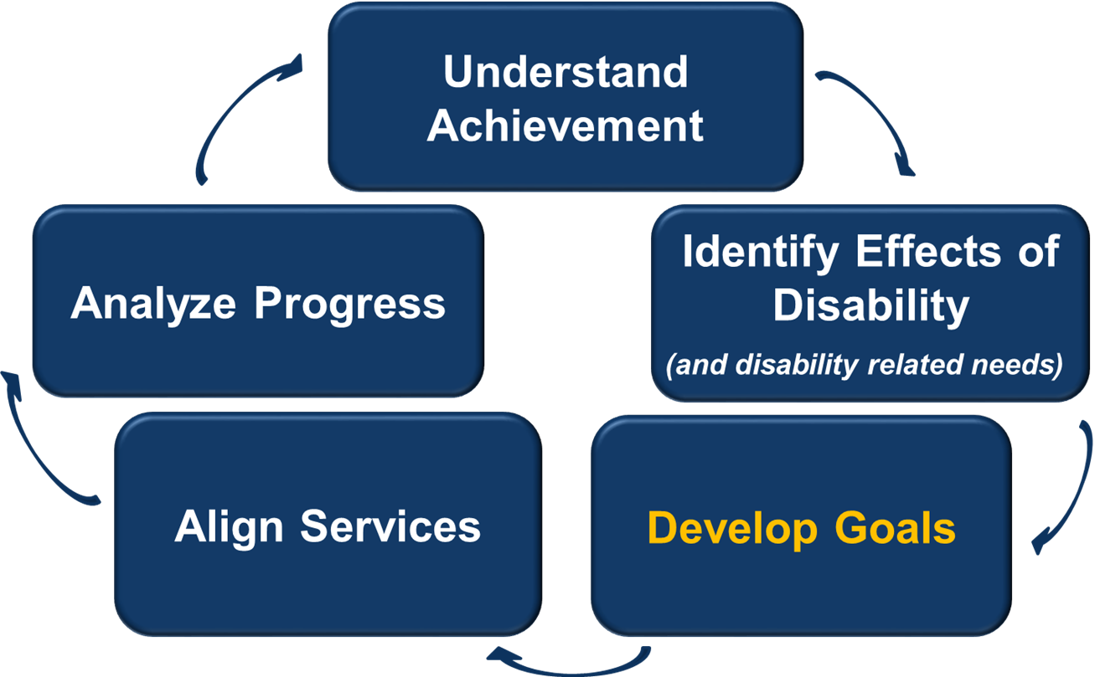
Next Stop… Step 3
Notes:
I know many of you have been waiting for us to get to this step!

Slide 65
CCR-IEP Process Chart
Notes:
Refer to chart- moving on to Step 3

Slide 66
Step 3: Develop Ambitious and Achievable Goals
Develop ambitious and achievable goals that close achievement gaps and support the unique strengths and needs of the student.
Notes:
When a team completes step 2, the rest of the IEP should be relatively straight forward to complete
Step 3: IEP team as developers
In Step 3, IEP teams develop ambitious and achievable annual IEP goals designed with the intent of closing individual achievement gaps by improving access, engagement and progress related to the effects of the student’s disability and disability related needs.
IEP goals also support the unique strengths and needs of the student.
IEP teams will use the information they discussed previously and summarized in the disability-related needs section to develop IEP goals.
Let’s go over this in more depth and do some application activities

Slide 67
Step 3 Key Ideas
IEP goals address “why” (i.e. root causes) the student is not meeting early childhood/grade-level standards or expectations
IEP goals address student specific disability-related need(s) that will improve access, engagement and progress toward standards and expectations (i.e., effects)
IEP goals are measurable, ambitious and achievable
Notes:
IEP goals address why the student is not achieving grade-level academic standards or functional expectations; including why the student is having difficulty accessing, engaging and making progress in the general education curriculum, instruction, or environment.
By connecting IEP goals to the disability-related need, the IEP team ensures the IEP goals address root causes of “why” the student is not meeting early learning/grade-level standards or expectations. Focusing on Root Causes should also limit the number of IEP goal to those really needed to address a student’s individual DRNs
Linking Step 2 with Step 3.
To make sure IEP goals address the student’s disability-related need(s):
The IEP team begins with the disability-related need(s) and then develops a goal specifically to address the need.
All goals should be student focused and strength-based. They should address what the student will accomplish…
Goals should reflect the students DRNs, not the entire educational program provided to all students. .
Each goal must be linked to at least one disability-related need. A goal may address more than one disability-related need. Likewise, multiple disability-related needs may be addressed by one goal.
In rare instances, the IEP team may decide a goal is not necessary to address the need and the need may only be aligned with a supplementary aid or service or with a related service, such as transportation. (See Next Slide)

Slide 68
Step 3 Key Ideas
How do we know when a goal is needed to address a disability related need?
  Ask, “Does the student need to develop or improve a skill or just use a skill that is already mastered”?
This question is also relevant when linking services to needs in Step 4
Notes:
Before the IEP team decides a goal is not needed, it should consider whether the student really has needs that should be addressed by a goal (such those related to self-advocacy and independence).
For example, when a student has mobility needs that require transportation as a related service, the IEP should ask whether the student has developed sufficient mobility skills or may need a self-advocacy goal related to the mobility needs.
Another possible eg: anxiety control supports, use of text reader, etc. BUT….
How to decide if need a goal or just a support/accommodation service? Ask: Does student need to develop/improve or use/apply skill already mastered?

Slide 69
Standards-Based IEPs
Completing Steps 1 and 2 of the 5 Step Process with fidelity will lead to the development of goals aligned with grade-level standards and expectations during Step 3
  Identify student’s current performance related to early childhood/ grade-level standards.
  Identify how the disability affects access, engagement and progress (effects)
  Discuss why (root causes) the student is not meeting grade-level standards and summarize disability-related needs.
  If goals address the whys and needs, the goal will be aligned with the standards
Notes:
Quick reminder

Slide 70
Components of an IEP Goal
The “measure” in measurable goals should align all of the following
Baseline
Level of Attainment
Procedures for Measuring Progress
Goal Statement
Notes:
This graphic shows the components of an IEP Goal and how they are aligned.
Ask Audience for background knowledge around these parts
Thumbs up- I could teach other about these
Thumbs sideways- I’m pretty sure I know what each means
Thumbs down–I’m new to IEP goals writing and am just starting to figure these out.
If most thumbs up- only highlight info here and on content slides
As has always been the case when developing a measurable annual goal, you must have:
A goal statement: Specifies the target skill/behavior and direction of change. What the student will do (e.g. increase reading fluency, develop organizational skills) --- i.e. reflect the target skill/behavior that needs to be improved, increased, developed (to improve access, engagement, and/or progress)
Baseline: The student’s skill level at the time of the IEP meeting.
Level of Attainment: The amount of growth anticipated within a year (or the specified duration) of special education services.
Procedures for Measuring Progress: The process or methods used to assess a student’s academic and functional performance during the school year for the purpose of analyzing the student’s response to special education services.
(NOT ON SLIDE- Goal page also must include How often progress will be reported to the parent)
How many have heard the term “Smart goals”? This may be another helpful way of thinking about measurable goals.
The goal statement, baseline, level of attainment and the procedures for measuring progress should all align to allow those implementing and periodically reviewing the IEP (including the IEP team, at least annually) to decide if the student is making progress towards the goal as well as the extent of progress being made.
Now let’s go over each component

Slide 71
Goal Statement
Reflects the disability-related need(s) and . . .
Must include a skill(s) that is measurable
Achieving the goal will improve the student’s access, engagement, and progress in general education curriculum and environment (ambitious/achievable)
May include baseline and level of attainment in the goal statement OR under the goal statement
  Sample form I-4 has prompts for each under the goal statement
May include condition statements
Notes:
As already mentioned, the goal statement reflects one or more disability-related needs.
We recommend each goal statement names a target skill(s) or behavior(s) (i.e., root causes) related to why the student is not meeting grade-level standards and/or expectations and having difficulty accessing, engaging, and making progress in curriculum, instruction, activities and environments. Attaining the goal will address the related effect(s) of the disability and disability- related need(s).
A goal may include benchmarks or short-term objectives. We will say more about benchmarks and short-term objectives in a few minutes.
We suggest the goal be written about the root cause rather than the effect (aka Symptom)- will discuss a bit more later. Think back to Jefferson Memorial Video.
Each goal must be measurable In order for a goal to be measurable, there must be a specific starting point (baseline) and target (level of attainment) .
The sample IEP forms provide a model for documenting IDEA requirements and encouraging discussions to address a student’s disability-related needs. We recommend IEP teams document the baseline and level of attainment separately from the goal statement for several reasons:
This helps ensure a discussion about the baseline and level of attainment occurs during the IEP team meeting.
It makes it very clear to all IEP team members what is the current level (or starting point) of performance of the target skill(s) from which to measure progress, AND what will be the expected level of attainment at the end of the IEP period.
It makes it easier to align baseline and level of attainment with progress monitoring measures.

Slide 72
Condition Statements
(not required)
Condition statements describe the circumstances under which a goal, benchmark, or STO is expected (may address access, engagement, environment)
  Context (when, where, how)
    During small group reading instruction . . .
    When given access to a word processor . . .
  Define complexity of task
    When reading a 4th grade text . . .
  Link accommodations to goals
    Given a choice of self-regulation techniques . . .
  Provide for student choice
    When given a choice of text . . .
Notes:
While conditions are not required, teams may include condition statements to provide context for the goal.
Condition statements describe the circumstances under which a goal, benchmark or STO is expected to be performed. They may address the context for access, engagement, and/or environment
Condition statements may be particularly helpful when the team believes it is important to describing the conditions under which you want the student to demonstrate the skill, behavior (e.g. as part of the baseline/LOA ) and especially when you are including STOs or benchmarks)
Here are some examples of condition statements:
Context (when, where, how)
During small group reading instruction . . .
When given access to a word processor . . .
Define complexity of task
When reading a 4th grade text . . .
Link accommodations to goals
Given a choice of self regulation techniques . . .
Provide for student choice
When given a choice of text . .

Slide 73
Matching Goals to Disability-Related Needs
Disability-related needs | Goals
Improve reading comprehension | A) Given 5th grade level text, student will read 100 words correctly per minute in 95% of trials
Improve phonological skills | B) Given passage at (5th gr) instructional level, student will identify the main idea with 95% accuracy on five consecutive weekly quizzes
Engage with peers during unstructured activities | C) After reviewing a social strategy, student will play with at least one peer for 15 minutes 3 out of 5 days per week without adult assistance
Notes:
Activity
Let’s stop and do a Quick Activity- before we move on:
Give 2 minutes for them to do w/ partner or table group.
Answers:
B
A
C
Reinforce the idea that the goal statement should address specific skills that relate back to the IEP team conversation about areas in which the student is and is not meeting standards as well as the root cause analysis that led to the summary of the student’s disability-related needs. For example, the goal related to the need to improve reading comprehension of grade-level text, focuses on the specific skills of making inferences and identifying main idea.

Slide 74
Baseline
The Starting Point
A baseline should reflect multiple data points
By definition, a baseline reflects average or median performance during the baseline collection period before initiating a change in programming or, in this case, at the start of the annual goal period
Establish baseline for the target skill/behavior identified in the goal statement using the same measure that will be used to compare performance (i.e. monitor progress) to the level of attainment (LOA)
Notes:
The baseline is the starting point for the target skill or behavior that you are addressing with the goal. It is where the student is at when you start working on this goal. It is also the point from which you start measuring progresses toward the LOA.
Reminders about establishing baselines:
Reliable baselines cannot be derived from a single data point
By definition, a baseline reflects average or median performance during the baseline collection period before initiating a change in programming or, in this case, at the start of the annual goal period.
The baseline should be established for the target skill identified in the using the same measure that will be used to compare performance to the level of attainment (LOA).
A well-developed baseline will include the number of trials as well as the type of measure used (NOTE: refer back to this when get to slide entitled Examples
Baseline to Level of Attainment - see 2nd example) .

Slide 75
Level of Attainment (LOA)
LOA= A student’s expected level of performance at the end of the IEP period (or other specified period of time, if different from duration of IEP)
  Must be consistent with baseline measure
  Must reflect progress from the baseline in target skill noted in goal statement
  Should reflect ambitious and achievable progress
  Will be linked to method of measuring progress
Notes:
The level of attainment (LOA) is like a goal post. It is where you expect the student to “get to” (or progress) by the end of the IEP term.
Similar to baselines, levels of attainment (LOAs) should be based on multiple data points. This slide includes guidelines for LOAs.
We have been getting some questions about how to set ambitious and achievable LOAs. Let’s stop for a moment to discuss this.
When a student’s performance in a skill area is significantly below the expected level for students in the same grade, the annual goals need not necessarily result in the student’s reaching grade-level standards/expectations within the year covered by the IEP, but the goals should be sufficiently ambitious to help close the gap. Source: From OSEP LETTER https://www2.ed.gov/policy/speced/guid/idea/memosdcltrs/guidance-on-fape-11-17-2015.pdf
Ambitious and achievable means the goals are designed to accelerate growth rather than maintain slow growth or reflect limited expectations for the student.
Here are some guidelines that may be helpful when setting ambitious and achievable LOA:
The LOA should be student specific. What is ambitious and achievable will vary from student to student.
The LOA should be based on data about prior performance during evidence- based instruction and interventions closely matched to student need and implemented with fidelity.
These guidelines assume prior goals and instruction have been developed and provided with high expectations in mind.
i.e. Should not be based on progress made during prior instruction that was not specifically designed to address the target skill/behavior. So, the first time you set a LOA for a new goal, you may need to revise the goal after you start addressing it if you find the LOA is too ambitious or not ambitious enough.
NOTE: Acknowledge tension--- between ambitious and achievable- Want to find the “sweet spot”.
When an IEP is implemented as intended and appropriate instruction matched to the skill area and individualized student learning needs is provided, you should know from progress monitoring if the goal is too ambitious or not ambitious enough.

Slide 76
Examples
Baseline to Level of Attainment
Baseline | Level of Attainment (within one year)
Reads 60 words correctly per minute in 3rd grade text (30 per min in 4th gr) | Read 100 words correctly per minute in 4th grade text
Sequences events from 5th grade narrative text with 40% accuracy across 10 probes | Sequence events from 6th grade narrative text with 80% accuracy across 10 probes
Needs average of 5 prompts per half hour period to use strategies to complete math assignments | Require less than 2 prompts per half hour to use strategies needed to complete math assignments
Over 10 trials, correctly answers 50% of recall questions (“who”, “what’, “when”, “where”) after reading 3rd grade level text | Over 10 trials, correctly answers 90% of recall questions and explicitly refers back to text after reading 4th grade text
Notes:
Here are a few examples of baselines and LOAs.
Note consistency/linkage - same indicators are used for the same target skill.
Note the 2nd and 4th examples include the # of trials used to establish baseline

Slide 77
Benchmarks or Short Term Objectives (STOs)
Required for students with the most significant cognitive disabilities who participate in alternate assessments aligned with alternate achievement standards
IEP teams may also determine benchmarks or STOs are appropriate for any other student with an IEP
Notes:
We have received a number of questions about the use of benchmarks and short term objectives. As a reminder, benchmarks and STOs are required for students with the most significant cognitive disabilities. The IEP team determines when a student meets the definition of “student with the most significant cognitive disability” and therefore will receive instruction based on alternate grade level standards (Essential Elements) and will participate in the alternate assessment. IEP teams may also decide Benchmarks and STOs are appropriate for any other student with an IEP.
Please remember, this is not the same as “intellectual disability”.) Additional information about who are students with the most significant disabilities is available on the DPI website at https://dpi.wi.gov/sped/topics/essential-elements (Link on slide) .
Generally, benchmarks refer to major milestones or time posts for progress toward the annual goal (e.g., X LOA performance by X date…. ).
Objectives generally refer to sub-components of the target skill/behavior in the goal statement.
However, some use these two terms interchangeably

Slide 78
Benchmarks or STOs
A separate baseline and level of attainment for the goal is not required if:
  Related: Each benchmark or short-term objective is directly related to the goal;
  Measurable: Each benchmark or short-term objective includes a measurable baseline and level of attainment; and
  All Met: The goal is achieved when all STOs are met.
Notes:
You’ll recall we just said for an annual goal to be measurable, the goal must include a baseline and a level of attainment.
When included, benchmarks or short-term objectives are read as part of the annual goal statement and therefore, must also be measurable. This means, each benchmark and short-term objective must include baseline and level of attainment.
When a goal includes benchmarks or short-term objectives, if at all possible, the annual goal should include a baseline and level of attainment. In rare occasions when this is not reasonable, a separate baseline and level of attainment for the goal is not required if:
Each benchmark or short-term objective is directly related to the goal.
Each benchmark or short-term objective is measurable: i.e. it includes a baseline and level of attainment that can be observed and measured.
When benchmarks or short-term objectives are used to measure the annual goal, all benchmarks or short-term objectives must be met (each level of attainment attained) in order for the goal to be considered met. Progress monitoring measures must align with the baseline and level of attainment measures in order to determine progress.
(From Sample Forms FAQ https://docs.google.com/document/d/1bkGpX3sqmYzIO86B1M88e6DvvdTp3Av3nSn_1lmNVOs/edit )
Presenter note- This seems to be a very difficult concept to explain and understand. Group may want to discuss this and generate some examples. If desired, you may want to show related examples from “additional Slides” at end of presentation

Slide 79
Procedures for Measuring Progress
Must be able to measure growth in the skill from baseline to level of attainment
Should include how often measure will be used
If a number is used in the baseline, there should be a number in the level of attainment and progress measures.
Notes:
Applying the procedures used to measure progress from baseline to LOA are often referred to a progress monitoring. “Progress monitoring” refers to an ongoing process and not a single event.
Progress toward the goal must be intermittently reported to parents on the schedule identified in the IEP.
§300.320 (a) (3)ii IEP must include… When periodic reports on the progress the child is making toward meeting the annual goals (such as through the use of quarterly or other periodic reports, concurrent with the issuance of report cards) will be provided to parents.
The IEP team must also determine and document when progress will be reported to Parent on the Goal page of the IEP
The decision about how progress from baseline toward LOA will be measured should allow for the collection of multiple data points during each monitoring period. There must be enough information each time to determine if progress is sufficient so this can be reported to the parent.
It would not be valid to base this decision on one observation, quiz, probe, or other single assessment.

Slide 80
Match Baseline/LOA to Progress Measures
Baseline/Level of Attainment | Measure
1. Correctly reads words from 30 to 100 words per minute | A) Daily frequency count of prompts needed
2. Sustains attention to stay on task from 50% to 80% of time during academic class periods | B) Monthly running records and weekly fluency probes of WPM
3. Requires average of 10 prompts to use strategies to complete math assignment to less than 2 prompts | C) Weekly comprehension quiz consisting of who, what, when, where questions.
4. Answers “who”, “what’, “when”, “where” questions from 50% accuracy to 90% accuracy at 4th gr level | D) Interval recording of time on task in two classes once every two weeks
Notes:
Partner or Table activity--- give 2-3 minutes
Answer key
1- B
2- D
3- A
4- C

Slide 81
Other Reminders
Progress towards goals must be periodically reported to parents
IEP goals must be reviewed and revised, as appropriate, on an annual basis
  This is covered more thoroughly in Step 5.
A disability-related need affecting reading must be addressed by a minimum of one goal
  Indicate on the IEP Linking Form which disability-related need is being addressed.
Notes:
Before we show you some more examples, let’s go over these quick reminders:
IEP goals must be reviewed and revised on an annual basis.
This is covered during step 5
A disability-related need affecting reading must be addressed by a minimum of one goal.
A disability-related need affecting reading can be related to improving reading skills (e.g., decoding, fluency, comprehension, use of text, etc.) or addressing functional skills that affect access, engagement, and progress toward meeting reading standards.
If your district is using a version of the DPI linking form I-4, you will note the number(s) of the disability related need(s) that the goal is addressing on the form
There should be a clear and direct link between the goal and the need. For example, after reading the IEP sections on current levels, special factors, effects and needs, the reader should be able to clearly tell that the goal relates to the referenced disability-related need. You should not have to infer the link.

Slide 82
Goal Activity
Apply the Step Check
Goal Statement: The student will increase reading comprehension by answering “who”, “what’, “when”, and “where” questions after independently reading a 4th grade passage.
  Baseline: average 50% correct per 10 trials in begin 3rd gr. level text
  LOA: average 90% correct per 10 trials in mid 4th gr. level text
Method of measuring progress:
  Comprehension quiz 2x weekly using graded reading passage (student responds orally to who, what , when, where questions).
Notes:
Lets try to apply what we just reviewed to this example
Refer to the Step Check on the At a Glance Document and the Goal Self-check handout (also see step check on next slide), read the goal on this slide and consider:
Question: Would you say this goal was well developed?
Think, why do you think so, and how do you know?
If not, what would you change?
“Turn and Talk”
After a few minutes- poll audience:
Thumbs up- Well developed- meets all checkpoints
Thumbs sideways- ok, but would make some changes
Thumbs down- not acceptable, would never use
Comments from prior groups:
Should baseline be at 4th grade?
Would have data for each WH question
Would this goal be enough for student would meet standards related to reading comprehension or might this just be an STO?
(depends on analysis of current data, effects and root cause analysis--- maybe yes/not)

Slide 83
Step 3 Check
Also refer to IEP Goal Self-Check
Does each goal address at least one skill or behavior associated with one or more disability-related need(s)?
Are goals ambitious and achievable?
  Designed to close gaps?
  Did team review progress before revising/developing a new goal?
Are goals (and benchmarks or STOs) measurable?
  Is there a baseline and a level of attainment for each?
Will methods of measuring progress allow for comparison of baseline and level of attainment?
Are goal statements understandable to all?
If need not addressed by a goal, has team discussed why goal not needed?
Notes:
In the At a Glance handout, we also provide a step check for use when you develop or review IEP goals. You may also want to look at a related resource, the IEP Goal Self-Check--- This latter resource may be most useful for staff to use as they draft goals. Both of these resources are in the webinar handouts and are posted on the CCR-IEP resources page. (Link on Slide)
Does each goal address disability-related need(s)?
Are goals ambitious and achievable?
Designed to close gaps?
If similar goal in most recent IEP, did team review progress before developing a new goal?
Are goals (and benchmarks or STOs) measurable?
Is there a baseline and a level of attainment for each?
Will methods of measuring progress allow for comparison of baseline and level of attainment?
Are goal statements understandable to all?
One additional reminder- If a disability related need is not addressed by any goal, has the team discussed why a goal is not needed? e.g. Has the IEP team considered whether a goal should be included specific to developing independence, self-advocacy, or self-determination related to the effect/need /root cause?

Slide 84
Step 3
Activity
Locate one of the student’s disability-related needs.
Locate the goal that addresses the disability-related need.
Review the goal to ensure it addresses why the student is struggling to do the desired skill/behavior
Review the goal to ensure it contains baseline and level of attainment.
Review how progress will be measured to ensure it aligns with the baseline and level of attainment.
Use the Step Check to determine if you have all the necessary information.
Record the goal on the Progress Chart
Notes:
In the At a Glance handout, we also provide a step check for use when you develop or review IEP goals. You may also want to look at a related resource, the IEP Goal Self-Check--- This latter resource may be most useful for staff to use as they draft goals. Both of these resources are in the webinar handouts and are posted on the CCR-IEP resources page. (Link on Slide)
Does each goal address disability-related need(s)?
Are goals ambitious and achievable?
Designed to close gaps?
If similar goal in most recent IEP, did team review progress before developing a new goal?
Are goals (and benchmarks or STOs) measurable?
Is there a baseline and a level of attainment for each?
Will methods of measuring progress allow for comparison of baseline and level of attainment?
Are goal statements understandable to all?
One additional reminder- If a need is not addressed by any goal, has the team discussed why a goal is not needed? e.g. Has the IEP team considered whether a goal should be included specific to developing independence, self-advocacy, or self-determination related to the effect/need /root cause?

Slide 85
CCR-IEP Process Chart
Notes:
Use your IEP to fill in the goal column on the CCR-IEP Process Chart. Are you seeing linkages across the chart?

Slide 86
Activity: What do you think?
Goal Statement: Improve phonological skills.
Baseline: average of 45 words read correctly per min (WCPM) over 5 measures of fluency in a row using 4th gr probe
LOA: average of 110 WCPM over 5 measures of fluency in a row using 4th gr probe
Benchmarks/STOs: None
Methods to Measure Progress: 4th gr. fluency probe weekly and running records on instructional level passage monthly
Notes:
Here is an example developed for our student a group during a district level training earlier this year.
What do you think about this goal?
Table talk- Decide how you will vote- be prepared to explain why:
Thumbs Up- I’d use this goal- it passes all the step checks
Thumbs sideways- Its ok, but I would make some changes (be prepared to share how you would change it)
Thumbs down- I’d never use a goal like this- it does not address the student’s needs (be prepared to share why)
Debrief as group
Note to presenters using previous versions of this training example--- WRC per minute was revised based on more accurate normative data: source: http://www.readingrockets.org/article/fluency-norms-chart

Slide 87
Activity: What do you think?
What challenges do you see with this goal?
What is the disability-related need addressed?
Goal Statement: The student will increase independent use of strategies to reduce frustration so they can stay on task and complete reading assignments
  Baseline: avg. needs 5 prompts for strategies + 70% work completed during academic class periods+ leaves class due to frustration avg of 2x per class per week for 10-15 min each time
  LOA: no more than 2 prompts + 90% work completed + no more than 2 breaks per day for 5-10 min each
Benchmarks/STOs- yes (need baseline/LOA for each)
  Student will:
  Identify when frustrated (baseline/LOA? )
  Identify strategy to help -such as text reader, 5 min break, identifying when frustrated, asking for teacher assistance (baseline/LOA- select strategy for task)
  Use strategy independently -(baseline LOA= prompts + use + task completion)
Notes:
NOTE- This example was developed to address the 2nd disability related need of the student example we have been using today (see EXAMPLE 1 Step chart handout) . It was put together during a district level training activity. It is not a complete example as they were not given enough time to fully develop STOs
Activity options:
If time and group seems to need more practice, do this as second activity
Split room in two and do both examples (see prior slide) at the same time
Or you can discuss this as a large group using same prompts as Goal #1
Activity prompts:
What do you think about this goal?
Table talk- Decide how you will vote- be prepared to explain why:
Thumbs Up- I’d use this goal- it passes all the step checks
Thumbs sideways- Its ok, but I would make some changes (be prepared to share how you would change it)
Thumbs down- I’d never use a goal like this- it does not address the student’s needs (be prepared to share why)
Discuss
QUICK STRETCH/COMFORT BREAK AFTER this ACTIVITY

Slide 88
CCR-IEP 5 Step Process
Understand Achievement
Analyze Progress
Identify Effects of Disability
(and disability related needs)
Align Services
Develop Goals
Notes:
Lets move onto Step 4.

Slide 89
Step 4: Align Special Education Services
Align specially designed instruction, services, supports and accommodations needed to support the goals and ensure access to the general curriculum.
Notes:
In Step 4: Align specially designed instruction, services, supports, and accommodations to support the student’s disability related needs and goals and ensure access, engagement, and progress in the general curriculum. During this step, the IEP team makes decisions about what types of special education services are required to support the student needs and to achieve IEP goals.
Consider access broadly…

Slide 90
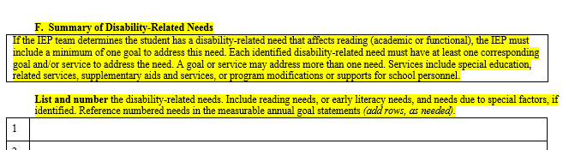
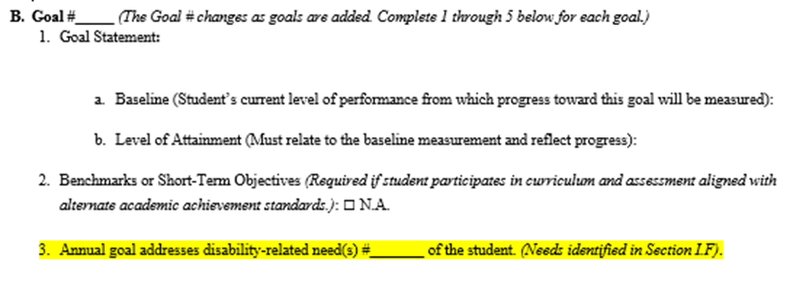
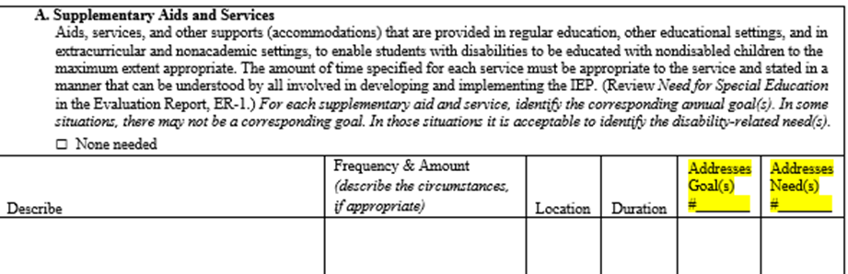
IEP Linkages: Aligning Services to Needs and Goals
(Linking Steps 2, 3 and 4)
Identify Needs
Develop Goals to Address Needs
Align Services with Goals and Needs
Notes:
The sample IEP forms clearly link together student needs, goals, and services.
Identification of disability-related needs is critical to the linking process in the IEP.
The IEP team identifies and numbers each of the student’s disability-related needs.
The IEP team develops goals to address each need. For each goal, the IEP team identifies which disability-related need is addressed by the goal.
The IEP team aligns special education services so the student can achieve the IEP goals within one year. The IEP team identifies which goals and needs are supported by each service.

Slide 91
Step 4 Key Ideas
Understanding the purpose of IEP services and why each service is needed to improve access, engagement and/or progress is central to linking services to IEP goals and disability-related needs
Notes:
Understanding the purpose of IEP services and why each service is needed to improve access, engagement and/or progress is central to linking services to IEP goals and disability-related needs

Slide 92
Step 4 Key Ideas
Services are aligned to address disability-related needs and support goal attainment
  Enable the student to make sufficient progress towards the goals
  Reduce barriers and support access, engagement, and progress in early childhood/ grade level standards-based curriculum and instruction, other activities, and environments
  All disability-related needs must be addressed by services
Notes:
Identification of a student’s disability-related needs is critical to the linkage between services and the rest of the IEP.
During Step 4, services are aligned to address the student’s disability-related needs and directly support the student’s ability to meet the ambitious and achievable annual IEP goals.
IEP services are intended to assist the student to access, engage, and make progress in early childhood/grade level standards-based curriculum and instruction, other activities, and environments.
IEP services are intentionally and deliberately planned to address the student’s unique needs and goals
Each of the student’s disability-related needs must be addressed by at least one service. It is not unusual for a need to be addressed by more than one service.
This also means each IEP goal must be aligned with at least one service. It is also not unusual for an IEP goal to be supported by more than one service.

Slide 93
Step 4 Key Ideas
Services may include:
  supplementary aids and services,
  specially designed instruction,
  related services, and
  program modifications & supports for personnel
Specially designed instruction must be included in every IEP
If a disability-related need affects reading, there must be at least one goal and service to support that need
Notes:
IEP Services include supplementary aids and services, specially designed instruction, related services, and program modifications and supports for personnel.
All IEP services are provided to meet the unique needs of a child with a disability, and must be provided at no cost to the parents

Slide 94
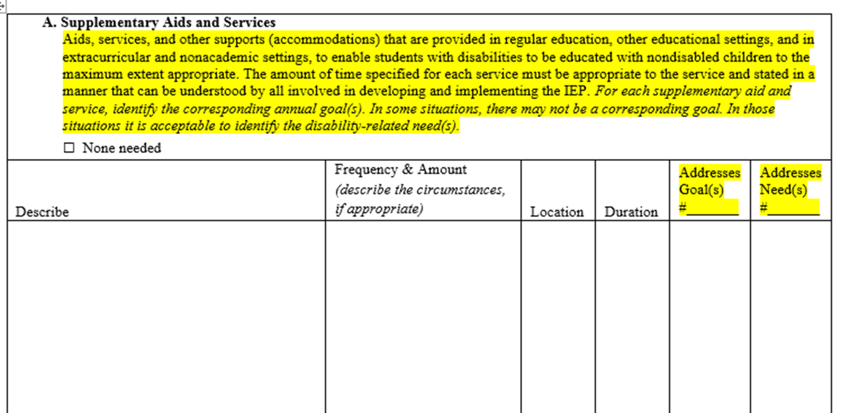
IEP Linking Form (I-4)
Program Summary
Notes:
This is an excerpt from the I-4 linking form program summary- Link to DPI form on slide
In earlier sections, the IEP team will have summarized and numbered each of the student’s disability-related needs. The team will also have numbered each goal developed to address the needs.
After the needs and goals are identified, the team is then ready to align services and develop the program summary. It is very important to wait until Steps 1, 2, and 3 are completed before developing the program summary during Step 4.
Each service will include the number or numbers of the goal(s) or needs) that the services is intended to address. This linkage helps to ensure there is a special education service for each goal to enable the student to make sufficient progress toward the goal and that each need is supported with services.
There may be more than one service to address a goal or need, or one service may address multiple goals/needs.
You will notice Supplementary Aids and Services are considered first when aligning special education services with a student’s IEP goals.
Ask why they think we moved this to the top of the program summary?
This reinforces the concept of least restrictive environment and the desire to first consider education in the regular education environment with supports.

Slide 95
Considering Supplementary Aids & Services
Accommodations and Supports
Increase access to general education standards, instruction, settings, or activities
Help the student be more independent
Improve motivation and engagement
Reflect student choice and input
May be available to the student in future higher education or employment
Notes:
Accommodations are a kind of supplementary aid and service. Accommodations are supports that provide equitable access to grade-level content and allow students to demonstrate what they know. Accommodations are intended to reduce or eliminate the effects of a student’s disability that may result in difficulty accessing instruction and engaging in typical learning and other school activities.
The use of accommodations and supports do not reduce learning expectations-do not substantively change the content or required skill level of a lesson, activity, or test.
Accommodations and other supplementary aids and services can serve multiple functions, all which help support the student on a pathway to college and career readiness. Accommodations and other IEP supports may be needed both to access and engage in specific academic tasks, as well as to support functional needs of students across various environments.
Selected Accommodations and supports should be based on the unique needs of each student with an IEP and should support the goals in the IEP.
Relate back to Equity Picture--- “boxes” Need to be careful- this can be about building boxes without thinking about breaking down barriers.
The appropriate use of needed accommodations may:
Increase access, engagement, and progress in general education standards, instruction, settings, or activities.
Help the student be more independent.
Improve motivation and engagement (this also connects with Universal Design for Learning Guidelines).
Accommodations may also support the student by the following:
Provide Student Choice and Input that helps to foster self-determination.
Be Available to the Student in Future Higher Education or Employment.
Some accommodations and other supplementary aids and services provided in schools may be available in post-secondary education settings, as well as in jobs and community activities. The accommodations available today for students, post high school continue to expand. Because accommodations available in these settings are increasing, it is important for IEP teams to reach out to potential employers and higher education resource staff to find out about the types of accommodations available and provide students with sufficient instruction on self-advocacy and the use of accommodations during K-12.

Slide 96
National Instructional Materials Accessibility Standard (NIMAS)
Students who are blind or visually impaired or have other print disabilities, must timely receive accessible materials in the appropriate format
NIMAS establishes criteria for standardization of accessible electronic text files for eligible students
  Materials sent to access center (NIMAC) by LEA request via Wisconsin Accessible Materials Portal (WAMP)
During Step 4, the IEP team considers if student requires instructional materials in a specialized format to address disability related needs
Notes:
A provision in the Individuals with Disabilities Education Act of 2004 (IDEA) establishes the NIMAS [34 CFR 300.172(a)(1).]
This Standard requires LEAs to ensure all students who are blind or visually impaired, and those with other print disabilities, receive accessible materials in an appropriate specialized format and in a timely manner (i.e. at the same time all other students receive their print materials.
The standard provides for consistent source files to be used to create specialized formats for students with print disabilities, including those who are blind and visually impaired.
Wisconsin School districts can access such materials for eligible students (blind, visually impaired, other print disabilities) from the National Instructional Materials Access Center (NIMAC). They do this by making a request through the Wisconsin Accessible Materials Portal (WAMP).
LEAs must also ensure student with IEPS who need instructional materials in accessible formats, but are not included under the definition of blind or other persons with print disabilities or who need materials that cannot be produced from NIMAS files, receive those instructional materials in a timely manner.
During Step 2, the IEP team should have already identified whether the student’s disability affects the student’s access to print materials and if there are corresponding disability-related needs that must be addressed to increase such access so the student can engage in instructional activities. If so, the team may decide goals are needed to address the access need.
In Step 4, when linking services to needs, the IEP team should consider if the student needs instructional materials in specialized format to address their disability related needs so they can meet their IEP goals AND access, engage and make progress in the general education curriculum.
Services related to this need would include the supplementary aid and service of accessible print materials and could include other services such as specially designed instruction on the use of such materials, as appropriate.
Specific guidance for districts can be found at: https://www.wamp.k12.wi.us/guidance-for-districts/ (Link on slide and at end of presentation)
Contact: Jayne Bischoff, UDL and AT Consultant

Slide 97
Supplementary Aids and Services Example
Service Described using Conditions
Type of Service | Frequency and Amount | Location
Comfort, sensory, or walk break | 5-10 minute break when the student becomes anxious or overstimulated and is unable to continue accessing or engaging in class activity. | General education environments
Notes:
Here is an example of a service described using conditions
Type of service: (The student will be given) a short comfort, sensory, or walk break (inside or out of classroom)
Frequency (Conditions): When the student becomes anxious or overstimulated and is unable to continue accessing or engaging in the class activity.
Amount: 5-10 minutes
Location: general education environments (classroom or other environment)

Slide 98
Specially Designed Instruction
Special Education mean specially designed instruction to meet the unique needs of an eligible student
Specially designed instruction means adapting, the content, methodology, or delivery of instruction to address the unique needs that result from the student’s disability and ensure access to the general curriculum, so the student can meet the educational standards that apply to all students in the district.
Notes:
In IDEA specially designed instruction is used as a verb and means adapting, the content, methodology, or delivery of instruction to address the unique needs that result from the student’s disability and ensure access to the general curriculum, so the student can meet the educational standards that apply to all students in the district.
Lets use an activity to talk more about what this means in practice.

Slide 99
Quick Check Discussion
Are these descriptions of Specially Designed Instruction?
Reading fluency instruction
Tests read to student
LD resource support
Instruction in self-regulation techniques
Provision of text in alternate format (NIMAS)
Co-taught math instruction
Notes:
Trainer Note: USE this large group activity to guide conversation about the different types of services. in particular, highlight specially designed instruction. The purpose of this activity to deepen participant understanding of what makes a service, specially designed vs. a support or accommodation. Slide has timing- Click to show each item.
Activity prompt: If this was written in the program summary under “specially designed instruction” would you say it could be an example of specially designed instruction? Note: these are only types of services and not complete service statements because they don’t include amount/frequency/location)
Response: Thumbs up or down
Discuss why/why not for each
During debrief, emphasize that specially designed instruction is intentionally and deliberately planned and delivered to directly improving student skills/behaviors targeted by IEP goals. Allow participants to generate and discuss other examples and ask questions
Answers:
LD Resource Support- No. . It is not clear as to what exactly will be provided to the student nor what area(s) of skill/behavior is being addressed. A statement of specially designed instruction should describe the specific content, methodology, or delivery that is being adapted “LD Resource” is often considered a location. The service needs to describe what will happen there. “support” is not clear?
Co-Taught Math- No- Co-taught math means the same as general education math. General education math is not a special education service. Co-teaching is generally considered to be a kind of general education service delivery model and an approach to providing instruction to all students in a class. A statement of specially designed instruction, must specify what was being adapted specifically for this student. For example, specially designed math instruction could be an acceptable statement.
Reading fluency instruction- Yes- This could be specially designed instruction to address a reading fluency goal.
Tests read to student- No. This is an accommodation to allow a student to access test content. It is a supplementary aid and service.
Provision of text in alternate format (NIMAS) – No. This is an accommodation to allow a student to access text and engage in text based activities.
Instruction in self- regulation techniques- Yes- This could be specially designed instruction to address a social-emotional, behavior. transition, and/or self-advocacy goal.

Slide 100
Examples
Specially Designed Instruction
Type of Service | Frequency and Amount | Location
Specially designed reading instruction to improve reading comprehension Pre-teach social studies and science vocabulary Small group instruction on social skills to build peer relationships and social interaction skills | 30 minutes 3x week 30 minutes 2x week 30 minutes 2x at the start of each unit/chapter 45 minutes 1x per week | General Ed Classrm Sp Ed Resource Room Sp Ed Classroom General Ed Classrm
Notes:
Here are some examples of specially designed instruction.
Note that the type of specially designed instruction, the amount/frequency, and the location are clear.
Reminder: The statement of service should pass the “stranger test” (i.e. someone who wasn’t at the meeting should be able to tell what the service is intended to provide and how much and how often it will be provided).
In addition, everyone who may be involved in implementing the student’s IEP must be informed of their specific responsibilities for implementing or supporting the implementation of IEP services.

Slide 101
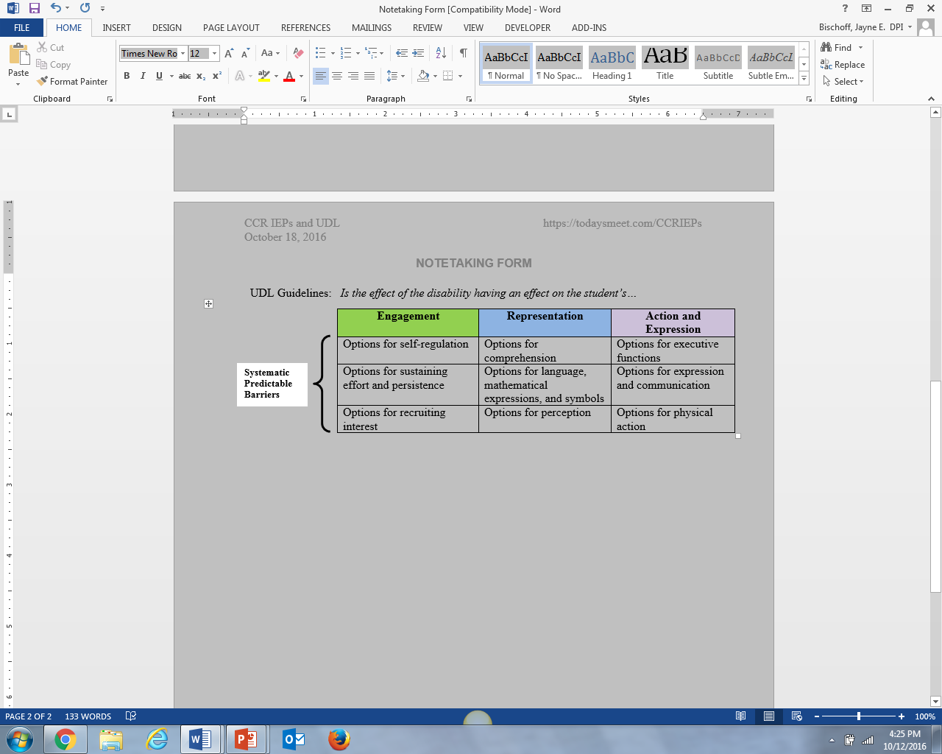
For further discussion
UDL and Step 2
How might these guidelines help us identify barriers we see the student face as a result of their disability?
Notes:
The UDL framework provides a helpful lens for considering effects of disability including the barriers students may encounter as a result of their disability, and for exploring options to better support access, engagement and progress.
If you are not familiar with UDL I encourage you to click on the link and explore the resources after this session.
If time, possible activity/discussion:
Review the UDL guidelines through the lens of the students you work with and the guidelines as potential barriers (or supports) that may relate to the effect of a student’s disability.
Consider how exploring these potential barriers may lead to an improved understanding about the effect of the student’s disability on access, engagement and progress in curriculum, instruction and other activities across educational environments
For example, how might a student’s disability affect their ability to self-regulate during certain types of activities or in certain environments? How might their disability affect how well they understand grade-level text used during certain classes or under specific conditions?
How might this exploration clarify root causes of observed effects of the student’s disability?
How might it then lead to the identification of disability related needs that when addressed will result in improved learning outcomes?
Keep in mind, this exploration can also lead to the identification of services and supports that will be required to address the effects of the student’s disability and the student’s disability-related needs, but that will need to wait for Step 4.
Can you relate this to your prior discussion about effects of disability and disability related needs? Anything you would add or change as a result?

Slide 102
Activity: What Services Might be Needed?
Disability Related Needs | Measurable Goals
The student needs to improve ability to segment words into syllables and blend syllables into words. Learn to use a text reader to independently access grade level text. | Given 5th gr level vocabulary, the student will independently read the words by segmenting words into syllables and blending syllables into words. Baseline: On average, able to accurately read 102 WPM of 3rd gr level words over a 4 week period. Level of Attainment: Able to accurately read 130 WPM of 5th gr level words over a 4 week period. Will independently use electronic text-reader when reading grade-level textbooks. Baseline: Has no experience using a text reader. Level of Attainment: Independently access and use in classroom and at home when reading grade level texts.
Notes:
Turn and Talk or whole group depending on size of group
Prompt: Describe the services that might be required to address the needs and goals
The point of this activity is for participants to practice describing the various kinds of IEP services that may be appropriately linked to needs and goals, rather than selecting/ sorting services according to IDEA service types (e.g. specially designed instruction, supplementary aids and services, related services, program modifications and supports for staff)
This activity also provides an example of when a student may need a goal to learn how to use and access a supplementary aid or service (text reader).
Debrief/Discussion:
How do the services address access, engagement, progress?
Specificity– type, frequency, amount or conditions, location duration (As appropriate, Refer to bulletin 10.07 , Describing Special Education Services at https://dpi.wi.gov/sped/laws-procedures-bulletins/bulletins/10-07
How might multiple services providers address the same need/goal?
Note: the last example in 2nd column was revised w/ input from prior workshop participants

Slide 103
Step 4 Check
Are all disability-related needs and IEP goals addressed by at least one service?
  If disability affects reading, do services address related needs?
Are the services stated in a manner that can be understood by all?
  Type of service; and clear and logical amount, frequency (or conditions), location, and duration?
Do supplemental aids and services support access, engagement, and progress?
  Do they address independence and use in school, community, and eventually, post-secondary settings?
Are there necessary supports for staff (e.g. training, consultation)?
Notes:
Here is the Step 4- Step-Check:
Are all IEP goals and disability-related needs addressed by at least one service?
Is a clear description of the service provided?
Is a clear and logical amount, frequency, location and duration provided?
Are there procedures for verifying IEP implementation?
Do services support access, engagement and progress in the general curriculum and environment?
Are supports, such as training in literacy instruction, provided for educators?
Each of the At a Glance documents also include tips for IEP teams about each step. We have already gone over the tips for this step during the presentation. There is a link to the Step 4 At a Glance on this slide.

Slide 104
Step 4
Activity
Locate the student’s disability-related needs.
Locate the student’s goals to address the disability-related needs.
Is there a service to address the disability-related need / Is there a service to support the goal?
Is the location, frequency and amount of the service clear?
Use the Step-Check to ensure all the necessary information is provided.
Record the service/s on the Progress Chart.
Notes:
The At A Glance documents also include Step-Checks that individuals or teams can use to review their IEPs.
Here is the Step 4- Step-Check:
Are all IEP goals and disability-related needs addressed by at least one service?
Is a clear description of the service provided?
Is a clear and logical amount, frequency, location and duration provided?
Are there procedures for verifying IEP implementation?
Do services support access, engagement and progress in the general curriculum and environment?
Are supports, such as training in literacy instruction, provided for educators?
Each of the At a Glance documents also include tips for IEP teams about each step. We have already gone over the tips for this step during the presentation. There is a link to the Step 4 At a Glance on this slide.

Slide 105
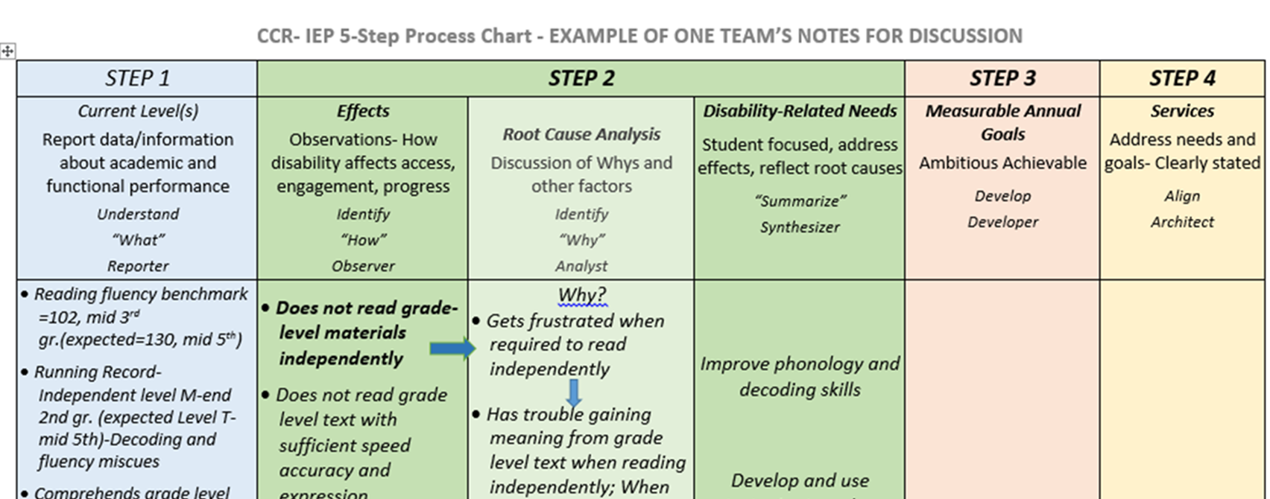
Linking Steps 1-3 with Step 4
Notes:
Use your IEP to complete the CCR IEP Process Chart Step 4 column.
-----------------------------------
Before moving on
As a reminder, when linking services to needs, we think:
What kinds of services might be needed to address needs and goals?
How do the services address access, engagement, progress?
Specificity– type, frequency, amount or conditions, location duration?
How might multiple services providers address the same need/goal?
There are no specific right or wrong answers for any particular student need or for students with any particular impairment. The answers come from the IEP team’s understanding of each student’s individual needs and how the service addresses the need.

Slide 106
For Discussion
What do you see as the most challenging aspects of this step?
What questions might you ask to help prompt IEP team participants to address the key ideas of this step during an IEP team meeting?
Notes:
Pause here- discuss w/ large group
Any questions about Step 4?

Slide 107
College and Career Ready IEP
Five Step Process
Understand Achievement
Analyze Progress
Identify Effects of Disability
(and disability related needs)
Align Services
Develop Goals
Notes:
Lets move onto the last step-

Slide 108
Step 5: Analyze Progress Towards Goals
Analyze progress towards goals to evaluate what works and what is needed to close the student’s achievement gaps.
Notes:
This is a very critical step. The revised forms now help the team document a part of the IEP team process that was rarely documented.
Two new forms were developed to assist IEP teams with this step: the Interim Review of IEP Goals and the Annual Review of IEP Goals
Presenter note: Sometimes during review/revise, Step 5 will be addressed/reviewed by IEP team before/be part of Step 1---- will review progress before review/revise goals. Step 5 goes along w/ IEP 5 and 6 forms

Slide 109
Step 5 Key Ideas
The purpose of Step 5 is to review progress toward goals and how well disability-related needs are being addressed
Step 5 is about IEP planning, review, and revision
Reviewing progress helps identify what is working and what needs to change
Step 5 represents both an ongoing process of progress monitoring as well as scheduled IEP team reviews
Notes:
Now let’s summarize the key ideas for Step 5. These are also summarized in the Step 5: At a Glance handout.
Step 5 represents both an ongoing process of progress monitoring as well as scheduled IEP team reviews and includes:
Ongoing data collection for progress monitoring and instructional planning
Periodical review of progress and reporting to parents-
IEP team review of progress (must happen at least annually) (Could be interim using I-6 or annual (using I-5)
-----------
We want to emphasize the overall purpose of this step is to review the effectiveness of the IEP in addressing the student’s disability-related needs related to progress towards grade level/early childhood standards and expectations.
Step 5 starts with the ongoing collection of data use to monitor student progress (using the methods outlined in IEP goals during Step 3) and the ongoing analysis of this data and adjustment of instructional techniques and methods that teachers regularly do in response to ongoing progress monitoring.
Progress data is summarized and periodically reported to parents on the schedule identified on the student’s IEP. Districts may use the Interim Review of IEP goals for periodic reporting outside of IEP team meetings.

Slide 110
Step 5 Key Ideas
The IEP team analyzes the student’s progress towards the IEP goals to inform future IEP development
The IEP must be reviewed periodically, but at least annually
  The IEP must state when IEP progress will be reported to parents (e.g., quarterly, concurrent with general education report cards, etc.)
Notes:
At least annually, the IEP team must meet to formally review progress toward all IEP goals and revise the IEP as appropriate to address: ,
The student’s disability-related needs
Any lack of expected progress toward IEP goals
Any lack of expected progress in the general education curriculum
How IEP goals and services support the student in closing gaps in early learning/academic achievement and functional expectations
To do this, the IEP team reviews the disability related needs and the goals (or objectives) for which good progress is being made and determine what additional progress may be needed. The team asks, “Has the IEP been effective in addressing the student’s disability-related needs to help the student make progress toward academic standards and functional expectations at the desired rate?”
The IEP team uses the information collected and already reported to the parent during interim review(s) of progress, and any other relevant information, to determine if IEP goals have been met and if special education services are effectively meeting the student’s needs. If not, the team considers what revisions to the IEP are needed to support the student?
If a goal has been met, perhaps the goal is no longer needed or a more ambitious goal should be added (i.e., change in level or increased independence of performance; different aspect/higher level skill).
If not all needs are addressed by a goal, the team should also review the degree to which the need is being met.
Example: A student who requires a wheelchair or walker has a disability that affects the student’s mobility. Therefore, improved mobility to allow access to school is a disability-related need. It is possible that the student has acquired the requisite mobility skills needed to use and transfer from his walker or wheelchair, but still has mobility related needs. In such case, the student may not have an IEP goal related to mobility but will still require the related service of specialized transportation.
When analyzing progress always consider how the student’s strengths, areas of success, and strategies that are working well may apply to areas in which progress is not so good.

Slide 111
Step 5 Key Ideas
When a student is not making sufficient progress towards achieving IEP goals and closing achievement gaps, the CCR IEP Five-Step Process provides a good framework for reviewing and revising the IEP
Notes:
Read slide.
When a student is not making sufficient progress towards achieving IEP goals and closing achievement gaps, the CCR IEP Five-Step Process provides a good framework for reviewing and revising the IEP.
For instance, the IEP team should return to step 1 and consider what team members know about the student.
Upon IEP review/revision, progress made toward goal attainment cycles back to Step 1 discussion and a summary of progress data becomes part of the current level of performance statement for the next IEP.

Slide 112
Step 5
Check Your System
Are there set procedures and schedules for reviewing IEP goals?
Are there procedures for ensuring IEPs are implemented with fidelity?
Do all educators have access to data needed to review IEPs?
Are instructional resources available to match student needs with effective interventions?
Do educators need additional training or support to implement IEP services ?
Do educators need additional training or support to monitor and interpret progress data? To adjust instruction based on data?
Notes:
Carrying out step 5 of the CCR IEP process effectively, requires a number system prerequisites to be in place. This slide highlights a few of these. District and building level leadership are encouraged to consider these examples as they implement the 5 step process.
Move to Resource Slides before Facilitate Group Work time.

Slide 113
Step 5 Check
Is progress data aligned with baseline and level of attainment for each goal?
Are interim progress reports on each goal included in review?
Was the IEP reviewed annually?
Is data/information from multiple sources included (teachers, student and parents)?
Is student making sufficient progress? Is there data to support?
If student is not making sufficient progress, has IEP been revised to address lack of progress?
Notes:
Carrying out step 5 of the CCR IEP process effectively, requires a number system prerequisites to be in place. This slide highlights a few of these. District and building level leadership are encouraged to consider these examples as they implement the 5 step process.
Move to Resource Slides before Facilitate Group Work time.

Slide 114
Step 5
Activity
Review the I-6 (Interim Review)
  Is the student making sufficient progress?
  What data supports this conclusion?
  If not, how is lack of progress being addressed?
Review the I-5 (Annual Review)
  Were goals reviewed prior to developing new IEP?
  What data supports this conclusion?
  If goals weren’t met, how was IEP revised?
Notes:
The At A Glance documents also include Step-Checks that individuals or teams can use to review their IEPs.
Here is the Step 4- Step-Check:
Are all IEP goals and disability-related needs addressed by at least one service?
Is a clear description of the service provided?
Is a clear and logical amount, frequency, location and duration provided?
Are there procedures for verifying IEP implementation?
Do services support access, engagement and progress in the general curriculum and environment?
Are supports, such as training in literacy instruction, provided for educators?
Each of the At a Glance documents also include tips for IEP teams about each step. We have already gone over the tips for this step during the presentation. There is a link to the Step 4 At a Glance on this slide.

Slide 115
For Discussion
Step 5
What do you see as the most challenging aspects of this step?
How might you prepare to review progress during an IEP team meeting?
Notes:
Use this slide or Step 5 Check your System for Group Activity Option #2

Slide 116
For Further Practice
Chart and Discuss Linkages using an existing IEP
Review “At A Glance” documents for Steps 1-4
Pick one disability-related need
Look at the services statement(s) identified to address the need and, as appropriate, corresponding goal(s) (refer to numbered need/goal)
Is there a clear and logical link between the disability-related need, corresponding goal(s), and service(s)?
  Are goals and services explicitly developed to address a root cause rather than symptom(s)?
Try to trace the process backwards by seeing if you can write the corresponding information from Steps 4, 3, 2, and 1 on a blank 5 Step Process Chart
Notes:
You may want to do this in small groups using an IEP that is familiar to everyone in the group.
Reviewing and discussing your IEPS with colleagues using the tips and step checks can be a great way to practice and become more comfortable with the 5 Step Process.
Allow at least 15-20 minutes for activity then additional time for debriefing and questions.

Slide 117

Resources
Notes:
The following pages highlight some resources available from links on our website related to this presentation

Slide 118
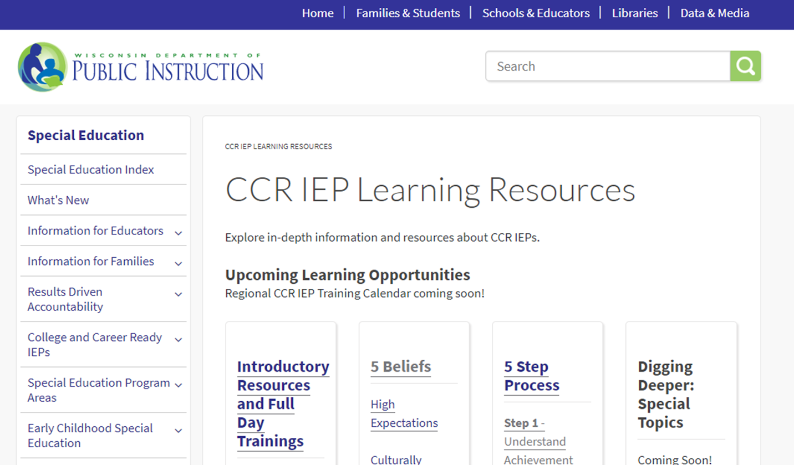
CCR IEP Learning Resources
Notes:
On this page, you will find links to all DPI CCR-IEP resources. Please check this page often as we will be adding new resources regularly

Slide 119
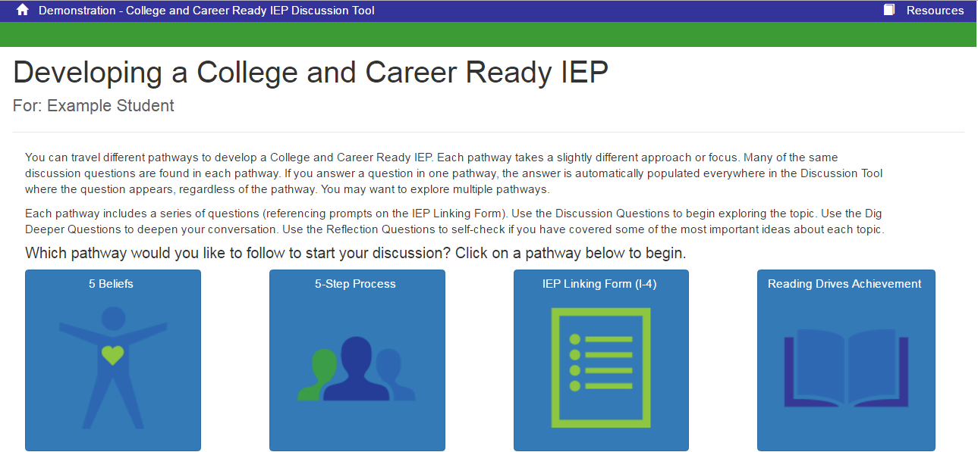
CCR IEP Discussion Tool
Notes:
This discussion tool has been developed to help IEP teams complete the forms. It is aligned with the 5 Step process
Guiding questions in the discussion tool can be used to promote conversation about the 5 beliefs

Slide 120


CCR IEP Video
Notes:
We have a 5 minute video that describes the CCR IEP 5 Step Process at https://youtu.be/wRIyZoiHRdQ

Slide 121
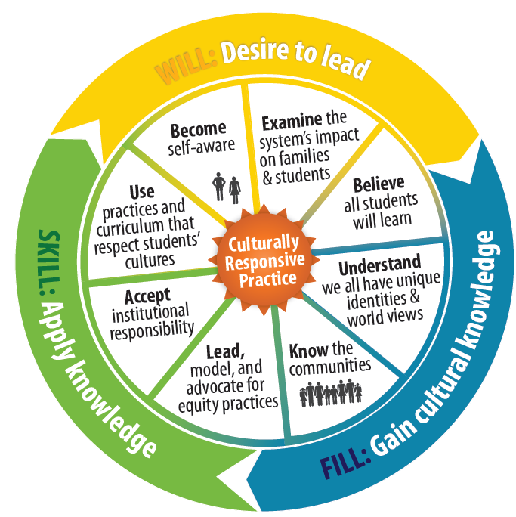
Culturally Responsive Practice
Notes:
The next few slides highlight a few our DPI resources that address the CCR-IEP beliefs.
This graphic from the Wisconsin RtI center, provides a framework for educators to learn, apply knowledge, and stand up to support the unique identity of each student.
There is a link on slide to RTI center page with more culturally responsive practice resources.
Being Culturally Responsive is one of the CCR IEP Five Beliefs: IEP teams know and respect the unique identity of the student and explore programs, practices, procedures, and policies that meet the diversity of the student’s abilities, race, gender, language, and culture.
We know that every student is unique and for educators to best support students we have to reach out to learn about each and every student’s unique identity.

Slide 122


Family and Community Engagement in Promoting Excellence For All
Report of the State Superintendent’s Parent Advisory Council dpi.wi.gov/pacreport
Wisconsin State Parent Educator Initiative (WSPEI)
http://wspei.org/
WSPEI CCR-IEP Family Engagement Resources
http://www.livebinders.com/play/play?id=2191148
Notes:
Every Student a Graduate, College and Career Ready is State Superintendent Tony Evers’ vision for every child in Wisconsin to graduate college and career ready. Within that vision, Promoting Excellence For All recognizes that the education of our students of color requires swift, targeted, and deliberate attention.
In this report, the State Superintendent’s 2014-15 Parent Advisory Council recommended ways for schools to engage families and communities in helping to close student achievement gaps, from the parent perspective.
This report and additional strategies and resources for family engagement are all available on the DPI web site. The Wisconsin Statewide Parent Educator Initiative (WSPEI) also provides family engagement support through a discretionary grant from our Special Education team that focuses on family engagement for families of students with IEPs.
Note that in collaboration w/ WSPEI, the department is developing family engagement resources specific to implementing the CCR IEP process

Slide 123

Collective Responsibility
Co-Teaching
https://youtu.be/Xurgvdq3J8s
Notes:
Perhaps one of the most challenging beliefs to realize when supporting students with IEPs is the belief of Collective Responsibility.
DPI’s special education team has begun developing resources that support collective responsibility such as greater outreach to school principals and administrators, stronger collaborations with Title I and other teams at the Department, and guidance on co-teaching, a powerful strategy for achieving collective responsibility.
The department has developed a co-teaching introductory video and is making a Co-teaching toolkit to help educators explore and improve their co-teaching practices. (Link to page on slide)
The co-teaching toolkit contains resources for educators to explore best practices in co-teaching including slide decks, selection tools, resources to improve essential components of co-teaching, and a practice profile that outlines what to look for when entering a co-teaching classroom that can be used to improve co-teaching practices.

Slide 124
Sample IEP Forms and PCSA
Resource Links
DPI Special Education Forms Page (includes copies of all sample forms, history of changes to forms, and additional guidance)
Guide to Special Education Forms
Sample IEP Forms Frequently Asked Questions (FAQ)
Information about Procedural Compliance Self-Assessment (RDA-PCSA)
Notes:
Here are some other resources specific to the DPI Sample Forms and the Procedural Compliance Self Assessment.
REFER TO HANDOUT
Web site: http://dpi.wi.gov/sped/laws-procedures-bulletins/procedures/sample

Slide 125


