Slide 1

Wisconsin's Children Moving Forward
OSEP Child Outcomes
Target Setting For Indicator #7 Child Outcomes
WDPI Stakeholder Group
December 16, 2009
Ruth Chvojicek
Statewide Child Outcomes Coordinator

Slide 2
Goals for today
Review Indicator 7 data
Set targets for two summary statements for each of the three child outcomes

Slide 3
Indicator #7 – Child Outcomes
Percent of preschool children aged 3 through 5 with IEPs who demonstrate improved:
  Positive social-emotional skills (including social relationships);
  Acquisition and use of knowledge and skills (including early language/communication and early literacy); and
  Use of appropriate behaviors to meet their needs.

Slide 4
Basic Reporting Requirements
Districts determine child’s level of functioning using a 7-point scale and report entry and exit data to the state
State converts the data to 5 progress categories and reports to OSEP
New – State tabulates data from 5 progress categories into 2 summary statements and reports to OSEP

Slide 5
Data Timeline
20005-2006
Small Pilot – 16 Districts
Children who entered services April 1 – June 30, 2006
2006 – 2007
Began sampling – Districts in 2006-2007 Self- Assessment Cycle
2007-2008
Districts in 2007-2008 Self-Assessment Cycle joined sample
2008-2009
Districts in 2008-2009 Self-Assessment Cycle joined sample
February 2009 APR reported all children who exited in 2007-2008
February 2008 APR reported all children who exited 2006-2007
Progress data
Progress data

Slide 6
Data Timeline
2009-2010
Districts in 2009-2010 Self-Assessment Cycle joined sample
2010 - 2011
Districts in 2010 – 2011 Self-Assessment Cycle will join sample
February 2011 APR will report all children who exited in 2009-2010 cycle year compared to targets for 2009-10
2011 - 2012
February 2012 APR will report all children who exited in 2010-2011 cycle year compared to targets for 2010-11
February 2010 APR will report all children who exited in 2008-2009 cycle year
Baseline Data
Have option to adjust targets with justification
DPI will publicly report LEA results on Special Education District Profile
DPI will publicly report LEA results on Special Education District Profile

Slide 7
Wisconsin’s “Birth to 6” Child Outcome System
  Part B sampling strategy (Part C – Census)
  Any child with an initial IEP and placement date that falls between July 1 and June 30 of the district’s self-assessment cycle year makes up a district’s sample cohort.
    Report on all children in cohort until they turn 6 or exit the program
  Builds on existing practices
  Emphasizes on-going assessment
  Uses a team process to share information

Slide 8
Wisconsin’s “Birth to 6” Child Outcome System
Using the child outcome summary, team determines the entry rating within 60 days of entry into preschool program for each child who begins services between July 1st and June 30th of the cycle year.
Each child in the sample cohort is followed until they turn six, exit services, or moves out of a district.
It is recommended but not required that the Part C exit rating be used as the Part B entry rating. This data is available on the Program Participation System (PPS).
Child outcome information is reported on the DPI Special Education Web Portal – Child Outcomes database by September 1st following the June 30th close of their entry year and each subsequent year until all of the students in the sample cohort have exited.

Slide 9
Three Child Outcomes
Children have positive social-emotional skills (including social relationships)
Children acquire and use knowledge and skills (including early language/communication and early literacy)
Children use appropriate behaviors to meet their needs

Slide 10
Child Outcomes Summary Form (COSF)
7 point rating scale
Team summarizes multiple data sources (NOT an assessment)
Rating the status of child’s functioning at entry and again at exit
Comparing child’s functioning to what is expected at his/her age

Slide 11
Child Outcomes Summary Form (COSF)

Slide 12
The two COSF questions
a. To what extent does this child show age-appropriate functioning, across a variety of settings and situations, on this outcome? (Rating: 1-7)
b. Has the child shown any new skills or behaviors related to [this outcome] since the last outcomes summary? (Yes-No)

Slide 14
OSEP Reporting Categories
Percentage of children who:
a. Did not improve functioning
b. Improved functioning, but not sufficient to move nearer to functioning comparable to same-aged peers
c. Improved functioning to a level nearer to same-aged peers but did not reach it
d. Improved functioning to reach a level comparable to same-aged peers
e. Maintained functioning at a level comparable to same-aged peers

Slide 15
Must have 2 data points to calculate progress
Calculations are done at the state level using an analytic calculator developed by the Early Childhood Outcomes Center (ECO)
 |  | Entry |  |  |  | Exit |  |  |  |  |  |  | Outcome 1 | Outcome 2 | Outcome 3
ID | Program | Date | Outcome 1 | Outcome 2 | Outcome 3 | Date | Outcome 1 | Progress | Outcome 2 | Progress | Outcome 3 | Progress | OSEP Category | OSEP Category | OSEP Category
 |  | ###### | 7 | 7 | 7 | ###### | 7 | Y | 7 | Y | 7 | Y | e | e | e
 |  | ###### | 2 | 3 | 2 | ###### | 3 | Y | 3 | Y | 4 | Y | c | b | c
 |  | ###### | 3 | 3 | 3 | ###### | 4 | Y | 5 | Y | 5 | Y | c | c | c
 |  | ###### | 5 | 4 | 5 | ###### | 7 | Y | 7 | Y | 7 | Y | d | d | d
 |  | ###### | 6 | 4 | 7 | ###### | 7 | Y | 7 | Y | 7 | Y | e | d | e
 |  | ###### | 6 | 5 | 7 | ###### | 5 | Y | 4 | Y | 6 | y | b | b | e

Slide 16
The “a” category
a. Percent of preschool children who did not improve functioning
  Children who acquired no new skills or regressed during their time in the program
  Didn’t gain or use even one new skill
  Children with degenerative conditions/ significant disabilities

Slide 17
Entry
Exit

Slide 18
Entry
Exit

Slide 19
The “b” category
b. Percent of preschool children who improved functioning but not sufficient to move nearer to functioning comparable to same-aged peers
  Children who acquired new skills but continued to grow at the same rate throughout their time in the program
  Gained and used new skills but did not increase their rate of growth or change their growth trajectories while in services

Slide 20
Entry
Exit

Slide 21
Entry
Exit

Slide 22
The “c” category
c. Percent of preschool children who improved functioning to a level nearer to same-aged peers but did not reach it
  Children who acquired new skills but accelerated their rate of growth during their time in the program
  Made progress toward catching up with same aged peers but were still functioning below age expectations when they left the program
  Changed their growth trajectories --“narrowed the gap”

Slide 23
Entry
Exit

Slide 24
The “d” category
d. Percent of preschool children who improved functioning to reach a level comparable to same-aged peers
  Children who were functioning below age expectations when they entered the program but were functioning at age expectations when they left
  Started out below age expectations, but caught up while in services

Slide 25
Entry
Exit

Slide 26
The “e” category
e. Percent of preschool children who maintained functioning at a level comparable to same-aged peers
  Children who were functioning at age expectations when they entered the program and were functioning at age expectations when they left
  Entered the program at age expectations and were still up with age expectations at exit

Slide 27
Entry
Exit

Slide 28
Entry
Exit

Slide 32
The Summary Statements
Of those preschool children who entered the preschool program below age expectations in each Outcome, the percent who substantially increased their rate of growth by the time they turned 6 years of age or exited the program.
The percent of preschool children who were functioning within age expectations in each Outcome by the time they turned 6 years of age or exited the program.

Slide 33
Summary Statement #1
Of those preschool children who entered the preschool program below age expectations in each Outcome, the percent who substantially increased their rate of growth by the time they turned 6 years of age or exited the program.
In other words… How many children changed growth trajectories during their time in the program? Percent of the children who made greater than expected gains, made substantial increases in their rates of growth, i.e. changed their growth trajectories.
Formula c+d a+b+c+d

Slide 34
Summary Statement #2
The percent of preschool children who were functioning within age expectations in each Outcome by the time they turned 6 years of age or exited the program.
In other words… How many children were functioning within the bounds of age expectations when they left the program? Percent of the children who were functioning at age expectations in this outcome area when they exited the program, including those who: started out behind and caught up 9”d”) Entered and exited at age level (“e”)
Formula d+e a+b+c+d+e

Slide 35
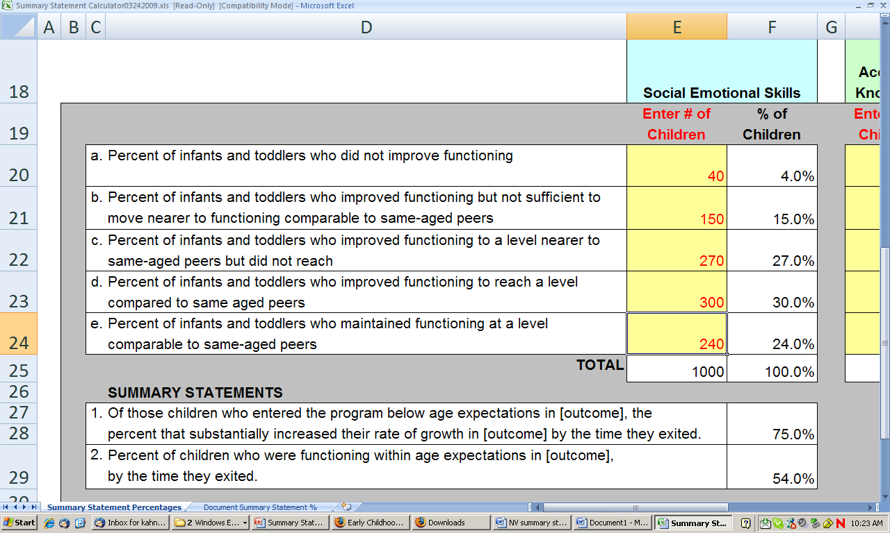
Where do the #s come from?
– Summary Statement Calculator

Slide 36
Wisconsin’s Data

Slide 37
Wisconsin’s Data

Slide 38
What Does This Mean for Outcome #1 –
Positive Social-Emotional Skills?
Of those preschool children who entered the preschool program below age expectations in each Outcome, 79.6% substantially increased their rate of growth by the time they turned 6 years of age or exited the program.
70.3% of preschool children were functioning within age expectations in each Outcome by the time they turned 6 years of age or exited the program.

Slide 39
What Does This Mean for Outcome #2 –
Acquisition & Use of Knowledge & Skills?
Of those preschool children who entered the preschool program below age expectations in each Outcome, 81.9% substantially increased their rate of growth by the time they turned 6 years of age or exited the program.
62.5% of preschool children were functioning within age expectations in each Outcome by the time they turned 6 years of age or exited the program.

Slide 40
What Does This Mean for Outcome #3 –
Use Appropriate Behaviors to Meet Needs?
Of those preschool children who entered the preschool program below age expectations in each Outcome, 83.2% substantially increased their rate of growth by the time they turned 6 years of age or exited the program.
81.4% of preschool children were functioning within age expectations in each Outcome by the time they turned 6 years of age or exited the program.

Slide 43
Target Setting Considerations
Target for 2009-2010 may be lower than, equal to, or higher than the baseline
Target for 2010-2011 must be higher than the baseline

Slide 44
Three Options to Consider – Summary Statement #1
Lower Target First Year
Stay the Same First Year
2008-09 (Baseline) | 2009-10 Target | 2010-11 Target
7.A. 79.6 | 75 | 80.6
7.B. 81.9 | 80 | 82.9
7.C. 83.2 | 79 | 84.2
2008-09 (Baseline) | 2009-10 Target | 2010-11 Target
7.A. 79.6 | 79.6 | 80.6
7.B. 81.9 | 81.9 | 82.9
7.C. 83.2 | 83.2 | 84.2
Higher Target First Year
2008-09 (Baseline) | 2009-10 Target | 2010-11 Target
7.A. 79.6 | 80.6 | 81.6
7.B. 81.9 | 82.9 | 83.9
7.C. 83.2 | 84.2 | 85.2

Slide 45
Three Options to Consider – Summary Statement #2
Lower Target First Year
Stay the Same First Year
2008-09 (Baseline) | 2009-10 Target | 2010-11 Target
7.A. 70.3 | 66.4 | 71.3
7.B. 62.5 | 58.5 | 63.5
7.C. 81.4 | 77.4 | 82.4
2008-09 (Baseline) | 2009-10 Target | 2010-11 Target
7.A. 70.3 | 70.3 | 71.3
7.B. 62.5 | 62.5 | 63.5
7.C. 81.4 | 81.4 | 82.4
Higher Target First Year
2008-09 (Baseline) | 2009-10 Target | 2010-11 Target
7.A. 70.3 | 71.3 | 72.3
7.B. 62.5 | 63.5 | 64.5
7.C. 81.4 | 82.4 | 83.4

Slide 46
Improvement Activities Impacting Outcomes
Immediate
Data quality
  Enhanced use of Child Outcomes Fidelity Self Assessment
Professional development
  Web-based training modules including video of team decision making process
Focused data-driven technical assistance
Very Near Future
Increased data analysis
Connecting the data to practices (FRII)

