Slide 1
An Overview
WISEdata Conference ‣ Thursday March 7, 2024 1:00pm - 2:30pm
Shelby Renoos, Zach Johnston, Wyatt Berglund
Notes:
Shelby

Slide 2
Introductions
Shelby Renoos
Customer Success Coordinator
Zach Johnston
Database Administrator
Wyatt Berglund
Database Technician
Notes:
4 min Introductions: Shelby, Zach, Wyatt

Slide 3
Agenda
What is a data dashboard?
What is WISEdash Local?
WISEdash Local & WISEdata
WISEdash Local & Your SIS
Overview of Dashboards
Demonstrations
Customizations: Member Examples
The Future of WDL
Notes:
1 min Agenda Shelby

Slide 4
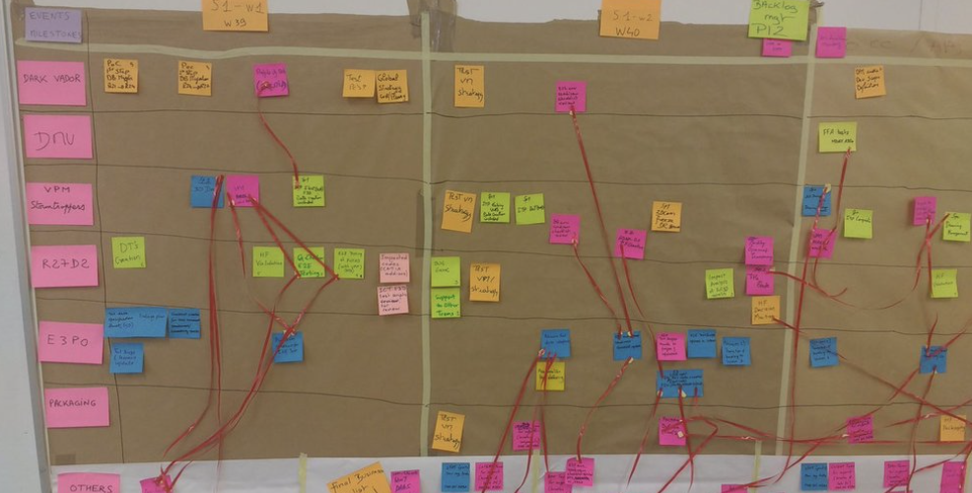
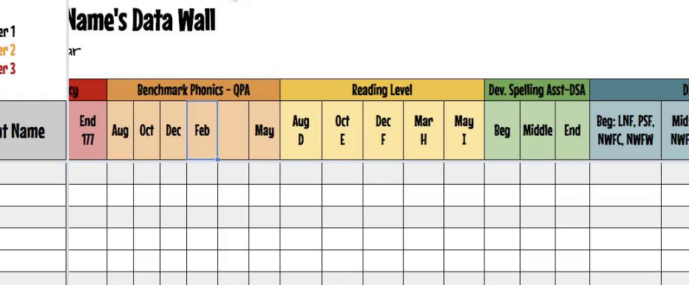
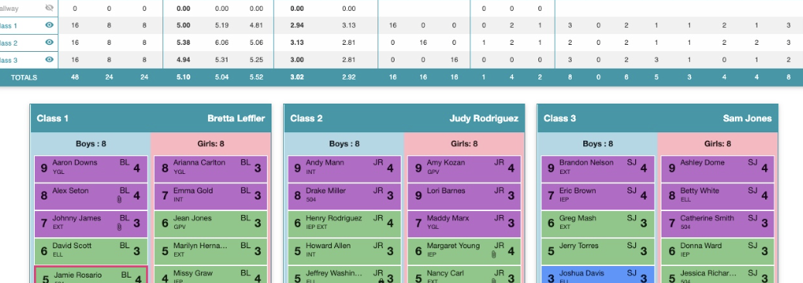
What is a data dashboard?
A tool used to visually track and create collections of graphs and tables, show multi-year trends, to be analyzed by an organization.
What does your school/district/PLC use today?
Notes:
1 min Shelby

Slide 5
Discussion
Show of hands… What is your role?
Administrator
Administrative support
Teacher or Student Support
Tech Team
Snaps & Claps:
We currently use (or have used) a data warehouse
We have not used a data warehouse
Live Poll! Let’s talk about data use: Polleverywhere.com presentation
Notes:
1 min Shelby

Slide 6
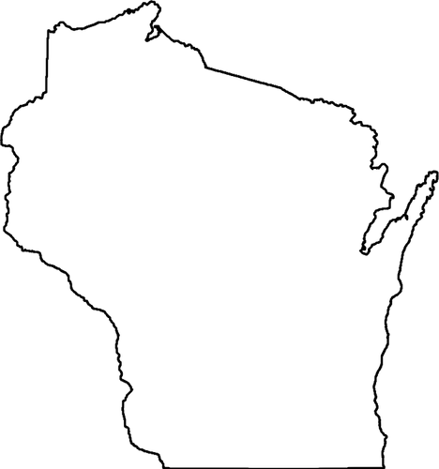
What is WISEdash Local?
WDL Consortium and Governance
WISEdash Local (WDL) is a consortium of innovative WI school districts working together to create a single location data warehouse and dashboard reporting system for your school and student data. Data from your student information system and statewide/local assessments integrate onto WDL dashboards, giving teachers, principals, administrators and board members access to daily-updated comparisons, and helping you visualize your progress toward school-wide initiatives and district goals.
Board of Operations: 9 seats filled by member district representatives
2024: 39 member districts
2014:
5 member districts
Fiscal Agent:
Notes:
3 min The consortium, governance structure Shelby

Slide 7
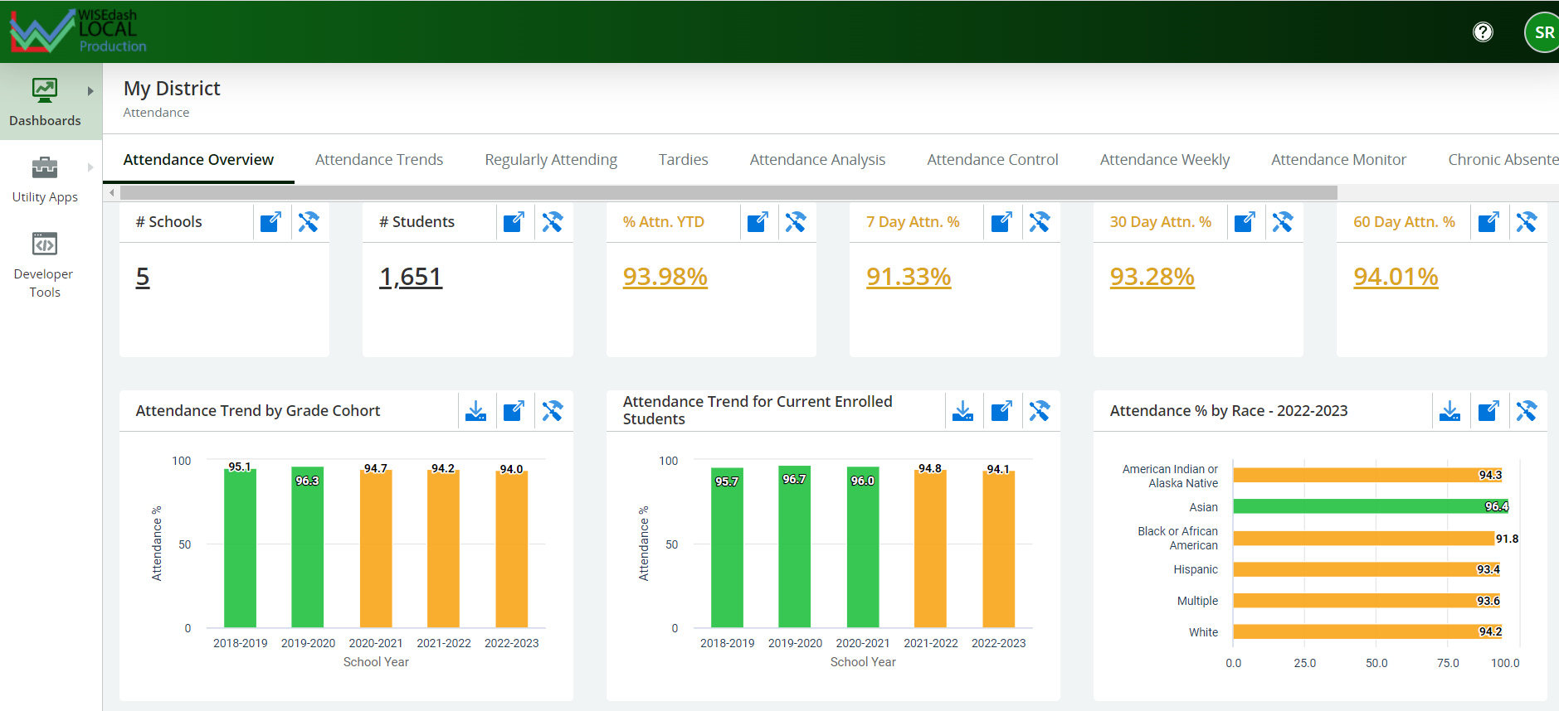
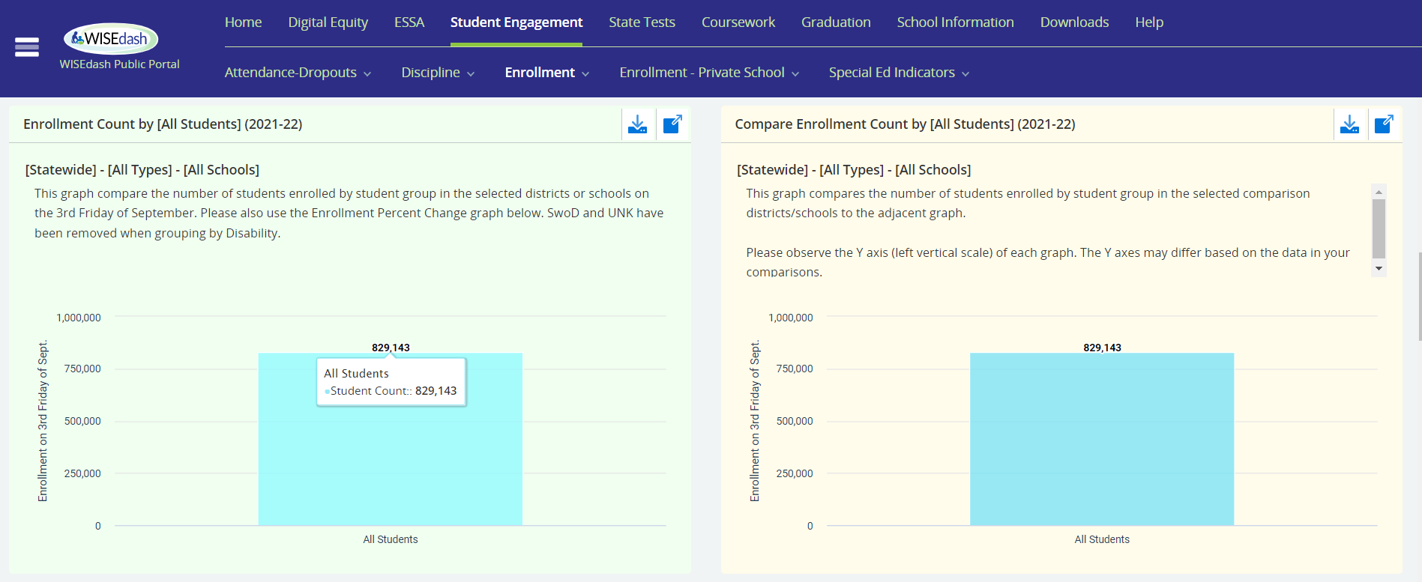
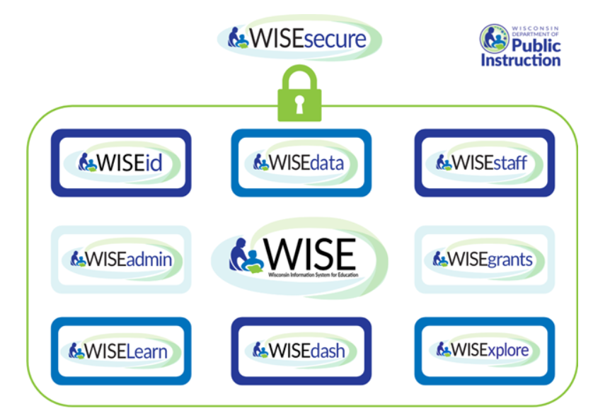
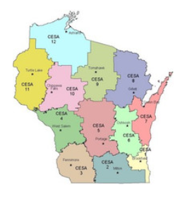
WISEdash Local & WISE data
Establish an automatic connection for nightly update
WISEdash Local
WISEdash Districts/Public
funds
Data from your SIS
Member Districts
collaboration
Connected for nightly updates
sent/submitted
Secure Storage
support
Division of Enterprise Technology (DET)
Notes:
3 min Differences and Similarities with WISEdash portals
Shelby

Slide 8
Your SIS
And the importance of clean data
Attendance
Clean and accurate data reflected daily on your dashboards…
Staff Responsibilities
Enrollment
Your organization’s data practices
Data reflected in WISEdash
Discipline
Calendars/Codes
…Helps you reach
goals, meet student needs, and adjust practices
Grades
Notes:
8 min Relationship with your SIS and the importance of clean data
Zach

Slide 9
WDL Dashboards:
Security and Roles
User Role
Dashboards
Drill Downs
Tools
Customized
Access levels are determined by your organization
District
Full Access
School
Building Access
Classroom
Student Roster
Student
Personal Data
Board of Ed
Drill down capabilities: three clicks to student-level data
Tools include: data filters, creation of groups and cohorts
Notes:
2 min Security and Roles: District Level, School Level, Teacher Level, Student Level, Board Members
Shelby

Slide 10
WISEdash Local:
Onboarding
WISEdash Local Staff walk you through the onboarding with continuous support, weekly check-ins, problem solving, and troubleshooting
Lorem 2
Form Connection
Lorem 3
Send Paperwork
Data Mapping
Lorem 1
Lorem 2
Lorem 3
Lorem 1
Move to Production
Data Validation
Assessment Loading
Notes:
4 min Outline of the onboarding process
Wyatt

Slide 11
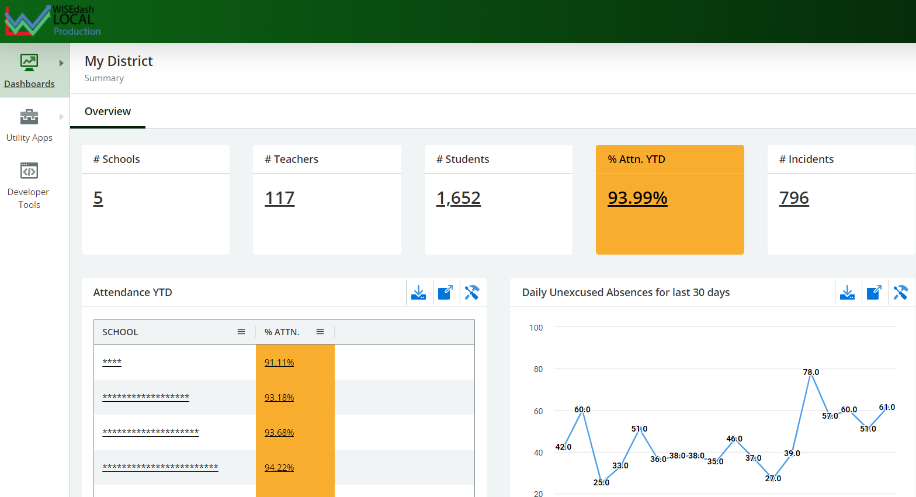
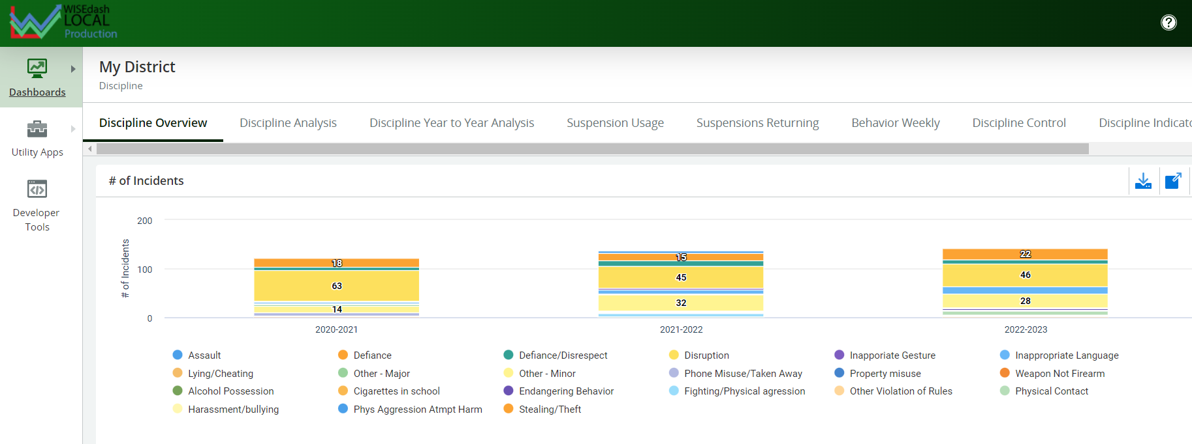
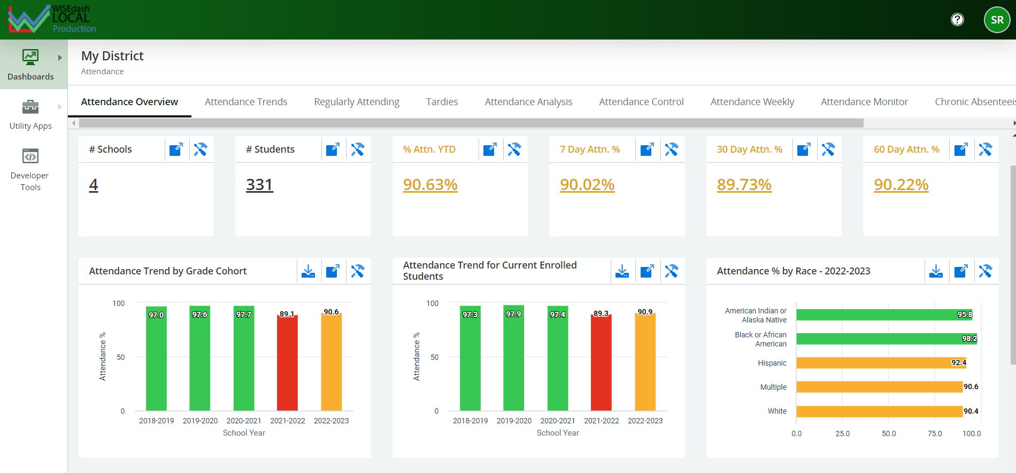
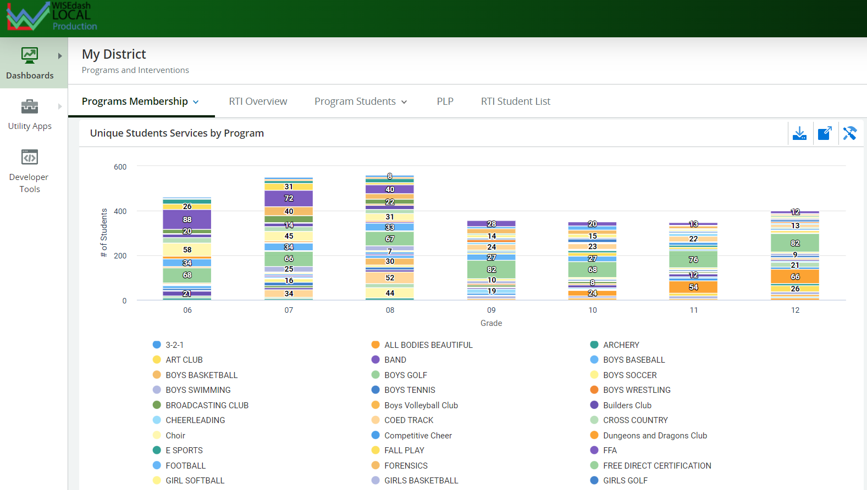
WDL Dashboards:
My District
Summary Page (Options)
Discipline
Attendance
Programs
Demonstration
Notes:
3 min My District overview Shelby

Slide 12
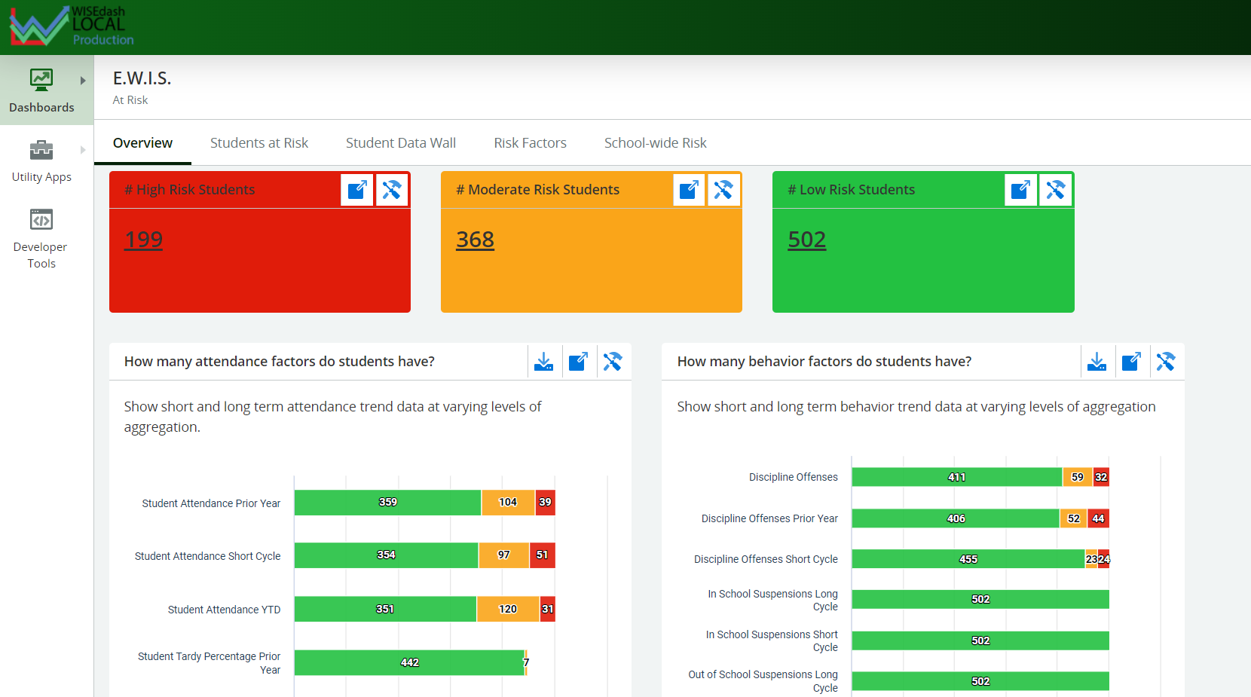
WDL Dashboards:
Early Warning Indicator System
Set your own thresholds to monitor at-risk students
Low, Medium, and High Risk indicators
Demonstration
Notes:
1 min EWIS overview Shelby

Slide 13
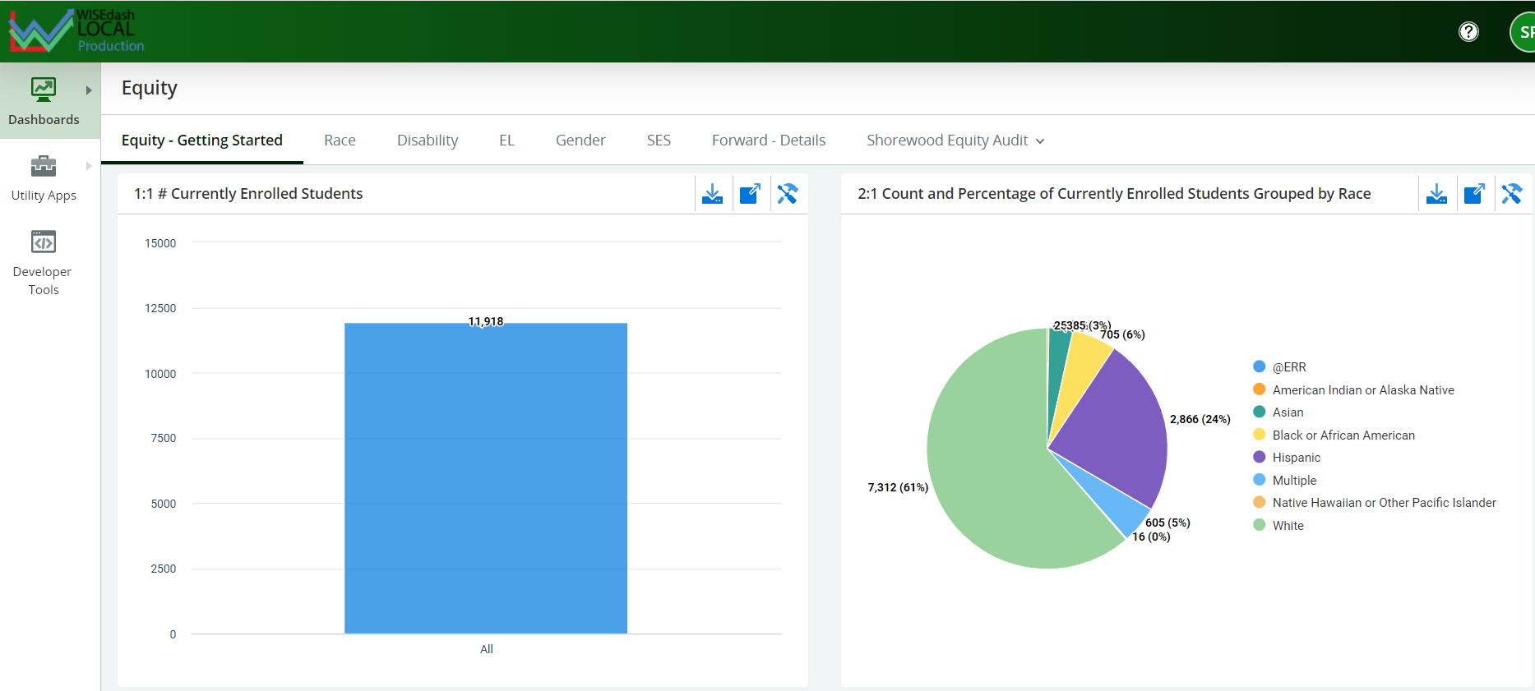
WDL Dashboards:
Equity
Perform your own equity check based on a variety of factors
Demonstration
Notes:
1 min Equity Overview Shelby

Slide 14
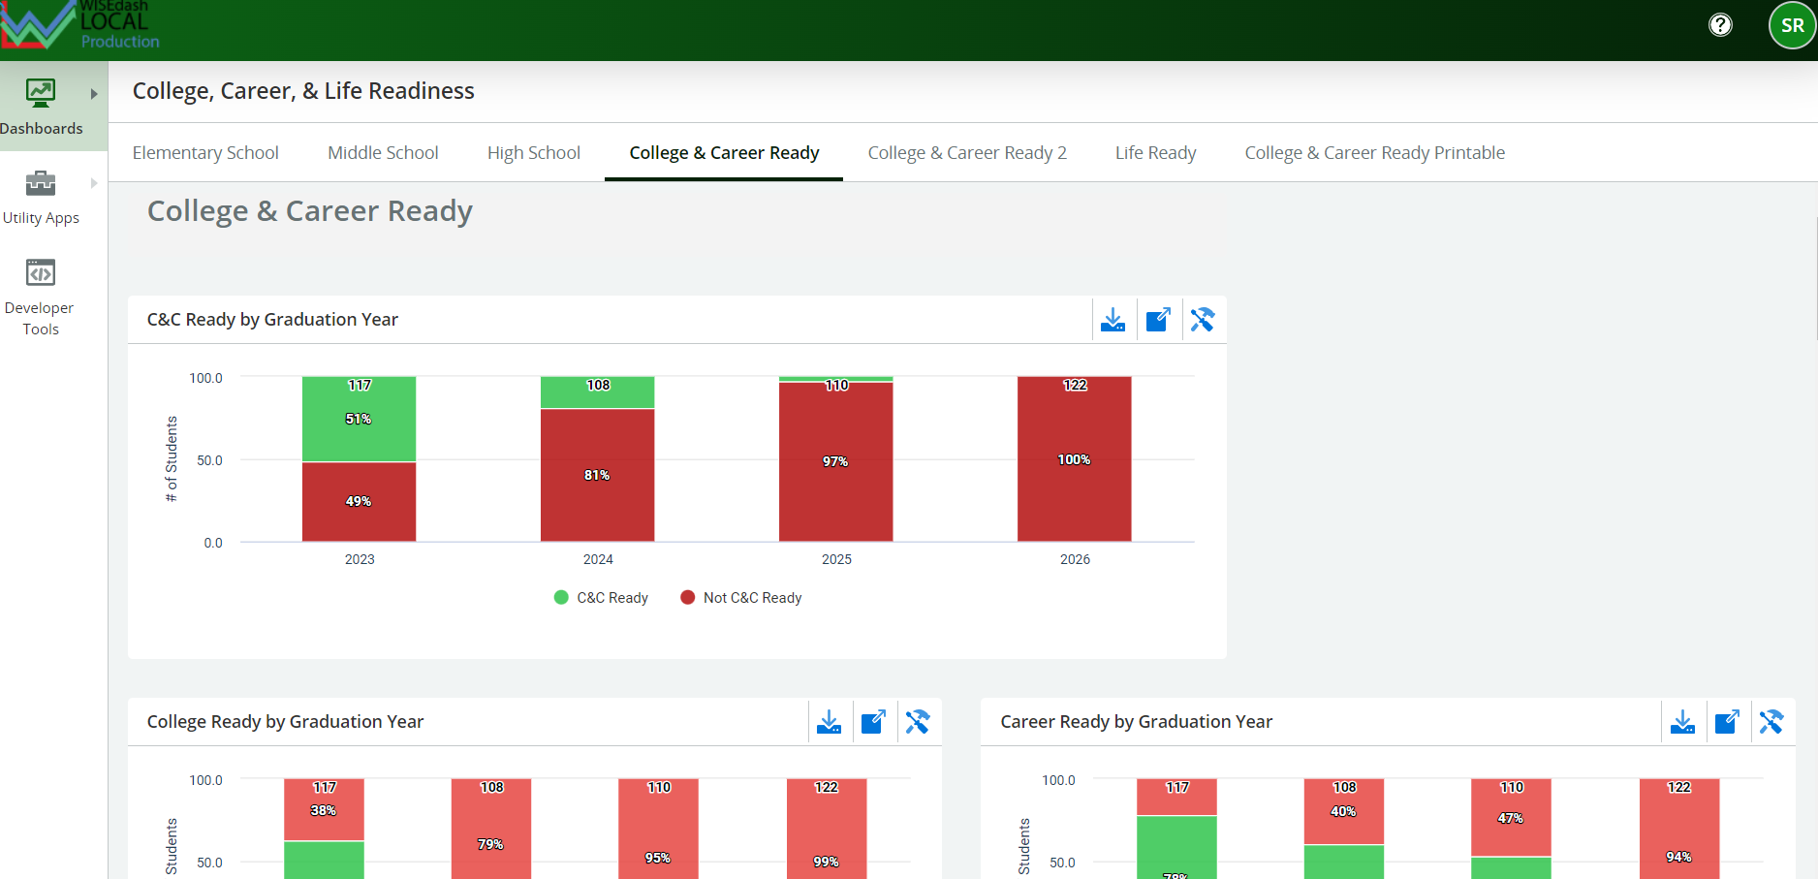
WDL Dashboards:
College and Career Readiness
Examine College, Career, and Life Readiness Standards for student cohorts
Demonstration
Aligned to Redefining Ready standards
Notes:
5 min College and Career Readiness overview Shelby/Zach

Slide 15
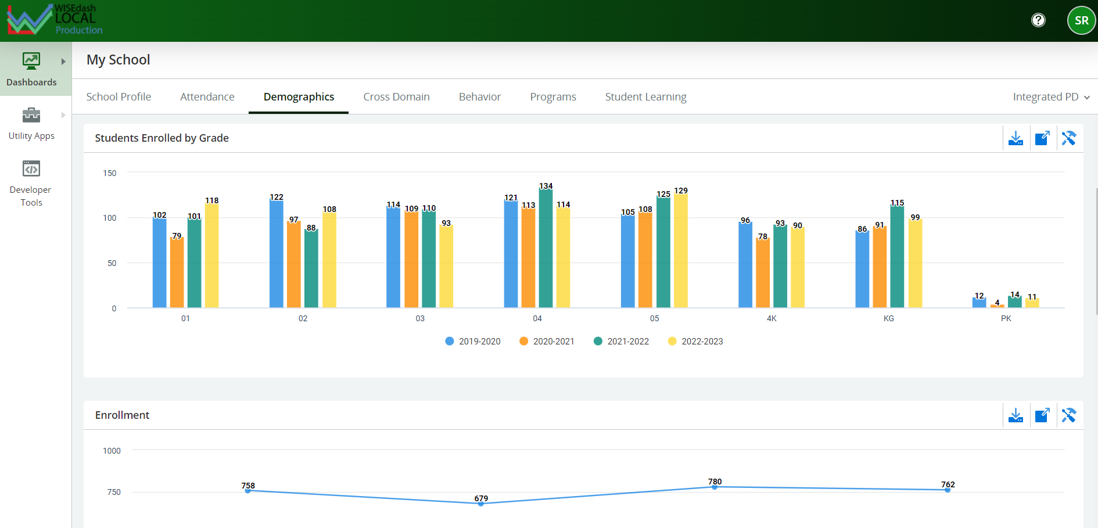
WDL Dashboards:
My School
Examine data with your school-wide team
School Profile
Attendance
Demographics
Cross Domain
Behavior
Programs
Student Learning
Notes:
1 min My school - overview Shelby

Slide 16
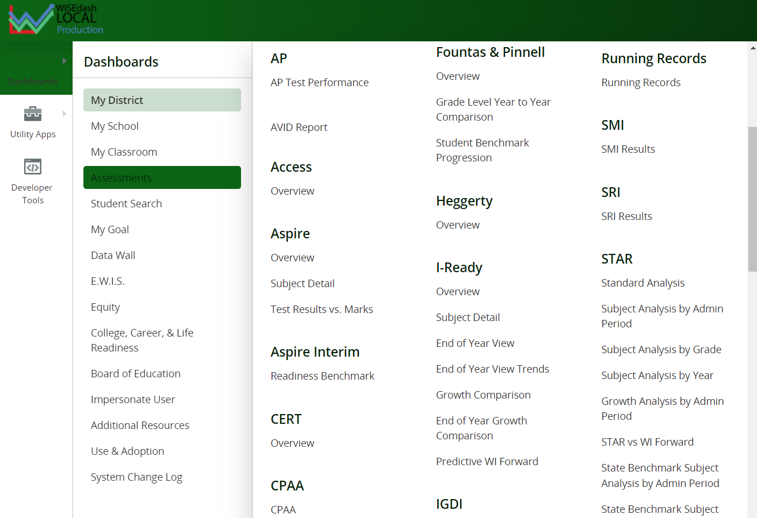
WDL Dashboards:
Assessments
Demonstration
WDL adds regularly to our list of available assessment metrics
Notes:
4 min Assessments Wyatt

Slide 17
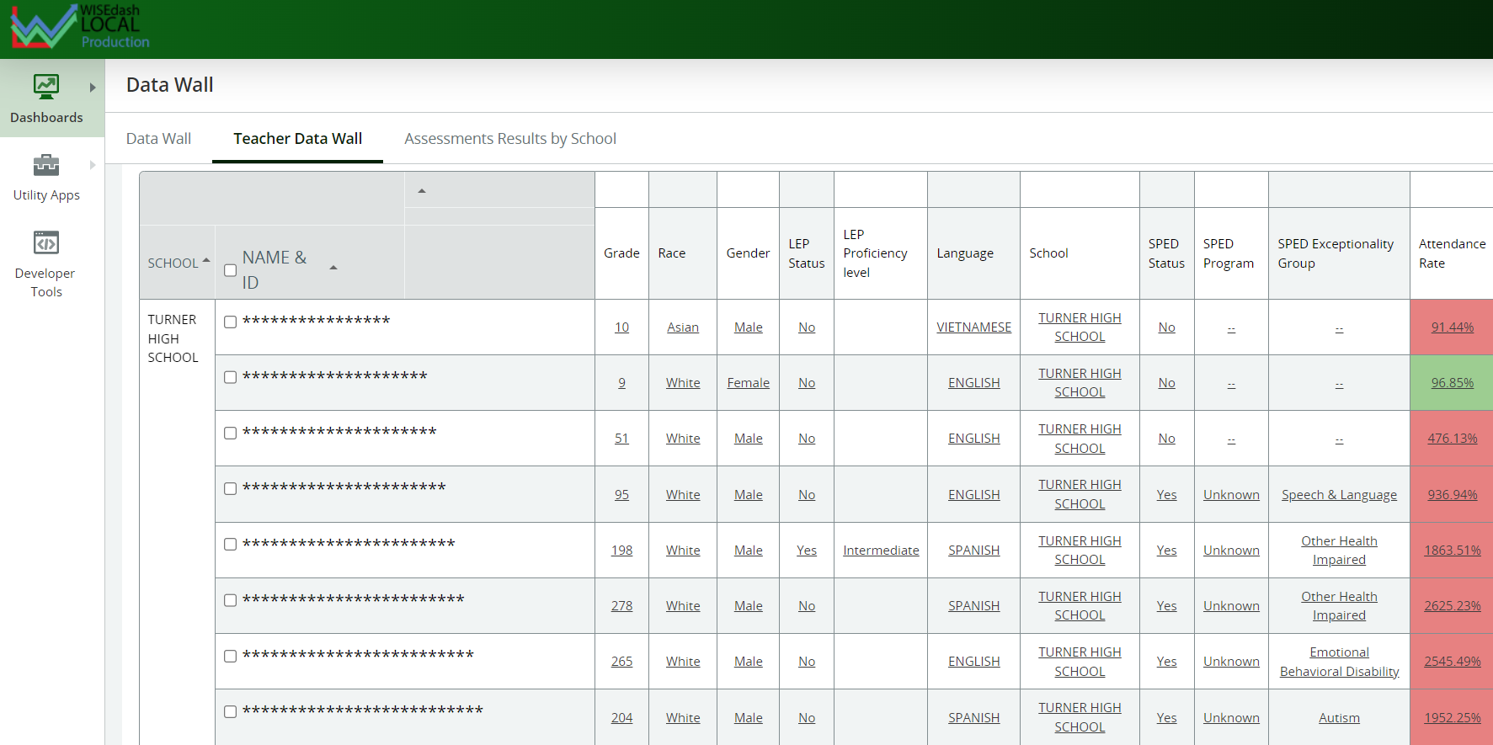
WDL Dashboards:
Data Walls
Customize your details to provide the data your team needs for daily decision making!
Customize the information included in your data wall: demographic, assessments, outcomes, and more!
Notes:
2 min Data walls overview and examples Zach

Slide 18
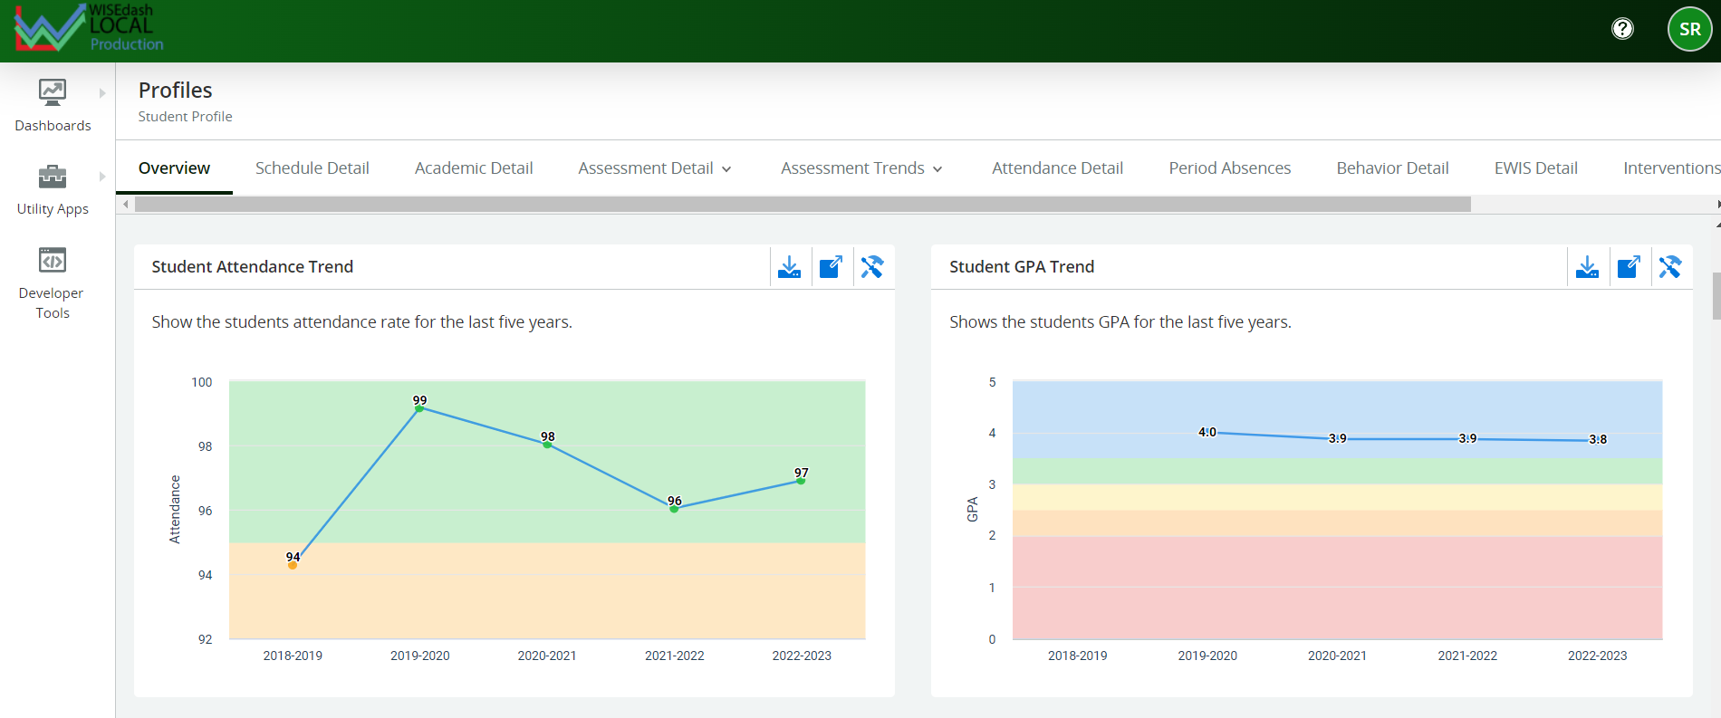
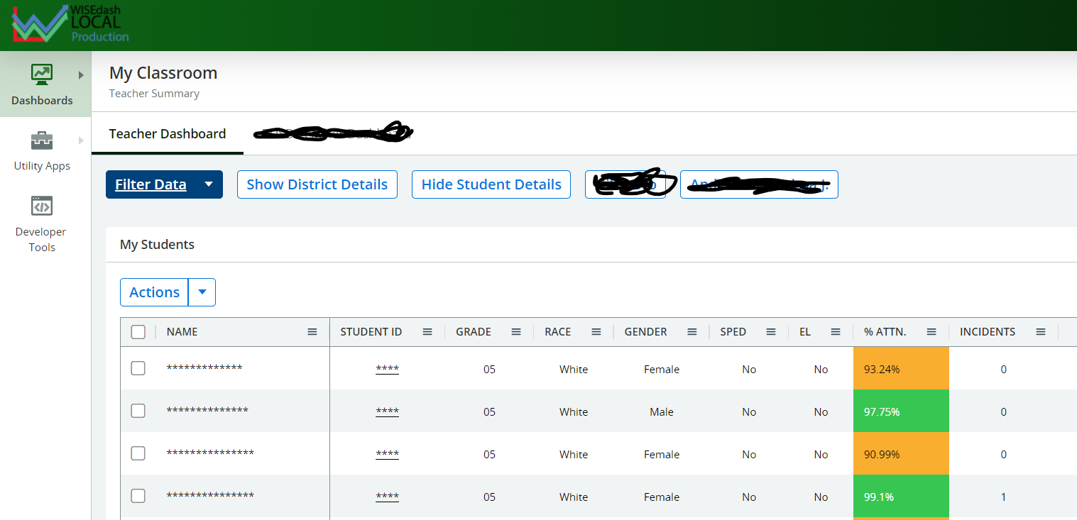
WDL Dashboards:
My Classroom
Teachers view all data for their classroom roster
Student profile gives in depth options for supporting individual needs
Data driven decision making supports student achievement!
Notes:
3 min My classroom- student roster, Student Search, My Goals Shelby

Slide 19
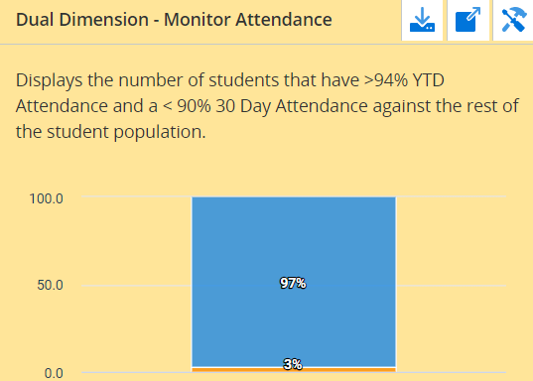
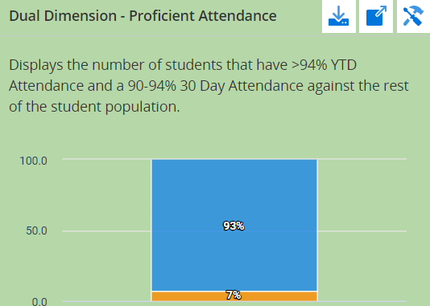
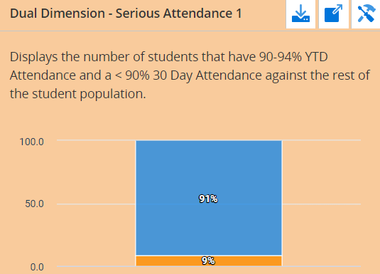
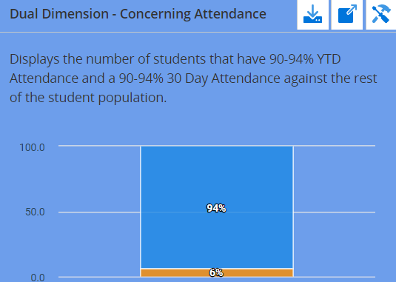
WDL: The power of Customizations
Member Spotlight:
Beloit Turner
Development of Dual Dimension Dashboards
Attendance, GPA, Literacy
Leverage WDL data tool to guide daily work
Notes:
3 min District example, Shelby

Slide 20
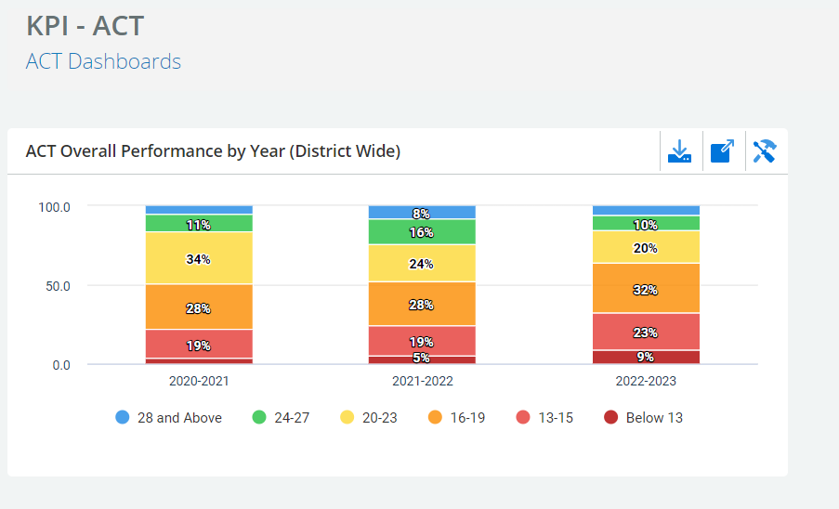
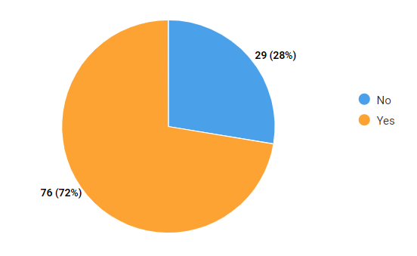
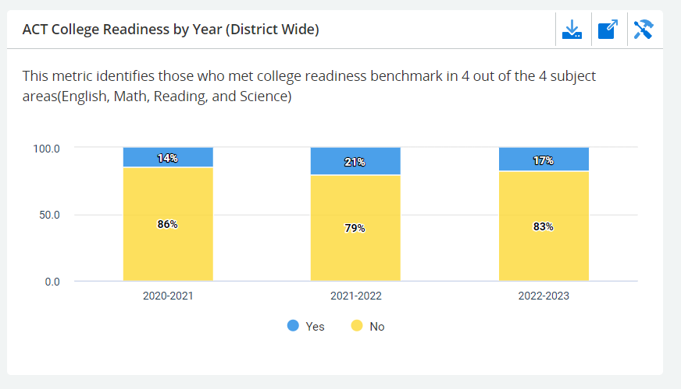
WDL: The power of Customizations
Member Spotlight:
Waukesha
Key Performance Indicators
Frame common goals/language across district
Notes:
3 min District Example, Shelby

Slide 21
WISEdash Local Community
Continuous improvement
Onboarding Processes * Dashboard Audits * New Assessments
Problem solving
Metric Development * Validating New Data
Collaborative learning
Collaborative Learning Series * District Partnerships
Notes:
3 min Consortium Community Shelby

Slide 22
The Future of WDL
‣ Continued training to support member districts
‣ Opportunities for Collaboration
‣ New Metrics
‣ Innovative Dashboards
Notes:
3 minThe Future of WDL: new dashboards, new initiatives Shelby

Slide 23
Contacts
Wisedashlocal.org
Shelby Renoos
Customer Success Coordinator
srenoos@wisedashlocal.org
(715) 413-2456
Zach Johnston
Database Administrator
zjohnston@wisedashlocal.org
(608) 572-6912
Wyatt Berglund
Database Technician
wberglund@wisedashlocal.org
(715) 413-1614
Notes:
1 min Contacts Shelby

Slide 24
Preview next session
Interested in learning more? Stick around for our Open Demo Workshop:
Notes:
12 min Preview next session Shelby

Slide 25
Questions
?
Notes:
12 min: Q& A Shelby, Zach, Wyatt

