Slide 1
ESL and Bilingual Program Data:
What’s New?
Amy Maciolek, DPI
Tanya Morin, DPI
March 6, 2024

Slide 2
Meet Your Presenters
Amy Maciolek
Multilingual Learners and Title III
Tanya Morin
Dual Language and Bilingual-Bicultural Education
Notes:
Amy, Tanya

Slide 3
Who’s in the room?
How familiar are you with reporting data on language learners?

Slide 4
Session Goals
Understand who English Learners (ELs) are
Understand why data is collected for ELs
Understand what data is collected for ELs (EL Data Elements)
Explore Language Instruction/LIEP data
Become familiar with LIEP crosswalk
Q&A

Slide 5
Center English Learners with Data
You are tasked with uncovering the needs/strengths and successes/challenges of English Learner students in your district.
What information do you need to collect?

Slide 6
English Learner Acronyms
EL
ELP or ELD
DLL
ML/MLL
ACCESS for ELLs
WIDA
Screener
LTEL
ELDS
Exited
LIEP
BLBC
ESL
LOTE
HLS
SLIPA
Photo by Farzad Mohsenvand on Unsplash
timer: https://www.youtube.com/watch?v=CH50zuS8DD0y

Slide 7
English Learner Acronyms Explained
EL- English Learner
ELP/D - English Language Proficiency/Development
DLL- Dual Language Learner
ML/MLL - Multilingual Learners (Emergent Bilingual)
ACCESS for ELLs - Assessing Comprehension and Communication in English State-to-State for English Language Learners
WIDA- annual proficiency assessment organization
Screener-Initial Language Proficiency Screener used for Identification
LTEL- Long-term English Learner
ELDS- English Language Development Standards
Exited- The time when an EL reaches native proficiency and is no longer served in an Language program.
LIEP/Crosswalk - Language Instruction Education Program /Document
BLBC - Bilingual-Bicultural Program
ESL - English as a Second Language
LOTE - Language other than English
HLS - Home Language Survey
SLIPA- Student Language Instruction Program Association

Slide 8
English Learner: Legal Definition
Aged 3-21
Enrolled/preparing to enroll in elementary or secondary school
Not born in U.S. or whose native language is a language other than English
AND
Where difficulties in speaking, reading, writing, or understanding English language may be sufficient to deny them:
Ability to meet State’s proficient level of achievement on State assessment
Ability to successfully achieve in classrooms where language of instruction is English; or
Opportunity to participate fully in society

Slide 9
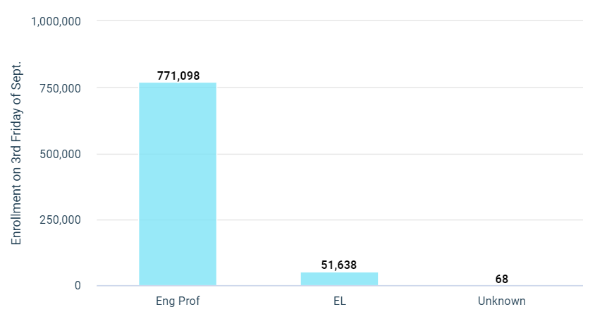
2022-2023 EL Student Population, WISEdash
Wisconsin English learners
51,638 represents 6.7 % of the current enrolled students reported. (SY21-22: 49,812)
Total School Population: 771,098
Nearly 80% of ELs identify Spanish as their first language.
Notes:
AMY
Enrolled student population as report via WISEdash Public Portal. Retrieved 11/30/2023

Slide 10
Why do we collect data?
Meet reporting requirements
Inform research and data analysis for growth
Assess program efficacy
Measure student academic and linguistic progress
Provide systems of support for areas of identified need
State-level policy and budget
Guide teacher recruitment, training, and retention

Slide 11
Title III: EL Data Reporting Requirements
Title III - Lays out federal reporting requirements for ELs
Part of Elementary and Secondary Education Act of 1965 (ESEA), as amended by Every Student Succeeds Act of 2015 (ESSA)
Purpose - To help ensure ELs attain English language proficiency and meet state academic standards

Slide 12
What data do we collect for English Learners?
Number of ELs
Enrolled in the state
By ELP assessment administered,
EL accountability status, and
disability status
By assessment participation status
assessed for the first time (ELP assessment)
By grade level , race and ethnicity
program type
Not attained EL proficiency within 5 years within initial classification
Accountability status
Exited status by year
Who not exited an LIEP as a result of attaining English Proficiency
Graduation rates
Language Instruction Education Programs
Type of LIEPs
Termination of programs
Languages
Common languages spoken in the state
Data for Immigrant Students
Number of Immigrant Students
Native Language of Immigrant Students
Participation of immigrant students in Language Programs
# of LEAs receiving funds under this part
Number of teachers in Title III
Language instruction educational programs (LIEPs)
by certification status
Number of Former ELs
Academic subject assessed
proficiency status
Disability status
Activities
Instructional
professional development
Family Engagement

Slide 13
Turn and Talk: Collaboration
Data collection requires collaboration between data experts and ESL/bilingual program experts
Who do you collaborate with to collect and report EL data?
What policies/procedures are in place to support collaborative data collection efforts?

Slide 14
Language Proficiency Data
Score of 1-4.9 on ELP assessment (ACCESS) = EL
Score of 5 = Must exit EL status
May exit with score of 4.5-4.9
Exited ELs = ELP code 6
Language Instruction Monitoring Year
Content progress for former ELs - 4 years
Number of ELs who have not obtained proficiency after 5 consecutive years

Slide 15
Immigrant Children and Youth
Immigrant Children and Youth under ESEA Section 3201(5):
The term “immigrant children and youth” means individuals who –
(A) are aged 3 through 21;
(B) were not born in any State*; and
(C) have not been attending one or more schools in any one or more States for more than 3 full academic years
*Each of the 50 states, the District of Columbia, and Commonwealth of Puerto Rico

Slide 16
Immigrant Data Determination/Collection
To determine whether or not a student meets the Title III definition of an immigrant child and youth, a school and/or district should never directly ask about a student, parent, guardian, or sponsor’s citizenship or immigration status or date of entry into the United States upon enrollment
For purposes of determining if a student meets the definition of immigrant children and youth under Title III, district staff should request only information about a
student’s date of birth,
place of birth,
and prior school enrollment

Slide 17
Immigrant Children and Youth Grant
Immigrant Children and Youth Grant
Grants amounts range from $10,000-$50,000
Individually or with a CESA consortia
5% of Title III allocation
Discretionary grants
Enhanced opportunities for immigrant children and youth

Slide 18
Native or Primary Language
Native language: Language or dialect first learned by an individual or first used by parent/guardian with child; often referred to as primary language
Required field for WISEdata records if:
English Language Proficiency Code = 1-5
OR
Immigrant (Title III) = Y (Regardless of Grade Level)
School Districts should identify first/native language using a list of 3-digit alpha codes for languages

Slide 19
Turn and Talk: Language Learners
Who are the EL students in your school or district?
Are many of your ELs also immigrant students?
What are the most common primary languages spoken by EL students?

Slide 20
Today’s Data Focus:
Language Instruction Services (i.e., LIEPs)
Learners for whom data is reported
Language Instruction Primary Service
Revised LIEP crosswalk and codes

Slide 21
Learners
Identified English Learners
ELP Code 1-5
Must have an identified LIEP
Primary and secondary LIEP, if applicable
Non-English Learners
Former English Learners (ELP CODE 6)
Students who were never identified as English learners (ELP CODE 7)
No LIEP reported
If participating in a dual language program, reported through World Language Education Program Data

Slide 22
Language Instruction Services
Language instruction services (LIS) - Data element that describes language instruction educational program (LIEP) an EL is receiving
Report each service student is receiving for current reporting period
Must indicate primary LIEP
Not reported for non-ELs, including former ELs (ELP level 6)
Different than “Language of Instruction”

Slide 23
Language of Instruction
Course-level data element
Language used for teaching and learning within the course
English as default
Data enhancement aimed at better understanding language learning environments
DPI Language of Instruction webpage

Slide 24
What is an LIEP?
Defined in Elementary and Secondary Education Act (ESEA)
Language instruction educational program for EL students (Bilingual and/or ESL)
Purpose to assist students in:
Developing/attaining English proficiency (English Language Proficiency Standards)
Meeting challenging state academic content/achievement standards
May include instruction in English and student’s primary language to facilitate English language development (Other Language proficiency Standards)
May include participation of non-ELs if goal is proficiency in English and target language for all students

Slide 25
Reporting LIEP Data
Collected by DPI as part of WISEdata reporting requirements for ELs
Collected at student level using program codes
Tracked via school information system (SIS)
Reported only for ELs
May report each service student is receiving for current reporting period.
Must indicate primary LIEP

Slide 26
Language Instruction Data Reporting
Language Instruction Primary Service
Language Instruction Primary Service
Data element associated with language instruction
True/False indicator
Primary LIEP service = One in which student spends majority of time
Report only one service as primary
*New this year - Can also report secondary LIEP (not required)

Slide 27
Language Instruction Beginning/End Dates
Month, date and year on which the student first began receiving and language Instruction
Month date and year on which the student exited the language instruction program
Format: mm/dd/yyyy
Language Instruction Data Reporting

Slide 28
Turn and Talk: Strengths and Challenges
What do you see as your district’s biggest strengths in its efforts to collect data related to ELs?
What do you see as your district’s biggest challenges in its efforts to collect data related to ELs?

Slide 29
2022 LIEP Crosswalk
LIEP crosswalk lists:
LIEPs for ELs in WI
Associated reporting codes
Released Spring 2022
Used for reporting starting in 22-23 school year
Can be accessed here

Slide 30
Data Enhancements
Separate reporting of Caregiver Refusal and No LIEP available data
Collect full data set for dual language education programs
Create means to identify an primary and secondary LIEP’s
Ability to track LIEP history for former ELs
Design reports to assess LIEP outcomes and growth

Slide 31
Overview of 2022 LIEP Crosswalk
Three main sections:
Bilingual Programs
English as a Second Language (ESL) Programs
Missing/Refusal/Other
For each LIEP, includes:
Name of LIEP and Reporting Codes
Description and Learners
Standards and Outcomes
Federal and State Funding and Plan of Service (POS) Requirements
2022 LIEP Crosswalk

Slide 32
Revised LIEPs
Bilingual LIEPs | ESL LIEPs | Missing
Dual Language Education - Two-Way Bilingual Dual Language Education- Developmental Bilingual Transitional Bilingual - Early Exit Transitional Bilingual - Late Exit American Indian Language Bilingual Heritage Language Bilingual Newcomer Bilingual Bilingual- Integrated Self-Contained SPED | Content-Based ESL Sheltered Instruction Integrated ESL Newcomer ESL Structured English Immersion Stand Alone ESL/ELD ESL Integrated Self-Contained SPED | No LIEP Available Caregiver Refusal Other

Slide 33
Crosswalk Organization: Example (1 of 2)
2022 LIEP Crosswalk
Notes:
Here is an example of what one row of the crosswalk looks like. In this case, the LIEP is a type of ESL program known as content-based ESL For this LIEP, and all other LIEPs, the crosswalk lists the following information:
Name of LIEP and Reporting Codes (first column)
Description and Learners (second column)
Standards and Outcomes (third column)
Federal and State Funding and Plan of Service (POS) Requirements (fourth column)
It is our intention to come out with more information that speaks to each of these programs and what this would look like in practice.
WE should talk about WHY THE LICENSURE has been taken out.. and refer them to the LEAD team!

Slide 34
Crosswalk Organization: Example (2 of 2)
Program Model
Reporting Code
2022 LIEP Crosswalk

Slide 35
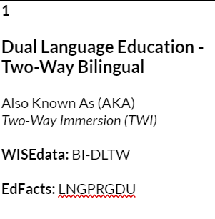
Closeup: Models and Codes

Slide 36
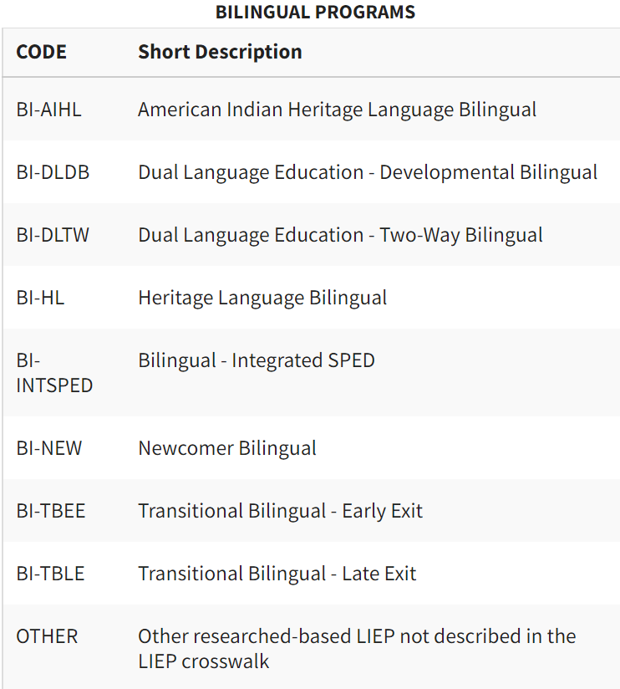
LIEP Models and Codes (Bilingual)

Slide 37
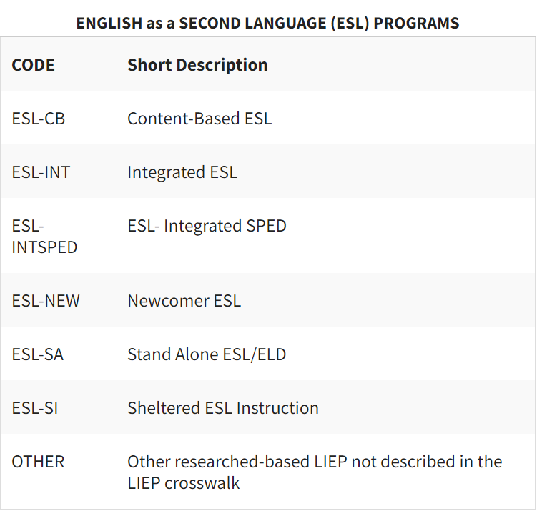
LIEP Models and Codes (ESL)

Slide 38
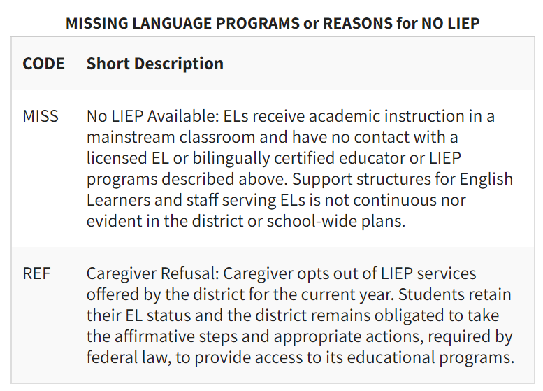
No LIEP Codes

Slide 39
Caregiver Refusal
Caregivers have a right to decline or opt their children out of a school district’s EL program or out of particular EL services
Decision must be knowing and voluntary
Upon opting out, students retain their EL status and LEAs must still take affirmative steps and appropriate action in providing access to the educational program
Annual proficiency testing is still required
Monitoring for two years

Slide 40
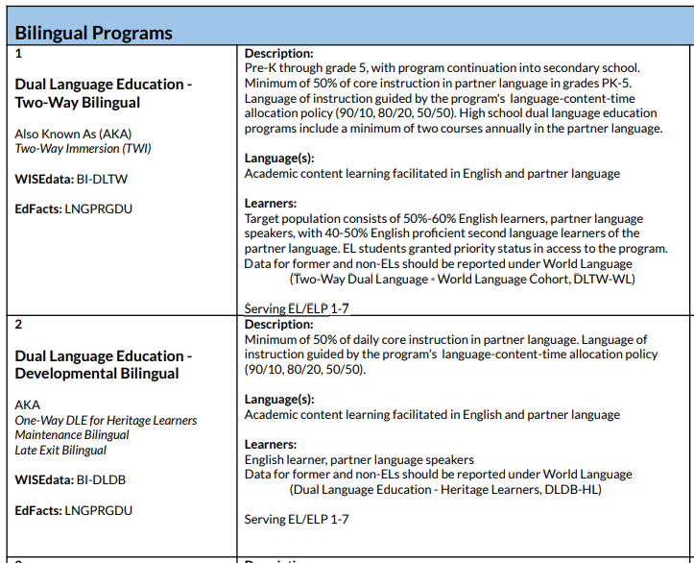
LIEP Crosswalk Close Up

Slide 41
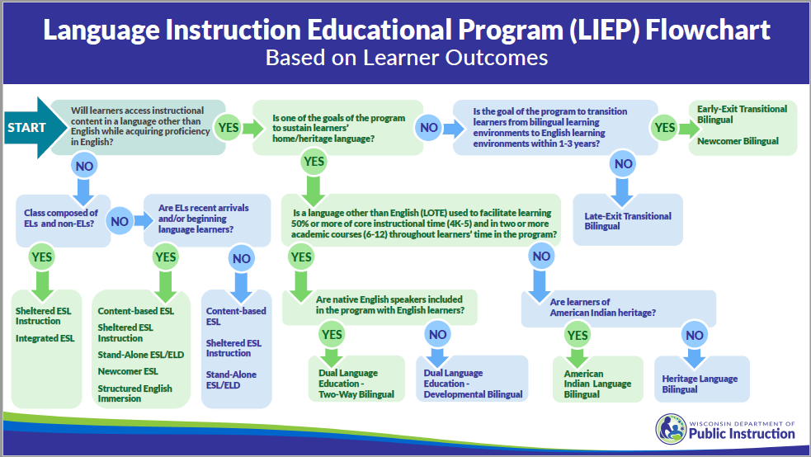
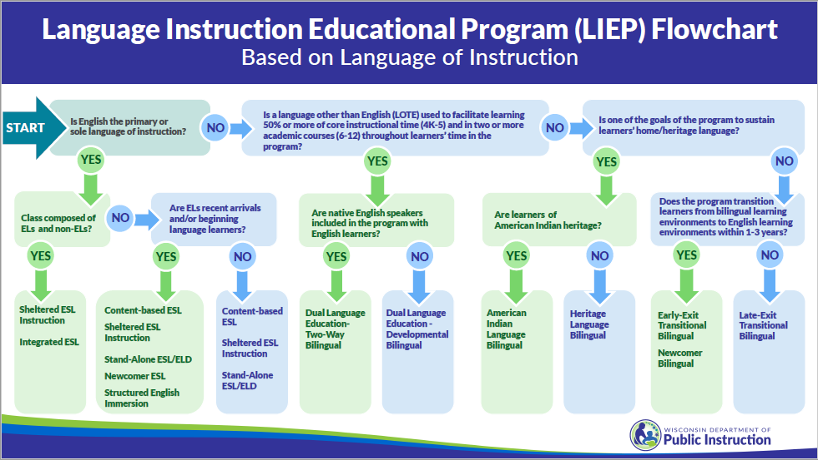
LIEP Flowcharts
Decision-making tools
Version A: Learner Outcomes
Version B: Language of Instruction

Slide 42
LIEP Crosswalk: Explore
Open and review the 2022 LIEP Crosswalk
What are the program models and reporting codes used in your district?

Slide 43
Program Search
What is the program code for the program model in which about 50% of students are native speakers of a target language and 50% are native speakers of English and instruction is provided in both languages?
What is the program model name for a program in which an EL educator pushes into a general education classroom and provides support in English?
What is the program code used for programs that serve immigrant students in grade 2 or higher from different language groups who have been in the country for one year or less?
2022 LIEP Crosswalk

Slide 44
? !
What questions do you have?
What suggestions do you have?

Slide 45
DPI Reference Resources
LIEP Crosswalk (2022 Version)
WISEdata Language Instruction Services
WISEdata Language Instruction Services FAQs
What Can I Teach Resource (2020 Version)

Slide 46
DPI Contacts
Multilingual Learners & Title III
Amy Maciolek amy.maciolek@dpi.wi.gov
Dual Language/Multilingual & Multicultural Education
Tanya Morin tanya.morin@dpi.wi.gov
World Language and Global Education
Pam Delfosse pamela.delfosse@dpi.wi.gov

Slide 47
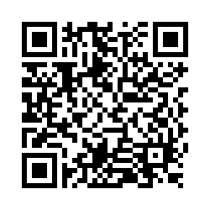
Questions?
Thank you! Thank you!
Please scan the QR code to provide us with your feedback!

