Slide 1
Title Slide
WISEdata Portal: Student Enrollments
Britt Mueller – WISE Relationship Manager, Customer Service Team
March 6, 2024
Notes:
Hello, thank you for joining us today. My name is…. In this session, we are going to go over the ins-and-outs of reporting WISEdata enrollments, including some uncommon enrollments scenarios, tips and tricks, and how to review for accuracy.

Slide 2
Why Are Enrollment Records Important?
Enrollment records are used to determine services provided, student accountability, and FAY (full academic year).
A new enrollment record is required each school year.
Timely enrollment begin and exit dates are every school’s responsibility.
Exit students for gaps where no services are provided.
Delete enrollments which are invalid, such as no-shows.
Notes:
Enrollment records are used to determine services provided, accountability, and FAY
Students begin a new enrollment each school year even when continuing in the same school.
Timely exit of students is necessary to facilitate proper validation of student records in WISEdata.
If your District or School has school board policy for assigning enroll and exit date, then use the school board policy. DPI recommends aligning enroll and exit dates with the date range during which the student was receiving services, commonly referred to as ‘sitting in a seat’. If another school is reaching out to confirm attendance, please work with them.
Students should be exited during gaps in enrollment when the students is not receiving services such as expulsion without services, foreign exchange, residential treatment, and family sabbatical. Providing homework to a student does not constitute providing educational services.
Should an enrollment be sent to WISEdata and later determined to be invalid, such as a No-show, the enrollment should be deleted from WISEdata.

Slide 3
Agenda
WISEdata Basics: Agency Contacts, Navigation, Data Flow, Filters, KBAs
Enrollment Records: Begin and Exit Dates, Effective Dates, Count Date Inclusions, Student No-Shows, Expected Transfers, Error 6719
Exports: DPI SSA Effective Dates, DPI Count Inclusion
Uncommon Scenarios

Slide 4
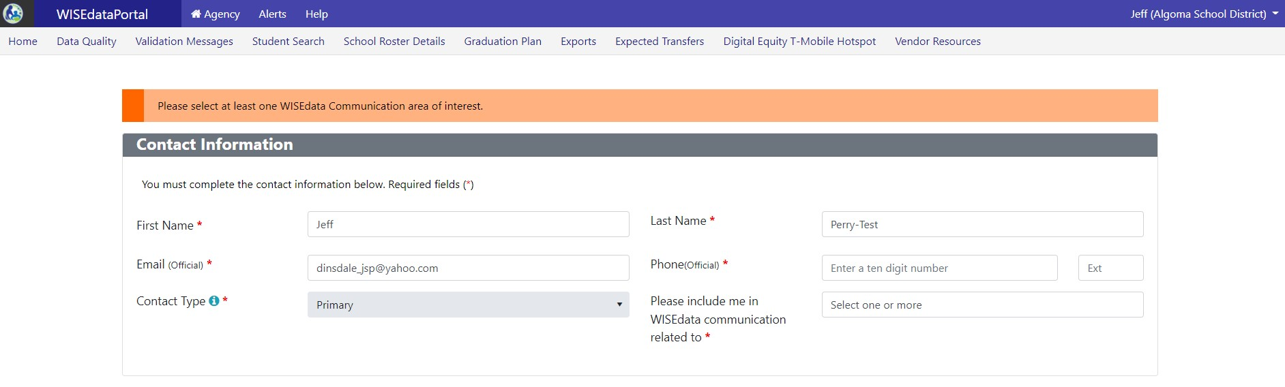
WISEdata Portal: Agency Contacts
Updating Agency Contacts Mini-Tutorial

Slide 5
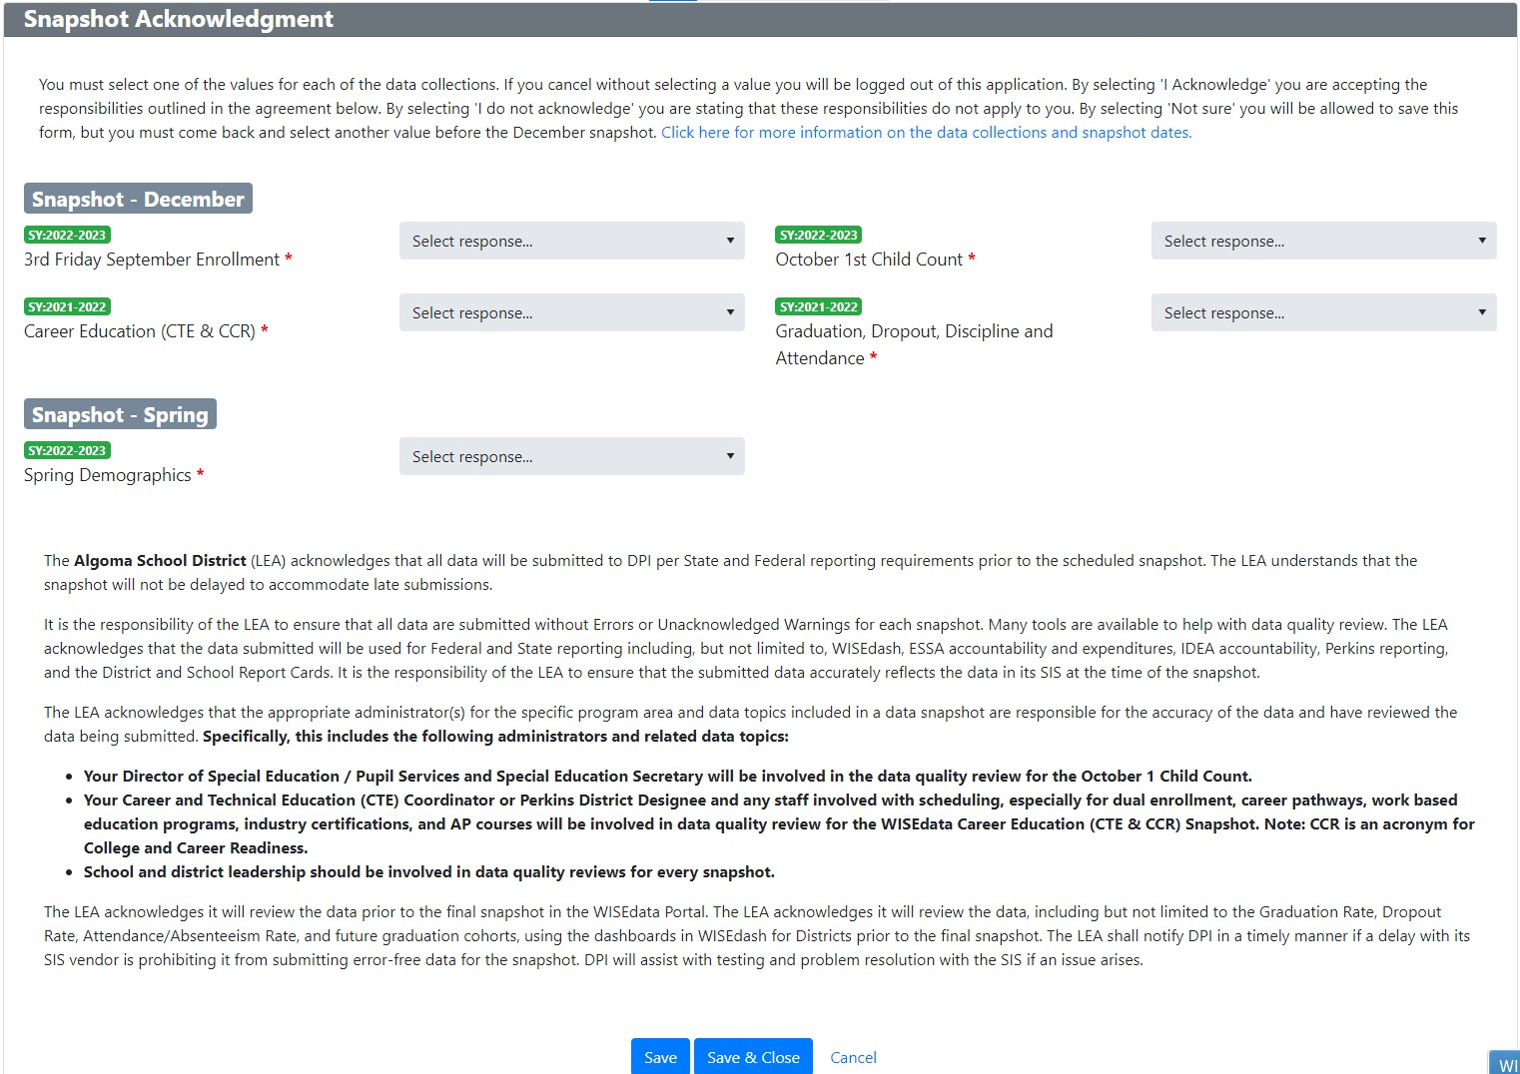
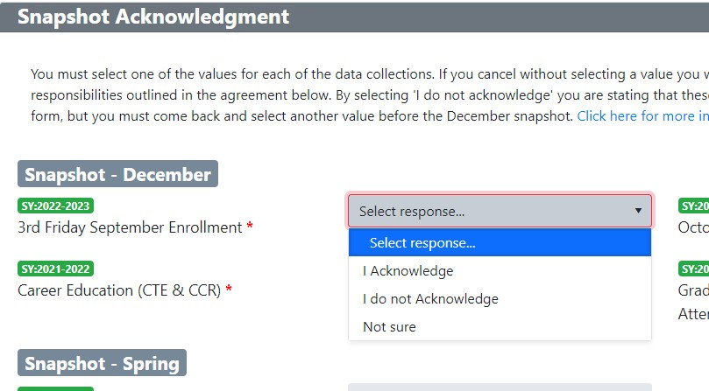
WISEadmin Portal: Agency Contacts
Updating Agency Contacts Mini-Tutorial

Slide 6
Application Navigation: Agency Menu
Home: Data flow between your SIS and WISEdata, ensure the data is pushing correctly
Validation Messages: Indicates data for review and needing corrections
Exports: Download spreadsheets of data submitting in WISEdata for review
Expected Transfers: Indicated with ETC exit type, need response

Slide 7

Application Navigation: Resources Menu
Vendor Resources: Vendor-specific assistance
Overlapping Enrollments: View of all students with overlapping enrollments

Slide 8
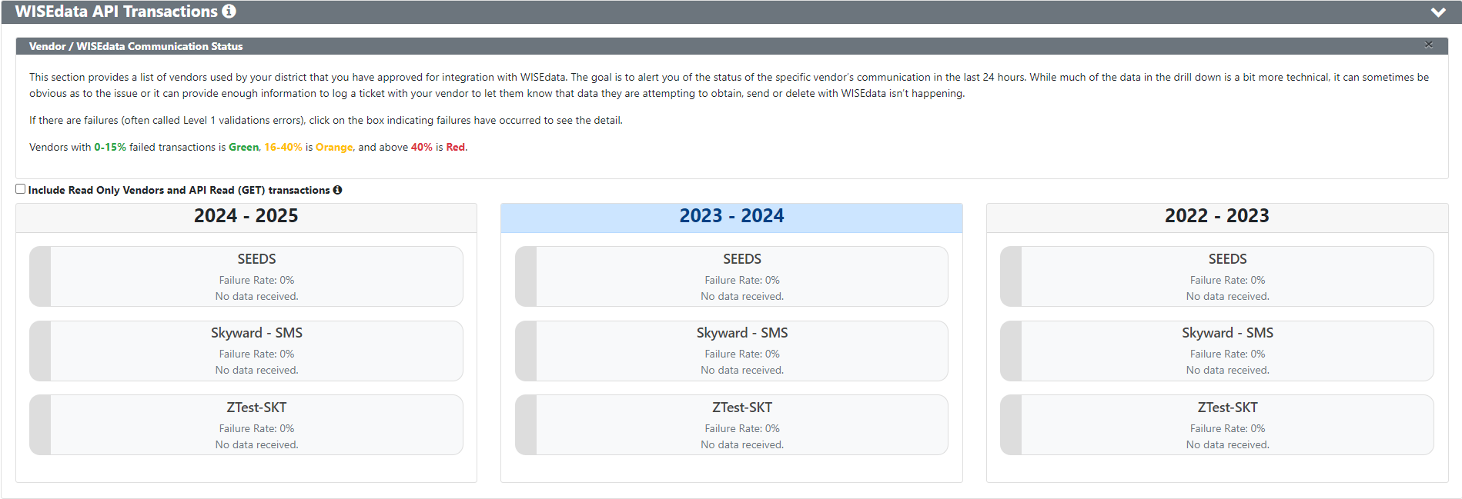
Sample Graph
Data Flow – Vendor/API Transactions
Failed Transaction Rate
Green: 0-15%
Orange: 16-40%
Red: < 40%

Slide 9
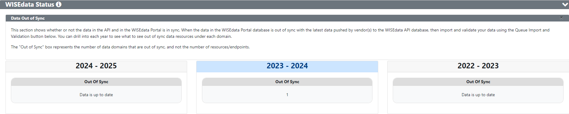
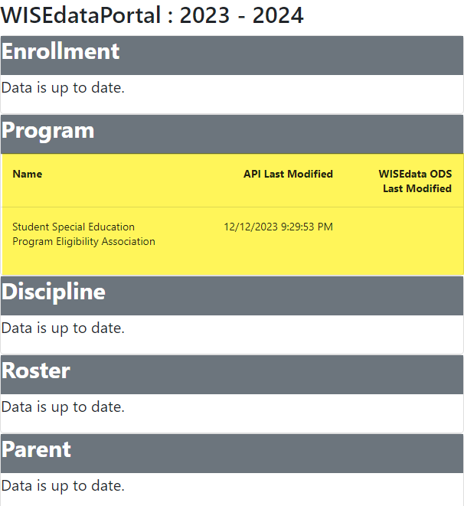
Data Flow – WISEdata

Slide 10
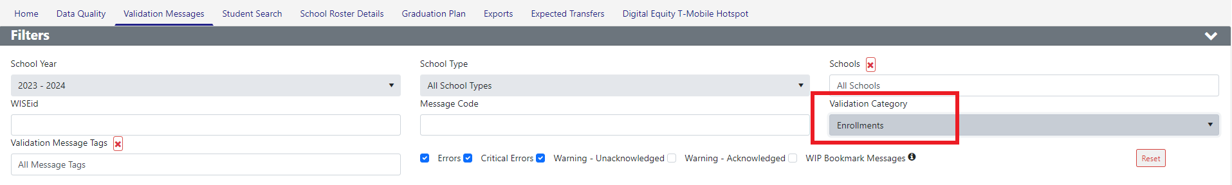
Filters

Slide 11
Sample Table
KBAs
Knowledge Based Article (KBA):
Description of validation messages
Business Logic
How to Fix
Example
Related webpages

Slide 12
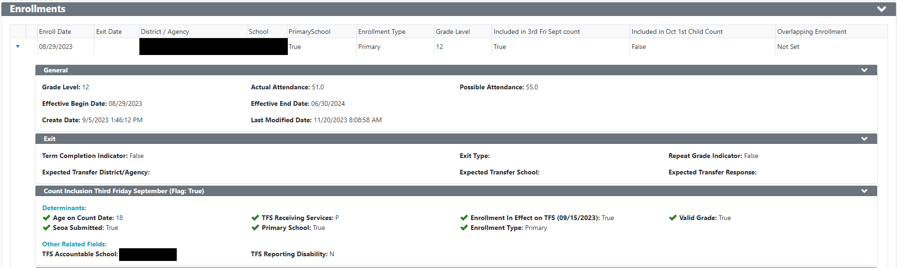
Sample Video Slide
Enrollment Record

Slide 13
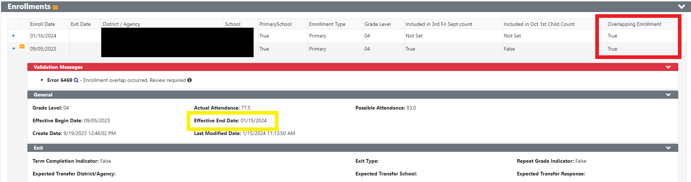
Overlapping Enrollment
Effective End Date is the system reporting an end date for your record based on additionally submitted records.

Slide 14
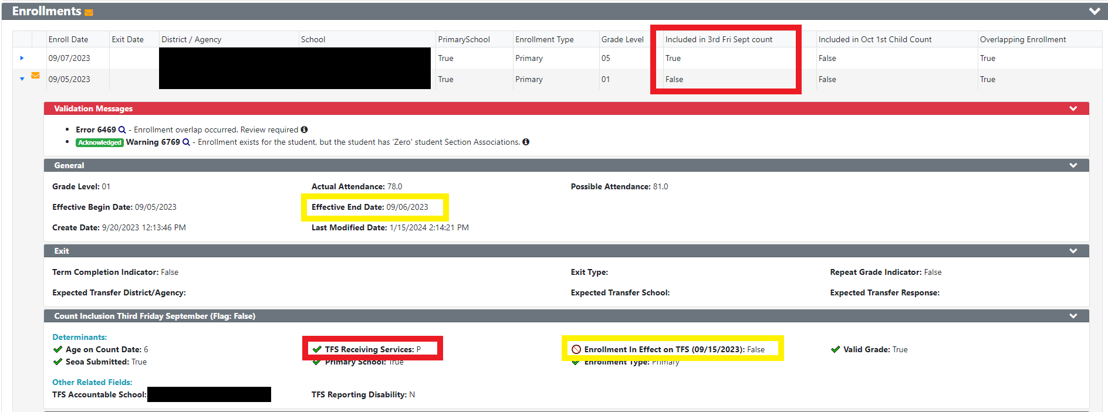
Overlapping Enrollment – Count Date

Slide 15

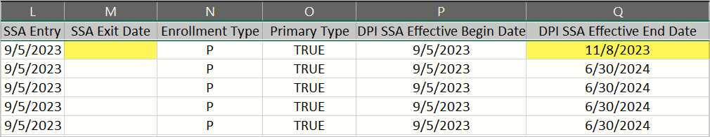
Overlapping Enrollment – Exports (M & Q)
Exports > Mass Enrollment > column M vs Q
SSA Exit Date – what the district reports as the student’s exit date
DPI SSA Effective Dates – what the system overwrites as the exit date based on additional records submitted
How-to: Audit for Enrollment Data
Notes:
Commonly seen on this export for overlapping enrollments, column M would be blank meaning that no exit date was reported by the school, while there will be a date in column Q meaning that WISEdata Portal 'exited' the enrollment record. This indicates an overlapping enrollment because the school did not report an Exit Date (column M), yet, the WISEdata system has calculated (based on some other reported enrollment data) an effective end date for that enrollment record (column Q).
DPI – SSA Effective Begin Date: This is a DPI calculated field. When enrollment dates are submitted to WISEdata sometimes there could be overlap between primary enrollments or overlap between primary and secondary enrollment within a school or enrollments could be totally encompassed or enrollment is invalid. In these cases DPI calculates the Effective begin and end dates for the enrollment. Effective begin date is always the SSA entry date.
DPI – SSA Effective End Date: This is a DPI calculated field. When enrollment dates are submitted to WISEdata there could be overlap between primary enrollments or overlap between primary and secondary enrollment within a school or enrollments could be totally encompassed or enrollment is invalid. In these cases DPI calculates the Effective begin and end dates for the enrollment. Effective end date is calculated based on the scenario.
- If DPI calculated effective end date is less than effective begin date then this record is thrown out for reporting.
- If DPI calculated effective end date is adjusted to day prior to next SSA entry date that means DPI is eliminating the overlap by adjusting the dates.

Slide 16
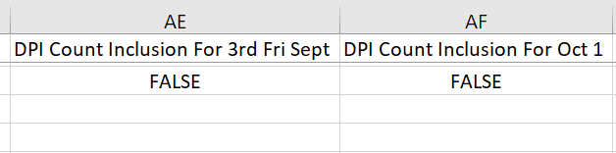
Overlapping Enrollment – Exports (AE & AF)
Exports > Mass Enrollment > column AE and AF
DPI Count Inclusion – what the system overwrites as the inclusion value based on additional records submitted
Notes:
DPI Count Inclusion For 3rd Fri Sept: Count Date Inclusion denotes whether a student is enrolled and receiving services to be eligible for credit on the count date.
For a student to be included in the Third Friday of September Count, the student must be enrolled in the school on the count date and the student must be assigned to a valid grade for his or her school. Effective Dates will be used to determine enrollment in the case of overlapping records. The student must also be between ages 3-21 as of the count date. The student must also have been marked as Present or Absent for Receiving Services. WISEdata logic will also review inclusion based on parentally-placed private (PPP) calculations, whether or not the school provides the primary educational services, and whether or not the student's enrollment is active.
DPI Count Inclusion For Oct 1: Count Date Inclusion denotes whether a student is enrolled and receiving services to be eligible for credit on the count date.
October 1 (public schools only): For the October 1 Child Count, the student must be receiving special education services under an active IEP or ISP, and the student must be assigned to a valid grade for his or her school to be included. The student's special education program association (sSEPA) record must also cover the count date. Effective Dates will be used to determine enrollment in the case of overlapping records. Additionally, the student must be between the ages of 3-21 on the count date and IDEA eligible.

Slide 17
Student No-Shows
Students who may have registered or intended to attend your school but did not show up for service should not be reported to WISEdata.
Pull back your enrollment record from WISEdata using the Ed-Fi API ID. If you aren’t sure how to pull enrollment records back, please work with your SIS.
Neglecting to remove the record will most likely result in an overlapping enrollment or dropout.

Slide 18
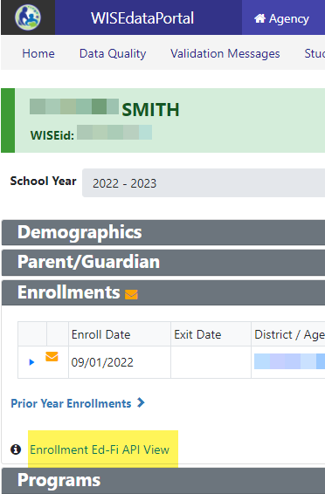
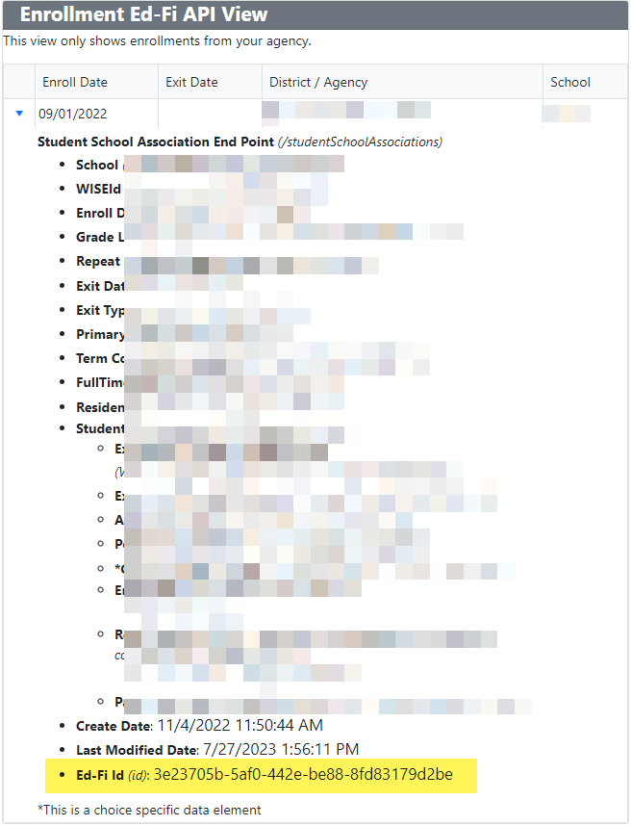
Student No-Shows: Screenshots

Slide 19
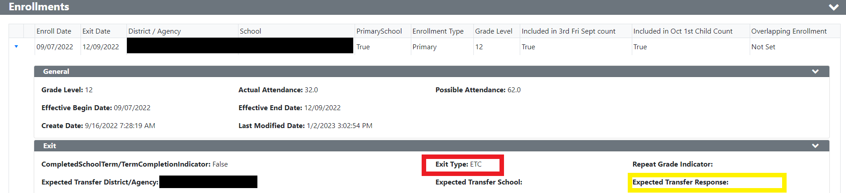
Expected Transfer
Exit Type = ETC –> Expected Transfer to new school covered by WISEdata. Not known to be continuing
WISEdata Error 6578 - Expected Transfer Response is missing.

Slide 20
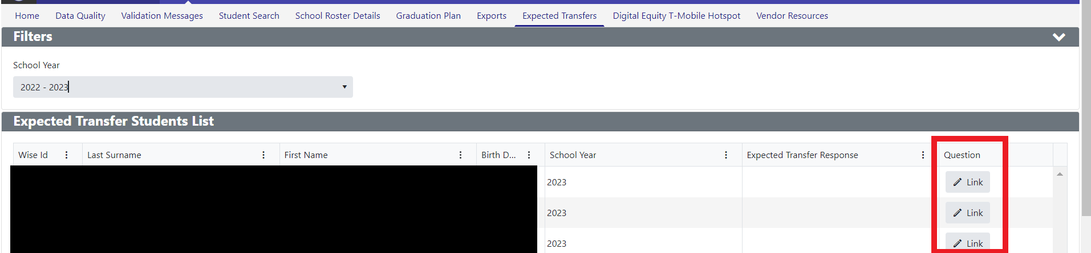
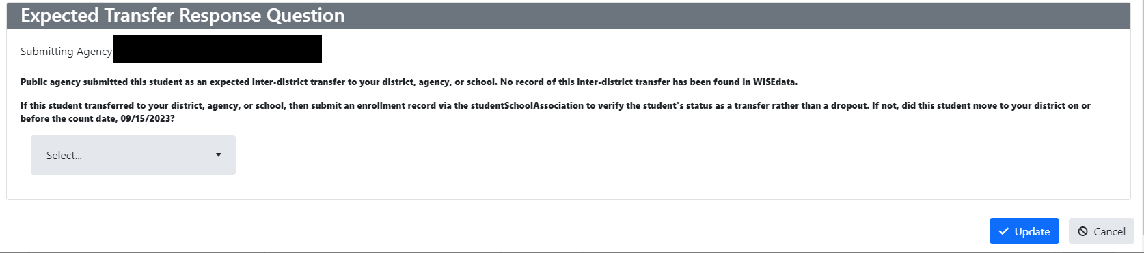
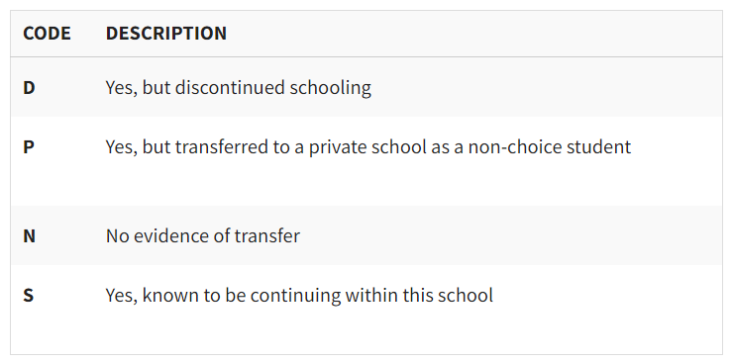
Expected Transfer Response

Slide 21
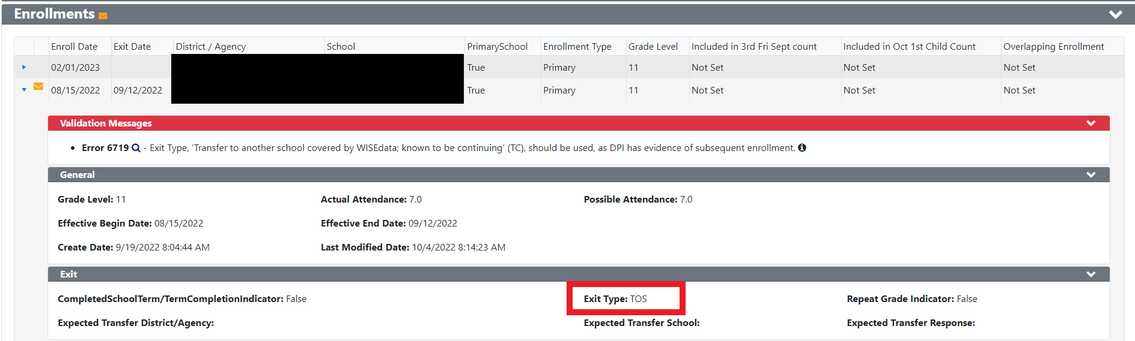
Error 6719
WISEdata reporting reflects a student's records over the course of the whole year (prior year to current year TFS), so the system sees a student as leaving and then returning within the same reporting year as TC: Continuing in WISE.

Slide 22
Uncommon Scenarios
Expected Transfers
Enrollment Types
  Primary
  Coursework
  ParentPlacedPrivate
Exit Types
  Known to be Continuing vs Not Known to be Continuing
  Compassion Exit
Homeschooled Students
Open-Enrolled Students
RVA – Rural Virtual Academy
  Affiliated
  Invested
Challenge Academy
Academic Credential Types
  Regular Diploma
  Other Diploma
  High School Equivalency Credential
Notes:
Enrollment Type:
Coursework will only report roster data
PPP may have a primary enrollment but not required, only report SPED data
Exit Types:
Compassion exit – terminally ill, abducted and presumed dead, removed by ICE, OR mental health or addiction treatment with plans to return the following year, connect with CST
RVA:
There are two different ‘tiers’ of RVA partnering districts
Affiliated: These are districts that are usually, but not always, in their first year of a 66.03.01 agreement with RVA and it is seen as a “trial run” to ensure the partnership is beneficial to all included. During the affiliated year(s), RVA reports the students to WISEdata via the Medford School District and reports the resident district for FAPE and Accountability. This means the students are included in Medford’s WISEdash Attending counts but the Accountability/Pupil Count is accounted to the resident district. If the district does not have an RVA school code set up in School Directory, they are most likely an affiliate district and Medford’s RVA will report their students for that year.
Invested: Once an affiliated district commits to the RVA program, a new 66.03.01 agreement is created, this is seen as them officially entering the RVA consortium, and WISEdata reporting responsibilities revert back to the resident district at this time. This is the usual case we see where the resident district is responsible for all student WISEdata reporting from the RVA. If the district has an RVA school set up for them in WISEdata, they are an invested district and are responsible for reporting to WISEdata.

Slide 23
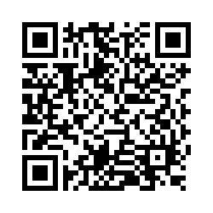
Questions?
Thank you! Thank you!
Please scan the QR code to provide us with your feedback!

