Slide 1
Title Slide
WISEdash Navigation Beginner
Curtis Maples
WISEdash Developer
March 6-7, 2024

Slide 2
Agenda
Agenda
Demo
Menu System - What do the major areas mean
Card Tools and Favorites
About the Data and Helpdesk Ticket
Presentation Slide
Drill to Student Detail and Profile
Student Search

Slide 3
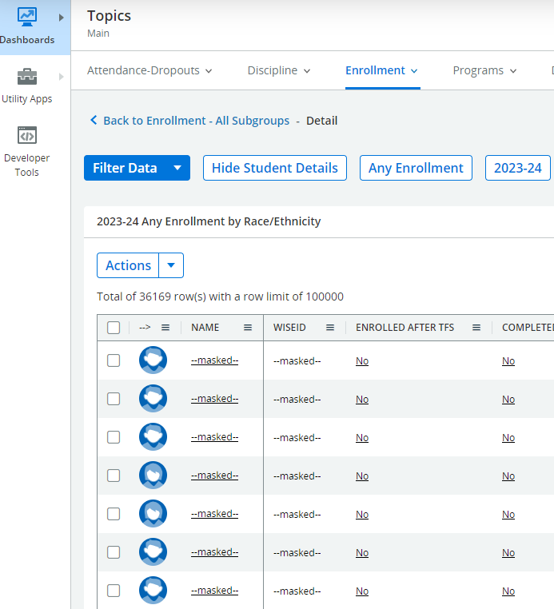
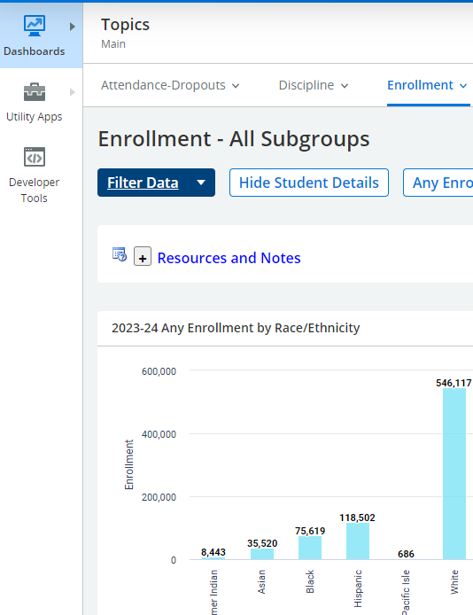
Student Detail
Click on a portion of the graph to get a detailed list of students that fit that criteria

Slide 4
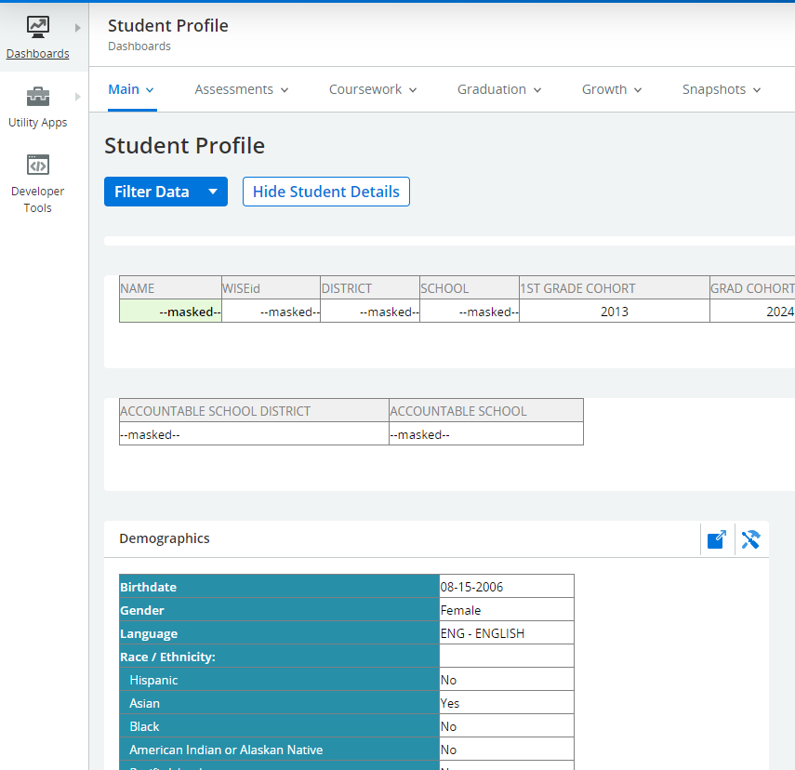
Student Profile
Click on a student in the student detail to get to the student profile
The student profile contains everything related to the academic history of that student

Slide 5
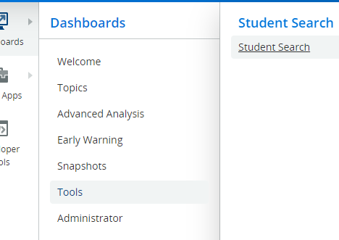
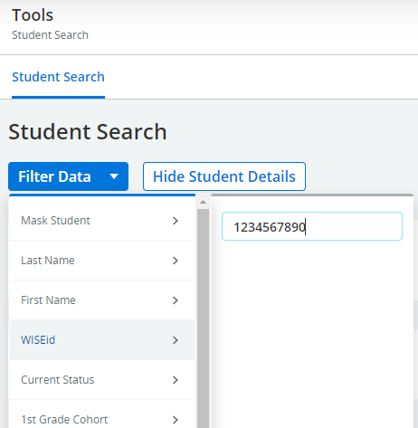
Student Search (1 of 2)
Student Search (1 of 2)
Student Search Found under Tools->Student Search
Search by a number of filters, but the most popular is by Name or WISEid
Can find current students and past students that either has last attended your district or was last accountable to your district

Slide 6
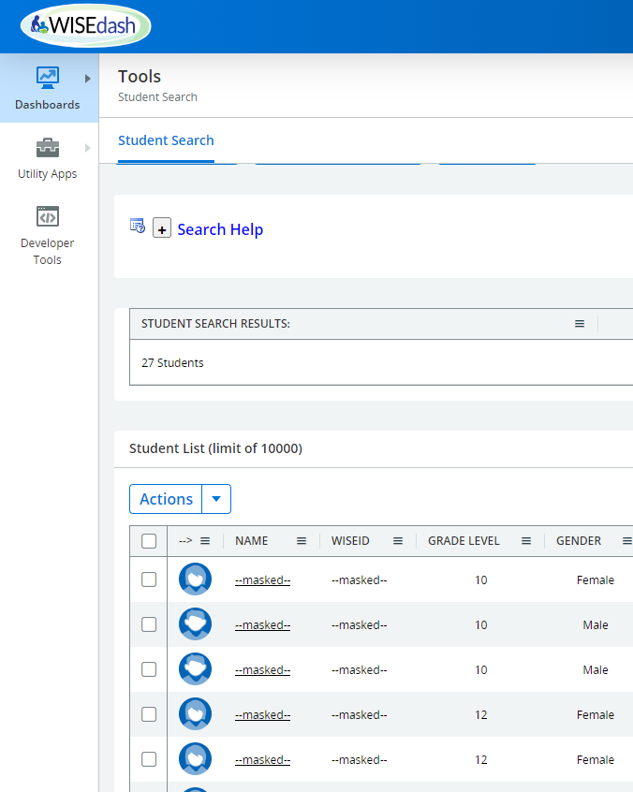
Student Search (2 of 2)
Student Search (2 of 2)
A student list matching search criteria is displayed similar to the drill-down detailed screen shown
Similar to the metric detail, you can use this screen to create cohorts or drill down to the student’s student profile

Slide 7
Q & A
Q & A

Slide 8
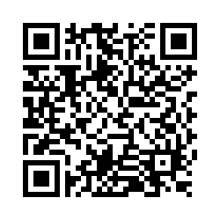
Thank You!
Thank You!
Please scan the QR Code to provide us with your feedback!

