Slide 1
WISEid Uploads and Match Review Process
Adam Mueller
Joshua Roy
Jennifer Janik
3/6/24

Slide 2
Session Goals
Demonstration
Learn how to complete the WISEid Person Upload process, including following up on any errors, potential matches, and Change Requests.
Coming soon! Self-verification of WISEid person changes will replace most LEA-to-LEA Change Requests and streamline approval of Change Requests that go to DPI for approval.

Slide 3
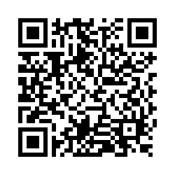
Questions?
Thank you! Thank you!
Please scan the QR code to provide us with your feedback!

