Slide 1

LEA 101
Establishing an Independent Charter School as Local Education Agency in Wisconsin
Facilitated by
The PEO Charter Schools Team
with Department-wide support
and hosted by WRCCS
July 2021

Slide 2
Agenda
1:00-1:10: Opening and introduction - Alex Roberson
1:10-1:30: Special education legal requirements - Sarah Okonkwor, Margaret McMurray
1:30-1:50: State Performance Plan, APR, LEA Determinations – Nancy Fuhrman
1:50-2:00: Break
2:00-2:20: Special Education funding – Rachel Zellmer
2:20-2:40: Title funding – Matt Baier
2:40-3:00: WISEdata, expectations and milestones - Jeff Perry (prerecorded)
3:00-3:20: Licensing – Julie Hagan
3:20-3:30: Accountability for School Districts – Jon Wong
3:30-4:00: ICS basics and per pupil funding; final questions– Alex Roberson
8:00pm: Root for the Bucks

Slide 3
Life as an LEA
An Independent Charter School (ICS) becomes its own LEA (Wis. Stat. 115.775)
All state and federal requirements and obligations of a school district belong to the governing board of the ICS charter school
  e.g., Civil Rights; ADA; IDEA; § 504; ESEA; FERPA; McKinney-Vento

Slide 4
Accountability
a charter school LEADER/OPERATOR is accountable to their GOVERNING BOARD
the GOVERNING BOARD is held accountable by the AUTHORIZER through non-renewal and revocation or required corrective action plans
There may be state and federal consequences for malfeasance, misfeasance, or nonfeasance (e.g., failure to provide a Free and Appropriate Public Education)
There are private rights of actions (e.g., ADA) that permit you to be sued

Slide 5
Disclaimers
This presentation is not all-encompassing or final.
This is a 30,000-foot view. You are still responsible for knowing the “Google Street” view.
The content of this presentation is for informational purposes only and not for the purpose of providing legal advice. You should contact your attorney to obtain legal advice, including compliance with state and federal laws and regulations.

Slide 6
Uniqueness of Independent Charter Schools
July 2021

Slide 7
WHAT IS A CHARTER SCHOOL?
Tuition-free public school
Created on the basis of a contract or “charter”
Contract with a local school board or authorizer
Autonomy over its operations in exchange for greater accountability
Notes:
Charter schools have greater autonomy and flexibility than traditional public schools because they are governed by a nonprofit board of directors and not a local school board. They have flexibility from certain state and local regulations in exchange for a higher level of accountability.

Slide 8
WHAT IS A CHARTER SCHOOL?
Independent charter schools, sometimes referred to as 2r or 2x charter schools, are charter schools that are not authorized by a public school district. Each of the following have authority to authorize a charter school in Wisconsin:
The common council of the city of Milwaukee
The chancellor of any institution in the University of Wisconsin System
Each technical college district board
Waukesha County Executive
College of Menominee Nation
Lac Courte Oreilles Ojibwe College
UW-System Office of Educational Opportunity
Notes:
Some charter schools are college oriented, some project based, etc.

Slide 9
WISCONSIN STATE STATUTE S.118.40
The terms "2r" or "2x" refer to the section of the charter school law within s. 118.40 that grants these entities authority to authorize charter schools. Independent charter schools may also be referred to as legacy or new independent charter schools. Legacy schools are schools chartered by authorizers who had the authority prior to 2015 Act 55 (UW-Milwaukee, the City of Milwaukee, UW-Parkside, and the Milwaukee Area Technical College), and new independent charter schools are those chartered by an authorizer who received authority to authorize in or after 2015 Act 55 (Waukesha County Executive, College of Menominee Nation, Lac Courte Oreilles Ojibwe College, Office of Educational Opportunity, any UW Chancellor (other than UW-Milwaukee and UW-Parkside), and any technical college district board (except MATC).
Under Wis. Stat. § 118.40(4)(ag), no more than a minority of the governing board's members may be employees of the charter school or employees or officers of the school district in which the charter school is located”. Therefore, no more than a minority of the governing board could be filled by employees or officers of the school district they are physically located in.
For more in-depth information on independent charter schools see: Wisconsin Legislature Chapter 118.40 quick reference or Wis. Stats. Chapter 118.40(2r) and (2x).
Notes:
2r part of the state statute
MATC has not authorized any schools

Slide 10
INDEPENDENT PUBLIC CHARTERS
Staffed by non-union teachers that are not employees of the school district
Enroll pupils that are not counted by school districts for state aid purposes
Receive funding from the state through an equal percentage school aid reduction in all Wisconsin districts
Notes:
Not connected to MPS although MPS has its own charter schools.

Slide 11
EXEMPTIONS AND REQUIREMENTS
Charter schools are exempt from most state education laws but must:
  Participate in the FORWARD and other state exams
  Complete the annual School Performance Report
  Count their students for membership
  Employ DPI-licensed teachers
  Have policies and procedures (ie Child Find)
  Participate in the self-assessment (PCSA)
  Must be open to all students in the district - cannot discriminate
  May not require any student to enroll
  May not charge tuition
  Must follow all health and safety requirements of public schools
  Conduct a lottery if more students apply than the contract allows

Slide 12
AUTONOMY AND ACCOUNTABILITY
Charter schools have increased autonomy and flexibility under the law in return for accountability
Charter schools are accountable to their authorizer to meet the goals in their charters and to produce positive student achievement results
Notes:
Often there is tension between special education regulations and the principle of autonomy that is central to the charter school concept. Charter schools vary considerably in the degree of freedom they are provided by law and policy but as part of the public education system, they are not free from regulations and oversight in the area of special education.

Slide 13
5 - YEAR CHARTER LIMIT
Under Wisconsin law, contracts/charters may be for any term not exceeding 5 school years
At the end of the term, the authorizer may renew the charter school with the governance board if goals are met or close the school if goals are not met
Notes:
Charter schools are often approved for a set period of time, usually three to five years.
They are accountable for performance goals defined in their charter. If they fail to meet those goals and do not operate in compliance with relevant laws and regulations, they may be closed.

Slide 14
INDEPENDENT CHARTER & SPECIAL EDUCATION
Charter schools must juggle autonomy and compliance with IDEA
Charter schools are public schools therefore they bear the same responsibility for FAPE
  Independent Charter Schools must follow Federal Laws to ensure FAPE (ie. Transition at age 16)
Notes:
Charter schools need to follow federal regulations regarding special education but are exempt from some state regulations because state regulations may go beyond what the federal regulation requires.

Slide 15
Special Education Enrollment
May not categorically deny admission to students based on disability
  Charter schools should not enroll students with disabilities at significantly lower rates than local public schools
  Students are underrepresented because they require more intense resources (ie. ID, EBD, Autism)
May not deny admission to a student with a disability solely because of a need for special education or related services
  Staff cannot discourage parents from enrolling students with disabilities and suggest a traditional public school can better meet their needs
Notes:
Counseling out

Slide 16
Special Education Enrollment
Must provide students with disabilities the opportunity to meet any appropriate minimum eligibility criteria for admission
  Schools cannot require admissions tests and interviews that result in students with certain disabilities being excluded
  Open enrollment “lottery” system includes students with disabilities

Slide 17
CONTINUUM OF PLACEMENTS
Instruction in regular classroom
Instruction in special education classroom
Homebound instruction
Instruction in alternative settings
Notes:
Charter schools often do not have a continuum of placement options. They may have one self-contained classroom or all special education students are included in general education. Many do not have resources for alternative placements. However, charter schools must ensure that appropriate instructional options are available for students whose needs can not be met in an inclusive setting. How can CESA’s representatives in charter schools help them develop these options? Regardless of the mix of approaches, charter schools are required to respond to student needs and not for students to fit into what the school can provide.

Slide 18
FOLLOW PROCEDURES
Develop the IEP, determine the placement, and decide how the IEP will be implemented
Ensure the IEP team makes placement decisions
With all transfer students, convene a meeting to adopt and review/revise the IEP
    Services just can’t disappear from an IEP; when a service is not something that you have provided, determine what will you offer to meet the student’s disability related need
Notes:
As members of IEP teams in charter schools keep in mind these procedures. Be especially cautious with transfer students. Sometimes if there is a service on the student’s IEP that is not provided in the charter school, it disappears. Be proactive and suggest best practices.

Slide 19
EDUCATIONAL ENVIRONMENT
Educational environment is...
Educational environment is not...
Reflection of participation with nondisabled peers
IEP team decision based on student’s disability related needs
Continuum of placements
Reflection of the amount of special education services
“One-size-fits-all” approach
One educational environment code preferred over another
Notes:
One environment is not necessarily better than another. Educational environment needs to be determined on an individual basis by the IEP team.

Slide 20
DECISIONS BASED ON AVAILABLE RESOURCES
When charter schools are focused on available resources, they may be tempted to work backward to develop a plan based on those resources.
Amending an IEP to match the services a charter school provides is illegal
Charter schools may have more flexibility under state law but they must abide by Federal laws concerning students with disabilities

Slide 21
Special Education Indicators
Indicator 1 (Graduation Rates)
Indicator 2 (Drop-Out Rates)
Indicator 3 (Assessments)
Indicator 4 (Suspension/Expulsion)
Indicator 5 (Educational Placements Age 6-21)
Indicator 6 (Educational Placements Age 3-5)
Indicator 7 (Preschool Outcomes)
Indicator 8 (Parent Involvement)
Indicator 9 (Inappropriate Sped Identification)
Indicator 10 (Inappropriate Identification Specific Disability Categories)
Indicator 11 (Timely Evaluation)
Indicator 12 (Preschool Transition Part C to Part B)
Indicator 13 (Transition Goals Age 16+)
Indicator 14 (Post High School Outcomes)
Compliance (SPP):
Indicator 1 (Graduation Rates)
Indicator 2 (Drop-Out Rates)
Indicator 3 (Assessments)
Indicator 4 (Suspension/Expulsion)
Indicator 5 (Educational Placements Age 6-21)
Indicator 6 (Educational Placements Age 3-5)
Indicator 7 (Preschool Outcomes)
Indicator 8 (Parent Involvement)
Indicator 9 (Inappropriate Sped Identification)
Indicator 10 (Inappropriate Identification Specific Disability Categories)
Indicator 11 (Timely Evaluation)
Indicator 12 (Preschool Transition Part C to Part B)
Indicator 13 (Transition Goals Age 16+)
Indicator 14 (Post High School Outcomes)
Notes:
This is part of the checklist we use with new charter schools.

Slide 22
ESSA/IDEA Determinations (JFN)
Joint Federal Notifications (JFN) include:
  ESSA report
  IDEA report
  Disproportionality report
Reports are found in the SAFE portal
  Released each March
Notes:
As a new charter school you need to be aware of these 3 reports that are sent in December. In your first year you will not receive this report. However there are things you need to be aware of during this first year and make sure you are in compliance. The previous slide showed some of the indicators schools are responsible for with compliance. Keep in mind whatever you do this year will be in your report next year if the school does not meet requirements of IDEA Part B. The following slides will explain each report.

Slide 23
ESSA REPORT
Requires SEAs to report on the performance of all students and specific student groups
Notify schools that qualify for Comprehensive, Targeted or Additional Targeted support
Contains 5 areas:
  Academic achievement
  Student growth
  Graduation rate
  ELP progress
  Absenteeism
Notes:
ESSA requires SEAs to report on the performance of all students and specific groups of students. They need to notify schools if they qualify for comprehensive, targeted or additional targeted support.
LEAs with a Federal identification can schedule a meeting with DPI staff to review reports and plans. CESAs are also available to assist.

Slide 24
IDEA DETERMINATIONS REPORT
Graduation
Dropouts (grades 7-12)
Math Assessment Participation
ELA Assessment Participation
Math Proficiency
ELA Proficiency
Disproportionate Discipline
Education Environment (6-21)
Education Environment (3-5)
Disproportionate Special Education
Disproportionate Specific Categories
Timely Initial Evaluations
Preschool Transition (Doesn’t apply to charter schools)
Post-secondary Transition Plan (Required age 16+)
Timely and Accurate Reporting
Notes:
The purpose of this determination is to inform LEAs of their IDEA compliance based on the data submitted to DPI. Information and resources are provided to help in their improvement planning.

Slide 25
DISPROPORTIONALITY REPORT
Data is collected to determine if significant disproportionality based on race and ethnicity is occuring in local educational agencies
Review and revision of policies, practices, and procedures
May need to participate in disproportionality procedural compliance self-assessment
Notes:
Data is examined with respect to the identification of children with disabilities, the placement in particular educational settings and the incidence, duration, and type of disciplinary action.

Slide 26
Assurances and Budget
WISEGrants portal
Assurances need to be signed by July 1
Budget needs to be created
Assurances include:
  Allowable costs
  Budget modifications
  Charter schools and their students
  MOE
  CEIS, CCEIS and more
  See this website to review assurances:
https://dpi.wi.gov/sites/default/files/imce/sped/pdf/f3201-assurances.pdf

Slide 27
Title Slide
State Performance Plan
Annual Performance Report
LEA Determinations
Nancy Fuhrman
ECSE Indicator Consultant/Part B Data Manager
July 20, 2021

Slide 28
17 Indicators
Indicators
1 | Graduation |  | 9 | Disproportionate Representation
2 | Dropout |  | 10 | Disproportionate Representation - Disability Categories
3 | Assessment - Participation and Performance |  | 11 | Timely Initial Evaluations
4 | Discipline |  | 12 | Preschool Transition Part C to Part B
5 | Educational Environment - School Age |  | 13 | Postsecondary Transition Goals
6 | Educational Environment - Preschool |  | 14 | Post High School Outcomes
7 | Child Outcomes |  | 15 | Resolution Sessions
8 | Parent Engagement |  | 16 | Mediation Agreements
 |  |  | 17 | State Systemic Improvement Plan
Indicator Data Sources and Reporting Responsibility
Notes:
Each state is required to develop a State Performance Plan (SPP) based on the 17 indicators listed.
The purpose of the SPP is to improve educational results and functional outcomes of students with disabilities while ensuring the requirements of the Individuals with Disabilities Education Act (IDEA) are met. Some of the indicators are compliance indicators meaning the target has been set at 100% or, for those focusing on disproportionate representation, 0%. Other indicators are results or improvement indicators for which annual targets have been set through a stakeholder process.
Each year the state must submit an Annual Performance Report (APR) that documents the state’s progress in relation to the targets for each indicator.
For federal fiscal year (FFY) 2020, the state begins a new six-year SPP/APR cycle. With this new reporting cycle, the state will be setting new annual targets for the indicators focusing on results.
WISEdata is the data source for many of the indicators. For other indicators, the data source is a stand-alone application for which special education staff in your agency will use to report the data. In the upcoming slides, we will identify the data source for each indicator.
For more information related to the indicators, go to http://dpi.wi.gov/sped/about/state-performance-plan and click on the specific indicator.

Slide 29
Compliance Indicators
Indicator |  | Target | Data Source | Reporting Responsibility
4B | Discipline Significant Discrepancy – Suspension/Expulsion > 10 Days by Race/Ethnicity | 0% | WISEdata Year End | District
9 | Disproportionate Representation by Race/Ethnicity - Identification | 0% | WISEdata October 1 Child Count | District
10 | Disproportionate Representation by Race Ethnicity - Disability Categories | 0% | WISEdata October 1 Child Count | District
11 | Timely Initial Evaluations | 100% | Timely Initial Evaluations Application | Special Education
12 | Preschool Transition Part C to Part B | 100% | Preschool Transition Application | Special Education
13 | Postsecondary Transition Goals | 100% | Postsecondary Transition Plan (PTP Application | Special Education
Indicator Data Sources and Reporting Responsibility
Notes:
There are six compliance indicators as identified in the slide.
Indicator 4B - Discipline Significant Discrepancy – Suspension/Expulsion > 10 Days by Race/Ethnicity
Indicator 9 - Disproportionate Representation by Race/Ethnicity – Identification
Indicator 10 - Disproportionate Representation by Race Ethnicity-Disability Categories
Indicator 11 – Timely Initial Evaluations
Indicator 12 – Preschool Transition Part C to Part B
Indicator 13 – Postsecondary Transition Goals
Indicator 4B (Discipline Significant Discrepancy) and Indicators 9 and 10 (Disproportionate Representation) focus on racial equity. The data source for all three indicators is WISEdata.
LEA identification for Indicator 4B (Discipline Significant Discrepancy) will require the LEA to conduct a review of its policies, procedures, and practices to determine if they contribute to the significant discrepancy for students by race/ethnicity. Likewise, LEA identification for Indicators 9 and 10 (Disproportionate Representation) will require the LEA to conduct a review of its policies, procedures, and practices to determine if they contribute to the inappropriate identification of students by race/ethnicity.
For Indicator 11 (Timely Initial Evaluations), Indicator 12 (Preschool Transition), and Indicator 13 (Postsecondary Transition Goals), the data source is a stand-alone special education application. Indicator 12 (Preschool Transition) does not apply for independent charter schools as the Birth to 3 Program will not be making referrals to the charter school. Indicator 13 (Postsecondary Transition Goals) is specific to students ages 14 and older.
For Indicator 11 (Timely Initial Evaluations) and Indicator 13 (Postsecondary Transition Goals), the LEA will need to ensure that staff responsible for these indicators have access to the applications.

Slide 30
Results Indicators
Indicator |  | Data Source | Reporting Responsibility
1 | Graduation | WISEdata Year End | District
2 | Dropout | WISEdata Year End | District
3 | Assessment – Participation and Performance | Wisconsin Student Assessment System (WSAS) | N/A
4A | Discipline Significant Discrepancy – Suspension/Expulsion > 10 Days | WISEdata Year End | District
5 | Educational Environment - School Age | WISEdata October 1 Child Count | District
6 | Educational Environment - Preschool | WISEdata October 1 Child Count | District
Indicator Data Sources and Reporting Responsibility
Notes:
There are nine results indicators as identified on this slide and the next slide.
Indicator 1 - Graduation
Indicator 2 - Dropout
Indicator 3 - Assessment – Participation and Performance
Indicator 4A – Discipline Significant Discrepancy – Suspension/Expulsion > 10 Days
Indicator 5 – Educational Environment – School Age
Indicator 6 – Educational Environment – Preschool
Indicator 7 – Child Outcomes
Indicator 8 – Parent Engagement
Indicator 14 – Post High School Outcomes
Indicator 17 – State System Improvement Plan (SSIP)
For the indicators identified on this slide, the data source is either WISEdata or the Wisconsin Student Assessment System (WSAS).
As mentioned previously, there is a new State Performance Plan (SPP)/Annual Performance Plan (APR) cycle beginning with the federal fiscal year (FFY) 2020 and as such, the state is currently in the process of setting annual targets for each of these indicators.

Slide 31
Results Indicators Continued
Indicator Data Sources and Reporting Responsibility
Indicator |  | Data Source | Reporting Responsibility
7 | Child Outcomes | Child Outcomes Application | Special Education
8 | Parent Engagement | WISEdata Family Engagement Survey | District Special Education
14 | Post High School Outcomes | WISEdata – Year End Post School Outcomes Survey | District Special Education
Notes:
The indicators on this slide all make use of a special education application to gather the needed data.
Indicator 7 (Child Outcomes) is an early childhood indicator specific to children in grades PK or 4K. Children’s functioning as compared to what is age-expected is rated using a 7-point scale in each of three outcome areas when they begin to receive special education services and then again at year end prior to kindergarten entry. The three outcome areas include:
Positive Social-Emotional Skills
Acquisition and use of knowledge and skills (including early language/communication and early literacy)
Use of appropriate behaviors to meet their needs
Both Indicators 8 (Parent Engagement) and 14 (Post High School Outcomes) use a survey to gather the needed data.
For Indicator 8 (Parent Engagement), using WISEdata, DPI will identify the students whose families should be contacted to complete the survey. The independent charter school will need to reach out to the families requesting they complete the survey.
For Indicator 14 (Post High School Outcomes), using WISEdata, DPI will identify the students who exited high school the prior year because of receiving a high school diploma, receiving a certificate, reaching maximum age for special education services, or dropping out. The independent charter school will need to provide contact information for the students.

Slide 32
Results Indicators – Dispute Resolution
Indicator Data Sources and Reporting Responsibility
Indicator |  | Data Source | Reporting Responsibility
15 | Resolution Sessions | Dispute Resolution Log | DPI
16 | Mediation Agreements | Dispute Resolution Log | DPI
Notes:
Indicator 15 (Resolution Sessions) and Indicator 16 (Mediation Agreements) are specific to dispute resolution for which an annual target has been set. Data for these two indicators is gathered by DPI; there is no data submission required by the independent charter school.

Slide 33
Results Indicators – Statewide System Improvement Plan (SSIP)
Indicator Data Sources and Reporting Responsibility
Indicator |  | Data Source | Reporting Responsibility
17 | Statewide Improvement Plan (SSIP) Statewide Literacy Assessment: Grades 3-8 | Wisconsin Student Assessment System (WSAS) & Other Data | DPI
Notes:
The final indicator is Indicator 17 (Statewide System Improvement Plan or SSIP). For Indicator 17, states selected the focus area. Wisconsin chose as its focus area literacy assessment for grades 3-8.

Slide 34
Cyclical Indicators
Indicator |  | Collection Timeline | Data Year
8 | Parent Engagement | August – November 15 | Report on initial evaluations where parent consent was received in the prior school year.
11 | Timely Initial Evaluations | January – June 30 | Surveys are given to parents of students with IEPs, ages 3-17 (excluding parentally placed private students).
14 | Post High School Outcomes | June 1 – September 1 | Surveys are given to exiters with IEPs who exited at least one year ago.
Indicator Data Sources and Reporting Responsibility
LEA completes once every 5 years
https://dpi.wi.gov/sped/about/state-performance-plan/cycle-actions
Notes:
LEAs are not required to submit data for all indicators every year unless the LEA has an average daily attendance of 50,000 students or more.
Indicator 8 (Parent Engagement), Indicator 11 (Timely Initial Evaluations), and Indicator 14 (Post High School Outcomes) are referred to as cyclical indicators meaning the LEA only needs to submit data once every five years.
For Indicator 8 (Parent Engagement), the survey window opens in January of the reporting year and closes in June. There is a required parent response rate. If the LEA does not meet the required response rate, the LEA will need to participate in Indicator 8 again the following reporting year.
For Indicator 11 (Timely Initial Evaluations), the application opens in August of the reporting year and closes in November of the reporting year. The data submitted is for initial evaluations completed the prior school year.
For Indicator 14 (Post High School Outcomes), the survey window opens in June and closes in September. Students surveyed will be those who exited high school the previous school year.
The link on the slide can be used to access the cyclical reporting year for the LEA.

Slide 35
Reading Drives Achievement: Procedural Compliance Self-Assessment (RDA:PCSA)
Goal of the self-assessment is to ensure compliance with selected legal requirements
LEA completes once every 5 years
  Application opens August 15 of reporting year
  Data due November 15 of reporting year
Correction of Noncompliance completed within 1 year of LEA being notified
More information and reporting cycle - https://dpi.wi.gov/sped/educators/rdapcsa/cycle
Indicator Data Sources and Reporting Responsibility
Notes:
While the Reading Drives Achievement: Procedural Compliance Self-Assessment (RDA:PCSA) is not specific to an indicator of the State Performance Plan (SPP)/Annual Performance Report (APR), it is included as it is a requirement that the LEA is expected to complete once every 5 years.
The RDA: PCSA requires the LEA to review student records specific to selected legal requirements for a sample of students. If the LEA identifies noncompliance related to a self-assessment item, the LEA will need to correct the noncompliance for the specific students impacted and then will also need to demonstrate current compliance by providing DPI with student records to review. Each LEA has an assigned consultant on the Special Education Team that would work with the LEA to complete the procedural compliance self-assessment requirements.
For more information and the reporting cycle, go to https://dpi.wi.gov/sped/educators/rdapcsa/cycle.

Slide 36
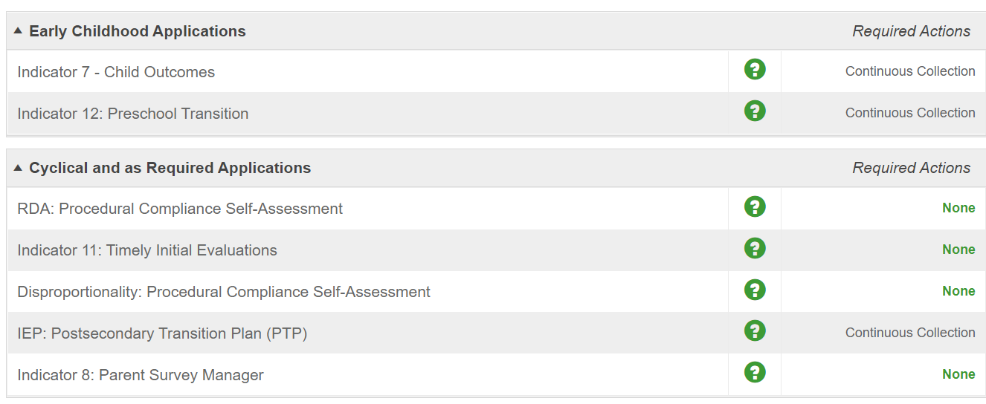
Special Education Portal
Indicator Data Sources and Reporting Responsibility
https://devsped.dpi.wi.us/spedportal
Notes:
Most of the stand-alone special education applications used to support the indicators are accessed through the Special Education Portal. The exception would be Indicator 14 (Post High School Outcomes) which currently has its own portal and is managed through a discretionary grant awarded by DPI.
This slide shows the Main Menu of the Special Education Portal. The link to access the Special Education Portal is https://devsped.dpi.wi.us/spedportal. There are also blue Special Education Portal buttons available on the webpages for the individual indicators.

Slide 37
Special Education Portal Access
Application Access Granted by Application Administrator
Application Administrator Designated by District Security Administrator
Indicator Data Sources and Reporting Responsibility
Early Childhood
Indicator 7 Child Outcomes | Special Education Portal – Early Childhood Application Administrator
Cyclical/As Required
Indicator 8 Parent Survey Manager Indicator 11 Timely Initial Evaluations RDA: Procedural Compliance Self-Assessment | Special Education Portal – Cyclical Application Administrator
Postsecondary Transition Plan
Indicator 13 Postsecondary Transition Plan (PTP) | IEP: Postsecondary Transition Plan (PTP) Application Administrator
WISESecure - https://dpi.wi.gov/wise/wisehome-info
Notes:
The applications within the Special Education Portal are grouped by heading.
Early Childhood
Cyclical/As Required
Postsecondary Transition Plan
For each grouping, the LEA needs to have one or more individuals assigned as the Application Administrator. The Application Administrator for a grouping is then responsible for granting and removing users with access to the applications within the grouping.
It is the District Security Administrator within the LEA who will designate an Application Administrator for a grouping.
WISESecure is the application used by both District Security Administrators to designate Application Administrators as well as by Application Administrators to grant users access to the individual applications.

Slide 38
LEA Determinations
50% Compliance Indicators | LEA Determination
Indicator 4B Indicator 9 Indicator 10 Indicator 11 Indicator 12 Indicator 13 Correction of Noncompliance Timely and Accurate Reporting | Meets the requirements and purposes of the IDEA Needs assistance in implementing the requirements of the IDEA Needs intervention in implementing the requirements of the IDEA Needs substantial intervention in implementing the requirements of the IDEA
50% Results indicators
Indicator 1 Indicator 2 Indicator 3 Indicator 5 Indicator 6 | Special Education Portal – Cyclical Application Administrator
Indicator Data Sources and Reporting Responsibility
https://dpi.wi.gov/sped/about/state-performance-plan/determinations
Notes:
The Department of Public Instruction receives each year from the Office of Special Education Programs (OSEP) a state determination based on a combination of compliance and results indicators as part of OSEP’s accountability framework, called Results Driven Accountability (RDA). RDA brings into focus the educational results and functional outcomes for children with disabilities while balancing those results with the compliance requirements of IDEA.
Based on this review by the OSEP, the state receives one of four possible determinations.
Meets the requirements and purposes of the IDEA
Needs assistance in implementing the requirements of the IDEA
Needs intervention in implementing the requirements of the IDEA
Needs substantial intervention in implementing the requirements of the IDEA
RDA also requires DPI to make annual LEA Determinations using the same four possible levels of determination. The slide shows both the compliance and results indicators currently being used when making the LEA Determinations. Based on the LEA Determination received, there may be additional requirements placed on the LEA.

Slide 39
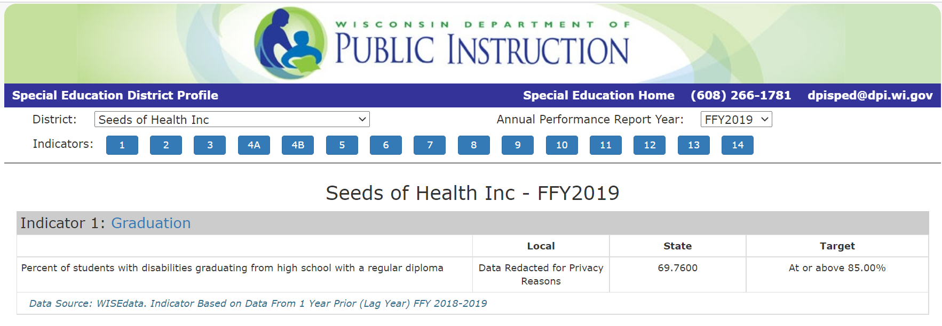
District Profile
Indicator Data Sources and Reporting Responsibility
https://sped.dpi.wi.gov/spedprofile
Notes:
A requirement of the State Performance Plan (SPP)/Annual Performance Report (APR) is that DPI must annually publicly report the results by LEA for Indicators 1-14. In Wisconsin, this public reporting currently is being done through the District Profile; however, work is being done to include the data in WISEdash Public.
The District Profile shows for each LEA for the reporting year, local indicator data, state indicator data, and the indicator target.
The District Profile can be accessed at https://sped.dpi.wi.gov/spedprofile.

Slide 40
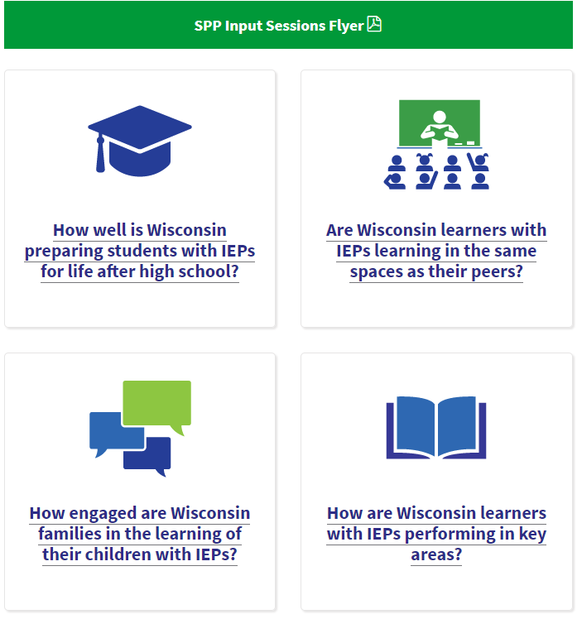
FFY2020-25 APR Target Setting
Indicators 1, 2, 14
  Live input session June 25, 2021
  Recorded webinar coming soon
  Survey available to provide input
Indicator 4A, 5, 6, 8
  Live input session September 24, 2021
  Recorded webinar coming soon
  Survey available following live input session
Indicators 3, 7, 17
  Live input session December 3, 2021
  Recorded webinar coming soon
  Survey available following live input session
  https://dpi.wi.gov/sped/spp-target-setting
Indicator Data Sources and Reporting Responsibility
Notes:
DPI is seeking stakeholder input related to setting the targets for the results indicators for the upcoming Annual Performance Report (APR) cycle. Targets are being set for federal fiscal years 2020-21 through 2025-26. LEAs are encouraged to provide input.
Stakeholder input is being gathered through surveys. DPI is holding live input sessions via Zoom specific to the results indicators. The first live session was on June 25 specific to Indicators 1 (Graduation), 2 (Dropout), and 14 (Post High School Outcomes). The live session was recorded and will be posted soon for review. The next live session will be on September 24 specific to Indicators 4A (Discipline), 5 (Educational Environment School Age), 6 (Educational Environment Preschool), and 8. Similar to the first session, this live session will be recorded and posted for review for those unable to attend the live session. The final live session will be December 3 specific to Indicators 3 (Assessment), 7 (Child Outcomes), and 17 (State Systemic Improvement Plan).

Slide 41
Contact Information
Nancy Fuhrman
Early Childhood Indicator Consultant/
Part B Data Manager
608-266-6438
nancy.fuhrman@dpi.wi.gov

Slide 42
Break
Break from 1:50 to 2:00
How many independent charter schools serving students in Wisconsin during the 2021-2022 academic year?

Slide 43
An Independent Charter School Introduction to IDEA Funding in Wisconsin
July 2021
Notes:
This presentation is an “An Independent Charter School Introduction to Special Education Funding in Wisconsin.” My name is Rachel Zellmer, my pronouns are she/hers, and I am a Federal Fiscal Monitoring Consultant on the Special Education Team at the Wisconsin Department of Public Instruction. In this introductory session, I will provide an overview of the main sources of funding available to public schools in Wisconsin for the costs of special education instruction and related services.

Slide 44
Acronyms
FAPE - Free Appropriate Public Education
IEP - Individualized Education Program
SEA - State Education Agency
  Wisconsin Department of Public Instruction
LEA - Local Education Agency
  Defined by state statute as the agency responsible for FAPE
    Wisconsin Public School Districts
    Wisconsin Independent Charter Schools
    Wisconsin Dept of Corrections, Dept of Health Services
Notes:
Before we begin, I would like to provide definitions for acronyms that we frequently use when discussing special education funding. The purpose of special education funding is to offset the costs incurred when ensuring that a student with a disability receives a free appropriate public education – or FAPE. This happens through the IEP process, where an Individualized Education Program is created and outlines the services and supports that are necessary to meet the unique needs of a student with a disability. The services and supports are above and beyond what is provided through the core curriculum, and must be provided at no cost to the student’s family.
Under Federal Education regulations, the Wisconsin Department of Public Instruction is an “SEA,” which is federal lingo for the State Education Agency. Each state has its own SEA.
In turn, public schools and independent charter schools are referred to as “LEAs,” or Local Education Agencies. Being labeled as an “LEA” is an important term, because it identifies an education agency as being responsible for different parts of Federal and State education law. Wisconsin state statute defines LEAs as the FAPE agency, or the agency that is responsible for providing a free appropriate public education to students who have been identified as students with disabilities who require special education services. Our state statute further specifies which education agencies are LEAs and they are Public School Districts, Independent Charter Schools, the Department of Corrections and the Department of Health Services. Only these agencies are held accountable for ensuring FAPE is provided to students.

Slide 45
Excess Cost of Special Education
Direct costs that are incurred when providing
special education instruction and related services.
Costs are generated by the unique needs of the
students with IEPs.
If the school or district had no students with disabilities enrolled, the cost would not exist.
Notes:
Prior to understanding special education funding, it is important to understand the concept of “Excess Cost” related to FAPE. When we speak of the excess cost of providing special education and related services, we’re describing the costs incurred when providing services to students with IEPs that are above and beyond the instruction and services provided to all kids through general education. Excess costs are tracked separately, and this helps LEAs understand what costs are eligible for IDEA and state special education categorical aid funding.

Slide 46
What does that mean to an ICS?
Understand what is a general education cost versus a cost
that is driven by the requirements in an IEP.
A third grade teacher has a class of 25 students, of which five students have IEPs. Is any part of this teacher’s salary an excess cost of providing special education?
A speech and language teacher provides speech services to
the five students with IEPs. Is any part of this teacher’s salary an excess cost of providing special education?

Slide 47
What does that mean to an ICS?
Understand what is a general education cost versus a cost
that is driven by the requirements in an IEP.
Each of the 25 students in the third grade class receive a chromebook; 5 of the students have an IEP. Are any of the chromebooks an excess cost of providing special education?
Only the 5 students with IEPs receive their own chromebook to ensure they can access the general ed curriculum. Are these 5 chromebooks an excess cost of providing special education?

Slide 48
WI Accounting for Excess Cost
Fund 27 – A segregated area used to hold all costs and revenue
generated only by special education.
Project Codes – Tags given to each expenditure in Fund 27 to
identify how it will be funded.
Project 019
Costs that will be paid for using
local funds only
Project 011
Costs initially paid using local funds, but will then be partially reimbursed with state aid or Medicaid
Project 340
Costs that will be paid for by the IDEA grants
Notes:
All LEAs, including independent charter schools, are required to track excess cost expenditures separately from all other costs. These accounts are also reported to DPI on an annual basis. LEAs are required to follow the Wisconsin Uniform Financial Accounting Requirements (WUFAR) when submitting financial reports to DPI. Under this system, public school districts and many independent charter schools account for all special education “excess costs” in “Fund 27.”
Costs are further identified by type of cost, department or program, and project codes. Project codes identify the funding source. Every expenditure recorded in Fund 27 must have a project code.
^Expenditures tagged with a project code of 019 are costs that will be paid for using only local funds.
^Expenditures tagged with a project code of 011 are costs that are initially covered using local funds, but will later be partially reimbursed with state funds or Medicaid.
^Expenditures tagged with a project code of 340 are costs that are reimbursed with IDEA grant funds.

Slide 49
What does that mean to an ICS?
In the accounting records, identify and separate out costs
that are considered an excess cost of special education.
Easily be able to pull a report of only special education expenditures.
Identify (through tagging) which of those expenditures
(or portion of those expenditures) are going to paid for
using IDEA federal formula funds.

Slide 50
Local
  Will cover the majority of special education expenditures
State
  Categorical Aids
  High Cost fund
Federal
  IDEA Formula
  Medicaid
Notes:
There are three main revenue sources that pay for the cost of special education and related services – Local, State and Federal.
“Local” funds will cover the majority of special education costs.
“State” funds are provided through appropriations made in Wisconsin’s biennial state budget. These payments to LEAs are referred to as “Special Education Categorical Aids.” The High Cost program is a fund that helps defray the costs of students whose individual needs end up generating expenditures in excess of $30,000.
“Federal” special education funds are provided through two main streams – those awarded under the Individuals with Disabilities Education Act and Medicaid reimbursements.

Slide 51
IDEA – Federal Funding Source
US Department of Education grants IDEA Part B funds to Wisconsin’s State Education Agency (which is DPI).
DPI subgrants IDEA funds to approximately 440 agencies:
  Flow-through Formula (FT)
  Preschool Formula (PS)
  Discretionary Statewide Initiatives
Notes:
Federal special education law exists under the Individuals with Disabilities Education Act, which we often shorten to “IDEA.” In addition to providing the regulations around FAPE, IEPs, Due Process, LEA Program Determinations, etc., it provides an annual funding amount to each state to support special education and related services at the state and local level. With those federally awarded funds, DPI subgrants to approximately 440 agencies through formula funding and discretionary grants and contracts.

Slide 52
Formula funds under IDEA are awarded on a non-competitive basis for programs and services to students with disabilities.
Preschool (PS)
Provides funding for special education services to children ages 3 to 5.
Flow-through (FT)
Provides funding for special education services to children ages 3 to 21.
Types of IDEA Formula Grants
Notes:
The Individuals with Disabilities Education Act provides formula funding to LEAs to help defray the costs of providing special education instruction and related services. There are two separate sources of formula funding under IDEA and are often referred to as “Part B” funding.
The first is called “preschool” and is intended to fund special education instruction and related services for students with IEPs, ages 3 to 5. The other, much larger source of funding, is called “flow-through” and is intended to fund special education instruction and related services for students with IEPs ages 3 to 21.
The term “flow-through” is used because the funding is awarded to the Wisconsin Department of Public Instruction, and we “flow” the funding to the LEAs on a non-competitive basis. The amount of funding each LEA receives annually is based on a calculation that is set in federal regulations.
As you can see, the funding actually covers the age group 3 to 5 twice. The amount available through the preschool grant is very small and meant for some of the unique needs of this age group – such as providing services to a 3-year-old who is not yet in school.
If an independent charter school only includes middle or high school grades, there is no preschool grant awarded.

Slide 53
Under Wisconsin statute, the following agencies are responsible for FAPE (a free appropriate public education for students with disabilities):
  School districts
  Independent charter schools
  Department of Corrections
  Department of Health Services
Other agencies, such as CESAs and CCDEBs, are not responsible for FAPE and are thus not eligible for IDEA formula funding.
In Wisconsin, the “LEA”
with FAPE responsibility
is the only subrecipient of the IDEA formula grants.
IDEA Formula Grant Eligibility
Notes:
Under IDEA, a subgrantee of IDEA formula funds is responsible for providing FAPE to students with disabilities within its jurisdiction and ensuring funds are expended in accordance with the applicable provisions of the law.
In Wisconsin, only public school districts, public independent charter schools, the Wisconsin Department of Corrections, and the Wisconsin Department of Health Services are required to provide FAPE to students with disabilities and to meet the requirements of IDEA. Therefore, in Wisconsin, DPI subgrants IDEA formula funds only to these agencies.
Neither IDEA nor the U.S. Education Department’s General Administrative Regulations authorize a subgrantee to further subgrant funds to other entities. Therefore, LEAs may not further subgrant IDEA funds to CESAs or other agencies; however, subrecipients may use their federal formula funds to contract with outside agencies to provide special education instruction or related services to their students with IEPs.

Slide 54
Base Payments
Each LEA generates a
“base amount” established
with child count data reported in the late 1990s.
LEA Formula Funds
Base
Payments
IDEA Fund Increases
15% Poverty Based
85% Enrollment Based
IDEA Increases
Since the base amounts were established, the award to Wisconsin has increased creating “new funds.”
85% Enrollment & 15% Poverty Count
IDEA funds not obligated for base payments are distributed based on an LEA’s total student enrollment and the number of students living in poverty.
Notes:
IDEA Part B formula funds are calculated according to a formula established with the IDEA Amendments of 1997.
Prior to the 1997 amendments to IDEA, federal funds were distributed on the basis of “child count,” the number of students with disabilities receiving services in an LEA. This type of funding formula made it difficult for LEAs to rely on a stable funding source and was frequently criticized as an incentive for over-identifying students for special education services.
The formula revisions in the 1997 amendments ended the reliance on child count data and substituted a population factor, plus a poverty factor.
The formula kept a portion of the old calculation method by determining a base payment, which is the amount that the LEA received in IDEA funds the final year child count was used to determine the allocation. This is the amount that the LEA can rely on every year, no matter the LEA’s student population.
Since the late 1990s, the IDEA grant to Wisconsin has increased leaving a balance after the base payments are reserved.
These “new funds” are then distributed to LEAs based on total student enrollment and the percentage of those students living in poverty. Of the new funds, 85% is provided based on the number of all students enrolled in the LEA, both public and private schools, and not just students with disabilities. The remaining 15% of new funds is distributed based on the LEA’s poverty count. In Wisconsin, we use the poverty based calculation used by the Title I program.

Slide 55
What does that mean to an ICS?
An initial IDEA formula and preschool allocation is created using estimated student counts and set percentages,
including establishing a “Base” amount.
50% of the initial allocation amount is available on July 1.
In January, DPI determines the ‘true’ allocation based on
Third Friday in September / October 1 Child Counts and adjustments are made (and the remaining funds released).

Slide 56
Base Pay Amount
Total Student Enrollment
85%
Poverty Count
15%
Estimated
Flow-through Allocation
This is an example of
an ICS’s preliminary first year allocation calculation for IDEA flow-through funds.
10% of the total est. enrollment
Estimated enrollment from ICS
Estimated Poverty Rate from ICS
Base + Enrollment + Poverty
40 Students
400 Students
300 Students
$24,560
$50,841
$54,945
$130,346
Notes:
This is a preliminary flow-through calculation example for an independent charter school with amounts.
^Because the new independent charter school did not exist in 1999 when the original base amounts were established, the independent charter school creates a base in their first year of existence. The amount is based on the October 1 Child Count, so we need to estimate the amount because the date won’t happen for three months after the fiscal year starts. We do this by determining that 10% of the total students enrolled will be students with IEPs. We use this percent because it matches the states prevalence rate for students with IEPs.
When IDEA was amended in 2004, it meant that any increase in funds awarded to Wisconsin would be allocated based on an LEA's total student enrollment and poverty count. ^When allocating the increase in funds, 85% would be based on an LEA's total student enrollment collected on the Third Friday of September of the prior fiscal year. Because the independent charter school does not have a Third Friday in September Count from the prior year, we use the total enrollment estimate that is provided by the independent charter school. In this example, we used the count of 400 students – which includes students with and without IEPs. The amount that is generated from this number is actually based on the percentage of this LEA's total student enrollment compared to the state's total student enrollment. For this independent charter school, the estimated count generated an amount of $50,841.
The other distribution for the increase in funds is determined by the Census poverty count numbers (which is the same count used to generate Title I allocations). Again, this is supposed to be from the prior fiscal year, so we use the independent charter school’s estimated poverty rate. This independent charter school felt that 75% of their total student enrollment would be students considered at or below the poverty level. In this example, there were 300 students, of the 400 total students, living in poverty which established an amount of $54,945.
Including the base payment and the amounts determined by total student enrollment and students living in poverty, the independent charter school would generate an initial estimated flow-through formula allocation of $130,346.

Slide 57
Base Pay Amount
Total Student Enrollment
85%
Poverty Count
15%
Total
Flow-through Allocation
The allocation amount is adjusted and “finalized” in January based on actual counts captured in WISEdata.
October 1 Child Count
Third Friday in September Count
Estimated Poverty Rate from ICS
Base + Enrollment + Poverty
10 Students
300 Students
200 Students
$6,140
$38,130
$36,630
$80,900
Notes:
The original estimated IDEA flow-through allocation was based on numbers provided by the independent charter school. Once the independent charter school is up and running, student information is submitted through your student information system to WISEdata. WISEdata collects the “Third Friday in September” count, which is your total student enrollment, as well as the “October 1 Child Count,” – the number of students with active IEPs on October 1. We use the official “snapshot,” which happens in late November / early December of each year. The data collected through this snapshot is used to adjust an independent charter school’s preliminary allocation so it is based on actual numbers.
In this example, the Third Friday in September count ended up being 300 students instead of 400, but the poverty rate stayed on as 75%. However, the number of students with an active IEP on October 1 was not 10% of the student population, but only 3%. The actual counts were lower than the estimates, so the preliminary allocation is adjusted in January.

Slide 58
What does that mean to an ICS?
The preliminary flow-through allocation, based on estimated numbers, was $130,346.
When actual counts were collected, the allocation dropped
to $80,900.
Prior to having actual counts, DPI will release 50% - or $65,173 - to protect subrecipients from claiming more than their actual final allocation amount.

Slide 59
What does that mean to an ICS?
The October 1 Child Count sets the base amount. Make sure that students with active IEPs on October 1 are properly
accounted for in your Student Information System.
If the Child Count is zero (and this happens) on your first
October 1, the base is $0 (the smallest of the three parts
of the equation). If the Child Count is greater than zero
the next year, the base will be adjusted.

Slide 60
IDEA Formula Grant Availability
Each Formula Award –
Available for 27 Months
Forward Funding:
3 months
(July 1 – Sept. 30)
Award Period:
12 months
(Oct. 1 – Sept. 30)
Tydings Period:
12 months
(Oct. 1 – Sept. 30)
Notes:
A new IDEA grant award is allocated to LEAs each year. Each “annual” award is for a 12-month period; however, regulations exist to extend the amount of time that is available for an LEA to obligate the single year’s IDEA award.
^The first extension actually happens before the award even begins. This is called forward funding. The federal award start date for a grant does not actually take place until the federal fiscal year begins on October 1. But, states are allowed to award the funds to LEAs beginning on our fiscal year start date, which is July 1. So the first three months of the IDEA grant’s availability, July 1 to October 1, are actually before the award year even begins.
^Next is the actual ‘official’ 12 months of the grant availability. The 12 months occur from the federal fiscal year start date, October 1, through the end of the federal fiscal year, September 30.
^Congress adopted the Tydings Amendment as incorporated in the General Education Provisions Act. The amendment provided LEAs additional time to spend the Federal funds they receive. Based on the Tydings Amendment, the Education Department General Administrative Regulations (EDGAR) allows grantees to carryover for one additional year any Federal education funds that were not obligated in the period for which they were awarded.
So, including the forward-funded time period and the Tydings period, LEAs can have up to 27 months to obligate a single year’s grant award funds.

Slide 61
Allowable IDEA Formula Costs
Most costs tied to the provision of special education instruction and related services, not reimbursed by
another Federal program such as Medicaid.
IEP Software
Specialized Transportation
Special Ed Teachers
Specialized Curriculum
Travel
Related Services Staff
Supplies
Special Education Evaluations
Early Childhood Programs
Professional Development
Equipment
Software
Aides
Notes:
An LEA’s IDEA formula allocation can be used for most costs incurred by providing special education as long as it is allowed under IDEA and the Federal Uniform Grant Guidance. For it to be allowed under IDEA, it must be an excess cost of providing special education. There are also additional guiding pieces, such as the staff providing special education instruction and related services must be appropriately licensed per the SEA.

Slide 62
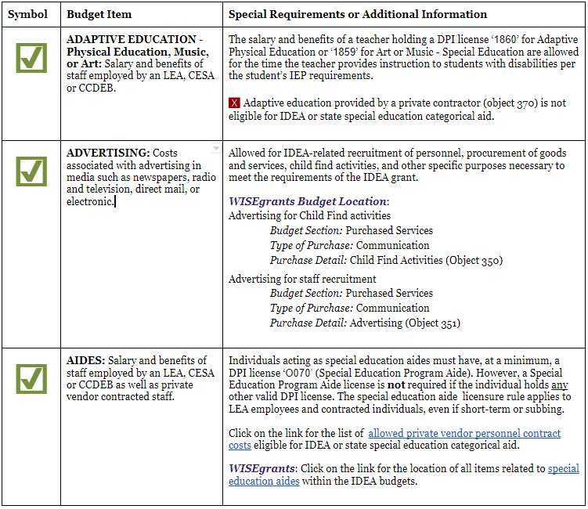
IDEA Formula Allowable Costs
The “IDEA Allowables” technical assistance document lists over 100 items that can and cannot be charged to the IDEA formula grants.
The document often maps where the item can be located in the web-based IDEA formula application (WISEgrants). The Allowables document is updated on a regular basis.
http://bit.ly/idea-allowable
Notes:
To help LEAs determine what costs are eligible for IDEA funding, an expansive technical assistance document has been created to help quickly identify costs that are allowed, not allowed, or are allowed but certain circumstances must be met. This document also helps LEAs in account for these costs correctly, because appropriate coding feeds into meeting fiscal monitoring requirements under IDEA and the Uniform Grant Guidance.
The list is expansive – but not all inclusive. Whether or not a cost is listed in this document, if the LEA is unsure of whether or not a cost is eligible for IDEA reimbursement, those guiding costs around determining excess cost should be utilized.

Slide 63
Allowable Costs & WISEgrants
IDEA Formula Grants Budget Application Technical Assistance Page
https://dpi.wi.gov/sped/educators/fiscal/idea-wisegrants
IDEA Formula Grants Allowable Costs Technical Assistance Page
https://dpi.wi.gov/sped/educators/fiscal/allowable
Claiming IDEA Formula Grants Technical Assistance Page
https://dpi.wi.gov/sped/educators/fiscal/claims

Slide 64
IDEA Formula Application Process
WISEgrants Web Portal:
  Federal grant assurances
  Flow-through and Preschool budget and claim submission
    DPI Special Education Team staff approve budgets before claims can be submitted for reimbursement.
Once the ICS incurs the expenditure, a claim can be submitted immediately after the transaction for cash reimbursement.
Notes:
Although IDEA formula funds are granted to LEAs on a non-competitive basis, there is still an application process. Through DPI’s WISEgrants web portal, LEAs sign and submit IDEA grant assurances that cover both programmatic and fiscal requirements that they will adhere to federal and state special education law.
LEAs then create budgets for their flow-through and preschool formula funds and submit to DPI for review. Members of DPI’s Special Education Team approve the budgets. LEAs cannot submit claims for funding until a budget has been approved, and the claim itself represents the approved budget items.
When an LEA does submit a claim, a payment is made by DPI within a short period of time. On the LEA’s ledger, the expenditure is created and the IDEA formula funds received offset the expense. All expenditures and revenue received are tied to a specific fiscal year, which in Wisconsin begins on July 1 and ends on June 30.

Slide 65
Wisconsin has two funding programs to support the costs of special education and related services.
Special Education Aid
This is the major categorical aid program supporting special education in Wisconsin, and far exceeds the federal portion - in FY 2020-2021, the state made $450,276,200 available as categorical aid; whereas IDEA formula funding for the same year was only $206,208,604.
High Cost Special Education Aid
Provides additional funding for individual students with exceptionally significant and costly needs.
Types of Special Ed Categorical Aid
Notes:
In Wisconsin, state appropriations are made to help offset the excess cost of special education and related services provided to students with IEPs. The largest appropriation is called “Special Education Categorical Aid” and is a much larger amount than what is made available under the federal IDEA program.
A second state-funded special education appropriation is called “High Cost” and is meant to provide funding for costs incurred by individual students with especially costly expenses. In fact, the student must generate $30,000 worth of special education expenditures first before eligibility for the aid begins. At that point, amounts over $30,000 generate reimbursement – as an example, a student who has services with an annual cost of $70,000 is eligible as a high cost student, but only $40,000 would be used to determine the funding amount.
Both of these program are managed by DPI’s School Financial Services team.

Slide 66
State Special Education Categorical Aid
is a cost reimbursement program that provides funding based on eligible costs incurred in the prior year.
Only the excess costs of providing special education to students with IEPs ages 3 to 21 are eligible for special education categorical aid reimbursement.
Aid is available for the salary and benefits of licensed teachers, aides and support staff, as well as transportation and a few other specific costs.
The eligibility expenditures for categorical aid reimbursement are generally stricter than for funding under a federal IDEA grant.
Notes:
Like IDEA formula funding, state special education categorical aid is only paid on expenditures that are a result of the excess cost of providing special education and related to services to students with IEPs.
Unlike IDEA formula funding, state special education categorical aid is limited on what expenditures are eligible for reimbursement. For the most part, the costs of licensed special education staff - which include teachers, therapists and paraprofessionals - as well as some portion of pupil services staff, such as school psychologists and school social workers, are eligible for aid. Costs generated from providing specialized transportation are also eligible for state categorical aid – but like IDEA, it is only considered “specialized” if the transportation is required in the student’s IEP.
Other items, such as special education supplies, curriculum, equipment and training are not eligible for state special education categorical aid.

Slide 67
State Special Education Aid Process
At the closing of each fiscal year, eligible agencies submit annual financial statements to DPI identifying the special education expenditures that were not reimbursed with IDEA formula funds.
Of those non-grant funded expenditures, the costs eligible for state special education categorical aid reimbursement (per state statute) generate a reimbursement amount that is paid out in six payments the following year.
Notes:
At the closing of each fiscal year, eligible agencies submit annual financial statements to DPI identifying the special education expenditures that were not reimbursed with IDEA formula funds.
Of those non-grant funded expenditures, the costs eligible for state special education categorical aid reimbursement (per state statute) generate a reimbursement amount that is paid out in six payments the following year.
Under IDEA funding, the LEA incurs the cost and submits for reimbursement right away. Under state aid, the LEA incurs the cost in one fiscal year and receives funding generated by that cost in the following fiscal year – there is no direct expenditure / off-setting revenue relationship.

Slide 68
State Aid Reimbursement
Sum-certain appropriation in the biennial budget
Aid payments are prorated between 23 to 28%
Example:
$100,000 in eligible expenditures generates a reimbursement of $25,000;
the remaining $75,000 is paid for by the ICS with
their own local funds.
Notes:
Special education categorical aid is a sum-certain appropriation in the biennial budget and costs eligible for reimbursement far exceed the amount of the appropriation available.
Because of this, aid payments must be prorated - in recent years the proration rate has been between 25 to 30% on the dollar.
As an example, if an LEA codes $100,000 in eligible expenditures to project 011 (categorical aidable project cost) it will generate a state reimbursement amount of $25,000. Because state aid is paid out on the “whole local dollar,” none of this cost was reimbursed with federal IDEA funds. The remaining $75,000 would be paid for by the LEA with their own local funds.

Slide 69
State Aid & Federal Aid
The salary and benefits of special education teachers and related services staff may be funded through IDEA, state special education categorical aid, or a combination of both aid programs.
IDEA funds reimburse claimed expenses at 100%.
State special education categorical aid reimburses claimed expenses at approximately 23 to 28%.
But, the same expense cannot be claimed for both.
Notes:
The salary and benefits of special education teachers and related services staff may be funded through IDEA, state special education categorical aid, or a combination of both aid programs. IDEA funds reimburse claimed expenses at 100%. State special education categorical aid reimburses claimed expenses at approximately 25 to 30%.
However, the same expense may not be claimed for both federal IDEA and state special education categorical aid funding.

Slide 70
Special Education Teacher Salary / Benefits =
$100,000
Federal IDEA Funds
State Aid
Both
x
Claim 100% and receive $100,000
No state categorical aid funds may be claimed for this individual and no local funds are used.
x
Claim 100% and receive approx. $26,000 (26%)
No IDEA funds may be claimed for this individual. The remaining $74,000 is covered by local funds.
x
Claim 60% from
IDEA - $60,000
Claim 40% for
state aid - $10,400
The remaining $29,600 is covered
by local funds.
Notes:
^In the Federal IDEA Funds panel, the $100,000 compensation is budgeted and claimed for under IDEA. No state categorical aid funds may be claimed for this individual, and no local funds need to be used because the cost was 100% covered.
^In the State Aid panel, as was explained on the previous slide, the LEA will still have to cover a portion of a state aidable cost with local funds. The non-reimbursed amount of $74,000 cannot be submitted for IDEA funds because the state aid percentage is based on the full $100,000 being 100% locally funded to start.
However, and this is just an FYI, costs that are submitted for state aid can also be submitted for Medicaid SBS reimbursement but not costs that are charged to IDEA formula funds.
^The final panel displays that the compensation could be covered by IDEA formula funds and submitted for state categorical aid, as long as the “same dollar” is not submitted for reimbursement. If, of the $100,000 compensation, $60,000 is budgeted and claimed on the IDEA flow-through formula grant, then that would leave $40,000 eligible for state categorical aid. ^At a 26% reimbursement rate, the LEA would receive $10,400 in state categorical aid and would use local funds for the remaining $29,600.

Slide 71
Additional Technical Assistance
IDEA Formula Grants Technical Assistance Page
https://dpi.wi.gov/sped/educators/fiscal
State Special Education Categorical Aid Technical Assistance Page
https://dpi.wi.gov/sfs/aid/special-ed/overview

Slide 72
Overview of Title I, Part A
Notes:
Stacy

Slide 73
ESEA and Title I, Part A
The purpose of this title is to provide all children significant opportunity to receive a fair, equitable, and high-quality education, and to close educational achievement gaps.
Title I, Part A funds are targeted to high-poverty LEAs and provide supplementary education to students who are educationally disadvantaged or at risk of failing to meet the state standards.
20 USC 6301
Notes:
We will begin with discussing the Elementary and Secondary Education Act or ESEA. ESEA was first enacted in 1965. ESEA encompasses numerous programs across ten titles. Title I began with the passage of ESEA. Title I contains many components. Today's presentation will focus exclusively on Title I, Part A.
Title I funds are targeted to high-poverty school districts and are used to provide supplementary education to students who are educationally disadvantaged or at risk of failing to meet the state standards.

Slide 74
Allocation of Funds to LEAs
The formula is based on:
  the state’s average per pupil expenditure, and
  the count of children from low-income families.
US Census Bureau
Small Area Income and Poverty Estimates (SAIPE) are used to determine poverty.
20 USC 6333
Notes:
The formula to allocate funds to LEAs relies on two primary elements: the state's average per pupil expenditure and the LEA's count of children from low-income families.
For Independent Charter Schools, the allocation is calculated off of poverty counts of students by district, using the resident district’s poverty %.

Slide 75
Allocation of Funds to LEAs
LEA Poverty Percentage
Basic
Targeted
Financial Incentive
Concentration
15%
X
X
X
X
5%
X
X
X
2%
X
20 USC 6333
Notes:
An LEA's Title I allocation is based on the LEA's US Census Bureau's poverty percentage and consists of as many as four separate funding streams: basic, targeted, financial incentive and concentration grants. (CLICK)
If a LEA has at least 10 children in poverty and a population of those children that exceeds 2% of the LEA's total student population, the LEA is eligible for a basic grant. (CLICK)
Targeted and Financial Incentive Grants are distributed to LEAs with at least 10 children in poverty and the number of children in poverty is at least 5% of the LEA's school aged population.
If an LEA is at 4.99% poverty one year and then their poverty rate increases to over 5% in the next year, the funding allocation will jump because the LEA will then receive their allocation from the three funding streams. Consequently, if an LEA is at 5% poverty one year and 4.99% poverty the next year, an LEAs allocation will be less because it will only receive their allocation from the basic funding stream. (CLICK)
Finally, an LEA with a poverty rate of 15% or more, will receive the first three grants plus a concentration grant.
An LEA's allocation could change dramatically from year to year, if they teeter between 14.99% and 15% poverty because they would go between three funding streams and four.
It is important to keep in mind that an LEA receives one total allocation for all the funding streams applicable to their LEA.

Slide 76
Equitable Participation
ESEA contains provisions for serving private school children out of each of the Title formula grants. Independent Charter School LEAs do not geographic boundaries and do not have students that are attending private schools within those boundaries, therefore there are no equitable participation requirements for charter-school LEAs.
However, you may notice functionality in WISEgrants that references Private Schools, as this requirement applies to some district LEAs.

Slide 77
Reservations
The LEA may take funds “off the top” of their allocation for various reasons before making per pupil amount allocations at the school level.
Some reservations will not apply to Independent Charter School LEAs. We are updating WISEgrants to make this clearer in the future.
There are some reservations that may be required. Other reservations are optional and at the discretion of the LEA.
20 USC 6313(a)(3)

Slide 78
Required Reservations
Homeless reservation:
    Required for all LEAs.
    Used to provide equitable services to students experiencing homelessness at any time during the year.
Family Engagement reservation:
    Required if the LEA allocation is greater than $500,000.
    Must reserve 1 percent for family engagement activities.
20 USC 6313(c)(3) and 6318(a)(3)

Slide 79
Reservations
Other reservations can include, but are not limited to:
  administrative costs,
  centralized services (if multiple charter school LEA)
  professional development,
  services to certain student groups (i.e. students in out-of-home care or migratory status), and
  additional resources for Title I Targeted Support Identification and Comprehensive Support and Improvement Identification.
20 USC 6313

Slide 80
Title I School Eligibility
For district LEAs, school building eligibility is determined through ranking based on poverty. For most Independent Charter School LEAs consisting of a single school, the ranking is pro forma, and the PPA can be determined by dividing the available funds by the low-income enrollment.
20 USC 6313

Slide 81
Types of Title I Programs
Targeted Assistance
Schoolwide (SWP)
Title I supplemental services are provided to a select group of children.
All staff, students, & resources are part of the Title I schoolwide program.
Eligible children – children identified with the greatest academic need (failing, or most at risk of failing) the state’s academic achievement standards.
The SWP is a comprehensive reform strategy designed to upgrade the entire educational program in order to improve the achievement of the lowest achieving students.
Notes:
There are two kinds of Title I-A programs. Schools may elect to operate as a targeted assistance program or a schoolwide program. This is just a brief overview of the two programs.
Title I Targeted Assistance programs provide services to a select group of children identified as those with the greatest academic need. The purpose of the targeted assistance program is to use Title I funds to improve the academic achievement of those identified Title I students. The goal of the Targeted Assistance program is to improve teaching and learning, to enable those identified students to meet the challenging state performance standards. A Targeted Assistance Program must include effective methods and strategies that rely on scientifically based research; instruction from highly qualified teachers; and parental involvement activities. Targeted Assistance programs may also include resources necessary to provide a well-rounded education.
Private Schools are served as targeted assistance programs.
A schoolwide program uses Title I funds to implement comprehensive strategies to upgrade the educational program in the whole school in schools to increase the academic proficiency all students. Title I schools start as Targeted Assistance programs and must apply to operate their school as a schoolwide program. Once a school is an approved schoolwide program it remains as a schoolwide program.
The emphasis of a Schoolwide Program is to serve all students by improving structures that support student learning and combining resources to achieve a common goal. Schoolwide programs allow for staff and stakeholders in schools the ability to redesign their programs to meet the needs of all children, so that every student is able to succeed.

Slide 82
Who are “Title I Eligible” Students?
Targeted Assistance
Schoolwide (SWP)
Title I students are identified through a multi-step process.
All students are Title I students.
Schools must first use multiple academic measures to identify eligible students.
Then schools rank students according to academic need.
Schools are not required to rank students for services. The SWP upgrades the educational program for all students while addressing the needs of the lowest achieving students.
Notes:
Title I students are identified through a multi-step process. Schools must first use multiple academic measures to identify eligible students, then rank and serve students according to academic need.
Students do not have to be from low-income families to receive services. Low-income poverty data is used to determine a Title I School’s eligibility for funding. Poverty data is not used to determine which students to serve. Once the funding reaches the school, children are selected for services solely on the basis of academic need.
In a Schoolwide Program all students are Title I students and are a part of the Title I program.
All staff at the school are also Title I staff. Finally as you might have guessed it, all families are Title I families.
In other words, that comprehensive program should aim to meet the needs of all students, staff, and families!
.

Slide 83


Allowable Costs & Needs
Targeted Assistance
Schoolwide
Services for the needs of Title I students, parents, and educators.
Strategies identified through the Schoolwide Plan.
Allowable costs must meet the needs identified for the Targeted Assistance program.
Allowable costs must support the comprehensive improvement efforts identified through the Schoolwide Plan.
Notes:
For Title I schools implementing a Title I Targeted Assistance program, the budget item should address the needs of the eligible Title I students, their parents, and their educators.
And, for Title I schools implementing a schoolwide program, the budget item should support the comprehensive improvement efforts identified in the schoolwide plan, because all students in a schoolwide program are eligible to receive services.

Slide 84
Title I Allowable Costs
Is the proposed budget item addressing the needs of Title I students?
Does the cost adhere to the Uniform Grant Guidance, EDGAR, and the LEA policies?
  Allowability checklist
Notes:
So how should an LEA determine if a cost is allowable under Title I?
Each LEA is required to have written procedures to determine allowability of costs and those procedures should include a step for the LEA to ensure that the school received its full share of state and local funds. When that is confirmed, the LEA needs to make sure the proposed budget item is addressing the needs of Title I students.
Additionally, like all budget items charged to any federal grant, the costs must be reasonable and necessary to meet the purpose of Title I.

Slide 85
Grant Period & Carryover Policy
Fiscal Year: July 1 to June 30
LEA’s Allocation* Less than $50,000 | LEA’s Allocation* Greater than $50,000
No limit on carryover. | LEAs may carryover 15% of the total allocation. LEAs must apply for a waiver to carryover more than 15% of the total allocation. This is only allowed once every three years.
*Allocation plus any funds transferred to Title I, Part A.
20 USC 6339
Notes:
Title I allocations are aligned to our state's fiscal year. This means that a grant's obligation period begins on July 1 and ends on June 30.
Grant funds not spent within the fiscal year the funds are awarded may be carried over into the next fiscal year. The amount that can be carried over depends on the size of the LEA's allocation.
Districts receiving a Title I allocation that is less than $50,000 per year may carryover unobligated funds without limitation.
A district with an allocation greater than $50,000 that obligates at least 85 percent of its Title I funds for a given fiscal year may carryover the unobligated funds and obligate them during the succeeding fiscal year.
It is important to note that carryover is based off the LEA’s Title I-A allocation amount plus an funds transferred from Title II-A.

Slide 86
Technical Assistance
Title I Shorts
http://dpi.wi.gov/title-i/title-i-shorts
DPI’s Title I Website
https://dpi.wi.gov/title-i
Notes:
For technical assistance on various topics covered in this presentation, please visit the DPI Title I website. There are Title I Shorts which are short videos, under 5 minutes, explaining different Title I topics.

Slide 87
WISEdata 101
Jeff Perry
DPI Customer Services Team Lead
July, 2021

Slide 88
What is WISEdata?
WISEdata is a multi-vendor, open data collection system that allows school districts, charter schools, and Choice schools to submit data to DPI from their student information system (SIS) vendor.
•WISEdata houses Graduation, Dropout, Completion (Exit), Enrollment, Attendance, Discipline, Special Ed, Coursework (Roster) data…
And More!

Slide 89
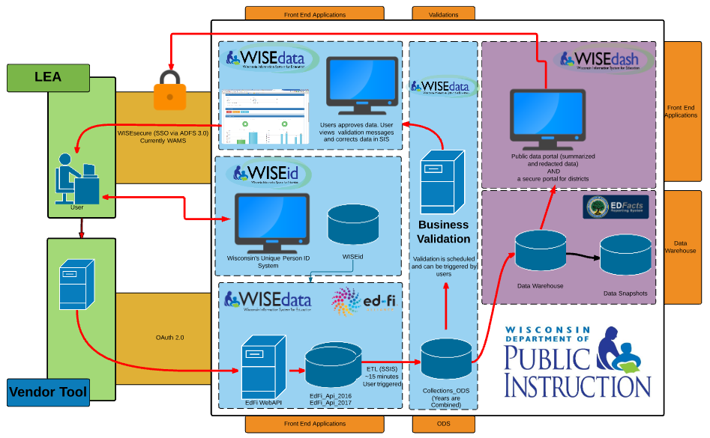
Notes:
John
Let us review the Wisconsin Ed-Fi implementation:
As you can see, there are several core components of the WISE suite. Let’s take a more detailed look at a flow chart to observe those WISE components and how they all work together.
LEA user enters info to WISEid (weekly) and into local SIS
That data from the SIS and from WISEid flow into WISEdata via the Ed-Fi API integration.
WISEdata runs a validation to check for sound and accurate data, rejects or reports errors and warnings accordingly back to LEA user.
LEA corrects and modifies data in SIS and WISEid until accurate and current.
Info in WISEdata collected (via snapshots and otherwise) into data warehouse and into WISEdash
WISEdash for Districts is a secure way for authorized LEA users to review submitted data in a timely and organized way.
WISEdash Public Portal is available to the public, such as for parents to view student data for their children’s schools.

Slide 90
Data Submission Process
SIS Selection: School selects a school information system (SIS).
Credentialing: School’s SIS must certify as their product is configured to WI Ed-Fi API standards to work with WISEdata.
User Security Setup: All users must register for WAMS IDs. WAMS IDs and/or Google credentials are used to log in to WISE applications via the WISEhome portal. District Security Administrators (DSA’s) will assign users’ security roles to access the various WISE applications.

Slide 91
Data Submission Process
Data Entry: Enter student data into the local SIS.
WISEid Setup: Request WISEids for all students and staff. This task is ongoing and can be done concurrently with data entry into your SIS.
WISEdata Portal Submission: Schools push data from their SIS to the WISEdata Portal for validation.
Validation Review: Users monitor and review the errors and warnings and make any necessary corrections in the SIS.

Slide 92
Data Submission Process
Continuous Collection:
Data updates are made in the SIS and pushed to WISEdata
DPI snapshots are taken periodically to “capture” data as of a given date
Snapshot data is used for state and federal reporting requirements

Slide 93
Data Privacy
Data Privacy Resources
Select Data Privacy from http://dpi.wi.gov/wise
Google Community: Wisconsin Educational Technology Leaders
https://plus.google.com/u/0/communities/116791071495953991220
Notes:
●We have many resources on our data privacy page available to you to use and reference in your districts and schools. Please use these resources in your districts!
●In addition, we are using the WETL-the Wisconsin Educational Technology Leaders google community as a way to connect around data privacy statewide.
●We encourage you to attend one of the PTAC sessions at the conference this year to learn more about specific topics around data privacy.

Slide 94
WISEdata Data Elements
Use the WISEdata Data Elements pages to view all the specific WISEdata data elements
The main page provides a quick summary of each element.
The links take you to individual pages that provide more detail about the element and which codes to report, as well as uses and FAQs.
This resource will be a staple when completing WISEdata reporting tasks and should be referenced often. You can link directly to data element pages from the WISEdata Portal.
Data Elements

Slide 95
Reporting Deadlines and Snapshots
See the WISEdata Events page for the most up-to-date information.
October 2021: approx. 8 weeks prior to snapshot
    DPI Data Quality outreach begins
December 2021 Snapshot
    2020-21 Year End
    2021-22 Third Friday of September Enrollment, Oct. 1 Child Count

Slide 96
Keep Track of Dates & Deadlines
Use the WISEdata Events Calendar to view snapshot and data submission deadlines. You can also register for User Group webinars and CESA trainings, as well as SIS vendor conferences.
You may view by the day or month view to see important events and dates.
https://dpi.wi.gov/wisedata/events/month

Slide 97
Confirm Contact Information
On your first log-in each school year you will be asked to enter your contact info - WISEid & WISEdata Portal
Both Primary and Secondary Contacts are required for each agency and must be updated each year
Generic contacts are optional

Slide 98
Stay in Contact
Weekly WISEdata user group webinars
Join our Google+ community (“Currents”) to connect with fellow WISEdata users and receive announcements and notifications from DPI and the WISEdata community
Annual WISEdata Conference

Slide 99
Getting Help
WISE Help Ticket for WISEdata Questions
https://dpi.wi.gov/wisedata/help/request
Notes:
Have a question, comment, and/or suggestion? Submit a help ticket and someone will respond to your question.
Two separate help tickets: one specifically around security and access and one for WISE questions

Slide 100
WISEsupport
Anyone can submit a WISEsupport Ticket.
WISEDATA/HELP / Start a WISEsupport Ticket
School
CESA WISEsupport Team
DPI Helpdesk

Slide 101
E-Learning & Certification
WISE Classroom E-Learnings
WISE User Basics
WISE Overview, WISE Security, Data Submission Process, Data Flow, Resources, *Certification Quiz
WISEid
WISEid Overview & Person Menu, WISEid File Tasks Menu, WISEid Reports *Certification Quiz
WISEdata
WISEdata Overview, WISEdata Exports, Validations, Roster, Career Education, Discipline, *Certification Quiz
WISEdata: Understanding Economically Disadvantaged Status Data Reporting
Economically Disadvantaged Status Data, Obtaining Economically Disadvantaged Status Data, Review in WISEdata Portal, Review in WISEdash for Districts, *Certification Quiz

Slide 102
Helpful Resources
WISEdata Help: links to WISE help pages and useful resources
Data Elements: list of links to all WISEdata data elements and their descriptions, uses, and codes
Knowledge Base articles: useful articles on validations and other related topics
Info for Schools: basics of getting started with WISEid
Google+ Community: WISEdata community to view and post questions and comments to fellow users
WISEdata Events Calendar: View deadlines, trainings, webinars, etc.

Slide 103


Giving Feedback
Within most DPI applications you can
provide feedback directly,
enter a new suggestion, and
vote on suggestions made by other people.

Slide 104


Thank you!

Slide 105
Licensing in Charter Schools
Julie Hagen
Education Consultant
July 2021

Slide 106

Licensing for Teachers
Teachers must hold a license that covers the grades and subjects they are teaching at the Tier I, Tier II (provisional), Tier III (lifetime) or Tier IV (master educator) level.
The tiered licensing system allows teachers to be hired without completing an approved program, but the tier of license will drive eligibility for other licenses.
Charter license requires demonstration of content knowledge.

Slide 107
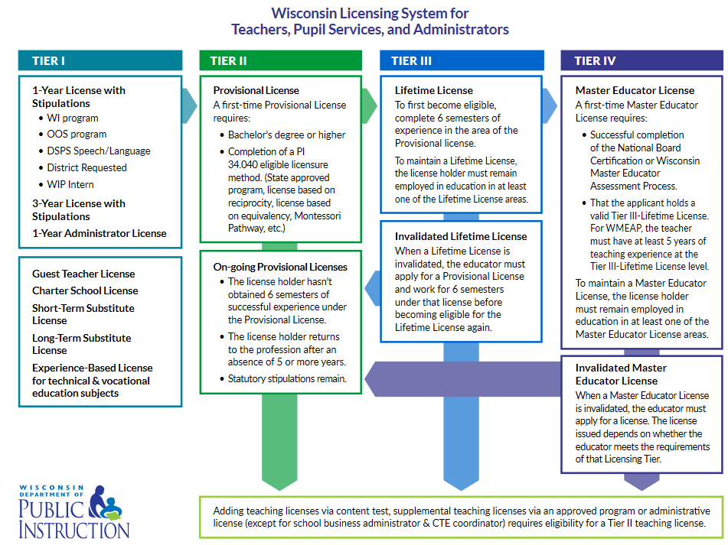
Tiered licensing

Slide 108
Typical Scenarios for teachers
Person with a bachelor’s degree is hired with no license
Licensing solution: Often times teachers are hired under the 1-year license with stipulations for the first year. By the end of the first year, the educator should either complete requirements for the charter school license or have made progress in an approved educator preparation program.
Person with a provisional license in math is hired to teach math and English
Licensing solution: A teacher can work under the 1-year license with stipulations for the first year. By the end of the first year, if this educator can pass a content test, can add another provisional license in English via content test or continue to renew the 1-year license with stipulations by making progress in an approved educator preparation program.

Slide 109

Licensing for Administrators
Charter School Principal license is the only Tier I level license.
Most principals or other school administrators will need to become eligible for a Tier II-Provisional license by completing a WI approved program or license by reciprocity or the out of state pathway.

Slide 110
Applicable law
Requirements for licensure: s.121.02/s.118.40(2r)
Charter school teacher license: s.115.28(7)(g)/s.118.40(2r)(d)1.
Charter school principal: s.115.28(7)(gm)
Virtual charter school requirements: s.118.40 (8)(b)

Slide 111
Got Questions?
If you have questions about licensing in general or for a specific person, submit your questions to:
https://dpi.wi.gov/support/contact-us

Slide 112
Title Slide
Accountability for Schools and Districts
2020-21 School Year
Office of Educational Accountability
July 2021

Slide 113
Sample Text Slide
Wisconsin Accountability
The Office of Educational Accountability implements several of Wisconsin's state and federal accountability systems.
  · State Accountability (report cards)
  · Federal ESSA Accountability (identifications)
Note: there is also IDEA accountability, which is implemented by the DPI special education team.

Slide 114
Sample Text Slide
State Accountability Report Cards
All public schools and districts receive accountability report cards. Choice schools also receive report cards for choice students.
At least two years of 20 tested students, who were enrolled for the full academic year, are required to produce an overall score and rating. If a school/district does not meet this, alternate accountability is used.
Report cards are required by state statute and are released in the fall of the following school year.

Slide 115
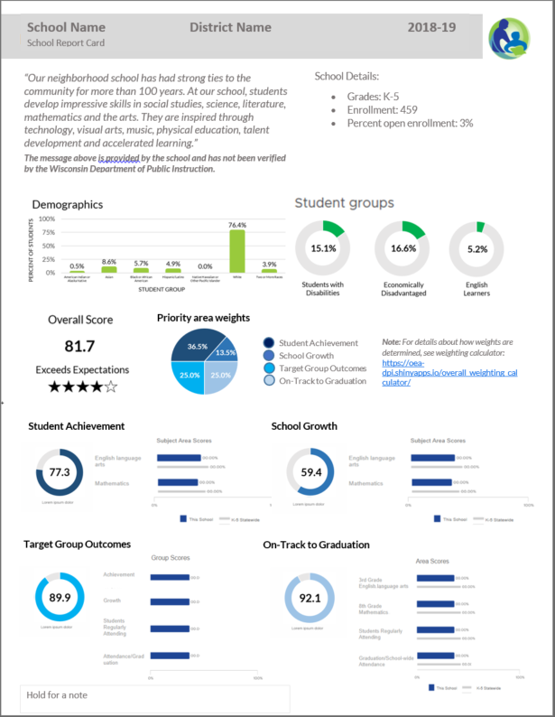
Sample Text Slide
Report Card Overview
· Overall score and rating
· School information
· Statement from School (optional)
· Four priority areas:
  Achievement
  Growth
  Target Group Outcomes
  On-Track

Slide 116
Sample Text Slide
Report Card Timelines
Two releases: Secure and Public
Secure release in October
  Via a secure login site (SAFE)
  Non-redacted data--should never be shared.
  Internal review, opportunity to open an inquiry for data corrections
wo releases: Secure and Public
Public release in November
  Final release – no more data inquiries

Slide 117
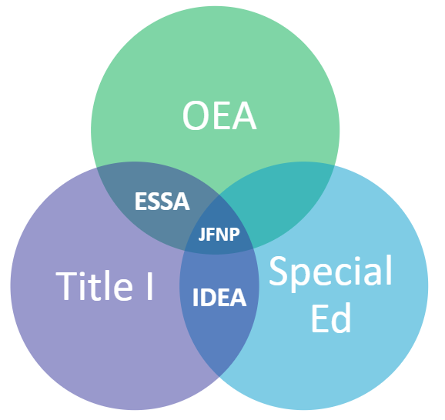
Sample Text Slide
ESSA Accountability is part of JFNP
ESSA Accountability is part of the Joint Federal Notifications Packet (JFNP) – a release system for two major pieces of federal legislation:
Three teams at Wisconsin DPI are part of the JFNP:
Every Student Succeeds Act (ESSA)
Individuals with Disabilities Education Act (IDEA)

Slide 118
Sample Text Slide
ESSA requires an identification system
Federal ESSA accountability requires an identification system:
  CSI: Comprehensive Support and Improvement
  TSI: Targeted Support and Improvement
  ATSI: Additional Targeted Support and Improvement

Slide 119
Sample Text Slide
ESSA Indicators
Absenteeism
ELP Progress
Growth
Achievement
Graduation

Slide 120
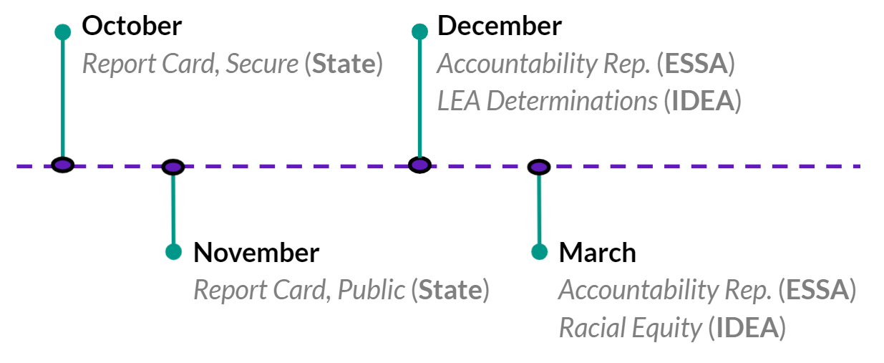
Sample Text Slide
Accountability Report Timeline

Slide 121
Sample Text Slide
Questions
Accountability Website:
https://dpi.wi.gov/accountability
Viji Somasundaram
Director of Accountability
Sam Bohrod
Assistant Director of Accountability
Patrick Chambers
OEA ​Education Consultant
Data and Policy Communications
?

Slide 122
ICS Basics
Alexander B. Roberson
Parental Education Options
School Administration Consultant
July 2021

Slide 123
What does it mean to be an ICS?
Independent Charter Schools are not authorized by a district
For the most part, statewide enrollment
No “open-enrollment”
Cannot be virtual

Slide 124
How do we get paid?
Schools submit a preliminary membership count report; a Third Friday in September count report; a Second Friday in January count report; and a membership audit
Payments in September, December, February, and June
See Program Calendar for specific dates

Slide 125
How do we get paid?
Submit the Pupil Count Report
Located on the ICS webpage
Instructions on the ICS webpage as well
Be sure to identify the correct resident district
Submit via Kiteworks on time

Slide 126
Who are our points of contact?
Everyone at DPI is student-driven and committed to helping you navigate and meet bureaucratic burdens so you can educate kids;
Unless you have a designated point of contact on another team (e.g., Program Calendar) contact Alexander B. Roberson first.
You should contact your board attorney, too.
You have friends at WRCCS.
You should always keep your authorizer informed.

Slide 127
Final Questions
Contact:
Alexander B. Roberson
School Administration Consultant
Alexander.Roberson@dpi.wi.gov
608.266.0452

