Slide 1
LEA 101
Establishing (and Maintaining!) an Independent Charter School as Local Education Agency in Wisconsin
Facilitated by
The PEO Charter Schools Team
with Department-wide support
and hosted by WRCCS July 2023

Slide 2
Agenda
9:00 –9:15: Welcome and Introductions 9:15 – 9:30: Office of Educational Accountability, Patrick Chambers 9:30 – 10:00: Financial Reporting & WUFAR, Matt Baier
10:00 – 10:15: Break
10:15 – 10:45: Title Funding, Brielle Glatzel 10:45 – 11:15: Special Education Data and Annual Identification, Courtney Reed Jenkins 11:15 – 11:45: Special Education Obligations, Patti Williams 11:45– 12:15: WISEData Review, Britt Mueller
12:15 – 1:15: Lunch
1:15 – 1:45: ELL/Multilingual Learners, Tanya Morin & Amy Maciolek 1:45 – 2:15: The Wonderful World of WRCCS, Dr. Sarah Hackett 2:15 – 2:30: ICS Basics, Alexander Burke Roberson

Slide 3
Life as an LEA
An Independent Charter School (ICS) becomes its own LEA (Wis. Stat. 115.775)
All state and federal requirements and obligations of a school district belong to the governing board of the ICS charter school
e.g., Civil Rights; ADA; IDEA; § 504; ESEA; FERPA; McKinney-Vento

Slide 4
Accountability
a charter school LEADER/OPERATOR is accountable to their GOVERNING BOARD
the GOVERNING BOARD is held accountable by the AUTHORIZER through non-renewal and revocation or required corrective action plans
There may be state and federal consequences for malfeasance, misfeasance, or nonfeasance (e.g., failure to provide a Free and Appropriate Public Education)
There are private rights of actions (e.g., ADA) that permit you to be sued

Slide 5
Disclaimers
This presentation is not all-encompassing or final.
This is a 30,000-foot view. You are still responsible for knowing the “Google Street” view.
The content of this presentation is for informational purposes only and not for the purpose of providing legal advice. You should contact your attorney to obtain legal advice, including compliance with state and federal laws and regulations.

Slide 6
LEA 101
School & District Report Cards
Office of Educational Accountability
July 20, 2023

Slide 7
School and District Report Cards
All Wisconsin public schools and districts and choice schools receive a report card annually per state statute. This includes charter schools.
Report card score requires two years of at least 20 tested students, who were enrolled for the full academic year.
Schools that do not have enough tested students (including new schools) participate in alternate accountability.

Slide 8
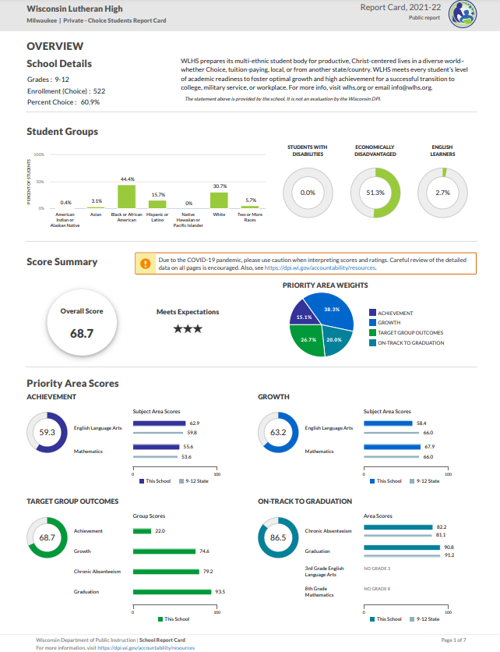
Report Card Overview
Report cards contain the following information:
Overall score and rating
School information
Statement from School (optional)
Four priority areas:
Achievement, Growth, Target Group Outcomes, On-Track to Graduation
For schools with grades 9-12
Course and program data (not on front page)

Slide 9
Report card timelines
Two report card releases: Secure and Public
Secure release in Oct
Via a secure login site (SAFE)
Non-redacted data--should never be shared.
Internal review, opportunity to open an inquiry for data corrections
Public release: Nov
Final release – no more data inquiries
New schools in 2023-24 will receive their first report card(s) in the fall of 2024. Those report cards will be rated using alternate accountability because we will only have one year of data for the school. Their first scored report cards will come in the fall of 2025.

Slide 10
Report Card Resources
Please visit our Accountability Resources webpage for resources specific to last year’s report cards and stay tuned to this page for updated resources in the fall.
Here are some other helpful links related to report card requirements and reporting:
Snapshot Preparation
Course and Program Data
Report Card Inquiry Process
Notification Requirements
For questions about report cards, please contact OEA at ReportCardHelp@dpi.wi.gov

Slide 11
Questions?
Viji Somasundaram
Director of Accountability
Sam Bohrod
Assistant Director of Accountability
Patrick Chambers
OEA ​Education Consultant
Data and Policy Communications

Slide 12
Hold for Matt Baier

Slide 13
Financial Reporting, WISEdata Finance & WUFAR
LEA 101
7/20/23

Slide 14
What is WISEdata Finance?
DPI’s new secure application to accept the submission of financial data from LEAs’ financial systems
Data is sent directly to WISEdata Finance (WDF) via the Ed-Fi API from the LEA’s system, just as student data is sent directly from the LEA’s Student Information System (SIS)
Financial data is collected to meet reporting requirements and calculate state aid payments.

Slide 15
What is WISEdata Finance?
LEAs use finance vendors pull the current Wisconsin Uniform Financial Accounting Requirements (WUFAR) Chart of Accounts (COA) from DPI
District crosswalks ledger to a Local COA in WUFAR and pushes data to WDF
The Local detail COA rolls up to the required DPI COA level
District pushes financial data as three sets of data: Local Accounts, Budget Amounts and Actual Amounts

Slide 16
What Does This Mean For LEAs?
LEA’s financial ledger (the local “books”) pushed to WDF must be consistent with WUFAR accounting and the DPI Chart of Accounts to avoid WISEdata Finance reporting quality issues
Validations are triggered within WISEdata Finance
WiSFiP will be developed to collect additional information to supplement WISEdata Finance data in order to complete reporting requirements.
Notes:
Wisconsin Uniform Financial Accounting Requirements (WUFAR)
https://dpi.wi.gov/sfs/finances/wufar/overview

Slide 17
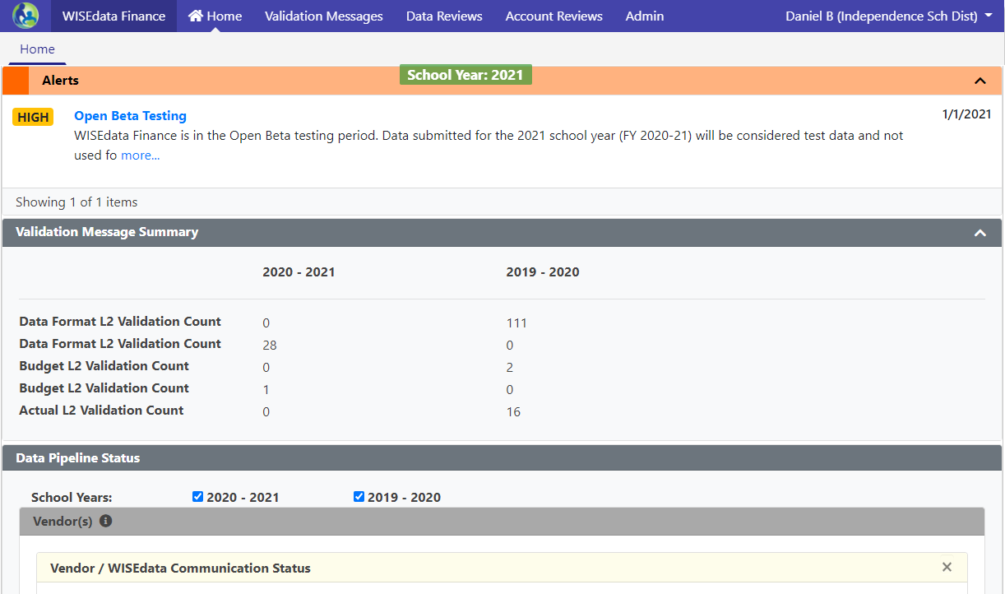
Mindset Shift: WISEdata Finance
Data submissions in WISEdata Finance are point-in-time looks, and it helps to think about data validations more as bringing issues to your attention than giving you a list of errors to clear
“Doing the report” will mean pushing clean data
Fixing your books and pushing that data to WDF is how you fix your reporting

Slide 18
Alternative Reporting Mechanism (ARM)
WISEdata Finance includes an upload-based alternative reporting mechanism (ARM) available to LEAs for submitting financial data to DPI without the use of an Ed-Fi certified financial software vendor.
Primarily designed as an option for Independent Charter Schools to address concerns around the cost of school financial software and differences in accounting requirements for ICS versus school districts.
Notes:
ICS

Slide 19
Validations - Tools to Confirm Data
Two levels of validation rules at work:
Level 1 (L1) validations reject’s LEA data before it can be stored in our data warehouse. Validation message are triggered when data is pushed to DPI.
Level 2 (L2) validations are run on data saved into the data warehouse (have passed L1 validations). These validations trigger based on data format issues or for specific fiscal criteria.

Slide 20
Addenda
Reduced the number of Addenda for LEAs to complete
Addenda triggered by specific fiscal criteria to collect additional required information
Completed through either WDF or within the Budget or Annual Report in WiSFiP

Slide 21
Landing Page - Validation Summary Panel
Panel has been updated to display count summary for L1 data validations, L2 data and financial validations, and Addenda by status.

Slide 22
New Process - Financial Transparency
We recommend LEAs push financial data to WISEdata Finance at least monthly, suggested as a task after the monthly bank reconciliation
Set up a scheduled job to push data if vendor offers the functionality

Slide 23
WI School Finance Portal
Which you will probably only hear referred to as WiSFiP (whiz-fip)
DPI’s next generation portal to house all school finance related reporting going forward
Hosted in WISEhome, along with other DPI secure applications (WISEdata, WISEgrants, WISEdash)
Access to applications managed through WISEsecure by agency

Slide 24
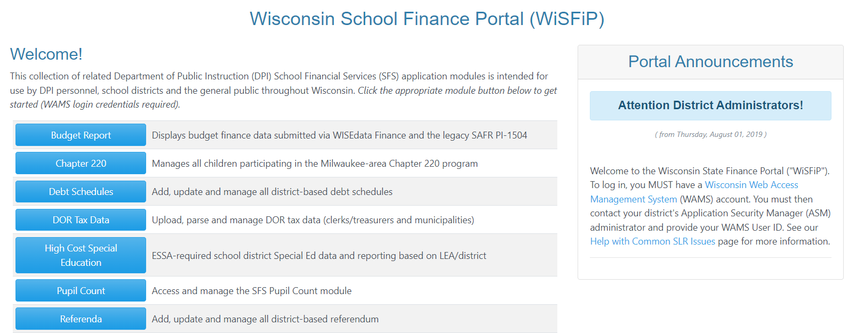
Wisconsin School Finance Portal
WiSFiP is the platform that will house all School Finance Reporting going forward.

Slide 25
WiSFiP Development Timeline
Budget Report (replacing the PI-1504)
Annual Report (PI-1505)
Special Education Annual Report (PI-1505-SE)
Pupil Count Report (PI-1563) developed and in pilot phase with small group of LEAs

Slide 26
What is WUFAR?
A multi-dimensional reporting system that can also be used as an accounting system by the Local Education Agency (LEA).
Not required for accounting, but required for reporting and claims to DPI.
Always used in conjunction with the state Budget and Annual Reports (full and special education), as well as ESSA School-Level Reporting.

Slide 27
Why WUFAR?
DPI needs a uniform system for reporting LEA activity for:
Reporting purposes (both state and federal)
Calculating general and categorical aid
Determining compliance with federal regulations
Comparing activity between LEAs
State budget building
Ensuring compliance with Uniform Grant Guidance requirements to track federal grant expenditures
Notes:
DPI uses WUFAR because every State Education Agency needs a uniform system for reporting both state and federal activity and fiscal reports. It also enables DPI to calculate state-funded general and categorical aids paid to the LEAs. The program teams use it to determine compliance with federal regulations. And lastly, the standardized financial information we receive from the LEAs helps DPI create a state budget and requests for funding from the legislature because we are able to determine local need.

Slide 28
GAAP & GASB
WUFAR meets requirements under Generally Accepted Accounting Principles (GAAP) and Governmental Accounting Standards Board (GASB) which apply to all state and local governments.
Changes to GAAP and GASB are one of the primary reasons DPI makes revisions to WUFAR on a periodic basis.

Slide 29
WUFAR Sequence of Dimensions
This sequence is what you would normally see when looking at an expense report.
Fund
Location
Object or Source
Function
Project
Notes:
There are five components of the WUFAR expenditure account string. ^Fund, ^Location, ^Object of Expense, ^Function, and ^Project. We usually add the word “Code” onto Object and Project – so you will hear someone saying “What is the Object Code?” or “What Project Code should we use?”

Slide 30
WUFAR Account Sequence
A WUFAR account is a sequence of dimensions:
10
E
120
111
122150
141
Fund – Type – Location – Object/Source – Function - Project
Notes:
At the LEA-level, using WUFAR allows for a consistent system and common language around expenditures and revenues. By using WUFAR, LEAs can easily communicate among themselves and work with DPI regarding allowable costs, state aid payments, and audits.

Slide 31
WUFAR is Hierarchical
100000 Instruction
WUFAR dimensions “roll up” from lower detail levels to higher summary levels
A zero means “this includes anything at a lower level with a digit here”
120000 Regular Curriculum
122000 English Language
122100 Language Skills
122150 Reading Specialist

Slide 32
WUFAR is Hierarchical
DPI only defines dimensions to a certain level
100000 and 120000 are required functions for reporting to DPI
122000 and 122100 are optional DPI-defined functions for local use
122150 is a locally created function for an even greater level of detail
100000 Instruction
120000 Regular Curriculum
122000 English Language
122100 Language Skills
122150 Reading Specialist

Slide 33
WUFAR is KEY
Simplified and flexible chart of accounts - ensures adherence to state and federal financial reporting requirements, and gives LEAs the ability to segregate and group accounts.
Revisions to WUFAR are done on at least a yearly basis to address needed changes, fix errors, or adhere to requirements under GAAP and GASB.
DPI Chart of Accounts integrated by the vendor. Ensure your local accounts account for changes to WUFAR and the DPI COA so accounts roll up correctly.
Notes:
What are the drivers of the system modernization?
The system has become difficult to manage, utilize outdated or overly-expensive technologies (classic ASP, .NET webforms, and Oracle), and no longer meet DPI IT standards.
School-level reporting: nothing we had could accommodate this. Data was collected through .csv files and the data was not identified by location or school level.
A chart of accounts is an organizational tool.
Not rip and replace, rather custom-configure a system that works with our needs

Slide 34
Chart of Accounts
Vendors mapped the LEA’s detailed accounts to a general umbrella DPI account - WISEdata Finance displays both the DPI account and the local detailed account.
Local Account | DPI Account | Budget | Actual
27E-100-411-152000-347 | 27E-100-410-152000-000 | $1,500.00 | $1,292.13
27E-100-412-158000-019 | 27E-100-410-158000-000 | $5,000.00 | $2,563.00
By using the “mapping” methodology, DPI no longer has to create hundreds of accounts every time a new grant is created.
By collecting the Local Account, DPI’s program areas have access to the level of detail necessary to determine compliance with Federal grant regulations.

Slide 35
Resources
WISEdata Finance and WiSFiP webpage
WUFAR webpage
Introduction to WUFAR
For WISEdata Finance questions submit a help ticket
https://dpi.wi.gov/wisedata/help/request
General SFS questions: dpifin@dpi.wi.gov
Matt’s Booking page:
https://outlook.office365.com/owa/calendar/MatthewBaier@WIDPIPRD.onmicrosoft.com/bookings/

Slide 36
Questions
Notes:
What’s working

Slide 37
Overview of
Title I, Part A

Slide 38
ESEA and Title I, Part A
Purpose: Provide all children significant opportunity to receive a fair, equitable, and high-quality education, and to close educational achievement gaps.
Title I, Part A funds are targeted to high-poverty LEAs and provide supplementary education to students who are educationally disadvantaged or at risk of failing to meet the state standards.
20 USC 6301
Notes:
The Elementary and Secondary Education Act (ESEA) was first enacted in 1965 with the goal to reduce achievement gaps by providing all children fair and equitable education. ESEA includes numerous programs across a total of ten titles, including Title I. While Title I contains many components, we’re just going to focus on Title I, Part A.
Under the Title I, Part A grant funds are targeted to high-poverty school districts and are used to provide supplementary education to students who are educationally disadvantaged or at risk of failing to meet the state standards.

Slide 39
ESEA Titles

Slide 40
Allocation of Funds to LEAs
The formula is based on:
the state’s average per pupil expenditure, and
the count of children from low-income families.
US Census Bureau
Small Area Income and Poverty Estimates (SAIPE) are used to determine poverty.
20 USC 6333
Notes:
The formula to allocate funds to LEAs relies on two primary elements: the state's average per pupil expenditure and the LEA's count of children from low-income families.
For Independent Charter Schools, the allocation is calculated off of poverty counts of students by district, using the resident district’s poverty %.

Slide 41
Allocation of Funds to LEAs
Basic
Targeted
Financial Incentive
Concentration
15%
X
X
X
X
LEA Poverty Percentage
5%
X
X
X
2%
X
20 USC 6333
Notes:
An LEA's Title I allocation is based on the LEA's US Census Bureau's poverty percentage and consists of as many as four separate funding streams: basic, targeted, financial incentive and concentration grants. (CLICK)
If an LEA has at least 10 children in poverty and the number of children in poverty exceeds 2% of the LEA's total student population, the LEA is eligible for a basic grant. (CLICK)
Targeted and Financial Incentive Grants are distributed to LEAs with at least 10 children in poverty and the number of children in poverty is at least 5% of the LEA's school aged population.
If an LEA is teeters between 5%, the LEA could see it’s allocation increase or decrease between years. If at 5% or higher, the LEA will receive their allocation from the three funding streams. But, if an LEA is falls below 5%, the allocation will only receive funding from the basic funding stream. (CLICK)
Finally, an LEA with a poverty rate of 15% or more, will receive the first three funding streams plus the concentration stream.
Similar to LEAs that teeter around 5%, LEAs that teeter around 15% can experience drastic shifts in their allocations between years because they go between three to four funding streams.
Regardless of the number of funding streams that go into the allocation, an LEA only receives one Title I allocation each year.

Slide 42
Equitable Participation
ESEA contains provisions that require an LEA to provide equitable services to private school children attending a private school located within the LEA’s boundaries. These provisions, often referred to as equitable participation, are required under each of the Title formula grants.
Since Independent Charter School LEAs do not have geographic boundaries there are no equitable participation requirements for charter-school LEAs.
However, you may notice functionality in WISEgrants that references Private Schools, as this requirement applies to some district LEAs.

Slide 43
Reservations
The LEA may take funds “off the top” of their allocation to support certain initiatives before making per pupil amount allocations at the school level.
Some reservations may be required. Other reservations are optional and at the discretion of the LEA.
20 USC 6313(a)(3)

Slide 44
Required Reservations
Homeless Reservation:
Required for all LEAs.
Used to provide equitable services to students experiencing homelessness at any time during the year.
Family Engagement Reservation:
Required only if the LEA’s allocation is greater than $500,000.
Must reserve at least 1% of allocation for family engagement activities.
20 USC 6313(c)(3) and 6318(a)(3)

Slide 45
Reservations
Optional reservations may include:
Family Engagement (if LEA’s allocation is less than $500,000),
Administrative Costs,
Centralized Services (if multiple charter school LEA),
Professional Development,
Services to specific student groups (i.e. students in out-of-home care, in neglected/delinquent institutions, or with migratory status), and
Additional financial resources for LEA’s with Title I Targeted Support Identification (TSI) and/or Comprehensive Support and Improvement Identification (CSI).
20 USC 6313

Slide 46
Title I School Eligibility
For district LEAs, school building eligibility is determined through ranking based on poverty.
For most Independent Charter School LEAs, which consist of a single school, ranking is considered a formality, and the PPA can be determined by dividing the available funds by the low-income enrollment.
20 USC 6313

Slide 47
Who are “Title I Eligible” Students?
Targeted Assistance
Schoolwide (SWP)
Title I students are identified through a multi-step process.
All students are Title I students.
Schools must first use multiple academic measures to identify eligible students.
Then schools rank students according to academic need.
Schools are not required to rank students for services. The SWP upgrades the educational program for all students while addressing the needs of the lowest achieving students.
Notes:
In a Targeted Assistance Program, Title I students are identified through a multi-step process. Schools must first use multiple academic measures to identify eligible students, then rank and serve students according to academic need.
Students do not have to be from low-income families to receive services. Low-income poverty data is used to determine a Title I School’s eligibility for funding. Poverty data is not used to determine which students to serve. Once the funding reaches the school, children are selected for services solely on the basis of academic need.
In a Schoolwide Program all students are Title I students and are a part of the Title I program.
All staff at the school are also Title I staff. Finally as you might have guessed it, all families are Title I families.
In other words, that comprehensive program should aim to meet the needs of all students, staff, and families!
.

Slide 48
Allowable Costs & Needs
Targeted Assistance
Schoolwide
Services for the needs of Title I students, parents, and educators.
Strategies identified through the Schoolwide Plan.
Allowable costs must meet the needs identified for the Targeted Assistance program.
Allowable costs must support the comprehensive improvement efforts identified through the Schoolwide Plan.
Notes:
For Title I schools implementing a Targeted Assistance program, the budget item should address the needs of the eligible Title I students, their parents, and their educators.
And, for Title I schools implementing a Schoolwide program, the budget item should support the comprehensive improvement efforts identified in the schoolwide plan, because all students in a schoolwide program are eligible to receive services.

Slide 49
Title I Allowable Costs
Is the proposed budget item addressing the needs of Title I students?
Does the cost adhere to the Uniform Grant Guidance, EDGAR, and the LEA policies?
Allowability checklist
Notes:
So how should an LEA determine if a cost is allowable under Title I?
Each LEA is required to have written procedures to determine allowability of costs and those procedures should include a step for the LEA to ensure that the school received its full share of state and local funds. When that is confirmed, the LEA needs to make sure the proposed budget item is addressing the needs of Title I students.
Additionally, like all budget items charged to any federal grant, the costs must be reasonable and necessary to meet the purpose of Title I.

Slide 50
Grant Period & Carryover Policy
Fiscal Year: July 1 to June 30
LEA’s Allocation* Less than $50,000 | LEA’s Allocation* Greater than $50,000
No limit on carryover. | LEAs may carryover 15% of the total allocation. LEAs must apply for a waiver to carryover more than 15% of the total allocation. This is only allowed once every three years.
*Allocation plus any funds transferred to Title I, Part A.
20 USC 6339
Notes:
Title I allocations are aligned to our state's fiscal year. This means that a grant's obligation period begins on July 1 and ends on June 30. For FY24, this would be July 1, 2023 through June 30, 2024.
Grant funds not spent within the fiscal year the funds are awarded may be carried over into the next fiscal year. The amount that can be carried over depends on the size of the LEA's allocation.
Districts receiving a Title I allocation less than $50,000 can carry over any remaining funds.
A district with an allocation of $50,000 or greater than $50,000 can only carry over 15% of the total allocation.
It is important to note that carryover is based off the LEA’s Title I-A allocation amount plus an funds transferred from Title II-A and/or TIV-A.

Slide 51
Title I Technical Assistance
Title I Shorts
http://dpi.wi.gov/title-i/title-i-shorts
DPI’s Title I Website
https://dpi.wi.gov/title-i
Notes:
For technical assistance on various topics covered in this presentation, please visit the DPI Title I website. There are Title I Shorts which are short videos, under 5 minutes, explaining different Title I topics.

Slide 52
Joint Federal Notifications
Office of Educational Accountability
Special Education
Title I - Continuous Improvement
July 20, 2023

Slide 53
Identifications Respond to Needs
 | IDEA | ESSA
Legislation | Individuals with Disabilities Education Act | Every Student Succeeds Act
Goal | Provide students with disabilities a free, appropriate public education | Enhance outcomes for all students
Report Level | Districts | Schools (Does not apply to choice schools)
Identifications | LEA Determinations Meets Requirements Needs Assistance Needs Intervention Needs Substantial Intervention Racial Equity in Special Education Yes No | Schoolwide Comprehensive Support & Improvement (CSI) Student Subgroups Targeted Support & Improvement (TSI) Additional Targeted Support & Improvement (ATSI)

Slide 54
There are 3 ESSA Identifications
least severe
most severe
TSI
ATSI
CSI
Targeted Support & Improvement
Every year
Identifies low performing school student groups
Bottom 10% of overall performance and
bottom 10% of student group
Additional Targeted Support & Improvement
Every 3 years
Identifies lowest-performing school student groups
ATSI schools are TSI schools that fall below the CSI threshold
Comprehensive Support & Improvement
Every 3 years
CSI-Lowest Performance
Bottom 5% of Title I schools ranked by summary score
CSI-Low Graduation Rate
Schools <67% graduation rate
Notes:
PC

Slide 55
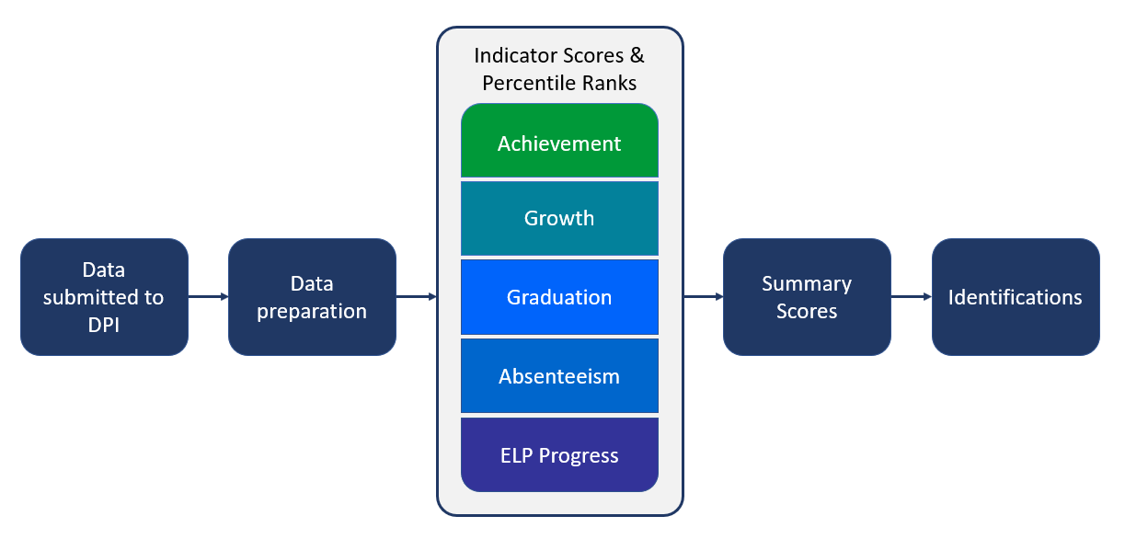
Entering ESSA Identifications
Notes:
PC

Slide 56
Entering ESSA Identifications
Achievement
3rd-8th and 11th grade assessment results from Forward, ACT, and DLM
Growth
4th-8th grade student growth percentiles (SGPs)
Graduation
4-year and 7-year graduation rates
Absenteeism
Chronic absenteeism rates
ELP Progress
SGPs for English learners
Notes:
PC

Slide 57
Exiting ESSA Identifications
There are three exit criteria for schools with CSI and ATSI identifications.
TSI identifications do not have an exit process, because the identifications are for one year only.
Exit Criterion | Definition
1 | Not be eligible for identification in the current year
2 | Make sustained and sustainable improvement toward the long-term goals
3 | Demonstrate evidence of systems, structures, and/or procedures that ensure sustained and sustainable high-quality improvement planning and practices are in place
Notes:
PC

Slide 58
IDEA LEA Determs with Required Actions
least severe
most severe
Needs Assistance
Needs Intervention
Needs Substantial Intervention
Score of 60-79%
Required actions for this determination begins upon the second consecutive year of the finding.
Score of <60%
Required actions begin immediately, with additional requirements upon three consecutive years of this finding.
Not Score Dependent
Usually the result of incomplete and/or inaccurate reporting which prevents DPI from issuing a determination based on data.

Slide 59
IDEA LEA Determinations
Results | Compliance
Graduation | IDEA Part C to Part B Transitions
Dropouts | Timely Initial Evaluations
Assessment Participation | Post-Secondary Transition Plans
Assessment Proficiency | Corrected Non-Compliance
Placement | Timely and Accurate Data

Slide 60
All LEAs Receive Reports
Release | Date | Reports | Location
Preliminary | February 2024 | ESSA Accountability Report IDEA LEA Determinations District Summary Report | SAFE
Final | April 2024 | ESSA Accountability Report IDEA LEA Determinations District Summary Report IDEA Racial Equity in Special Education | ESSA Public App and SAFE
*Select ESSA-identified schools also receive ESSA Progress to Exit reports
Key Takeaway:
Every LEA receives a JFN packet so that every LEA has data in support of continuous improvement.

Slide 61
Continuous Improvement Process
ESEA improvement plan for focus and/or priority schools
IDEA improvement plan(s)
Continuous improvement of adult practices to improve student outcomes
School and district improvement plans

Slide 62
Statewide System of Supports
Intensive:
MPS/Racine
Needs Intervention
Targeted: Networked Improvement Teams:
TA Network for Improvement
Wisconsin Urban Leadership Institute
IDEA discretionary grant projects
Universal:
Educator Effectiveness
Equitable Multilevel Systems of Support
IMPL

Slide 63
Key Take-Aways
December 5, 2023
DATA SNAPSHOT
Ensure accurate data
February 2024
SECURE ACCESS FILE EXCHANGE
Review JFN Packet
Spring 2024
CONTINUOUS IMPROVEMENT
May have required activities

Slide 64
Independent Charter Schools and Special Education
Patricia Williams
Director, Special Education Team
July, 2023

Slide 65
Overview
Evaluations
Providing Free Appropriate Public Education (FAPE)
IEP development

Slide 66
Independent Charter Schools and Special Education
Although exempt from many state laws, independent charter schools must comply with federal laws such as the Individuals with Disabilities Education Act (IDEA)

Slide 67
Special Education Enrollment
May not deny admission to students based on disability
May not deny admission to a student with a disability solely because of a need for special education or related services

Slide 68
Evaluation Responsibilities
Accept referrals
Anyone may make a referral
Must be in writing
Must include the name of the child and why the person believes the child has a disability
School staff often assist parents in completing forms

Slide 69
Referral for Evaluation
Individuals required to make referrals
DPI licensed school staff
Physicians, nurses, psychologists, social workers and administrators of social service agencies
Teachers and other professionals must inform parents they are going to make a referral
Anyone else, including parents may make a referral

Slide 70
Evaluation Process and Timelines
Review of existing data by IEP team
Seek parental consent for conducting assessments
Conduct assessments and gather information
Meet to determine eligibility
60 days from receipt of parental consent

Slide 71
Disability Categories
Autism
Blind and Visually Impaired
Deaf and Hard of Hearing
Deafblind
Emotional Behavioral Disability
Intellectual Disability
Orthopedic Impairment
Other Health Impairment
Significant Developmental Delay
Specific Learning Disability
Speech or Language Impairment
Traumatic Brain Injury

Slide 72
Child with a Disability
Two-part test
First, does the child meet the educational eligibility impairment criteria for one of the disability areas that adversely affects their educational performance
And, as a result of the disability, does the child need special education and related services

Slide 73
Section 504 Eligibility
A person is eligible if they have a physical or mental impairment which substantially limits one or more major life activities, has a record of such impairment, or is regarded as having such impairment
“Major life activities” means function such as caring for one’s self, performing manual tasks, walking, seeing, hearing, speaking, breathing, learning, and working. Not an exhaustive list
Schools may use the same evaluation process as under IDEA.
If eligible, develop a 504 accommodations plan
Notes:
If the child does note meet eligibility requirements, the child may need a 504 plan.

Slide 74
LEA Responsibility
Independent Charter Schools, as an LEA, must ensure the provision of a free appropriate public education (FAPE) to children with disabilities in virtual schools
IEP developed that meets FAPE standard and is implemented

Slide 75
What is FAPE?
FAPE as defined by IDEA means special education and related services that
Are provided at public expense under public supervision and direction,
Meet the standards of the department and Part B of IDEA, and
Are provided in conformity with an IEP

Slide 76
Rowley and Endrew F
Rowley (1982): The IEP must be reasonably calculated to enable the student to receive educational benefit
Endrew F (2017): The IEP must be reasonably calculated to enable a student to make progress appropriate in light of the student’s circumstances
Notes:
These US Supreme Court decisions outline the requirements of an IEP

Slide 77
FAPE
Districts must provide FAPE to each student with a disability by developing a program based on the student’s unique needs that is reasonably calculated to enable the student to make progress appropriate in light of the student’s circumstances, documenting that program in the IEP, and implementing the program articulated in the IEP

Slide 78
Required IEP Team Participants
The student’s parent(s)
At least one regular education teacher of the child
At least one special education teacher of the child
A representative of the local educational agency (often called LEA Rep)
A person able to interpret the instructional implications of evaluation results
Others with knowledge or special expertise about the child
Whenever appropriate, the student (must be invited if purpose is to determine postsecondary goals and transition services)

Slide 79
IEP Contents
Present Levels
Effects of Disability
Disability Related Needs
Goals
Services

Slide 80
Special Education
Special education means specially designed instruction, regardless of where the instruction is conducted, that is provided at no cost to the child or the child’s parents, to meet the unique needs of a child with a disability

Slide 81
Key Concepts
IEPs must be individualized/based on student’s unique needs
Appropriately ambitious in light of the student’s circumstances
Reasonably calculated

Slide 82
IEP Implementation
Schools must have an IEP in place for each student with a disability at the beginning of the school year
IEPs must be implemented as written

Slide 83
Behavior: IDEA Requirements
If the student’s behavior impedes his or her learning, or the learning of others, the IEP team must consider the use of positive behavioral interventions and supports, and other strategies to address the behavior.
Notes:
The IEP team must determine how these supports can be provided in a virtual setting (examples….)

Slide 84
Behavior and FAPE
Failure to address the behavioral needs of a student with a disability can result in both a denial of FAPE and a denial of placement in the least restrictive environment.
Addressing behavioral needs may include developing goals, providing specially designed instruction, related services, et cetera.
Notes:
Patti
Failing to address the behavioral needs of a student can result in both a denial of FAPE to the student and a denial of placement in the least restrictive environment.
In a Dear Colleague letter issued by OSEP in 2016, it was stressed that the consideration of whether a student needs positive behavioral supports and strategies applies regardless of the student’s specific disability, and is a consideration for every IEP team. The letter goes on to state that incidents of misbehavior and classroom disruptions, as well as violations of a code of student conduct, may indicate that the student’s IEP needs to include appropriate positive behavioral supports. This is especially true when there is a pattern. So the letter emphasizes that the behavioral needs of a student must be addressed in the IEP.

Slide 85
Resources
IEP Forms
Forms Guide
Model Policies and Procedures
CCR IEP Framework and Resources

Slide 86
Resources
CESA 1 Special Education Capacity Building Initiative
Supports independent charter schools in compliance, programming (focus on literacy), data collection and reporting, and fiscal management.
Resources include a special education roadmap, planning template, and special education process outline.

Slide 87
Questions?

Slide 88
WISE Reporting
WISE Basics & WISEdata Portal Navigation
Britt Mueller
WISE Relationship Manager
Customer Services Team

Slide 89
Requesting WISE Access
User Security Setup: WAMS IDs and/or Enterprise Google accounts are used to log in to WISE applications via WISEhome. District Security Administrators (DSAs) and Application Administrators will assign users’ security roles to access the various WISE applications.
WISEhome - homepage for your WISE application access
Request a User Role - instructions on how to request an application user role
WISE User Roles - different user roles within each application

Slide 90
WISE Applications
WISEid: an application that allows you to assign a unique identifier to students and staff for reporting.
WISEdata Portal: a multi-vendor, open data collection application that allows you to submit data to DPI from your student information system (SIS) vendor.
WISEdash for Districts: a secure application that allows you to review data as it will be publicly reported and allows you to make informed decisions about student learning.

Slide 91
Data Submission Process
Data Entry: LEA (school/district) enters student data into the local SIS.
WISEdata Portal Submission: Schools push data from their SIS to the WISEdata Portal for validation.
Validation Review: Users monitor and review the errors and warnings and make any necessary corrections in their SIS.
Once the data is submitted correctly, it will flow into the data warehouse, also known as WISEdash.

Slide 92
Data Flow
Data Entry
WISEdata Portal Submission
Validation Review
Accountability Report Card is pulled from the WISEdash for Districts.
Once the data is submitted correctly, it will flow into the data warehouse, also known as WISEdash.
LEAs (school/district) collect student data and enter into the local SIS.
LEAs push data from their SIS to the WISEdata Portal for validation.
LEAs monitor and review the errors and warnings and make any necessary corrections in their SIS.

Slide 93
Data Submission Process
Continuous Collection: Schools maintain high quality data, updating information as needed.
Snapshot: DPI snapshots are taken periodically to obtain particular data statistics as of a given date. That data is used for state and federal reporting requirements.

Slide 94
WISEdata Portal
Navigate to WISEhome (you will want to bookmark this)
Log in using your WAMS or Google login information
Select WISEdata Portal

Slide 95
Helpful Resources
WISEdata Help: Links to WISE help pages and useful resources
Mini Tutorials: Tutorials to assist with individual tasks within the applications
Data Elements: List of links to all WISEdata data elements and their descriptions, uses, and codes
Knowledge Base Articles: (KBA) Useful articles on validations and other related topics
Info for Schools: Basics of getting started with WISE
WISEdata Annual Tasks Checklist: General guide of necessary tasks and preparation for each of the collections and snapshots
WISEdata Events Calendar: View deadlines, trainings, webinars, etc.

Slide 96
Stay Connected
Join the weekly WISE User Group Calls to hear weekly updates from different teams and ask questions of DPI staff on the call
Join our Google+ Community to connect with fellow WISEdata users and receive announcements and notifications from DPI and the WISEdata community
Submit a Help Ticket for our WISEsupport or Customer Service Team to assist you
Attend one of the New User Trainings for additional navigation and portal review

Slide 97
Lunch Break
Notes:
Tanya
Welcome to our LEA 101 presentation on English Learners
Put questions in chat
Will also be time for questions at the end

Slide 98
LEA 101: English Learners
Amy Maciolek, DPI
Tanya Morin, DPI
July 20, 2023
Notes:
Tanya
Welcome to our LEA 101 presentation on English Learners
Put questions in chat
Will also be time for questions at the end

Slide 99
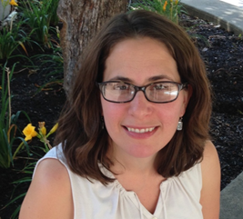
Introductions
Amy Maciolek - ML/Title III
608.266.1570
amy.maciolek@dpi.wi.gov
Tanya Morin- Dual Language/Bilingual-Bicultural
608.267-9393
tanya.morin@dpi.wi.gov
Jesse Roberts - EL Assessment
608.267.5153
jesse.roberts@dpi.wi.gov
Notes:
Tanya/Amy
Who we are
What we do
Mention Jesse as ACCESS testing person

Slide 100
Who is an English Learner?
An English learner (EL) is a student:
aged 3-21;
enrolled or preparing to enroll in elementary or secondary school
who was not born in the United State or whose native language is a language other than English; and
where difficulties in speaking, reading, writing, or understanding of English may be sufficient to deny them
the ability to meet State’s proficient level of achievement on State assessments
the ability to successfully achieve in classrooms where language of instruction is English; or
the opportunity to participate fully in society
Notes:
Tanya
Many terms you might hear for students who speak a language other than English at home (ELL, multilingual learner, emerging bilingual, etc.)
Official legal term per Title III/ESEA - English Learner (EL)
Official definition (age, enrolled in school, not born in US or native language is a LOTE, level of English proficiency impacts academic achievement, ability to participate fully in society)
Schools/districts have certain legal responsibilities they must meet when serving these students - which we will review during this presentation

Slide 101
English Learner Alphabet Soup
ELDS
HLS
LIEP
LIEP Crosswalk
BLBC
ESL
Exited or Reclassified
EL
ELP or ELD
DLL
ML/MLL
ACCESS for ELLs
Screener
LTEL
Photo by Farzad Mohsenvand on Unsplash
timer: https://www.youtube.com/watch?v=CH50zuS8DD0y
Notes:
Amy
Invite participants to put in the chat what there are

Slide 102
English Learner Alphabet Soup
EL- English Learner
ELP/D - English Language Proficiency/Development
DLL- Dual Language Learner
ML/MLL - Multilingual Learners (Emergent Bilingual)
ACCESS for ELLs - Assessing Comprehension and Communication in English State-to-State for English Language Learners
WIDA Screener- Assessment used for identification of ELs
LTEL- Long-term English Learner
ELDS- English Language Development Standards
HLS - Home Language Survey
LIEP = Language Instruction Education Program
LIEP Crosswalk- Document outlining sound language programs
BLBC - Bilingual-Bicultural Program
ESL - English as a Second Language (license 1395)
Exited /Reclassified- when a student’s EL status is changed to former EL.
Notes:
Amy

Slide 103
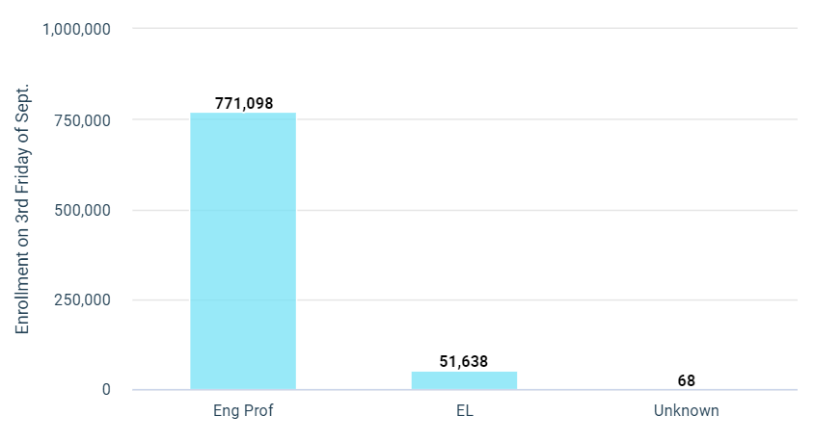
Wisconsin EL Landscape
2022-2023
51,638 students, represents 6.7 % of the current enrolled students reported. (SY21-22: 49,812)
Total School Population: 771,098
Nearly 80% of ELs identify Spanish as their first language.
Top Languages:
Spanish
Hmong
Arabic
Chinese
Somali
Enrolled student population as report via WISEdash Public Portal. Retrieved May 30, 2023
Notes:
Amy
English learners in WI - number, languages, in communities across the state, including larger urban districts, suburban districts, and smaller, rural districts.

Slide 104
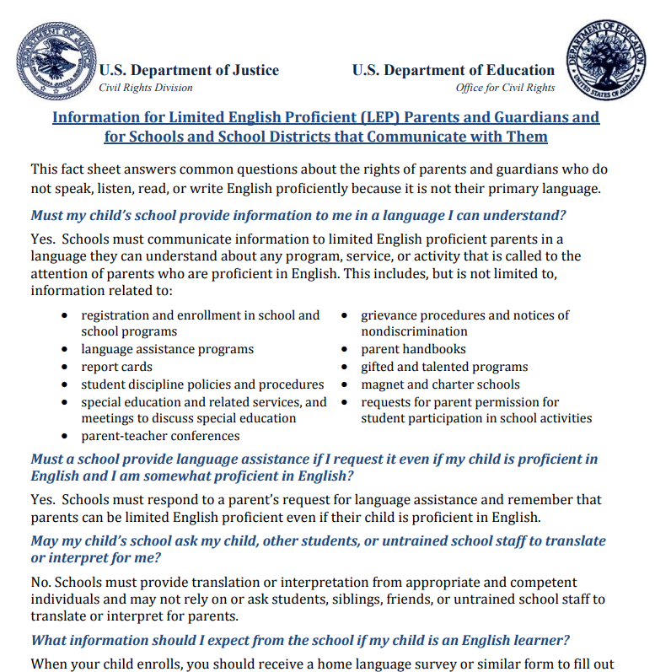
Legal Requirements: Federal
ESEA (Title I, III)
Civil Rights Act of 1964
Equal Education Opportunities Act
Lau vs. Nichols
Castañeda vs. Pickard
See Fact sheets and Chapter 14 of EL Policy Handbook
Notes:
Amy

Slide 105
Civil Rights Obligations
Identify and assess all potential English Learners
Provide students with a language assistance program
Provide sufficient staffing and resources to have an effective program.
Provide meaningful access to all curriculum and extra /co-curricular programs
Core curriculum and Specialized Curriculum
Avoid unnecessary segregation of students
Evaluate EL students for Special Education services
Meet needs of students whose parents have opted them out of an ESL program
Monitoring and exiting students from EL Programs
Demonstrating the effectiveness of programs
Ensure meaningful communication with EL parents
Notes:
Amy

Slide 106
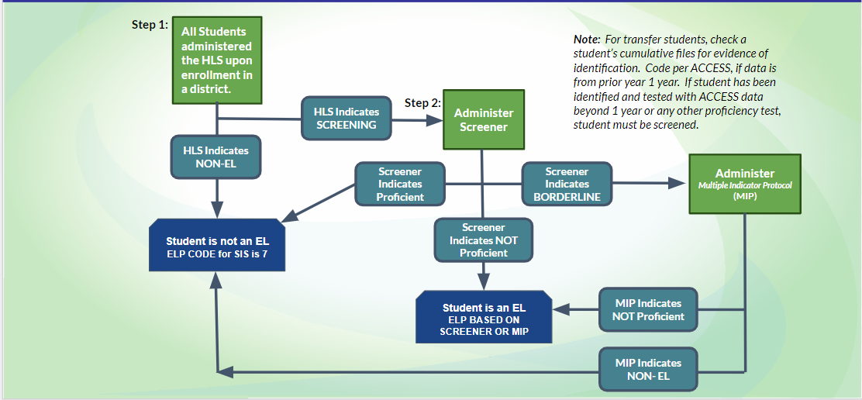
Entrance Procedures
Notes:
Amy
Highlight - translations available on website
Two-step process, Lau plan

Slide 107
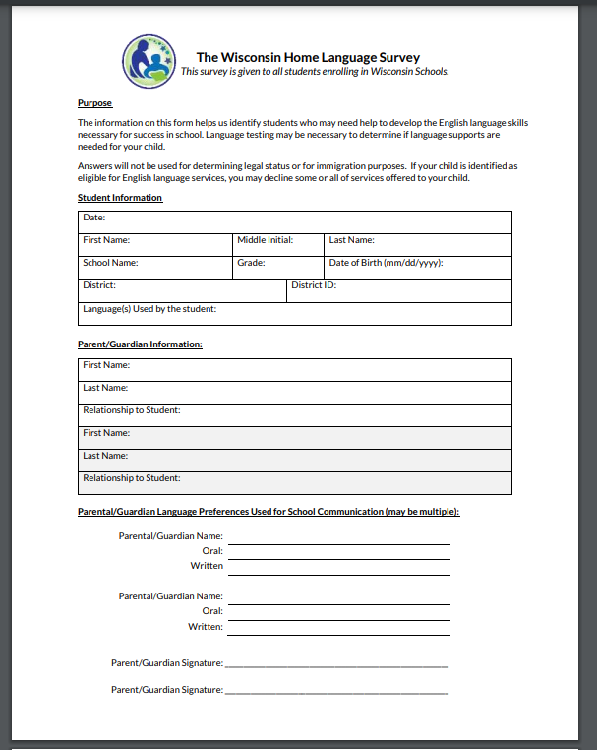
Home Language Survey (HLS)
Purpose:
Use of Language in the home
Identify students (language support)
Language Needs of Caregivers
See EL Policy Handbook chapters 1-3
Notes:
Amy

Slide 108
Parent Notification
the expected rate of transition from such program
expected rate of graduation from high school
how such program meets the objectives of the individualized education program
reasons for the identification of their child
placement in a language instruction educational program;
child’s level of English proficiency, how such level was assessed,
the status of the child’s academic achievement;
methods of instruction used in the program, methods of instruction used in other available programs,
how the program will meet needs of their child
how such program will specifically help their child learn English and meet age-appropriate academic achievement standards
specific exit requirements for the program
Must be provided in writing:
right that parents have to have their child immediately removed from such program
options that parents have to decline to enroll their child in such program or to choose another program or method of instruction,
assisting parents in selecting among various programs and methods of instruction
Parent Notification Tool
Notes:
Amy

Slide 109
Effective Programs
LEA/SEA required to ensure districts provide effective programming for ELs
Language assistance programming for EL students must:
Be educationally sound in theory and effective in practice
Include sufficient staff and resources.
Be regularly assessed and continually improved, Effective
Additionally, districts must be able to demonstrate program effectiveness in supporting both:
Academic content needs of ELs
EL students’ English language proficiency proficiency growth
See DPI’s EL Policy Handbook Chapter 8 for more information
Notes:
Amy

Slide 110
Program Models: LIEP Crosswalk
Language Instruction Educational Program (LIEP)
Plan for serving EL students
Variety of models: LIEP Crosswalk
LIEP flowcharts
See Chapter 8 of EL Policy Handbook for more details
LIEP webinar
Notes:
Tanya
Chapter 8 of handbook: https://docs.google.com/document/d/1lUN0b-Iam2FLbOd1b2MALAqIagu0qB-oMvbNU-kvS60/edit
Revised crosswalk
Codes for students
Bil/ESL
Flowchart

Slide 111
English Language Development Standards
State required to adopt English Language Development (ELD) Standards
WI Standards: WIDA English Language Proficiency Standards
Aligned to ACCESS for ELLs
Guiding Beliefs for the Language Development of ELs
See DPI’s ELD Standards webpage for more information
ELD Standards 101 webinar
Notes:
Tanya
Requirement - Comes from Title I of ESEA/ESSA
Adoption - 20-21
WIDA 2020 ELDS Framework/can find on DPI website and WIDA website
21-22 - first year of rollout, 22-23 continue rollout, building understanding, preparing for implementation

Slide 112
ACCESS for ELLs
Required to assess English language proficiency (ELP) for all ELs annually, including for students whose caregivers have refused services
Must use state-defined ELP assessment
ELP assessment for WI: ACCESS for ELLs
Annual ELP assessment window: December - February.
Check annually with DPI’s Office of Student Assessment for exact dates
See Chapter 5 of EL Policy Handbook for more details
Notes:
Tanya
Frequency/timeline
Reporting scores
Exiting based on scores

Slide 113
ACCESS Test
WIDA Score Range 1.0-6.0 and Labels
5
BRIDGING
6
R
E A C H I N G
A student’s proficiency level is determined by the annual English proficiency test. For the state of Wisconsin, this test is called the
WIDA ACCESS for ELLs
4
EXPANDING
3
DEVELOPING
ENGLISH PROFICIENT
An overall composite score of 5 or higher is required in the state of WI to be considered proficient.
2
EMERGING
TYPICAL GROWTH
English Learners
Range: 1.0-4.9
Multiple Indicator Protocol
Range: 4.5-4.9
1
ENTERING
Notes:
Tanya
Most of you are probably familiar with the ACCESS- English Language Proficiency test. Just a couple of reminders pertaining to this specific test.
Students are still required to take the ACCESS assessment, even if parents/caregivers have refused services.
There really is no caregiver opt-out provision for the language assessment.

Slide 114
Exit Procedures
ACCESS Testing
Composite 5- MUST exit
Composite 4.5-4.9 (may exit w/MIP)
2 year Monitoring upon exit
See Chapter 6 and Chapter 15 of EL Policy Handbook for more details
Notes:
Amy

Slide 115
Data Reporting
Data Elements:
Immigrant children
Languages spoken
Primary Service: LIEP
ACCESS Data
Long Term ELs
* This list is not exhaustive
Notes:
Amy
Immigrant children - beginning of year
LIEP - beginning of year
ACCESS - initial id - beginning of year

Slide 116
Family Engagement Requirements
Title I/III family Engagement
Family and Community Engagement
Families meaningful engage in the education of their children
Holding and Sending Notice of opportunities for regular meetings* in order to gather and respond to recommendations from parents.
*regular meetings are defined as a minimum of 2 meetings annually.
Notes:
Amy

Slide 117
State Bilingual Education Requirement
Wisconsin Statute 115.95 – State bilingual education requirement
Threshold numbers:
10 students in grades K-3
20 students in grades 4-8
20 students in grades 9-12
Create and communicate plan for bilingual-bicultural (BLBC) program
Approved programs eligible for reimbursement of a percentage of costs
See DPI’s Bilingual-Bicultural page for criteria and application information
Notes:
Tanya
State-level bilingual ed requirement
Applies to districts serving a certain number of students from the same language group
Trigger numbers - based on grade bands
Offer bilingual services/program - instruction in the home language of students using appropriately certified teachers
State aid
If you believe you meet those numbers, contact me about submitting an initial plan or getting a waiver

Slide 118
Professional Learning and Networks
WIDA training
Self-paced workshops
Facilitated workshops
CESA EL Networks/Consortia
EL Stakeholders
District Admin and EL Coordinators
Title III listserv (email Amy)
BLBC listserv
Notes:
Tanya
WIDA trainings - shared via network meetings, Title III listserv, Google currents
State-level conference
Partner with CESAs to offer EL networks/consortia

Slide 119
Resources
DPI’s Bilingual and English Learners webpage
DPI’s EL Policy Handbook
USED/OELA EL Toolkit
USED/OELA Newcomer Toolkit
Center for Applied Linguistics
WIDA self-paced workshops
Notes:
Tanya
Many helpful resources
Encourage you to join the Title III listserv - contact Amy

Slide 120
Questions?
Notes:
Tanya/Amy

Slide 122
WRCCS Beliefs and Assumptions
EVERYONE IS DOING THEIR ABSOLUTE BEST with what they have been given.
NO JUDGEMENT today or in the future about what you have done and/or what you are planning on doing to best serve your community.
IMPROVEMENT WILL BE NEEDED as we continue to roll out strategies and systems.
TOGETHER WE ARE STRONGER as we share ideas and support.
CONTROL WHAT WE CAN CONTROL knowing our daily actions will influence positive outcomes.
WE MAY SHARE RESOURCES presented to assist in improving charter schools across the state.
Notes:
We will share resources except if not ready for public.

Slide 123
WRCCS Website

Slide 124
Work to support specific needs of All schools to meet the needs of ALL students
Build a continuous warehouse of resources and awareness of the needs and strengths of
WI Charters.
Cultivate relationships among schools and facilitate sharing of high quality practices.
Notes:
Nick

Slide 125
WRCCS Team

Slide 126
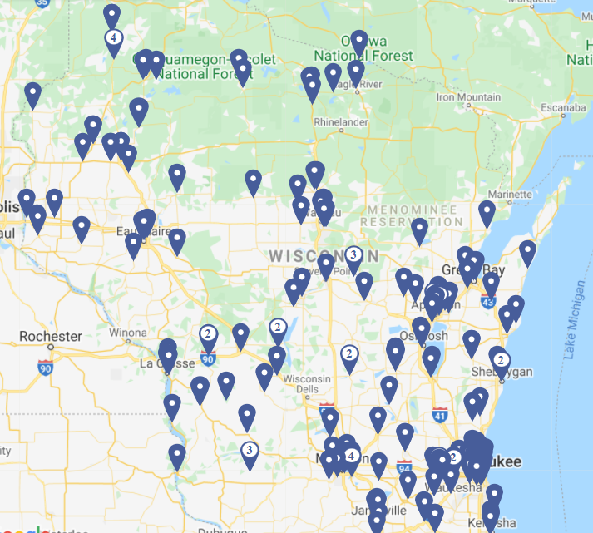
50,861
Charter School Students
236
Charter Schools
100
Authorizers
95 authorizers are school districts

Slide 127
Celebrate the Past!
Let’s Celebrate together!
Celebrate a success or a solution that
your school team or board successfully
implemented in the past year
Notes:
WRCCS Rep - take note of celebration and upload here: https://docs.google.com/spreadsheets/d/1Uy-JhehVpILy3upbFdt2NYUxJbBDQ2P7sJlQw6TDIdQ/edit#gid=1920429508
Chamomile

Slide 128
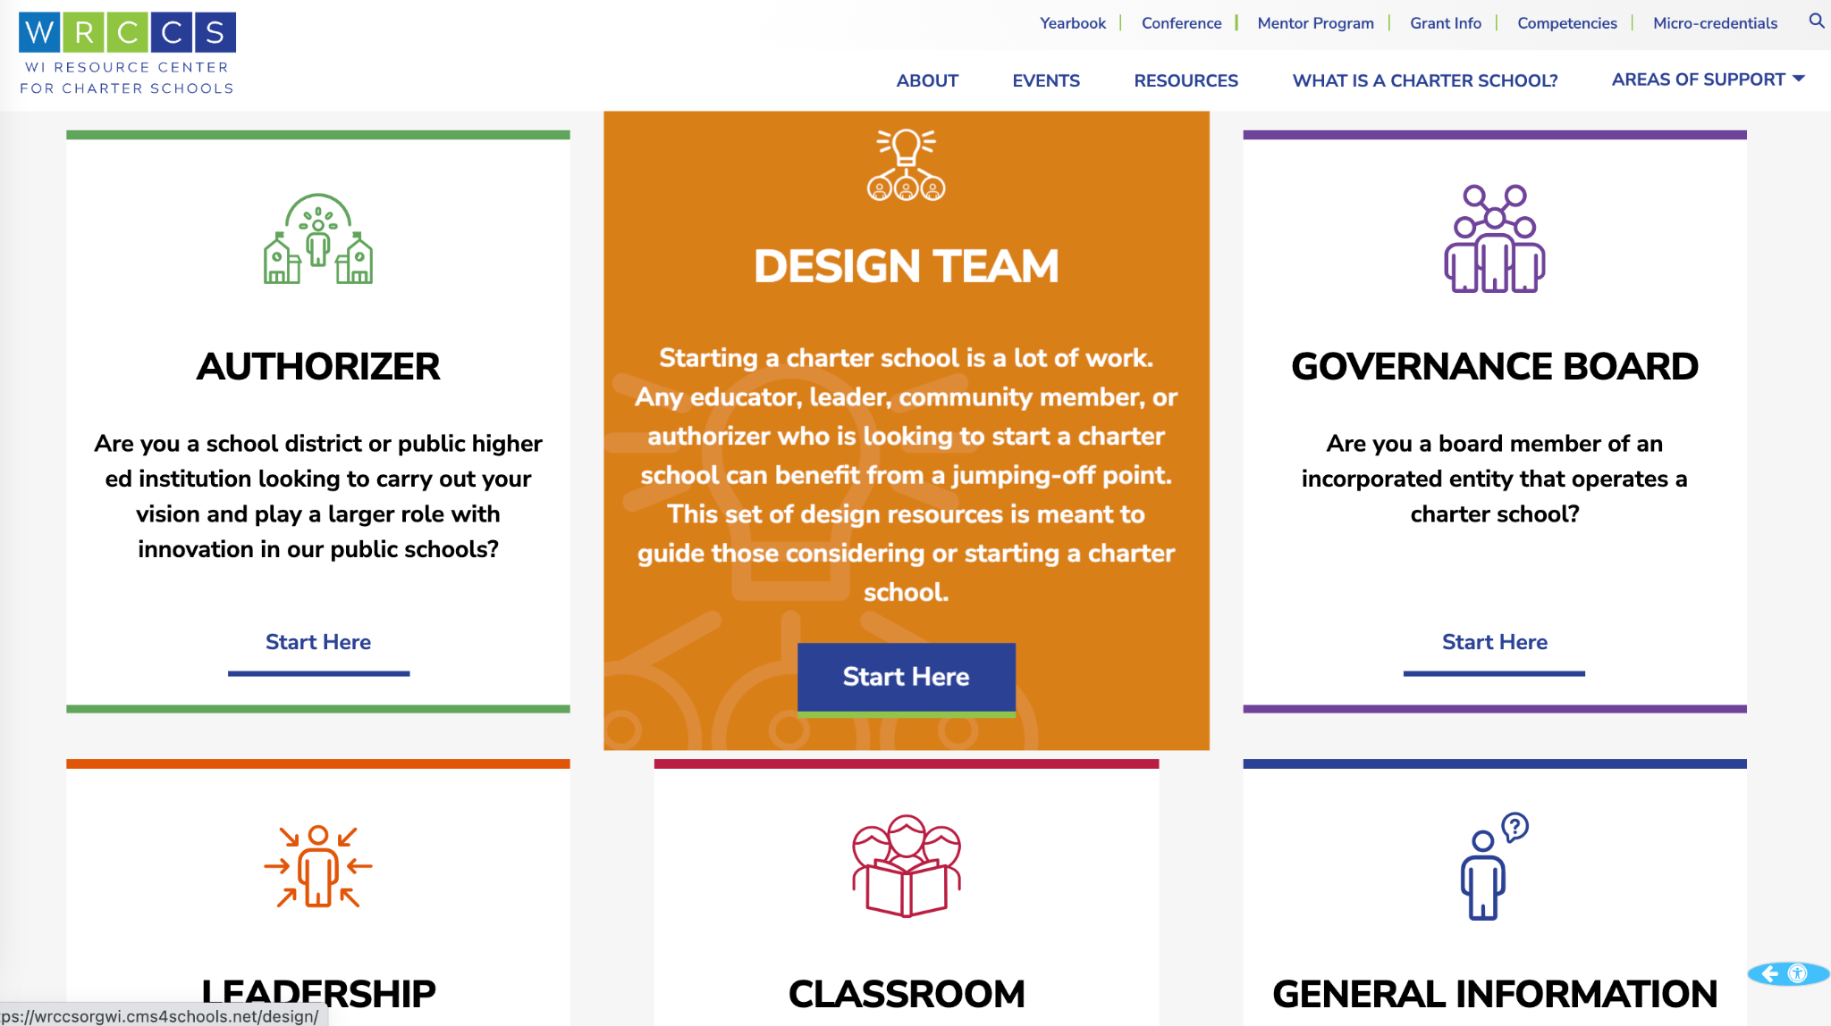
WRCCS Competencies
Academic Program
Business Operations
Community Engagement
Culture
Effective Governance
Legal
Mission
Performance Monitoring
Recruiting Students
Resources
Staffing
Strategic Planning
Technology Considerations
WRCCS Support

Slide 129
Charter School Competencies
Authorizer:
Charter School Performance Monitoring
Charter School Application Review Process
Purpose, Mission and Vision Development
Meeting Community Needs
Legal Responsibilities
Governance Board:
School Leader Evaluation
Governance Practices
Organizational Structures and Procedures
Policy and By-law Development
Self-Assessment
Charter Leadership:
School Culture
Human Resource Management
School Leadership Teams
Staff Evaluation
School Finance
Charter Classroom:
Virtual and Blended Learning Systems
Personalized Learning
School Culture
Designing Learning Targets
Academic Program
WRCCS also offers resources for families,
students, and communities.
See full competencies list here!

Slide 130
WRCCS Resources Available
1:1 trainings throughout the state
personalized support & coaching
online documents, eCourses, videos
annual charter schools conference
workshops and networking communities (online and in person)
Authorizers
Classroom Educators
Families / Caregivers
Leaders
General Information
Governance Boards

Slide 131
Specific Resources for Independent Charter Schools and LEAs
5-year budgeting sample
Life as an LEA guide
Charter School Policy Manual
Independent 2r Model Contract
Independent 2r Charter School Contract Benchmarks

Slide 132
Micro-credential Opportunity
Get Recognized for the work you are ALREADY doing!
Defend at the WRCCS conference - July
Resources:
WRCCS Micro-credential Guidebook
WRCCS Micro-credential Overview Video
WRCCS Micro-credential Defense Protocol
WRCCS Micro-credential Reviewer Rubric
Apply Here
If you have questions contact Zaynab - zbaalbaki@wrccs.org

Slide 133
WRCCS is supported by the work of:
21 mentoring charter schools in Wisconsin
20+ professional organizations and consultants

Slide 134
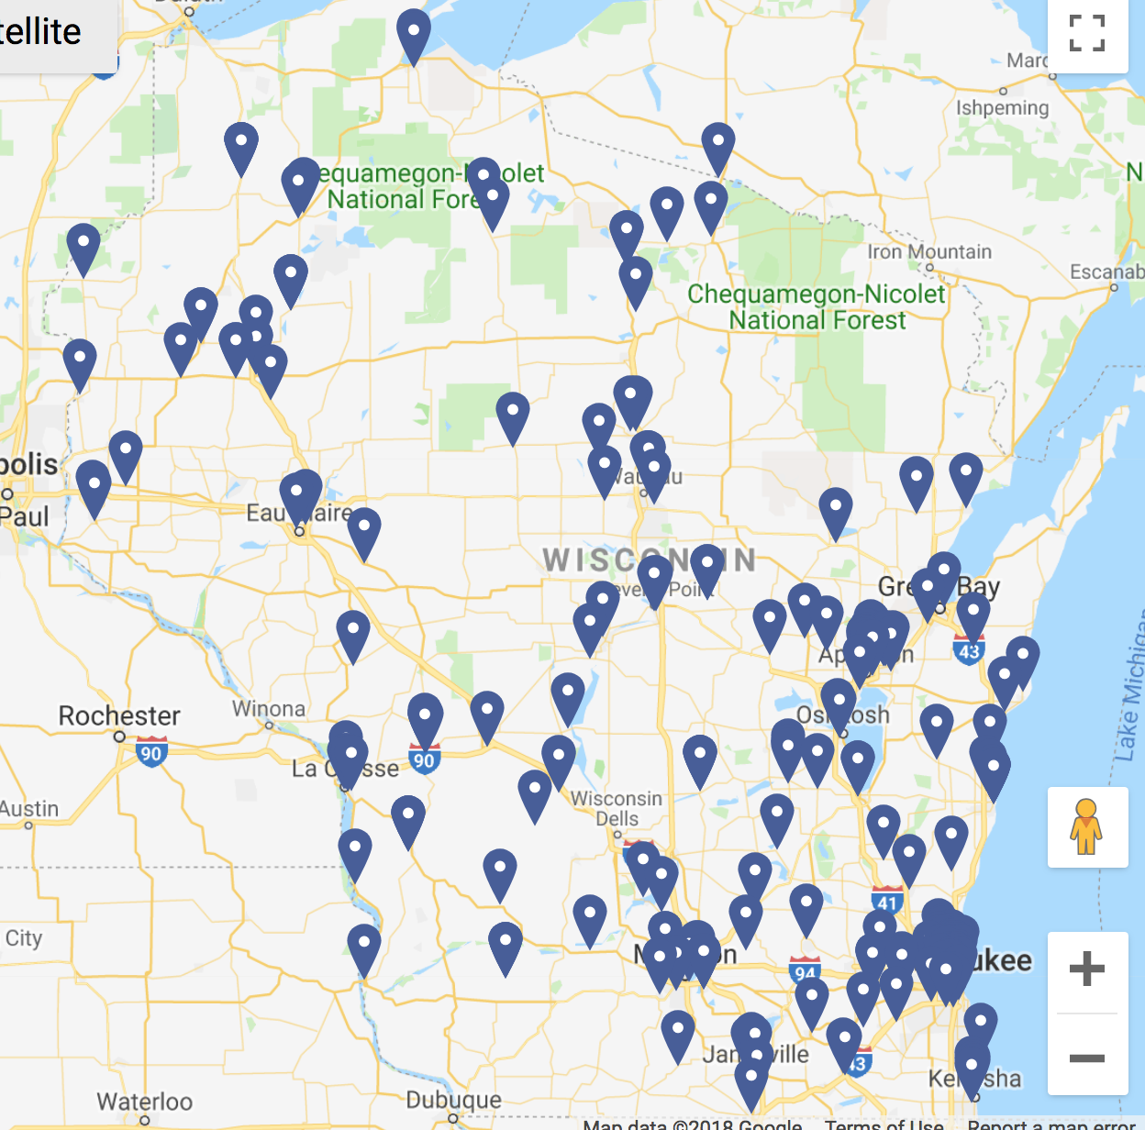
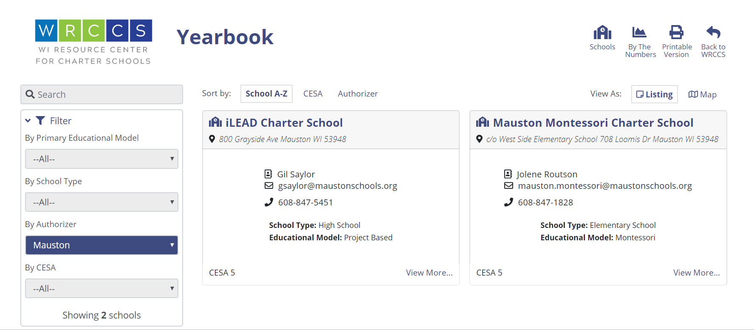
Wisconsin Charter Schools Yearbook

Slide 135
Professional Learning Networks
Project Based Learning
Charter School Governance
Virtual Charter Schools (collaboration with DPI)
Charter School Design Team
District Authorizing
Charter Leadership
ICSs (collaboration with DPI)
Click here to register

Slide 136
Agenda Overview
Tuesday, July 25, 2023 Charter Governance and Authorizer Day
Wednesday, July 26, 2023
Charter Leadership and Classroom Day
Click to sign up your team!
Notes:
Nick

Slide 137
Where can we go from here??
Sign up for the 23-24 WRCCS PLNs (more coming soon!)
Sign up for the WRCCS newsletter and/or the WRCCS google groups
Join us in January at the WASB conference or April at the ISN conference
Reach out to schedule school visits, access personalized support, discuss engaging in PD from WRCCS and our partners, or give us ideas for how we can support you!

Slide 139
Independent Charter School Basics
Facilitated by
Alexander Burke Roberson July 2023

Slide 140
Independent Charter School Basics
Per Wis. Stat. 118.40(7)(b), chapters 115 to 121 of state law do not apply to charters “except as explicitly provided.”
Per Wis. Stat. 115.775, an Independent Charter School (ICS) becomes its own LEA.
There are is a distinction between independent charter schools, based on the authorizer, that impact the source and method of per pupil aid payment.
There is no difference between 2r and 2x or Legacy and New ICS that impact the amount of per pupil aid payment or eligibility for categorical aids

Slide 141
What does it mean to be an ICS?
State-wide enrollment, without the need for students to open enroll.
Cannot be a virtual school.
Not authorized by a district, so ICS operate without district supports.
The LEA reporting obligations and civil rights responsibilities fall on the school.

Slide 142
What do we get paid - Per Pupil?
The independent charter school per pupil aid payment amount for both (2r) and (2x) charters schools is based on a formula found in 118.40(2r)e.
(see also, (2x)(e)1m)
The dollar amount is determined by adding:
1) the adjustment to the revenue limit, if positive;
2) the sum of a calculation that determines the change in the amount of certain statewide categorical aids per pupil between the previous school year and the current school year, if positive, and;
3) the sum of the amount paid the year prior.
In 2023-24, the ICS Per Pupil Aid Payment is $11,385

Slide 143
What do we get paid - Categorical Aid?
Independent charter schools are eligible for some (e.g, special education) but not all (e.g., per pupil) state categorical aid.
All independent charter schools are eligible for the same categorical aids.
All independent charter schools are eligible for Title, IDEA funding, Special Education aid, food service aid, transportation aid, and various grants.
https://dpi.wi.gov/sfs/aid/categorical/overview

Slide 144
How do we get paid?
For per pupil, schools submit a preliminary membership count report; a Third Friday in September count report; a Second Friday in January count report; and a membership audit
A lot of important data we use are in the hidden columns.
Payments in September, December, February, and June
See Program Calendar or Payment Letter for specific dates
Other payments are based off data in the WISE Systems

Slide 145
How do we get paid?
Submit the Pupil Count Report
Located on the ICS webpage
Instructions on the ICS webpage as well
Be sure to identify the correct resident district
Submit via Kiteworks on time

Slide 146
Who are our points of contact?
Everyone at DPI is student-driven and committed to helping you navigate and meet bureaucratic burdens so you can educate kids
Unless you have a designated point of contact on another team (e.g., Program Calendar) contact Alexander B. Roberson first.
You should contact your board attorney, too.
You should always keep your authorizer informed.

Slide 147
How will we know what to do?
Independent Charter Schools Program Calendar
Emails from DPI
Some from PEO, some from other teams
Some emails will go only to the email on the school directory
Payment Letters, Instructions on the website
Visit the ICS webpage first
Sometimes other webpages don’t apply to ICS

Slide 148
Final Thoughts
Not trying to play “gotchya!”
Surprises v Bad News
Please keep me informed
DPI wants to support in navigating your bureaucratic burdens so you can focus on educating Wisconsin students.

