Slide 1
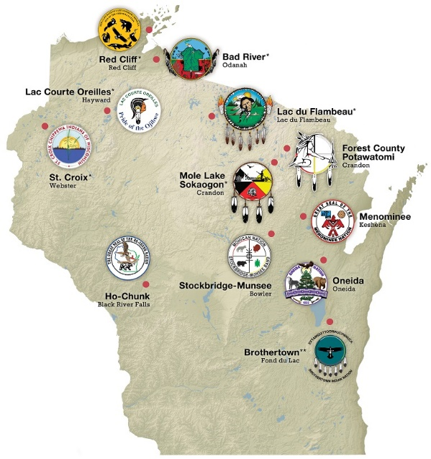
American Indian Studies Wisconsin Act 31
Notes:
“Wisconsin Act 31” refers to the requirement that all public school districts and pre-service teacher education programs provide instruction in the history, culture, and tribal sovereignty of the 11 federally recognized American Indian nations and tribal communities in the state of Wisconsin.
List of Wisconsin’s 11 federally recognized American Indian nations:
Ojibwe (Chippewa) Six Bands
Bad River Band of Lake Superior Chippewa
Lac Courte Oreilles Band of Lake Superior Chippewa
Lac du Flambeau Band of Lake Superior Chippewa
Sokaogon Chippewa Community (Mole Lake Band of Lake Superior Chippewa)
Saint Croix Chippewa Indians of Wisconsin
Red Cliff Band of Lake Superior Chippewa
Forest County Potawatomi
Ho-Chunk Nation
Menominee Indian Tribe of Wisconsin
Oneida Nation of Wisconsin
Stockbridge-Munsee Community Band of Mohican Indians
*The Brothertown Indian Nation is not federally or state recognized tribal nation.
Note: the statutes in the bill that we will be discussing is commonly referred to as “Wisconsin Act 31.” The name is a reference to the budget bill, which was numbered Act 31 in the year 1989.

Slide 2
What is Wisconsin Act 31?
The 1989-1991 biennial budget bill addressed several educational needs and included provisions requiring the study of American Indian history, culture, and tribal sovereignty of the eleven federally-recognized nations and tribal communities in the state of Wisconsin .
This budget also appropriated funding for the American Indian Studies Program at the Wisconsin Department of Public Instruction.
Notes:
The Wisconsin legislature in 1989 intended these requirements to address the controversy that followed the 1983 Voigt decision, which affirmed the Lake Superior Band of Chippewa or Ojibwe treaty-based right to hunt, fish, and gather within the ceded territory under the treaties of 1837 and 1842.
The Wisconsin legislature at the time recognized that at the heart of the tension was a fundamental misunderstanding of treaty rights and tribal sovereignty, and passed legislation to ensure that these topics would be included in the K-12 curriculum in public schools.

Slide 3
Wisconsin Act 31 Created the Following Statutory Sections
s. 115.28(17)(d), Wis. Stats.
s. 118.01(c)7-8, Wis. Stats.
s. 118.19(8), Wis. Stats.
s. 121.02(1)(h), Wis. Stats.
s. 121.02(1)(L)4, Wis. Stats.
Notes:
Note: the Wisconsin legislature at the time further recognized that the controversy was only partially about Lake Superior Band of Chippewa or Ojibwe treaty rights.
They identified several related issues and included language in the 1989-1991 biennial budget designed to remedy each one. Thus, those mentioning “Wisconsin Act 31” in the context of education are likely referring to the Wisconsin state statutes listed above.

Slide 4
s. 115.28(17)(d), Wis. Stats. Treaty Rights Curriculum
The state superintendent shall:
In conjunction with the American Indian Language and Culture Education Board, develop a curriculum for grades 4 to 12 on the Chippewa Indians’ treaty-based, off-reservation rights to hunt, fish, and gather.
Notes:
This statute dealt with the most immediate cause of the controversy -- the lack of accurate, authentic information about Lake Superior Band of Chippewa or Ojibwe treaty rights.
This state statute charged the Wisconsin Department of Public Instruction (DPI) at the time with the duty to develop a suitable instructional resource to address this issue.
The instructional resource material that was developed was Classroom Activities on Chippewa Treaty Rights (1991). It was developed by a team of authors from the University of Wisconsin-Eau Claire led by Ronald N. Satz, Rick St. Germaine, and Anthony Gulig. This material developed a series of activities designed to promote an understanding of the historical, cultural, and legal issues related to Lake Superior Band Chippewa or Ojibwe treaty rights.

Slide 5
s. 118.01(c)7-8, Wis. Stats. Human Relations
Each school board shall provide an instructional program designed to give pupils:
7. An appreciation and understanding of different value systems and cultures.
8. At all grade levels, an understanding of human relations, particularly with regard to American Indians, Black Americans, Hispanics, Hmong Americans, and Asian Americans..
Notes:
This indicated there was a great need for measures designed to promote a greater understanding of human diversity.
Note: Wisconsin is a local control state, which means it is up to local school boards to determine what their instructional program or curriculum will consist of for their school district under state law.

Slide 6
s. 118.19(8), Wis. Stats. Teacher Certification
Beginning July 1, 1991, the state superintendent may not grant to any person a license to teach unless the person has received instruction in the study of minority group relations, including the history, culture, and tribal sovereignty of the federally recognized tribes and bands located in the state.
Notes:
Beginning July 1, 1991, the state superintendent may not grant to any person a license to teach unless the person has received instruction in the study of minority group relations, including the history, culture, and tribal sovereignty of the federally recognized tribes and bands located in the state.

Slide 7
s. 121.02(1)(h), Wis. Stats. Instructional Materials
Each school board shall:
Provide adequate instructional materials, texts, and library services which reflect the cultural diversity and pluralistic nature of American society.
Notes:
Efforts to provide accurate, authentic information depend on the use of quality instructional materials that are free of bias and stereotypes.
Note: in order to prepare students to live in a diverse world, they must be exposed to resources that reflect one.

Slide 8
s. 121.02(1)(L)4, Wis. Stats. K-12 Social Studies Instruction
Each school board shall:
Beginning September 1, 1991, as part of the social studies curriculum, include instruction in the history, culture, and tribal sovereignty of the federally recognized American Indian tribes and bands located in the state of Wisconsin at least twice in the elementary grades and at least once in the high school grades.
Notes:
Many consider this state statute to be the heart of “Wisconsin Act 31” requirements.
For purposes of this state statute, the elementary grades are K-8, and Wisconsin school districts typically include these topics in one or more of the following classes: fourth grade Wisconsin history; fifth grade U.S. history; seventh grade civics; and eighth grade U.S. history.
High schools offer this instruction in a variety of courses and some infuse American Indian history, culture, and tribal sovereignty throughout their social studies courses.

Slide 9
American Indian Studies Program – Activities and Services
Presenting at conferences, workshops, and in-services.
Organizing or assisting with planning of related conferences, workshops, and trainings, including the annual Wisconsin American Indian Studies Summer Institute.
Developing, acquiring, and/or disseminating instructional resources.

Slide 10
American Indian Studies Program – Activities and Services
Collecting and disseminating pertinent information and updates.
Serving as DPI liaison to Indigenous nations and tribal communities of Wisconsin, and other associations and organizations:
Great Lakes Inter-Tribal Council (GLITC)
Wisconsin Indian Education Association (WIEA)
Special Committee on State-Tribal Relations
Office of Indian Education - U.S. Department of Education

Slide 11
American Indian Studies Program – DPI Publications
American Indian Education in Wisconsin (2015)
Classroom Activities on Chippewa Treaty Rights (1991)
Classroom Activities on Wisconsin Indian Treaties and Tribal Sovereignty (Bulletin 1996)
Notes:
American Indian Studies Program staff have led the development of a number of quality resources materials that are available from DPI Publications Sales or online.
American Indian Education in Wisconsin (2015)
Classroom Activities on Wisconsin Indian Treaties and Tribal Sovereignty takes a broader view of issues first explored in the context of Chippewa (Ojibwe) treaty rights. In addition to activities for students in grades 4-12, it includes a number of brief background pieces and the full text of each treaty signed with a Wisconsin American Indian tribe or band. It received the Distinguished Document Award from the Wisconsin Libraries Association in 1996.

Slide 12
American Indian Studies Program – DPI Publications
Developing Agreements between Local Education Agencies and American Indian Nations and Tribal Communities: A WISCONSIN PERSPECTIVE (2017)
Promoting Excellence for All: A Report from the State from the State Superintendent’s Task Force on Wisconsin’s Achievement Gap (2014)
Wisconsin Act 31 Survey Report (2014)
Notes:
American Indian Studies Program staff have led the development of a number of quality resources materials that are available from DPI Publications Sales or online.
American Indian Education in Wisconsin (2015)
Classroom Activities on Wisconsin Indian Treaties and Tribal Sovereignty takes a broader view of issues first explored in the context of Chippewa (Ojibwe) treaty rights. In addition to activities for students in grades 4-12, it includes a number of brief background pieces and the full text of each treaty signed with a Wisconsin American Indian tribe or band. It received the Distinguished Document Award from the Wisconsin Libraries Association in 1996.

Slide 13
American Indian Studies Program – Website
Announcements, Calendar of Events, Fact Sheet, and Updates
State Statutes for Wisconsin American Indian Studies
Tribal Nations of Wisconsin Information
Resources
- Articles, Journals, Reports, and Research
- Teaching and Learning
- Publications
- Bibliography Series for American Indian Studies
Notes:
Links to and information on articles, journals, reports, and research, along with information resources and materials in on the Teaching and Learning subsections.
Also available is information on publications regarding American Indian studies along with a bibliography series.

Slide 14
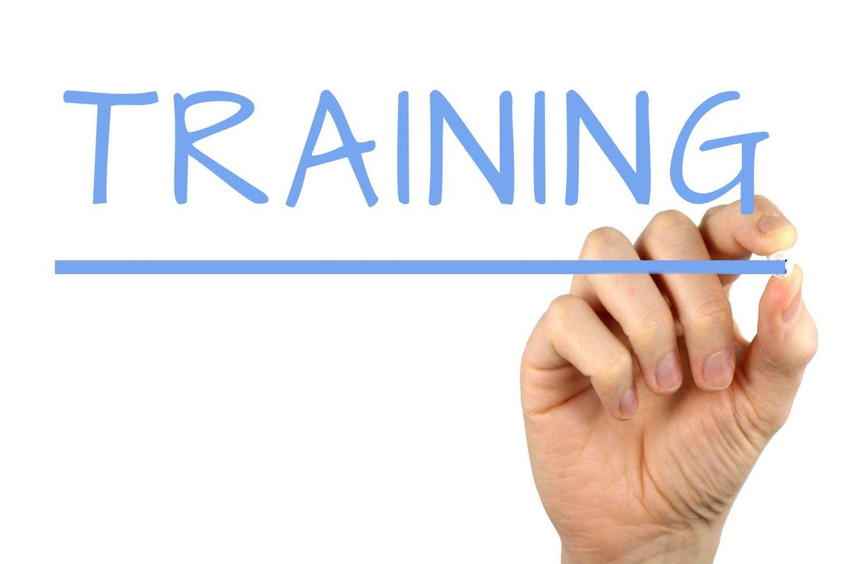
American Indian Studies Program – Website
Grants, Professional Development, and Training Opportunities
Annual Summer Institute
Language and Culture Education Licenses
wi-aislist Listserv - Wisconsin American Indian Studies
Calendar of Events
Notes:
It is also a place to find information about grants and professional development opportunities. One example is information about American Indian Language Revitalization Grants, which are grants that will be awarded on a competitive, annual basis to public schools or CESAs who partner with a tribal government, or consortia of one or more school districts and one or more tribal government. Funds can be used for activities related to providing instruction in one or more tribal languages as curricular or co-curricular offerings, such as curriculum design, creation of appropriate assessment instruments, professional development activities, language-related activities for parents and community members, instructional delivery, and program evaluation.
The annual Wisconsin American Indian Studies Summer Institute is an active, highly participatory, week-long workshop designed to increase participants’ understanding of issues related to the history, culture, and tribal sovereignty of the 11 federally recognized American Indian tribes and bands in Wisconsin. Our goals relate to both American Indian studies and the education of American Indian students. This event aims to improve teaching and learning and to enrich student services so that they may become more culturally responsive. Participants will learn how to adapt or develop new techniques best suited to their unique circumstances
State law includes provisions for certification of school staff working in American Indian Language and Culture Education. Licenses are available for: Indian Home-School Coordinator (924) , Language and Culture Aide (925), Indian Language Teacher (926), Indian History and Culture Teacher (927), School Counselor--Indian Language and Culture (963).
The Wisconsin American Indian Studies listserv allows you to receive updates and announcements and to correspond with others interested in American Indian Studies and education of American Indian students.
Calendar of Events shares events and programming across Wisconsin and the United States.

Slide 15
Contact Information
David J. O’Connor, Education Consultant
American Indian Studies Program
Wisconsin Department of Public Instruction
125 South Webster Street
PO Box 7841
Madison, WI 53707-7841
(608) 267-2283
david.oconnor@dpi.wi.gov
http://dpi.wi.gov/amind

