Slide 1
Small City, Big World: Helping our students reach their potential in BRF
Mary Byrns - HS Business Teacher/Tech Integration
Sue Leadholm - HS Counselor

Slide 2
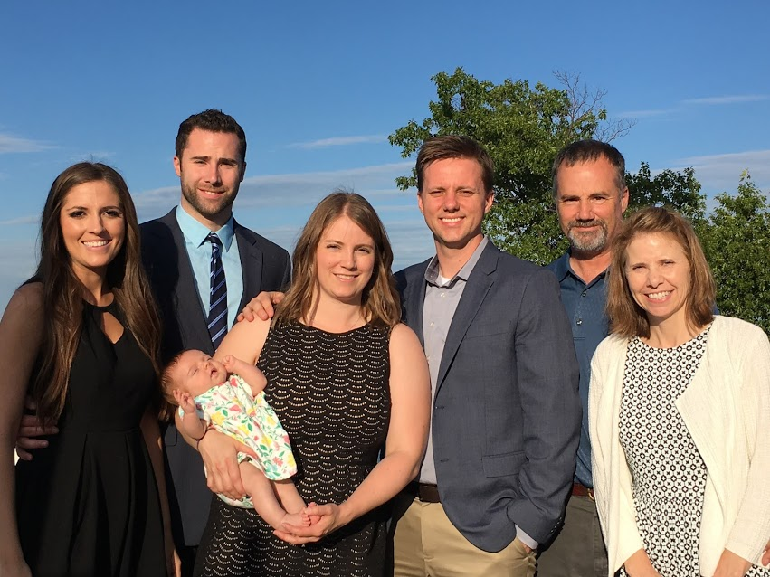
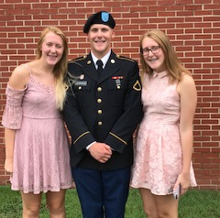
Our first ‘dry-run’ of ACP - Being a parent
Notes:
Good Afternoon - I here to support Sue and help explain our advising program from an advisor perspective. It is like being a parent. I am happy to say that my two children have homes and careers. My daughter Jennifer is here in Madison with her husband Jake and their new baby Kayla. My son Ray is in Dallas and engaged to be married next September. Both benefited from the work Sue did and still does counselor at BRFHS. Transitioning to college was easy for them. I am starting my 8th year at Black River Falls and have been involved in some form of an advising program all 8 years. Sue makes our job easier by providing us with resources, training, and checklists. We’ve gone through some modifications over the past 8 years that Sue will cover, but I think we have landed on a format that works best for advisors and advisees. From my experience, our advising program allows us to really connect with our group of advisees the four years we have them. It is a great way to start the day. We are there to help them set a career goal and stay on track to achieve it. Maybe a little bit more like being a grandparent - we get to give advice, but don’t have to pay their bills.

Slide 3
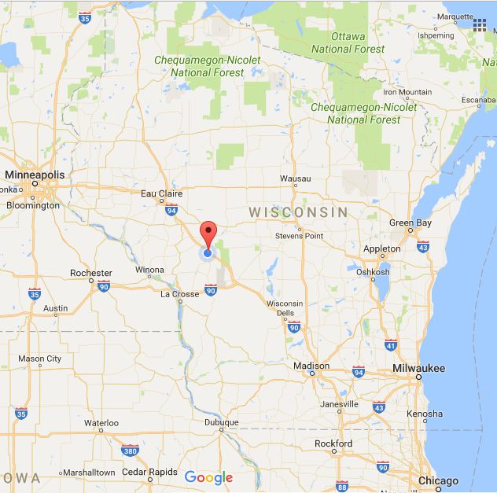
BRF - Small City, Big World
School District Demographics
The School District of Black River Falls is located in a rural setting in west central Wisconsin.
Our school district serves over 1750 students K - 12 with the help of 300+ dedicated staff. Our diverse population includes: 68.8% White/Caucasian, 24.2% American Indian, 3.1% Hispanic, 2.5% African American, and 1.4% Asian.
15.5% of the district’s population qualifies for special education services. 52.6% of the district’s population is considered economically disadvantaged. (2016)
Notes:
Number of students at the high school - 517
We are different from many other schools in the state because of our high Native American Population. The Ho-Chunk Nation’s executive building is located in Black River Falls. . In addition to the Executive Building, the Nation has a health and dental center, early childhood center, they provide social services, and recently built a beautiful new family rec center The Nation has worked hard to improve the quality of life for their members Their education and youth services departments work with students on ACP related activities such as post-secondary financial assistance, work experience, and they can help families obtain computers and get internet service. They have been a valuable community and school resource.

Slide 4
How did we get here? Our ACP path through Advising
In 2007, faculty-student groups were established to build a ‘culture of school engagement’. These 9 - 12 grade ‘families’ met once a month for counselor - created topics of discussion.
In 2009, our advising program met once a week on Wednesdays to ‘check in’ on academics, social concerns, and overall discussions of ‘how is it going?’
In 2012, we moved advising to every day during our focus at the end of the day. This homeroom approach allowed teachers to ‘see’ their students each day for a more consistent ‘check in’ process.
In 2016, we landed on the best arrangement yet. Our bell schedule changed to include a morning advising program for 39 minutes with a short focus of 20 minutes at the end of each day.
Each year, we continue to evaluate and review our advising program,
but this ‘new initiative’ is here to stay.
Notes:
Number of students

Slide 5
Black River Falls High School - Bell schedule
1st Block - Breakfast Advising | 7:50 AM | 8:29 AM
2nd Block | 8:35 AM | 9:53 AM
3rd Block | 9:59 AM | 11:17 AM
4th Block - 1st Lunch Class | 11:17 AM 11:57 AM | 11:51 AM 1:15 PM
4th Block - Class 2nd Lunch | 11:23 AM 12:41 PM | 12:41 PM 1:15 PM
5th Block | 1:21: PM | 2:39 PM
Focus | 2:45 PM | 3:05 PM
Notes:
Students need a secure common start to the day. Where they feel safe and supported. We have seen engagement improve.

Slide 6
Morning Advising
Number of Teachers: 40
Number of Students: 517 (9 - 12)
Average Advising Group Size: 15 students
No travel -- restrict activities, movement, and interruptions
Same students over 4 years - add new freshmen each year as we lose Seniors -- Builds a ‘great family’ atmosphere
Announcements (GM97 and Principal)
Check Email
Check Grades
Check Attendance
1:1 Meetings at least every two weeks - Specific grade level activities each week
Attendance Wars
GPA Competition - building goal
Notes:
1:1 meetings every two weeks (document in Career Cruising) gives us time to have a more in-depth discussion with each students. Process: each advisor has a Nexus tablet or iPad. We have an app that we load our advisees credentials into which allows us to easily check their grades by just swiping on their profile picture. The grade screen gives us all their grades for the semester in a glance. We also have the capability of drilling down to see missing assignments and assignments coming up. Our LMS has a “what-if” feature which will calculate their grade based on the points they put in. This helps us counsel them when they are missing assignments.

Slide 7
Examples of weekly advisory activities
Tiger Weeks -- all students (9 - 12)
(at least twice a month)
First week - schedule, transcripts
Homecoming week -- school spirit
October 2017 -- PT conference - ‘student-led conferences’
Advising Calendar 2017/18
Individual grades - “Freshmen Weeks”
First one:
Monday: Study skills, Organization
Wednesday: Involvement
In November:
Monday: “QPR” discussion
Wednesday: Have each other’s back

Slide 8
Advising -- ACP -- specific grade level work
9th grade activities and shared information
HS Transition
Goal-setting/Time Management
Study Skills
Stress Reduction
Involvement
Support systems - QPR
Career Cruising
Learning styles
Career Matchmaker
Resume
10th grade activities and shared information
Goal-setting
Strengths/Weaknesses
Involvement - ‘your role’
Resume building
Career Cruising
Learning styles
Career Matchmaker
Career/Life Goals

Slide 9
Advising -- ACP -- specific grade level work
11th grade activities and shared information:
Goal-setting
Academic strengths/weaknesses (ACT prep)
Involvement - ‘your role’
Future planning - college visits, job shadows
Resume building
Career Cruising
Learning styles
Career Matchmaker
Career/Life Goals
12th grade activities and shared information:
Graduation requirements
Future planning - college applications
Financial planning - college, living on own, job, career, savings/checking
Involvement - ‘your role’
Resume/Exit portfolio
Career Cruising
School selector
Career selector
Resume

Slide 10
Senior Exit Presentations
“Seniors…This is your BIG CHANCE. This is your “Time in the spotlight”.
This is your opportunity to leave a lasting impression on Black River Falls High School.
Here it is….the SENIOR EXIT Presentation….”
Individualized, Personalized, Honest, Opportunity to Reflect
Senior Exit Presentation Example
Notes:
They like to grumble about these, but most of them really seem to enjoy

Slide 11
Future Programming/Activities
There are always ways to improve:
Career Development opportunities -- Job Shadows, Internships
More guest speakers, ‘professionals with experience’
More ‘time’ - to meet all individualized needs/wishes
We are only as strong as our advisors...

Slide 12
Questions? Comments?

