Slide 1
Expanding College and Career Readiness Through
Career and Technical Student Organizations (CTSOs)
Session Speakers:
Janice Atkinson
Tim Fandek
Diane Ryberg
Dave Thomas
https://goo.gl/vDtNnw

Slide 2
Wisconsin CTSOs

Slide 3
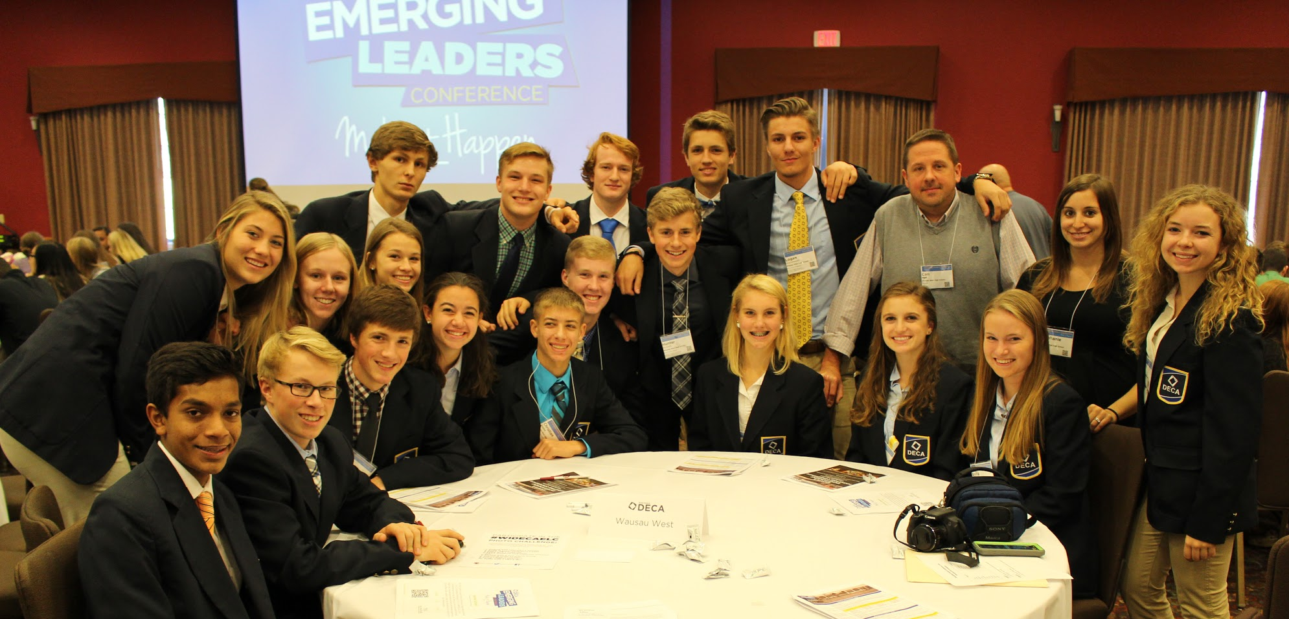
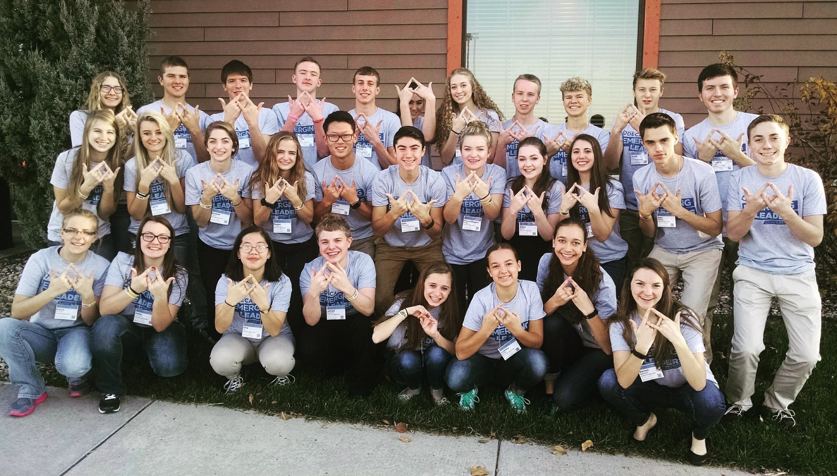
CTSO Fall Leadership Conferences
1,576 Students/Advisors

Slide 4
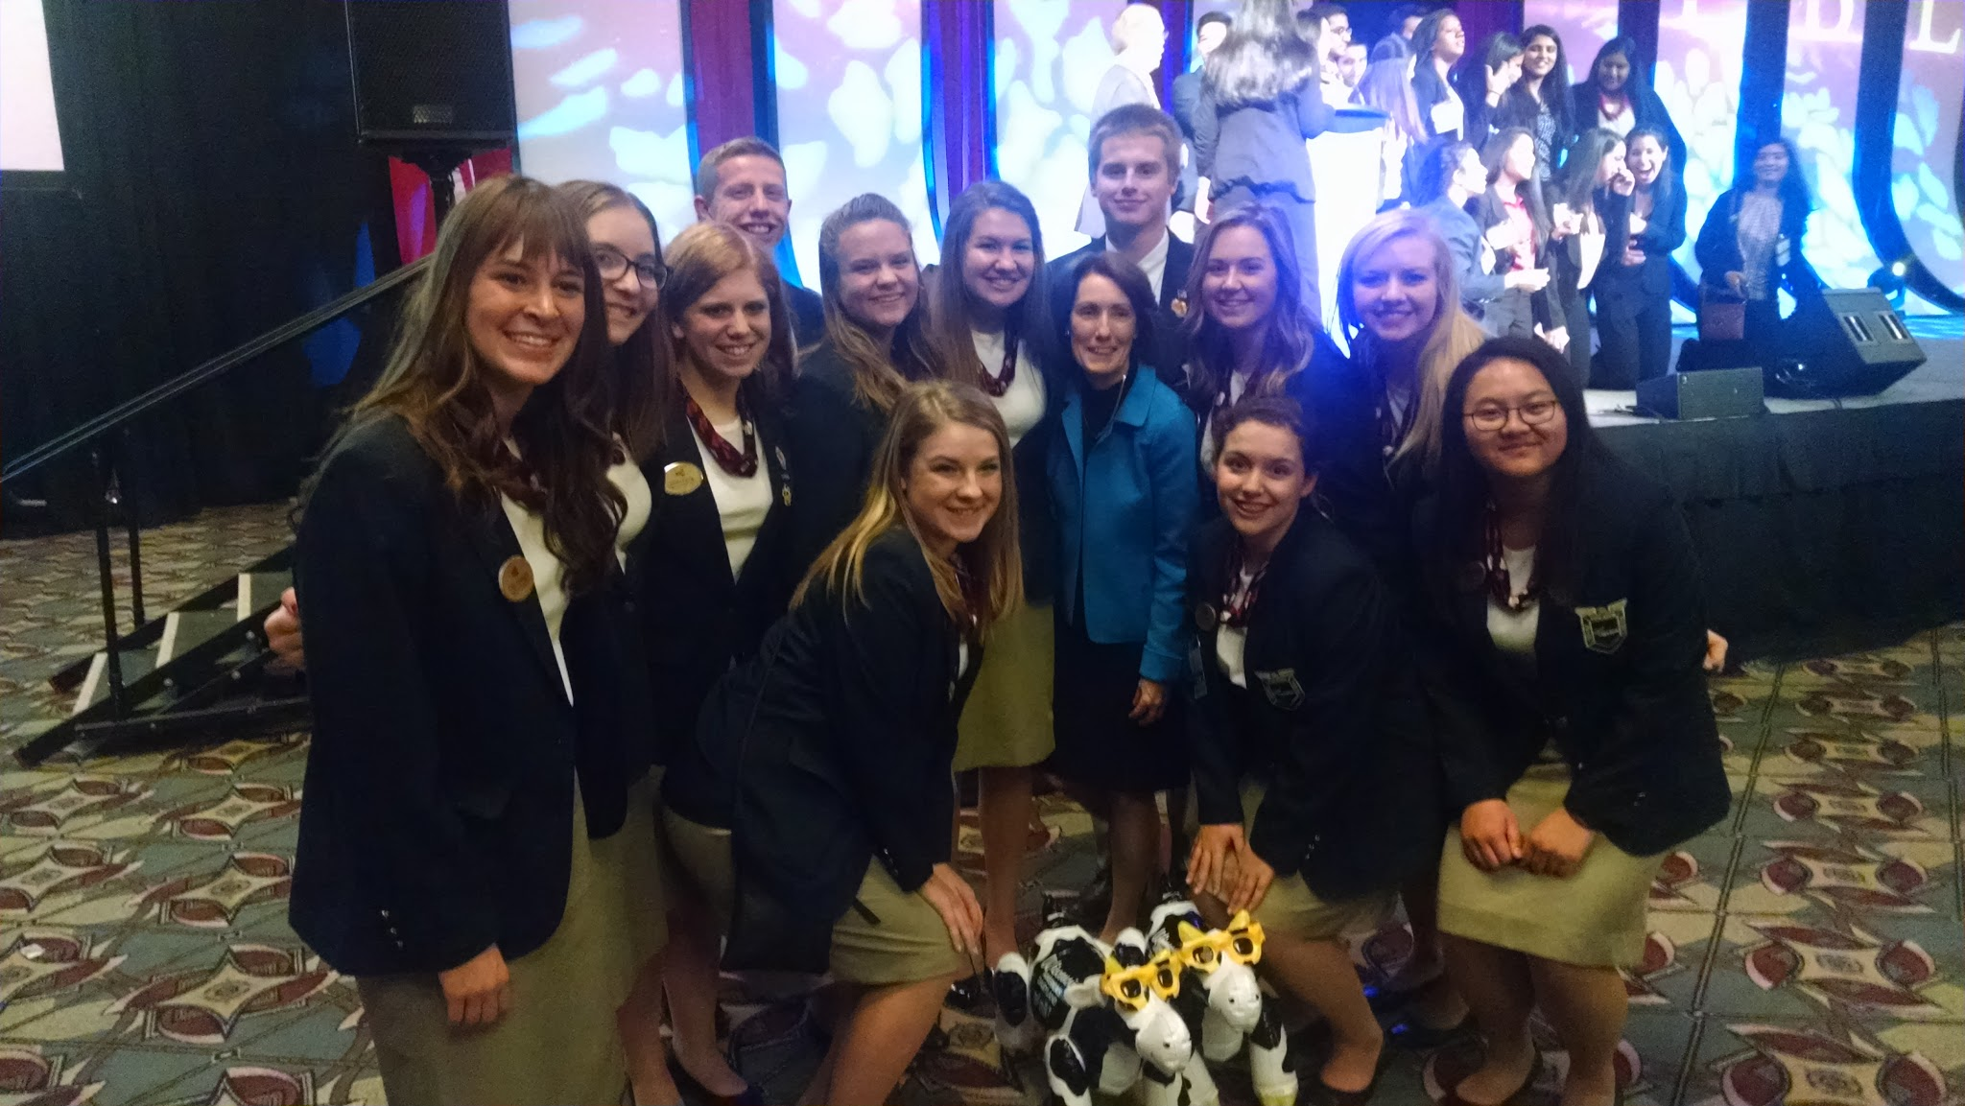
CTSO Fall Leadership Conferences
1,749 Students/Advisers

Slide 5
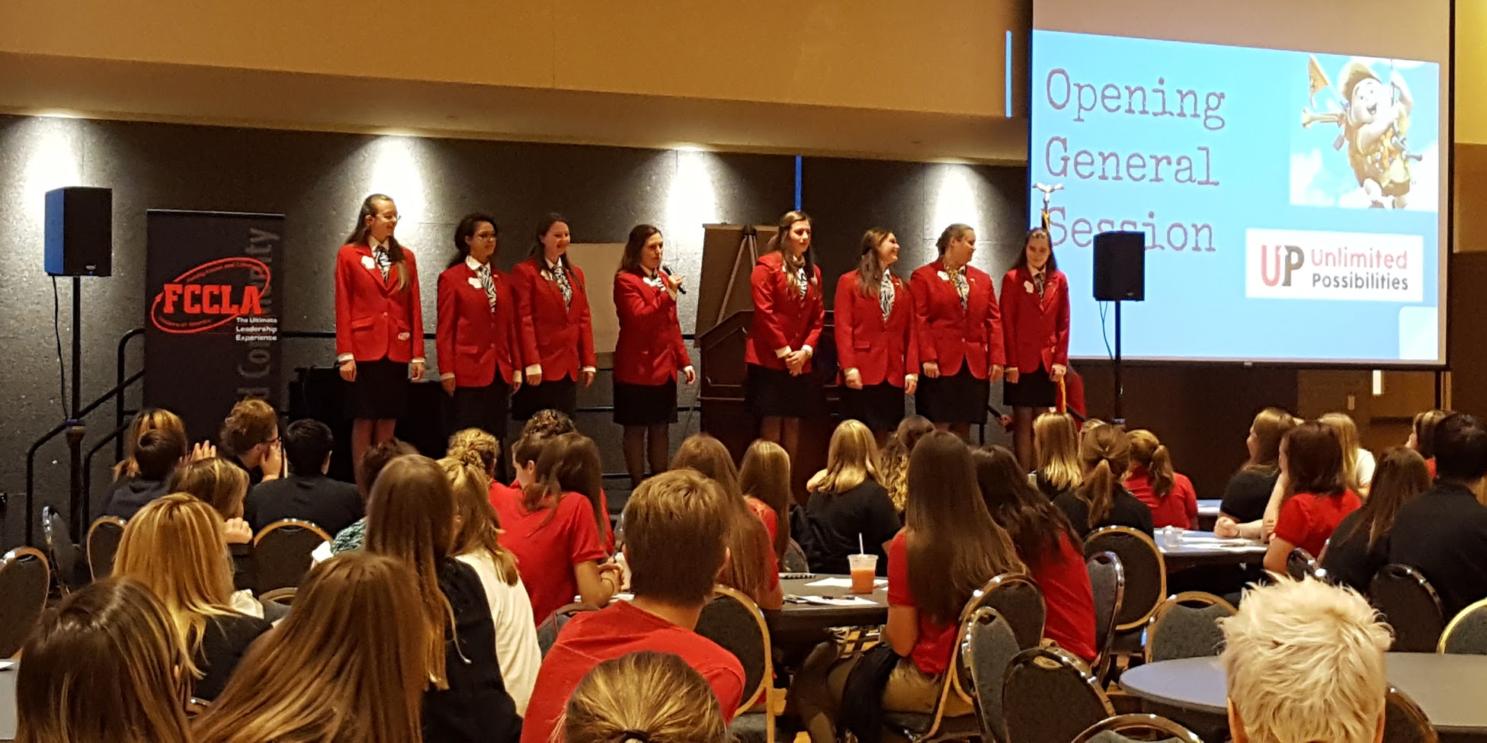
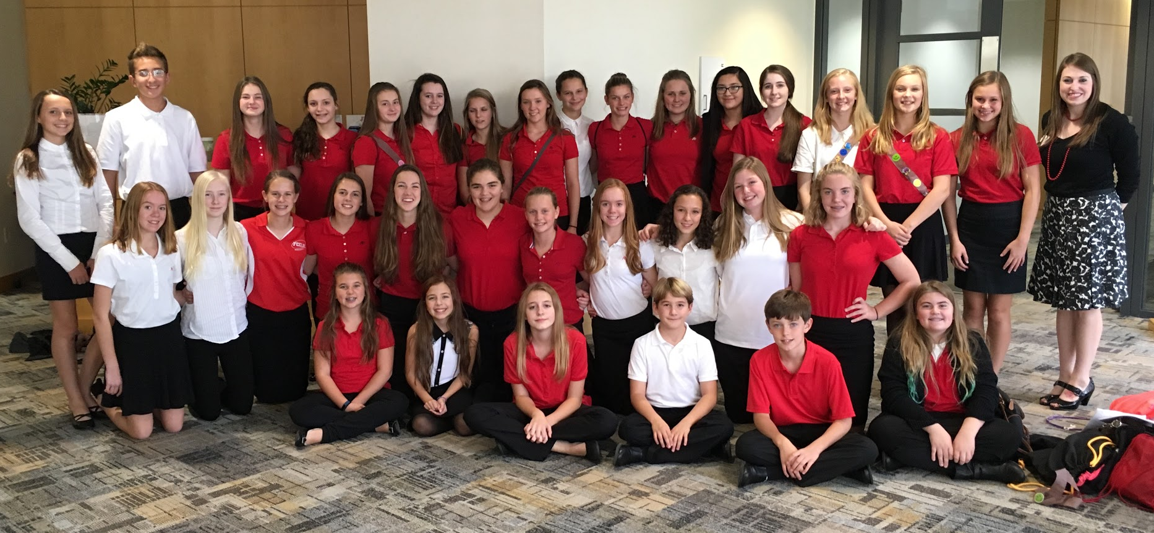
CTSO Fall Leadership Conferences
700 Students/Advisers

Slide 6
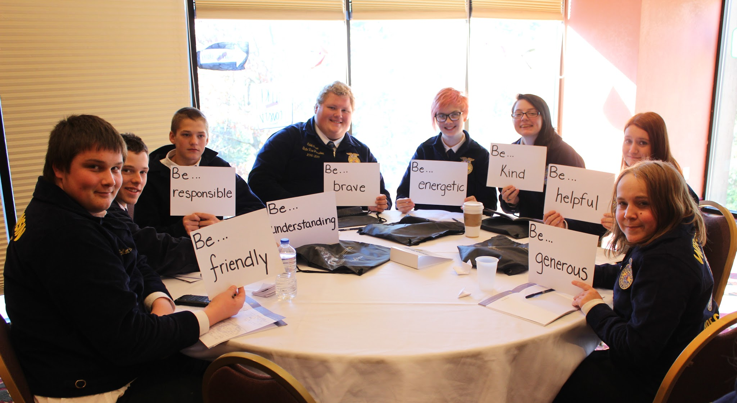
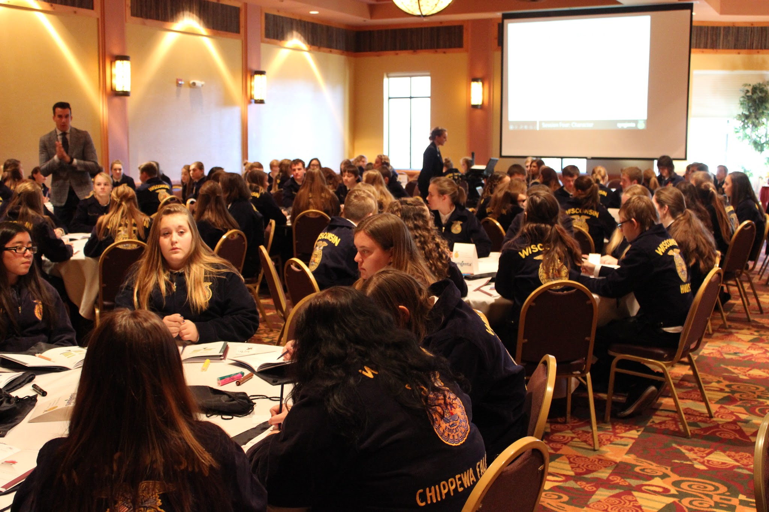
CTSO Fall Leadership Conferences
3,548 Students/Advisors

Slide 7
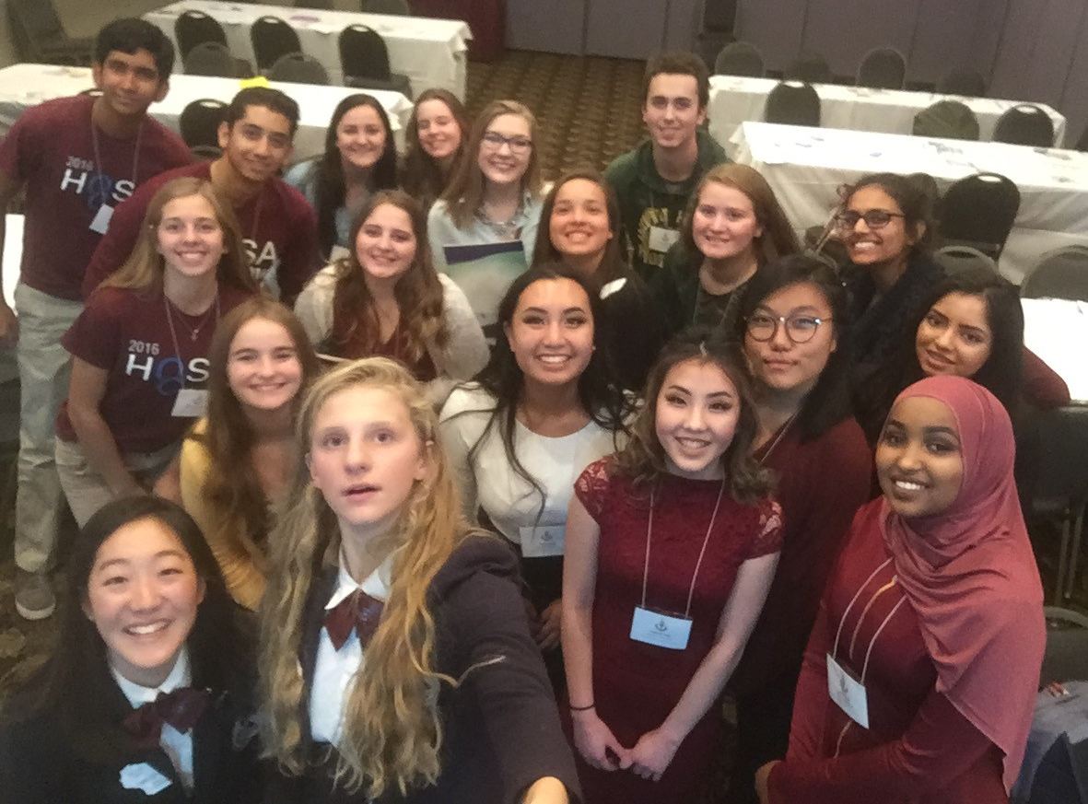
CTSO Fall Leadership Conferences
777 Students/Advisors

Slide 8
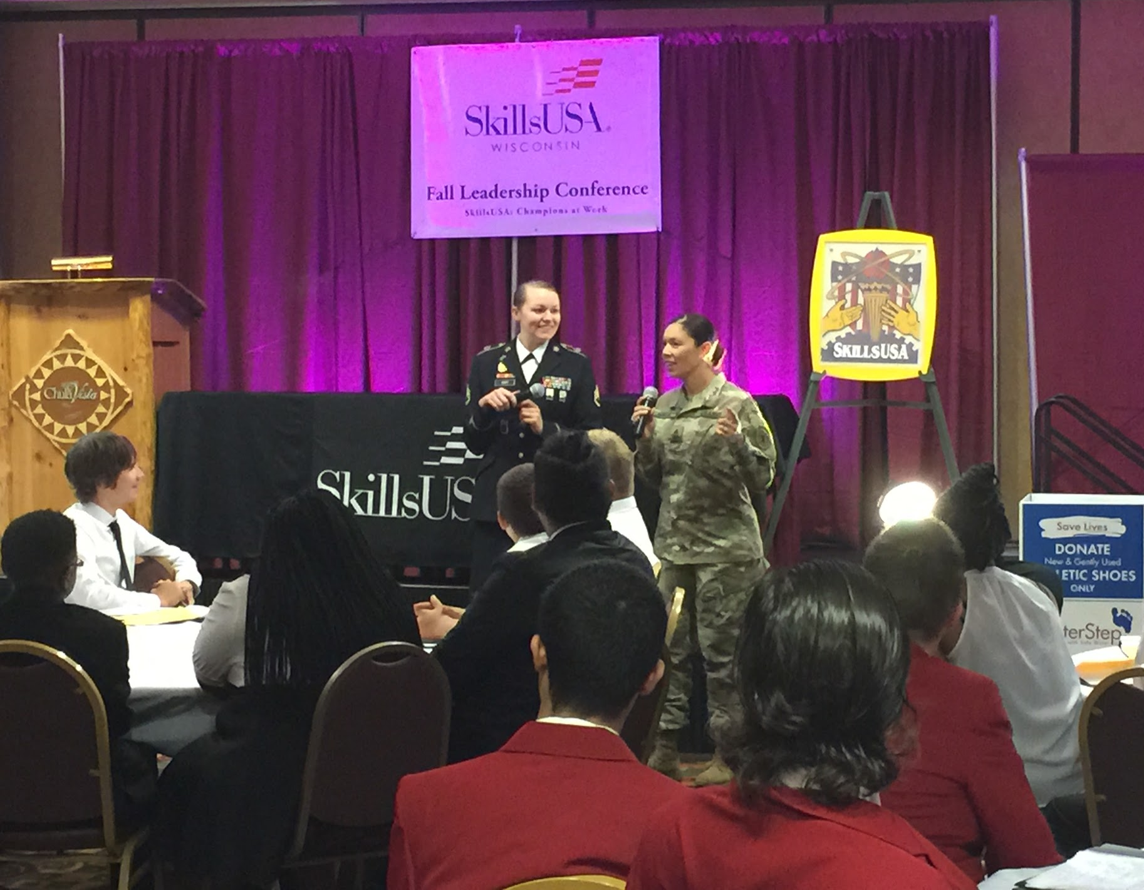
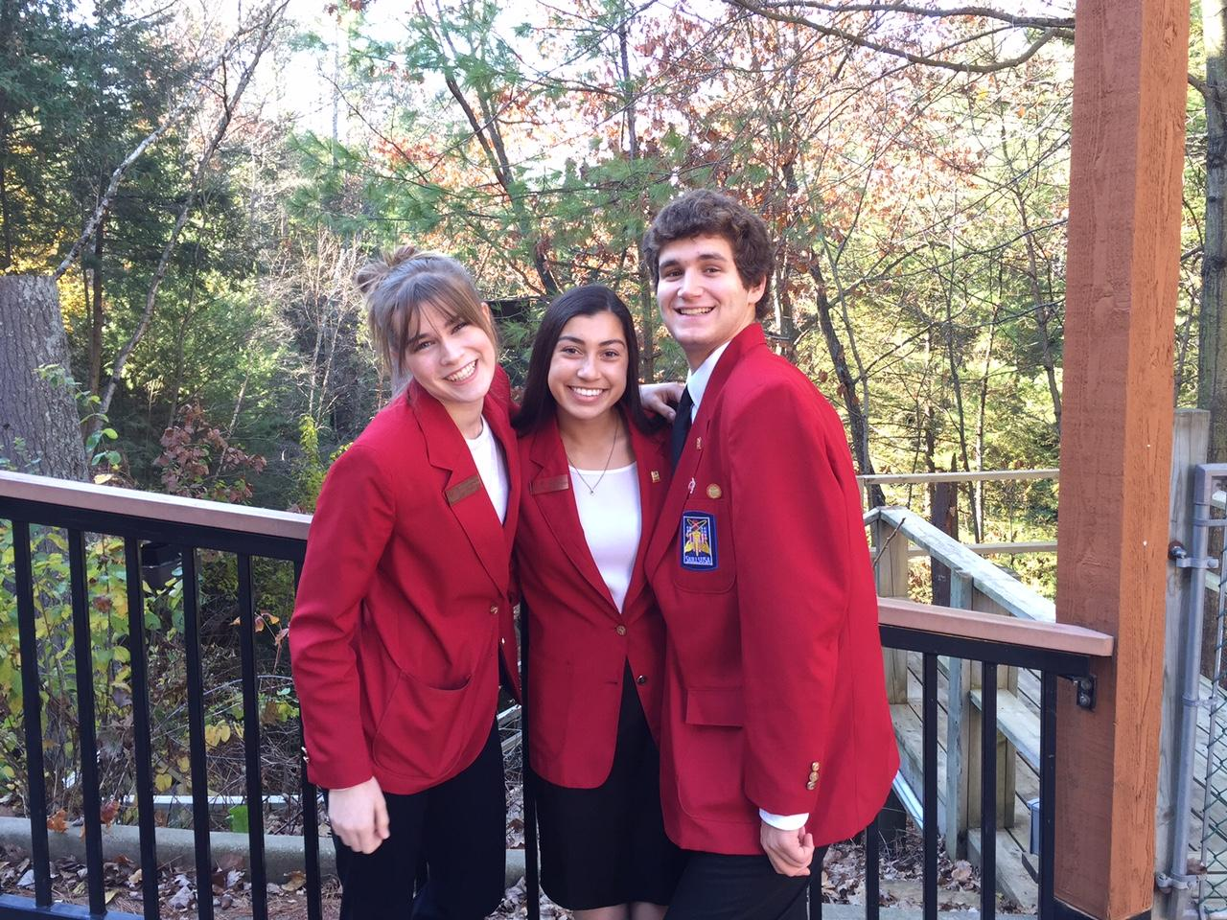
CTSO Fall Leadership Conferences
156 Students/Advisors

Slide 9
Overall Fall CTSO Leadership Conference
Impact:
8,506 Attendees!

Slide 10
CTSO
Community Service
Impact

Slide 12
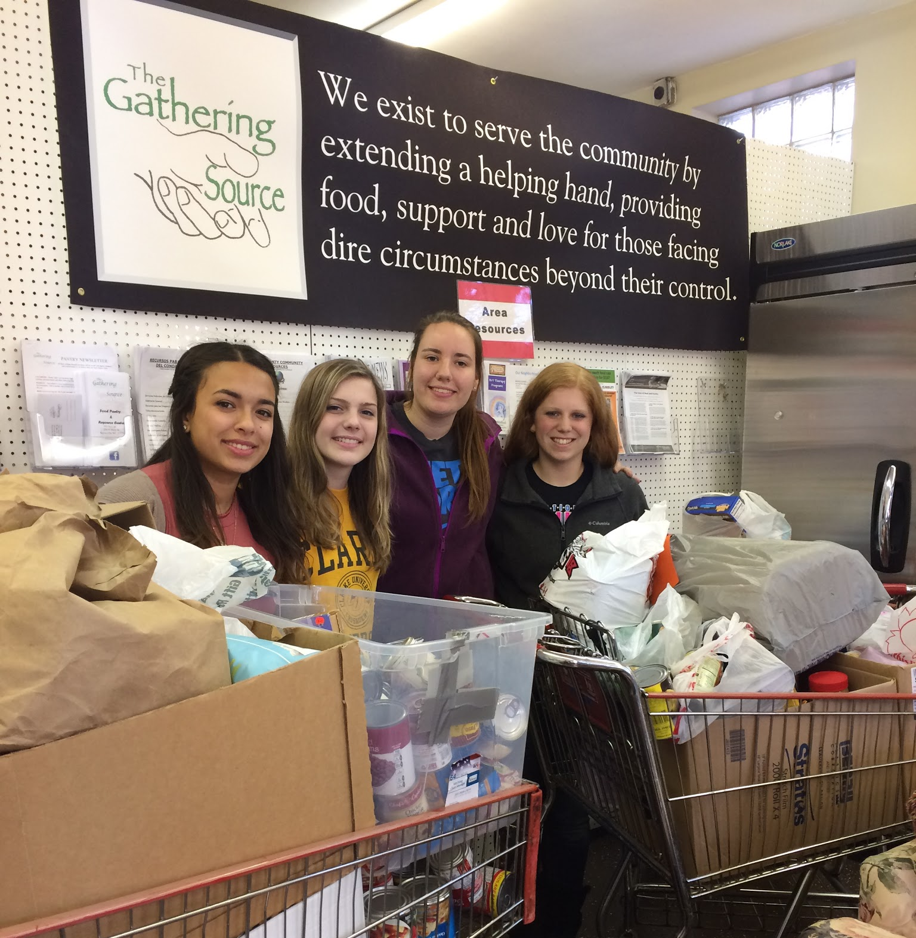

Slide 13
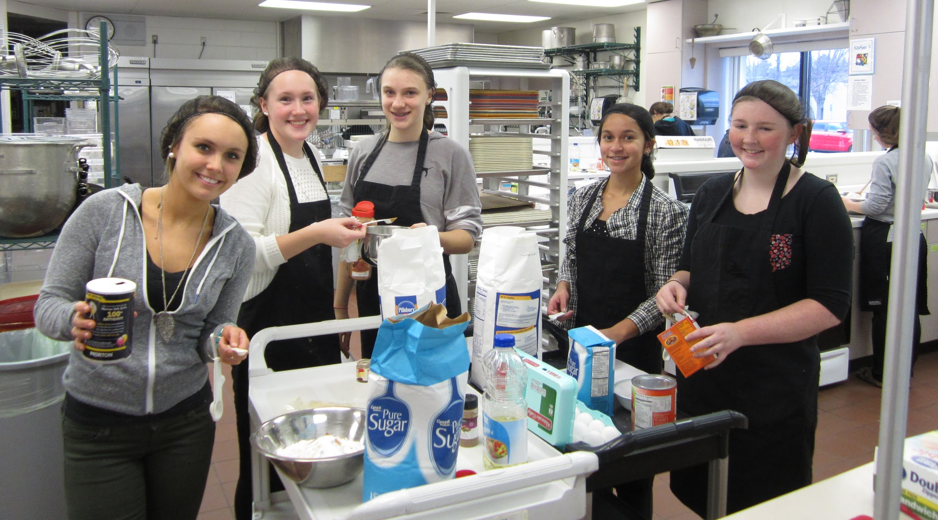
Wisconsin FCCLA

Slide 14
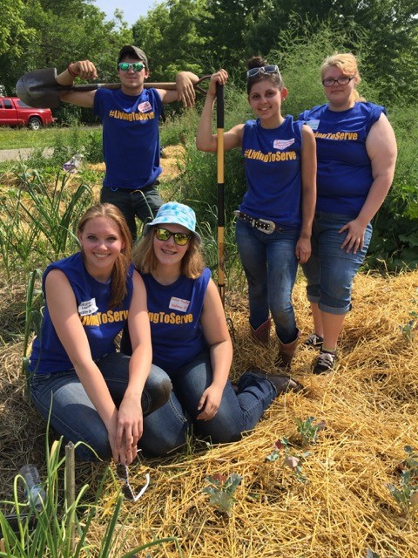

Slide 15
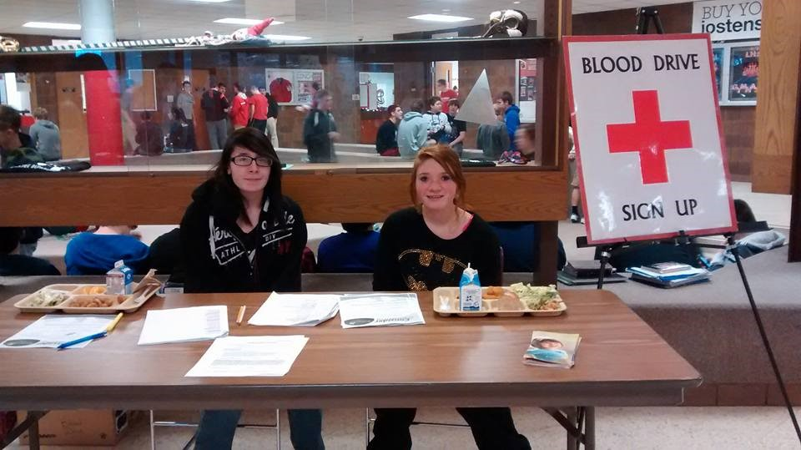

Slide 16
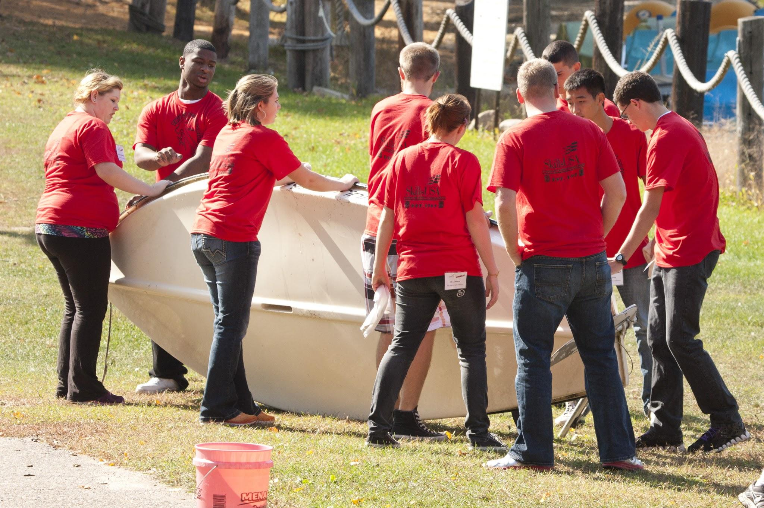

Slide 17
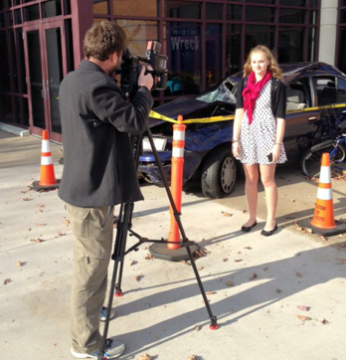
CTSO Community Service Collaborative Project

Slide 18
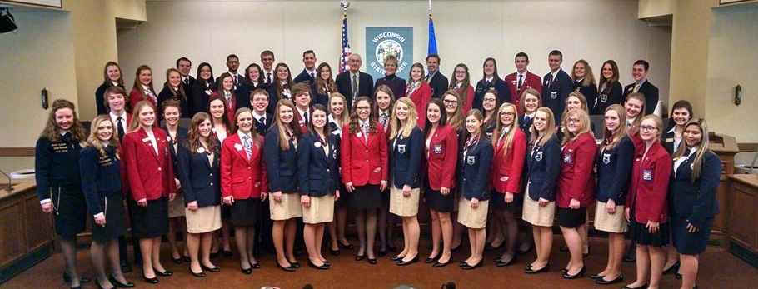
CTSO Advocacy

Slide 19
CTSO Officer Panel

Slide 20
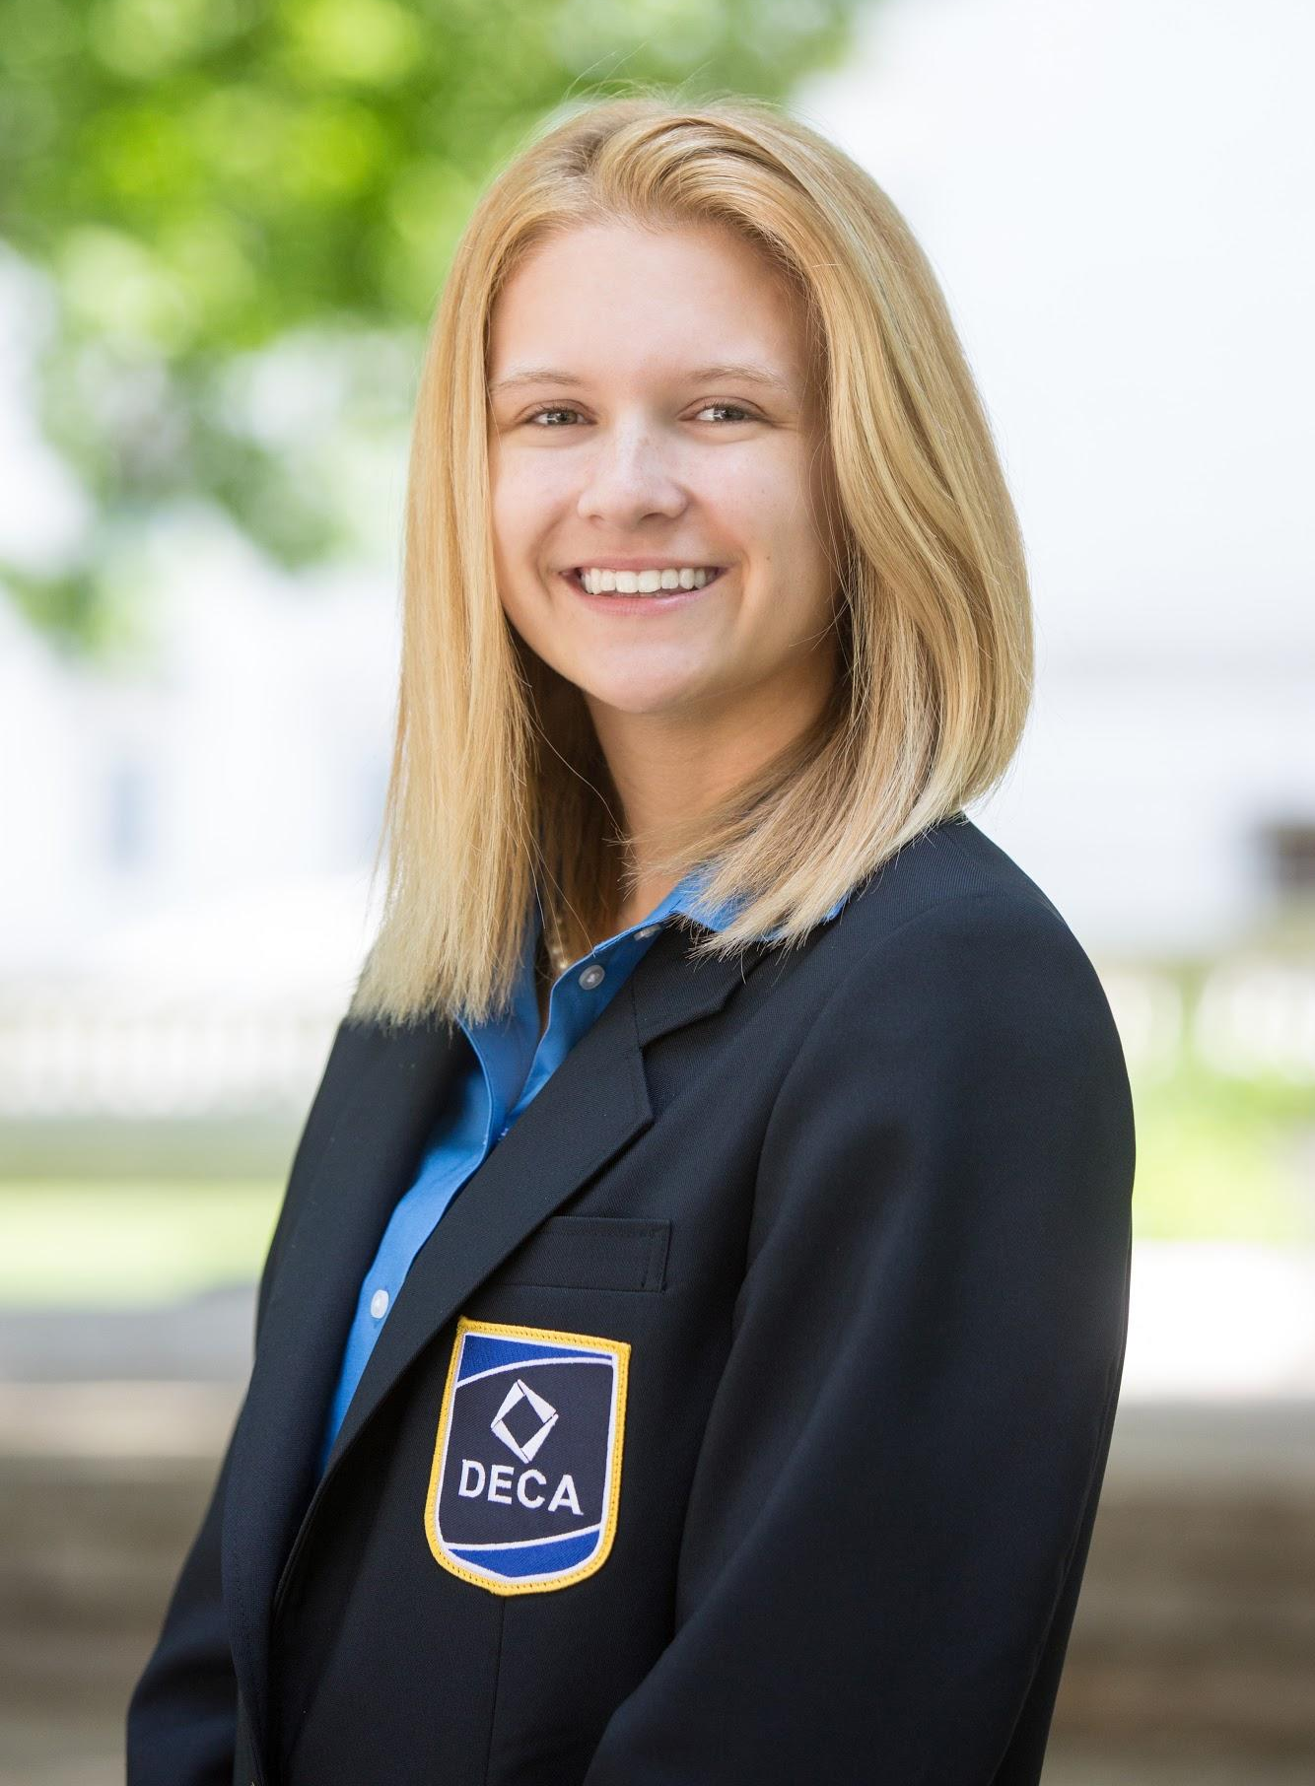
Addie Kubitz
Wisconsin DECA
Vice President of Brand Management
Monona Grove High School

Slide 21
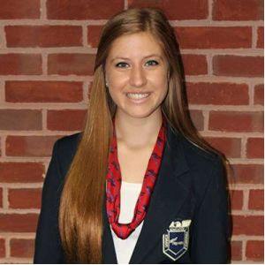
Hattie Kruschek
Wisconsin FBLA
North Central Region Vice President –
National Officer
Waunakee High School

Slide 22
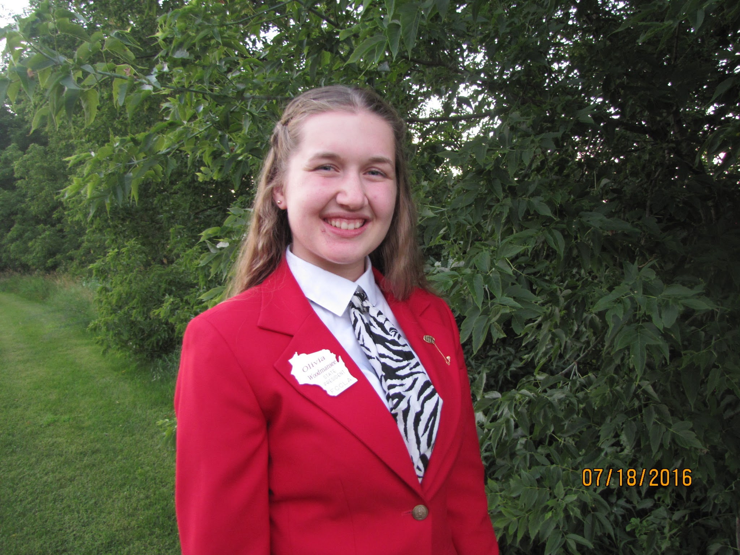
Olivia Woodmansee
Wisconsin FCCLA
State President
New Glarus High School

Slide 23
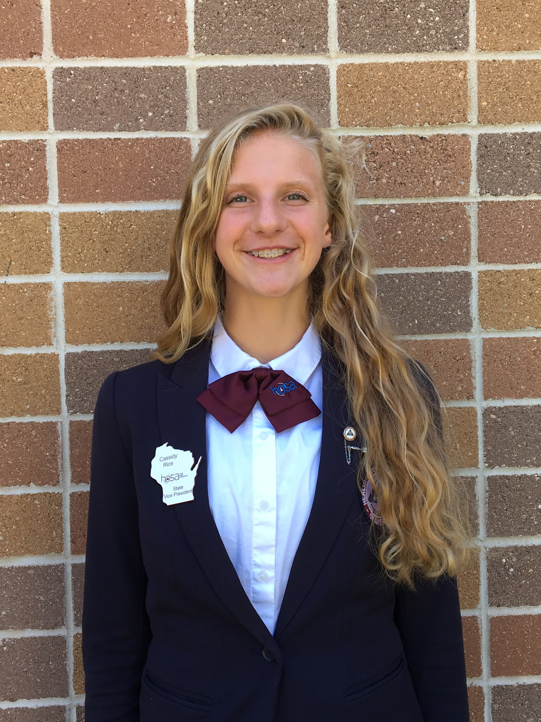
Cassidy Rice
Wisconsin HOSA
Vice President
Kimberly High School

Slide 24
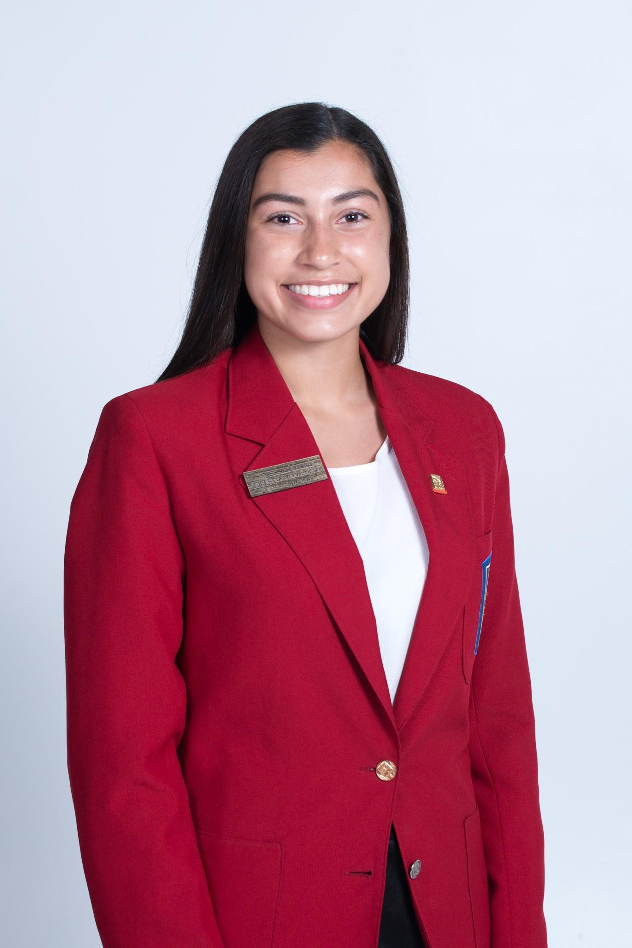
Jade Barma
Wisconsin SkillsUSA
District 4 Vice President
Waunakee High School

Slide 25
Why or how did you decide to take a CTE course?
Part 2: Expand upon this answer to share how you got connected to your Career & Technical Student Organization(s).
Addie Kubitz
Hattie Kruschek

Slide 26
How is your CTSO experience related to your classroom or academic experience?
Jade Barma
Olivia Woodmansee

Slide 27
Why did you become a state officer and how will this experience benefit you after high school?
Hattie Kruschek
Addie Kubitz

Slide 28
How has your leadership experience helped you and your fellow student members to explore college & career options through Academic & Career Planning?
Cassidy Rice
Jade Barma

Slide 29
Share why our organizations are actively involved in community service and what impact does this have on both the community and our participating members?
Olivia Woodmansee
Cassidy Rice

Slide 30
Share how your experience with Government Day has demonstrated your advocacy to share the benefits and support for our student organizations?
Olivia Woodmansee
Hattie Kruschek

Slide 31
How will your leadership have a positive influence on Wisconsin?
Jade Barma
Cassidy Rice
Addie Kubitz

Slide 32
For More Information
http://dpi.wi.gov/cte/ctso

