Slide 1
ACPs: Using Personalized Strategies for Enabling Youth to Drive Their Own Success
V. Scott Solberg, PhD (@vsolberg; ssolberg@bu.edu)
School of Education, Boston University
National Collaborative on Workforce & Disability for Youth

Slide 2
Notes:
Graphic of Arizona Gear-up

Slide 3
Notes:
Picture of students sitting attentively in school

Slide 4
Notes:
Graphic cartoon of a student who is a good listener with following captions - eyes on speaker, brain thinking about what is said, mouth is quiet, ears listening carefully, hands are still and feet are still.

Slide 5
Notes:
Graphic of quote: To persevere: patient endurance of hardship; persisting in a state of enterprise in spite of difficulties and discouragement.

Slide 6
Notes:
Picture of a weed growing in pavement with a caption that reads: never underestimate the power of persistence.

Slide 7
Notes:
Picture of a hot air balloon with the caption: exploring the unknown requires tolerating uncertainty by Brian Greene.

Slide 8
Notes:
Picture of a hand holding a ball that reads: psychic reading.

Slide 9
Notes:
Graphic of 4-H motto: to make the best better

Slide 10
Notes:
Moodle graphic about 4-H skills that include leadership, public speaking, teamwork, responsibility, and wide range of other soft skills needed to employment.

Slide 11
Key Points
Focus on gathering competencies not credits
ILPs/ACPs enable all youth – especially high-need youth - to become proactive and self-directed
We need to be the caring and encouraging adults that all youth need

Slide 15
My Existential Crisis Questions
Why are so many youth disengaged?
How should one respond when trying to motivate a disengaged student who responds…
How do you find the energy and enthusiasm to teach when the student you know has so much potential…

Slide 21
Notes:
Option # 3: We can just keep running knowing that if we stop the emotional pain will run us over
To quote the famous philosopher Neil Young: it’s better to burn out than it is to rust….

Slide 22
Notes:
Option #4: We can put up a cheesy poster…one that reminds us that the context in which our High need children live in is not the problem, it’s our personal inability to perceive their challenges as our opportunities to grow.
Not sure how the trauma and depression educators likely felt following the tragic event where they gave CPR to a dying child who was shot on a street corner down the street from school. I am not sure how this is a challenge that educators need to somehow reframe into an opportunity. It just is. It is unfair. There is no meaningful reason why this child was murdered.

Slide 23
Notes:
Option #5: Suggested option. We can reframe these communities as battle zones and discover whether we have the courage and composure needed for what Major Mary Jennings Hegar refers in her book Shoot Like a Girl as the “warrior spirit.”
We are at war to improve and in many ways save the lives of our must vulnerable, high-need youth. Our purple hearts come from the emotional scars we receive when our most talented students, the one’s we know will be great, the one’s with tremendous potential, leave school, are gunned down or die tragically. We never forget those events or the students we lost.
I have seen this warrior spirit at South Division where the motto is “shoulder to shoulder.” Unknown gang members sitting in cars down the street watching the students leave. Students walking out of school, looking down the street and then going back inside. Educators standing guard, choosing to work and coming back each year to battle for these students lives.
Our medals of honor come from getting back into battle and being willing to be emotionally available and ready to invest in those students who remaln. It is hard because we want to withdraw but the students who remain need as much care and support as the one’s we lost.

Slide 24
Notes:
And, it’s about channeling that anger in productive ways

Slide 25
ILPs [ACPs] Make it Happen

Slide 26
Drop Decision Making and Embrace A New Paradigm:
Enabling ALL Youth to Discover a Range of Career and Life Goals
Notes:
First component is providing access to quality career development activities.
Just published a handbook with a number of colleagues where we call for a paradigm shift in career development. The shift is to move away from decision-making and instead focus on positive youth and adult development.
Drop the “R” word; understand its connection with IEPs; Career development for significant disabilities is about self-determination; GEAR-Up needs to focus on ALL youth, not just four-year college bound

Slide 27
Career Development Skills that Establish Purpose
Self-Exploration Skills
Career Exploration Skills
Career Planning and Management
Work-Based Learning
Universal Design for Learning

Slide 28
Pathway to College and Career Ready
Access to quality career development opportunities facilitated by
caring and encouraging adults results in students…
Establishing career and life goals which leads to….
Academics now perceived as relevant and meaningful which leads to…
Youth taking action to direct their own development by seeking out learning opportunities that enable them to develop the competencies needed to pursue their goals which leads to…
Students becoming college and career ready and ready/able to enter and successfully complete a two our four-year postsecondary credential, program or degree

Slide 29
Notes:
We want all of our students to leave middle school able to say: I can. I can learn how to learn. I can identify my interests skills and values. I can explore and find new possibilties for my future, my career, my life. I can become. I can set goals. I can find purpose and meaning.
I will. I will pursue my career and life goals with determination. I will actively seek school and out of school activities that build my competencies. I will always have purpose and meaning in my life.
With their middle school story ended, they will now enter high school and beyond with new stories to create, new pathways to pursue, and new dreams to fulfill.
And your purpose as educators? You need to be able to say: I can inspire my students. I can maintain my composure to serve as a caring and encouraging mentor. I can enable them to see new possibilities beyond their current life circumstances. I will use my warrior spirit to stay and fight. I will always strive to reach my true potential as a master educator.
Your story, our story as educators working for the lives and minds of high-need students, however, that story never ends.

Slide 30
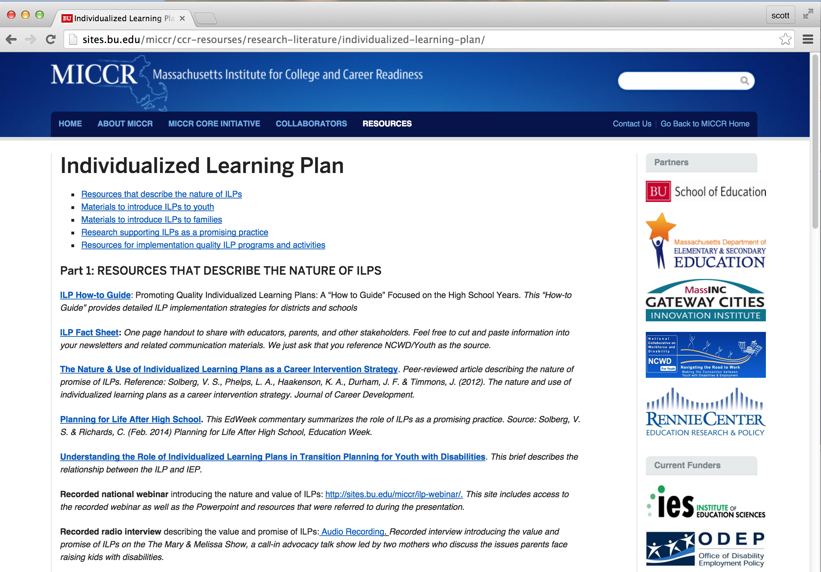
Notes:
MICCR – facilitates district and school’s capacity to design, implement and evaluate ILPs
NCWD/Youth is the national TA center that has designed a wide range of toolkits and materials to support ILP implementation efforts.

Slide 31
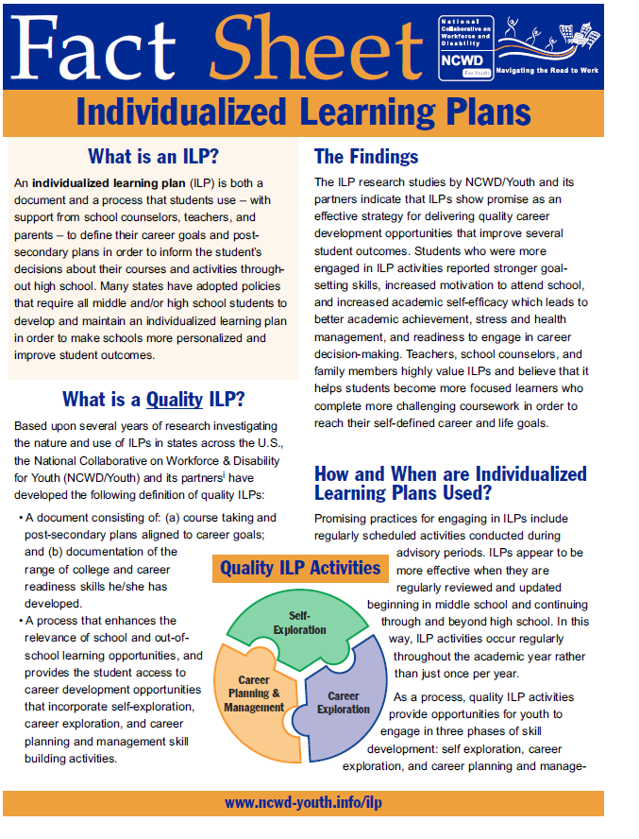

Slide 32
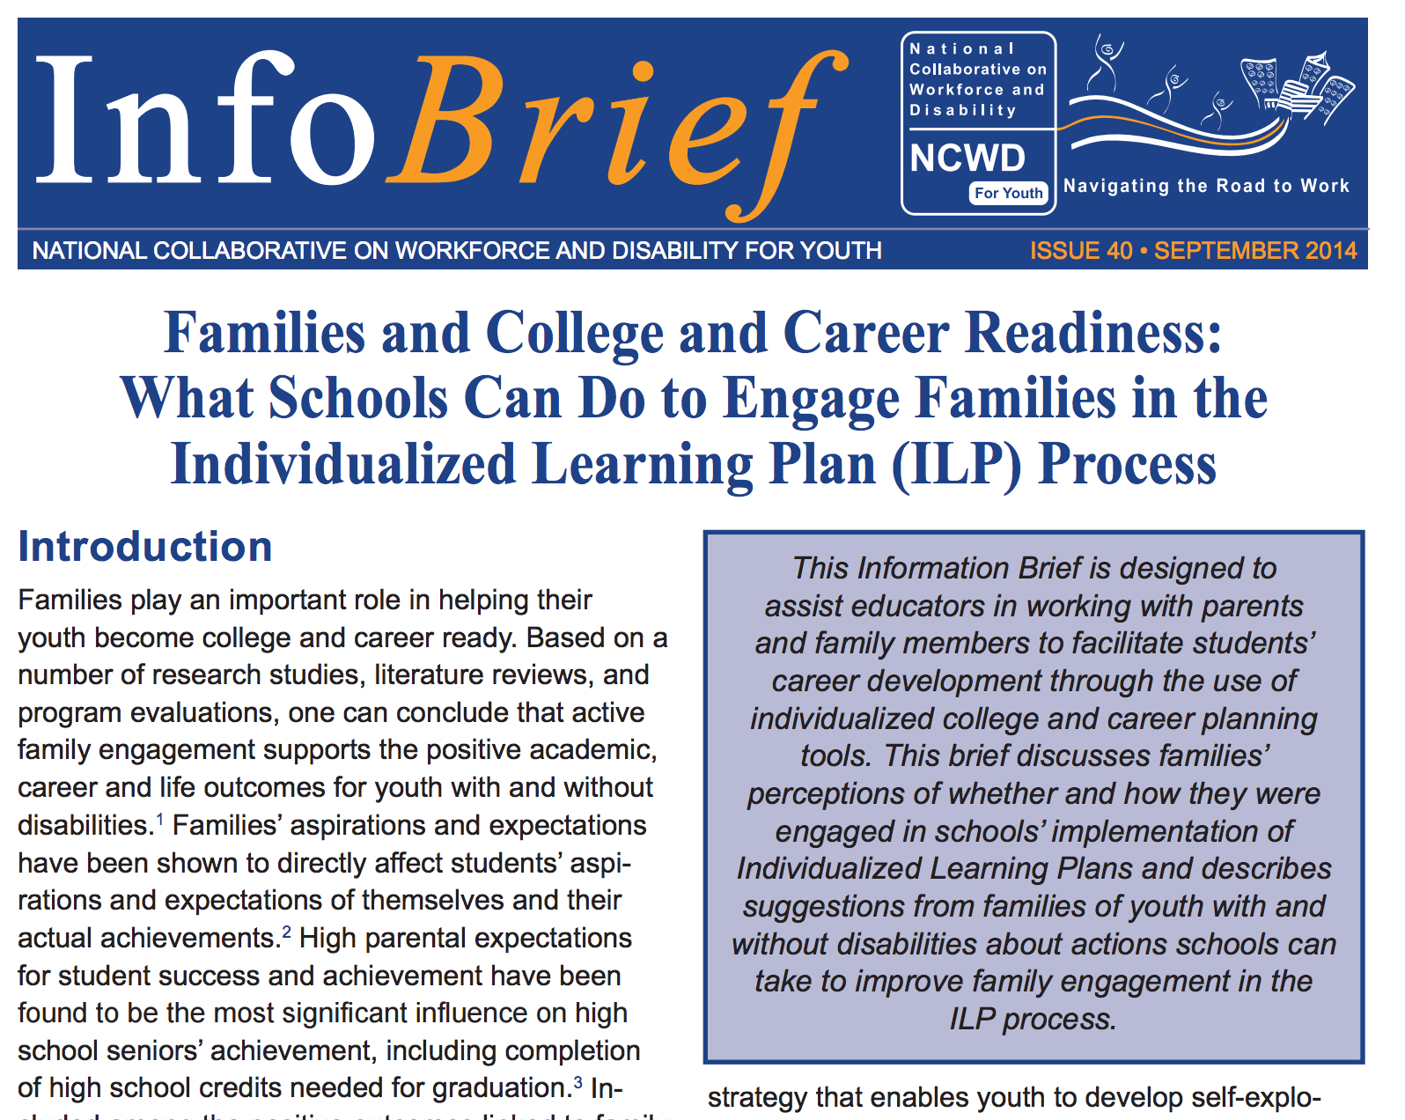
Notes:
Graphic showing cover of family guide for engaging in ILPs
http://www.ncwd-youth.info/sites/default/files/infobrief-40-families-and-college-and-career-readiness-ilp.pdf

Slide 33
Who We Are
Institute for Educational Leadership (IEL)’s Center for Workforce Development
National Collaborative on Workforce & Disability for Youth, a national technical assistance center
Focus on needs of ALL youth, including youth with disabilities and other disconnected youth
Improve state and local policy
Strengthen workforce development service delivery
Improve competencies of youth service professionals
Engage youth and families
Supported by Office of Disability Employment Policy, U.S. Department of Labor

Slide 34
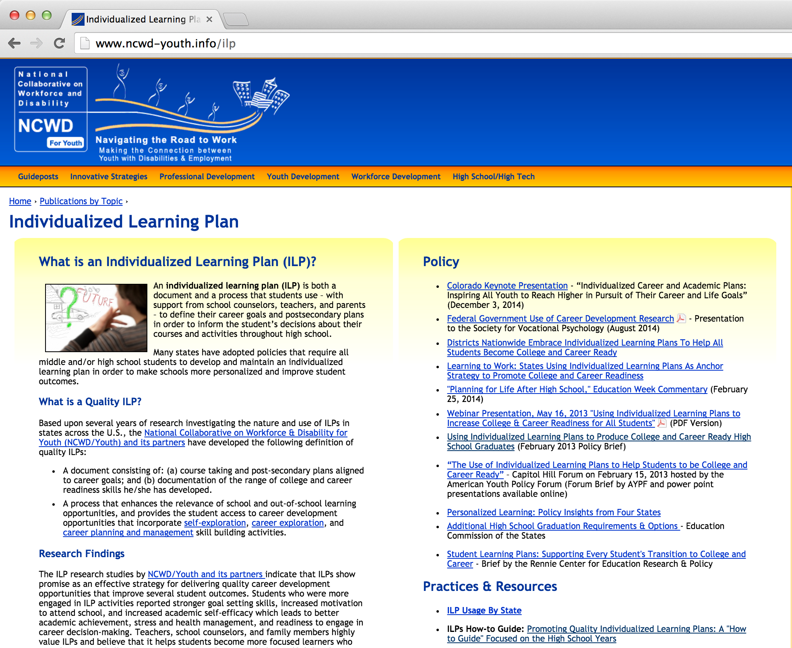

Slide 36
More Resources on ILPs
ILP Fact Sheet: http://www.ncwd-youth.info/fact-sheet/individualized-learning-plan
Policy Brief: “Using Individualized Learning Plans to Produce College and Career Ready High School Graduates” http://www.ncwd-youth.info/ilp/produce-college-and-career-ready-high-school-graduates
ILP Resources Home Page: www.ncwd-youth.info/ilp
Kick Start Your ILP (for Youth): http://www.dol.gov/odep/ilp/kickstart.htm
ILP Info Comic (for Youth): http://www.dol.gov/odep/topics/youth/ShellySaves.htm

Slide 37
Strategies & Tools for Work-based Learning Experiences
Engaging Youth in Work Experiences: An Innovative Strategies Practice Brief: http://www.ncwd-youth.info/innovative-strategies/practice-briefs/engaging-youth-in-work-experiences
Features strategies from 10 successful programs nationwide
Work-based Learning Jumpstart: http://www.ncwd-youth.info/work-based-learning
Ch. 3 in High School High Tech Program Guide: http://www.ncwd-youth.info/hsht/program-guide
Guide to Internships for Students with Disabilities: http://ncld-youth.info/Downloads/intern-guide-final.pdf
Strategies for Youth Workforce Programs to Become Employer-Friendly Intermediaries, http://www.ncwd-youth.info/information-brief-12

Slide 38
Engaging Families in Supporting Career Development
Briefs:
Understanding the New Vision for Career Development: The Role of Family, http://www.ncwd-youth.info/node/1463
Helping Youth Develop Soft Skills for Job Success: Tips for Parents and Families, http://www.ncwd-youth.info/information-brief-28
Helping Youth Build Work Skills for Job Success: Tips for Parents and Families, http://www.ncwd-youth.info/information-brief-34
Tapping into the Power of Families: How Families of Youth with Disabilities Can assist in Job Search & Retention, http://www.ncwd-youth.info/infobrief/tapping-into-the-power-of-families

Slide 39
More Career Development Resources
Using Career Interest Inventories, http://www.ncwd-youth.info/innovative-strategies/practice-briefs/using-career-interest-inventories-to-inform-career-planning
Career Exploration in Action, http://www.ncwd-youth.info/innovative-strategies/practice-briefs/career-exploration-in-action
Skills to Pay the Bills: Mastering Soft Skills for Workplace Success, http://www.dol.gov/odep/topics/youth/softskills/
411 on Disability Disclosure: A Workbook for Youth: http://www.ncwd-youth.info/411-on-disability-disclosure

Slide 40
NCWD/Youth: www.ncwd-youth.info
Funded by ODEP, U.S. DOL: www.dol.gov/odep
V. Scott Solberg ssolberg@bu.edu Curtis Richards richardsc@iel.org | Mindy Larson Ph. 202.822.8405 Ext. 169 LarsonM@iel.org Judith Martin Jlmart@bu.edu

