Slide 1
ACP Statewide Pre-Implementation (2016-17) Evaluation Results
Robin Worth & Grant Sim

Slide 2
Mission: Transformative evaluation support in direct response to the needs of PK-12 educators and policymakers.
Conduct high-quality evaluations
Build evaluation capacity
Wisconsin
Evaluation
Collaborative
Transform practice
Foster a community of evaluators

Slide 3
Background

Slide 4
ACP 3-Year Evaluation Plan
Pilot Phase (2015-16)
Statewide Pre-Implementation (2016-17)
Outcomes (Statewide Implementation – 2017-18)

Slide 5
Evaluation Questions
How have last year’s pilot districts followed up on their pilot activities?
What is the level of readiness across the state for ACP implementation in 2017-18?
What are students’ perceptions about ACP?
What are parent/family perceptions of ACP?
How are CESA partners serving districts around ACP?
What is the current state of ACP outcomes across the state?

Slide 6
Mixed Methods Evaluation
Interviews
former pilot district ACP coordinators
CESA ACP coordinators
Survey – statewide – building leaders
Focus groups
Educators (at ACP trainings across all 12 CESAs)
Students (8th and 11th graders across 4 districts)
Parents (in same 4 districts)
Baseline data for outputs and outcomes

Slide 7
This year’s findings
(2016-17)

Slide 8
General Findings by Evaluation Question
How have last year’s pilot districts followed up on their pilot activities?
Progress among pilot schools varied:
All have some degree of infrastructure in place
Half implementing to 100% of students with full implementation
Half still developing ACP scope and sequence
All providing PD related to staff on ACP
Nearly all engaged in collaboration with other districts
Noted challenge: finding sufficient time for ACP work
Notes:
For the most part, they’ve continued with the work they had planned. Many reported that they needed to revise their timelines to “slow down and get it right,” but they were making progress nonetheless.

Slide 9
General Findings by Evaluation Question
2. What is the level of readiness across the state for ACP implementation in 2017-18?
Infrastructure components:
75% have ACP leadership team in place
54% have dedicated ACP time in the schedule for at least some students, 26% for all students
42% have readiness assessment/gap analysis
46% have implementation plan
37% have communication plan
26% have family engagement plan
Notes:
Roughly speaking about 1/3 of the state was implementing quite a bit, 1/3 had plans in place and were partially implementing, and 1/3 were not doing much at all. Educator focus group data supported these findings.

Slide 10
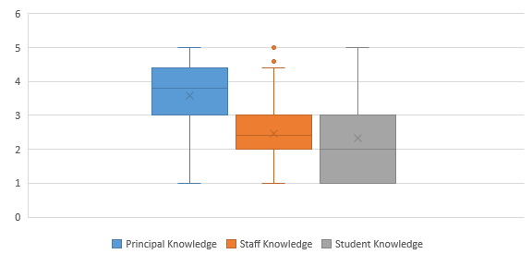
General Findings by Evaluation Question
2. What is the level of readiness across the state for ACP implementation in 2017-18?
Awareness and Knowledge:
Notes:
Roughly speaking about 1/3 of the state was implementing quite a bit, 1/3 had plans in place and were partially implementing, and 1/3 were not doing much at all. Educator focus group data supported these findings.

Slide 11
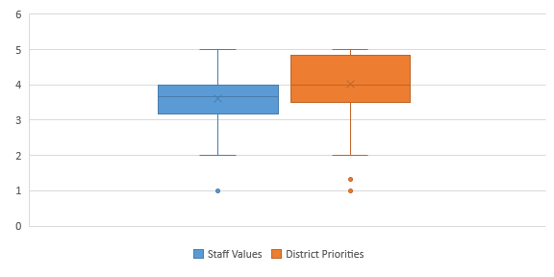
General Findings by Evaluation Question
2. What is the level of readiness across the state for ACP implementation in 2017-18?
ACP Buy-In:
Notes:
Roughly speaking about 1/3 of the state was implementing quite a bit, 1/3 had plans in place and were partially implementing, and 1/3 were not doing much at all. Educator focus group data supported these findings.

Slide 12
General Findings by Evaluation Question
3. What are students’ perceptions about ACP?
Purpose of ACP:
Preparing for one’s future, not just preparing for college
Value of ACP:
Nearly all agreed with ACP value overall
Different opinions of ACP individual components:
More value: resume writing, personal finance, apprenticeships and hands-on career exploration
Less value: soft-skill work
Varied: dedicated time for ACP delivery
Suggestion:
ACP should be rigorous and personalized
Notes:
Much interesting feedback; in general, students reported that if they were going to spend time on these activities, then they should be rigorous and personalized.

Slide 13
General Findings by Evaluation Question
4. What are parent/family perceptions of ACP?
Limited ability to obtain these perceptions
Families generally don’t know much about it yet
Mixed opinions on level of ACP engagement
Many wanted increased communication regarding ACP practices
Notes:
Most don’t know much about it yet. Perhaps surprisingly, there was a fair degree of variety about whether and how much parents wanted to be involved.

Slide 14
General Findings by Evaluation Question
5. How are CESA partners serving districts around ACP?
At least 77 trainings serving around 75% of districts in each CESA through a variety of means
Topics varied: ACP basics, team work time, Career Cruising, collaboration with other districts
Training needs:
Increasing buy-in, incorporating ACP in regular curriculum, core content teacher training
Notes:
CESAs are providing a variety of PD opportunities for districts. Districts report that they especially value the opportunity to share with and learn from other districts.

Slide 15
General Findings by Evaluation Question
6. What is the current state of ACP outcomes across the state?
Outputs examined:
Advanced course enrollment, AP/IB enrollment
Short-term outcomes examined:
Attendance rate, suspension rate
Intermediate-term outcomes examined:
ACT college readiness, ACT WorkKeys career readiness, AP exam pass rates, drop-out rates, post-secondary enrollment
Will strive to include others based on data availability

Slide 16
Key Findings
Administrator buy-in is key to program success.
Some teachers still resist ACP based on fears of increased workload and lack of expertise.

Slide 17
Key Findings
Some stakeholders are uncertain and suspicious about the future of ACP, compliance and monitoring.
Educators value the opportunity to share materials and strategies for ACP across districts.

Slide 18
Key Findings
Students value ACP programming and want it to be rigorous, encompassing, and personalized.
Students often do not see the full reach of ACP outside of dedicated ACP time.
Parents’ knowledge of ACP is generally low; parents want to know what they can do to better support their children.

Slide 19
Key Findings
Districts experience difficulties in sharing knowledge about ACP with local and regional businesses.
Districts want to better understand and communicate about outcomes.

Slide 20
Next steps: Statewide Implementation
(2017-18)

Slide 21
Possible questions / areas of inquiry:
What is the current level of implementation across the state?
Which infrastructural processes will positively impact student outcomes?
Example: How are ACP services are delivered to students, esp. school schedules and dedicated time periods. Sorting or grouping strategies?
Which student ACP activities will positively impact student outcomes?
What needs do districts have for local evaluation efforts?
Expanded look at student and parent/family perceptions.
Begin tracking output and outcome data.

Slide 22
Questions?

Slide 23
ACP Evaluation Information
DPI website – ACP - Quality Evaluation
dpi.wi.gov/acp/quality
Description of ACP statewide evaluation, phases
Downloadable reports of findings

Slide 24
www.wec.wceruw.org
Robin Worth robin.worth@wisc.edu
Grant Sim grant.sim@wisc.edu

