Slide 1
Academic Career Planning
Montello School District

Slide 2
RAISE YOUR HAND IF…
You are a rural counselor who wears many hats?
Your rural community has dwindling employers for your students to connect with?
Your staff is drowning in acronyms and feels like the plate is already overflowing?

Slide 3
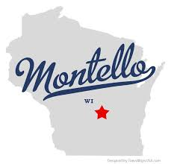
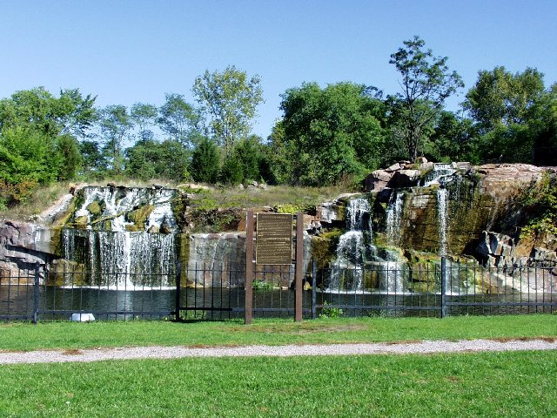
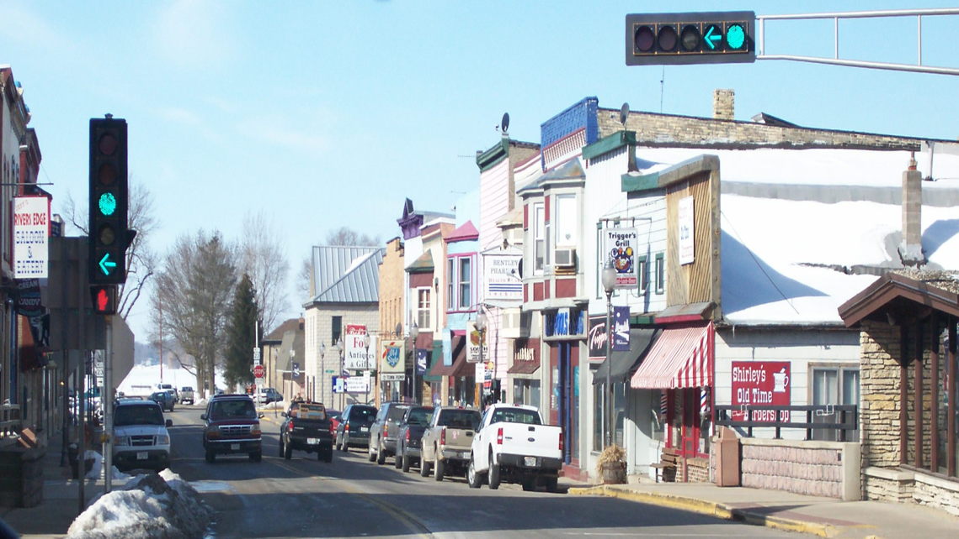
A little about Montello…
725 students K-12
48% free-reduced
8% non-white students
17% special education
PK-5, 6-8, 9-12
Notes:
Put in student demos

Slide 4
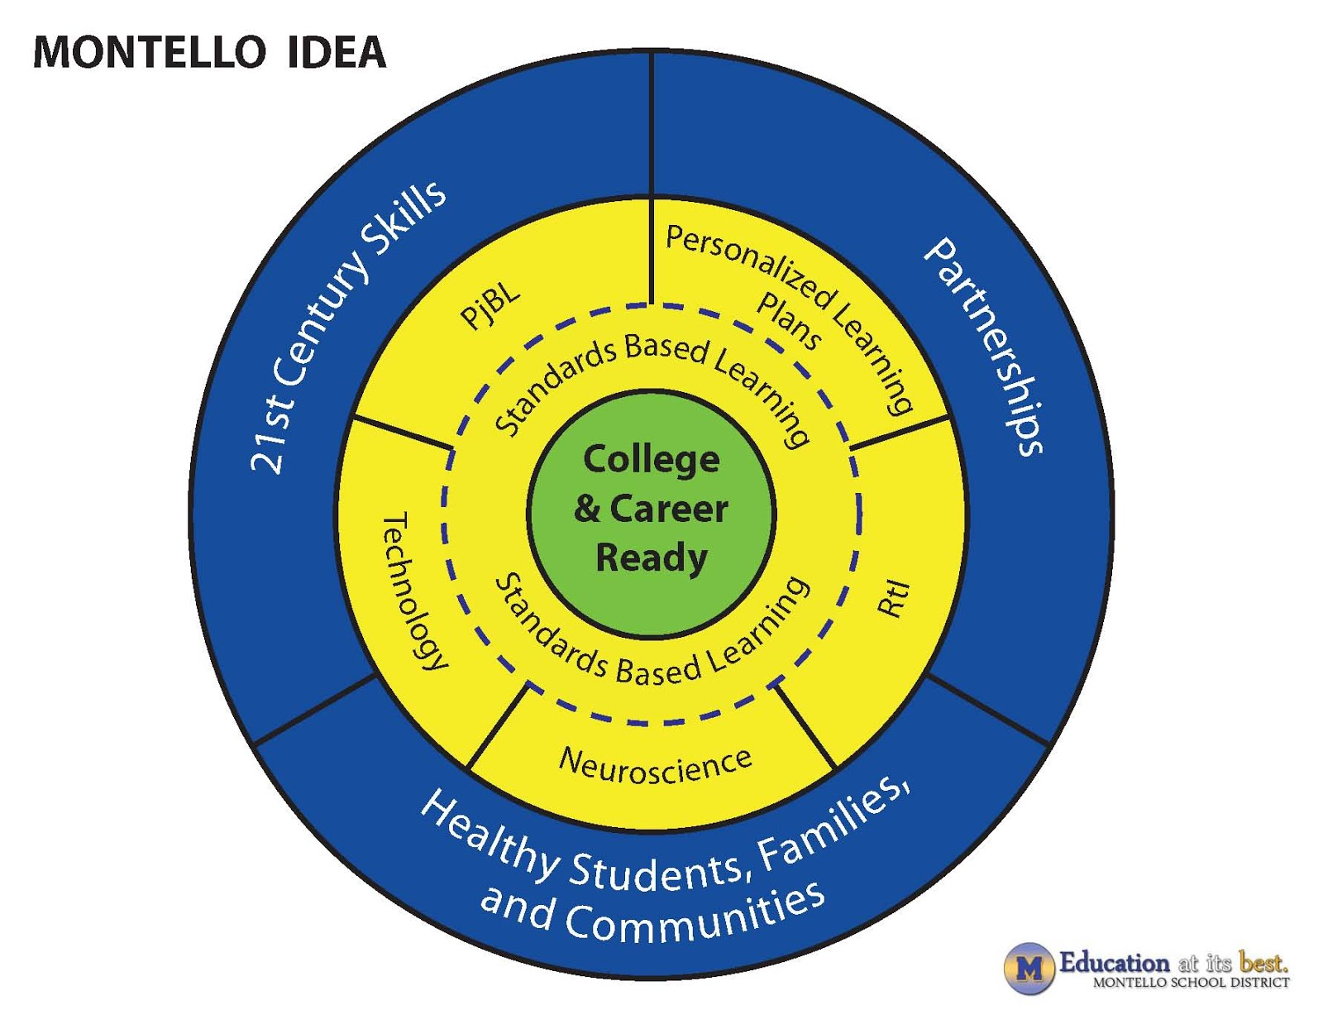
Montello’s Journey…

Slide 5
Personal Learning Plans
Product-Based
Some or Select Students
Act as a 4 year plan
Career application in CTE classes only
Career development in electives only
Student “on own” for its development
HS Graduation = End Point
Career development is only the school counselor’s job

Slide 6
Academic Career Plan
Process Based
All Students
Navigational tool for grades 6-12
Career application in all classes
Career development infused throughout all courses
Student-driven with collaboration
HS Graduation = Check Point
Career development is a systematic, whole-school responsibility

Slide 7
ACP-SLO-OMG!
By May of the 2016-2017 school year, 90% of students in grades 6-12 will have two identified career pathways as evidenced by completion of the career goal section of each individual student’s Academic and Career Plan.
Notes:
Talk about advisory here. Make sure that people have resources. Discuss why 90%. Every child has an opportunity to make a connection and have a career conversation.

Slide 8
Our ACP Pilot Goals:
All students in grades 6-12 will participate in a 25 minute advisory period 4 days per week. 25 minutes weekly will be dedicated to ACP activities culminating in each student having an active online ACP guiding their educational and career goals.
The ACP Leadership Team will establish ACP policies and procedures for the district and submit them to the school board for approval by May of 2016.
Students, parents and staff will be provided with ACP resources to increase ACP understanding once per month.

Slide 9
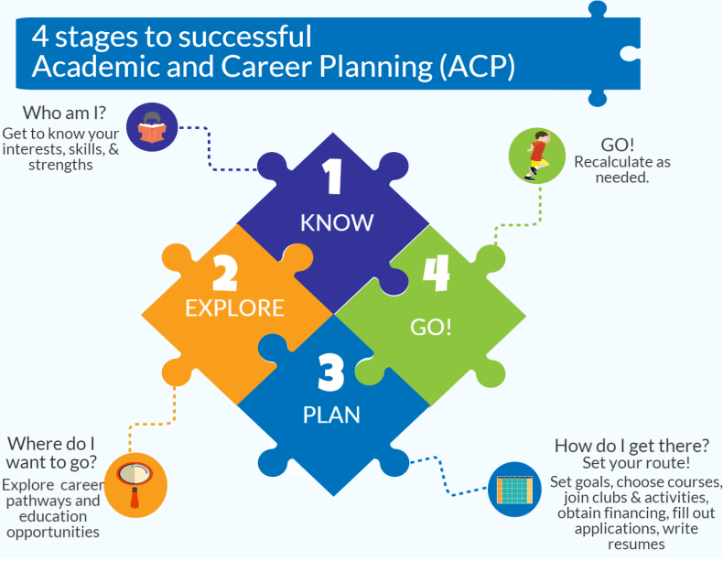
Creating a Culture of Career Based Learning

Slide 10
Montello 6-12 grade students will experience…
Employability Skills
A set of achievements, understandings and personal attributes that make individuals more likely to gain employment and to be successful in their chosen occupations, most frequently mentioned are: communication, teamwork, leadership, initiative, problem-solving, flexibility and enthusiasm
Career Awareness
Exposure to career opportunities to connect to personal interests, talents and employability skills needed for success
Exploration
Develop an ACP representing a match of interests, aptitudes and academic outcomes
Planning and Training
Self reflect and navigate career networks to support ACP
Identify an adult mentor/advisor from their ACP career network
Students will have:
a post-high school plan to implement and a back-up plan
an actual real-world exposure in their career focused area
Notes:
Discuss differentiating and scaffolding based on grade level.
I use these four areas when I am documenting EE evidence.

Slide 11
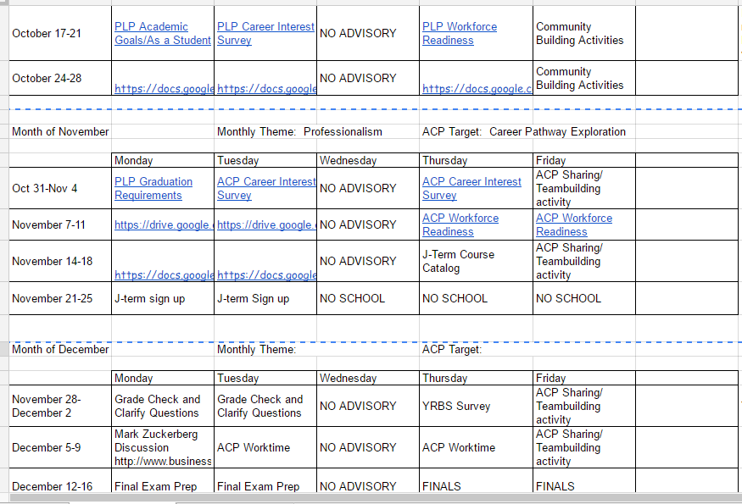
ACP lesson delivery via Google platform:
Notes:
The nice thing about this is that there is no prep for the teacher.

Slide 12
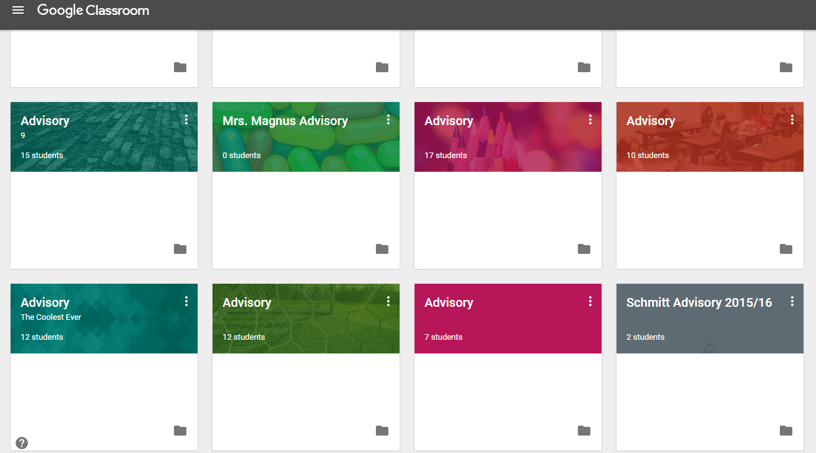
Easily drop lessons into Google Classroom:

Slide 13
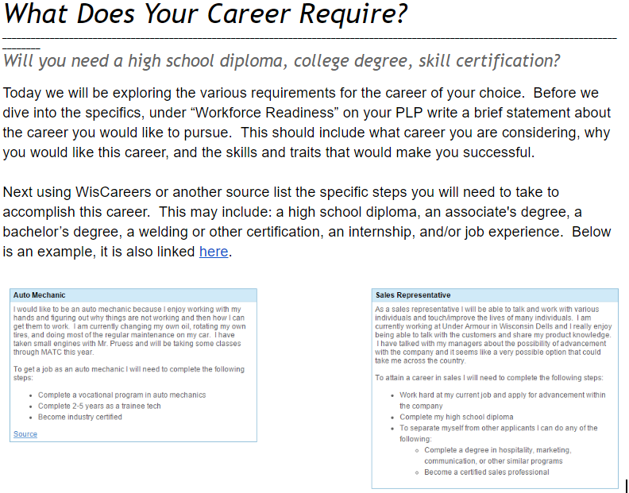
Sample Advisory lesson:

Slide 14
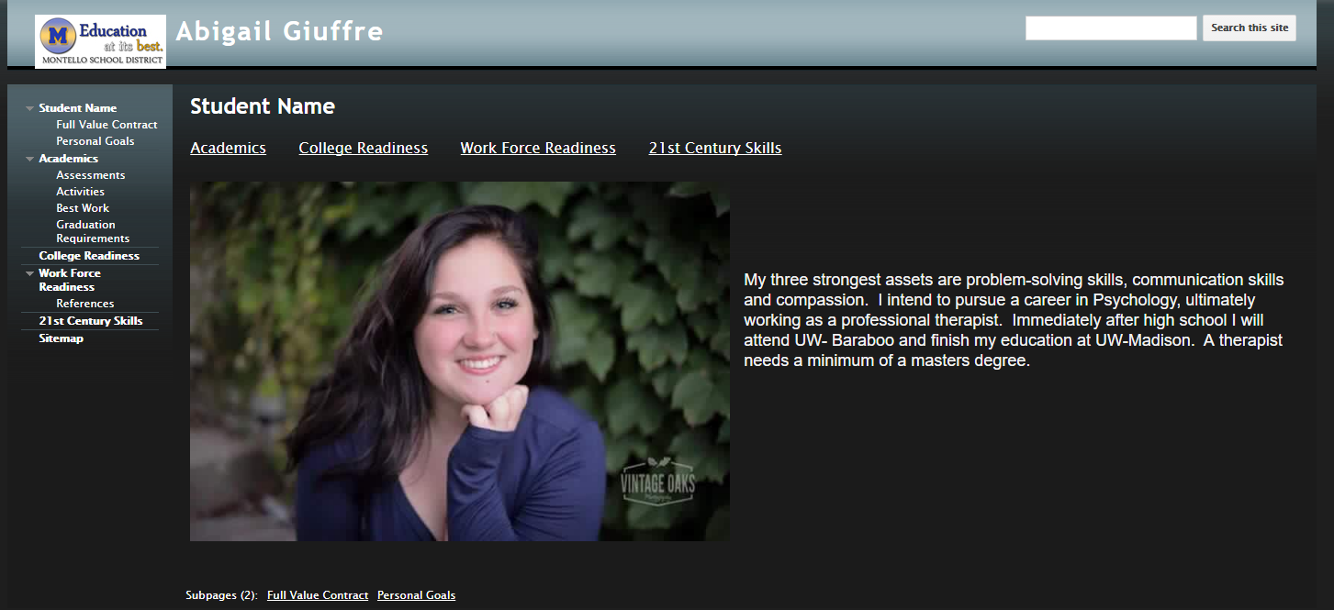
Sample of student ACP work in progress:
Notes:
Add the additional slides…

Slide 15
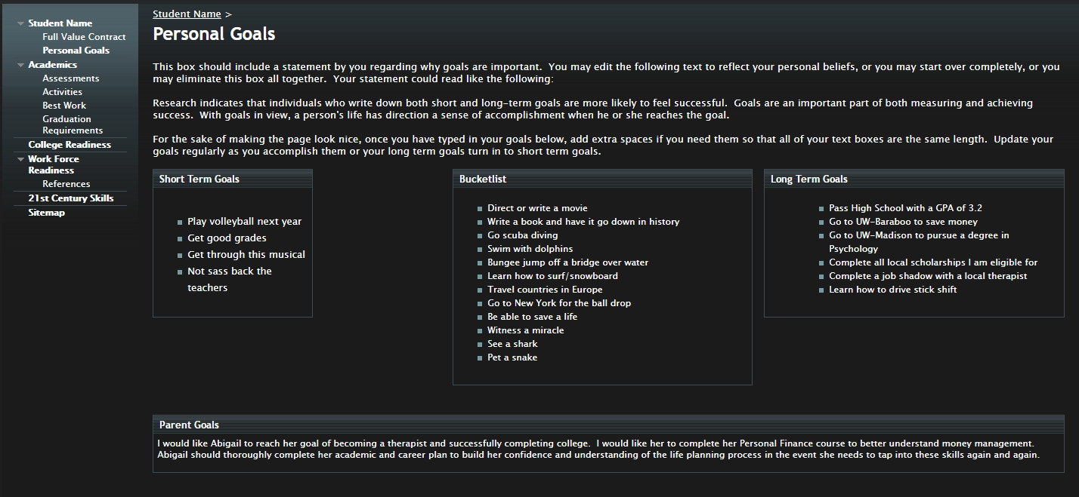
Goal Setting page in progress:

Slide 16
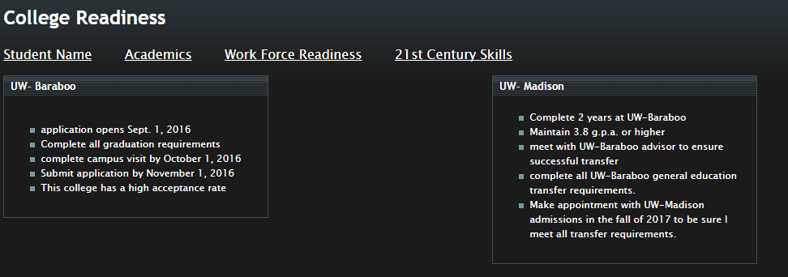
College Readiness page in progress:

Slide 17
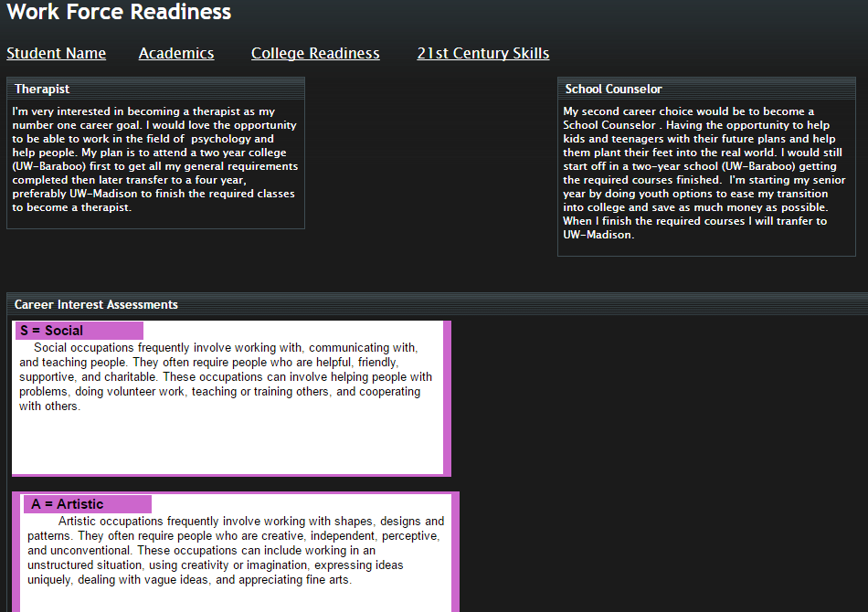

Slide 18
Moving forward…
Working toward a curriculum with career development infused throughout all courses
Student led ACP conferences with advisor/parent, fostering strong school to home connections
Full implementation of Career Cruising
Create and ACP “brand” – student led
Increase school-employer connections
Notes:
Allow districts to share successes or good ideas if time allows.

Slide 19
Contact Information:
Erin Logan
elogan@montelloschools.org
608-297-2126

