Slide 1
Creating Career Pathways with K-12 Collaborations
Sarah Dillon, Dean of College Enrollment
Tracy Ravn, K-12 Pathways Director
Yang Yee Lor, Academy Specialist
Dina Kilinski, Youth Apprenticeship Coordinator

Slide 2
Overview:
Overview of High School Academy Structure
Role of Partners:
External (K-12, Workforce)
Internal (Learning Divisions, Student Services, Regional Campuses, Marketing)
Resources & Cost Sharing
Program Outcomes
Notes:
Sarah:
Topics we plan to discuss today – focus on collaborations NTC has developed and sustained with area high schools

Slide 3
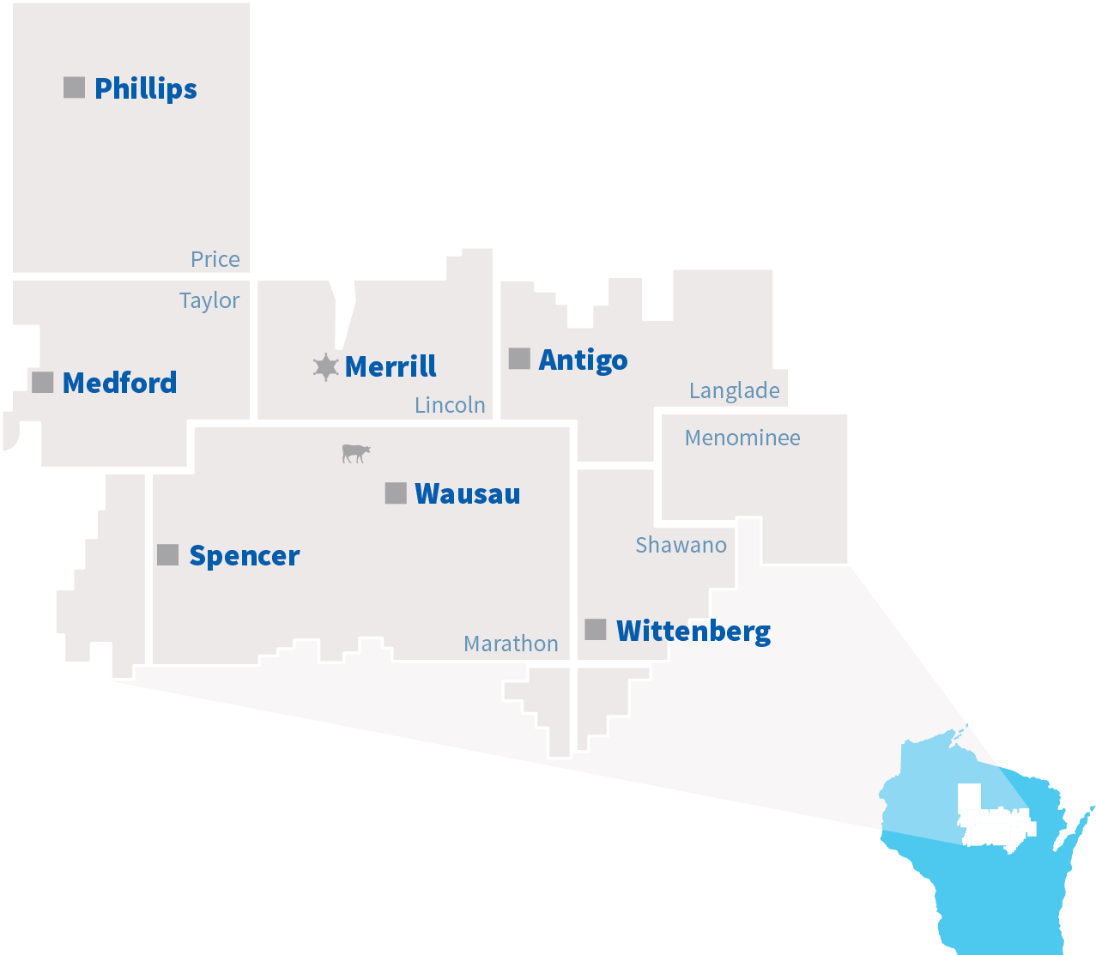
Northcentral Technical College
College Demographics:
Unduplicated Headcount: 28,603
Program Students: 5,694
FTE: 3,422
5,900 square mile, 10-county district
Notes:
Sarah:
To start, a bit about NTC’s district and who we serve

Slide 4
Northcentral Technical College
College Demographics (Cont.):
Nearly 200 associate degree, technical diploma, and short-term certificate programs
Over 350 transfer opportunities with 4-year colleges
Notes:
Sarah:
To start, a bit about NTC’s district and who we serve

Slide 5
Northcentral Technical College
K-12 Demographics within the district:
25 public high schools
Numerous private/parochial schools
Recent growth of 32% of students under age 25
Median age of students is 24
51% of program students are under 25
Notes:
Sarah:
Background on the K-12’s we serve

Slide 6
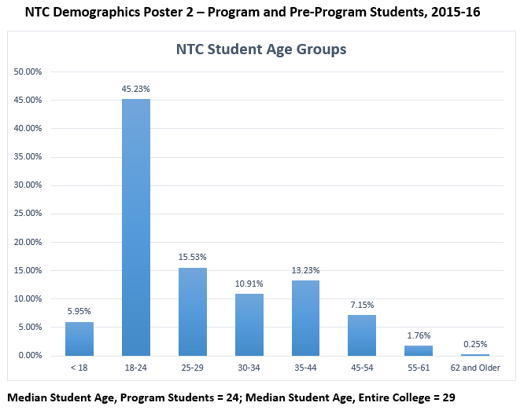
Northcentral Technical College
Recent increase in 18-24 year olds enrolling at NTC
Notes:
Sarah:
Background on the K-12’s we serve

Slide 7
Dual Credit & Academies
What is the difference?
Dual Credit: College courses taught by certified high school faculty
Academies are packaged courses that create strong career pathways for students
Dual Credit
Contracted Courses
Youth Options/Course Options
Notes:
Sarah – Explain the difference between the two

Slide 8
Academy Structures
Dual Credit: Students taking 2 or more related dual credit classes.
Regional Academies: Cohort of students taking classes the same time every day, some dual credit, some contracted, some course options.
Northern Academy: Classes held at the local high school 1st semester/then 2nd semester come to NTC campus for classes.
Notes:
Tracy: Colby---Manufacturing Academy

Slide 9
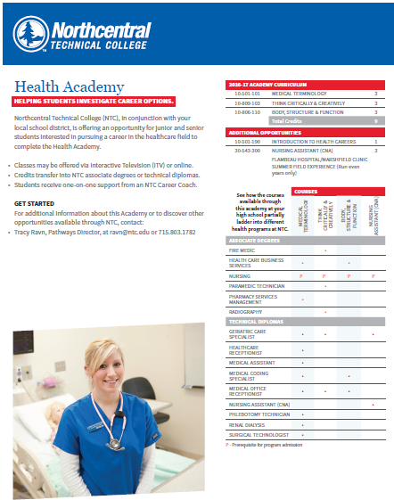
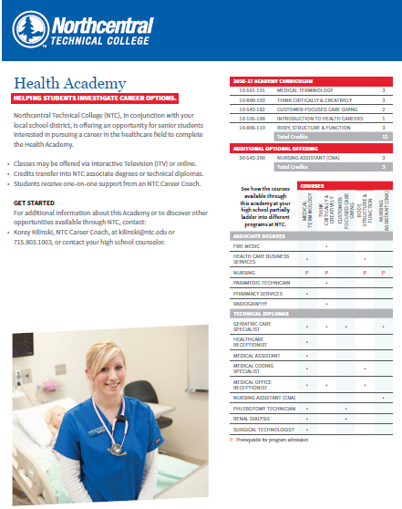
Regional Academy Structure
Academies are unique for each school or consortium
5 school Consortium option
2 school Consortium option
Notes:
Tracy: Academies may be unique to each district or consortium. Here is an example.

Slide 10
High School Dual Credit Academy Structure
Health Academy
XYZ High School | Northcentral Technical College
Medical Terminology | Medical Terminology 10-501-101 | 3 credits
Body, Structure, Function | Body, Structure, Function 10-806-110 | 3 credits
Introduction to Psychology | Introduction to Psychology 10-801-198 | 3 credits
(Youth or Course Options) | Nursing Assistant/C.N.A (YO) 30-543-300 | 3 credits
Calculus 1 | Calculus 1 10-804-198 | 4 credits
Think Critically & Creatively | Think Critically and Creatively 10-809-103 | 3 credits
Algebra 2 | Intermediate Algebra with Application 10-804-118 | 4 credits
 | Total Credits | 23 credits
 | Approximate Tuition Savings | $3,220.00
Notes:
Tracy: Academies may be unique to each district.

Slide 11
NEW: Pathway Academies
Formerly DWD WI Fast Forward – Blueprint for Prosperity Grant, Now GPR, College, and K-12 Funds
CNA, IT, Welding, Ag, Accounting, EMT
Cohort Based/Individual Academy Plan
Challenge: Tuition
50% Transition to NTC
Case Management is Key
Notes:
Sarah
New model – move to more case management

Slide 12
Pathway Academy Case Management
Schools help select students
Meeting with students before class begins
Parent orientations
Regular check-ins with students and NTC faculty
Feedback to K-12, parent(s), and student
Job skills training & college transition support
Notes:
Yang Yee
New model – move to more case management

Slide 13
Youth Apprenticeship Connections
Dual Credit Opportunities for related coursework
Case Management Model for YA
“Dual Enrollment” in YA and Academies:
Funding Resource to support tuition for academies
IT Student Success
Agriculture – Internship
Notes:
Dina
Students who’ve participated in both

Slide 14
Getting Started – From the Top Down
Building relationships with K-12 administrators and local employers
Discuss best package of courses
What are the needs of the students, districts, workforce?
Are there industry certifications/credentials available?
How will academies ladder into other programs?
Review teacher certifications & logistics
Notes:
Meetings with Administrators & Local Employers
Discuss packages of classes they would like to offer
Review teacher certifications
Meet with teachers and administrators to discuss class and competencies they will cover
Create a group of classes that relate that can fit into an academy and ladder into NTC programs
***If time….Tracy will talk about what we do with teacher certifications, etc.

Slide 15
Calculating Return & Benefits
Tracking outcomes vs. activities
Adjust based on regular feedback
Direct enrollment/Higher transition rates
For college: creates awareness, fights negative perceptions
For Workforce: meeting employee shortages
For K-12: providing opportunities to students & resource sharing
Notes:
CRM used to track events
Annual Report focused on outcomes versus activities
Adjustments made to programming based on regular feedback
Direct Enrollment Increases What’s in it for each partner
NTC: Enrollments, Creating a pipeline
Workforce: Meeting employee shortage, molding the future workforce
K-12: Supplementing coursework, providing opportunities, teacher shortages – still allows students the CTE coursework, credentials for students, resource sharing

Slide 16
Questions
Sarah Dillon:
dillon@ntc.edu
715.803.1147
Yang Yee Lor:
lory@ntc.edu
715.803.1881
Tracy Ravn:
ravn@ntc.edu
715.803.1782
Dina Kilinski:
kilinskid@ntc.edu
715.803.1190

