Slide 1
Developing Partnerships to Support a Thriving Community
Successful Academic and Career Planning through Collaboration
Academic and Career Planning Conference
December 6 & 7, 2016

Slide 2
Introductions
Ann Franz, Director, Northeast Wisconsin Manufacturing Alliance
James Golembeski, Executive Director, Bay Area Workforce Development Board
Lori Peacock, Director of College, Career and Community Readiness, Green Bay Area Public School District

Slide 3
Session Description
We will
  Describe why developing collaborative partnerships with PK-12 educators , institutions of higher education, and business and industry is vital to sustaining our future workforce.
  Provide examples of how to develop partnerships within your community to support Academic and Career Planning (ACP), workforce development and economic viability.
  Outline the important steps needed to develop and sustain collaborative relationships in your community and region.

Slide 4
Why Partnerships Support ACP

Slide 5

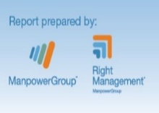
Growing Wisconsin’s Talent Pool
A Competitive Wisconsin
BE BOLD initiative
Notes:
What is the Human Age?
Manpower has identified that we are on the cusp of a new reality: we are entering the Human Age. The world is experiencing a global readjustment in which powerful forces, in flight over the last few years, are converging to create a new reality where business models will have to be redesigned, value propositions redefined, and social systems reinvented. In this new reality, human potential will become the major agent of economic growth. In the Human Age, people will take their rightful place at center stage as the world’s only source of inspiration, passion, and inspiration, and the driving force behind endeavor and enterprise.
What has caused the Human Age?
The world has experienced a series of tumultuous shifts over the last decade, and the velocity of change is increasing. ManpowerGroup has been tracking World of Work megatrends which are changing the face of the labor market – and business – globally. It is the combined impact of these changes and the speed with which they are transforming the world that has conspired to bring about the dawn of the Human Age:
Through the recession and now into the recovery, the pressure to do more with less has intensified, increasing competition for talent.
A technological revolution is transforming the World of Work, enabling the rapid and unfiltered exchange of ideas and innovation, giving a voice to millions and providing a new level of flexibility.
Power is shifting from employer to individual, leading to more individual choice. As employers seek to unleash human spirit, passion and potential, they are required to adopt a “one-size-fits-one” approach and engagement on a human level.
The shifting demographic landscape is creating a talent shortage; employers are struggling with a mismatch - finding the right talent in the right place at the right time.
The world is changing so fast, so dramatically, and so completely that only the intellectual curiosity, passion, empathy, imagination, commitment, and ultimate potential of humanity itself will enable us to move forward, adapt, evolve, and rebuild.
By making talent the new competitive advantage – the new it – we believe that those countries and companies can unleash the human potential as major agents of economic growth. We call this force talentism: the workforce strategy required to unleash human potential will be at least as important to your success as your capital strategy. These trends are so impactful that we are on the cusp of a new era – the Human Age where human potential will be the catalyst of change and the driving force economically, politically, and socially.

Slide 6
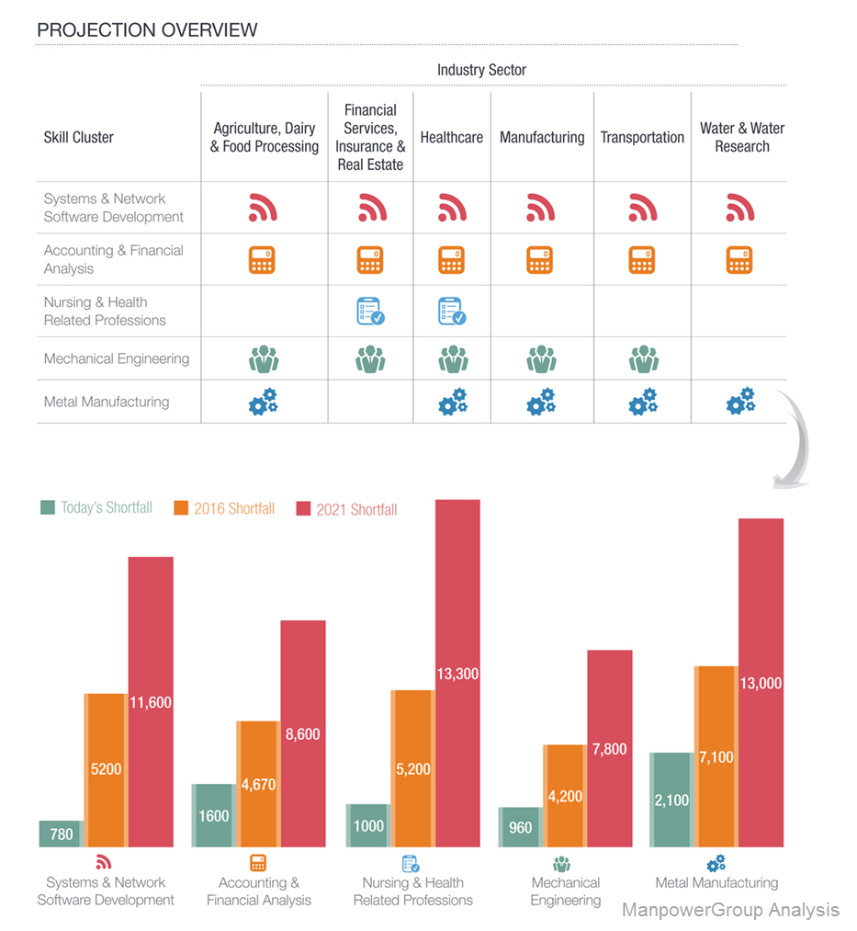
The BE BOLD 2 Supply/Demand Study

Slide 7

Occupational Category | View Jobs
Architecture and Engineering | 2388
Arts, Design, Entertainment, Sports, and Media | 776
Building and Grounds Cleaning & Maintenance | 1465
Business and Financial Operations | 3263
Community and Social Services | 1164
Computer and Mathematical | 2930
Construction and Extraction | 976
Education, Training, and Library | 903
Farming, Fishing, and Forestry | 48
Food Preparation and Serving Related | 4578
Healthcare Practitioners and Technical | 7495
Healthcare Support | 2208
Installation, Maintenance, and Repair | 2282
Legal Occupations | 108
Life, Physical, and Social Science | 931
Management Occupations | 4106
Military Specific Occupations | 11
Office and Administrative Support | 6606
Personal Care and Service Occupations | 1108
Production Occupations | 4886
Protective Service Occupations | 738
Sales and Related Occupations | 8147
Transportation and Material Moving | 4083
Job Orders
in Wisconsin
November 1, 2016
JobCenterofWisconsin.com

Slide 8
Demand
(Driver Industries)
Career Pathways in NEW North
Supply
Algoma
Ashwaubenon
Bonduel
Cedar Grove/Belgium
Crivitz
Denmark
Elkhart Lake/Glenbeulah
Gibraltar
Goodman/Armstrong Creek
Gresham
Howards Grove
Kaukauna
Kiel
Kohler
Little Chute
Manitowoc
Menominee Indian
Niagara
Oconto Falls
Oostburg
Plymouth
Random Lake
Sevastopol
Shawano
Sheboygan Falls
Southern Door
Tigerton
Suring
Valders
Wausaukee
Wittenberg-Birnamwood
Manufacturing
Food Processing
Metal Fabrication
Paper
Plastics
Packaging
Engineering
Industrial
Mechanical
Electrical
Healthcare
Transportation/
Logistics
Insurance/Finance
Information Technology
Sales
Appleton
Beecher/Dunbar/Pembine
Bowler
Coleman
De Pere
Florence
Freedom
Gillett
Green Bay
Hortonville
Howard-Suamico
Kewaunee
Kimberly
Lena
Luxemburg-Casco
Marinette
Menominee Tribal
Mishicot
Oconto
Oneida Nation
Peshtigo
Pulaski
Reedville
Seymour
Sheboygan
Shiocton
Sturgeon Bay
Two Rivers
Washington Island
West De Pere
Wrightstown
CESAs
Technical Colleges
Chambers
EDCs
DPI
Bay Area WDB
Youth Apprenticeship
Industry Alliances
GPS Education
Universities
Community Orgs
E
m
p
l
o
y
a
b
i
l
i
t
y
S
k
i
l
l
s

Slide 9
Northeast WI Manufacturing Industry
23%
Employed in Manufacturing Industry

Slide 10

The Perfect Storm
advanced skills
Growth
retirement
mfg. image
Workforce
2006 2020

Slide 11

Employees retiring outnumber teen workers for the first time in 60 years.

Slide 12
2020 Demographics
36%

Slide 13
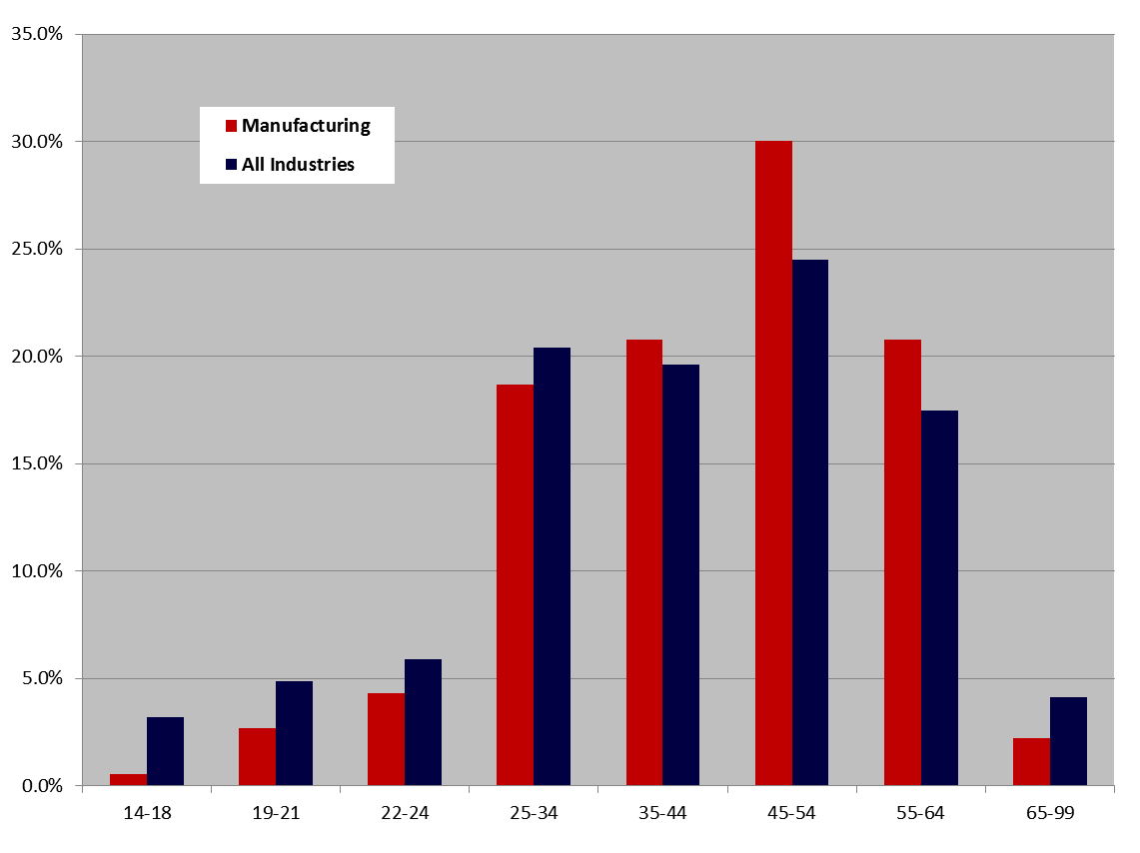
Manufacturing Workforce is Significantly Older
Source: Quarterly Workforce Indicators, U.S. Census Bureau

Slide 14
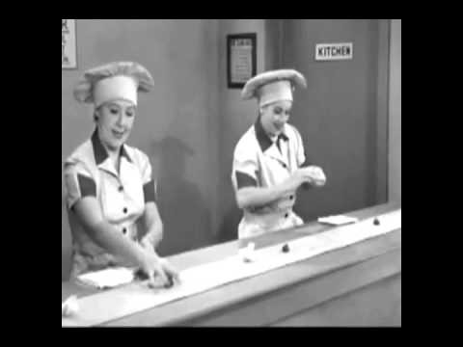
Manufacturing Image

Slide 15
Green Bay Area Public School
District Mission
We educate all student to be college, career and community ready, inspired to succeed in our
diverse world.
Notes:
District mission
ALL
College, career and community
Diversity of the world
Preparing students for the 21st and 22nd century
According to Wikipedia
2160 – Some scientists believe there are people born in 2010 who may still be alive in 2160

Slide 16
It All Started with One Question
“What do you want?”
- Mark Kaiser, CEO, Lindquist Machine Corporation, former President of the Northeast Wisconsin Manufacturing Alliance, May 2011
Notes:
In the spring of 2011, I was frustrated with the current state at the time, which was an unfortunate level of “finger-pointing” at education that we were not doing enough or not doing the right things to support workforce development.
Realized we were not in position to develop the future workforce alone; but did not feel like I was getting any help
On a recommendation from a friend, met with Mark Kaiser
That conversations changed my professional life and the trajectory of our district in developing career pathways aligned to workforce development demand

Slide 17
Understand Workforce Development
Labor market
Who are the key stakeholders
Community organizations
Career pathways PK-16
Focus on “why” and “what” before “how”
Get involved
Notes:
Before you can answer “what do you want?” get the ACP Team grounded in understanding your local and regional communities;
Understand the current and future workforce development demands
Labor market will drive your partnerships
Know who’s “IN” and who’s “Not Ready”
Community-based organizations may also be working on CCCR; understand what they are doing
Review the PK-16 pathways; are they aligned with workforce development
Are your key stakeholders involved in curriculum development; staff development; work-based learning; advisory committees (district & postsecondary)
YOU NEED TO KNOW “WHY” YOU WANT PARTNERS INVOLVED AND “WHAT” YOU WANT FROM THEM (AND THEM FROM YOU) BEFORE YOU LAUNCH INTO “HOW”
Divide and concur – get key members of the school staff involved on committees that support your ACP work

Slide 18
“Anchors” and “Champions”
Step 1: Identify your “anchors” and “champion” partners
Step 2: Be strategic
  Establish common, achievable goals and objectives
  Identify early successes
Step 3: Put your plan into action
  Start with one thing!
Build and sustain authentic relationships with your partners
Keep moving forward!
  Sustaining more important than building
Notes:
Anchor – your “go to” partners (e.g., Mark Kaiser for Manufacturing; David Cuene for Auto Tech; Jim Deleers and Cheri Galecki for Construction; and (6 individuals) NWTC and UWGB for postsecondary
Champions – work closely with the “Anchor” and help you to promote your work and provide resources (time, talent, $$$, equipment) to support ACP and career pathway development
Do not get caught up in my terminology; this helps me to know who to call/ask and for what
Sustaining is harder than building! Do not assume “if you build it they will come.”

Slide 19
How our Partnership Supports the Future Workforce

Slide 20


Step 1: You need a Career Planning Tool
Career Cruising
The K-12 Schools’ Part:
Integrating career planning and the school curriculum
for all students and sustaining it throughout the
K-12 experience.

Slide 21




Step 2: A connection to the business community
Options are being discussed and models are in place. Schools can evaluate two good programs.

Slide 22

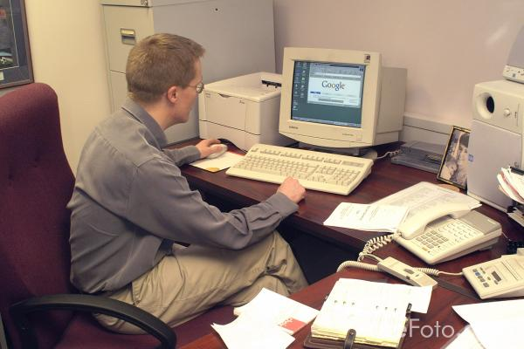


Step 3: A Manager is needed to sustain the linkage
Tuesday
Wednesday
Thursday
Friday
Monday
Chambers of commerce in Sheboygan, Fox Cities, and Green Bay
have models in place to learn from and demonstrate effectiveness.

Slide 23





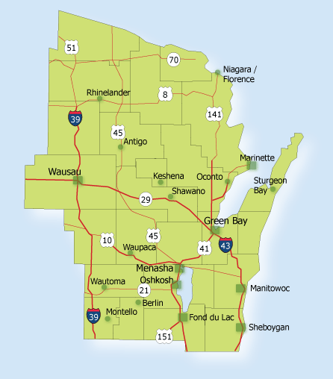














Step 4: Create a regional collaboration

Slide 24





Happiness
and
Prosperity

Slide 25
NEW Manufacturing Alliance
Industry sector partnerships in the New North: NEW Manufacturing Alliance, North Coast Marine Manufacturing Alliance, Healthcare Alliances, NEW Insurance Consortium and NEW IT Alliance.
Founded in June 2006
Over 190 members including: manufacturers, educational institutions, workforce development boards, chambers of commerce, economic development, and government entities in 18 counties in the New North.
The Vision is every Northeast Wisconsin manufacturer will find the talent it needs.

Slide 26
How did “Get Real Math” get started and why?
At a K-12 taskforce meeting in October 2012, a Math Teacher asked if there are applications industry uses that can help show students real applications for math.
  She was looking for a different way to show relevancy for Math in real world applications.
Industry partners saw this as an opportunity because there is a strong need for math and problem solving skills in manufacturing.
  The project met the needs of both Educators and Industry.

Slide 27
Collaboration
This was a total collaborative effort with the support of the Green Bay Public School system and area Manufacturers.
The decision was made jointly to create videos that teachers can show in the classroom.
  The videos have been aimed at Middle school math
  They were tied to specific Common Core standards

Slide 28
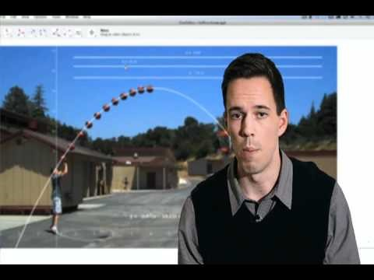
When am I ever going to use this?

Slide 29

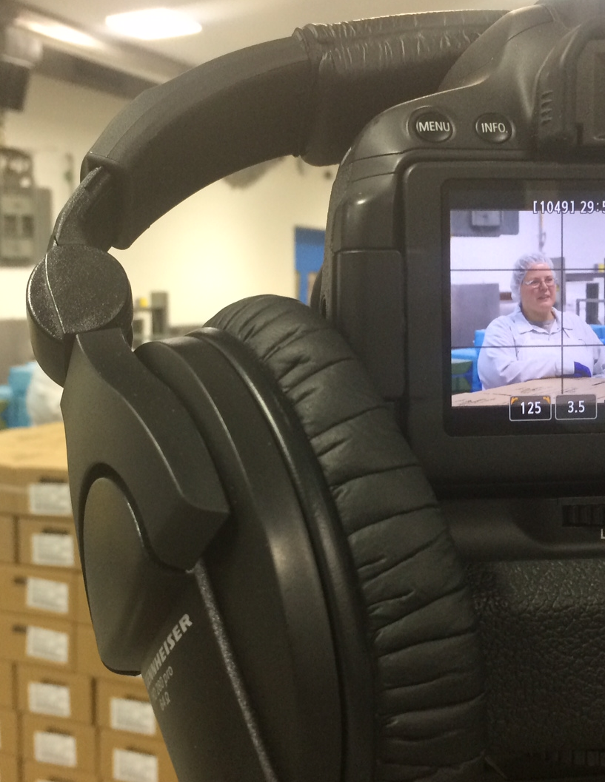
Notes:
The K-12 taskforce led the development of manufacturing-related math problem videos. Videos showcase how math is used in the real world, along with giving middle school age students career information. Five videos have been produced with film locations at KI, Ariens and Sargento Foods. The videos also focus on critical thinking skills and the implications of making a mistake.

Slide 30
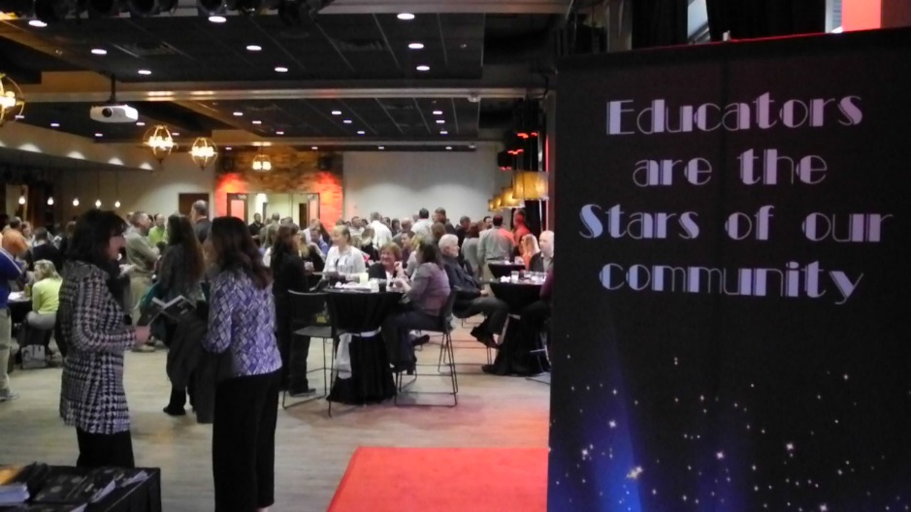
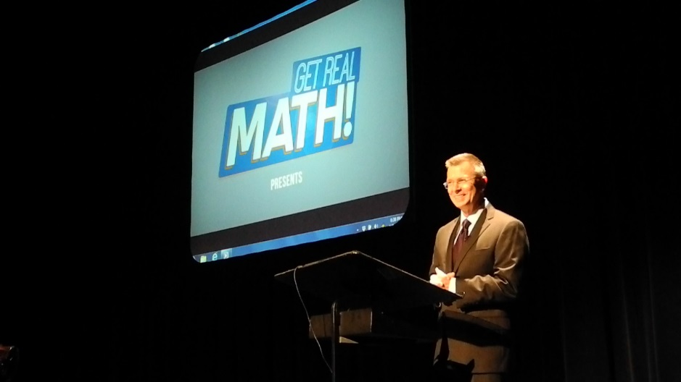
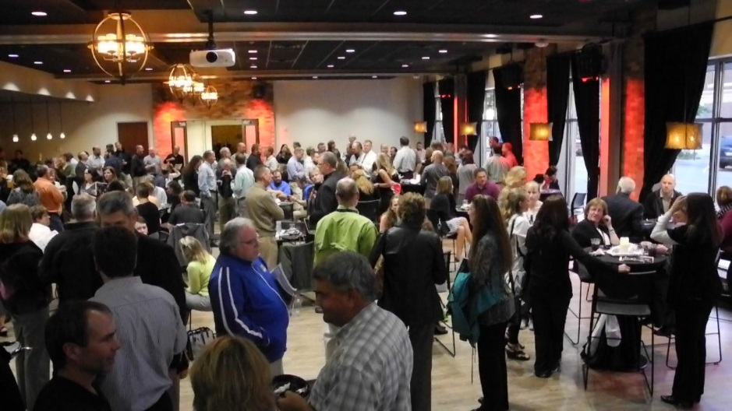
Video Premiere 10/4/16

Slide 31
6 keys to Success
Industry must lead initiative
There must be someone from the public sector facilitating and administrating of the partnership
Nonpolitical
Keep focused, don’t try to do too much
Think regionally, not just locally
Measure your results and celebrate successes

Slide 32
Website for Videos
http://www.newmfgalliance.org/math-videos.html
www.newmfgalliance.org

Slide 33

http://baylinkmanufacturing.gbaps.org/
Notes:
In a few minutes, I am going to share with you how our partnership helped to develop Bay Link Manufacturing.
Point out tag line: A Partnership Linking Education and Manufacturing

Slide 34
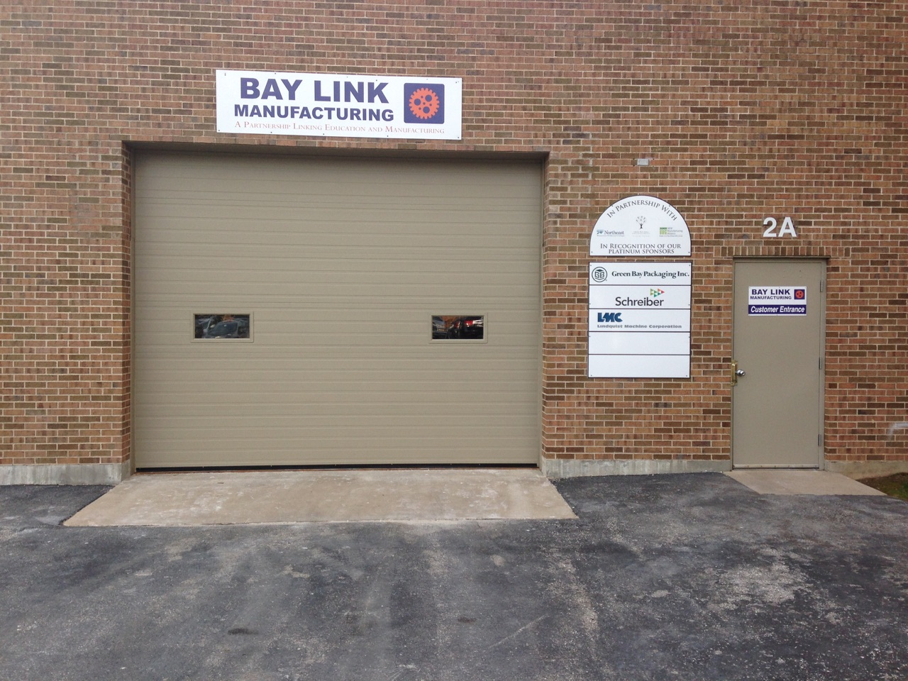
Bay Link Manufacturing is a high-precision manufacturing learning lab combining work-based learning with a strong academic foundation in manufacturing courses.

Slide 35

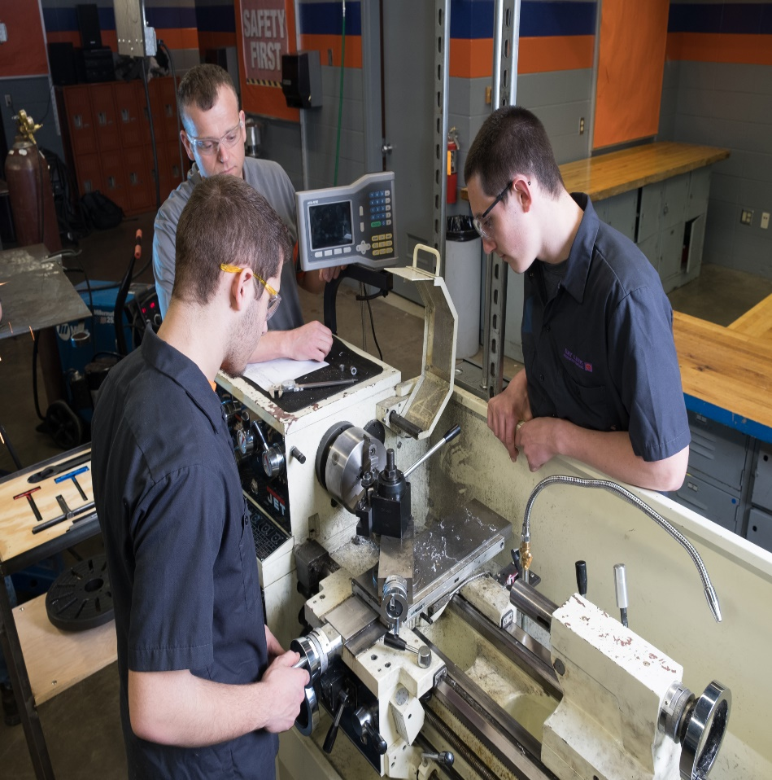
Students:
Design systems accounting, document control, bidding and purchase orders, production planning, shipping, marketing and communications.
Demonstrate employability skills and knowledge through real-world relevant work experience.
Earn 3 high school credits and 5 college credits.
“Work” on real projects presented by local companies in the areas of industrial welding, machine fabrication and metals.

Slide 36
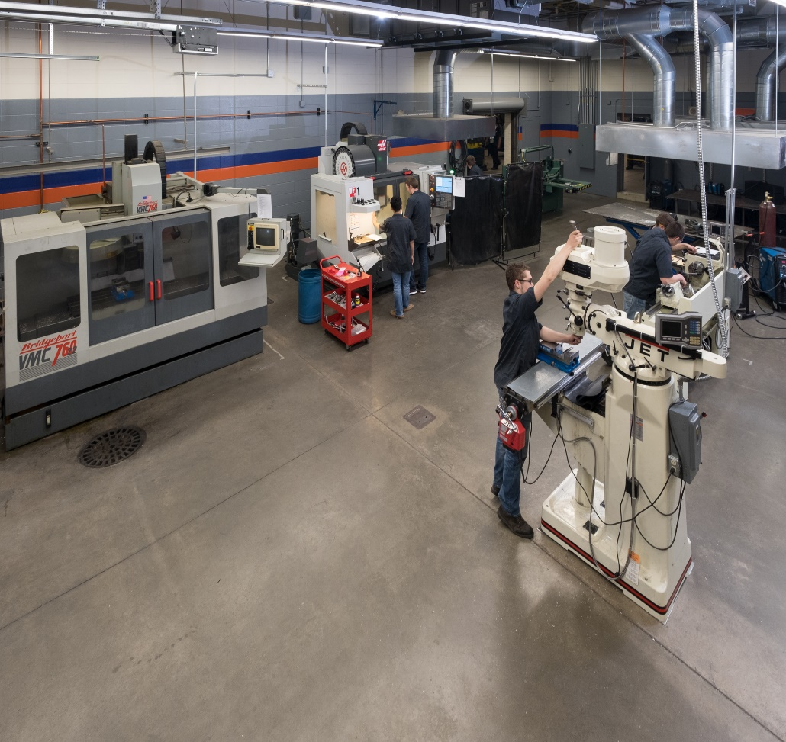
Career Pathways
Career awareness and exploration beyond a “degree” to a high skill, high demand, high wage career
Answers the questions,
  “When am I ever going to need to know this?” and
  “How can I support myself and my family?”
Sustain viable neighborhoods and a strong economy
Active Advisory Team

Slide 37
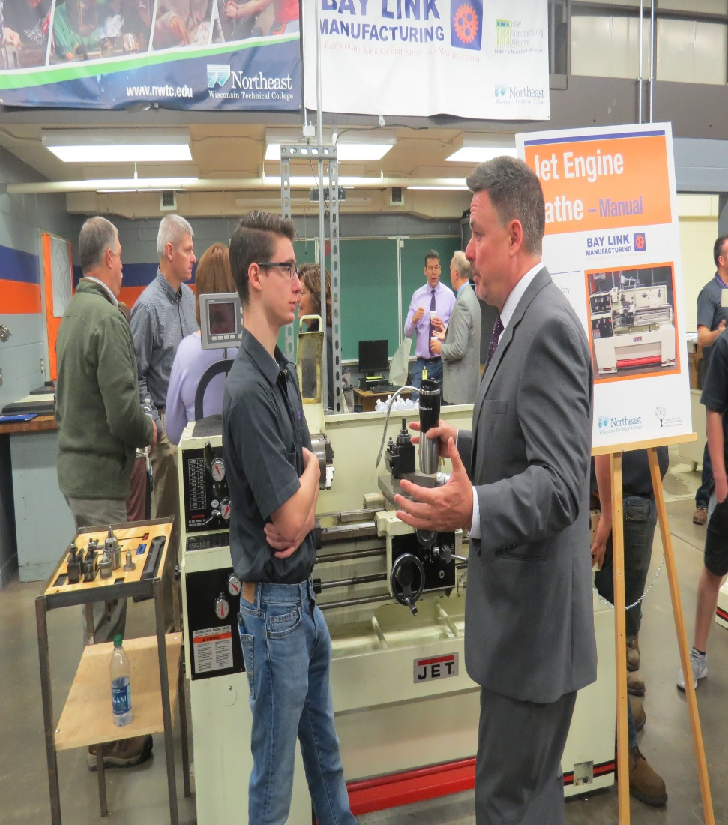
Community Sponsorships
Identify what we need
Identify potential sponsors and donors
Write grants
Receive donations of time, industry “talent” equipment and money
Demonstrate a commitment to quality education in the Green Bay area

Slide 38
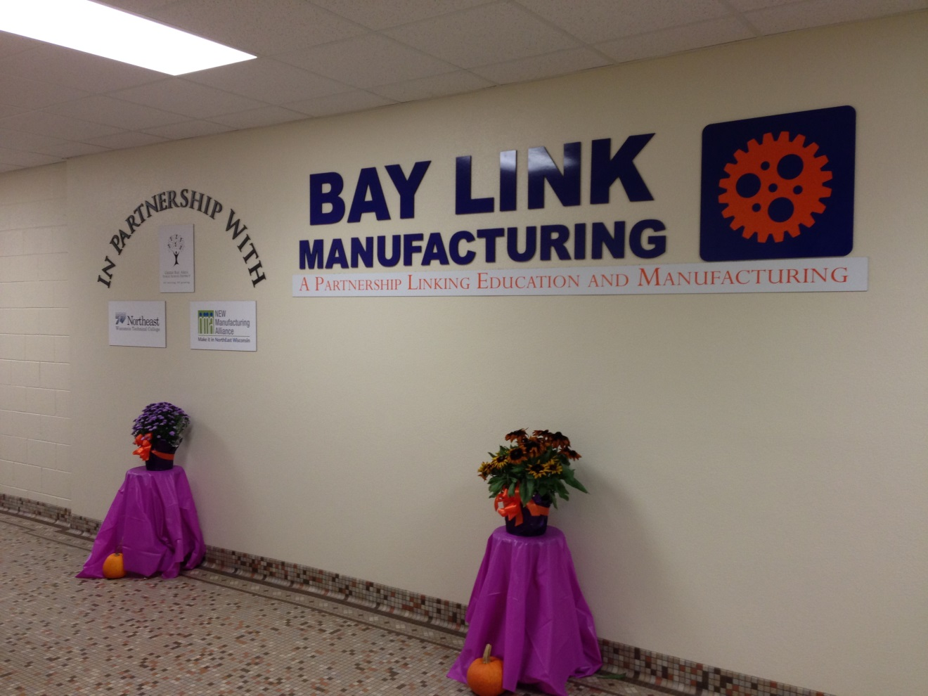
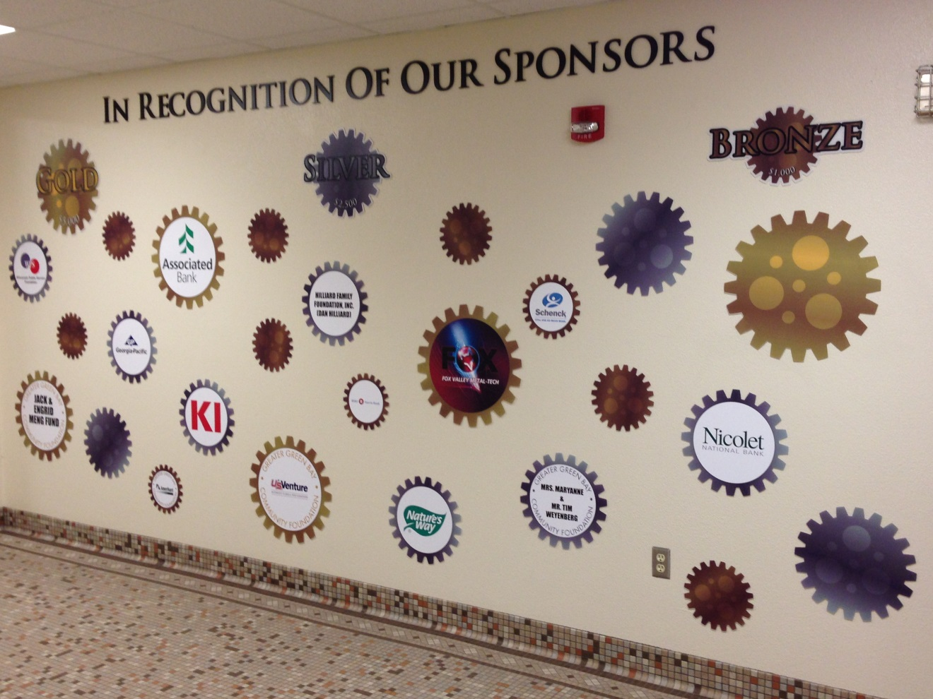
Technology Hallway
Green Bay West High School

Slide 39
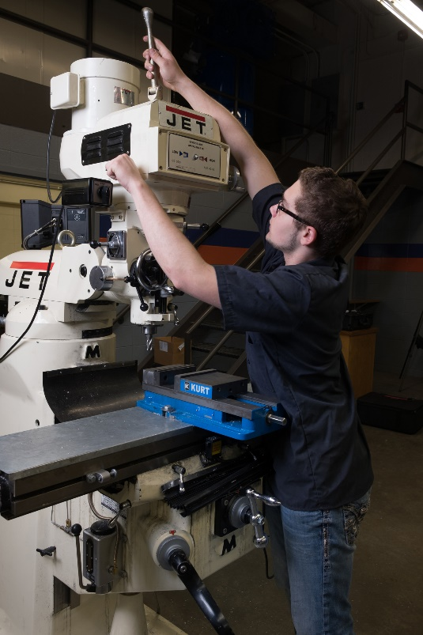
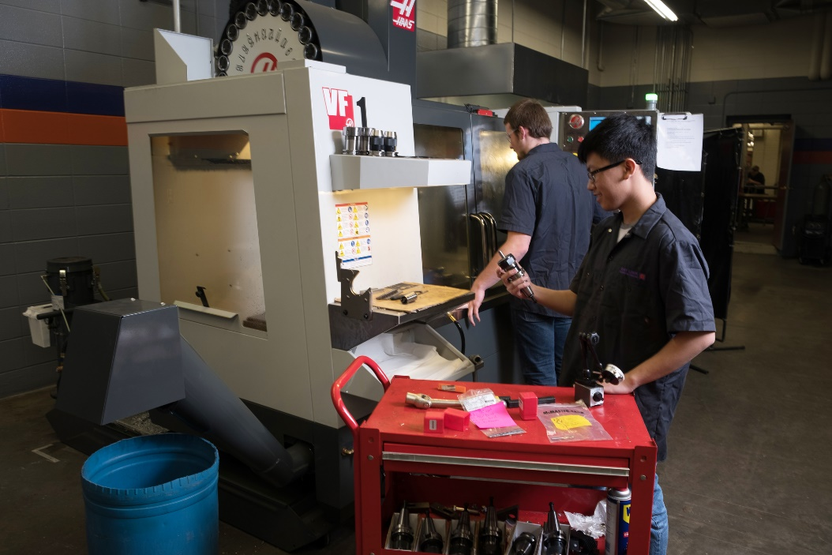
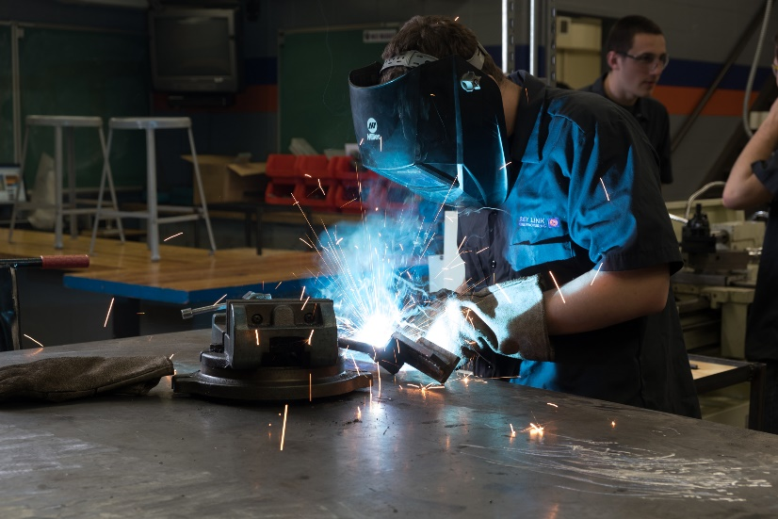
Our Future Workforce

Slide 40
Thank you!

