Slide 1

Connecting schools, higher education, and businesses
Working Together:
December 7, 2016
Crystal Huset, Jason LeMay, Courtney McGraw & Carrie Hirst

Slide 2

Just the facts . . .
Total population of the school district is approximately 2,856 people, made up of the village of Pardeeville and Wyocena, and some outlying areas.
Thirty-five miles from Madison
District has . . .
  823 students in 4K-12, with 253 students in the high school
  Four administrators: one principal at the elementary, middle and high school level, as well as a district administrator
  Total staff for the district is 68 individuals spread over three buildings

Slide 3
Partnerships between business and schools can significantly enhance the quality of education we are able to provide.
These partnerships can:
Promote improved student achievement
Create better school environments
Build stronger communities

Slide 4
Rural Columbia County
Labor Initiative

Slide 5
Purpose
To bring public educators, business leaders, and post-secondary professionals together to align local career and technical education opportunities to regional business employment needs.

Slide 6

AGENDA
8:30— 8:50 Breakfast & Networking
8:50— 9:00 Welcome and Purpose
Jason LeMay and Crystal Huset, Pardeeville High School
9:00— 9:30 Academic and Career Planning & CTE Incentive Grants
Jason LeMay and Crystal Huset, Pardeeville High School & School Districts
9:30— 9:35 Break
9:35— 10:00 Madison College & Dual Credit Opportunities
Juanita, Comeau, Madison College
10:00— 10:10 Break
10:10— 10:30 Youth Apprenticeships
Shelley Drescher, CESA 5
10:30— 11:30 Where do we go from here? & District Planning Time

Slide 7
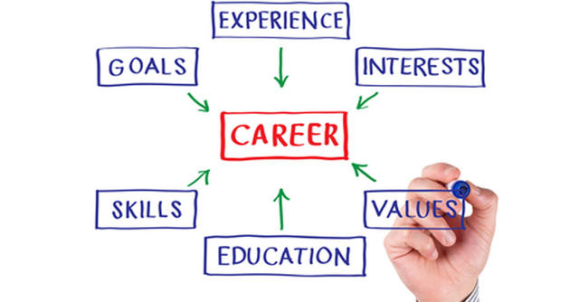

Slide 8
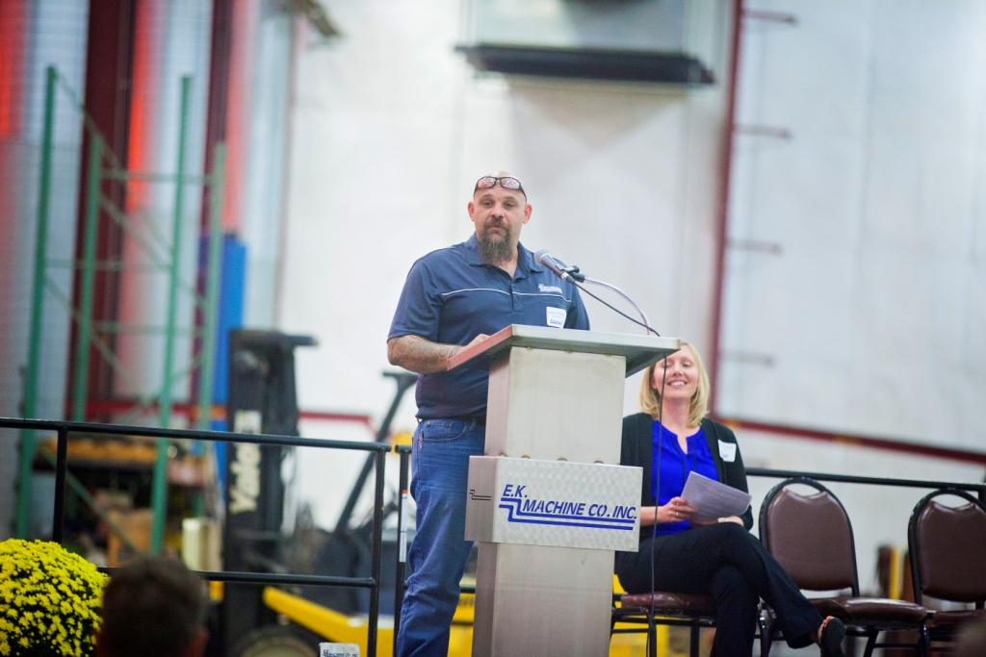
Looking to industry
Apprenticeships?
Materials?
Training?
Direction?

Slide 9
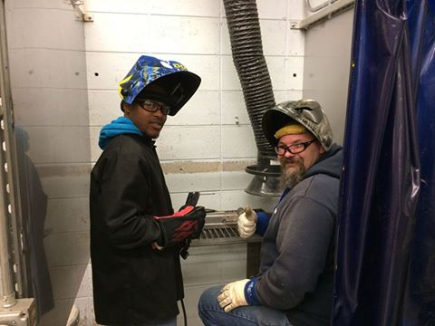

Slide 10
Where to Find Partners
Which teachers and administrators can I approach?
Which postsecondary partners can I approach?
Which vendors can I approach?
Which former students can I approach?
Which parents can I approach?
Which personal contacts can I approach?
Adapted from National Center for College & Career Transitions

Slide 11
Changes to the Curriculum

Slide 12
Increasing offerings in CTE, expanding dual credit, and interweaving courses across the curriculum with site visits.

Slide 13
Dual Credit Offerings
Accounting
Elementary Algebra
Microsoft Office: Word, Access, PowerPoint and Excel
2013
2015
Accounting
Introduction to College Writing and Reading Strategies
Elementary Algebra
Fundamentals of Manufacturing
Medical Terminology
Intro to Health Care Careers
Microsoft Office: Word, Access, PowerPoint and Excel

Slide 14
Dual Credit Offerings
In 2016 we offer the following dual credit offerings . . .
Agri-Business Management
Biotechnology
Advanced Horticulture
Golf Course & Landscape Design
Accounting
Introduction to College Writing and Reading Strategies
Elementary Algebra
Fundamentals of Manufacturing
Medical Terminology
Intro to Health Care Careers
Microsoft Office: Word, Access, PowerPoint and Excel

Slide 15
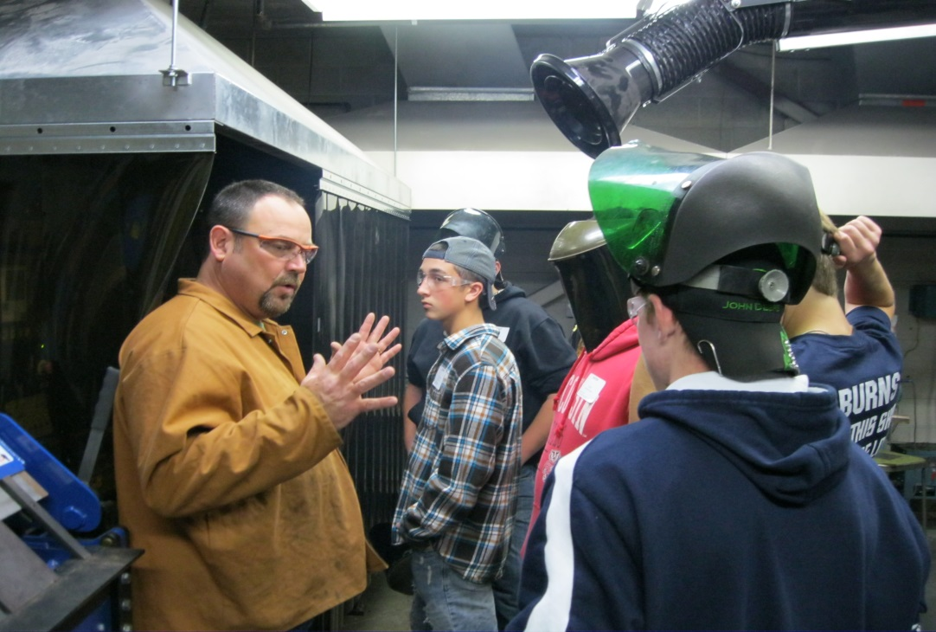
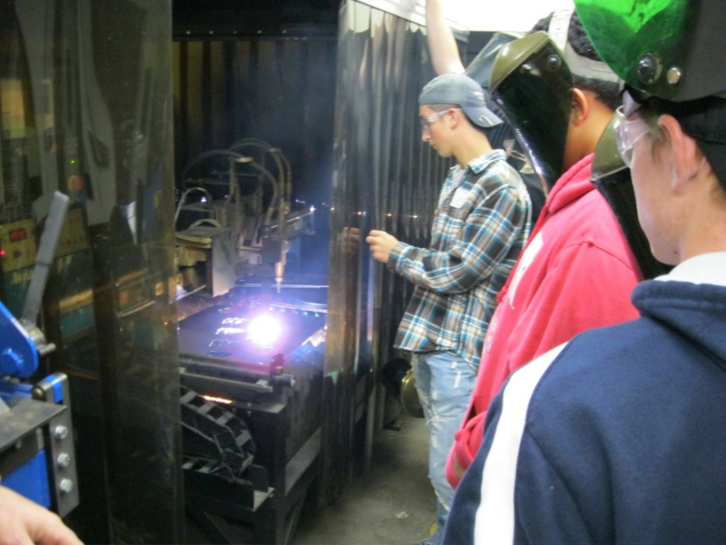

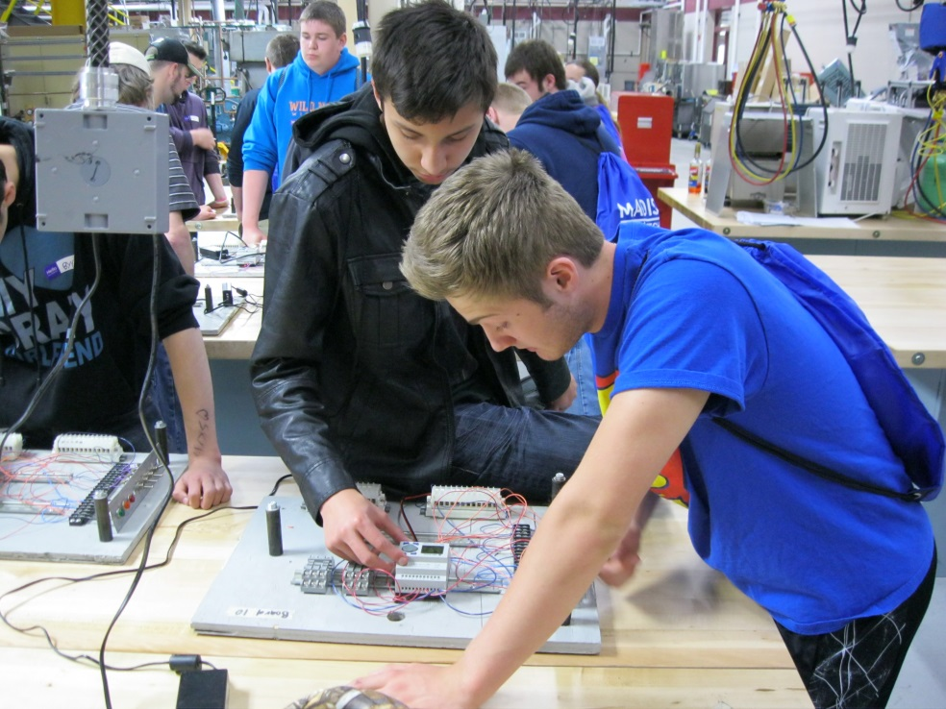
Field trips to Madison College –
Truax Campus

Slide 16
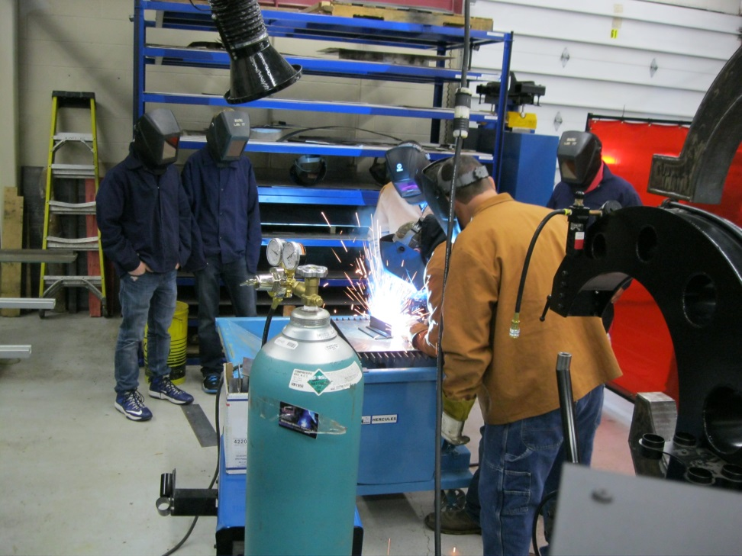
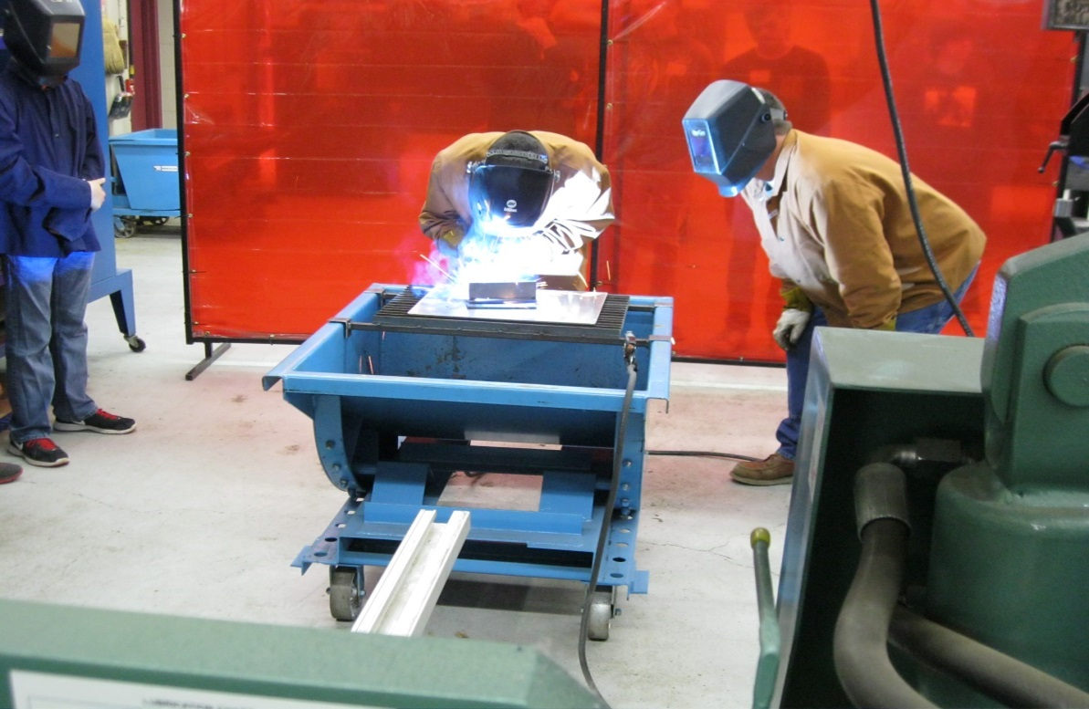
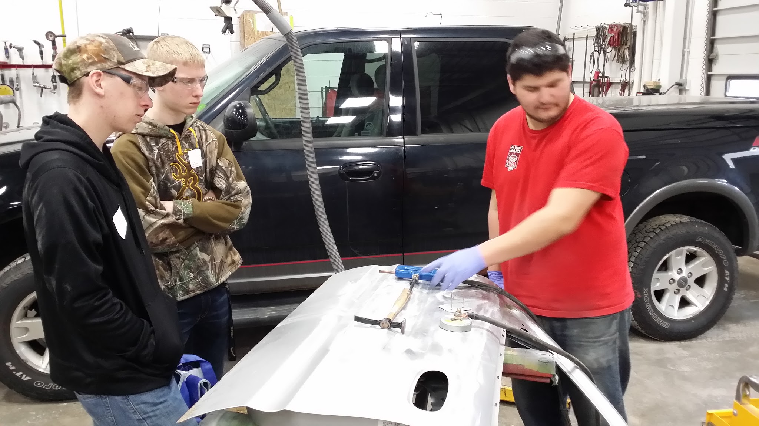

Slide 17
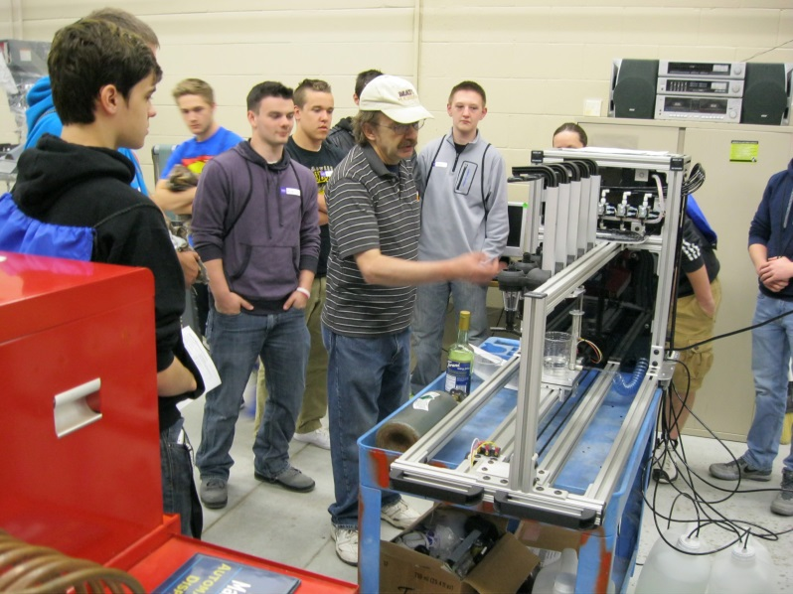
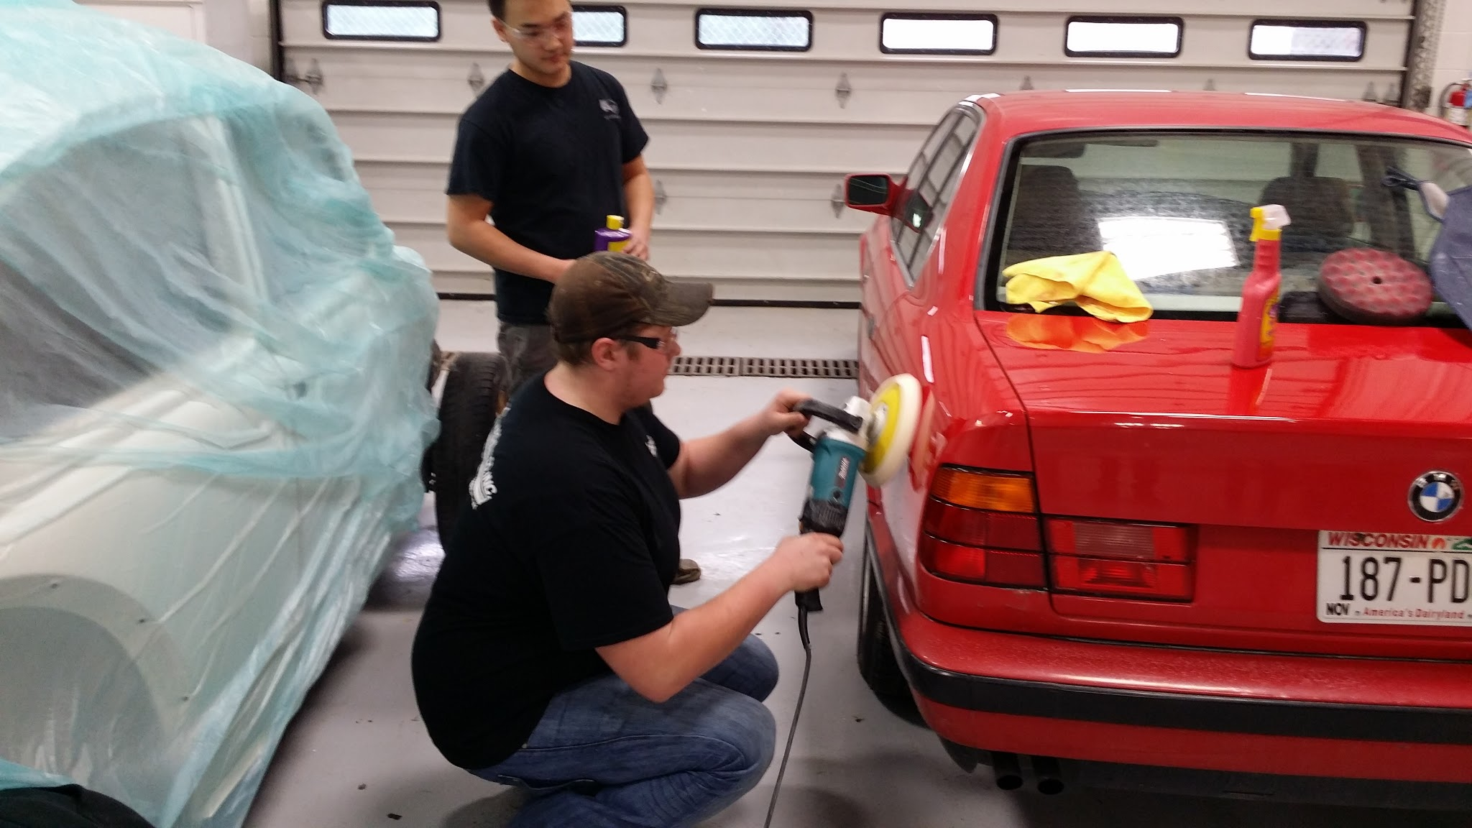
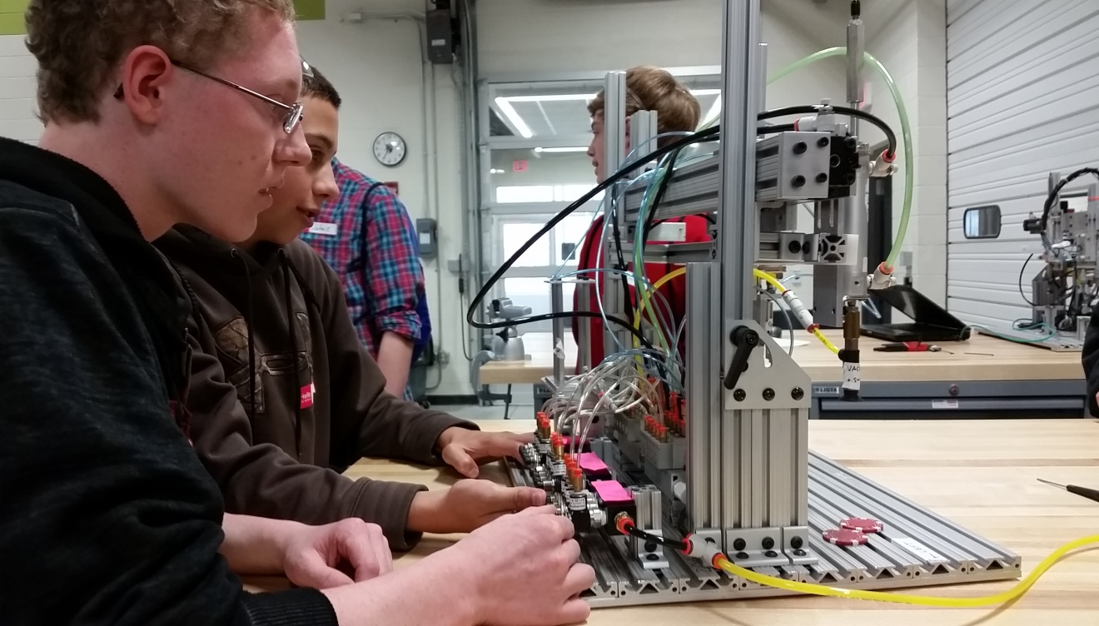

Slide 18
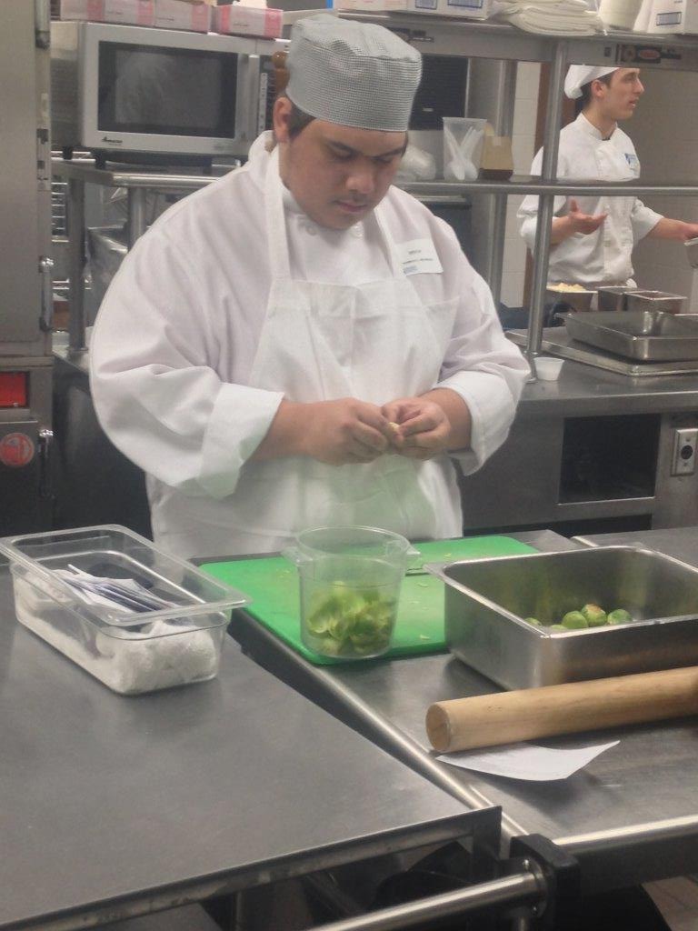
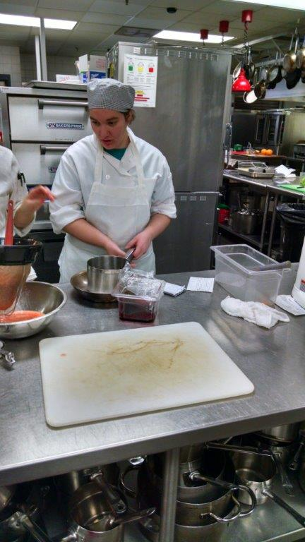

Slide 19
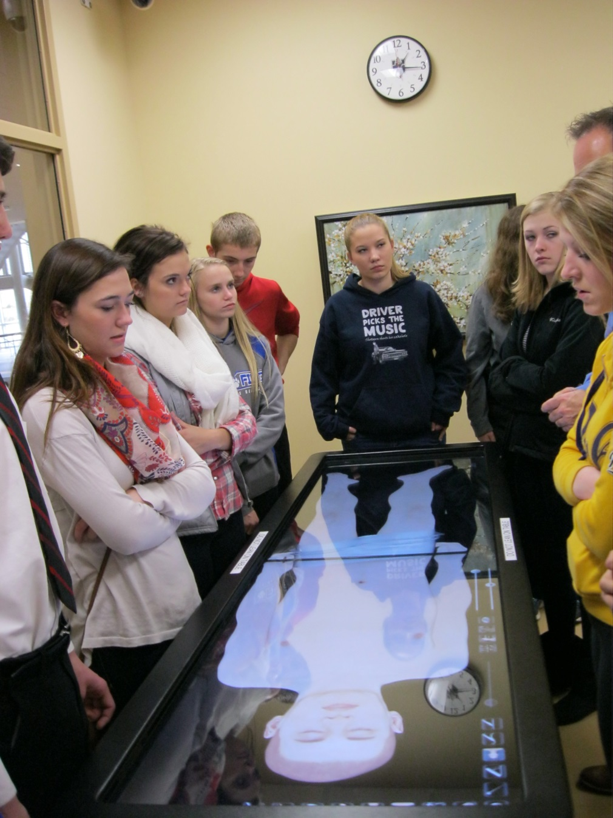
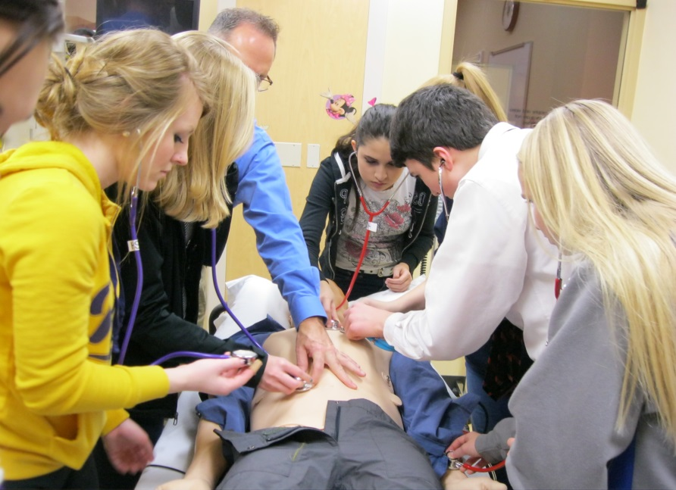
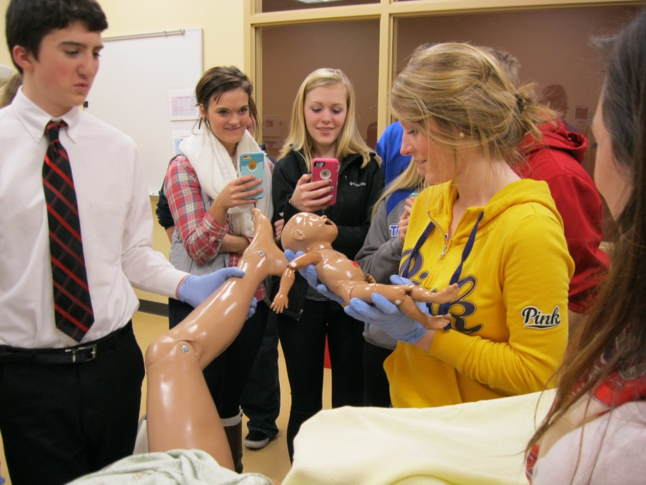

Slide 20
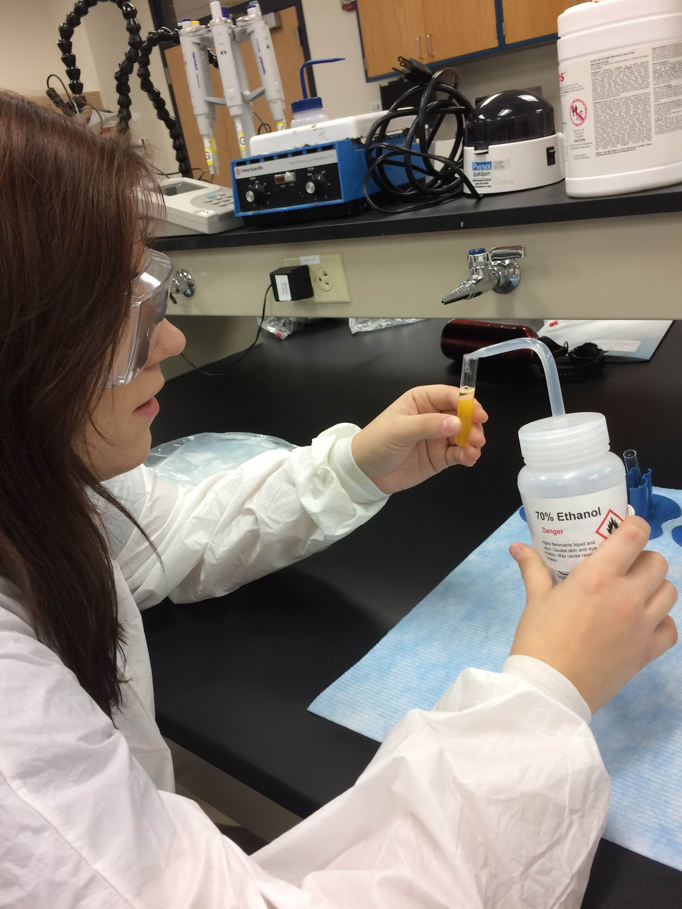
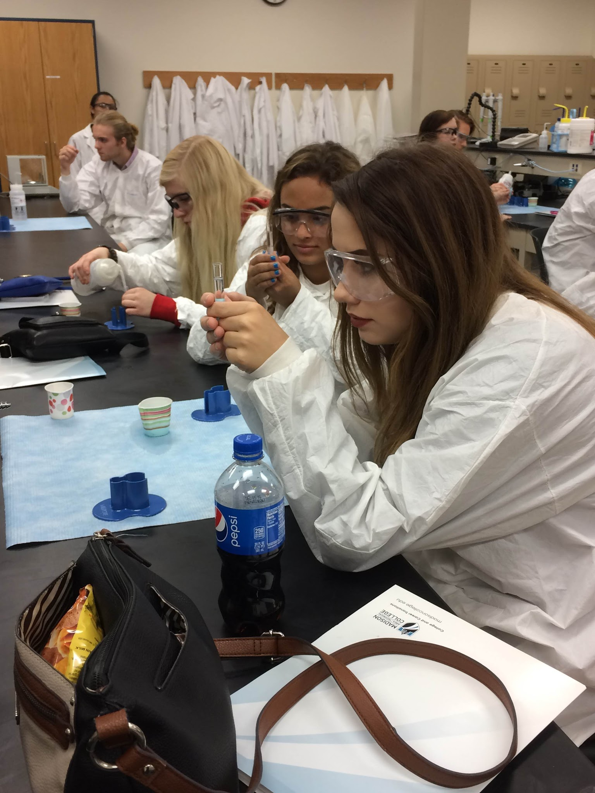

Slide 21
  Including ACP “components” on syllabi
  4 year planning - reduction in schedule changes

Slide 22

It’s not just students
Everyone is Involved
Required or elective classes, it’s all relevant

Slide 23
Professional Development for Staff
CESA 5 led trainings
Inservice to discuss law and what ACP is
Inservice for curriculum planning to discover what is already being done 6-12 that could be included
Staff traveling to industry and local colleges to see what is local and available over a 2 yr time period

Slide 24
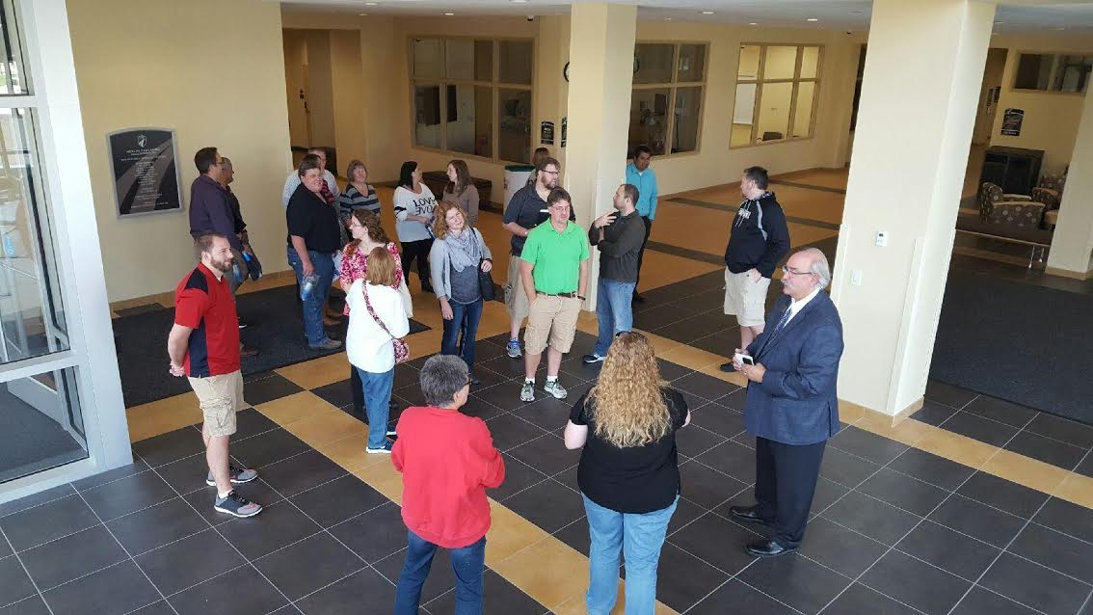
Professional Development for staff has included presentations at Madison College along with tours.

Slide 25
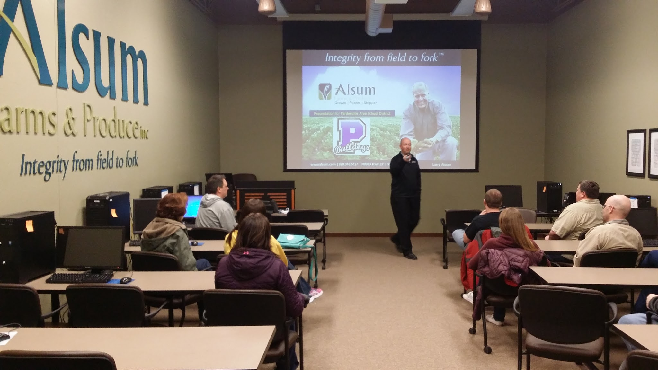
Local businesses have also provided staff with insight about what they’re looking for in employees.

Slide 26
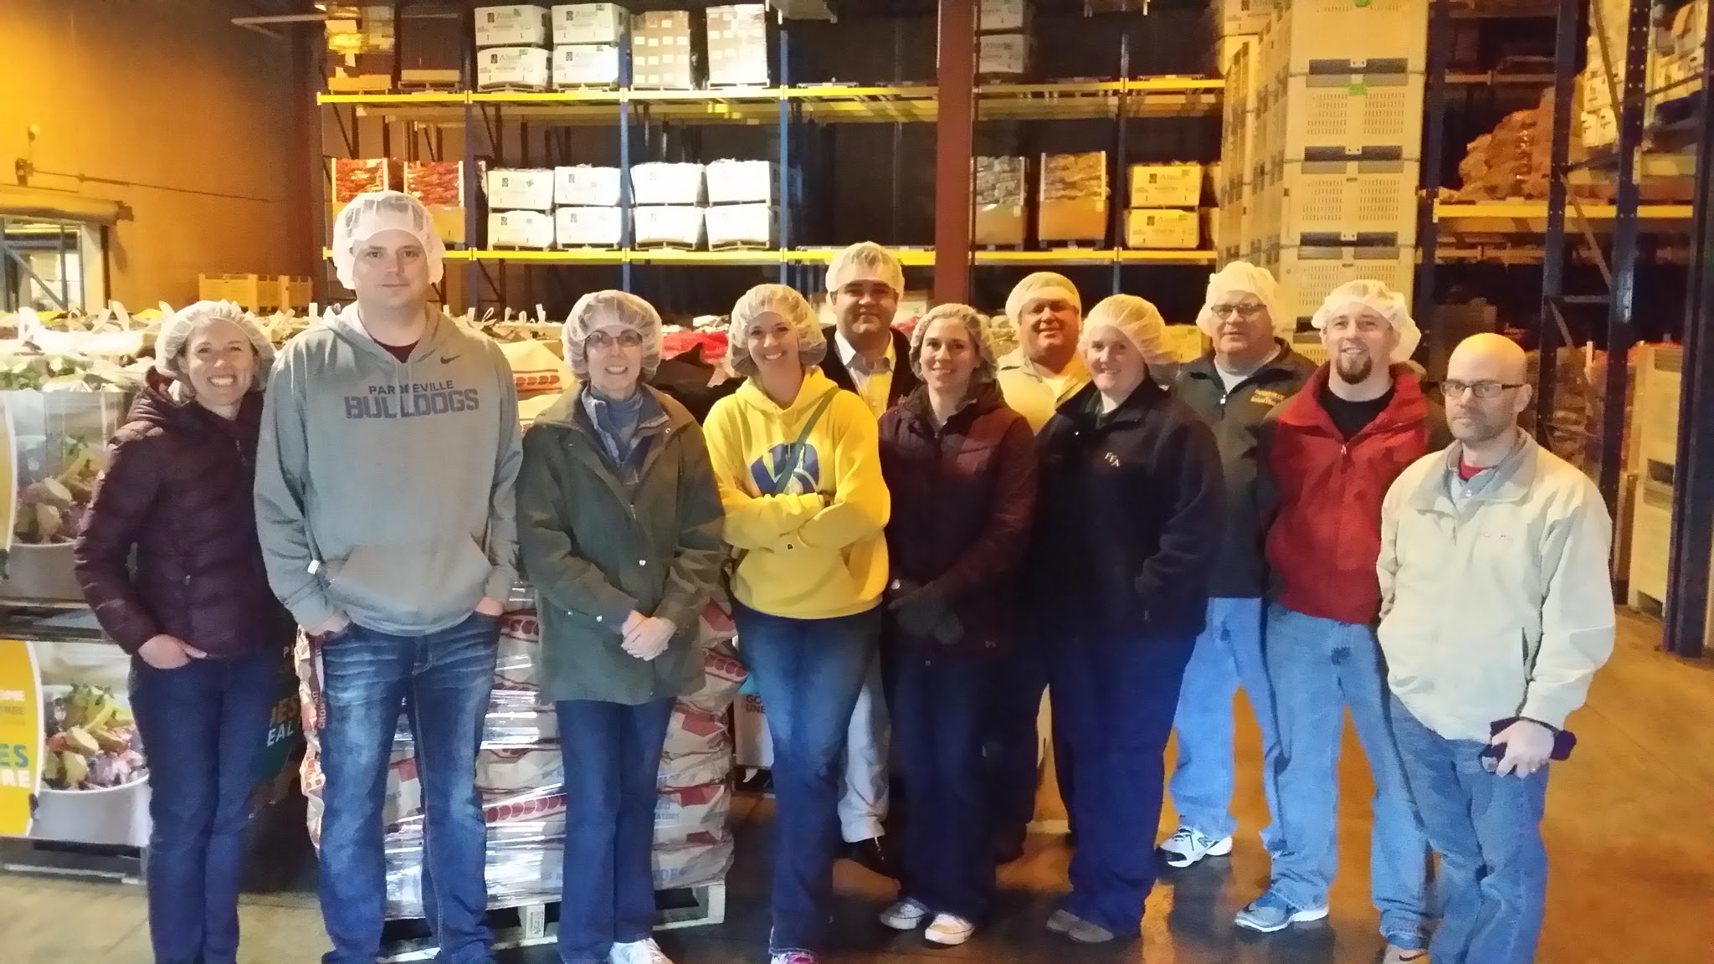
Even touring the plants

Slide 27
ACP vision and plan
  CESA 5 plan
  Graduation requirement
  Staff In-service education and curriculum work time
  Plan & board approval

Slide 28
Components for Students
Required Components
Elective Components

Slide 29
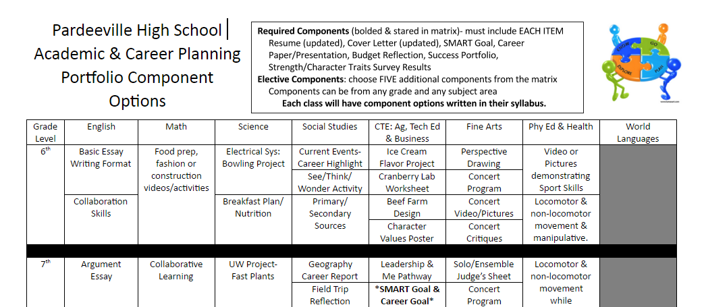

Slide 30
Roll out of grade level requirements
Class of 2020:
Resume
Cover Letter
SMART Goal
Career Paper (9th or 11th)
Budget Reflection Form
5 electives
Class of 2021:
Resume
Cover Letter
SMART Goal
Career Paper (9th or 11th)
Budget Reflection Form
Strengths Survey Results
5 electives

Slide 31
Take aways from today
Go out of your way to make contacts with higher education, businesses, parents, alumni, etc.
ACP is not a program, it’s a way of thinking that involves everyone.

Slide 32
Take aways from today
Schools and staff are already doing many of these things, but now schools are just putting it all together for kids to understand the big picture.
We are preparing students to be successful in life, not just in high school. What’s the plan 4 years, 6 years, or more after high school?

Slide 33

For more information
Crystal Huset
Jason LeMay
High School Counselor
Pardeeville School District
Pardeeville, WI
husecr@pasdwi.org
608.429.2153 ext. 367
High School Principal
Altoona School District
Altoona, WI
jlemay@altoona.k12.wi.us
715.839.6031 ext. 402
Check Pardeeville out on:

Slide 34

Questions?

