Slide 1
Notes:
Danielle

Slide 2
Welcome!
Introductions- Pewaukee School District Team
Danielle Bosanec, Assistant Director of Curriculum & Instruction
JJ Heesch, Insight Director
Adriana Plach, ACP Coordinator
Agenda
What is Insight?
Components of Insight
Where do I start?
Building Your District’s Connections
ACP Connection
Notes:
Danielle

Slide 3
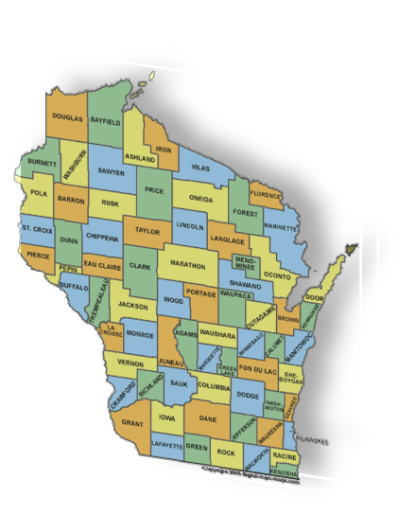
Pewaukee School District
Serving almost 2900 Students
About 300 Faculty & Staff
4 Schools on a Unique Campus Setting
Utilize the Baldrige Framework for Performance Excellence for continuous improvement
Demographics:
6.6% Special Education
11.9% Low SES
19.9% Non-White (7.1% Asian-primarily India)
20 Minutes west of Milwaukee
Notes:
Danielle

Slide 4
What is Insight?
A transformation of the high school experience that places students in professional settings while earning credits in rigorous courses uniquely designed to assist students to learn and develop skills for high-demand careers.
Notes:
Danielle

Slide 5
Notes:
Danielle

Slide 6
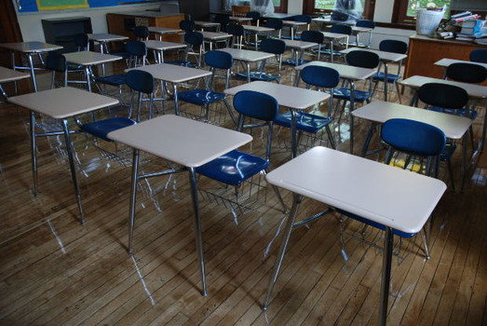
Pewaukee School District Personalized Learning Guiding Principle
Create a learning environment which recognizes each child and their unique learning needs. The environment seeks to support and challenge students on their individual pathway towards maximizing their College and Career Readiness based on individual interest, motivation, and readiness.
Traditional
Innovative
Notes:
Danielle

Slide 7
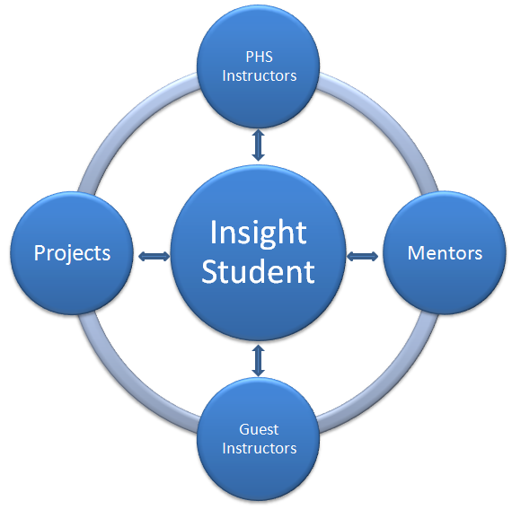
Components of Insight
Notes:
JJ

Slide 8
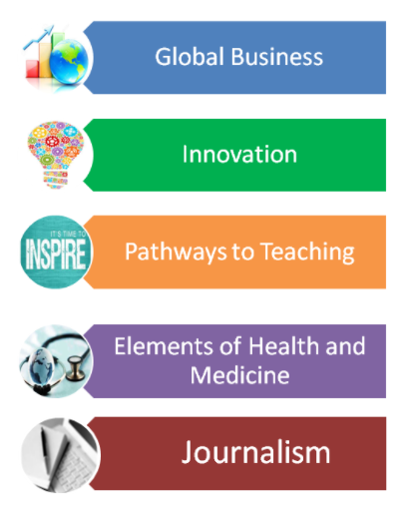
Notes:
JJ
Specific courses and numbers from each year
Juniors and Seniors
Application process

Slide 9
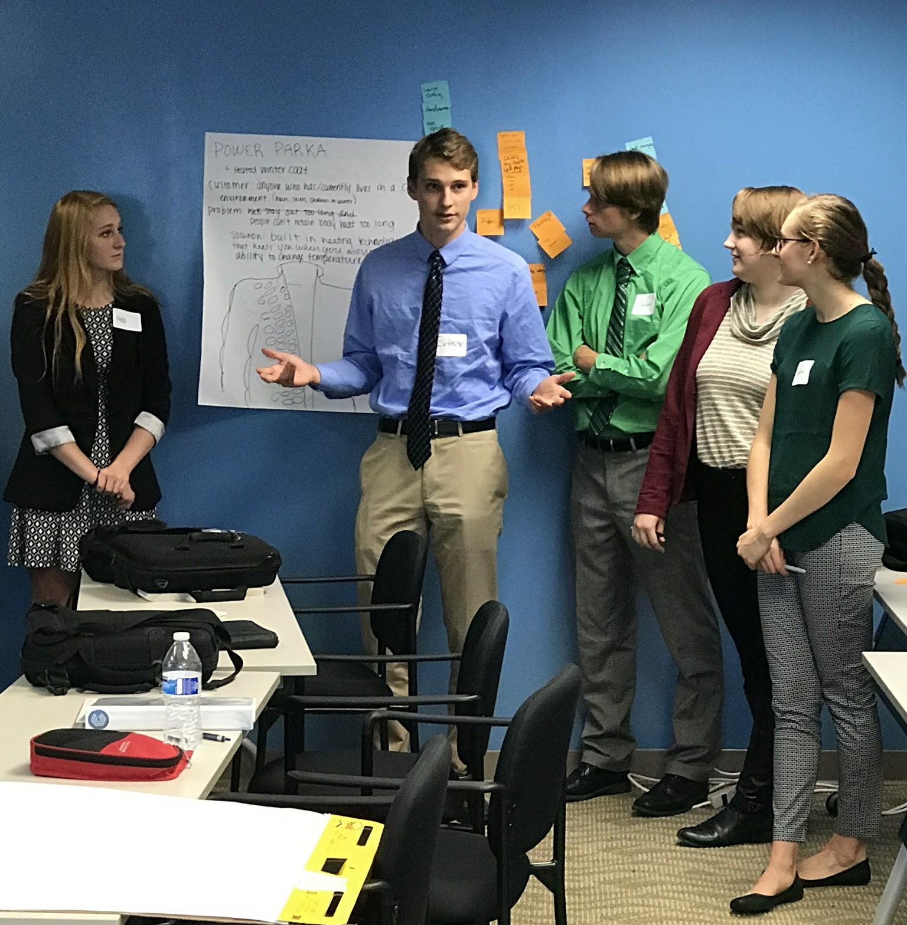
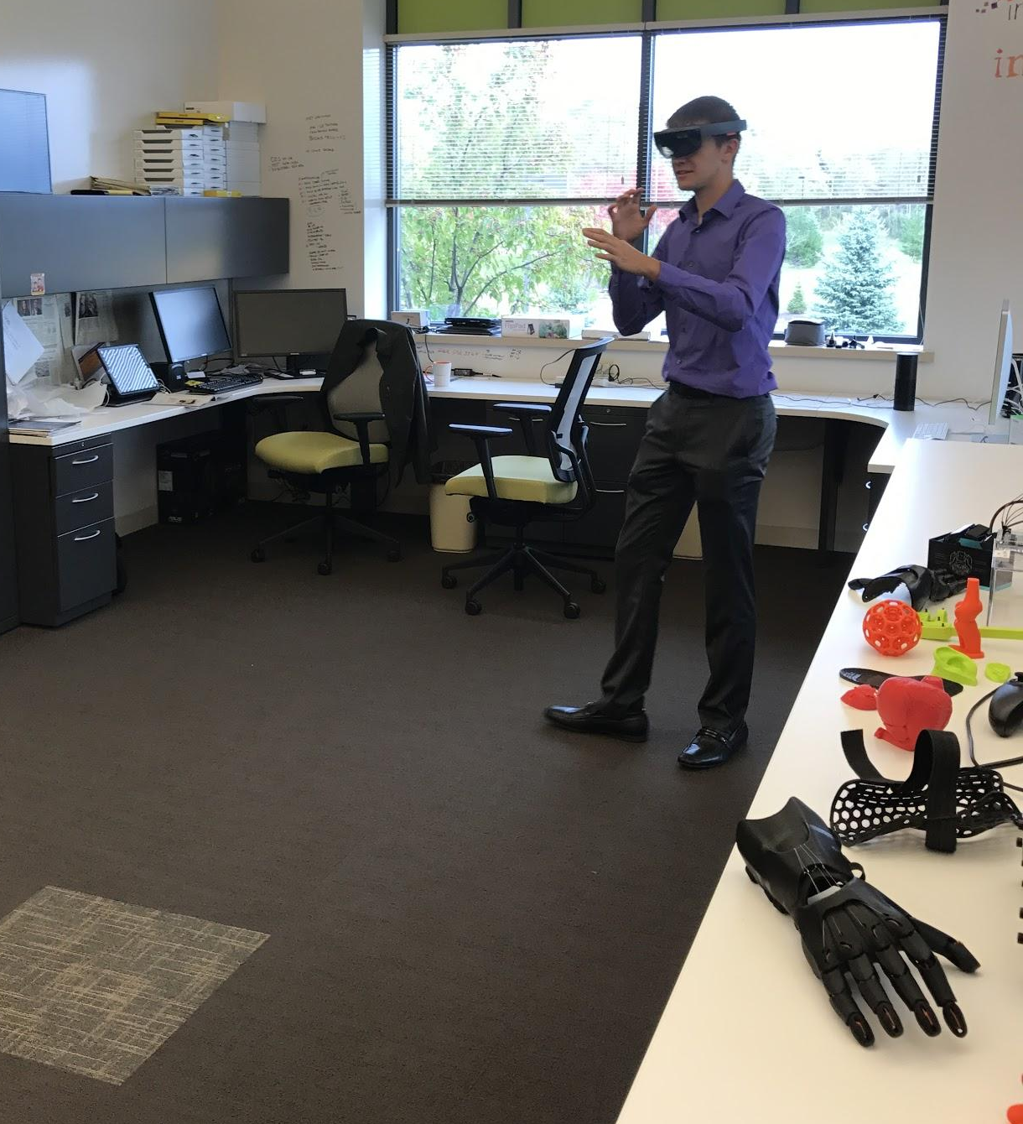
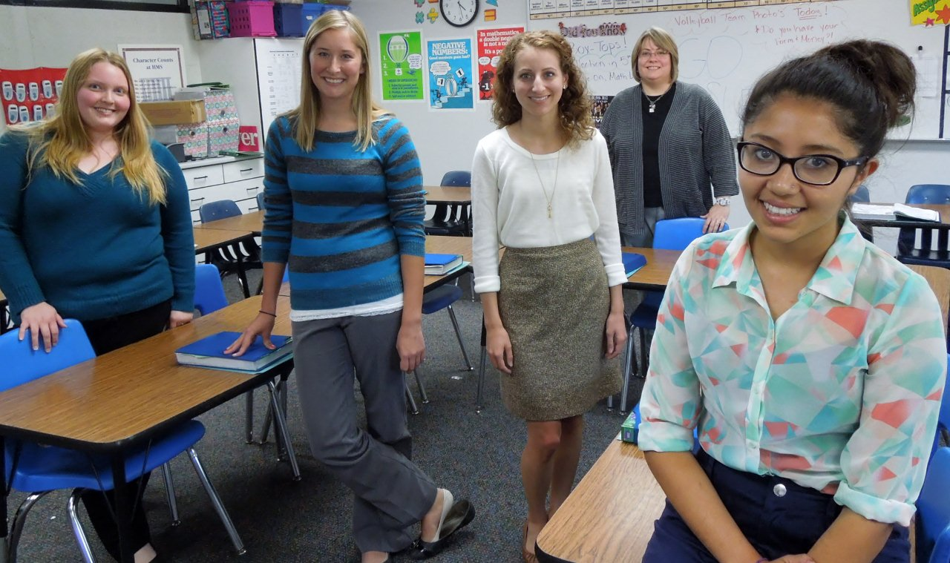
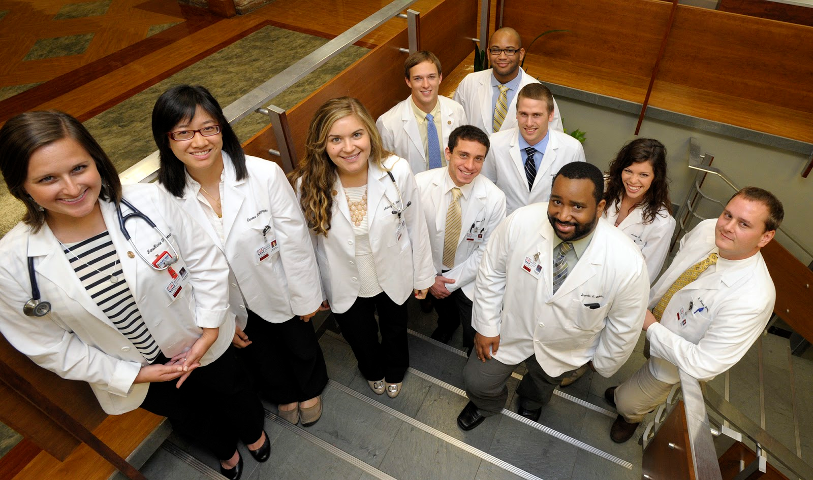
Authentic Projects / Clinicals
Notes:
JJ

Slide 10
Notes:
JJ
Here's where I started:
Apprentice
Layout of project
Called a friend of mine who sells honey at farmers markets and asked if we could redesign his logo
Called another business contact of mine, and we redesigned his website
We created a promotional strategy for a new invention
We helped a business with their social media strategy
The final task is an interview.
All students interview with a professional
The students who haven't been fired do a panel interview in front of the class with our superintendent, HR Director, a business professional, and me.
In my opinion, the most important part of this project was the feedback the professionals gave to students.

Slide 11
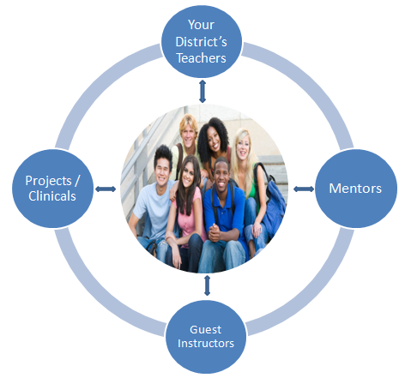
Building Your District’s Connections
Notes:
Danielle

Slide 12
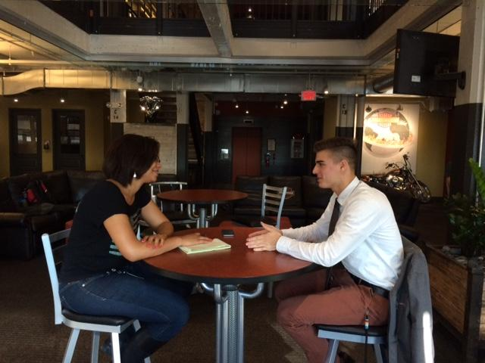
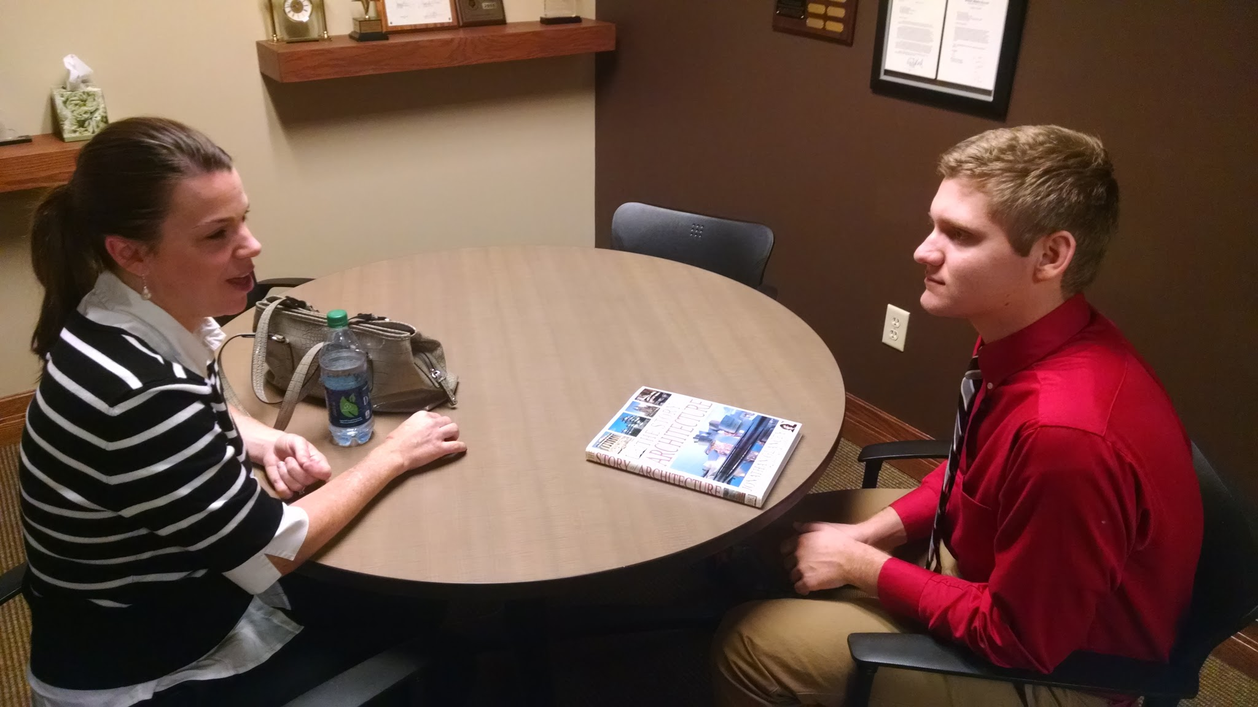
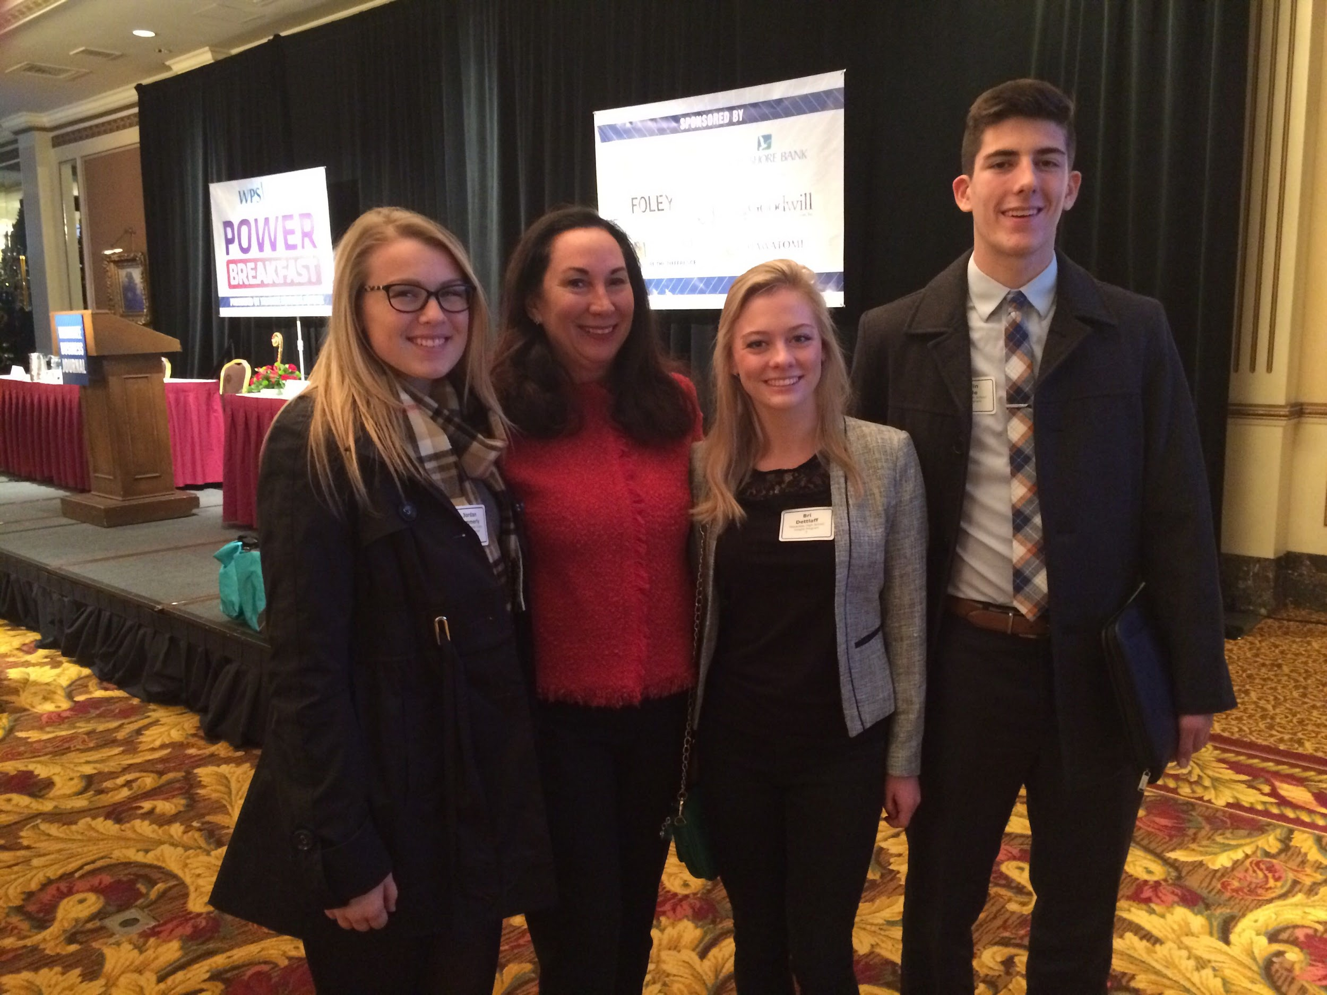
Mentor Connections
Who do you know that could be a mentor for your students?
Notes:
Danielle

Slide 13
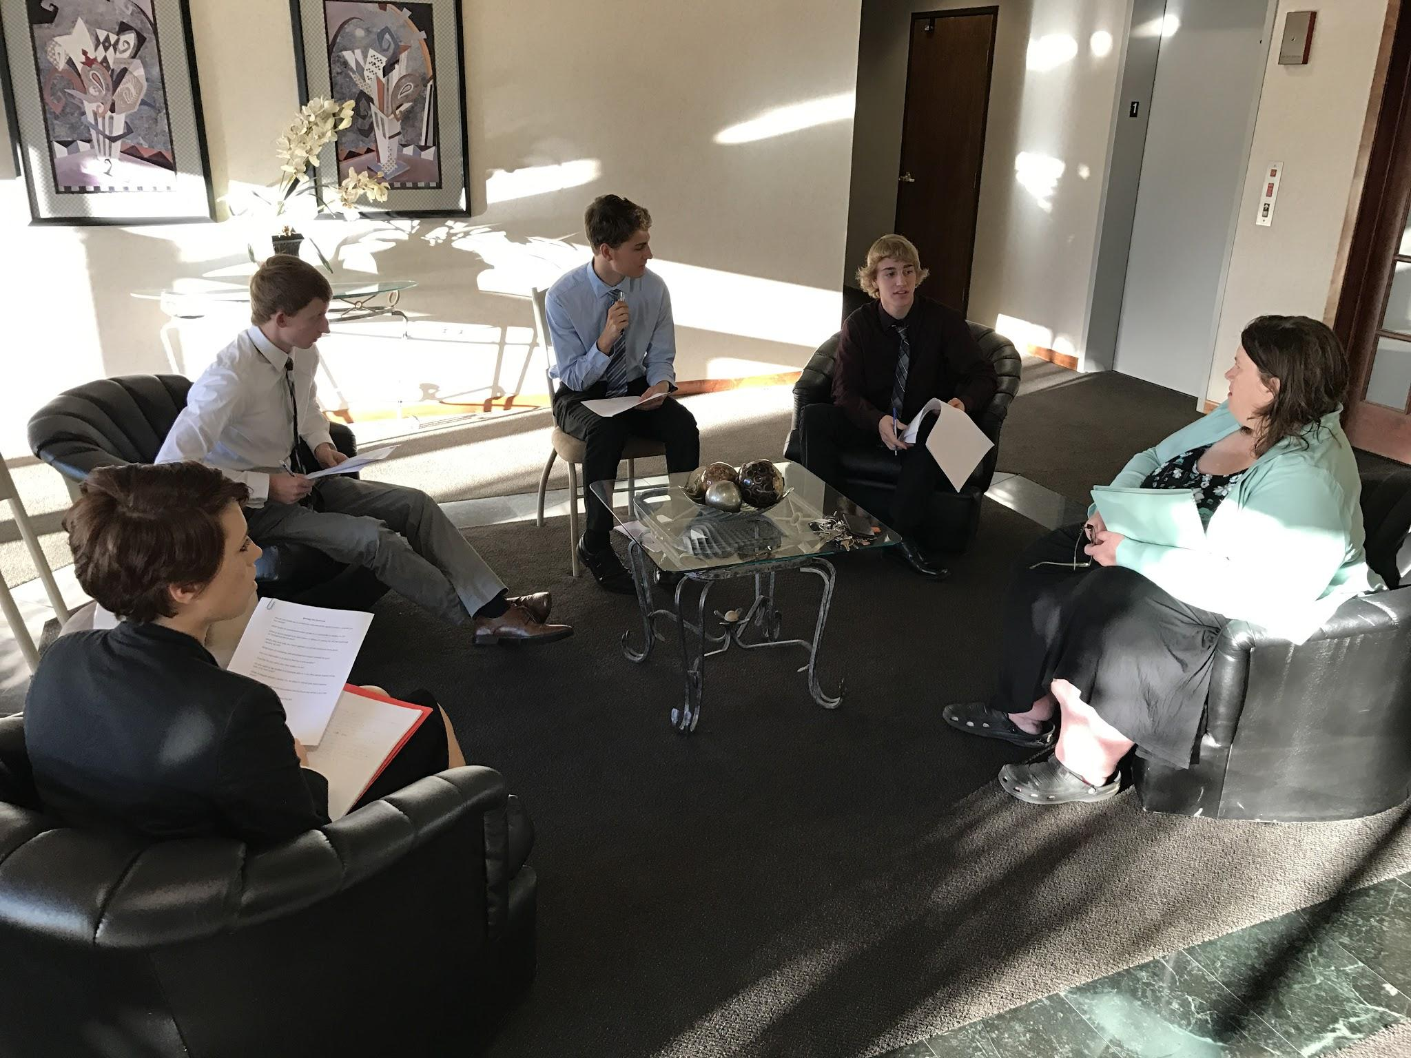
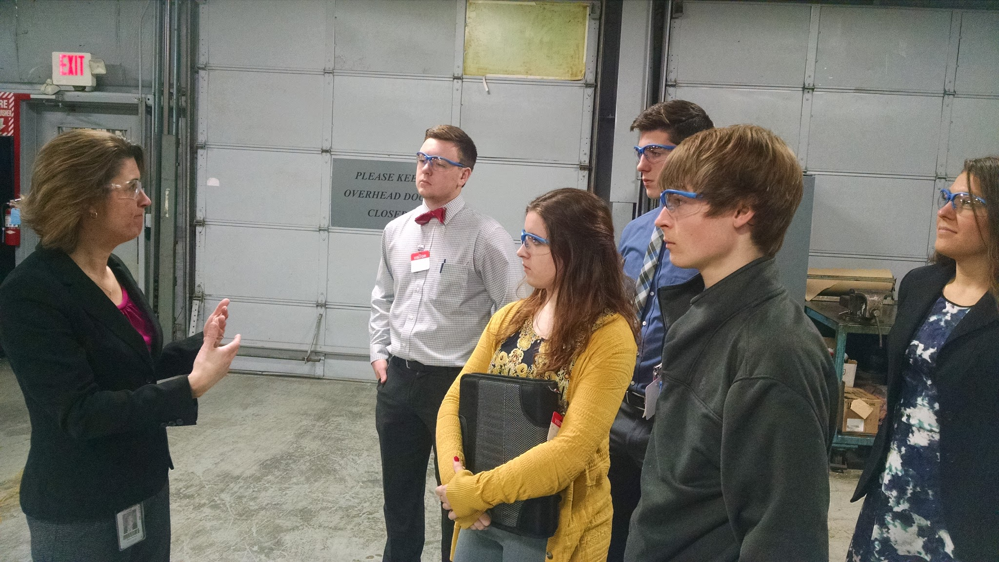
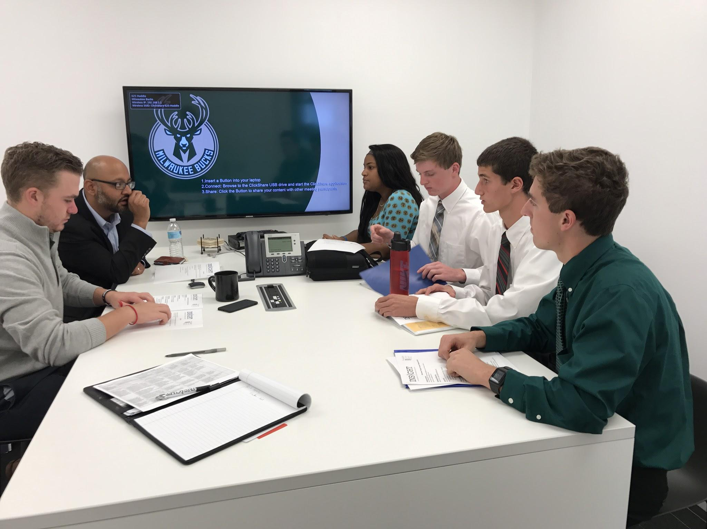
Community Connections
What businesses are in your community that you may want your students to work with?
What businesses do you know right now in your community that you could connect with for students to work with?
Notes:
JJ
Bring group back together after Danielle’s slide’s activity
Discuss Community Connections slide and let them do the activity

Slide 14
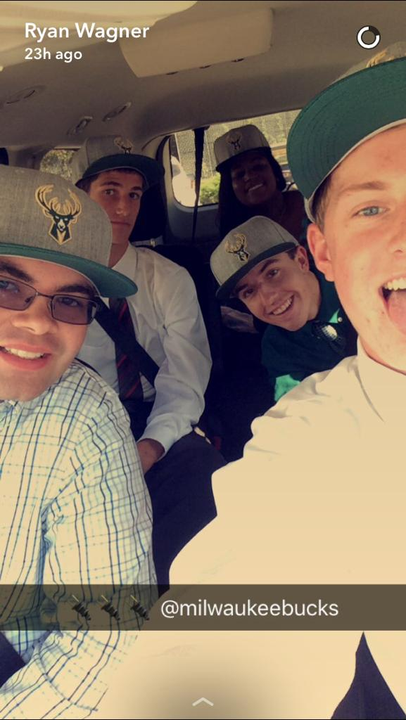
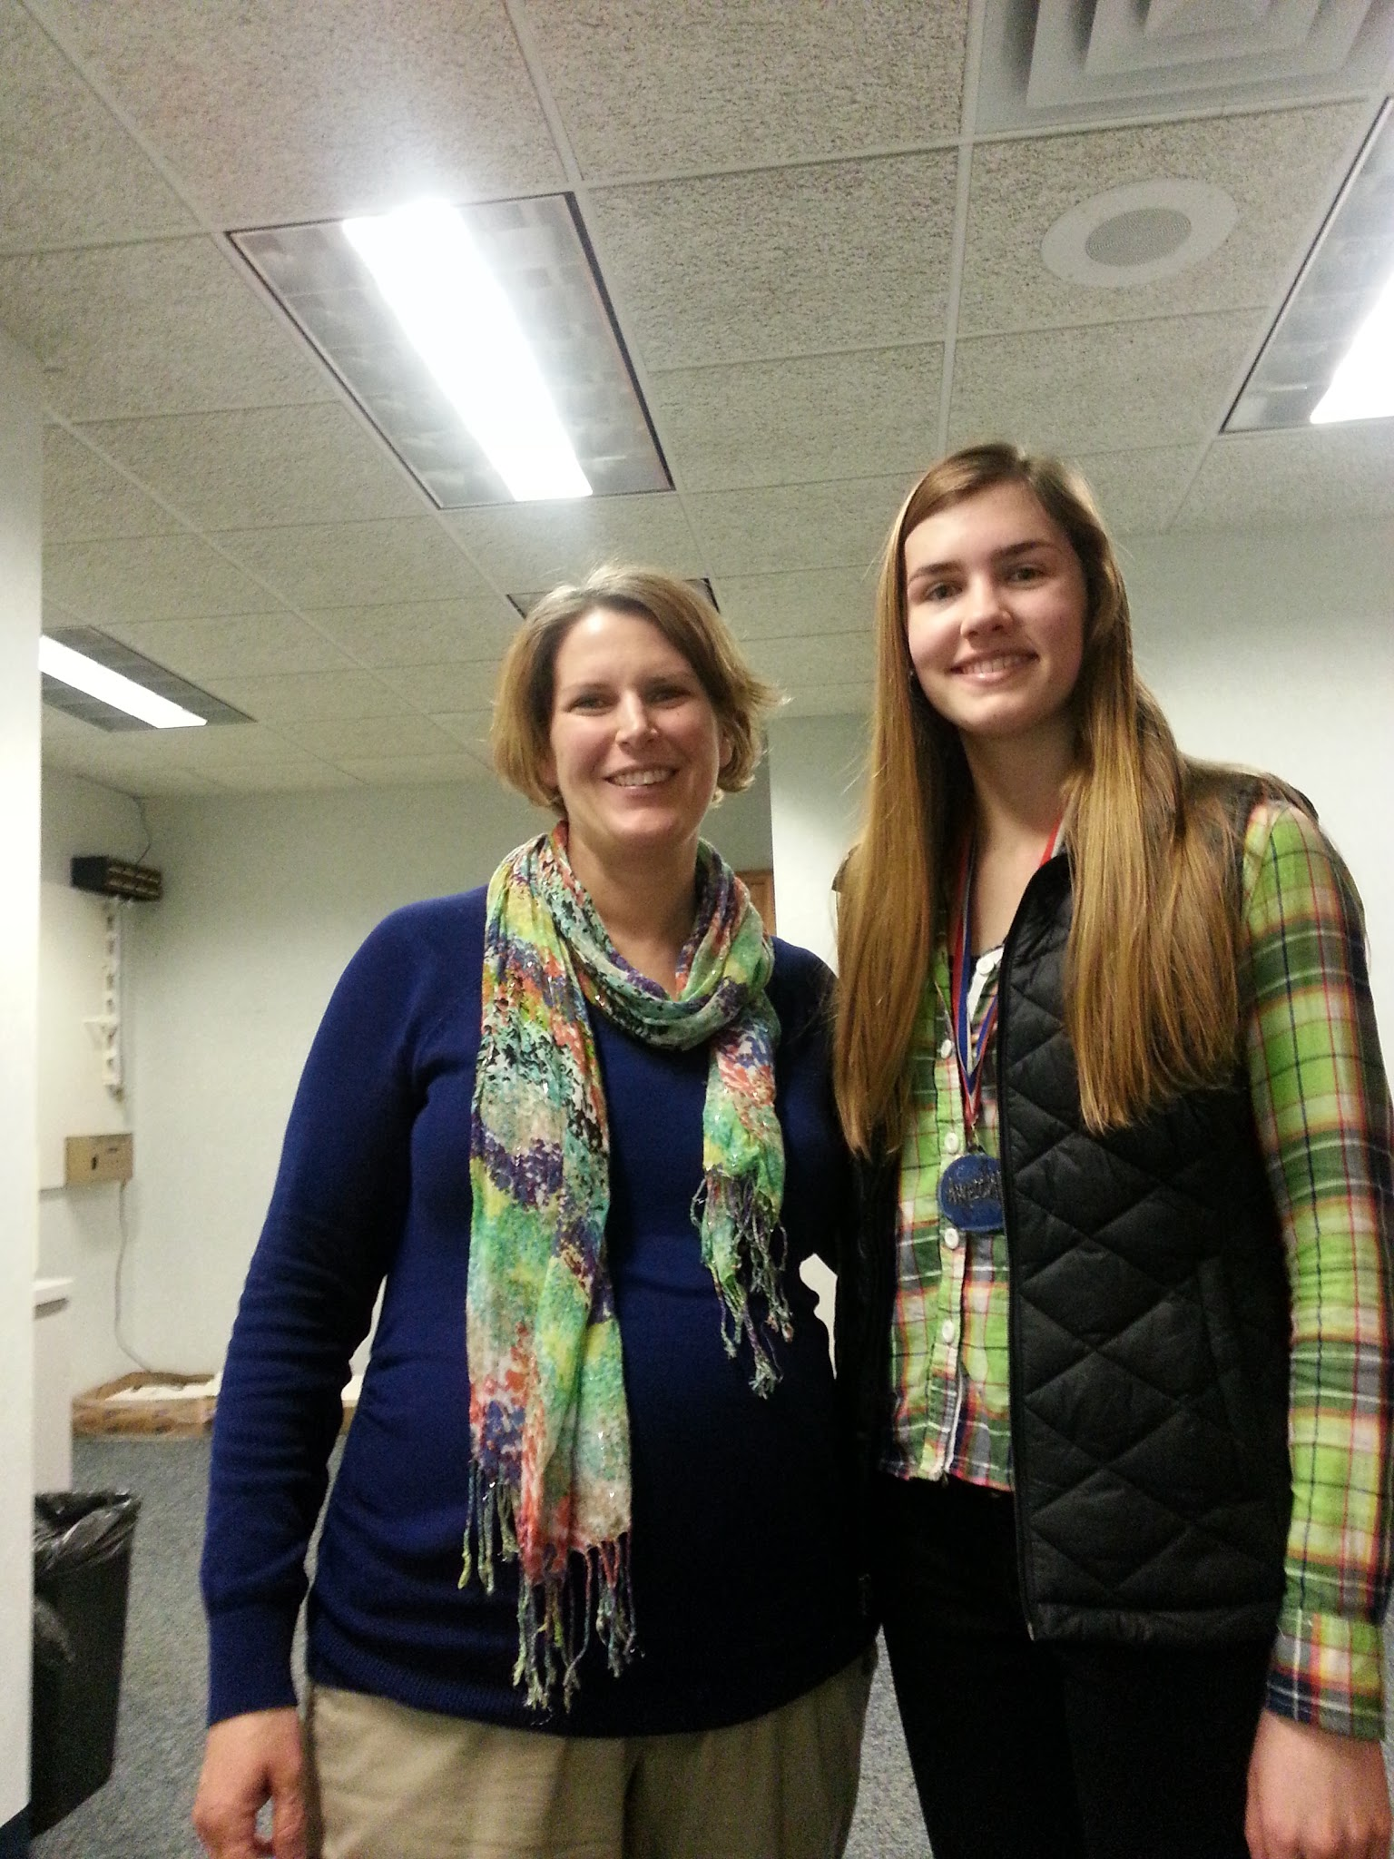
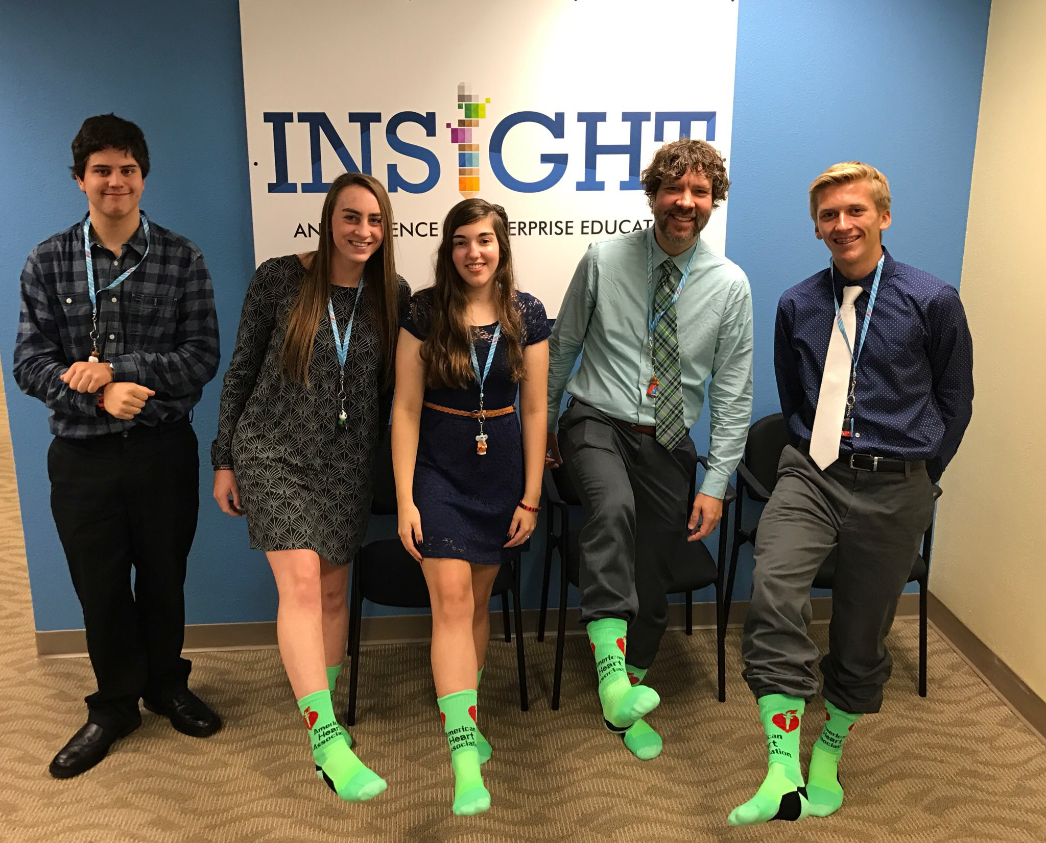
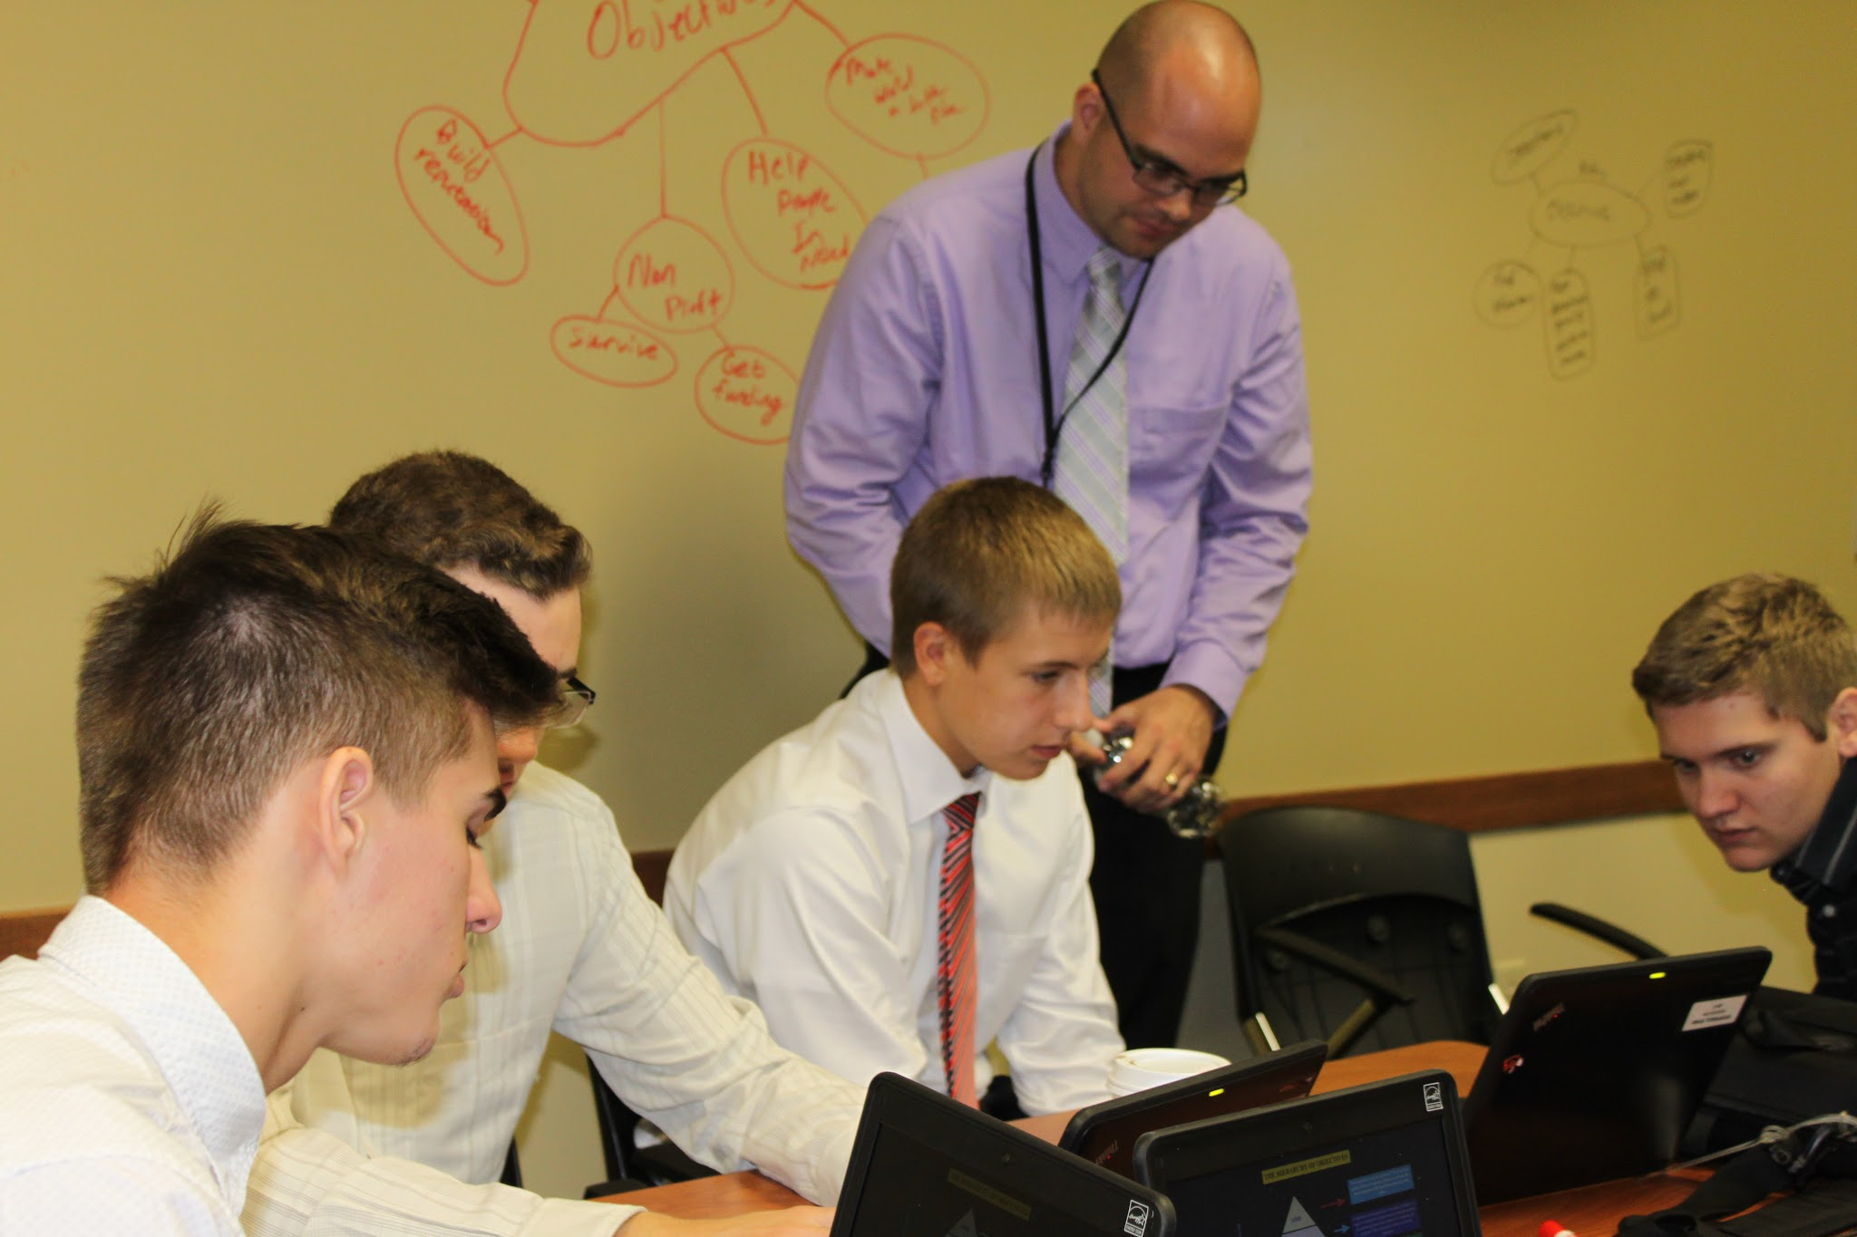
Curriculum Connections
If you had a business that was willing to do a project with your students tomorrow what class would you choose?
Which teachers/courses do you have that have the innovative, risk-taking mindset to try this approach to student learning?
Notes:
Adriana

Slide 15
ACP - Our Mission
What do we want our future graduates to have when they embark on their post-secondary journey?
Notes:
Adriana
Creating an infrastructure that ensures comprehensive processes and products that align with our:
Mission
Vision

Slide 16
ACP Connections - Building the Bridge
Building Relationships within our community, our parents, and our schools
Notes:
Adriana
Parent and Community Feedback from our District Leadership Team - engagement is key

Slide 17
Bringing it Together - Our Future Goals
Build upon successes of Insight to expand and bring opportunities and mentorships to 100% of our upper -level students
Examine the ACP building blocks that are needed to provide strong foundations within the early- level and middle-level years
Notes:
Adriana

Slide 18
Contact Us!
Website: www.pewaukeeinsight.com
@PewaukeeInsight
Danielle Bosanec, Asst. Director of Curriculum & Instruction
bosadan@pewaukeeschools.org
@dkbosanec
JJ Heesch, Insight Director
heesjef@pewaukeeschools.org
@jjheesch
Adriana Plach, ACP Coordinator
placadr@pewaukeeschools.org
@adrianaplach
Notes:
Danielle

