Slide 1
Career and Budgeting Project
Female Student

Slide 2
Career
Cosmetology
Hair Dresser
Barber
Makeup Artist

Slide 3
Career Cluster
Human Services
Personal Care Services

Slide 4
Why Cosmetology?
Great Job Outlook
Competitive
Short Training Period
Flexible

Slide 5
Why This Fits Me
Interest
Art
Style Hair
Helping Others

Slide 6
Why This Fits Me
Personality
Social
Dependable
Trustworthy
Congenial

Slide 7
Why This Fits Me
Values
Understanding
Listening
Patience

Slide 8
Why This Fits Me
Aptitude
Responsible
Caring
Dependent

Slide 9
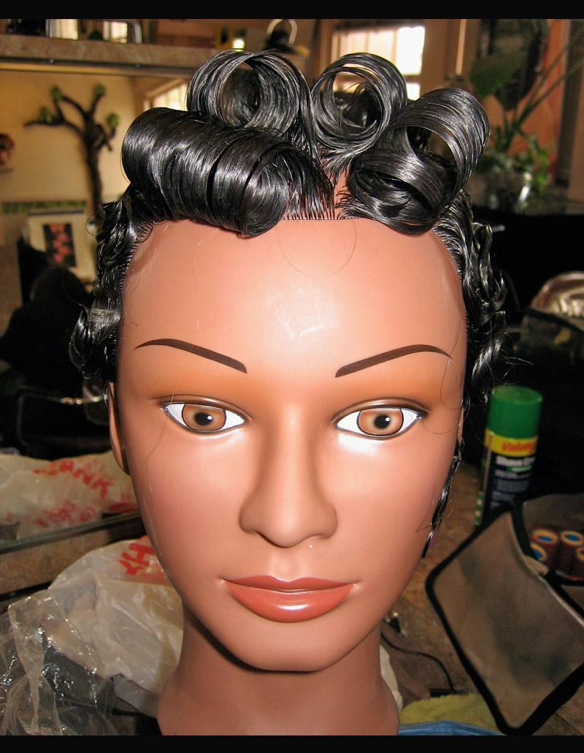
Why This Fits Me
Learning Style
Hands On
Fast Pace
Trial and error

Slide 10
Why This Fits Me
Skills
Listen
Comprehend
Style
Socialize

Slide 11
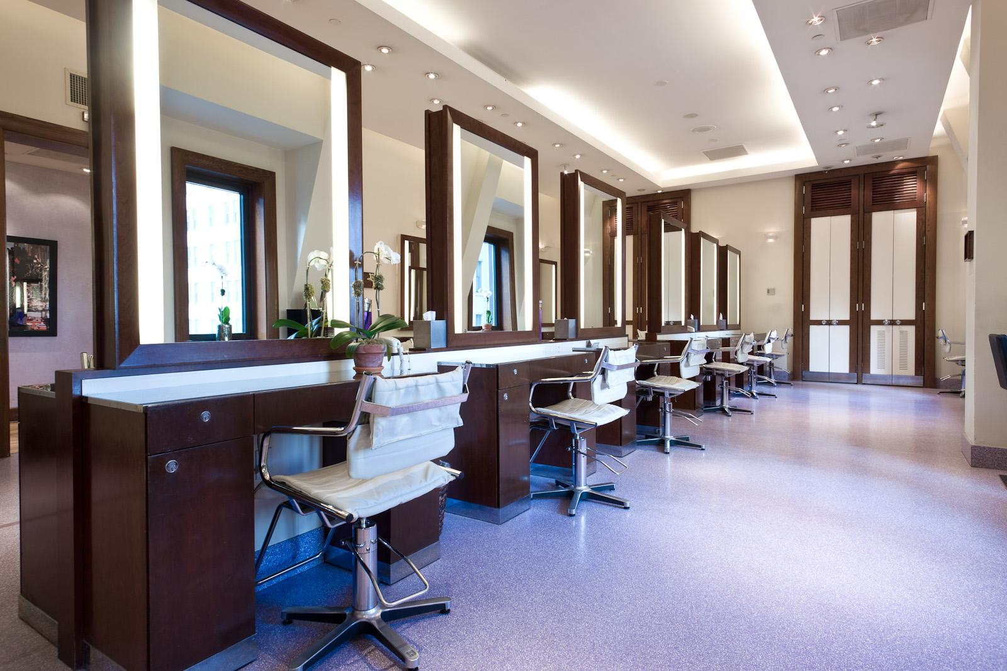
Locations of Work
Theaters
Fashion Shows
Salons
Anywhere

Slide 12
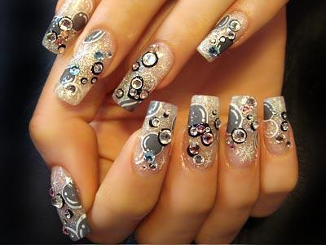
Responsibilities
Style Hair
Sell Products
Nail technician
Entrepreneur

Slide 13
Skills You Need
Communication
Coordination
Time Management
Budgeting

Slide 14
Rewards :)
Help Others
Build Personal Relationships
Work Anywhere
Love What You Do

Slide 15
Negative Affects
Around Chemicals
Hard On Your Feet
Tendonitis
High Maintenance Clients

Slide 16
Typical Work Day
Style Hair/Nails
Sell Products
Schedule Appointments
Build Clientele

Slide 17
Work Environment
Salons
Clean
Well-Lit
Relaxing

Slide 18
Hours
Choose your own hours

Slide 19
Income
Average: $10.25/hour
Plus Tips

Slide 20
Future In Cosmetology
Bright Outlook
Growth Opportunities
Competitive

Slide 21
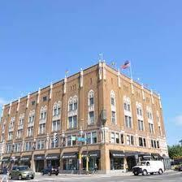
School I Chose
Aveda Institute Minneapolis

Slide 22
Why Aveda?
All Organic Products
Known World Wide
Great Training
Close to Home
Trained By The Best

Slide 23
Semester 1: Courses
Introduction/Introduction 2
Cutting
Styling
Chemical Restructuring of Hair
Safety Requirements.

Slide 24
Semester 1: Courses
Classroom: 455.25 hours
Clinic: 152.25 hours
Total: 607.50 hours
Weeks 1-18

Slide 25
Semester 2: Courses
Alpha Phase and Beta Phase
Latest Trends and Techniques
Permanent Waving
Interviewing
Resume writing.

Slide 26
Semester 2: Courses
Classroom: 105.00 hours
Clinic: 502.75 hours
Total: 607.75 hours
Weeks 19-36

Slide 27
Semester 3: Courses
Gamma Phase and Salon Life
Guest Service
Time Management
Self-promotion
Goal-Setting
Entrepreneurship

Slide 28
Semester 3: Courses
Gamma Phase and Salon Life
Entrepreneurship
Merchandise
Written Examination

Slide 29
Semester 3: Courses
Classroom: 18.00 hours
Clinic: 319.50 hours
Total: 337.50 hours
Weeks 37-46

Slide 30
Classes Covered
Plant Aromaology
Chemistry
Anatomy & Physiology
Shampooing/Conditioning
Hair Styling

Slide 31
Classes Covered
Personal/Career Development
Chemical Hair Relaxing/Restructuring
Hair Cutting
Permanent Restructuring

Slide 32
Classes Covered
Hair Coloring
Skin Care
Makeup
Nail Care
State Rules and Regulations

Slide 33
Aveda Locations

Slide 34
Tuition!
Tuition –$17,800
Kit Fee–$1,800
Application Fee – $100
Total Cost 19,800

Slide 35
Salary of Cosmetology

Slide 36
Gross Pay
Average $29,530 per year
Net pay $811.4 x 2= $1622.8
semi-monthly gross pay: $1,230.42
Federal Withholding: $126.91
Social Security: $76.29
Medicare: $17.84
Florida $0.00
Health Insurance: $39.63
Dental Insurance: $8.00
401k: $150.00

Slide 37
Pay Yourself First
Savings: $100.00
401k: $150.00

Slide 38
Monthly Savings
My savings account
Monthly deposit: $100.00
Ten Year Savings
Rate of Return: 0.05%
Savings for ten years: $12,030

Slide 39
Monthly Savings
1 year: $1,200
2 years: $2,401
3 years: $3,603
4 years: $4,805
5 years: $6,008
6 years: $7,211
7 years: $8,415
8 years: $9,619
9 years: $10,825
10 years: 12,030

Slide 40
Housing

Slide 41
My Housing Budget
$1,622.8 X .30=$486.84

Slide 42
My House
Cost:$59,000
Location: Fort Walton Beach, FL
Good Job Area
Beautiful
Walking distance from the beach

Slide 43
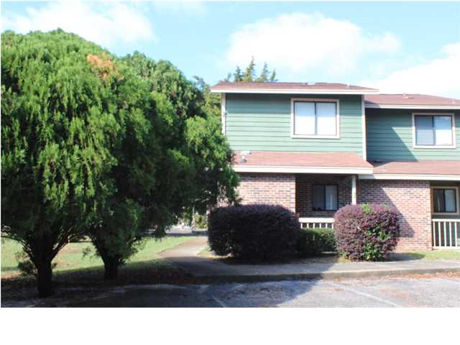
My House

Slide 44
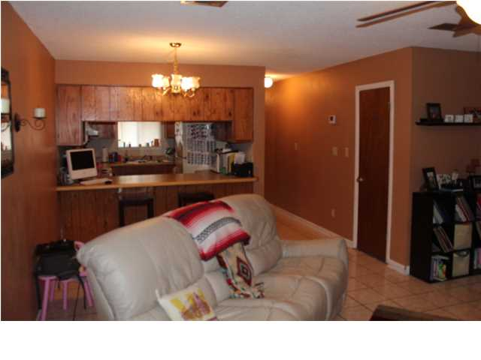
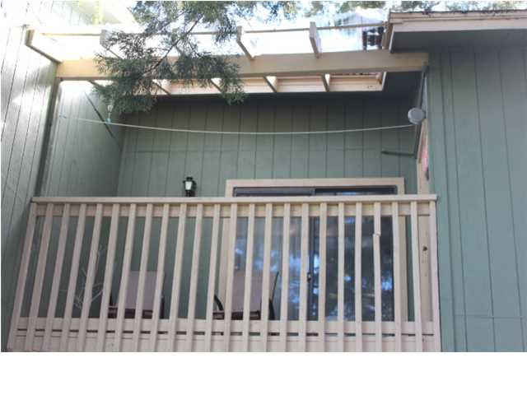
My House

Slide 45
Insurance On My Home
House Insurance=(square ft. X .25)
1,344 X .25=$336.00
$336.00/12=$28.00
Monthly payment: $28.00

Slide 46
Now Down to Business
Zero down
20 year payment
$59,000
Interest rate: 3.25%

Slide 47
Cont.
Loan payment: $334.65
Property taxes: (qualified for homestead exemption) $0.00
Homeowners Insurance: $28.00
Mortgage and Escrow: $362.65 dollars per month

Slide 48
My Monthly Payments
Heat/electricity:$110
Water and Sewer:$13.00
Garbage: =$0.00

Slide 49
Other Housing Item
Cell phone: $30.00
Laundry:$8.00
Cleaning Supplies:$5.00
Internet: $30.00
Total:$558.65

Slide 50
Mortgage
Loan Amount: $59,000
Annual Percentage Rate: 3.25%
Length of loan: (20 years)
Payment: $334.65
$334.65 x 12=$4,015.8
$4,015.8 x 15= $80,316
$80,316-$59,000= $21,316 (Interest)

Slide 51
After Paying Off the House
$21,316(interest) + 59,000 (loan)
=$80,316 (actual cost of mortgage)

Slide 52
Total Percentage for Housing
Mortgage and escrow:
$362.65/$1,622.8=
22.3% of my income
Mortgage:
334.65/$1622.8
=$20.6% of income
Total:$558.65

Slide 53
Transportation

Slide 54
My Budget
My Budget
$1,622.8 X .20=$324.56

Slide 55
My Car
2000 Ford Mustang
Why?
Affordable
Good Deal
Nice Looking
Fits the area I live in

Slide 56
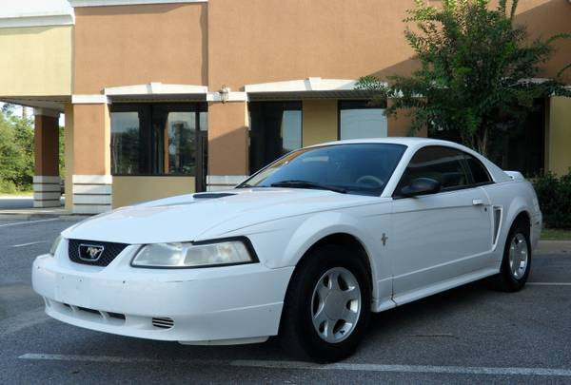
Information About My Car
Year= 2000
Cost= $2,400
Mileage= 100,000
Miles per gallon
(City 18)
(Hwy 26)

Slide 57
Car Loan
$2,400
3 years
36 payments
3.49%

Slide 58
Car Loan
Monthly payment: $70.31
Interest: $131.04
Total Amount: $2,531.04

Slide 59
Car Insurance
Progressive (25,50,25)
Bodily Injury Liability: $25,000/$50,000
Property damage liability: $25,000
Personal injury protection: $40,000
Uninsured motorist: $25,000/$50,000

Slide 60
Car Insurance
Comprehensive
with $500 dollar deductible
Collision
with $500 dollar deductible
Monthly premium: $166.34

Slide 61
Other Car Expenses
Gas: $41.00
Repairs: $39.00
Other: $8.33
Total: $324.98

Slide 62
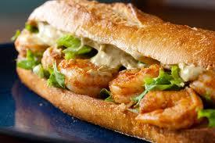
Other Expenses

Slide 63
Looking Good
Clothes: $40.00
Shoes: $20.00
Cosmetics: $10.00
Toiletries: $15.00
Hair: $0.00
Total: $85.00

Slide 64
Entertainment
Movies: $10.00
Concerts: $20.00
Fitness club: $12.00
Vacations: $50.00
Total: $92.00

Slide 65
Groceries/Eating Out
Groceries: $150.00
Lunch: $20.00
Snacks: $10.00
Dining out: $10.00
Total: $190.00

Slide 66
Health Care
Doctor: $50.00
Dentist: $20.00
$70.00

Slide 67
Gifts and Donations
Birthdays: $15.00
Major Holidays: $25.00
Religions donations: $20.00
Total: $60.00

Slide 68
Other
Hobbies and crafts: $10.00
Postage: $2.00
Total: $12.00

Slide 69
Summary

Slide 70
Summary
Housing: $558.65
Looking good: $85.00
Food: $190.00
Healthcare: $70.00
Transportation: $324.98

Slide 71
Summary
Entertainment: $92.00
Other monthly expenses: $12.00
Gifts and Donations: $60.00
Student loans: $0.00
Pay Yourself: $100

Slide 72
Total Payment
My monthly paycheck: $1,622.8o
Total Expenses: $1,618.58
Remaining: $ 4.22
NOTE: $100 was put into savings monthly.

Slide 73
Sources
www.wicarerrpathways.org
www.salary.com
www.paycheckcity.com
www.aveda.com
www.craigslist.com
www.rcu.com

