Slide 1
Career & Budgeting Project
Male Student

Slide 2
My Chosen Career
Manufacturing Specialist
Engineering and Technology pathway
Design, develop, test, and evaluate products
Manage industrial production process

Slide 3
How It’s Connected To Me
Artistic design portion
Realistic and conventional designing
Investigate prototypes and evaluate
Social interactions with employees
Enterprising work

Slide 4
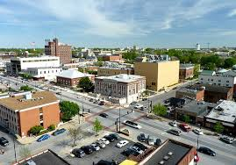
Employment Opportunities
Can find jobs in large and small cities
Mostly in urban areas

Slide 5
What The Job Is About
Design, test, and produce a product
Evaluate the prototype and make changes
Manage the shop floor

Slide 6
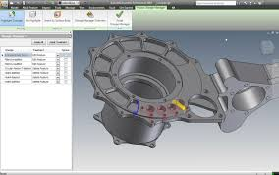
Skills Needed To Be Successful
Know how to use computer programs
Autocad
Inventor
Good math skills
Operate tools and machining equipment

Slide 7
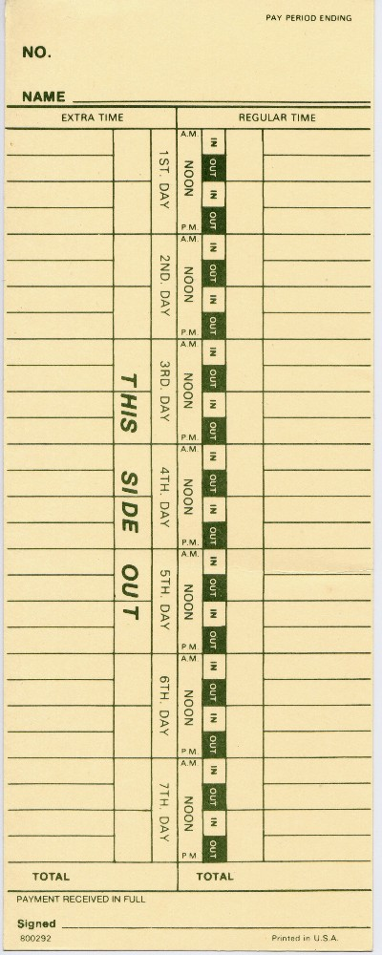
What Is Rewarding About This Job
Decent hours
Good pay
I would personally enjoy the job

Slide 8
Challenges And Frustrations
May get behind in production
May have to work overtime

Slide 9
Typical Work Day
Work mostly inside
Mostly work during the day
Rarely work weekends or holidays
Work with a lot of special equipment

Slide 10
Career Outlook
Below average national outlook
Above average wisconsin outlook

Slide 11
Skills, Training, & Education

Slide 12
Training Facility
UW-Stout

Slide 13
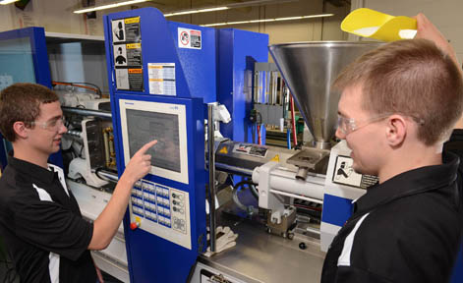
Why UW-Stout
Hands on learning
Great manufacturing engineering program
Close to home

Slide 14
Clubs And Organizations
Track & Field
Intramural sports
Baja Racing

Slide 15
Course Of Study
Majoring in Manufacturing Engineering
Four Year Program
129 total credits

Slide 16
First Year
Semester 1
Intro. to Engineering Materials
College Chemistry 1
Calculus 1
Composition 1
Fundamentals of Speech
Credits
3
5
4
3
3
Total:18

Slide 17
First Year
Semester 2
Fundamentals of Plastic Materials
Statistics
Calculus 2
Composition 2
Engineering Graphics Fundamentals
Credits
3
3
4
3
3
Total:16

Slide 18
Second Year
Semester 1
Material Removal & Forming Process
Chemistry of Materials
Dynamics
Probl & Statistics for Engineering & Sci
Engineering Graphics Using Models
Credits
3
4
3
3
3
Total:16

Slide 19
Second Year
Semester 2
Joining & Casting Processes
Mechanics of Materials
Thermodynamics & Heat Transfer
Differential Equations & Linear Algebra
University Physics 2
Credits
3
3
3
3
5
Total:17

Slide 20
Third Year
Semester 1
Fluid Mechanics
Circuits & Devices
Engineering Economy
Lean Manufacturing Systems
Quality Engineering
Credits
3
4
2
4
3
Total:16

Slide 21
Third Year
Semester 2
Mfg. Process Engineering 1
Design of Jigs, Fixtures & Tooling
Mfg. Process Engineering 2
Controls & Instrumentation
Arts and Humanities Elective
Credits
3
3
3
4
3
Total:16

Slide 22
Final Year
Semester 1
Computer Aided Manufacturing
Machine Vision & Robotics
Capstone 1: Concurrent Design
Arts & Humanities Elective
Social & Behavioral Science Elective
Credits
3
2
3
3
3
Total:14

Slide 23
Final Year
Semester 2
Capstone 2: Mfg. Systems Design
Mfg System Design & Simulation
Arts & Humanities Elective
Social & Behavioral Science Elective
Contemporary Issue Elective
Credits
3
3
3
3
3
Total:15

Slide 24
Tuition and Academic Fees
$4,534.5 per semester
$36,276 for 4 years

Slide 25
Occupational Salary
$52,506 - Salary.com
$51,360 - Wicareerpathways.com
$51,933 - Average

Slide 26
Net Pay

Slide 27
Pay Yourself First!
I plan on saving $200 of my net income a month

Slide 28
401K
I plan to add $200 to my 401k each month

Slide 29
Student Loans
Can I afford it?
YES!
417.47
2,967.41
14%
Total interest
$13,819.61

Slide 30
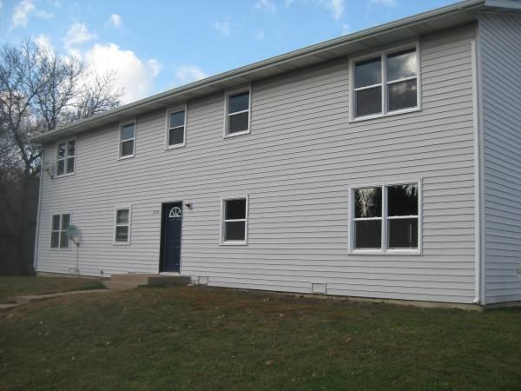
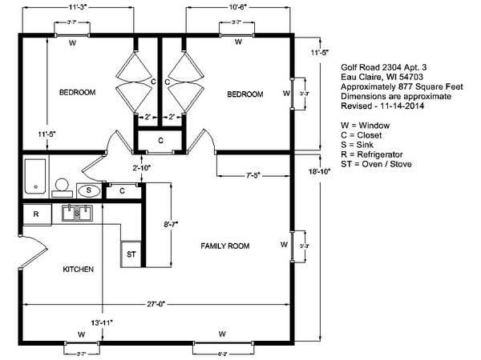
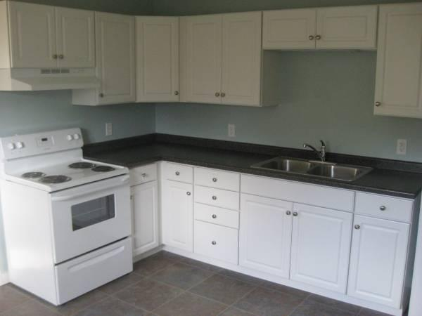
My Apartment
Duplex in Eau Claire
2 Bedroom
Convenient location

Slide 31
Can I Afford It?
520 / $2967.41 X 100 = 17.52%
YES!
Utilities included
Lawn care and snow removal included

Slide 32
Renters Insurance
Renters insurance is $22.50/month

Slide 33
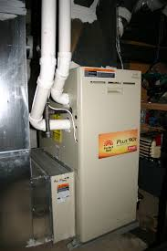
Heat and Electricity
Heating and Electric..............................Included

Slide 34
Cell Phone
$65 a month

Slide 35
TV and Internet
$121.50

Slide 36
Sewer and Water
Sewer......................................................
Water......................................................
Included
Included

Slide 37
Garbage
Included with apartment rental.

Slide 38
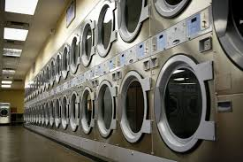
Laundry
Coin Laundry...........................................
Detergent................................................
Total.......................................................
$25
$5
$30

Slide 39
Cleaning Supplies
Paper Towels.........................................
Cleaning Products.................................
Dish Soap..............................................
Total......................................................
$5
$10
$5
$20

Slide 40
Food
Monthly groceries...................................
Eating out/Fast food ..............................
Lunches..................................................
Total.......................................................
$150
$50
$50
$200

Slide 41
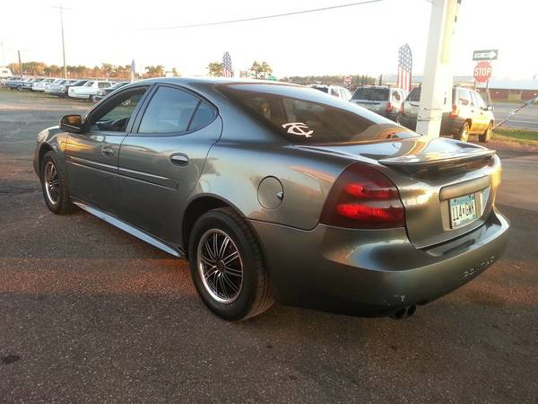
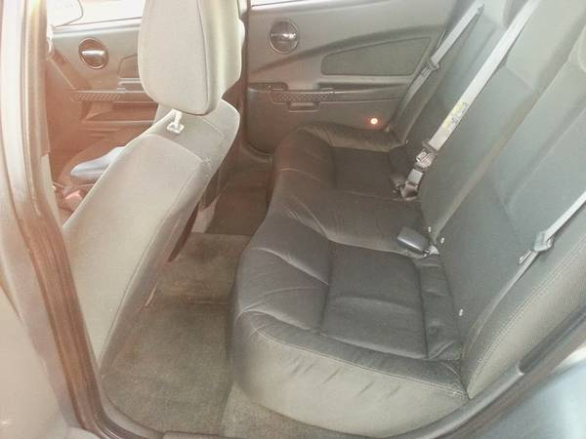
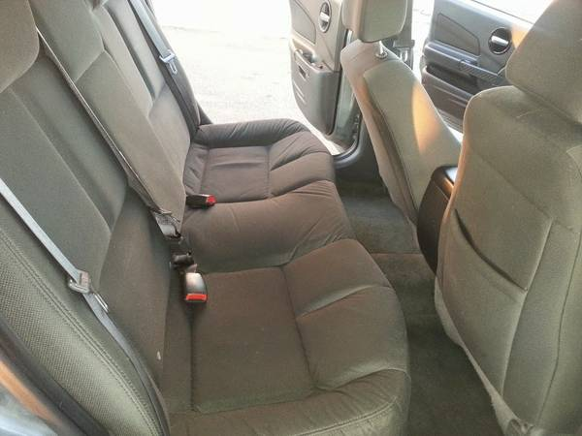
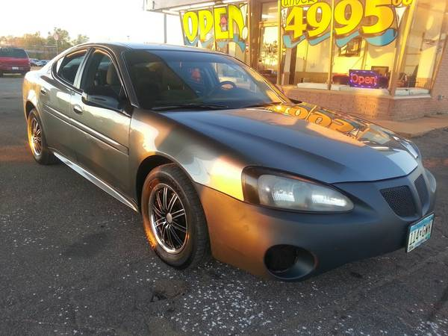
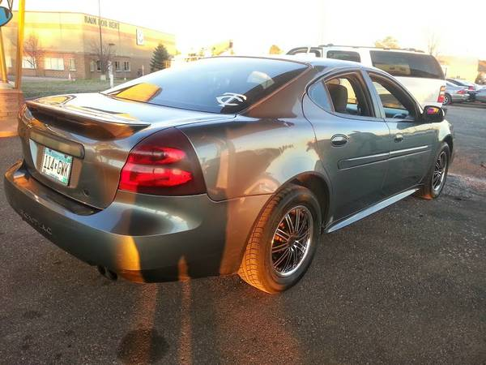
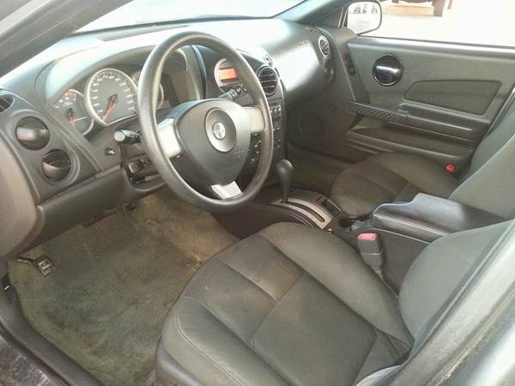
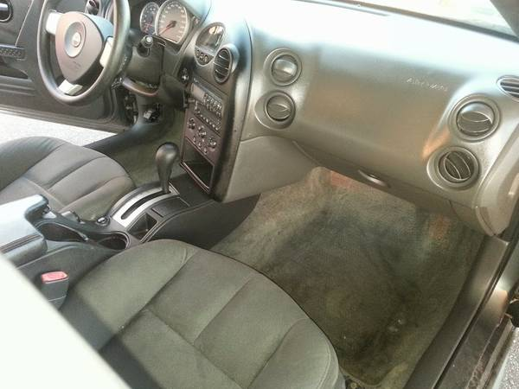
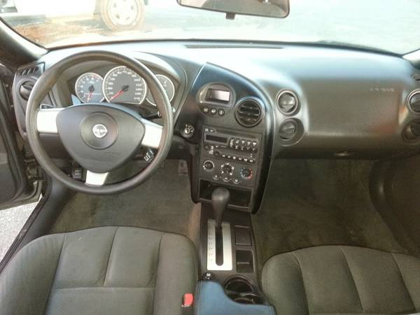
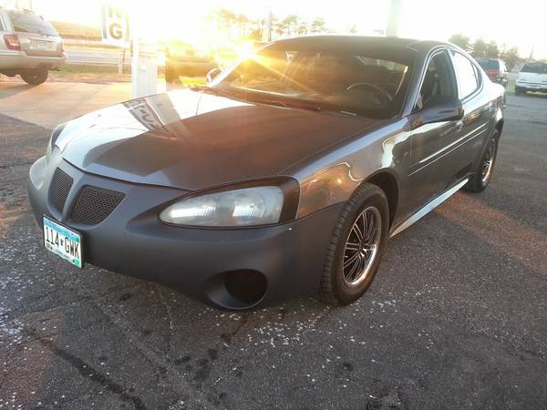
My Car
2002 Pontiac Grand Prix
$3495
180000 miles
4-door
Good Mpg’s

Slide 42
Car Loan

Slide 43
Can I afford it?
294.38 / 2967.41 = 9.92%
YES!
294.38 X 12 = 3532.56
- 3495
$37.56 interest

Slide 44
Auto insurance
$31.64 the first day
$80.08/month
100/300/100 insurance

Slide 45
Gas
Gasoline....................................................$100

Slide 46
Car Maintenance
Oil Change...............................................
Fixing it.....................................................
Total........................................................
$20
$30
$50

Slide 47
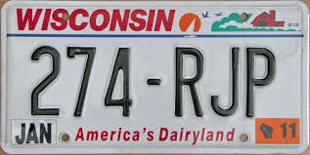
Licence Plate/Registration Fee
Licence plate registration....................$75/year

Slide 48
Hobbies and Crafts
Fishing........................................................
Ice Fishing....................................................
$15
$5

Slide 49
Postage
Stamps..........................................................$5

Slide 50
Clothes And Shoes
Clothing..........................................................
Shoes.............................................................
$25
$25

Slide 51
Toiletries
Shampoo..................................................
Toothpaste................................................
Toothbrush................................................
Deodorant.................................................
$5
$3
$3
$4
Total $15

Slide 52
Haircuts
Buzz Cut........................................................$10

Slide 53
Health Insurance
I get insured through my employer

Slide 54
Health Care
Medical.........................................................
Dental...........................................................
$90
$5

Slide 55
Entertainment
Movies...........................................................
Sporting Events.............................................
Fitness Club Fees........................................
Vacations.....................................................
Total............................................................
$5
$8
$30
$30
$73

Slide 56
Gifts and Donations
Gifts............................................................$40

Slide 57
Totals
$200.00
$779.00
$250.00
$530.71
$ 25.00
$ 75.00
Pay Yourself First...................................
Housing..................................................
Food.......................................................
Transportations......................................
Other Monthly Expenses........................
Looking Good.........................................

Slide 58
Totals Continued
Insurance.................................................
Healthcare...............................................
Entertainment...........................................
Gifts and Donations.................................
Other Monthly Debt Payments.................
Total.........................................................
$90.00
$5.00
$73.00
$40.00
$417.47
$2595.18

Slide 59
What's Left?
$2967.41
$2595.18
-
_________
$372.23

Slide 60
Sources
http://www1.salary.com/Manufacturing-Engineer-I-Salary.html
http://www.paycheckcity.com/calculator/salary/result
https://www.google.com/web https://eauclaire.craigslist.org/apa/4713921953.html
http://www.progressive.com/
http://www.bankrate.com/calculators/mortgages/loan-calculator.aspx

