Slide 1
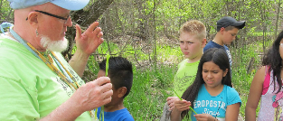
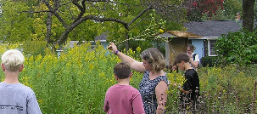
Wisconsin Center for Environmental Education
Wisconsin Association of Agricultural Educators
In-services
Forestry and Forest Products: Kits in the Classroom
Notes:
Welcome and Introductions

Slide 2
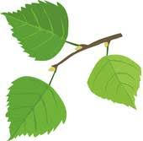
Overview of the Day
Quick Intro to WCEE and LEAF
Expert Presentation with WDNR Forest Products Specialist, WI Forest Industry: Rooted in Our Lives, Rooted in Our Economy
Forest Products Kit
Forest Health Kit and Activity
Forest Education Kit
Wrap Up
Notes:
Fill in the details of the day as you see fit.

Slide 3
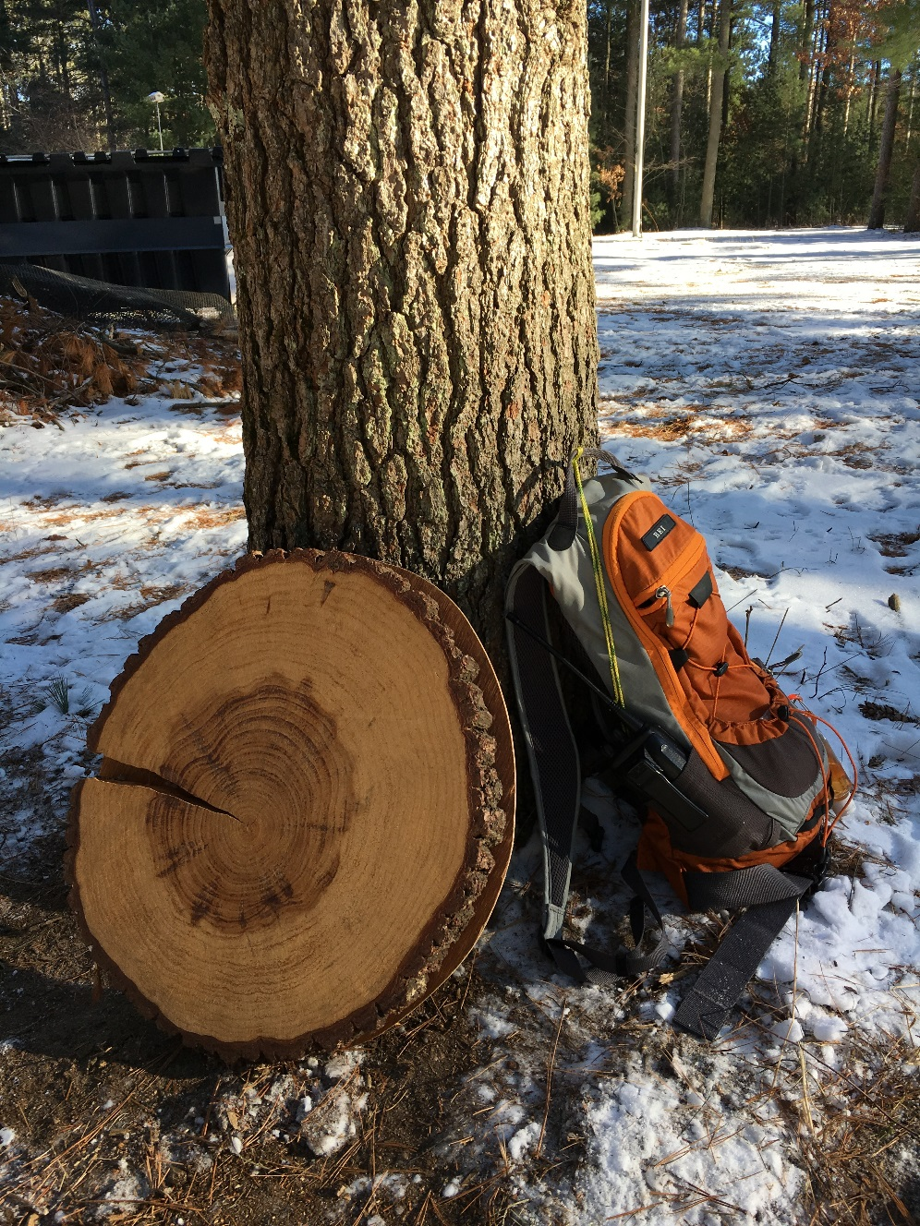
About the WCEE
Created in 1990, the WCEE envisions an actively engaged, educated population who create and maintain sustainable human and natural communities.
Mission: Provide leadership and resources to advance education for sustainable human and natural communities.
Notes:
Brief history and updated mission

Slide 4
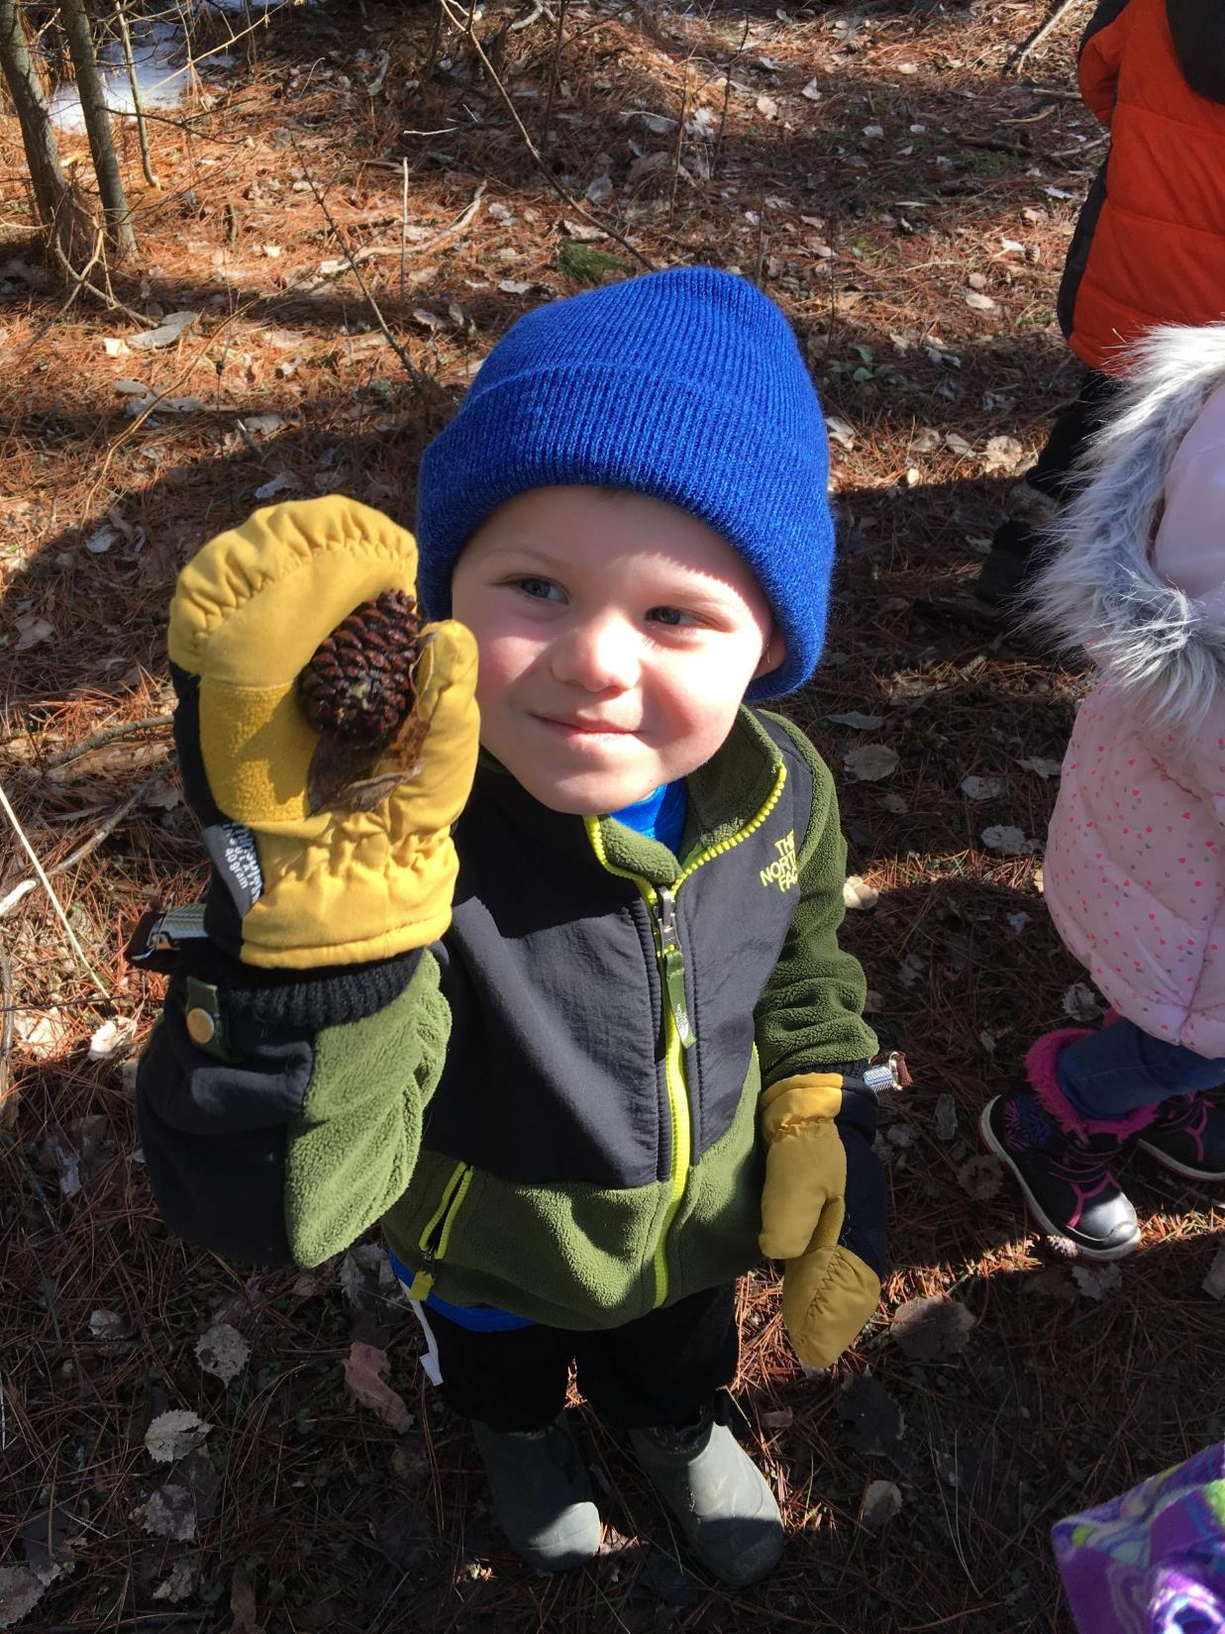
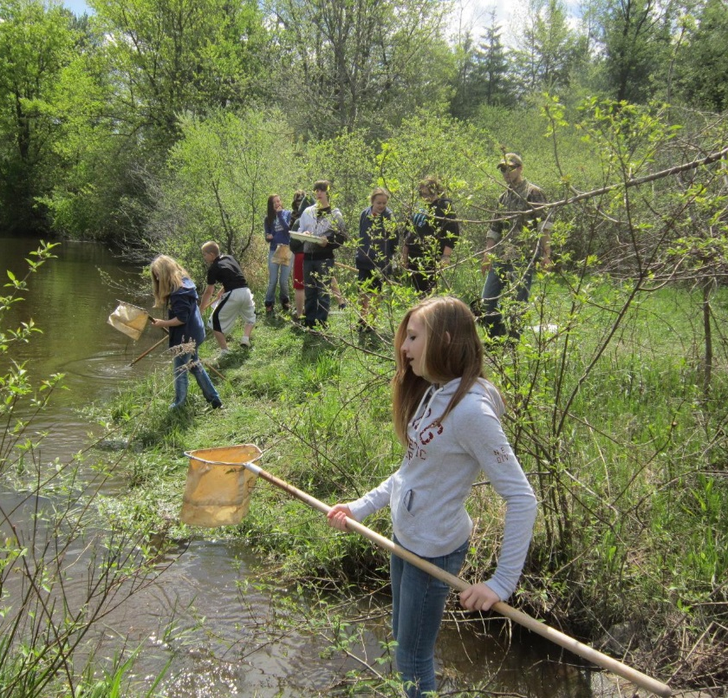
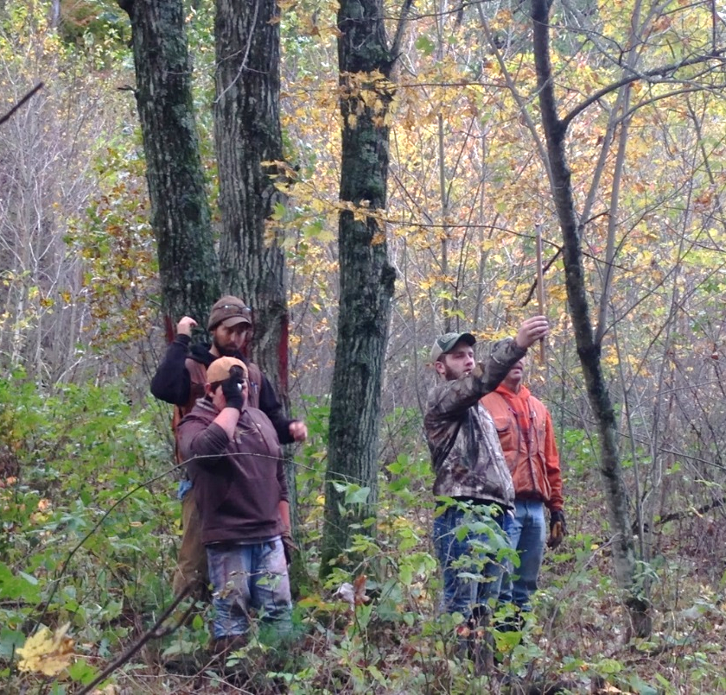
Notes:
LEAF was created in 2001 to help promote forestry education in WI and fill voids in teaching about Wisconsin’s forests.

Slide 5
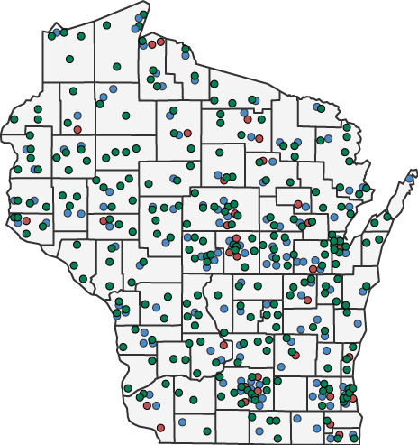
Wisconsin’s K-12 Forestry Education Program (LEAF)
What does LEAF do?
LEAF connects formal and non-formal educators in Wisconsin with quality forestry education materials
What is LEAF?
Partnership between the WI DNR-Division of Forestry and the WCEE.
PLT Workshops
School Forests
LEAF Professional Development
Notes:
Quickly address the focus/mission of LEAF

Slide 6
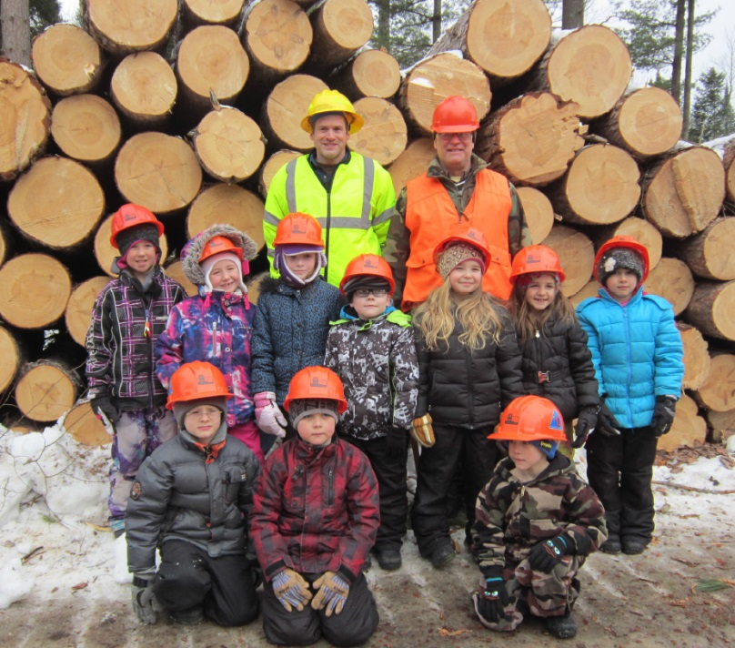
LEAF: Wisconsin’s K-12 Forestry Education Program
What LEAF Offers
Professional Development for Educators
School staff in-service trainings
Workshops
Online training opportunities
Curriculum Materials
Free to download
Grade-specific curricula tied to educational standards
Hands-on forestry education kits
Free to borrow from statewide locations
Contain real forestry tools and suggestions for connecting to curriculum
Support for Outdoor Classrooms
School Forests
Project Learning Tree (PLT)
Visit www.leafprogram.org for more info
Notes:
Very quick overview of what we’ll cover more indepth in the following slides.

Slide 7
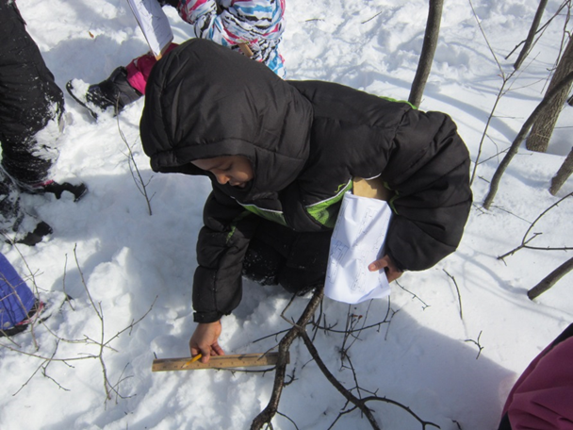
Forest as a place to learn and/or as a context for learning
Notes:
We view forests in multiple capacities. You can use the forest to learn about the forest and/or to learn about other subjects in the forest. Take a look at the picture. Can you think of some teachable moments or concepts the students in the picture can be learning about on that fallen tree?

Slide 8
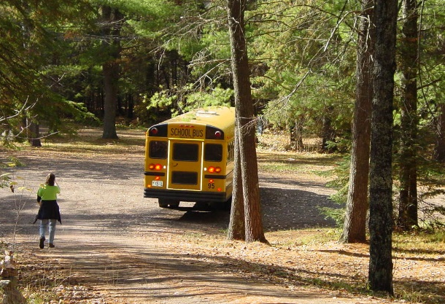
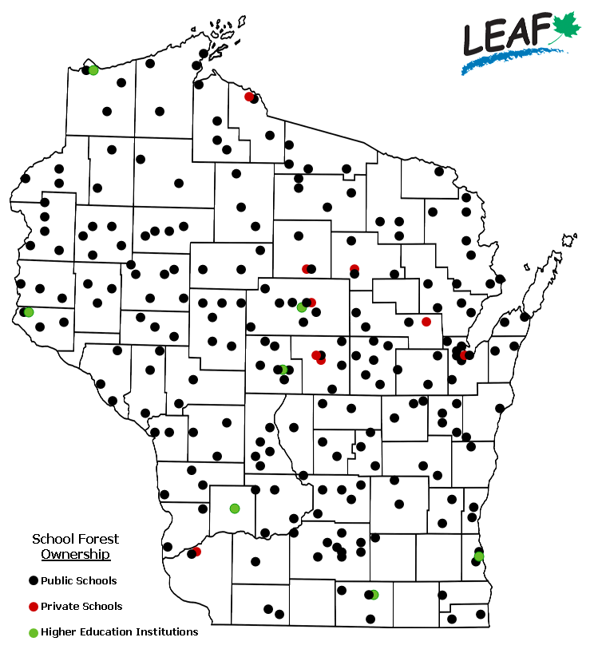
The WI School Forest Program
A school forest is…
land registered through state Community Forest Law
owned or controlled by a school and used for environmental education and natural resource management
425 school forests
247 different schools
Notes:
Quick overview of school forest basics

Slide 9
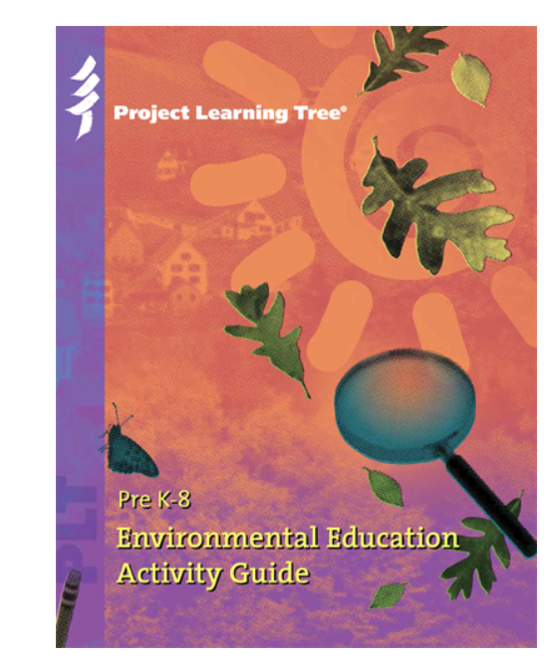
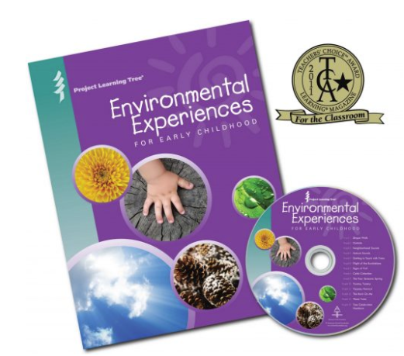
Project Learning Tree (PLT)
Notes:
LEAF is also the home of the WI PLT program.

Slide 10
Welcome WDNR Forest Products Staff

Slide 11
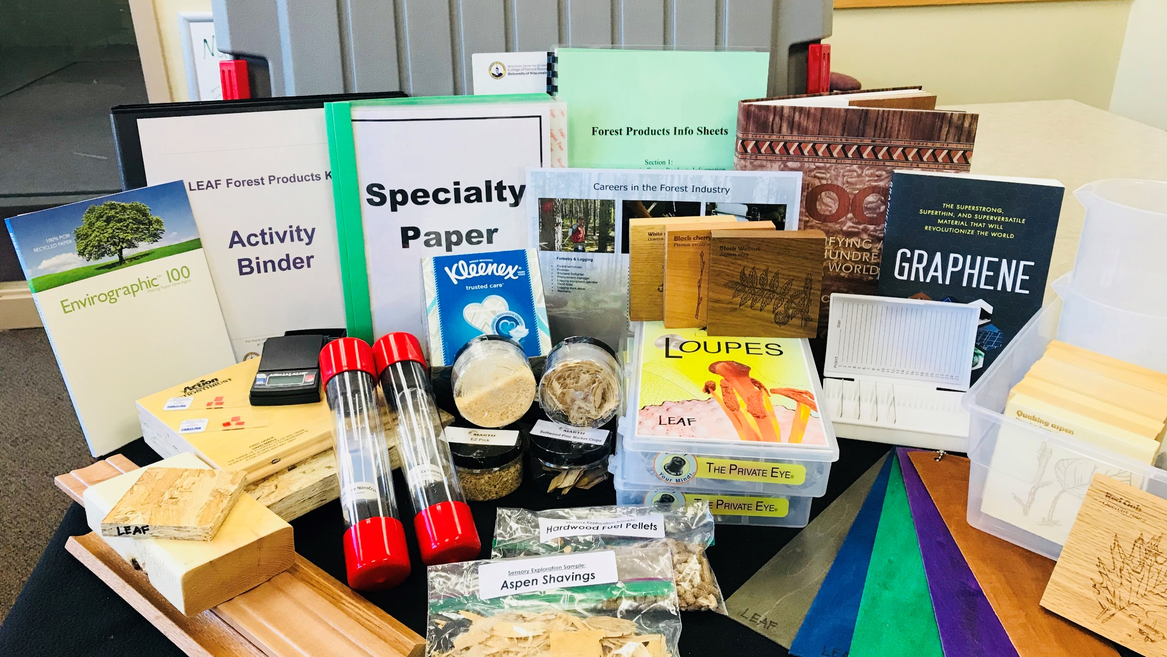
orest Products Kit
Kit 2: Forest Products

Slide 12
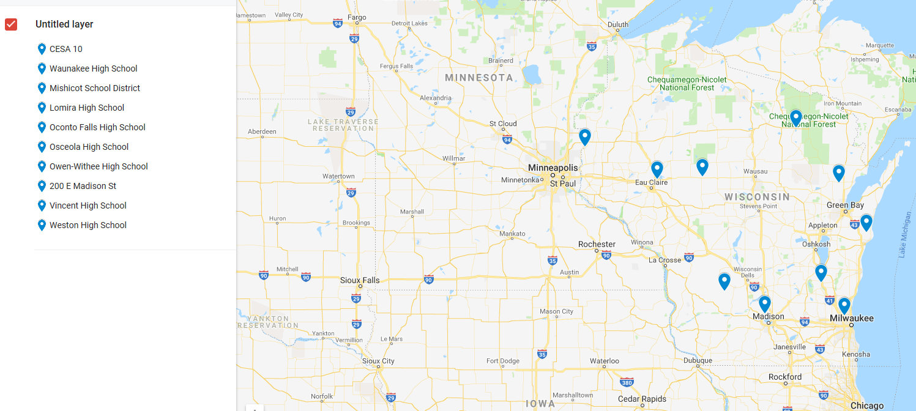
Eleven Locations in WI

Slide 13
CESA 10 Jennifer Peck 715-720-2034 jpeck@cesa10.k12.wi.us | Osceola High School Paul Jakupciak 715-294-2129 jakupciakp@osceolak12.org
Dane County Ag Teachers Association Rhonda Knapp 608-849-2100 x2317 rhondknapp@waunakee.k12.wi.us | Owen-Withee Travis Engel 715-229-2151 tengel@owen-withee.k12.wi.us
Mishicot High School Jamie Propson 920-755-3300 jpropson@mishicot.k12.wi.us | UW Extension Forest County Michelle Gobert 715-478-7797 michelle.gobert@ces.uwex.edu
Lomira High School Dan Robinson 920-269-4396 ext. 170 drobinson@lomira.k12.wi.us | Vincent High School Meghan Sawdy 414-758-1355 sawdyme@milwaukee.k12.wi.us
Oconto Falls Walter Taylor 920-848-4467 walter.taylor@of-ps.org | Weston School District Randi Osborne 608-986-2151 osborne@weston.k12.wi.us

Slide 14
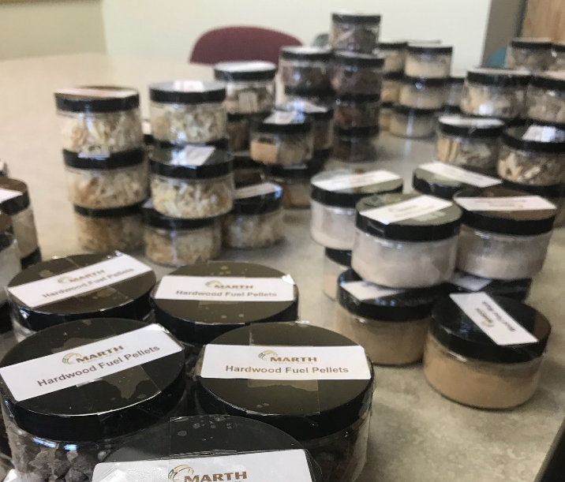
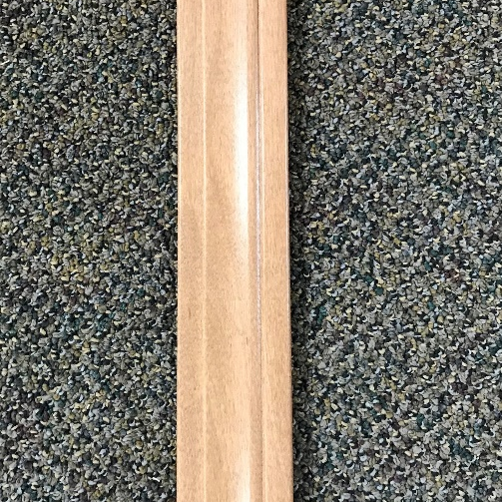
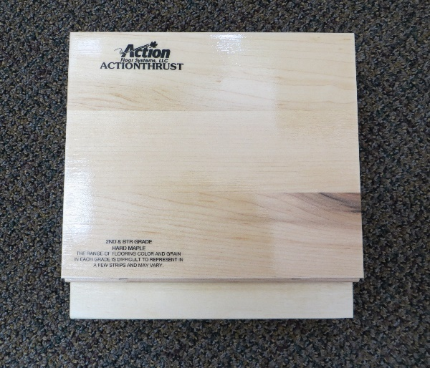
Track the Product: From Finish to Forest Lesson
Forest product
Processing
Tree

Slide 15
Forest Product
What is my product?
How is it used?
Who uses it?
Is the market local, national, or global?

Slide 16
Processing
How is the product made?
What is at least 1 Wisconsin-based company that makes the product?
How does this company contribute to the Wisconsin economy?
What are some careers associated with making the product?
What are the skills and qualifications for these careers?
What kind of benefits does such a career have?
Consider, Description of Position, Location, Education/Skills Required, Salary, Prior Experience Needed, Job Title, Why it interests you, Current skills needed for the job, Additional skills needed to get the job

Slide 17
From the Forest (tree)
What tree species or species make my product?
Where in Wisconsin does this forest cover type exist?
Does this forest cover type exist near your company that you are profiling?
Using the U.S. Forest Service Climate Change tree atlas, will that tree species or species be the same in 2100?
How might this change impact your forest product?

Slide 18
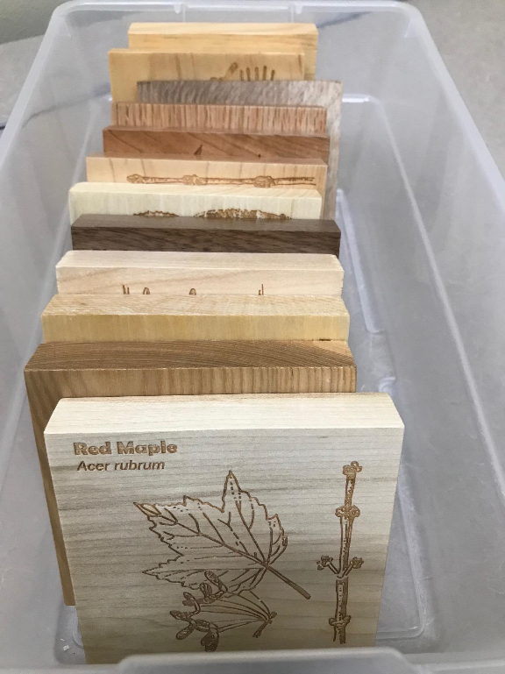
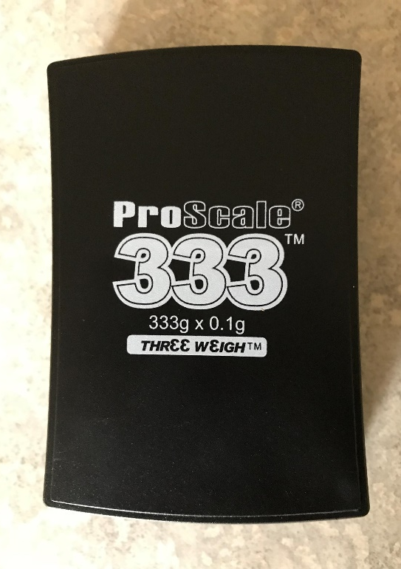
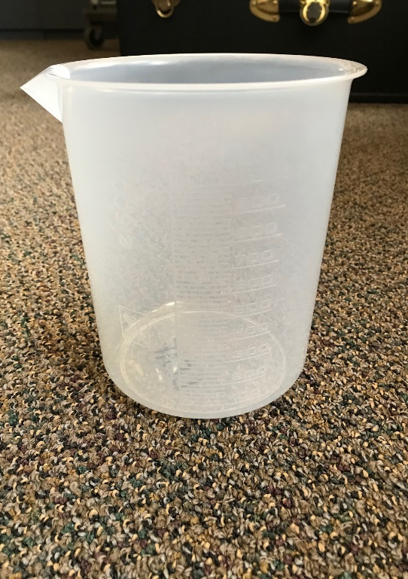
Wood density and wood identification lesson

Slide 19
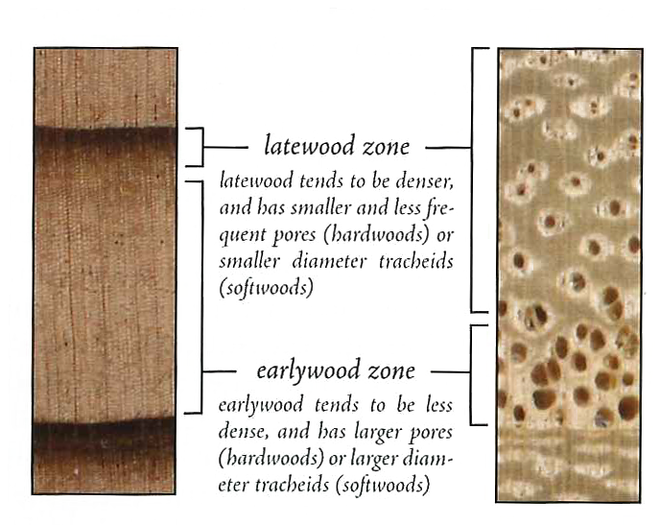
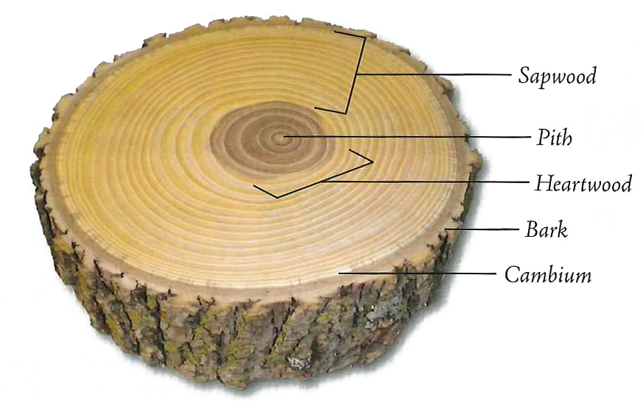
How trees grow
Pictures and information taken and modified with permission from Wood!: Identifying and Using Hundreds of Woods Worldwide (2016) by Eric Meier.

Slide 20
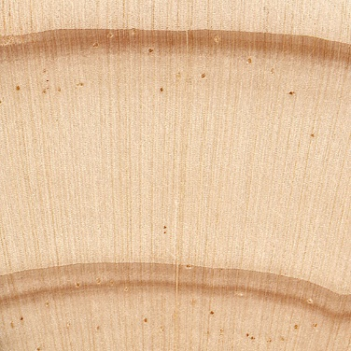
Tracheids (Softwood)
With resin canals
unique to conifers
open, tube-like spaces bordered by special cells that have the ability to secrete pitch or resin into the neighboring opening
used to protect and seal up a wound by exuding resin to cover the damaged area of the tree
Pictures and information taken and modified with permission from Wood!: Identifying and Using Hundreds of Woods Worldwide (2016) by Eric Meier.

Slide 21
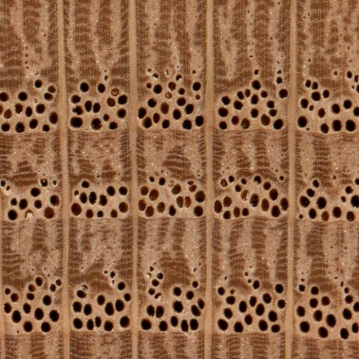
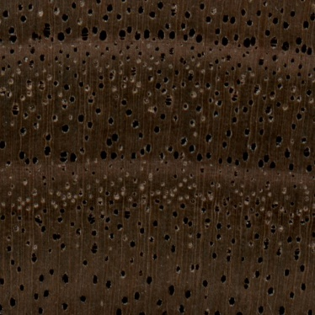
Hardwood ring porous vessel comparisons
Diffuse-porous Ring porous Semi-ring porous
Pictures and information taken and modified with permission from Wood!: Identifying and Using Hundreds of Woods Worldwide (2016) by Eric Meier.
Notes:
Mention that the holes/bubble-like features are the vessels.

Slide 22
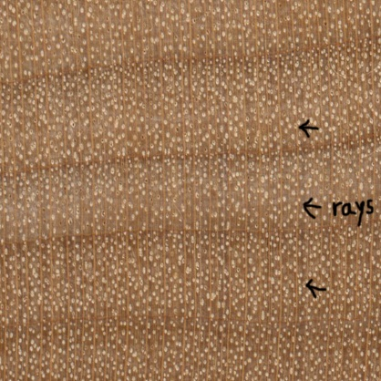
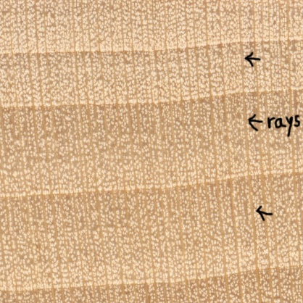
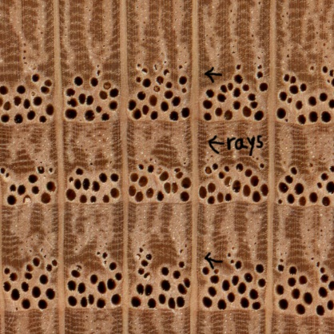
Rays:
cells run perpendicular to the rest of the wood fibers
serve to channel nutrients between the cambium, sapwood, and pith.
When viewed from the endgrain, rays appear as more-or-less straight, radial (vertical) lines spaced evenly across the wood sample.

Slide 23
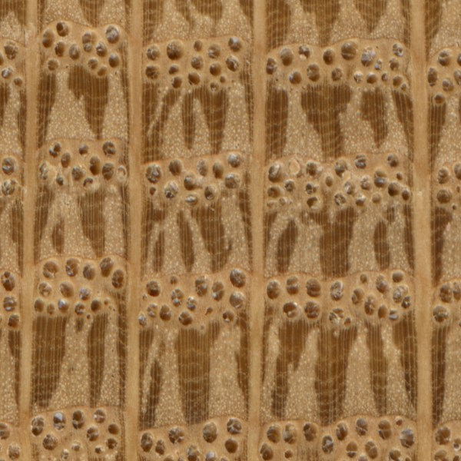
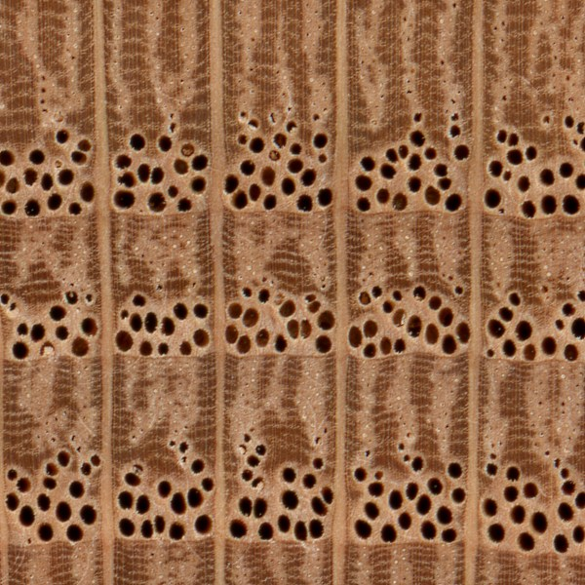
Tyloses are bubble-like structures that plug vessel elements. When the plant is stressed by drought or infection, tyloses will fall from the sides of the cells and "dam" up the vascular tissue to prevent further damage to the plant.
White oak (tyloses present)
Red oak (tyloses not present)
Pictures and information taken and modified with permission from Wood!: Identifying and Using Hundreds of Woods Worldwide (2016) by Eric Meier.

Slide 24
Images Copyright of Carolina Biological Supply. Used by Permission.

Slide 25
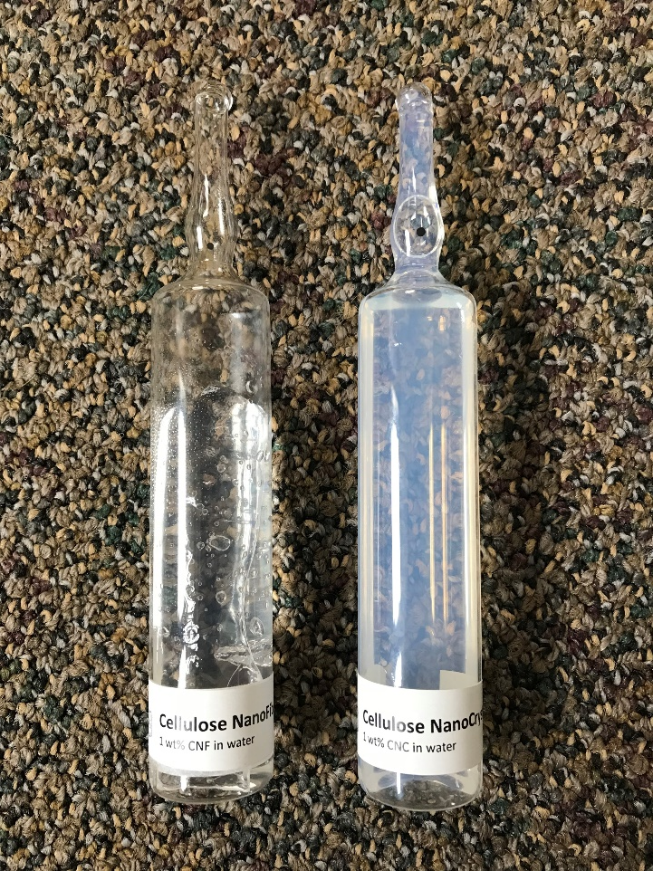
Graphene and Biotechnology Literacy Lesson
Forest Products’ Innovations: Literacy and Research

Slide 26
New Biotechnology
Biodegradable plastic made from 'tree glue' could be on shelves within five years.
Cheap and scalable: New wood material prints large 3D objects.
Nanowood – A New Insulator made from Wood may Edge Out Styrofoam.
New wood nanofiber biomaterial steals strength record from spider silk.
In a concrete jungle, one architect pushes for ‘plywood for giants’.
Paper biomass to build lithium-sulfur batteries.
Lumber’s lure: Thanks to physics, viable biofuel may grow in the woods.
New technique strengthens building structures using wood waste.
Wood to supercapacitors: Sustainable highly conductive electrode materials fom ultrathin carbon nanofiber aerogels derived from nanofibrillated cellulose.
Wood to build human body parts—and other bio-innovations.
Notes:
After learning about innovation and challenges and successes with the seed text, students apply these ideas to innovations in future forest products industry. These articles relate to biotechnology and some of the ag ed standards around these.

Slide 27
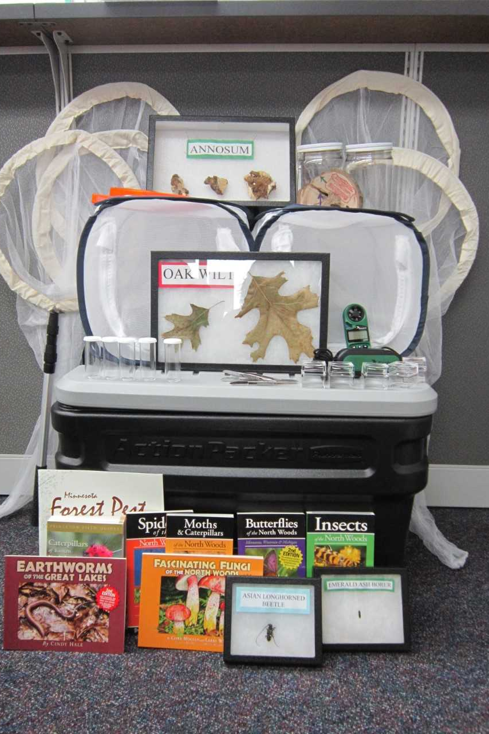
Kit 1: Forest Health
Notes:
Contains equipment and for insect identification, invasive species, disease, and climate

Slide 28
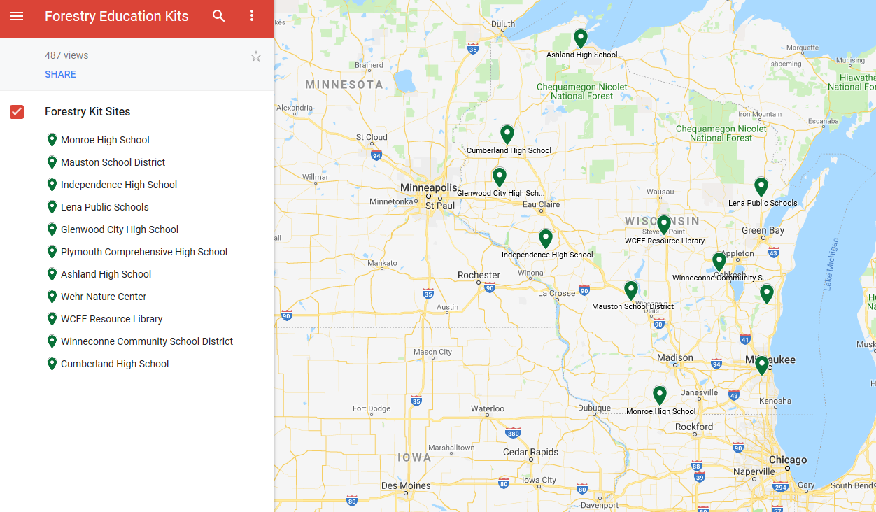

Slide 29
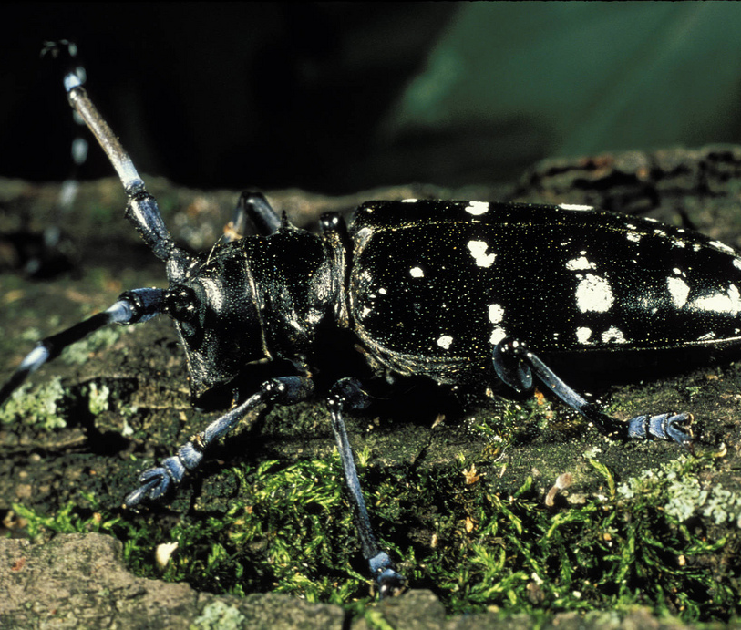
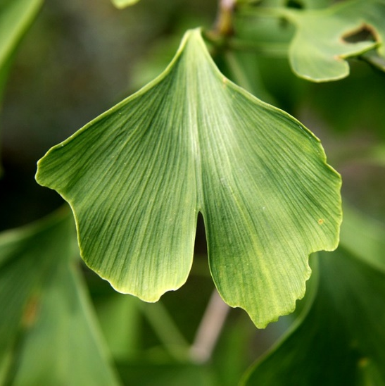
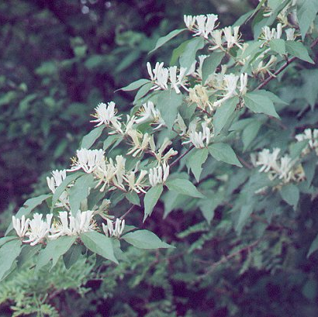
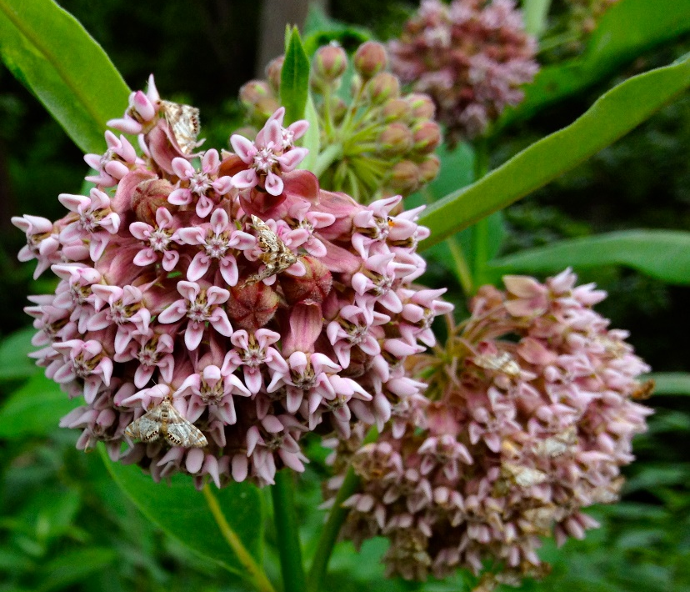
Native Species Exotic Species Invasive Species
Notes:
Common milkweed Asian long-horned beetle

Slide 30
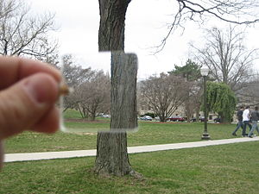
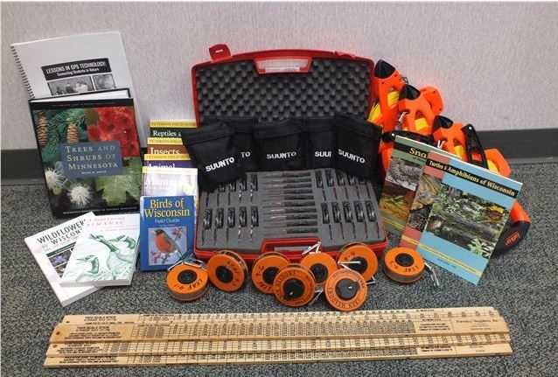
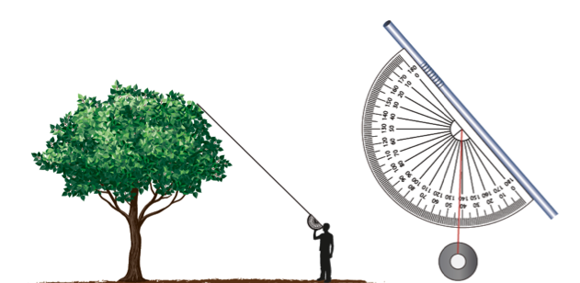
Kit 3: Forestry Education

Slide 31
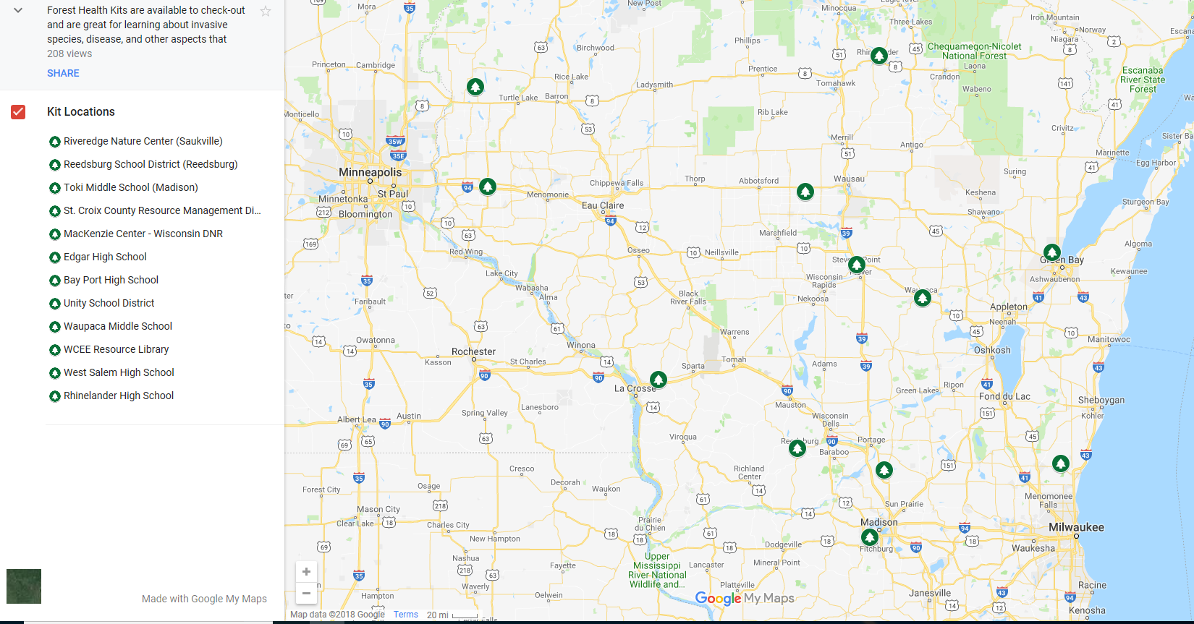
Eleven Locations in WI

Slide 32
LEAF Tree Measurement Tutorial

Slide 33
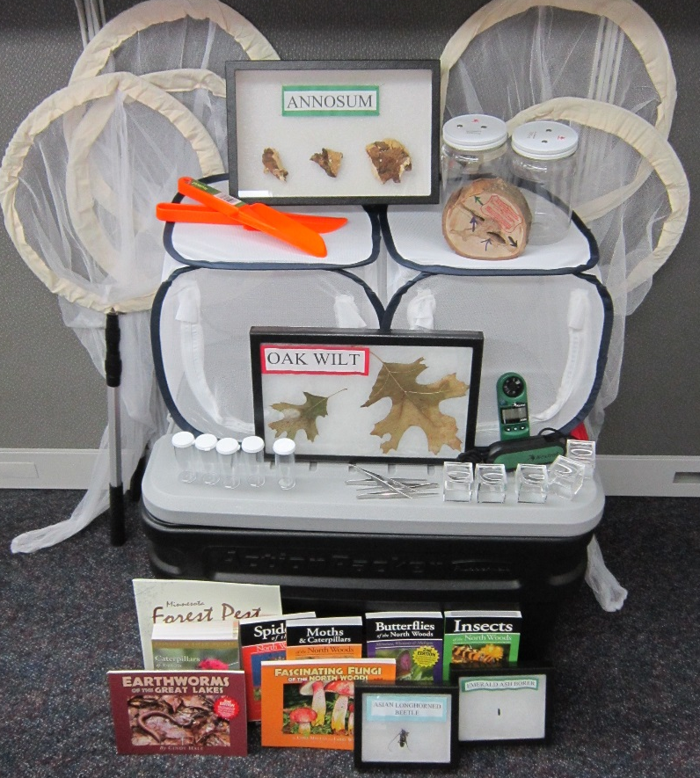
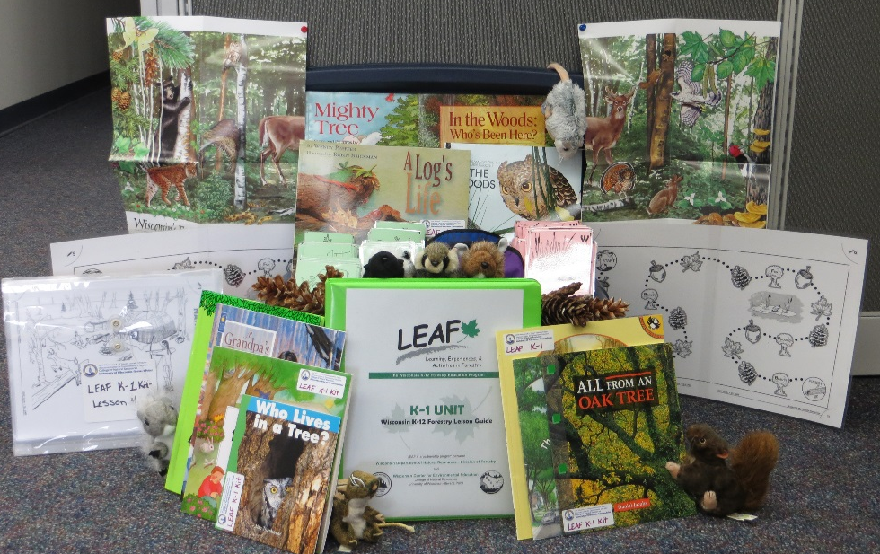
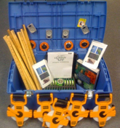
Hands-On Resources Just for You!
30+ Kits and Trunks Available
Ready to go
Most can ship (share shipping costs)
Forest Health Kit
Forestry Kit
(11 kits each throughout the state)
LEAF K-1 Lesson Guide Kit

Slide 34
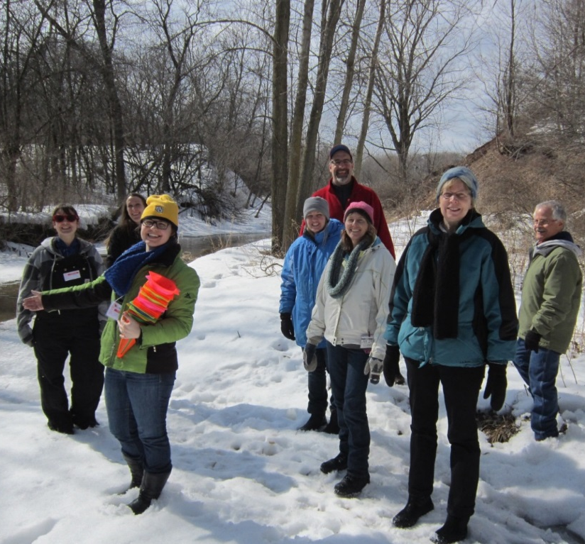
Other opportunities?
WCEE PD Calendar Online
Notes:
Click on Image to take you online to view the calendar.

Slide 35
What’s next?
Forest Products
Urban Forestry –
Community Tree Map

Slide 36
Stay Connected
www.leafprogram.org
Twitter - @WCEEStaff and @LEAF_K12_Forest
www.facebook.com/wicenterforee & @UWSPCNRLEAF
leaf@uwsp.edu
715-346-4956

